Slide 1
Orthology and protein families
Comparative genomics session 2

Slide 2
Topics
Orthology definition
Paralogy
Special cases
Clusters of Orthologous Groups
Tree-based algorithms
Protein families

Slide 3
Orthology

Slide 4
Genomes
1976 first viral RNA-genome (bacteriophage, 3.5 kb), Walter Fiers
1977 first DNA-genome, Fred Sanger (phage, 5.4 kb)
1995 first bacterial genome (Haemophilus influenzae, 1.8 Mb)
1996 first eukaryotic genome (Saccharomyces cerevisiae, 12.1 Mb)
2001 human genome (3.2 Gb)

Slide 5
Molecular evolution
Study of genomes
How do parts change in evolution?
Identification of the ‘same’ parts → orthologs

Slide 6
Orthology definition
Genes that descended from the same ancestral gene separated by a speciation event are orthologous.

Slide 7
Genes
Molecular unit of heredity (stretch of DNA)
Protein coding gene
Nucleotides (A,C,G,T) that code for amino acids
Differ between species

Slide 8
Orthology definition
Genes that descended from the same ancestral gene separated by a speciation event are orthologous.

Slide 9
Speciation
Speciation is the process that gives rise to new species
Notes:
Note 1 species, 2 species.

Slide 10
Speciation
A
B
Members of one species can
interbreed and have viable offspring

Slide 11
Orthology definition
Genes that descended from the same ancestral gene separated by a speciation event are orthologous.

Slide 12
Ancestral gene
Time

Slide 13
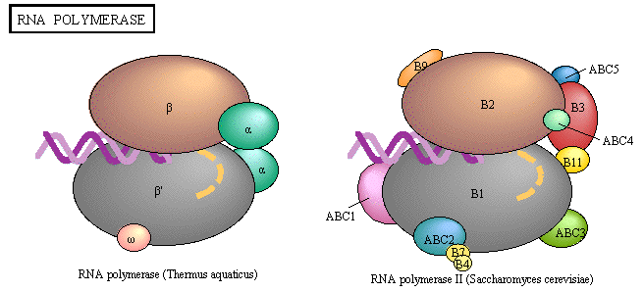
Example: RNA polymerase
Image credit: KEGG pathways

Slide 14
Operational definition
All genes species A
All genes species B
Pairs most similar in sequence, reciprocally
based on pairwise alignment score.
BBH: Best Bidirectional Hit
Notes:
In order to identify orthologs, one would have to travel back in time and sequence the genes/proteins.
BLAST, Smith-Waterman, NW.

Slide 15
Orthology definitions
Evolutionary: Genes that descend from the same ancestral gene separated by a speciation event are orthologous.
Operational: Genes that are most similar to each other in two separate species are deemed orthologous.

Slide 16
Complications
Paralogy: genes created by a duplication event within a genome
Notes:
Both light blue genes are orthologous to the red gene. Also referred to sometimes as co-orthologs.

Slide 17
Operational definition
All genes species A
All genes species B
Genes more similar to each other than any gene in the other species are called in-paralogs. Both genes are orthologous to the BBH.
Implementation: INPARANOID

Slide 18
Complications: duplication and gene loss
X
X
1
2
1
2
1
2
2 copies in the ancestor
Need more species for a solution
Notes:
Red gene 2 and blue gene 1 are NOT orthologous according to the evolutionary definition. Need extra data to solve this.

Slide 19
Complications: Multi-domain proteins.

Slide 20
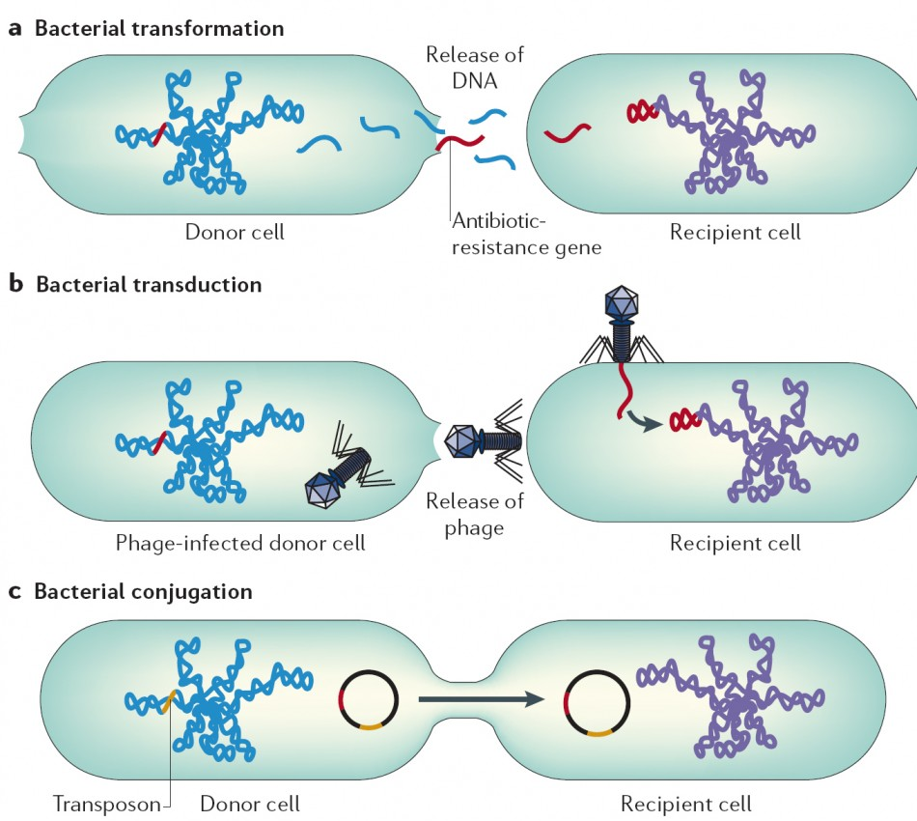
Complications: Horizontal Gene Transfer
Transmission of DNA between different genomes

Slide 21
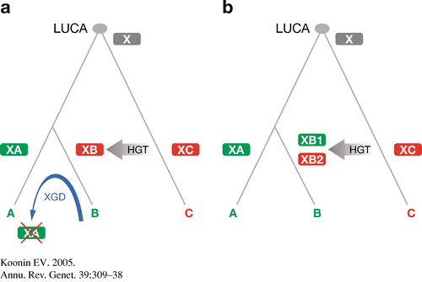
HGT, pseudoparalogy and xenology
xenology
pseudoparalogy
Notes:
Displacement leads to xenology

Slide 22
Clusters of Orthologous Groups

Slide 23
Procedure
7 complete genomes from 5 distinct clades
BeTs Best hiTs
Symmetrical BeTs Bidirectional Best Hits (BBH)
Create Triangles of BeTs where each point is from a different clade
Connect triangles that share a side.
Inspection for multidomain proteins.
Levels of sequence similarity analyzed to split COGs joined due to
Duplication and differential loss, split COGs.
Tatusov et al, Science 1997
Notes:
Initial steps are automated, review is manual!

Slide 24
Connecting triangles

Slide 25

Complications
Multi-domain proteins.

Slide 26
Complications
Duplication and gene loss
X
X
1
1
1
1
2
2
2
2
1
2
2 copies in the ancestor
more species provide a solution
Notes:
Gene 1 in red species and gene 2 in blue speciesare NOT orthologous according to the evolutionary definition. Need extra data to solve this.

Slide 27
Solutions
2
1
2
1
2
1
BBH / symmetrical BeT

Slide 28
‘Implementations’
EdgeSearch
OrthoMCL
eggNOG
InParanoid, MultiParanoid
MSOAR, MultiMSOAR
Homologene
RoundUp
OMA
OrthoFinder

Slide 29
Tree-based algorithms

Slide 30
Tree based algorithms
Rather than finding best hits, reconstruct phylogenies
First define homologs
Sensitivity of homology search
Splitting into orthologous groups
Explicit identification of duplication and speciation events
Slow

Slide 31
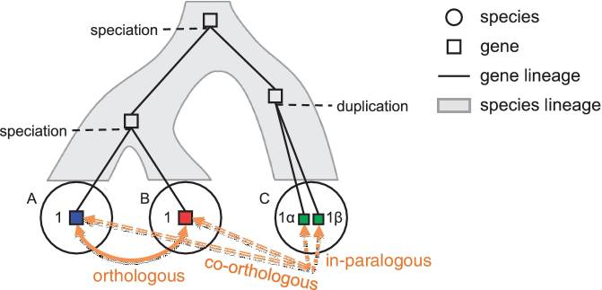
Evolution of genes

Slide 32
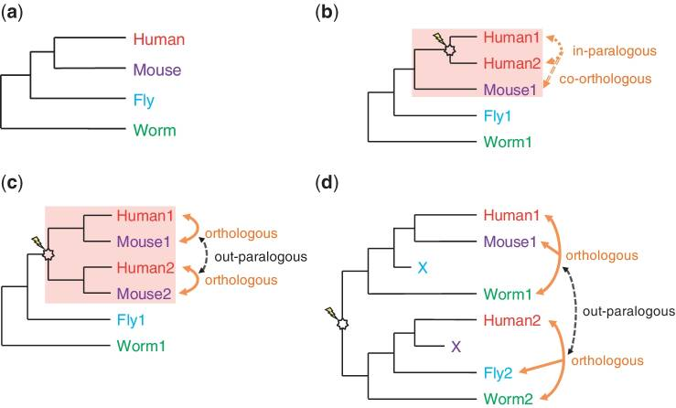
Species tree reconciliation
Kristensen et al Brief. Bioinformatics 2011
Notes:
The reconciliation of the species tree (a) with an instance of a gene tree (b–d) allows for inference as to when evolutionary events such as speciation (T-branch), gene duplication (star-branch), or gene loss (X) occurred. (b) Gene tree with recent duplication, and evolutionary relationships shown for the genes in the shaded area. Because all three genes diverged from a single common ancestor, they would form a single orthologous group. (c) Gene tree with duplication preceding speciation event and evolutionary relationships shown for the genes in the shaded area. These four genes form two separate orthologous groups, corresponding to the two ancestral genes leading to each distinct gene lineage (Human1 and Mouse1, and Human2 and Mouse2). (d) Gene tree with duplication prior to speciation, followed by differential gene loss of Fly1 & Mouse2, where again all of the descendants of each of the two ancestral genes form an orthologous group.

Slide 33
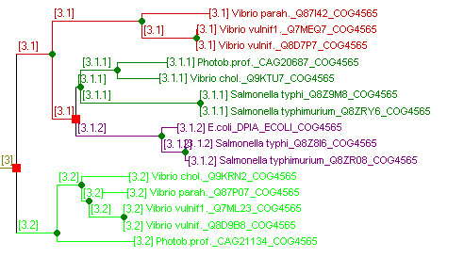
Species overlap
Speciation
Duplication
van der Heijden et al, BMC Bioinformatics 2007

Slide 34
Species overlap
Overlap of species in sub-branches
No need for species tree
Deals with small inaccuracies in the gene tree

Slide 35
Implementations
LOFT
TreeFam
SYNERGY
RIO
Orthostrapper
HOBACGEN, HOVERGEN, HOGENOME
Orthofinder

Slide 36
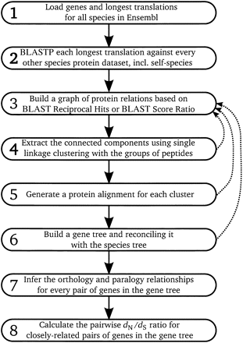
EnsemblCompara
Connect all BBHs
Delineate orthologs based on
Phylogenies (TreeBeST from
TreeFam)
Reconcile trees
iterate
Time-consuming
Tree topology can be erroneous
for large groups

Slide 37
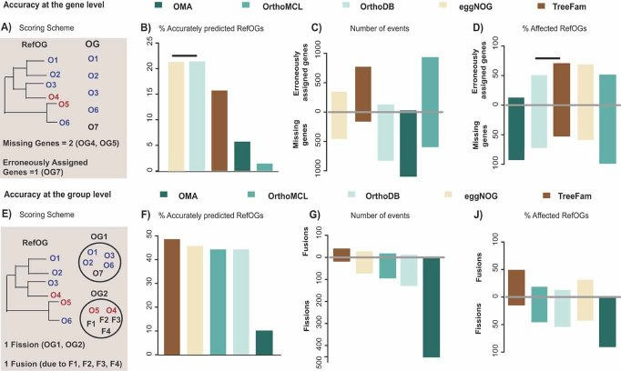
Comparison of methods
Trachana et al, Bioessays 2011

Slide 38
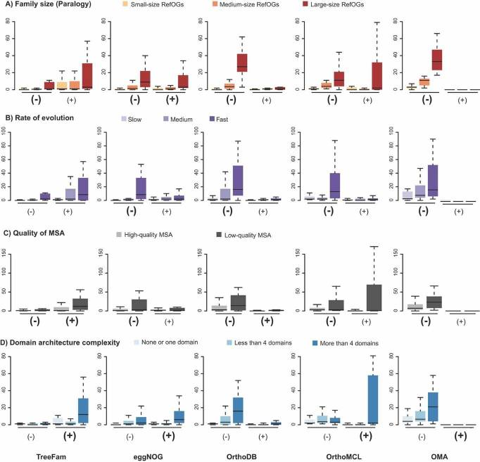
Trachana et al, Bioessays 2011

Slide 39
Protein families

Slide 40
Protein families
Homologs: protein coding genes that descend from the same common gene through duplication and/or speciation events.
Identification by pairwise alignment (BLAST, NW, SW)
Or by profile searches (HMM, psiBLAST)
Multiple sequence alignment (MSA) for analysis
Characteristics
Similar function
Similar 3D structure (fold)

Slide 41
Horizontal Transfer from animals to bacteria
Fibronectin (binds extracellular matrix in eukaryotes)
79 sequences labeled Fn3 from SwissProt
Alignment
Consensus pattern
Search for new members, add to the alignment etc.
Results in more than 300 sequences
Multiple alignments and trees
Horizontal transfer from animals to bacteria
Bork and Doolittle, PNAS 1992

Slide 42
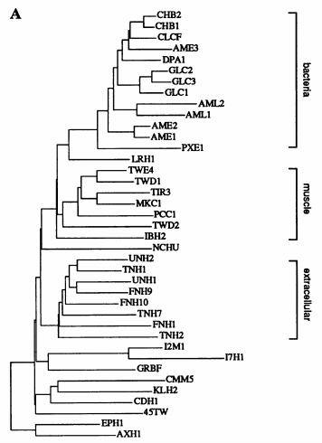
Bork and Doolittle, PNAS 1992

Slide 43
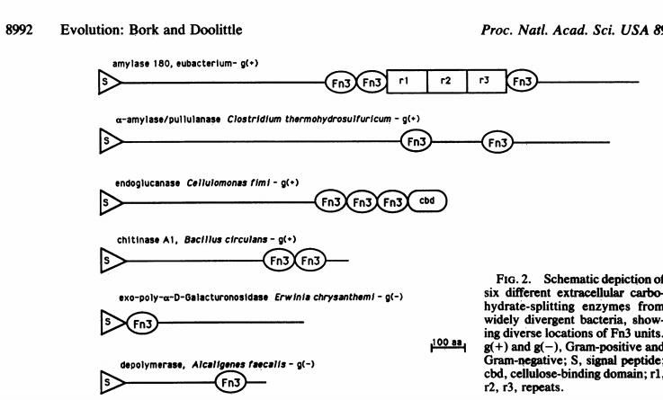
Bork and Doolittle, PNAS 1992

Slide 44
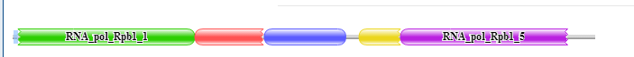
PFAM
Database of protein families (statistical models)
High-quality multiple sequence alignments
Profile HMMs from seed alignments using HMMer3
searching the profile HMM against the UniProtKB
family-specific sequence and domain gathering thresholds (GAs)
More sensitive than BLAST
Used for annotation (rather than best blast hit)

Slide 45
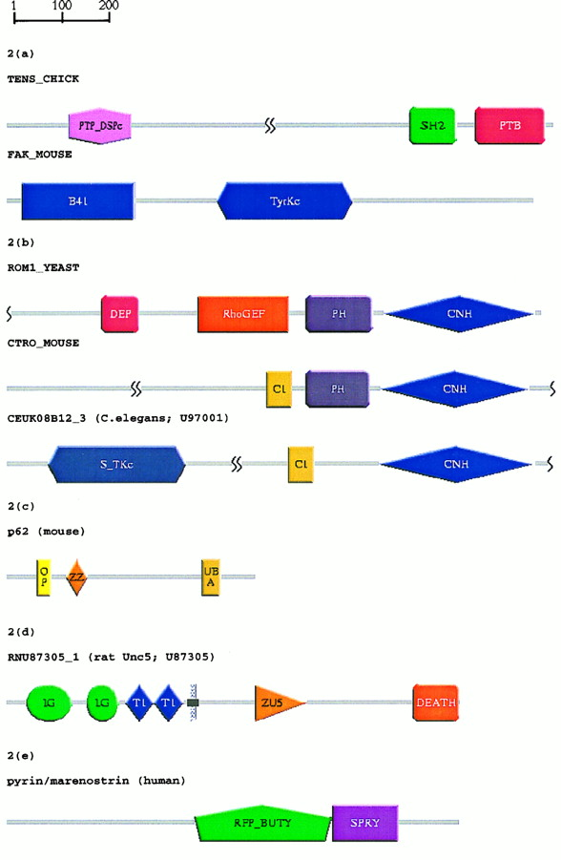

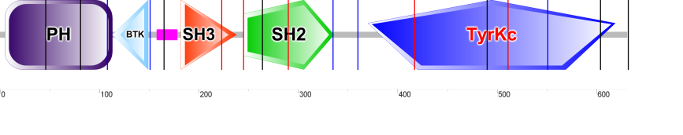
SMART database
MPN515 (RPOC_MYCPN)
TEC_HUMAN
Higher resolution than PFAM
Automatic seed generation
Schultz et al, PNAS 1998
Notes:
Subfamilies, automatic seeds,

Slide 46
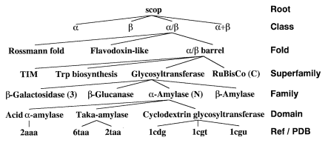
SCOP: Structural Classification of Proteins
3D similarity rather than sequence similarity

Slide 47
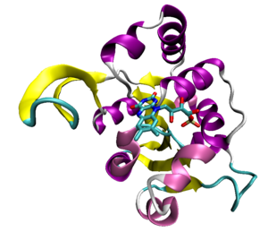
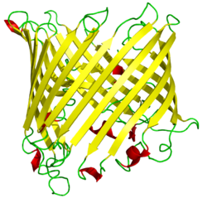
Classification
Family
Significant sequence similarity
Superfamily
Low sequence identity but structures suggest common origin
Fold
same major secondary structures in the same arrangement
Class
All-α, those whose structure is essentially formed by α-helices;
All-β, those whose structure is essentially formed by β-sheets;
α/β, those with α-helices and β-strands;
α+β, those in which α-helices and β-strands are largely segregated, and
Multi-domain, those with domains of different class and for which no homologues are known at present.
Rossmann fold
Beta-barrel

Slide 48
What you should know
Orthology definition
Evolutionary
Operational
Paralogy definition
Special cases
Problems encountered in orthology detection
Gene fusions, domain shuffling
Duplication and loss
HGT
Best Bidirectional Hit
Clusters of Orthologous Groups
Tree-based algorithms
Protein families

Slide 49
Homework
Read paper
COGs: Roman L. Tatusov, Eugene V. Koonin,* David J. Lipman (1997) A Genomic Perspective on Protein Families, Science 278 (631)
Course Documents -> Literature Comparative Genomics

Slide 50
Assignment

Slide 51
Assignment: predict the function of FG00500.1
Download OrthoSearch.txt copy to students.hpc.kuleuven.be
Fasta file contains fungal sequences. Names are taxonomy ID followed by a protein identifier
Create a multiple sequence alignment and bootstrap a phylogenetic tree based on these fungal proteins.
Visualize your tree in itol and root the tree. (Midpoint rooting or outgroup, encephalitozoa are an outgroup to the fungi taxids: 907965, 876142)
Locate [Search] the Saccharomyces cerevisae (yeast) proteins in your tree (taxid:4932).
What are the functions of these yeast proteins? Hint: go to SGD (http://yeastgenome.org/).
Locate [Search] protein FGSG_00500P0 (protein encoded by gene FG00500.1) in your tree (taxid:5518, Fusarium graminearum).
To which yeast protein is FGSG_00500P0 orthologous?
Which function do you predict for FGSG_00500P0?
New assignment

