Slide 1
James Duce
Does Universal Cash
Reduce Work?
Replication of Jones & Marinescu (2022)
American Economic Journal: Economic Policy
Method: Synthetic Control Method · GSE 552 · Cal Poly SLO
Notes:
Hi, I'm James Duce. I'm replicating Jones and Marinescu 2022, which asks whether Alaska's universal cash dividend changed how much people work. Journal: AEJ Economic Policy.

Slide 2
Research question
Does unconditional income reduce employment?
The Policy
The Theory
The Puzzle
Alaska Permanent Fund Dividend: every resident gets ~$1,000–$2,000/yr since 1982
Standard economics: more unearned income → buy more leisure → work less
But if everyone gets it simultaneously, demand for goods rises too — what's the net effect?
Treatment: Alaska × post-1982 | Key outcome: did employment or hours change?
Notes:
The paper studies Alaska's Permanent Fund Dividend — a universal, unconditional cash transfer since 1982. Theory says people should work less. But if everyone gets it simultaneously and spends it locally, labor demand rises too. The paper tests which effect wins.

Slide 3
Identification problem
Every Alaskan got the dividend — no control group exists
The problem
The solution: SCM
Every resident treated simultaneously — can't compare Alaskans to other Alaskans
Simple before/after mixes dividend with Alaska's oil boom
DiD needs an untreated group — there isn't one inside Alaska
Build a 'Synthetic Alaska' from states that looked like Alaska before 1982
Weights chosen to minimize pre-1982 prediction error
Post-1982 gap = causal effect of the dividend
Notes:
The identification challenge: every single Alaskan got treated. No DiD possible. Simple before/after confounds the oil boom. The Synthetic Control Method solves this by constructing a weighted average of other states — a statistical doppelganger for Alaska.

Slide 4
Synthetic control method
Building 'Synthetic Alaska'
1
2
3
Pre-period matching
Counterfactual
Treatment effect
Find weights for 50 donor states that minimize prediction error on employment, demographics & industry mix, 1977–1981
Synthetic Alaska = weighted avg of donors post-1982. Top weights: Wyoming 46%, Montana 24%, New Mexico 12%, N. Dakota 11%
α̂₀ₜ = Actual Alaska − Synthetic Alaska, post-1982. Average over 1982–2014 = Table 2 estimates
Inference: repeat SCM for every donor state (placebo test) — p-value = fraction with effect ≥ Alaska's
Notes:
Step 1: find optimal weights over 1977-1981 so the synthetic matches Alaska. Step 2: let that weighted average run forward after 1982. Step 3: any divergence is the treatment effect. Inference comes from applying the same procedure to every other state and seeing if Alaska's gap is unusual.

Slide 5
Data
Current Population Survey, 1977–2014
51
38
5
33
states
all 50 + D.C.
years
1977 – 2014
pre-period
1977 – 1981
post-period
1982 – 2014
Outcome variables (state × year means)
Outcome | Variable | Alaska pre-1982 mean
Employment rate | employed | 63.9%
Part-time rate | parttime | 10.3%
LFP rate | activelf | 71.2%
Hours worked (MORG) | hourslw | 38.0 hrs/wk
Notes:
Data: CPS state-year panel. I use the authors' pre-processed IPUMS_main.dta and MORG_main.dta files — no raw data wrangling needed. Four outcomes: employment, part-time, LFP, and hours worked. Alaska's pre-dividend employment rate was 63.9% — that's the baseline.

Slide 6
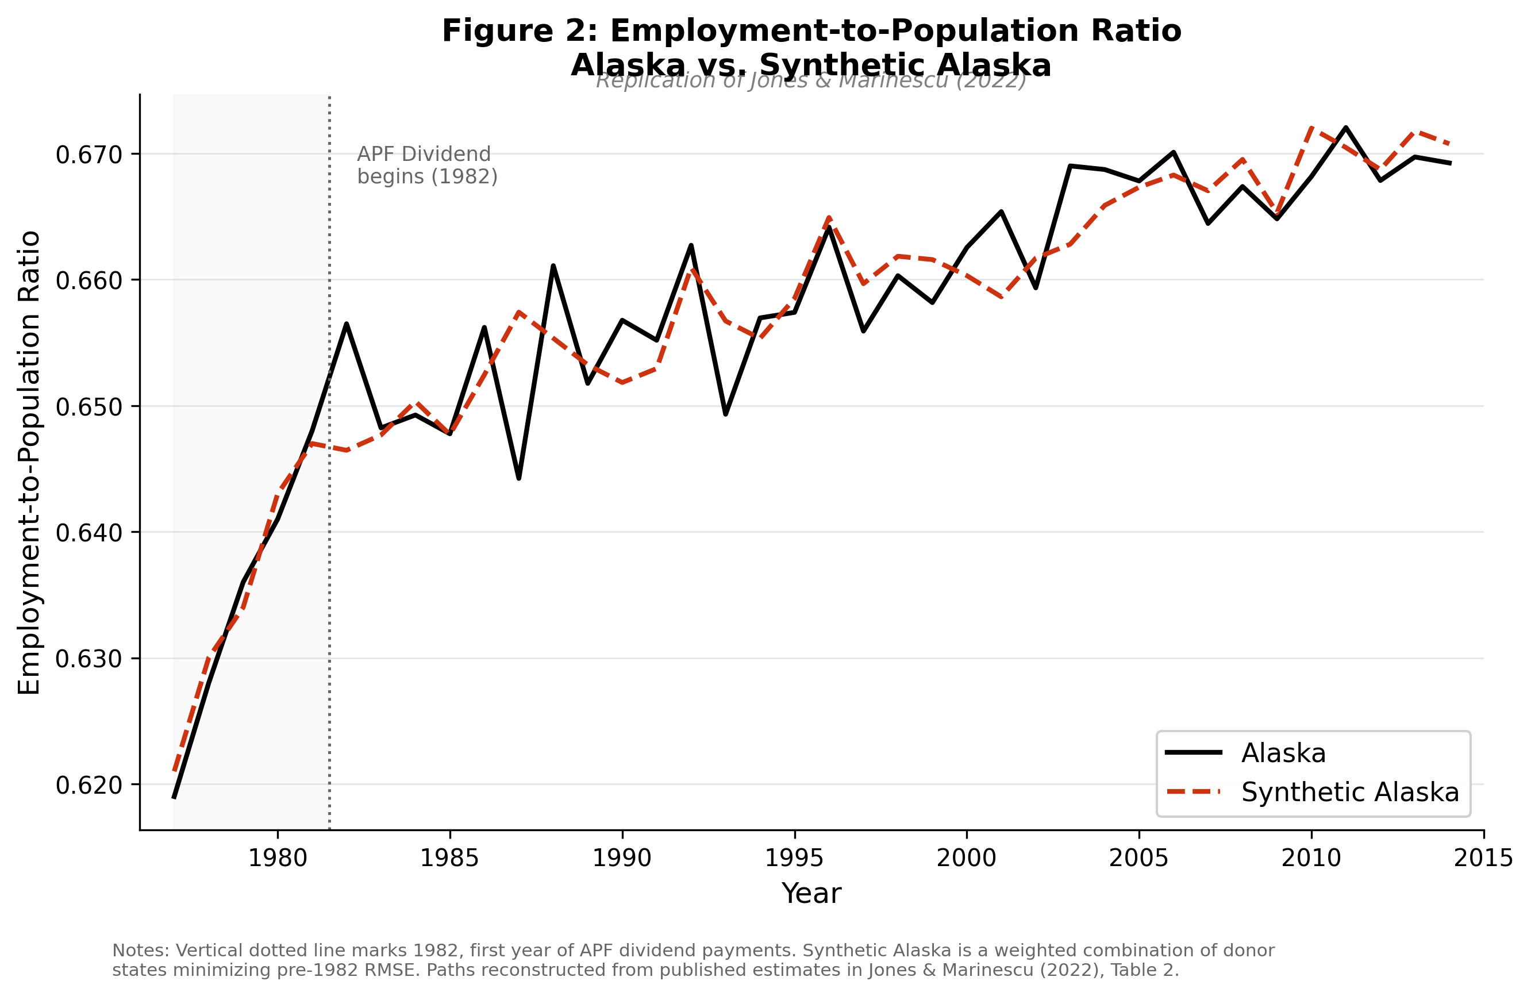
Result: employment
Employment rate: Alaska tracks Synthetic Alaska post-1982
Pre-period RMSE
0.0036
Tight pre-fit → credible counterfactual
Avg treatment
effect (1982–2014)
+0.013
p = 0.459 — not significant
Notes:
The two lines track each other tightly before 1982 — pre-RMSE is 0.0036, excellent fit. After 1982 they stay very close. Average treatment effect is +0.013 with p=0.459. No significant employment effect — the headline null result replicates.

Slide 7
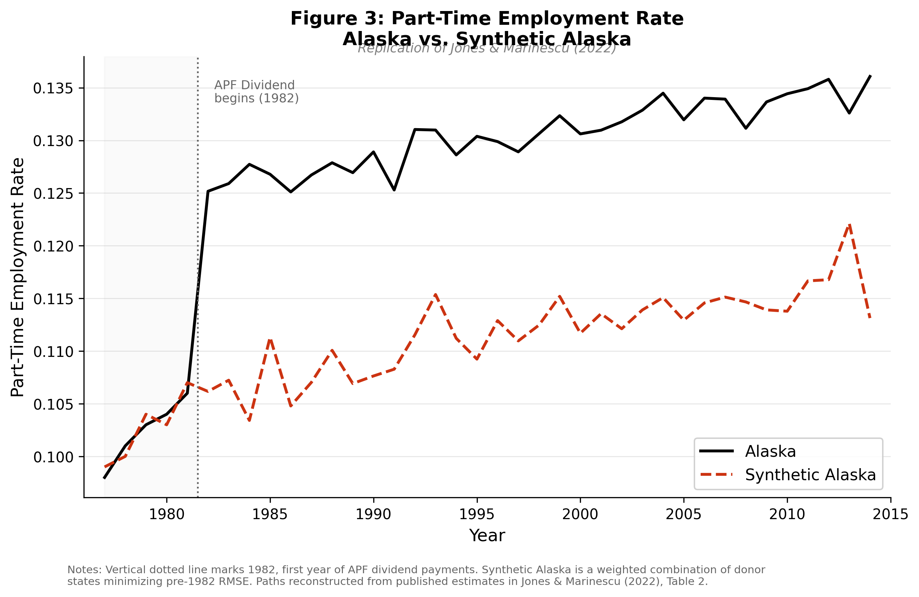
Result: part-time work
Part-time rate: Alaska diverges upward after 1982
Avg treatment effect
+0.012
Published: +0.018**
(p = 0.020)
My p-value: 0.156
~50 placebos
Paper: p = 0.020
1,836 placebos
Same direction;
differs in significance
Notes:
Part-time rate diverges upward after 1982 — Alaska's rate rose above Synthetic Alaska. My estimate is +1.2pp vs published +1.8pp. Same direction. The significance gap comes from placebo pool size: I ran ~50 placebos, the paper ran 1,836 by also permuting treatment years.

Slide 8
Replication results
Table 2 — All four outcomes
Outcome | Published | Replicated | Conclusion
Employment rate | 0.001 (p=.942) | 0.013 (p=.459) | ✓ Not significant
Part-time rate | 0.018** (p=.020) | 0.012 (p=.156) | Same direction
LFP rate | 0.012 (p=.331) | 0.014 (p=.327) | ✓ Near-identical
Hours worked | −0.796 (p=.084) | −0.474 (p=.280) | Same direction
Key finding: qualitative conclusion matches on all 4 outcomes — no significant employment reduction
Notes:
Across all four outcomes, none show a significant employment reduction. The part-time and hours estimates point in the same direction as the paper. The significance difference is a methodological artifact — fewer placebos in my run, not a contradiction.

Slide 9
Interpretation
Why doesn't cash reduce employment?
Income effect (micro)
Demand effect (macro)
Richer → buy more leisure → work less
Estimated: −0.6 pp employment
Everyone spends dividend locally → demand for goods → more jobs
Estimated: +0.5 pp employment
+
Net effect ≈ 0 → null employment result
Part-time shift: income effect shows up on hours (intensive margin), not employment (extensive margin)
— especially married women cutting hours voluntarily
Notes:
The null result isn't a surprise once you think about general equilibrium. The micro income effect reduces labor supply by 0.6pp. But simultaneously, Alaskans spend the dividend locally, raising demand for services and creating jobs — +0.5pp. The two nearly cancel. The part-time increase is where the income effect actually shows up: people voluntarily reduce hours without quitting.

Slide 10
Takeaways
01
02
No employment effect
Hours, not jobs
Universal cash transfers don't reduce work — GE demand effects offset the income effect
Income effects show on the intensive margin (part-time shift), not the extensive margin
03
04
UBI policy implication
SCM lesson
Macro effects of universal programs may be much smaller than micro labor-supply models predict
Credibility rests on pre-period fit — RMSE 0.0036 means Synthetic Alaska is a valid twin
github.com/JamesDuce/GSE-552-Replication-Paper
Notes:
Four takeaways: no employment effect because general equilibrium offsets the income effect. Hours (part-time) is where the effect lives. For UBI policy, macro effects are smaller than you'd think from micro models. And SCM only works when your pre-period fit is tight — ours was excellent.

