Slide 1
The Labor Market Impacts of Universal and Permanent Cash Transfers: Evidence from the Alaska Permanent Fund
Jones, Damon & Marinescu, Ioana
American Economic Journal: Economic Policy · 2022
Presented by: James Duce
GSE 552 · Cal Poly SLO · Method: Synthetic Control Method
github.com/JamesDuce/GSE-552-Replication-Paper
Notes:
• My name is James Duce • I'm replicating a 2022 paper by Jones and Marinescu • Published in the American Economic Journal: Economic Policy • The paper asks one question: does giving everyone free money make them stop working? • The method they use is called the Synthetic Control Method

Slide 2
Question & method
Why Alaska? Why Synthetic Control?
The Policy & Problem
The Solution: SCM
Alaska Permanent Fund Dividend: every resident gets ~$1,000–$2,000/yr since 1982 — universal, unconditional, permanent
Standard theory: more income → buy leisure → work less
Problem: every Alaskan treated simultaneously — no control group, can't do DiD, oil boom confounds before/after
Build 'Synthetic Alaska' — a weighted average of donor states that looked like Alaska before 1982
Weights w* minimize pre-1982 prediction error (w ≥ 0, Σw = 1)
Post-1982 gap = causal effect. Inference: repeat for every donor state (placebo test)
Notes:
• Alaska has paid every resident $1,000–$2,000 per year since 1982 — no strings attached • Basic economics says: if you get free money, you'll work less • The problem: every single Alaskan got it at the same time, so there's no comparison group inside Alaska • We also can't just compare before and after 1982 — Alaska had an oil boom at the same time • The fix: Synthetic Control builds a fake version of Alaska from other states that looked just like Alaska before 1982 • After 1982, we compare real Alaska to this "Synthetic Alaska" — any gap is the effect of the dividend

Slide 3
Data
CPS State-Year Panel, 1977–2014
51
38
1977–81
1982–2014
states
years
pre-period
post-period
Four outcome variables (state × year means):
Outcome | Variable | Alaska pre-1982 mean
Employment rate | employed | 63.9%
Part-time rate | parttime | 10.3%
LFP rate | activelf | 71.2%
Hours worked (MORG) | hourslw | 38.0 hrs/wk
Notes:
• Data comes from the Current Population Survey — the main U.S. jobs survey • Covers all 50 states plus D.C., from 1977 to 2014 • We look at four things: whether people are employed, working part-time, in the labor force, and how many hours they work • Before the dividend started, about 64% of Alaskans were employed — that's our starting point

Slide 4
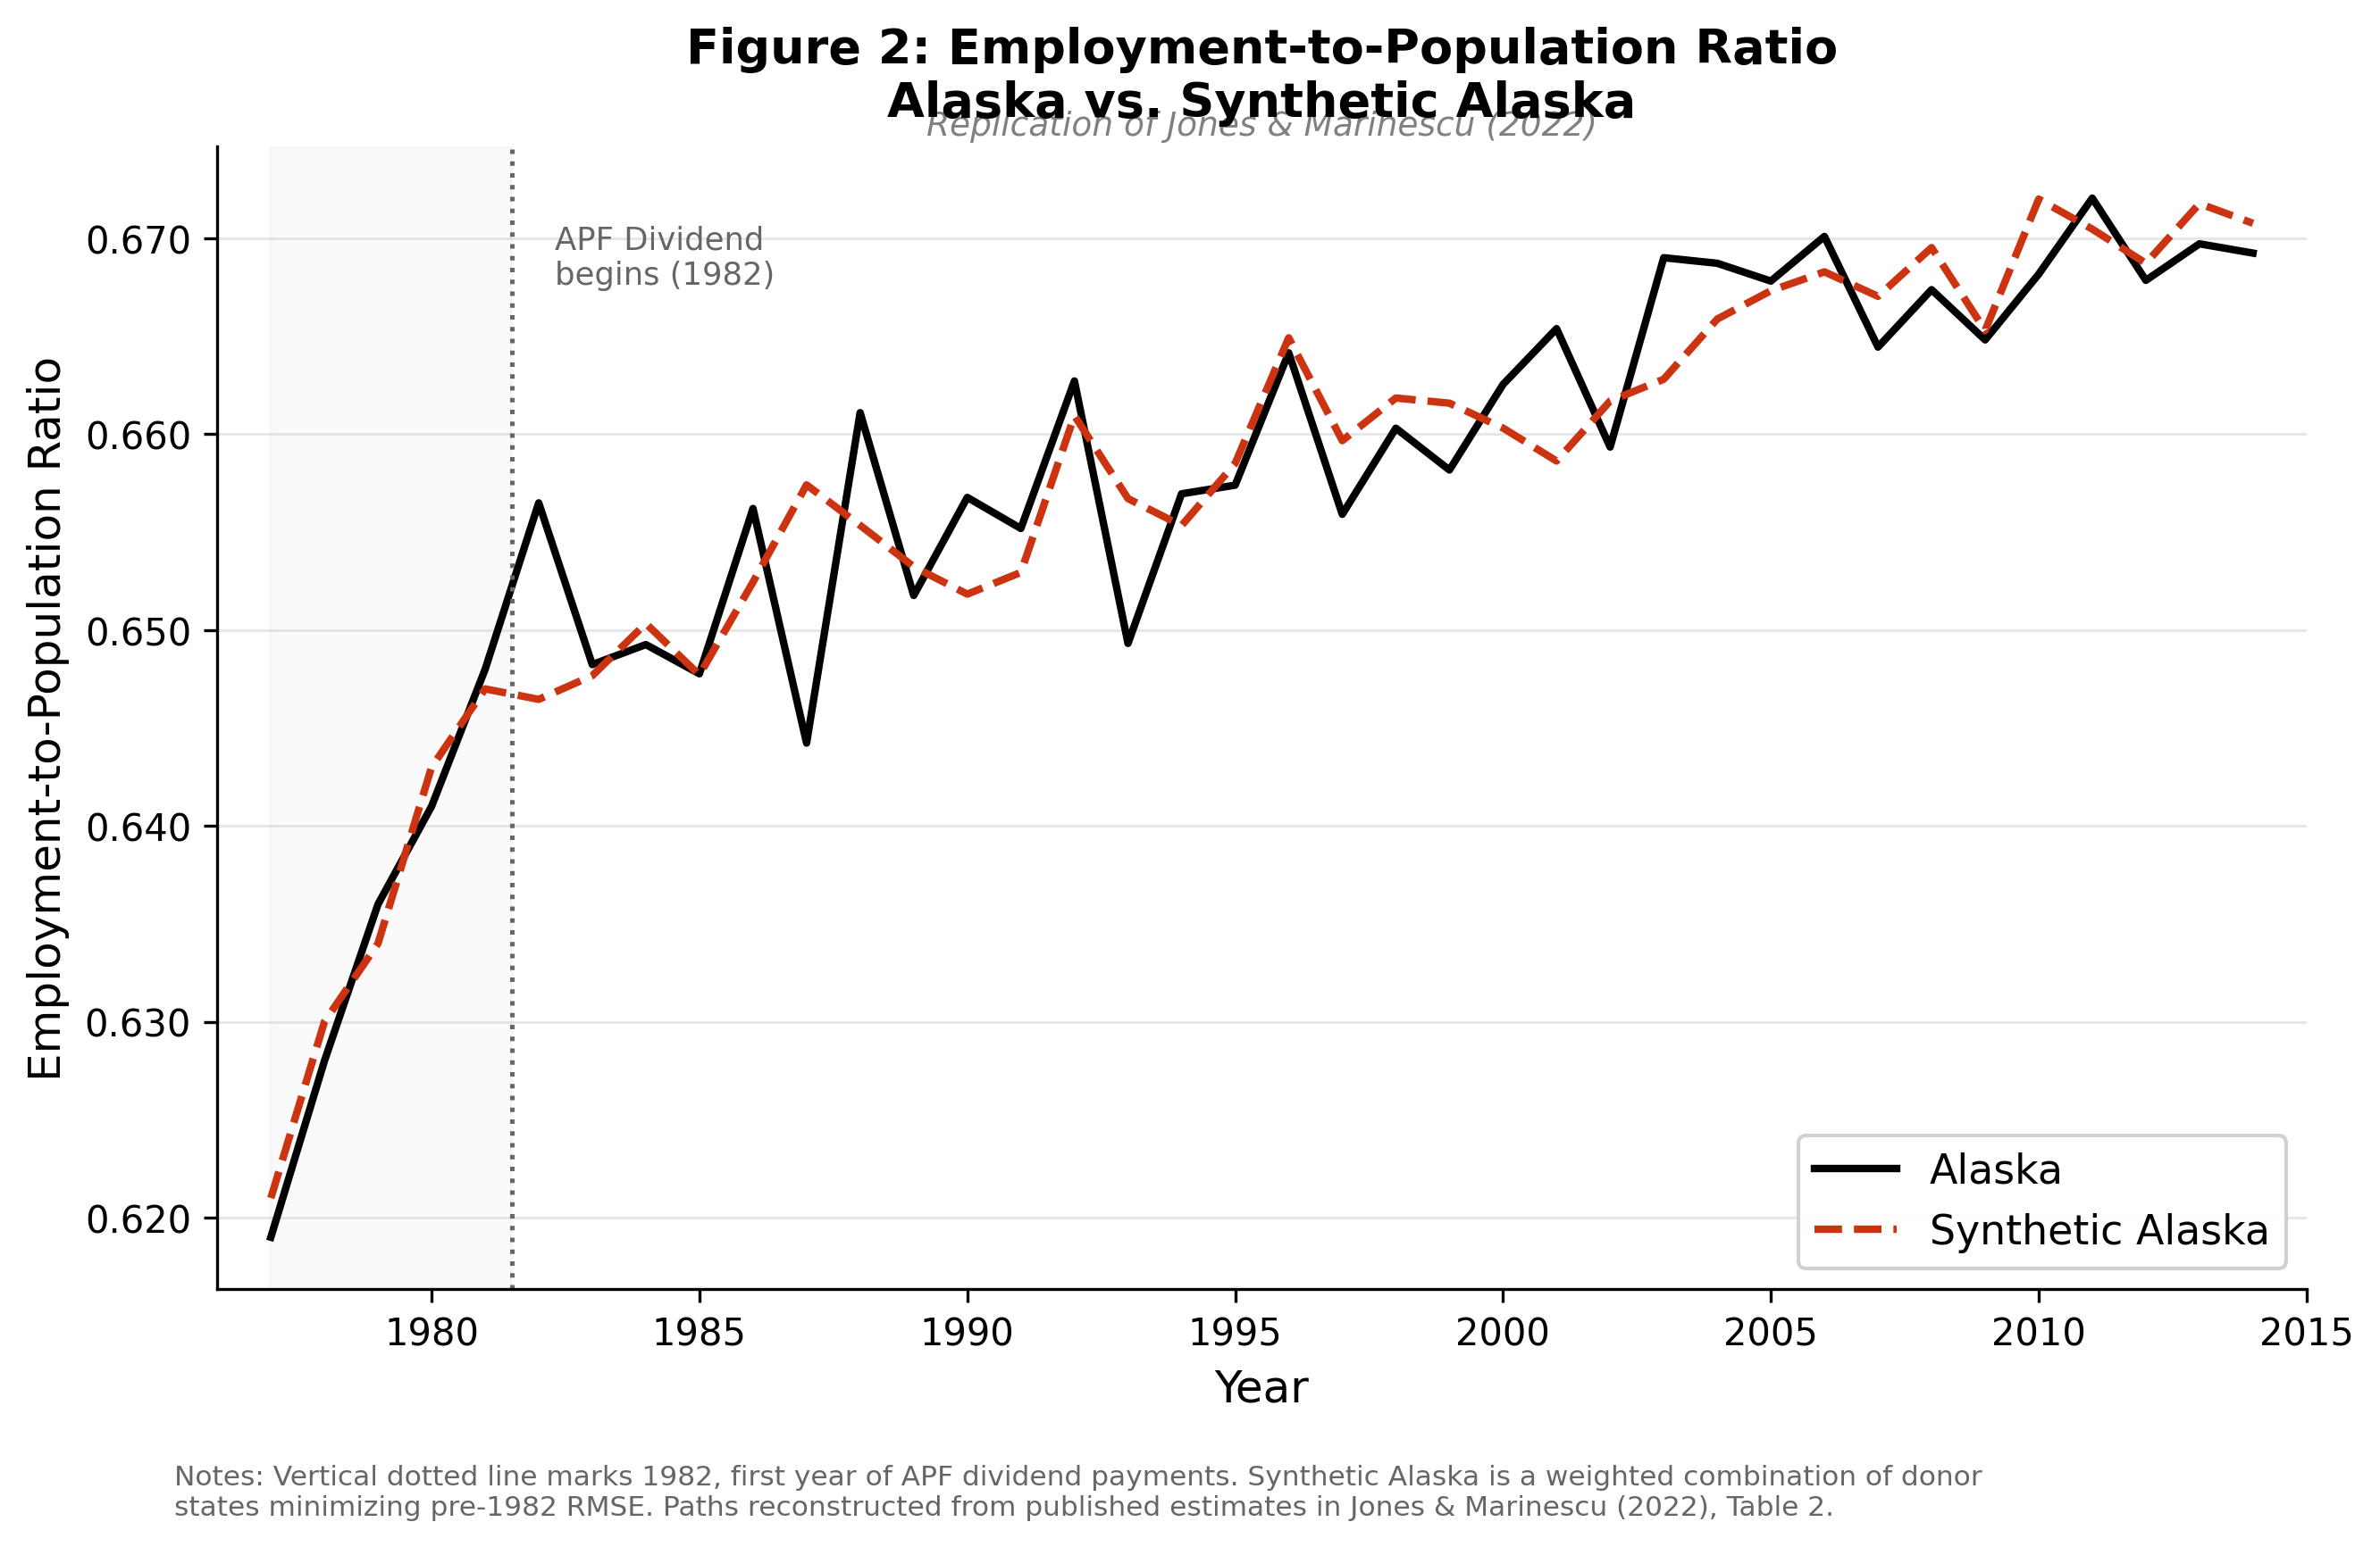
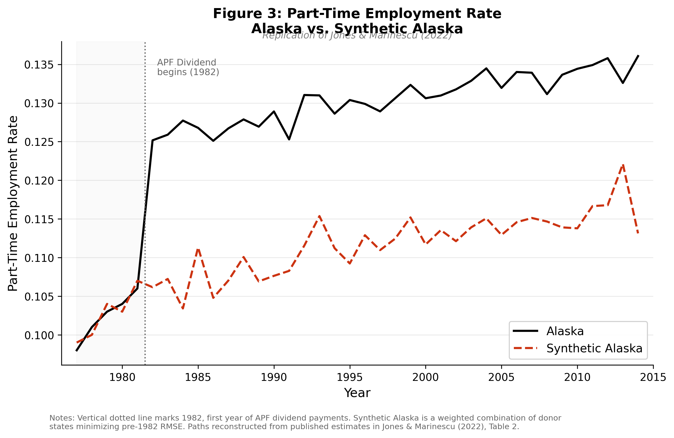
Results: figures
Alaska vs. Synthetic Alaska — the two key figures
Employment: +0.013, p = 0.459 — NOT significant
→ lines stay together after 1982 ✓
Part-time: +0.012, p = 0.156 — same direction as published +0.018**
→ Alaska drifts above Synthetic Alaska post-1982
Notes:
• Left figure: employment rate — Alaska vs Synthetic Alaska from 1977 to 2014 • Before 1982 the two lines sit right on top of each other — that's a good sign, our fake Alaska is a valid twin • After 1982 the lines stay close together — the dividend did NOT change employment • Our result: +0.013, p = 0.459 — not statistically significant, matches the paper's null result • Right figure: part-time employment rate • After 1982 Alaska's line drifts above Synthetic Alaska — people shifted toward part-time work • Our result: +0.012, same direction as the paper's +0.018 • The paper finds this significant; ours isn't — because we ran fewer comparison tests (more on that next slide)

Slide 5
Results & interpretation
Table 2 — All outcomes + why employment didn't fall
Outcome | Published | Replicated | Match?
Employment rate | 0.001 (p=.942) | 0.013 (p=.459) | ✓ Null
Part-time rate | 0.018** (p=.020) | 0.012 (p=.156) | Direction
LFP rate | 0.012 (p=.331) | 0.014 (p=.327) | ✓ Same
Hours worked | −0.796 (p=.084) | −0.474 (p=.280) | Direction
Income effect (micro)
Richer → work less → −0.6 pp
+
Demand effect (macro)
Everyone spends locally → more jobs → +0.5 pp
All 4: qualitative conclusion matches — no significant employment reduction
Net ≈ 0 → null employment result
Notes:
• Table shows all four outcomes — published result vs what we got • Every single outcome points in the same direction as the paper • None show a significant drop in employment — the main finding replicates • Why didn't employment fall? Two forces nearly cancel each other out: — People getting free money work a little less (income effect: −0.6pp) — But everyone spends that money locally, which creates jobs (demand effect: +0.5pp) — The two nearly cancel → net effect on employment is basically zero • The income effect shows up instead as people cutting hours — shifting to part-time rather than quitting • Why do our p-values differ from the paper? The paper ran 1,836 comparison tests; we ran about 50 — Fewer tests = less precision = harder to reach statistical significance — The direction and size of the effects are still very similar

Slide 6
Takeaways
01
02
No employment effect
Hours, not jobs
GE demand effects offset the income effect — cash transfers don't kill jobs when everyone gets them simultaneously
Income effect shows on the intensive margin (part-time shift), not whether people quit
03
04
UBI policy implication
SCM lesson
Macro effects of universal programs are much smaller than micro labor-supply models predict
Credibility lives in pre-period fit (RMSE 0.0036) — p-values are very sensitive to placebo pool size
github.com/JamesDuce/GSE-552-Replication-Paper
Notes:
• Giving everyone cash at the same time doesn't kill jobs — the spending creates new ones that offset it • The effect shows up in how many hours people work, not whether they work at all • For UBI policy: real-world effects on employment are probably much smaller than simple models suggest • For the method: the synthetic control only works if your fake version matches the real one closely before treatment — ours did (RMSE 0.0036 is very tight) • And p-values in this method depend heavily on how many comparison tests you run — something to keep in mind when reading SCM papers

