Slide 1
Bank Loan Risk Analysis
July 4, 2025

Slide 2
Agenda
Executive Summary
Income-Based Risk Analysis
Product-Based Risk Analysis
Highest Risk Loan Segments
Safest Loan Segments
Risk Spread Analysis
Strategic Recommendations Overview
Immediate Actions (0-90 Days)
Strategic Initiatives (90-365 Days)
Risk Management Framework
Business Impact Analysis
Implementation Roadmap
Success Metrics
Technical Methodology
SQL Analysis Highlights
Data Sources & Validation
Contact & Portfolio

Slide 3





Executive Summary
Overview
Project Scope
Key Findings
Business Impact
Tools Used
Timeline
Dataset of 32,581 loan records valued at $312.4M analyzed using SQL Server, T-SQL, and statistical methods within a defined timeline to deliver comprehensive risk assessment and recommendations.
Portfolio default rate at 21.82%, four times the industry average, with a 52 percentage point risk spread between safest and riskiest loan segments, identifying critical areas for loss reduction.
Potential annual savings exceeding $10 million identified by optimizing lending decisions through data-driven risk assessment and strategic rebalancing of the loan portfolio.
SQL Server, T-SQL, and statistical analysis tools employed to process and analyze the extensive credit risk dataset with 95% confidence level accuracy.
Complete analysis and recommendations delivered within the project timeline, ensuring timely insights to support strategic decision-making.

Slide 4



Income-Based Risk Analysis
Risk Analysis
Low Income (<$50K)
Default Rate: 33.37% | Portfolio Volume: $93.9M (30.1%) | Risk Assessment: ⚠️ HIGH RISK. This segment carries the highest default rate and substantial portfolio exposure, indicating elevated lending risk.
Middle Income ($50K-$100K)
Default Rate: 15.05% | Portfolio Volume: $163.7M (52.4%) | Risk Assessment: ⚠️ MODERATE RISK. This segment represents the largest share of the portfolio but has a default rate below the overall average.
High Income (>$100K)
Default Rate: 9.53% | Portfolio Volume: $60.2M (19.3%) | Risk Assessment: ✅ ACCEPTABLE. This segment shows the lowest default rate and smallest portfolio volume, representing the safest lending group.

Slide 5





Product-Based Risk Analysis
Risk Analysis
Debt Consolidation Risk
Medical Loan Risk
Home Improvement Risk
Default Rate: 28.59%, Portfolio Volume: $50.0M. This loan purpose is categorized as ⚠️ AVOID due to its high default risk impacting portfolio stability.
Default Rate: 23.59%, Portfolio Volume: $62.1M. Identified as ⚠️ HIGH RISK segment requiring close monitoring and potential repricing to mitigate losses.
Default Rate: 26.10%, Portfolio Volume: $37.3M. This segment is ⚠️ HIGH RISK due to elevated default rates, necessitating strategic action.
Venture Loan Risk
Education Loan Risk
Default Rate: 14.81%, Portfolio Volume: $54.8M. Marked as ✅ PREFERRED for portfolio growth given its relatively low default rate and volume.
Default Rate: 17.22%, Portfolio Volume: $61.1M. Classified as ✅ ACCEPTABLE, representing a stable segment with moderate risk and solid volume.

Slide 6
Highest Risk Loan Segments
Risk Analysis
Top Risk Segment
Second Highest Risk
Third Risk Segment
Fourth Risk Segment
Fifth Risk Segment
Low Income + Home Improvement has the highest default rate at 56.27%, with a portfolio volume of $6.9M and an estimated annual loss of $3.9M.
Low Income + Debt Consolidation loans show a 40.50% default rate, $15.4M volume, and estimated annual loss of $6.2M.
Low Income + Personal loans have a 33.42% default rate, portfolio volume of $15.7M, and an estimated loss of $5.2M.
Low Income + Medical loans exhibit a 32.70% default rate, $20.3M volume, and estimated annual loss of $6.6M.
Low Income + Education loans show a 27.23% default rate, $18.8M portfolio volume, and an estimated annual loss of $5.1M.

Slide 7
Safest Loan Segments
Risk Analysis
Rank 1: High Income + Venture
Rank 2: High Income + Education
Rank 3: High Income + Personal
Rank 4: Middle Income + Venture
Rank 5: High Income + Home Improvement
Default Rate: 4.32% - Volume: $10.8M - Risk Level: EXCELLENT
Default Rate: 7.13% - Volume: $19.9M - Risk Level: VERY GOOD
Default Rate: 7.57% - Volume: $10.3M - Risk Level: VERY GOOD
Default Rate: 8.92% - Volume: $27.5M - Risk Level: GOOD
Default Rate: 9.87% - Volume: $8.9M - Risk Level: ACCEPTABLE

Slide 8
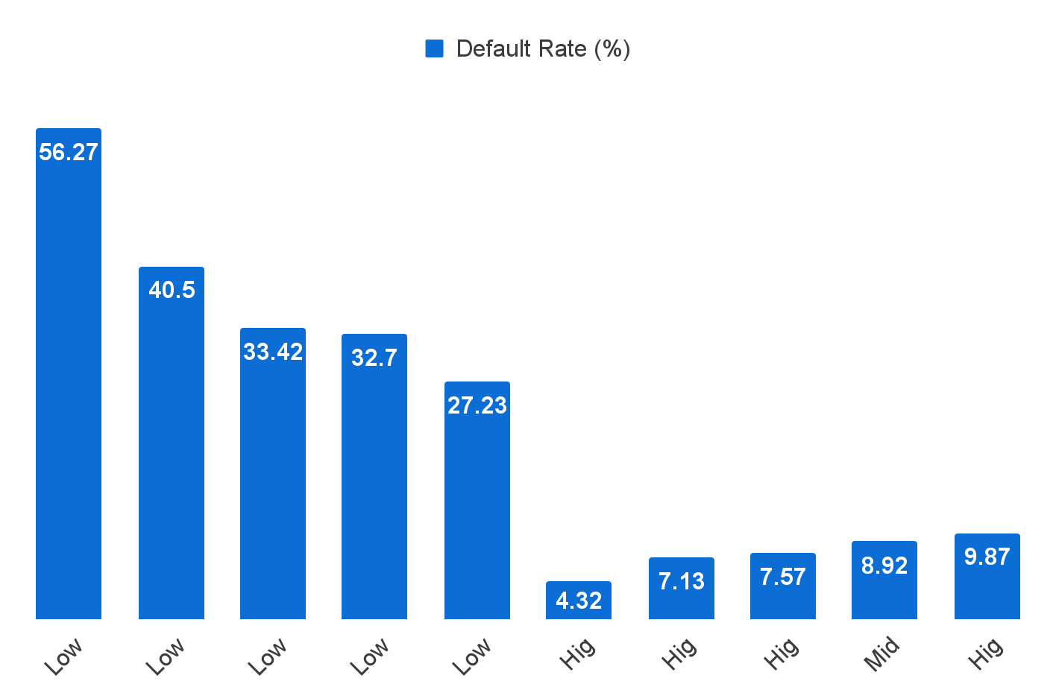
Risk Analysis
Risk Spread Analysis
Default Rates Across Loan Segments Showing Risk Spread
The 52 point spread between highest and lowest risk segments highlights the need for strategic lending adjustments.

Slide 9




Strategic Recommendations Overview
Recommendations
Immediate Discontinuations
Income Lending Restrictions
Loan Repricing Strategy
Portfolio Expansion
Risk Management Framework
Discontinue Low Income + Home Improvement loans with a 56.27% default rate and eliminate Low Income + Debt Consolidation products with a 40.50% default rate to reduce portfolio risk.
Restrict all lending to sub-$50K income groups due to their high average default rate of 33.37%, implementing minimum income thresholds for unsecured lending.
Apply a 200+ basis point risk premium on Medical loans to better price risk and improve portfolio profitability while managing exposure to risk.
Expand High Income + Venture lending (4.32% default rate) and grow Education loan portfolios for middle and high income segments to optimize portfolio quality.
Implement minimum income thresholds, enhanced documentation for sub-$75K applications, automated scoring models, and monthly default rate monitoring by segment.

Slide 10
Immediate Actions (0-90 Days)
Recommendations
DISCONTINUE Low Income + Home Improvement loans (56.27% default rate)
ELIMINATE Low Income + Debt Consolidation products (40.50% default rate)
RESTRICT All sub-$50K income lending (33.37% average default rate)
REPRICE Medical loans with 200+ basis point risk premium

Slide 11
Strategic Initiatives (90-365 Days)
Recommendations
EXPAND High Income + Venture lending (4.32% default rate) to capture low-risk growth opportunities.
GROW Education loan portfolio for middle/high income segments to diversify and enhance portfolio quality.
IMPLEMENT Income-based pricing model across all products to better align risk and return.
DEVELOP Enhanced underwriting criteria for identified risk segments to improve loan approval accuracy and minimize defaults.

Slide 12




Risk Management Framework
Risk Management
Minimum Income Thresholds
Enhanced Documentation
Set a $50K minimum income threshold for unsecured lending to limit exposure to high-risk borrowers and reduce default rates.
Require enhanced documentation for all loan applications under $75K to ensure thorough borrower verification and mitigate risk.
Automated Scoring
Monthly Monitoring
Implement an automated scoring system combining income and product risk matrix to objectively assess borrower risk and streamline underwriting.
Establish monthly monitoring of default rates by segment to detect risk trends early and adjust lending strategies proactively.

Slide 13
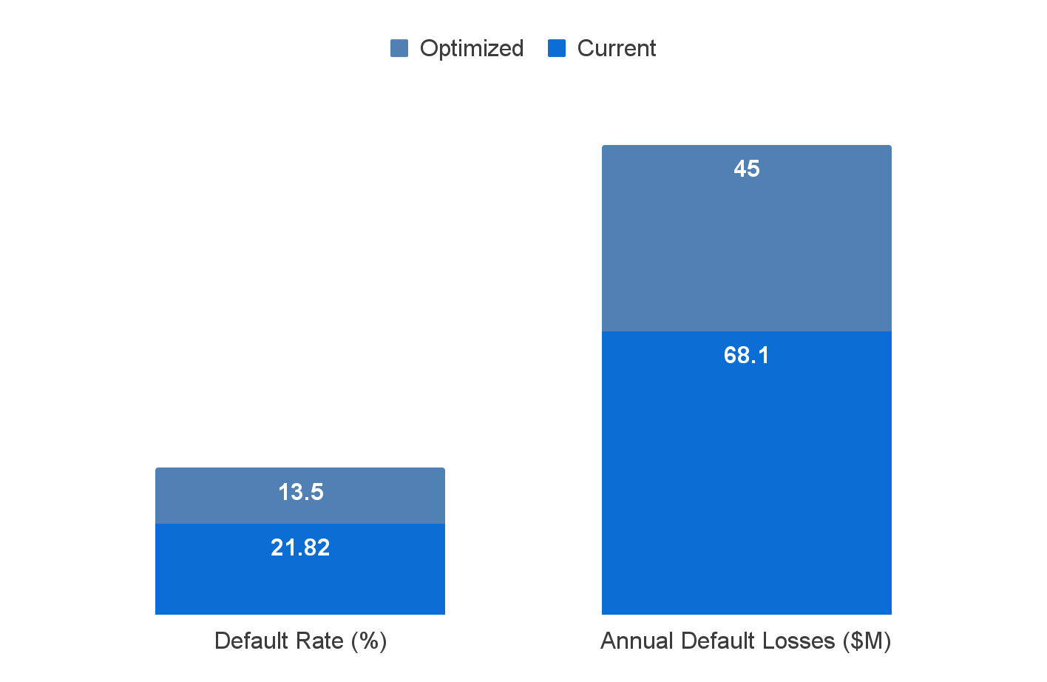

Impact
Business Impact Analysis
Default Rate & Annual Losses
Risk-Adjusted ROI & Quality Score
Default rate drops from 21.82% to 12-15%, cutting annual losses from $68.1M to $40-50M, saving $18-28M.
Risk-adjusted ROI improves from 8.2% to 15-18%, with portfolio quality rising from C+ to B+ grade.

Slide 14
Implementation Roadmap
Roadmap
A structured phased approach over 365 days ensures effective risk reduction and portfolio optimization through targeted actions.
Phase 1 (0-90 days)
Phase 2 (90-180 days)
Phase 3 (180-365 days)
Halt all high-risk lending segments and implement minimum income thresholds to reduce immediate portfolio risk.
Launch risk-based pricing model and enhance underwriting criteria to better align loan pricing with risk levels and improve lending decisions.
Rebalance portfolio with strategic growth initiatives focusing on safer segments and continuous monitoring of risk metrics for sustained improvement.
Discontinued high-risk loan products
Implemented $50K minimum income threshold for unsecured lending
Enhanced documentation requirements for sub-$75K applications
Income-based pricing model deployed
Underwriting criteria updated for identified risk segments
Repricing of medical loans with risk premiums
Portfolio rebalanced towards high income and preferred loan segments
Expanded education loan portfolio for middle/high income
Established monthly monitoring to track default rates by segment

Slide 15
Success Metrics
Metrics
<15%
80%
Monthly Default Rate Target
New Loan Quality in Acceptable Risk Segments
15%+
$10M+
Portfolio Risk-Adjusted ROI
Annual Loss Reduction Validated

Slide 16


Technical Methodology
Methodology
SQL Server Analysis
Statistical Validation
Risk Modeling Approach
Analyzed 32,581 loan records using SQL Server Management Studio and T-SQL queries to segment income levels and loan intent for risk assessment.
Performed statistical significance testing, confidence interval calculations, and cross-referenced results with industry benchmarks to ensure accuracy and reliability.
Implemented multi-dimensional segmentation analysis combining income level and loan purpose to model default risk and prioritize portfolio optimization strategies.

Slide 17
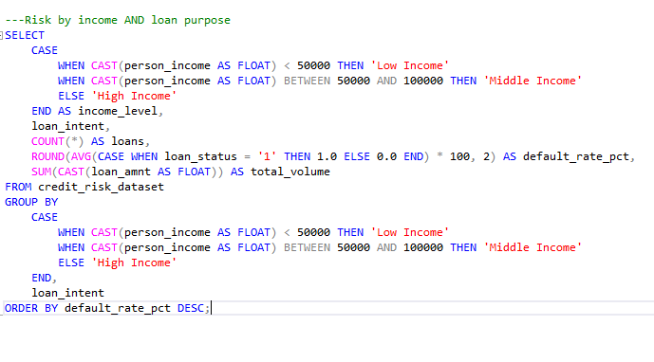
SQL Analysis Highlights
Key SQL Query for Cross-Segmentation Risk Analysis:
analysis.
Technical

Slide 18
Data Sources & Validation
Validation
Dataset: Credit Risk Dataset containing 32,581 loan records representing a $312.4M portfolio.
Validation: Complete data quality checks were performed including outlier removal to ensure dataset accuracy.
Methodology: Statistical significance testing and confidence intervals were applied to validate results.
Tools: SQL Server Management Studio and T-SQL were used for data querying and statistical analysis.
This rigorous approach ensured the reliability of findings and supported data-driven decision making in the loan risk analysis project.

Slide 19
Contact & Portfolio
Contact
James E. Nance Jr., Data Analytics Professional
Email: jamesenancejr@gmail.com
Phone: (405) 892-2636
GitHub: github.com/JamesENance/bank-loan-risk-analysis
LinkedIn: linkedin.com/in/jamesenancejr
www.jamesenance.com

Slide 20
Thank you

