Slide 1
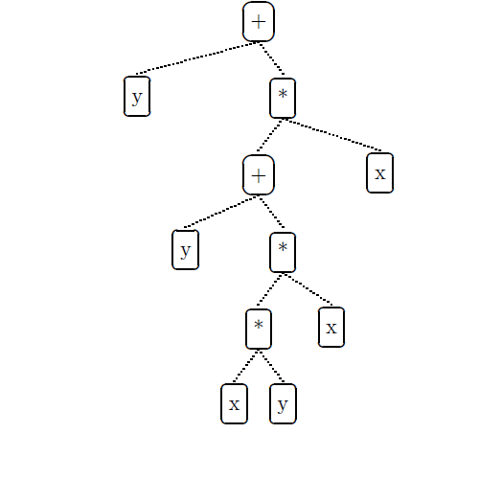
Genetic Programming Portfolio
COSC 4F90 – James Earle, Supervised by Dr. Ross

Slide 2
Contents
Introduction
Genetic Programming & Financial Forecasting
Ensemble Learning
Related Work
Data & Preliminary Trials
Experiments & Results
Conclusions & Future Work
References
Questions

Slide 3
Introduction
Artificial Intelligence and Financial Forecasting
Restricted access to other techniques due to financial backing
Yields significant improvement over traditional, manual methods (buy and hold)
Consider methodologies that provide strong models
Not to be actualized
Notes:
Note the choice for symbolic regression vs. rule-based GP. GP is a probabilistic system, therefore we use ensemble learning to not rely on a single run.

Slide 4
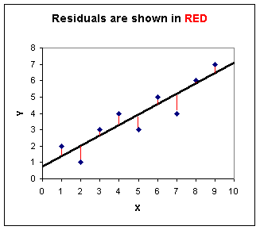
Genetic Programming & Financial Forecasting
Symbolic Regression
Finding a mathematical expression that best fits a curve
Rule-based GP
Fitness Function – Sum of Square Residuals (right)
Similar to Ordinary Least Squares (OLS) econometric regression testing
Notes:
Mention the finance literature for GP is divided into two approaches: rule-based or symbolic regression.
Symbolic regression more fit to the goal of this research.
OLS defines a STATIC equation and forces data to fit, symbolic regression does the opposite

Slide 5
Ensemble Learning
Using multiple learning algorithms to obtain better aggregate performance
Stacking 20 GP runs
Average vs. Median Fusion
Outliers pose a problem for average fusion technique
Notes:
GP is probabilistic, if one run is by chance very good, you can’t rely on this for accurate predictions. Ensemble Learning helps with this.
Be sure to define “Fusion” verbally

Slide 6
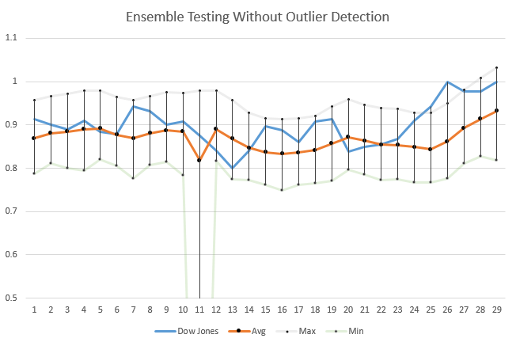
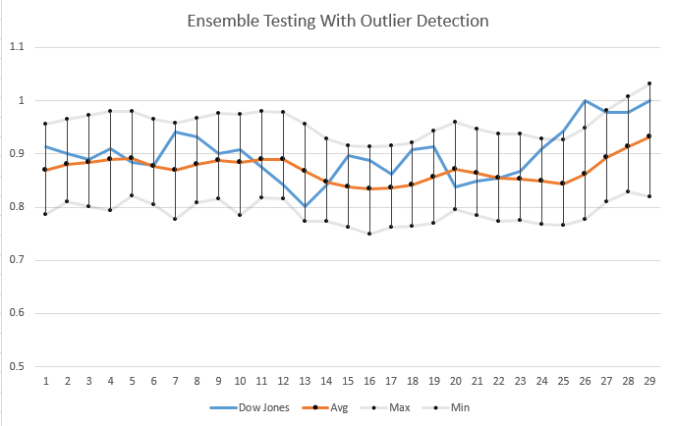
Ensemble Learning - Outlier Detection
Without 2σ Rule
With 2σ Rule

Slide 7
Related Work
Minkyu Kim et al. [1] – Minimization of overfitting in GP stock selection.
Kalyan Veeramacheneni et al. [2] – Ensemble learning for stock prediction at scale in a dynamic cloud-based system.
A similar outlier detection system
Michael F. Korns [3] – Time-constrained symbolic regression, providing insight on language variations inclusive of financial functions.
Ellery Fussel Crane et al. [4] – Exploration of size and depth limitations on GP, and the implications for population initialization.
John R. Koza [5] – Definition of many GP techniques and standards in terms of population initialization as well as chosen parameters.
Notes:
KIM – Robustness to overfitting is important, and data selection is a big part of that. Talks about variability in data set, ensuring a range of conditions
VEERAMACHENENI – Most important point is similar outlier detection system. They use a data stream with dynamic processing at scale
KORNS – Gives examples of financial functions as well as training methods. Includes noise in certain training functions to build robustness but doesn’t really improve anything, economic data is already very noisy.
CRANE – Contrasts the standard 17 tree depth used in work by John. R Koza, depends a lot on the content matter.
KOZA – the standard of GP, ramped half and half with depth limit of 17 recommended.

Slide 8
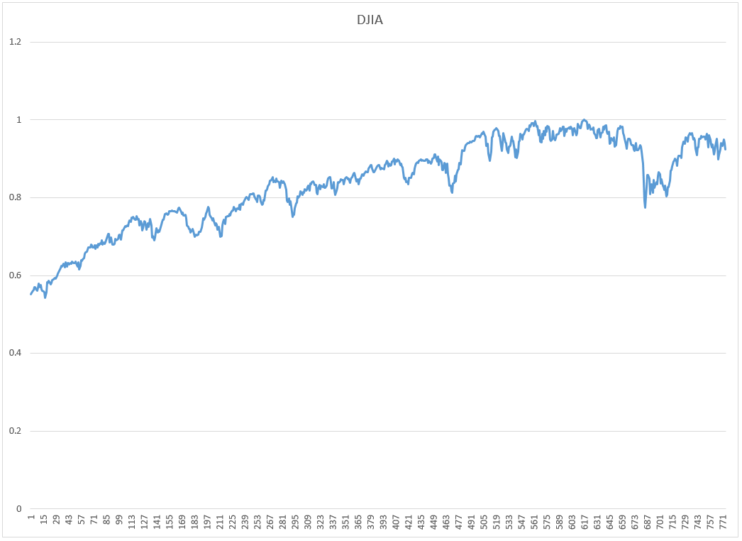
Data & Preliminary Trials
Chosen Data: Dow Jones Industrial Average
Jan. 1, 2013 – Jan. 1, 2016
3 Fiscal Years of variant growth patterns
Normalized to [0, 1]

Slide 9
Data & Preliminary Trials
Chosen Parameters in early examples yielded the strongest ensemble
Similar to the results of Kim et al. [1]
Parameter | Value
Crossover | 90%
Mutation | 10%
Elitism | 0
Tournament Size | 2
Max Tree Depth | 17
Pop. Size | 1000
Generations | 100

Slide 10
Experiments & Results

Slide 11
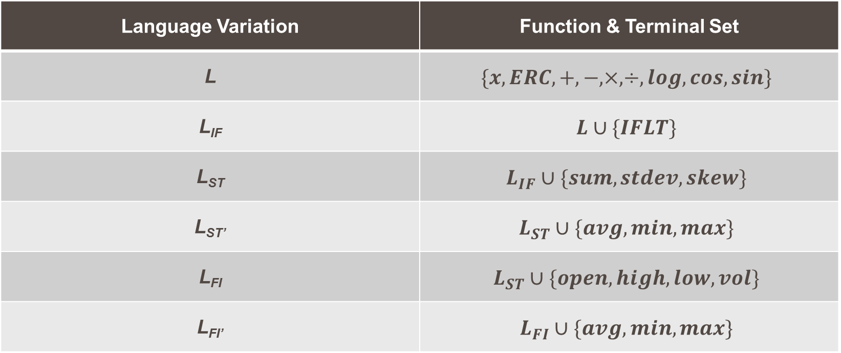
Language Definitions
Language Variation | Function & Terminal Set
L | $$\{x, ERC, +, −, ×, ÷, log, cos, sin\}$$
L_{IF} | $$L∪\{IFLT\}$$
L_{ST} | $$L_{IF}∪\{sum, stdev, skew\}$$
L_{ST’} | $$L_{ST}∪\{avg, min, max\}$$
L_{FI} | $$L_{ST}∪\{open, high, low, vol\}$$
L_{FI’} | $$L_{FI}∪\{avg, min, max\}$$
Notes:
A 70-30, 80-20, and 90-10 split will also be considered for L_{ST} and L_{ST’}
Also mention the 5 day lag period on the advanced functions

Slide 12
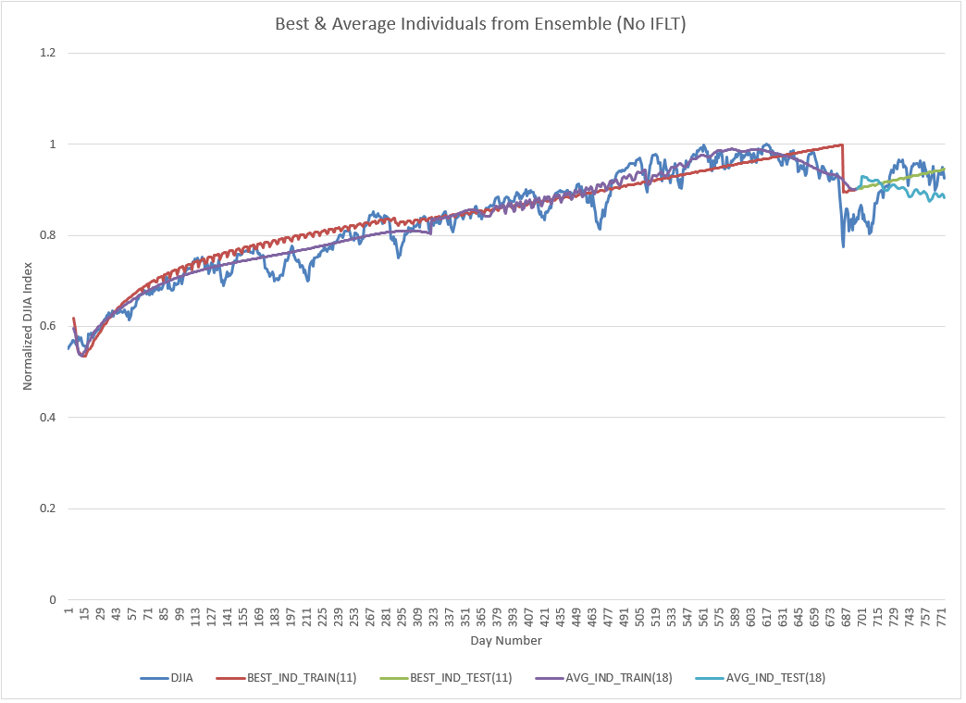
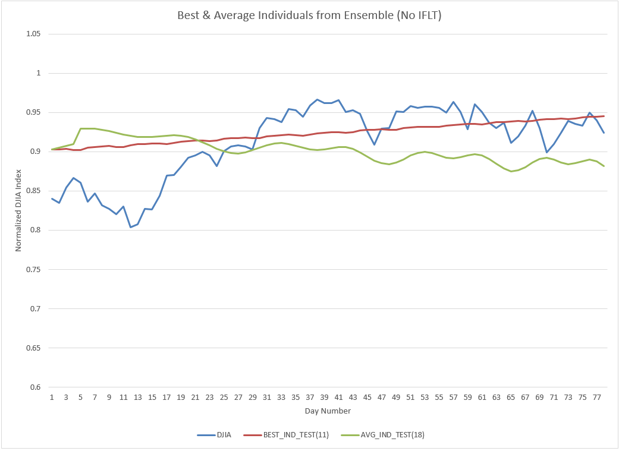
L: Comparison of Individual Models
Best & Average Models (Training)
Best & Average Models (Testing)

Slide 13
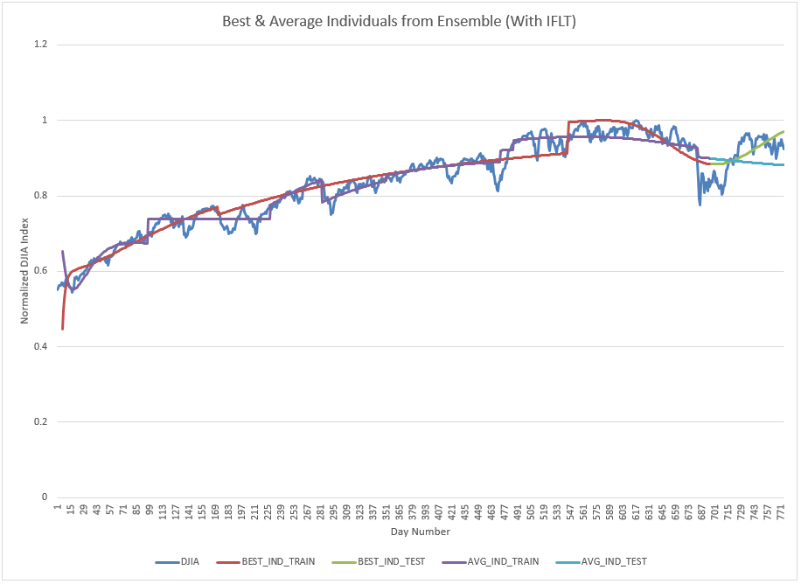
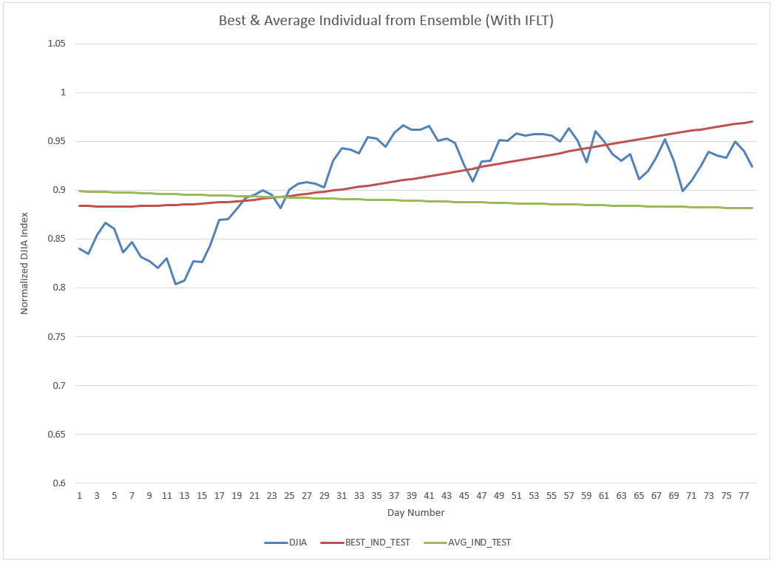
L_{IF}: Comparison of Individual Models
Best & Average Models (Training)
Best & Average Models (Testing)

Slide 14
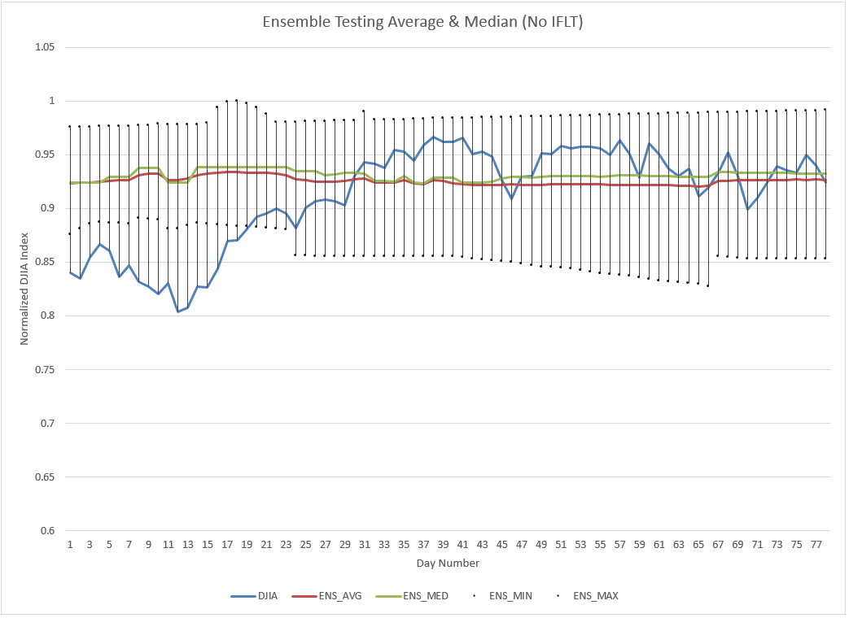
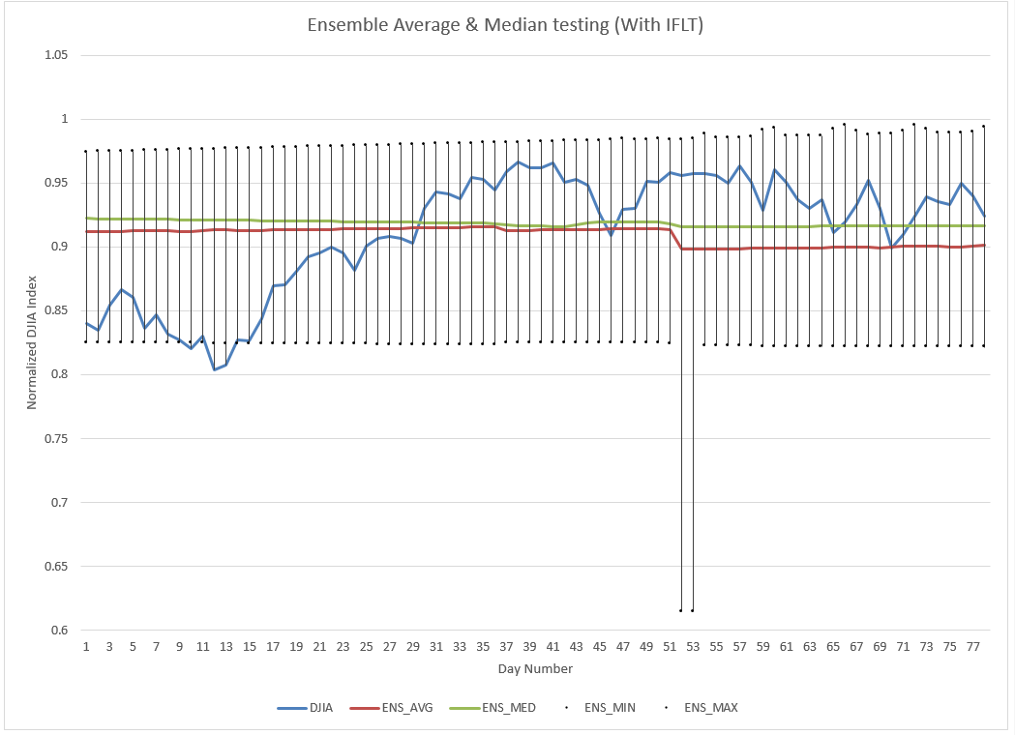
Ensemble Performance
L
L_{IF}

Slide 15
Ensemble Fitness
Language | Ensemble (Avg) Fit | Ensemble (Med) Fit | Outliers Removed
L | 0.194444 | 0.200982 | 35
L_{IF} | 0.185474 | 0.179552 | 43
Notes:
L_{IF} performs better in all cases, but also yields more outliers

Slide 16
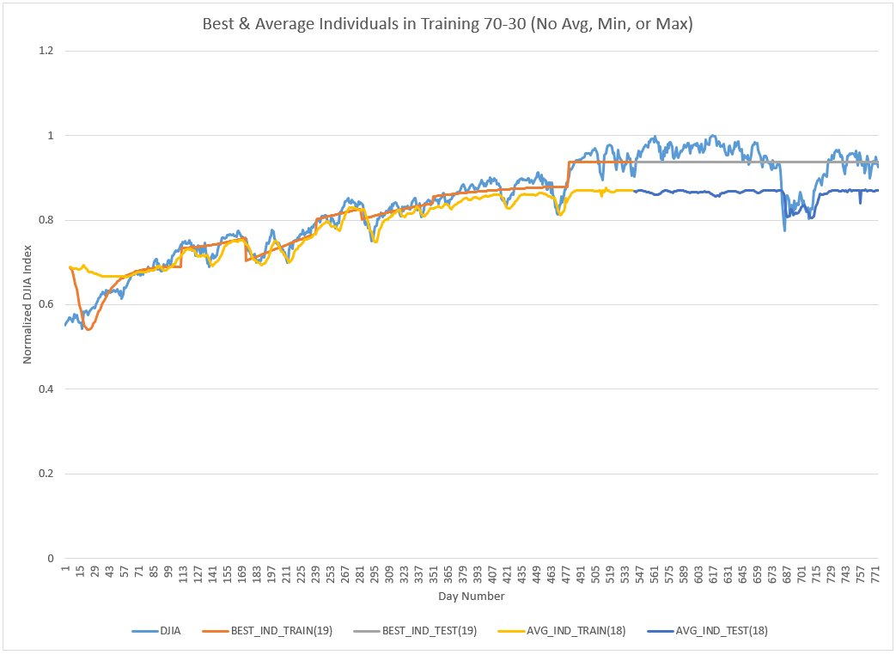
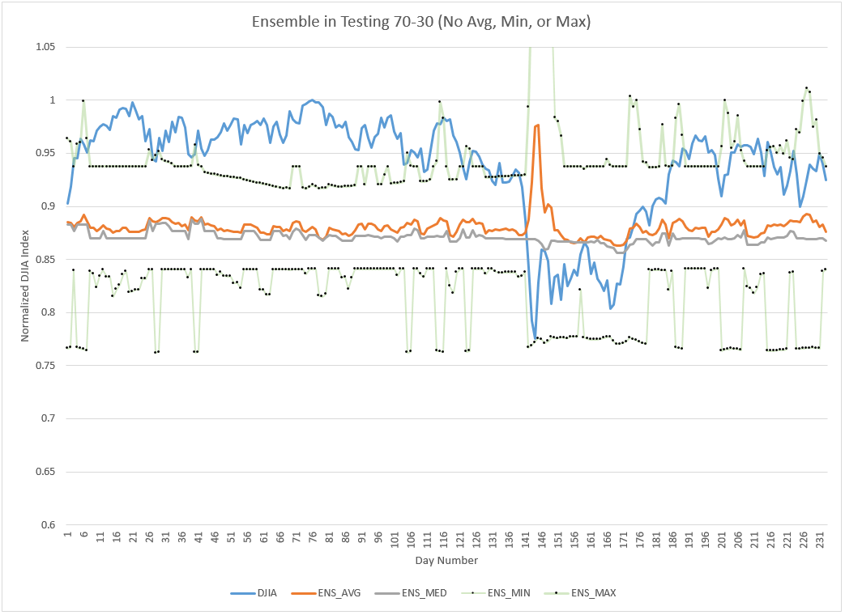
L_{ST}: Comparison of Individual Models (70-30)
Best & Average Models (Training)
Ensemble Testing

Slide 17
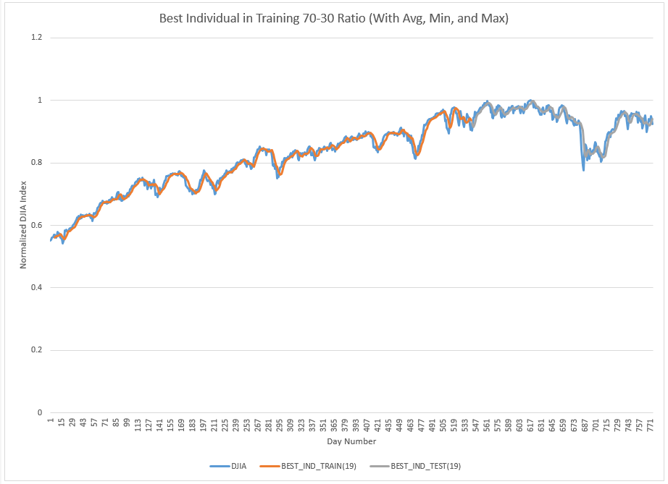
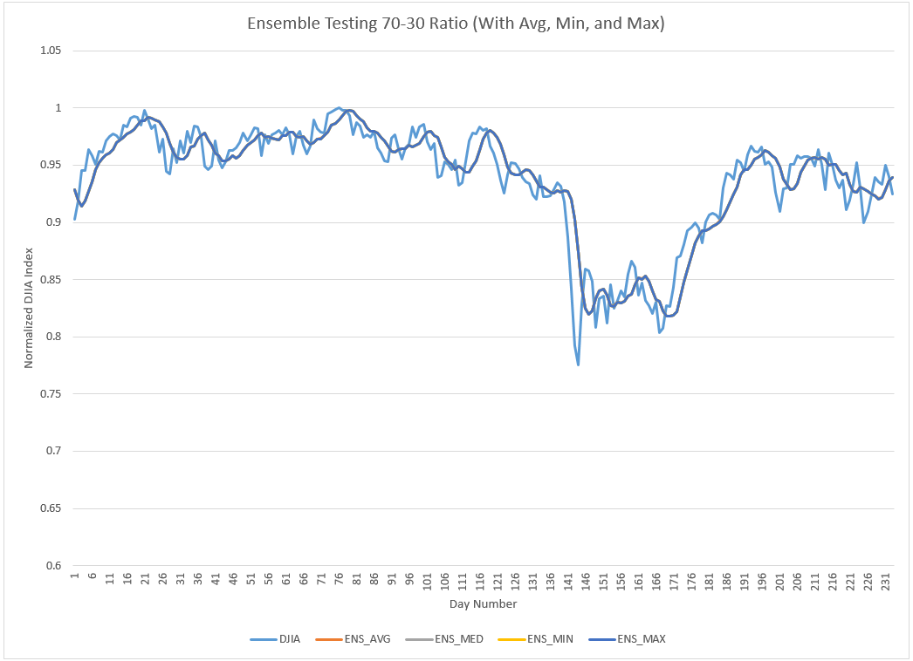
L_{ST’}: Comparison of Individual Models (70-30)
Best & Average Models (Training)
Ensemble Testing

Slide 18
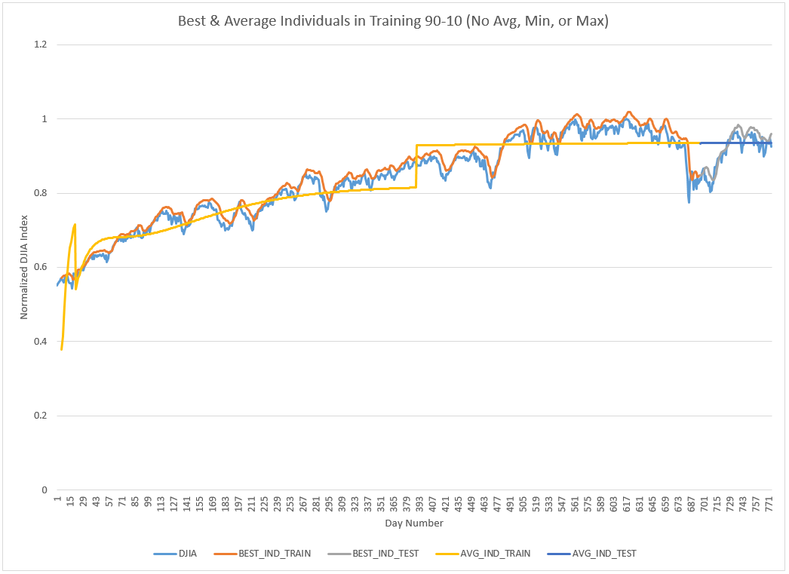
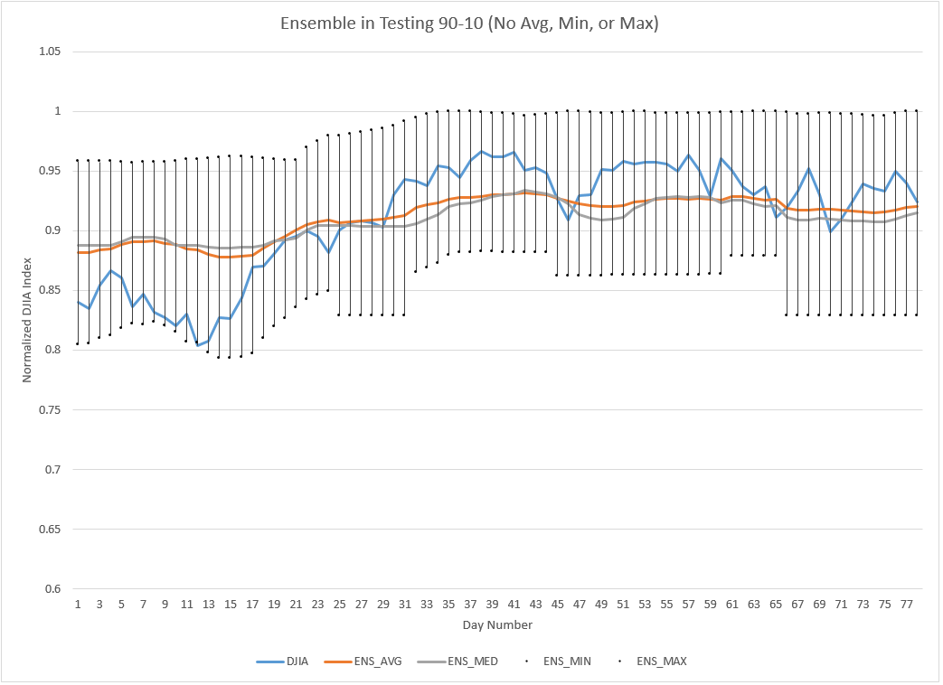
L_{ST}: Comparison of Individual Models (90-10)
Best & Average Models (Training)
Ensemble Testing
Notes:
Mention how close the best individual (left) is approximating the avg function using sum instead.

Slide 19
Ensemble Fitness
 | 70-30 | 80-20 | 90-10
L_{ST} | 1.395065 | 0.246555 | 0.073232
L_{ST’} | 0.088749 | 0.074097 | 0.026279
L_{ST} Outliers | 466 | 310 | 111
L_{ST’} Outliers | 384 | 253 | 18
Notes:
The marginal difference from 70-30 to 80-20 is small, but it is much larger in the 80-20 to 90-10. This implies that the shorter range of testing data is NOT the only reason for stronger fitness
Discuss the drawback of comparing varying size testing ranges because larger ranges are inclusive of smaller ones

Slide 20
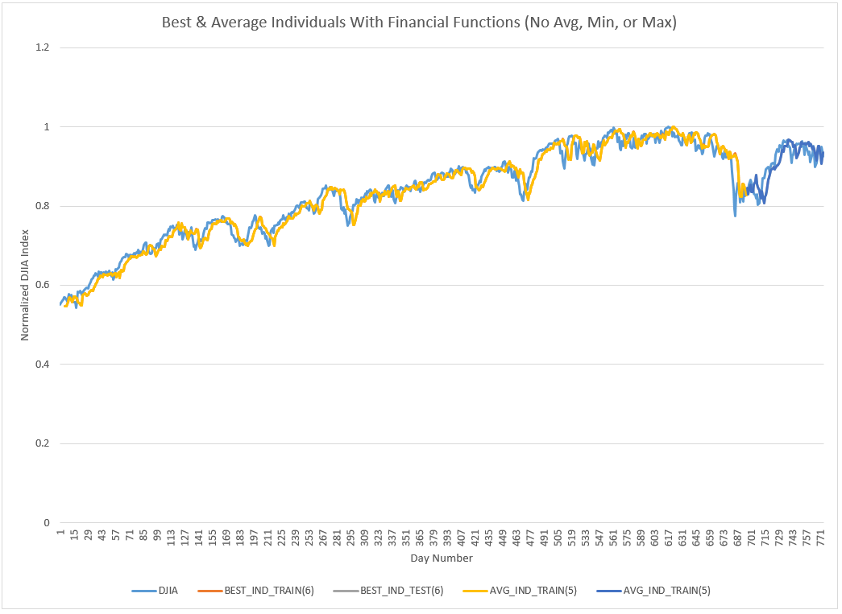
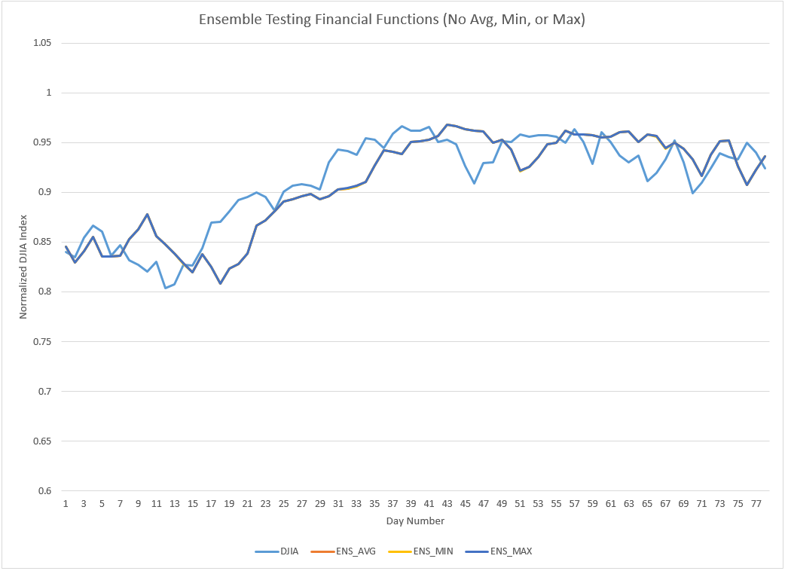
L_{FI}: Comparison of Individual Models (90-10)
Best & Average Models (Training)
Ensemble Testing

Slide 21
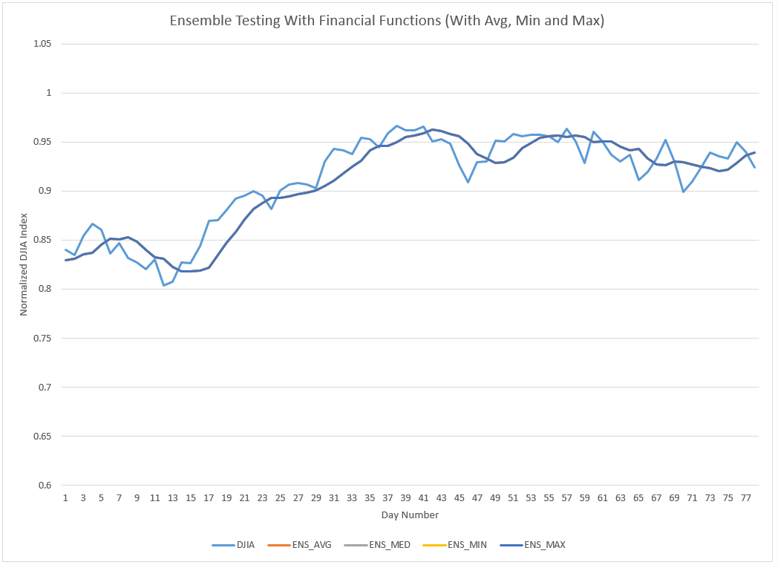
Comparison of HIGH and AVG
AVG
HIGH

Slide 22
Ensemble Fitness
Language | Ensemble Fit | Outliers Removed
L_{FI} | 0.057844 | 128
L_{FI’} | 0.026279 | 0
Notes:
L_{IF} performs better in all cases, but also yields more outliers

Slide 23
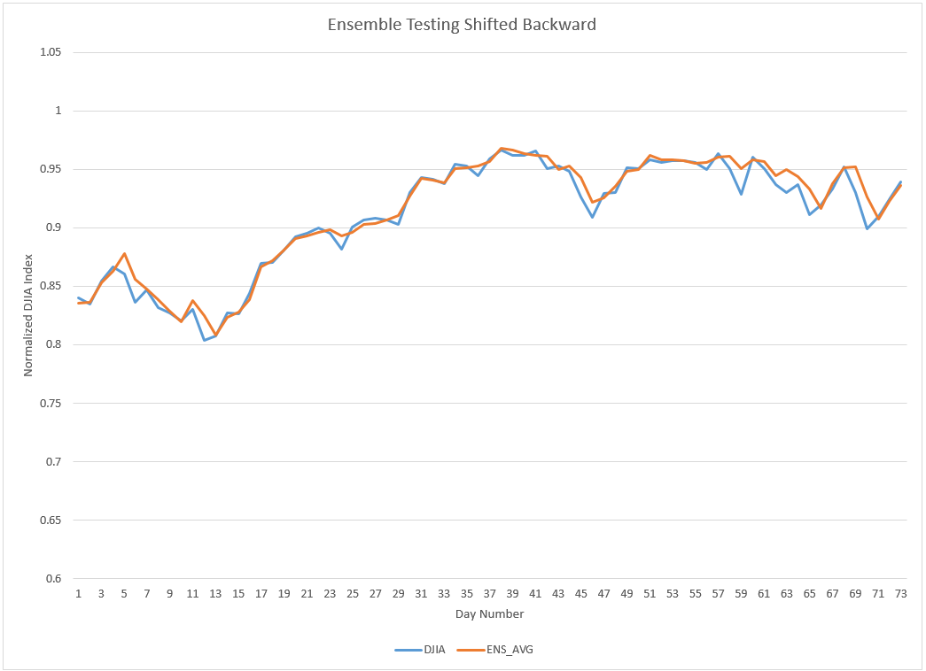
Shifted HIGH Ensemble Example

Slide 24
Ensemble Fitness Across Experiments
Language | Ensemble Fit | Outliers Removed
L | 0.194444 | 38
L_{IF} | 0.185474 | 43
L_{ST} | 0.073232 | 18
L_{ST’} | 0.026279 | 111
L_{FI} | 0.057844 | 128
L_{FI’} | 0.026279 | 0
Notes:
NOTE: All on 90-10 splits.

Slide 25
Ensemble Fitness Across Experiments
Language | Ensemble Fit | Outliers Removed
L | 0.194444 | 38
L_{IF} | 0.185474 | 43
L_{ST} | 0.073232 | 18
L_{ST’} | 0.026279 | 111
L_{FI} | 0.057844 | 128
L_{FI’} | 0.026279 | 0
Notes:
NOTE: All on 90-10 splits.

Slide 26
Conclusions
Highly dependent on use-case
Highly improved performance in advanced languages
Short-term – L_{FI}
Long-term – L_{FI’}
Volatility in financial functions
Smooth average
Transition to rule-based GP from symbolic regression when more advanced functions are introduced.

Slide 27
Future Work
Cross-Validation for comparison of training-testing data size ratios
Array-based GP language that applies operators to data series
Explore practical use of industry application

Slide 28
References
Minkyu Kim, Ying L. Becker, Peng Fei, and Una-May O’Reilly. Constrained genetic programming to minimize overfitting in stock selection. Genetic Programming Theory and Practice, 6:178-194, 2009 [1]
Kalyan Veeramachaneni, Owen Derby, Una-May O’Reilly, and Dylan Sherry. Learning regression ensembles with genetic programming at scale. Proceedings of the 15th Annual conference on Genetic and Evolutionary Computation, pages 1117-1124, 2013. [2]
Michael F. Korns. Large-scale time-constrained symbolic regression. Genetic Programming Theory and Practice, 4:299-314, 2009. [3]
Ellery Fussel Crane and Nicholas Freitag McPhee. The effects of size and depth limits on tree based genetic programming. Genetic Programming Theory and Practice, 3:223-240, 2006 [4]
John R. Koza. Genetic Programming: On the Programming Computers by Means of Natural Selection. MIT Press, 1992. [5]

Slide 29
Questions?

