Slide 1
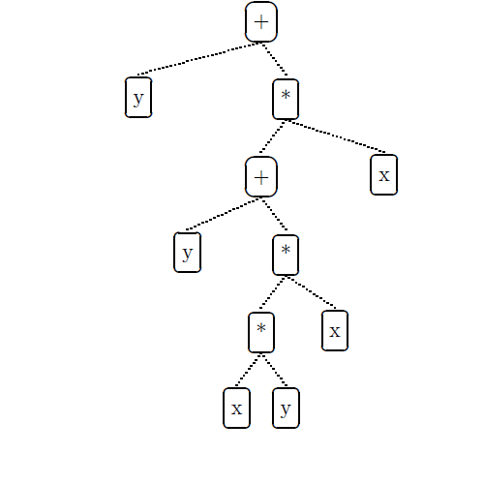
Genetic Programming Portfolio
COSC 4F90 – James Earle, Supervised by Dr. Ross

Slide 2
Contents
Introduction
Genetic Programming & Financial Forecasting
The System and Data
Experiments & Results
Discussion
Conclusion
Questions

Slide 3
Introduction
Artificial Intelligence and Financial Forecasting
Restricted access to other techniques due to financial backing
Yields significant improvement over traditional, manual methods (buy and hold)
Consider methodologies that provide strong models
Not to be actualized
Notes:
Note the choice for symbolic regression vs. rule-based GP. GP is a probabilistic system, therefore we use ensemble learning to not rely on a single run.

Slide 4
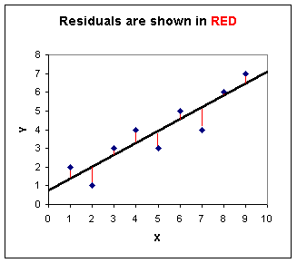
Genetic Programming & Financial Forecasting
Symbolic Regression
Rule-based GP
Fitness Function – Sum of Square Residuals (right)
Akin to Ordinary Least Squares (OLS) econometric regression testing

Slide 5
Ensemble Learning
Avoids reliance on probability in GP
Stacking 20 GP runs
Average vs. Median Fusion
Outliers pose a problem for average fusion technique

Slide 6
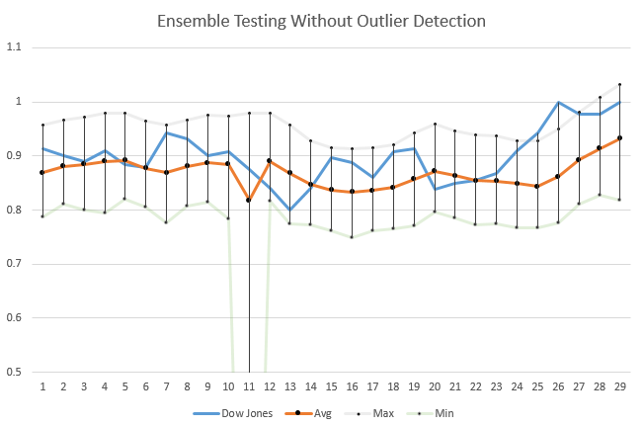
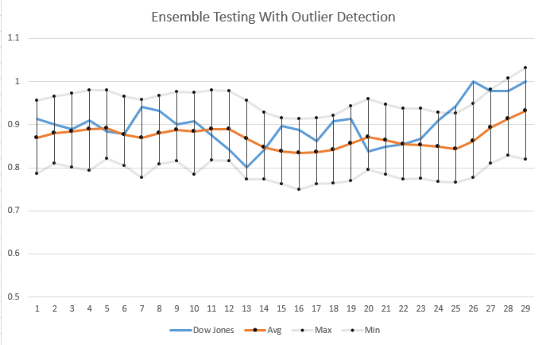
Outlier Detection
Without 2σ Rule
With 2σ Rule

Slide 7
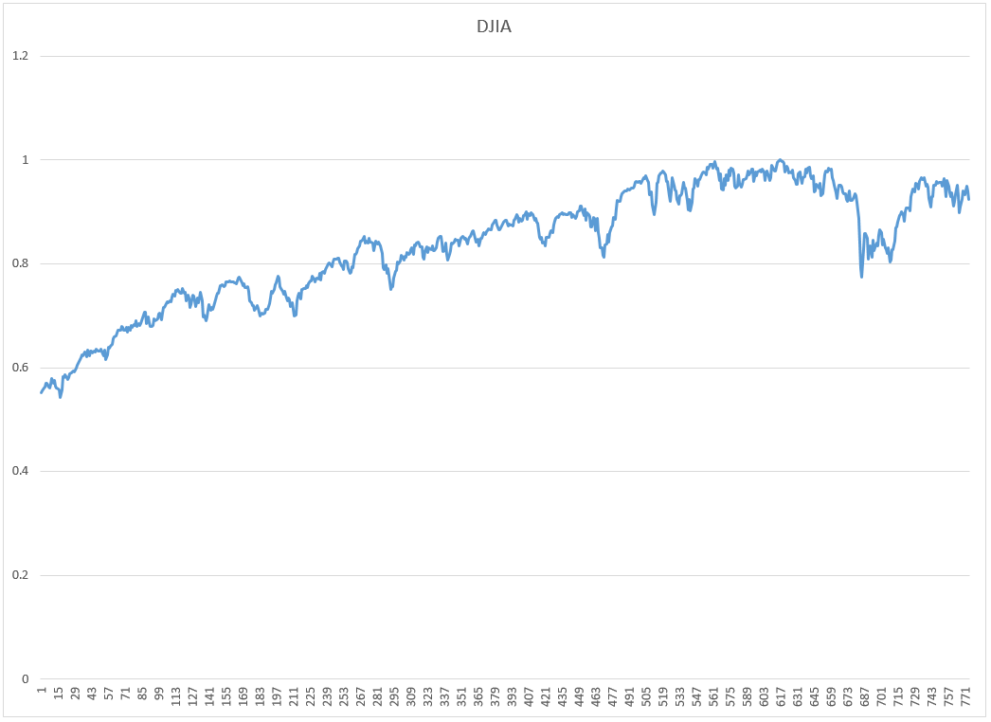
Data & Preliminary Trials
Chosen Data Dow Jones Industrial Average
Jan. 1, 2013 – Jan. 1, 2016
3 Fiscal Years of variant growth patterns
Normalized to [0, 1]

Slide 8
Data & Preliminary Trials
Chosen Parameters in early examples yielded the strongest ensemble
Similar to the results of Kim et al. [1]
Parameter | Value
Crossover | 90%
Mutation | 10%
Elitism | 0
Tournament Size | 2
Max Tree Depth | 17
Pop. Size | 1000
Generations | 100

Slide 9
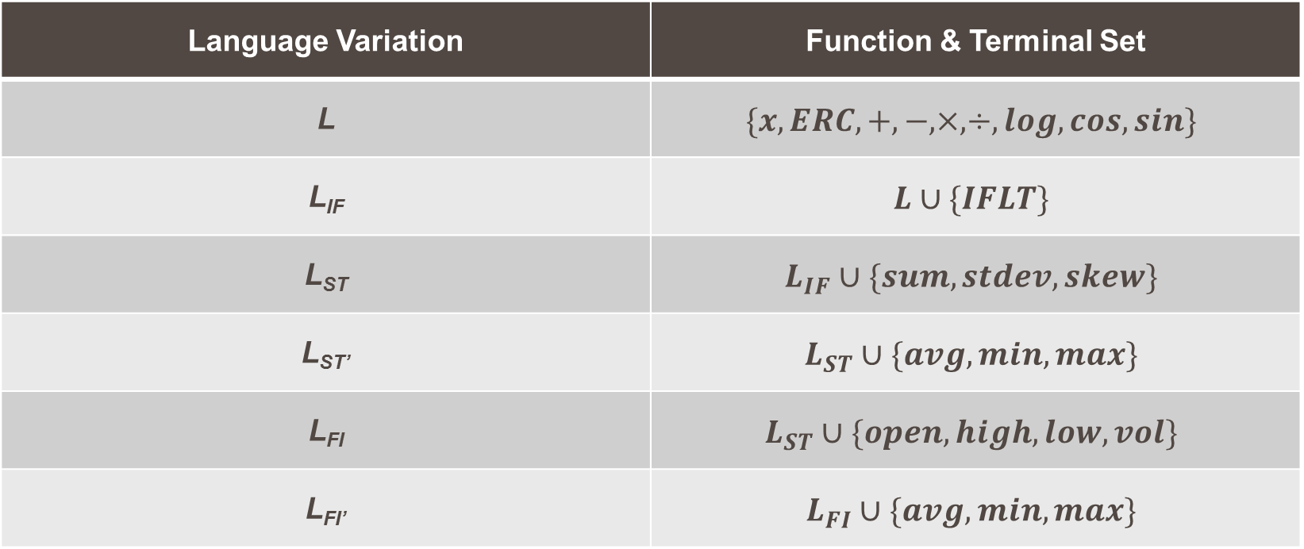
Language Variations
Language Variation | Function & Terminal Set
L | $$\{x, ERC, +, −, ×, ÷, log, cos, sin\}$$
L_{IF} | $$L∪\{IFLT\}$$
L_{ST} | $$L_{IF}∪\{sum, stdev, skew\}$$
L_{ST’} | $$L_{ST}∪\{avg, min, max\}$$
L_{FI} | $$L_{ST}∪\{open, high, low, vol\}$$
L_{FI’} | $$L_{FI}∪\{avg, min, max\}$$
Notes:
A 70-30, 80-20, and 90-10 split will also be considered for L_{ST} and L_{ST’}
Also mention the 5 day lag period on the advanced functions

Slide 10
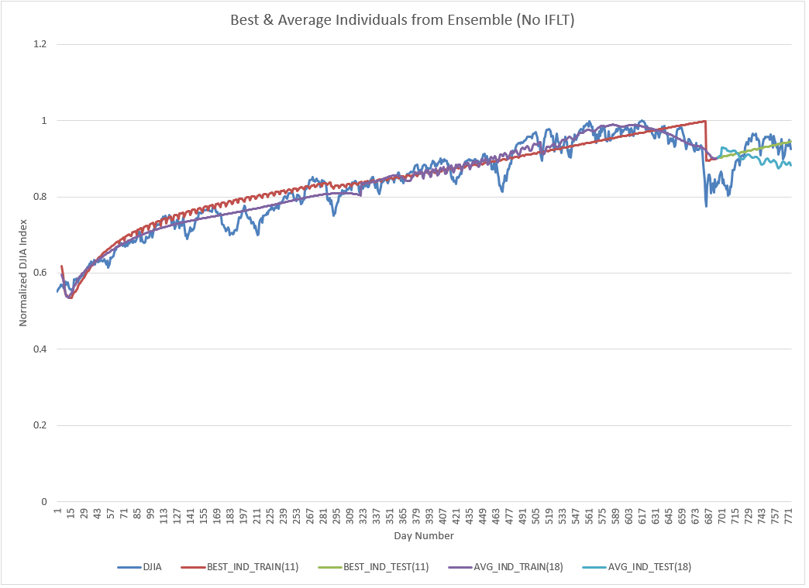
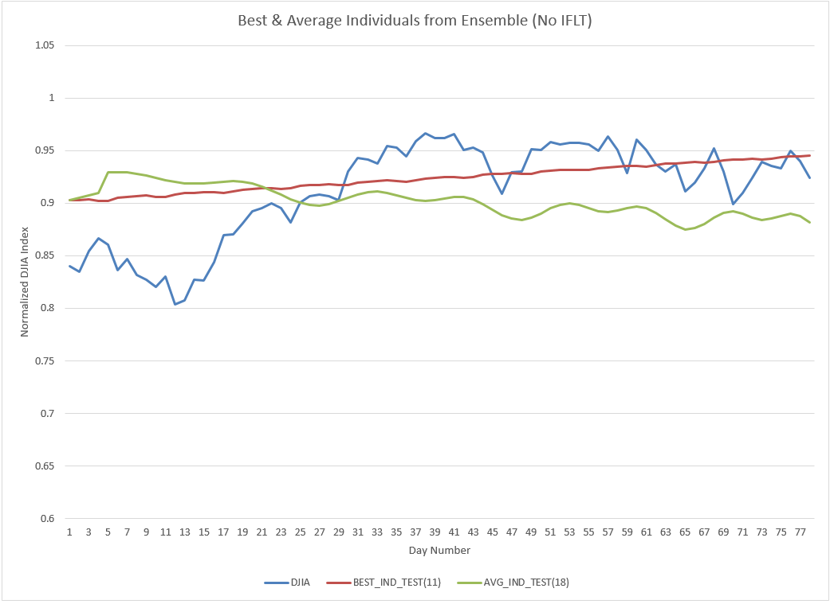
L: Comparison of Individual Models
Best & Average Models (Training)
Best & Average Models (Testing)

Slide 11
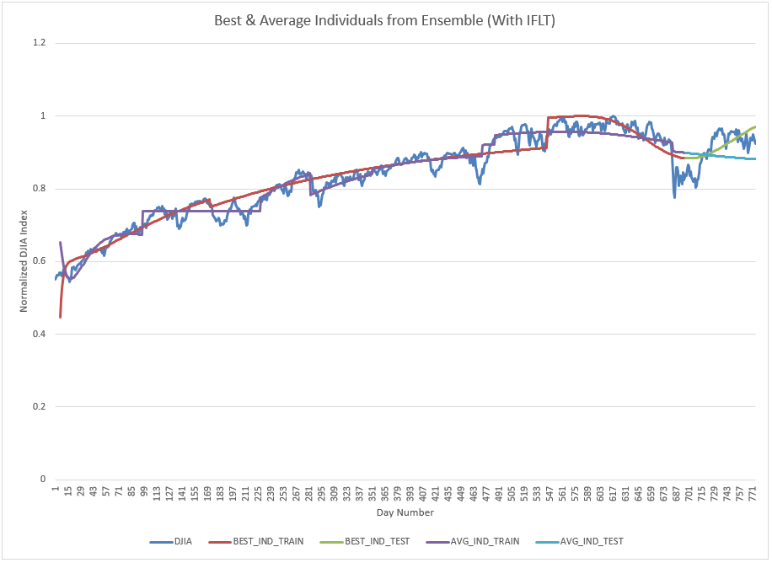
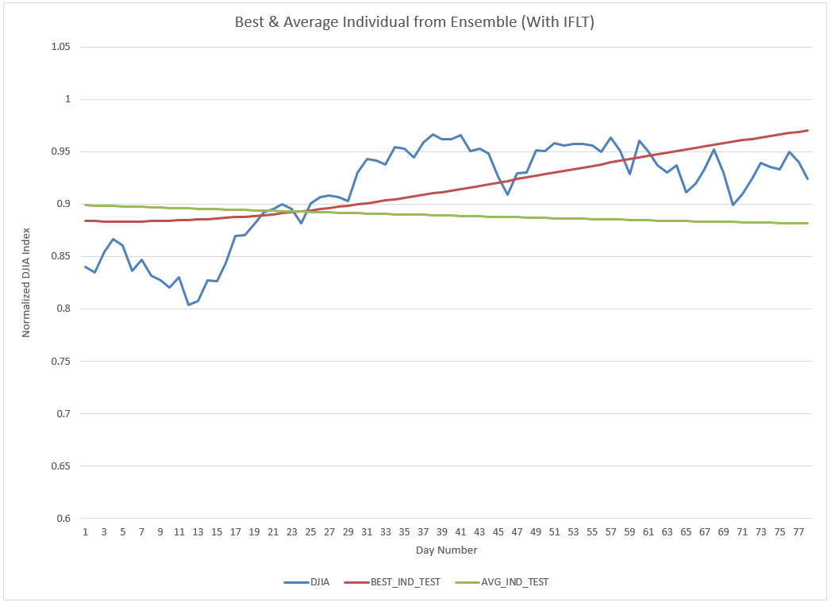
L_{IF}: Comparison of Individual Models
Best & Average Models (Training)
Best & Average Models (Testing)

Slide 12
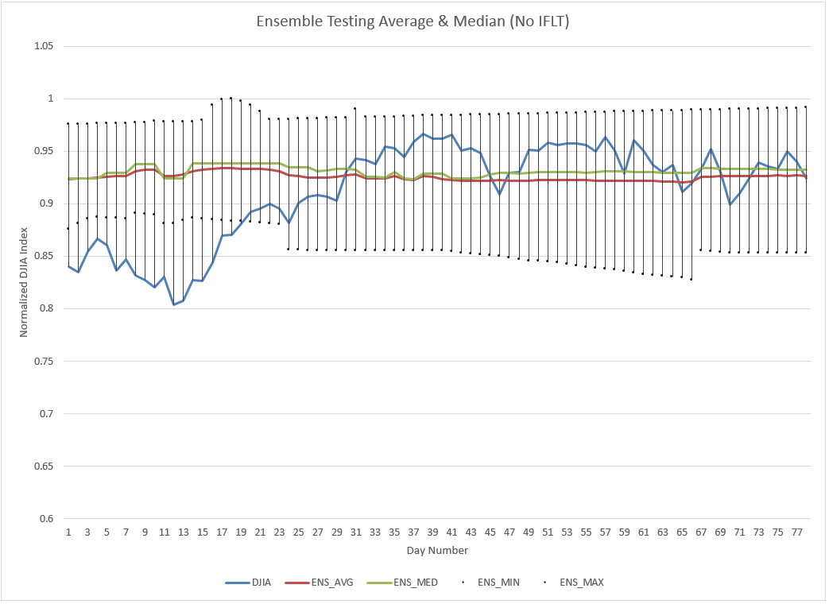
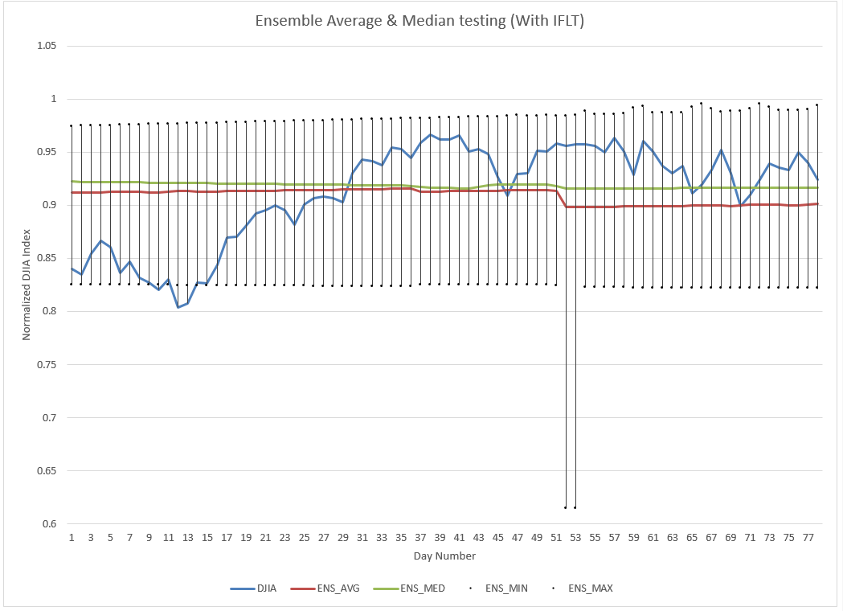
Ensemble Performance
L
L_{IF}

Slide 13
Ensemble Fitness
Language | Ensemble (Avg) Fit | Ensemble (Med) Fit | Outliers Removed
L | 0.194444 | 0.200982 | 35
L_{IF} | 0.185474 | 0.179552 | 43
Notes:
L_{IF} performs better in all cases, but also yields more outliers

Slide 14
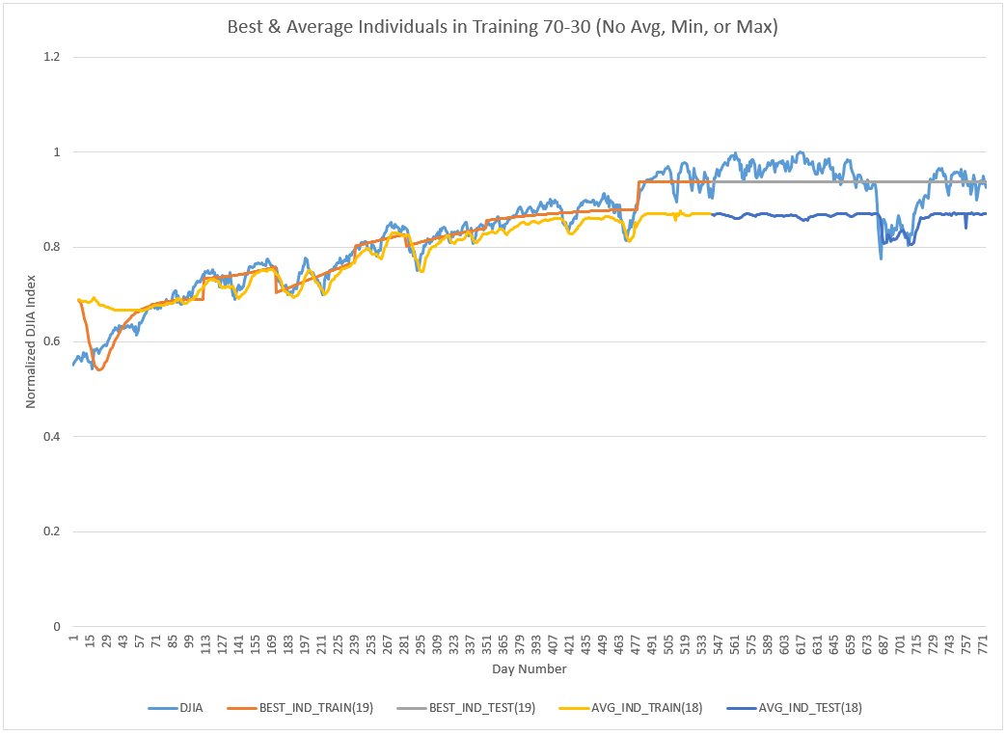
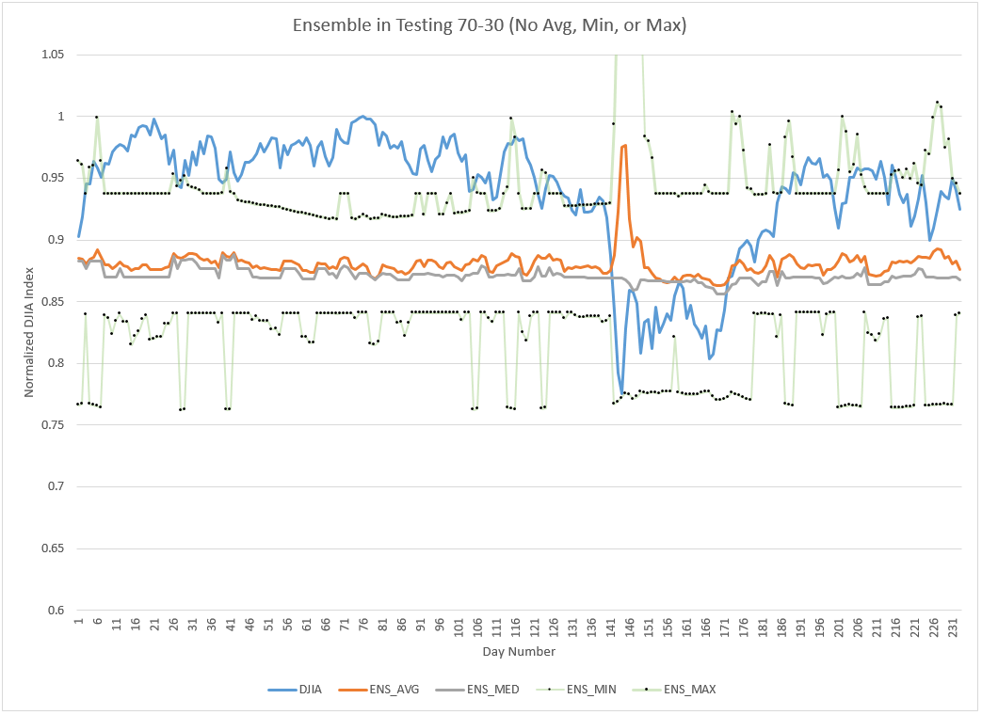
L_{ST}: Comparison of Individual Models (70-30)
Best & Average Models (Training)
Ensemble Testing

Slide 15
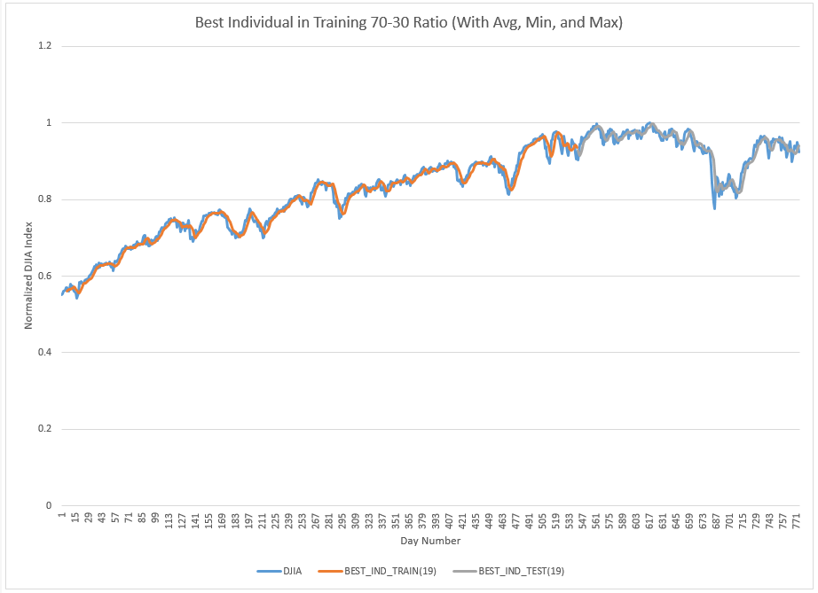
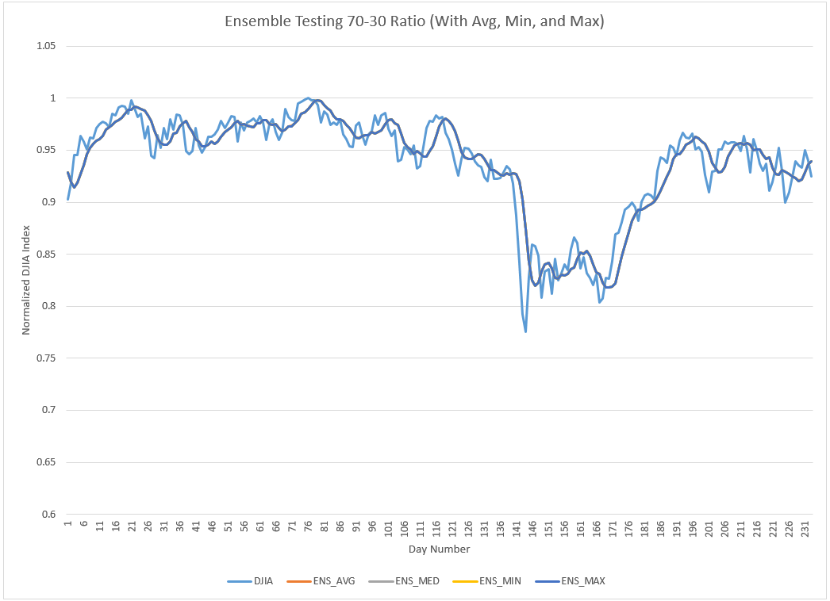
L_{ST’}: Comparison of Individual Models (70-30)
Best & Average Models (Training)
Ensemble Testing

Slide 16
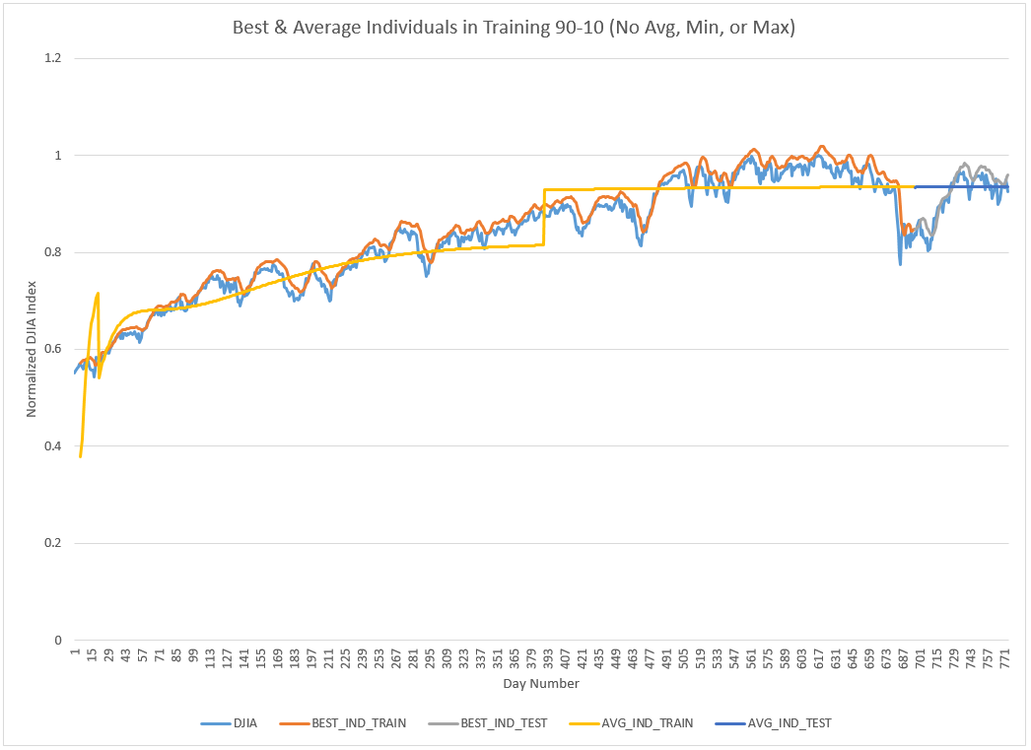
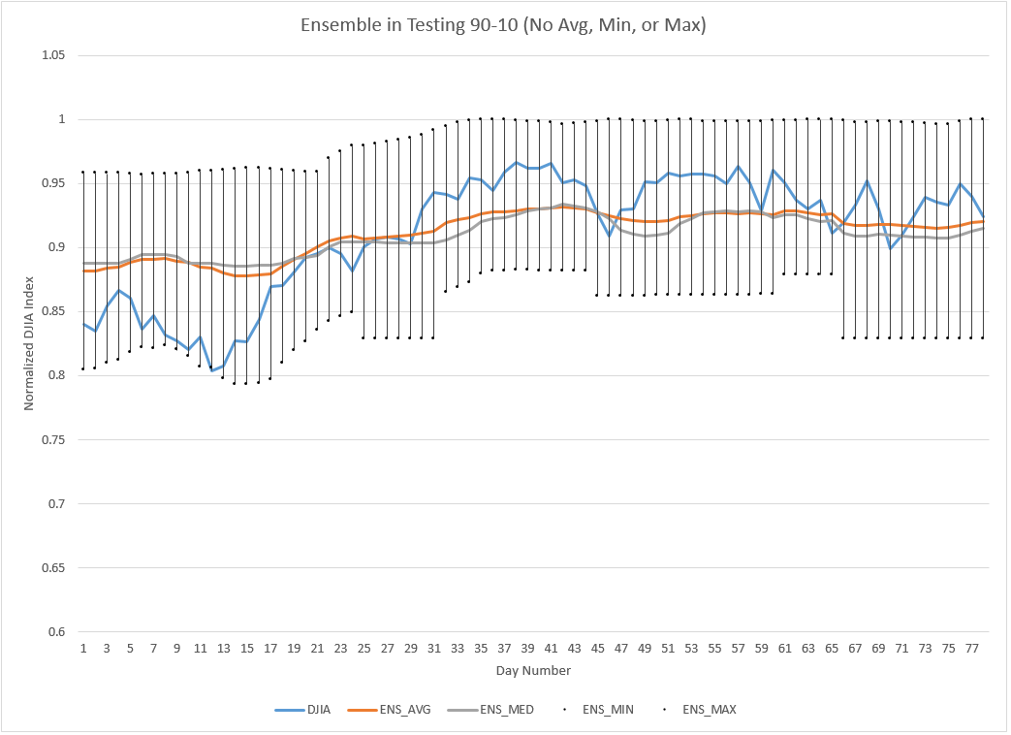
L_{ST}: Comparison of Individual Models (90-10)
Best & Average Models (Training)
Ensemble Testing

Slide 17
Ensemble Fitness
 | 70-30 | 80-20 | 90-10
L_{ST} | 0.088749 | 0.074097 | 0.026279
L_{ST’} | 1.395065 | 0.246555 | 0.073232
L_{ST} Outliers | 466 | 310 | 111
L_{ST’} Outliers | 384 | 253 | 18
Notes:
The marginal difference from 70-30 to 80-20 is small, but it is much larger in the 80-20 to 90-10. This implies that the shorter range of testing data is NOT the only reason for stronger fitness

Slide 18
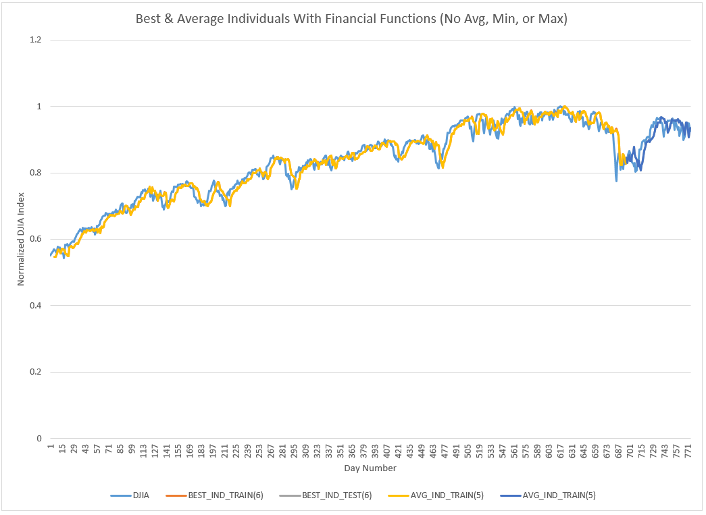
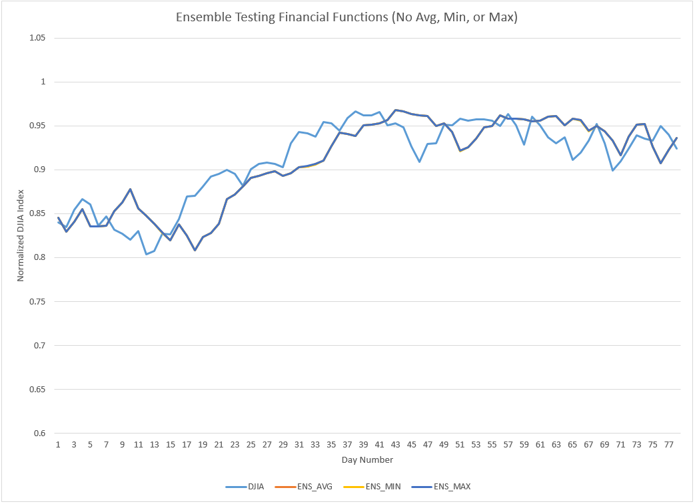
L_{FI}: Comparison of Individual Models (70-30)
Best & Average Models (Training)
Ensemble Testing

Slide 19
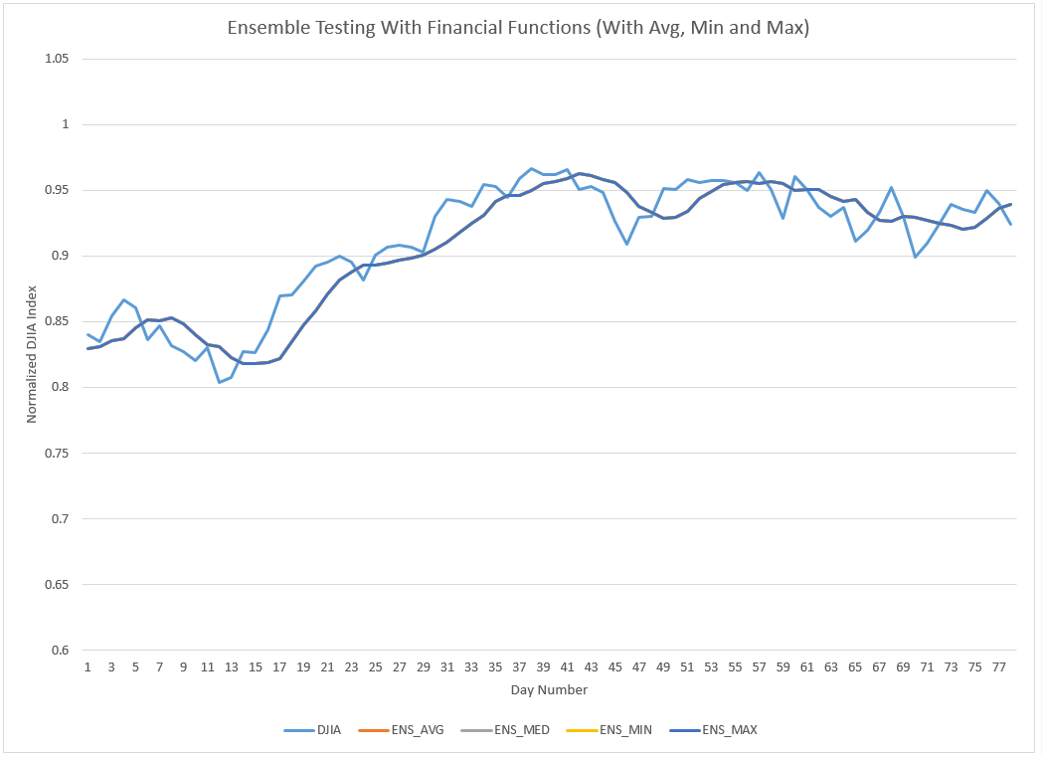
Comparison of HIGH and AVG
AVG
HIGH

Slide 20
Ensemble Fitness
Language | Ensemble Fit | Outliers Removed
L_{FI} | 0.057844 | 128
L_{FI’} | 0.026279 | 0
Notes:
L_{IF} performs better in all cases, but also yields more outliers

Slide 21
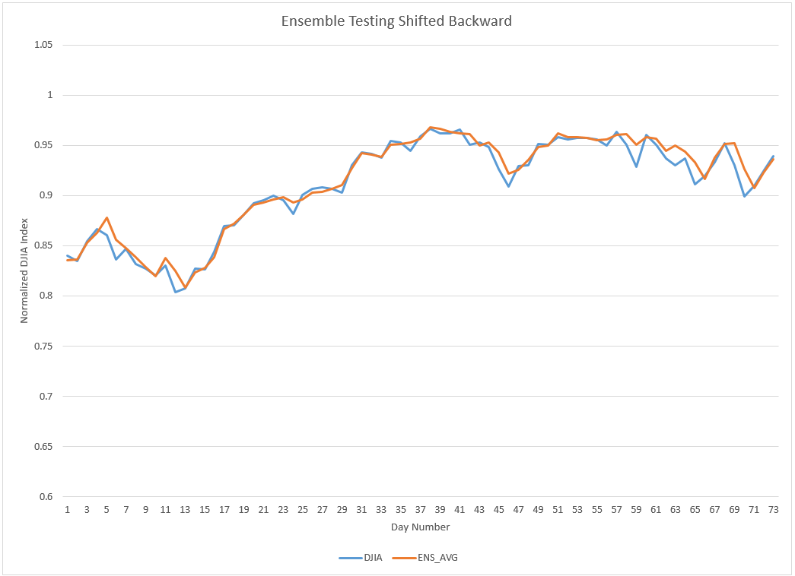
Shifted HIGH Ensemble Example

Slide 22
Ensemble Fitness Across Experiments
Language | Ensemble Fit | Outliers Removed
L | 0.194444 | 38
L_{IF} | 0.185474 | 43
L_{ST} | 0.073232 | 18
L_{ST’} | 0.026279 | 111
L_{FI} | 0.057844 | 128
L_{FI’} | 0.026279 | 0
Notes:
NOTE: All on 90-10 splits.

Slide 23
Ensemble Fitness Across Experiments
Language | Ensemble Fit | Outliers Removed
L | 0.194444 | 38
L_{IF} | 0.185474 | 43
L_{ST} | 0.073232 | 18
L_{ST’} | 0.026279 | 111
L_{FI} | 0.057844 | 128
L_{FI’} | 0.026279 | 0
Notes:
NOTE: All on 90-10 splits.

Slide 24
Conclusions
Highly dependent on use-case
Highly improved performance in advanced languages
Short-term – L_{FI}
Long-term – L_{FI’}
Volatility in financial functions
Smooth average

Slide 25
References
Minkyu Kim, Ying L. Becker, Peng Fei, and Una-May O’Reilly. Constrained genetic programming to minimize overfitting in stock selection. Genetic Programming Theory and Practice, 6:178-194, 2009 [1]

