Slide 1
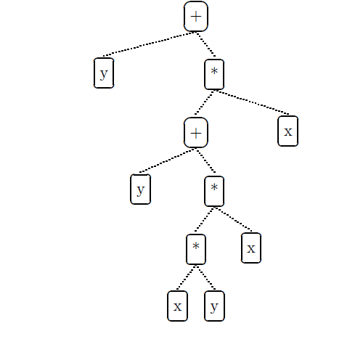
Genetic Programming Portfolio
COSC 4F90 – James Earle, Supervised by Dr. Ross

Slide 2
Contents
Introduction
Genetic Programming & Financial Forecasting
The System and Data
Experiments & Results
Discussion
Conclusion
Questions

Slide 3
Introduction
Artificial Intelligence and Financial Forecasting
Restricted access to other techniques due to financial backing
Yields significant improvement over traditional, manual methods (buy and hold)
Consider methodologies that provide strong models
Not to be actualized
Notes:
Note the choice for symbolic regression vs. rule-based GP. GP is a probabilistic system, therefore we use ensemble learning to not rely on a single run.

Slide 4
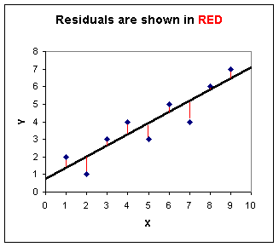
Genetic Programming & Financial Forecasting
Symbolic Regression
Rule-based GP
Fitness Function – Sum of Square Residuals (right)
Akin to Ordinary Least Squares (OLS) econometric regression testing

Slide 5
Ensemble Learning
Avoids reliance on probability in GP
Stacking 20 GP runs using average and median fusion techniques
Outliers pose a problem for average fusion technique

Slide 6
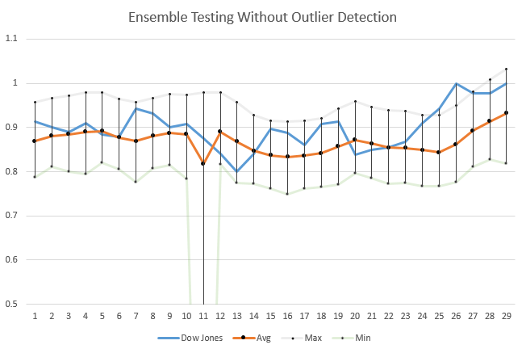
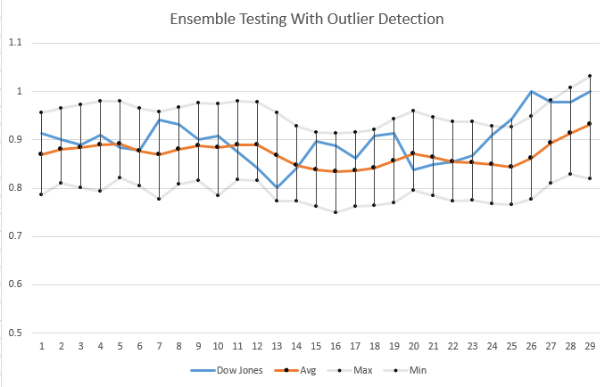
Outlier Detection
Without 2σ Rule
With 2σ Rule

Slide 7
Results & Discussion
Use of IFLT comparatively improved a simple math language

Slide 8

Picture with Caption Layout
Caption

