Slide 1
ENGR 4010: Professional Development Leadership Competencies
Class 6 – The Mission Continues

Slide 2
Guild Check-In
Weekly syllabus review
Student Co-Game Masters for the week – GM Vests!
Rules sheet distribution & quick reminders
Reveal of dice roll consequences on 3 priorities

Slide 3
Results of Mission Priorities Moving Forward...

Slide 4
Results of Dice Rolls on
All-Guild Meeting Priorities (7):
Infrastructure - (fail with consequences)
  Massive time crunch to complete structure and infrastructure build outs lead to less than ideal structures. They are standing; but they will not last for long.
  An unexpected early transport sent before we received the transmission from Nemorath arrives with many helping hands to assist in building, but the people on the ship almost ran out of food, so they arrived malnourished and require extensive support before they are prepared to assist in building.
  Able to use previous structures in Celestial Spires for temporary housing
  An attempt to construct landing zones for future transports in the Ender Dunes has begun, but intensive sand storms are creating significant delays.
  Life Weavers and Builders partner to set up makeshift hospital; it is no more than a glorified tent and is overrun with people between the new transport and the guild members recovering.
  Attempted, at times strained collaboration occurs between Builders, Radiants, Guardians, and Linkers
Research – (fail with major consequences)
  Resources are strapped with impending transports from Nemorath, so there is little time to complete further surveys of Heliora Prime to prepare. Below is what was accomplished:
  An exploration of existing structures from previous civilizations brought back an outbreak of an unknown illness has caused unpleasant symptoms (vomiting, gastrointestinal distress) across the guilds. No deaths, but the Life Weavers have been busy supporting everyone’s recovery; lessoning their ability to prepare for the new transports.
  Little was discovered in the survey of the structures and no signs of the previous inhabitants were seen.
  Potential natural resources and food sources available in the Sapphire Marshes Region; However, this is difficult to cultivate and transport because of the marsh environment.

Slide 5

Game Play – Return to Headquarters…

Slide 6
Cultural Competency - Social Identities
Social Identities – self-concept derived from membership in social groups that are typically culturally or historically defined
Both visible and invisible
We can't leave group membership at the door!
Salience - how much an identity stands out to us or holds a level of importance

Slide 7
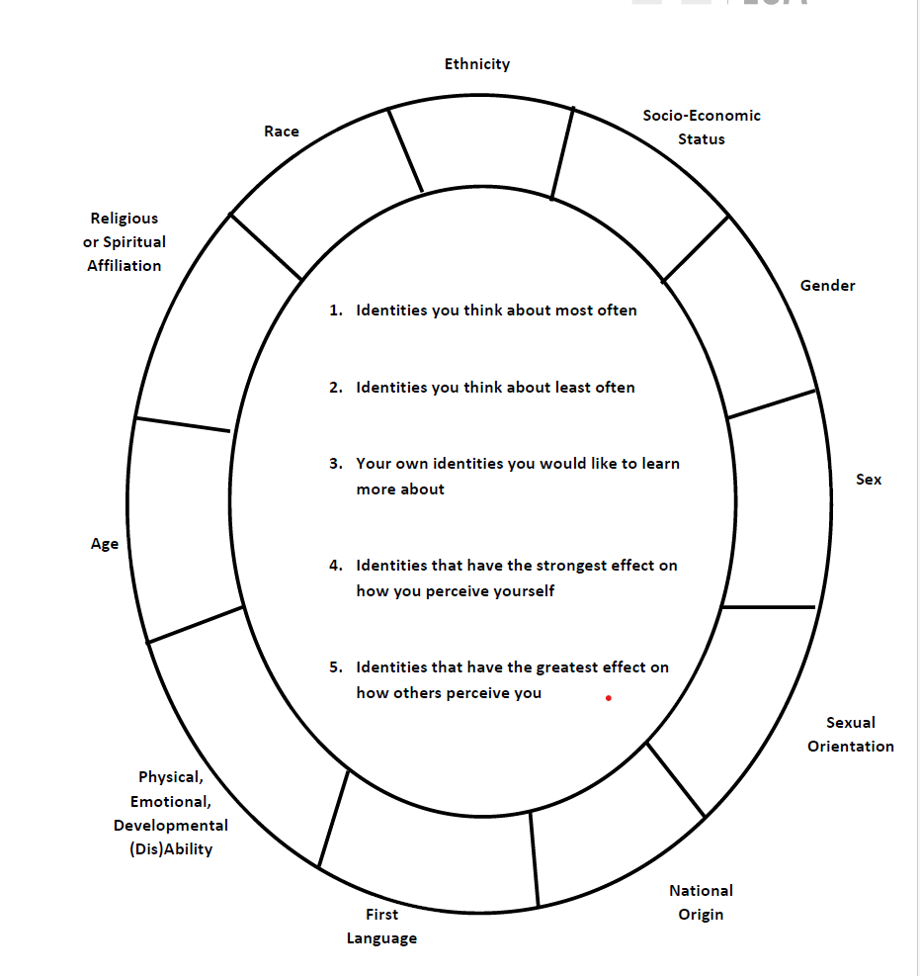

Slide 8
Class Community Ground Rules for Today's Game Play
Lead with curiosity
Name intent and own impact
Stories stay, lessons leave
Make space, take space
Work to suspend judgment
Creativity and Consent Matter
Yes, and....

Slide 9
Task from Mission Control
Complete the hiring selection of Captain and First Engineer of the four transports leaving Nemorath
Transports have less probability of success due to the rapidly deteriorating conditions
  The first transport will have 100% success and survival rate
  The second will have an 80% chance
  The third with have 60% chance
  The fourth and final transport has a 40% or less chance
  Make the best choice on which candidates to put on which transport from the profiles given

Slide 10
Debrief & Processing
1 minute personal written reflection – immediate reactions to your Guild's discussion and role play

Slide 11
Debrief & Processing
Find a partner from a different Guild:
Sprouts & Builders, LifeWeavers & Linkers, Radiants & PSA
  What did you notice during your Guild discussion, both within yourself and within the group?
  What criteria did your Guild use first when ranking candidates? Were they explicit or did they emerge as you talked?
  At what point, if any, did a candidate's identity enter the conversation?

Slide 12
Debrief & Processing
Pair up with another partner pair from a different Guild group for a group of 4:
  Did any identity factors get treated as risks to manage, and others as neutral? Which ones, and why?
  What role did identity salience play in your Guild's ranking?

Slide 13
Debrief & Processing – Large Group Themes

Slide 14
Student Co-GMs Eval, Belonging Survey & Next Class To-Dos
Right Now:
Complete eval for this week's Co-GMs
Complete Belonging Survey
Before Next Class:
Complete Cultural Competency Assignments (if have not already): Identity Wheel & Personal Cultural Competency Assessment (options)
Review Week 7 LMS Overview and any pre-class to-dos
Will be working in Guilds to prepare for receiving transports

Slide 15
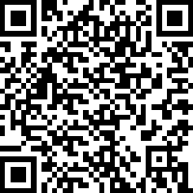
Student Co-GM Evals

