Slide 1
Purpose of the Application
Overall to cut down the number of applications my bank, and similar banks, must run throughout a workday, in order to complete transactions, make customer changes and store account information.
Banks are acting on these applications hundreds of times every week, globally, and there is more and more customer data being added into the system everyday.
From personal experience of working at a bank, I see how frustrated and annoyed both customers and employees get when they are waiting to conduct a transaction, or even just simply pull account information for a customer to inquire about.
Sometimes, these tasks that should take less than a few minutes, end up taking longer than 10 minutes, because of having to switch back and forth from one application to another, and then have to close and reopen each application for a new customer.
Putting all of these apps together would also save the user time by not having to click back and forth from one app to another and avoid closing windows just to reopen them for the next customer.

Slide 2


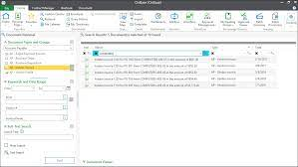
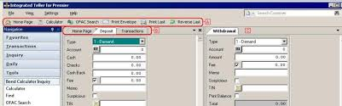
Comparison to other applications
Integrated teller is used to conduct any type of account transaction (deposit, withdraw, loan payment), anything that changes the balance of an account.
Other than the name, balance, and the account number of the customer, there is no account information used on this app, so verification has to come from other apps.
Director Unity Client is another application used specifically to store images of Photo ID’s and Signature Cards for customers and non-customers at the bank.
There is some account/customer information that is used on this app, but you have to look up the account information on a different app, and then type it in on Director Unity Client, in order to pull the stored customer images.
Requires the bank employee to open and close the entire application in order to look up a new customer.

Slide 3
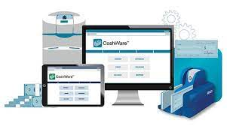


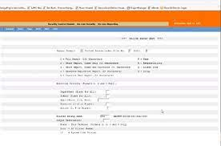
Comparison to other applications
Premier Navigator is the main storing application First Mid uses to store essentially everything there is to know about an account.
Stores customer information, account balances, account history, current perks/incentives, loan rates, etc..
There is no way to act on an account, or make a transaction.
You can’t even change the account information in this app. It has to be changed on a completely separate app as well.
Cashware V4 Client is the app we use to make change for customers who want to exchange bills.
Since a current balance isn’t being affected, and new cash is being brought in, it isn’t attached to any account(s).
It’s a separate app that we run in order to verify that the bills that are brought in are first, legitimate and second, in the correct amount as listed by the customer.

Slide 4
Application Features
Create/Read/Update/Delete Records in a database
Scan through a list of accounts and if an account is in good standing and at a certain balance for a certain amount of time, it will present rewards/ new account opportunities/ incentives/ rates
Pull a matched photo ID with one that has been scanned into the system and load it with the account information
See last and make new deposit(s)/ withdraw as well as view balance
View if perks have been entered into the account / receive notification when customer account information is entered
Have another button that goes through accounts and determines valid loans rates- for different types of loans (if the customer qualifies for a loan)

Slide 5
https://youtu.be/MeZ4QjT7Fdk

