Slide 1
Movie Scale Ratings Classification
James Frech

Slide 2

Motivation
Sentiment Analysis is important aspect of NLP
Product recommendation
public sentiment in elections
General consensus on movie/book, etc.
Movie reviews express multiple aspects of sentiment
Polarity
Intensity
Good candidate for multi-task learning
Learning multiple tasks -> higher accuracy

Slide 3
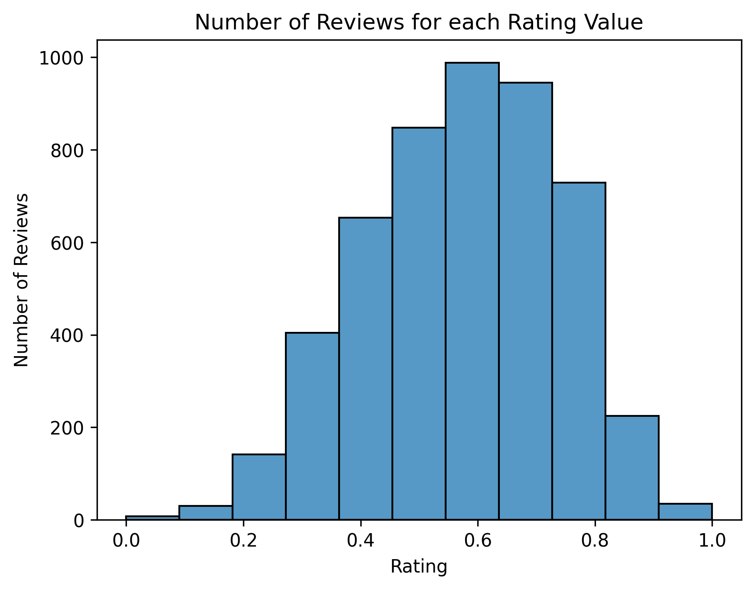
Data
Author | # Reviews
S.Rhodes | 1770
J.Berardinelli | 1307
D.Schwartz | 1027
S.Renshaw | 902
Cornell Movie Review Scale Ratings
5000 Movie Reviews between 4 authors.
All reviews are full length paragraphs.
Scale of 0.0, 0.1, 0.2, …, 1.0 (11 classes)
Binned Ratings: 3 class, 4 class, Polarity
0.0 - 0.3 (0), 0.4 - 0.5 (1), 0.6 - 0.7 (2), 0.8 - 1.0 (3)
0.0 - 0.4 (0), 0.5 - 0.6 (1), 0.7 - 1.0 (2)
0.0 - 0.5 (Negative), 0.6 - 1.0 (Positive)
70% train, 20% validation, 10% test split

Slide 4
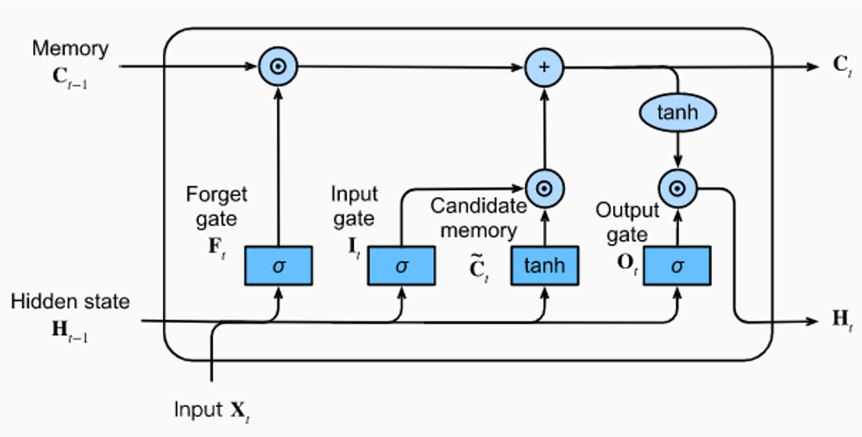
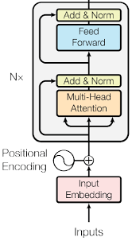
Models
Baseline: Random Forest Classifier
5 fold cross validation (combined train/validation sets)
Rule Based Sentiment Analysis using Spacy
Scored between -1 and 1
Top 50 bigrams and unigrams containing adjectives (excellent_movie etc).
Long Short-Term Memory (LSTM) neural network
Tunes weights for word embeddings
Multi-Task learning implemented for improved performance
Benchmark: Pretrained ROBERTA transformer
Hugging Face model with tokenizer.
Fine-tuned last two transformer layers and classification head.

Slide 5
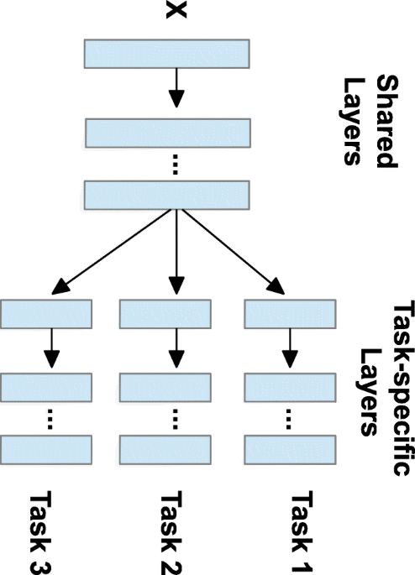
Multi-Task Learning
Training a model to perform multiple tasks at once
Share weights in encoder layers of model
Separate classification heads for each task
Well aligned tasks trained together can improve performance
Sum Individual loss functions together
Movie Review Application
Improve accuracy of scale rating by training with:
Authorship, 3 class classification, 4 class classification, polarity
Trained scale rating with one of each task separately.
Combine all 5 tasks together in one model.
Tested on LSTM and transformer

Slide 6
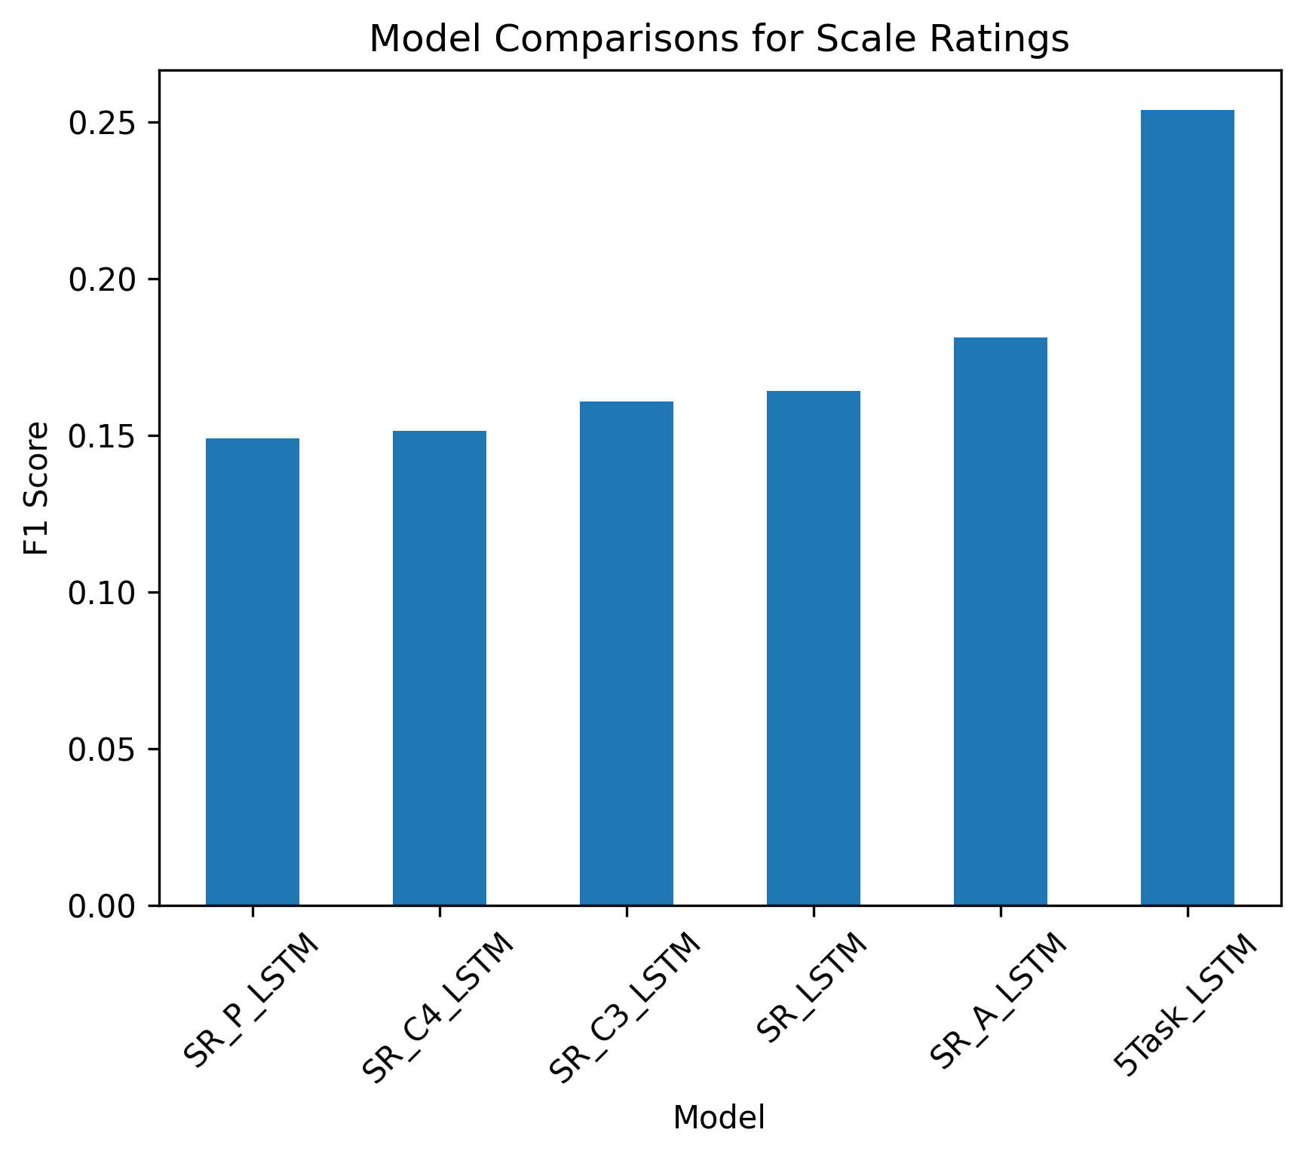
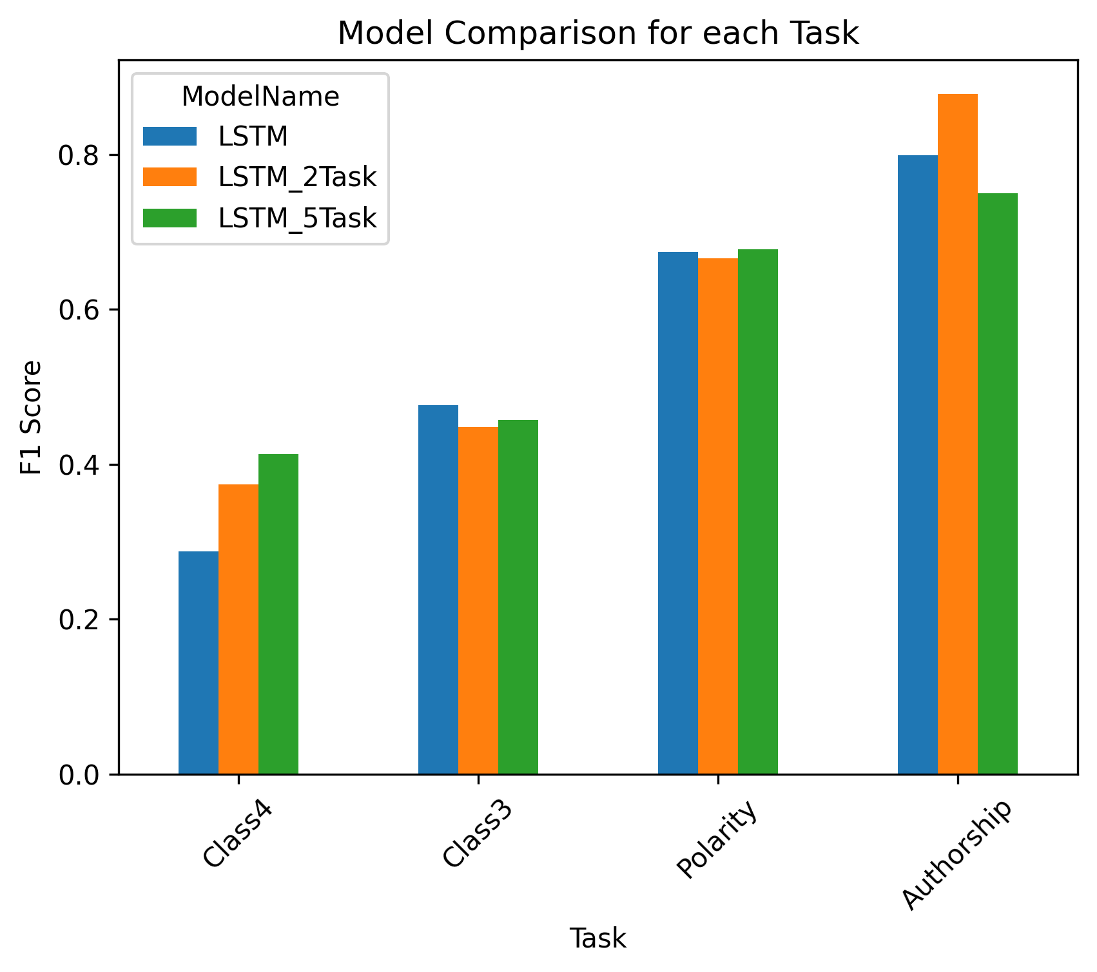
Multi-Task Learning Results
Scale rating classification
Improvement when trained with authorship
Highest accuracy with 5 tasks (+9% F1)
No Improvement for:
3 class scale rating classification
Polarity classification
Transformer model (results not shown)
Improvement for
4 class classification
2 tasks: +8.6%
5 tasks: +12.5%
Authorship
2 tasks: +8%

Slide 7
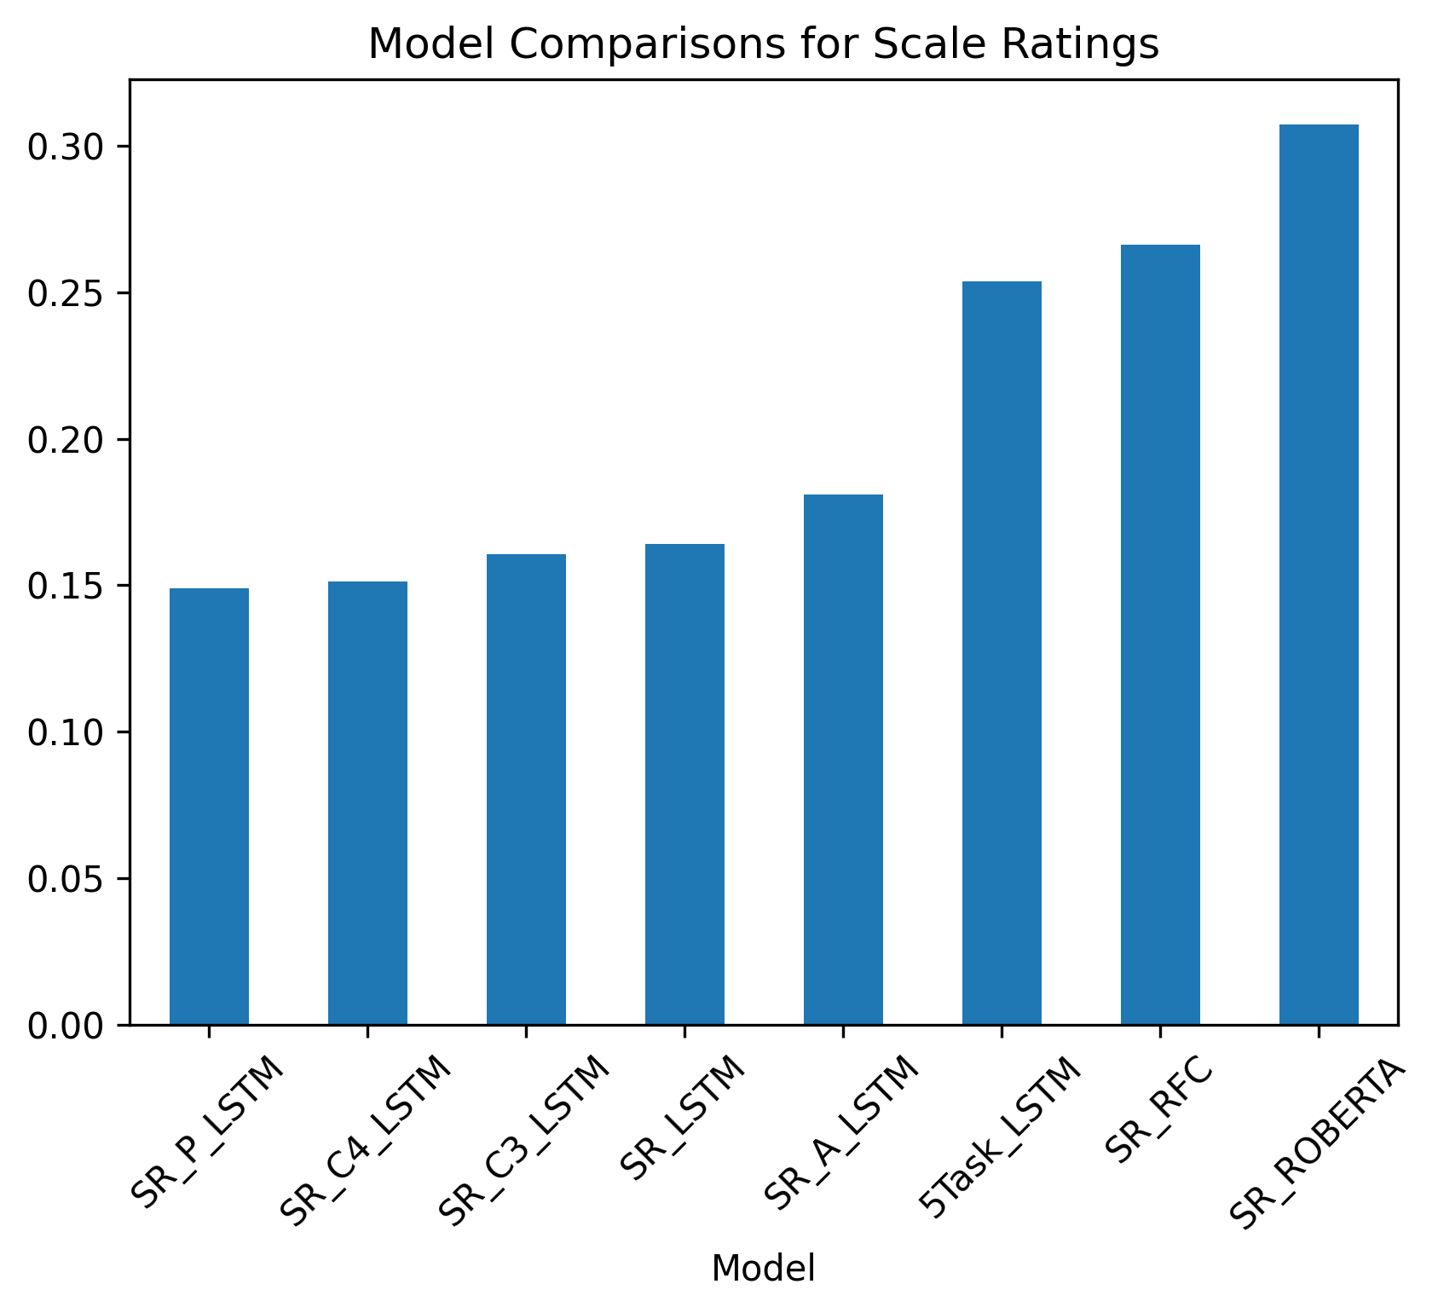
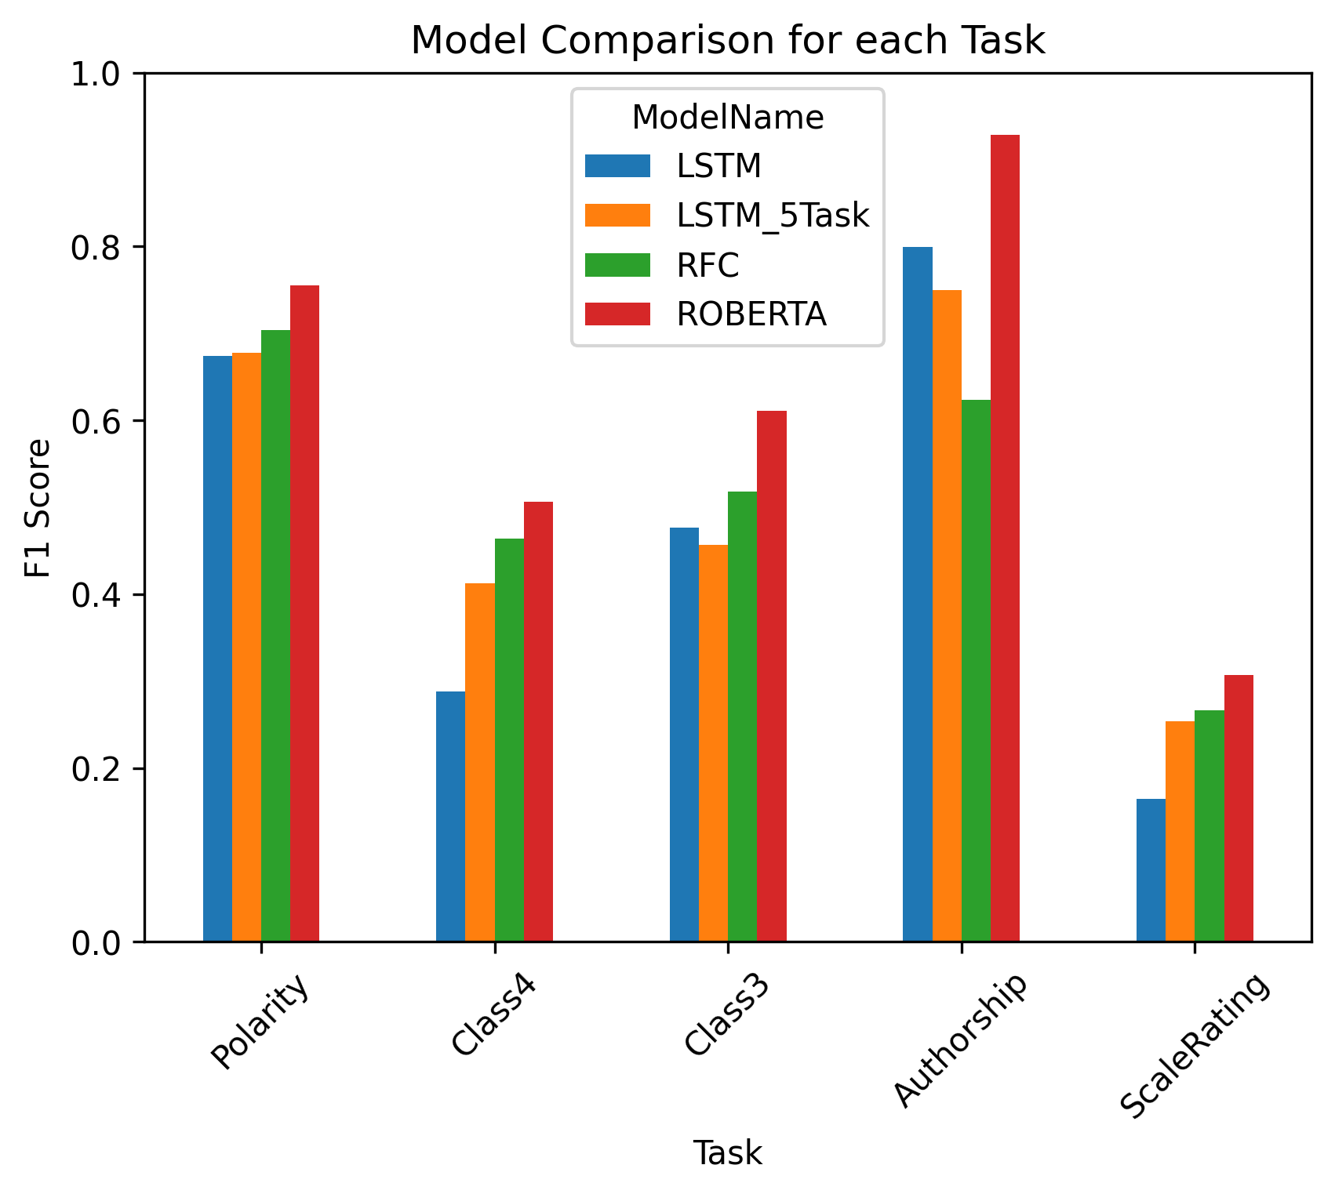
Model Comparison
Scale Rating
Base LSTM Outperformed by random forest and ROBERTA
5 task LSTM on par with random forest
Overall
LSTMs perform better on authorship task than random forest
Random forest outperforms LSTM on all sentiment based tasks
ROBERTA easily outperforms other models for all tasks

Slide 8
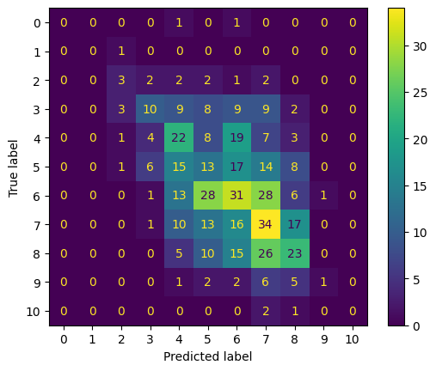
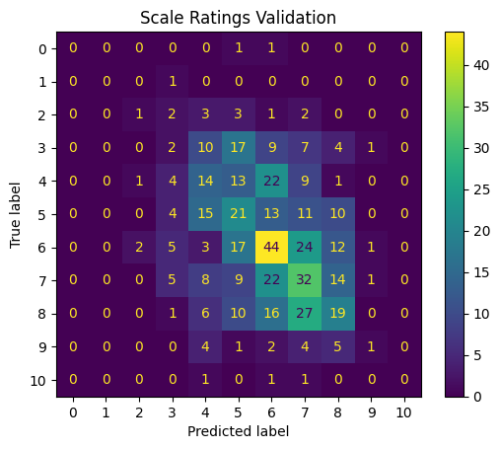
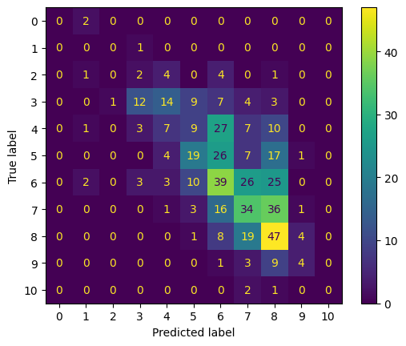
Confusion Matrices for Scale Ratings
Random Forest
5 Task LSTM
Roberta

Slide 9
Limitations
Large class imbalance
Hard to predict 0.0, 1.0
Potential further improvement for LSTM
Initialize word embeddings with Word2Vec
Make bidirectional
Extrapolating data to other authors
Can’t train with authorship as task for robustness.
Random Forest Inputs
Further tune important bigrams and unigrams (remove Jurassic Park).
Keep some stop words (not)
Use trigrams (not_good_movie) vs (good_movie)

Slide 10
Summary
Multi-Task Learning shows to improve performance of scale review classification for movie reviews.
However, the random forest using rule based sentiment analysis still performs on par, and the transformer outperforms it easily.
While F1 score is low, most predictions are near the diagonal in the confusion matrices, showing that the models are capable of getting the general idea, however, 11 subjective classes are just hard to predict.
Meanwhile, all other tasks have much higher performance, especially authorship.
ROBERTA outperforms all other models for all tasks.

