Slide 1
Asteroid NeoWs

Slide 2
Introduction
NeoWs (Near Earth Object Web Service) is a NASA web service for near earth Asteroid information.
The data describes Asteroids based on their closest approach date to Earth, along with physical characteristics such as size and speed.
GOAL:
Our goal for the project was to align data processing technologies to allow a user to interactively visualise data from a NASA data-source.

Slide 3
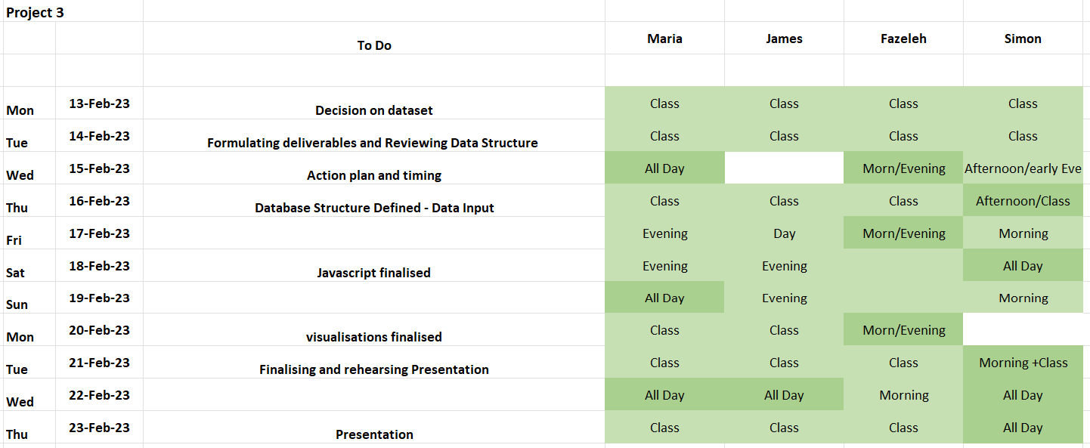
Main Challenges
Team organisation, task assignment and time management.
Interfaces between the various data technologies used to complete the dataflow
Identifying the type of visualisations and the user interaction required

Slide 4
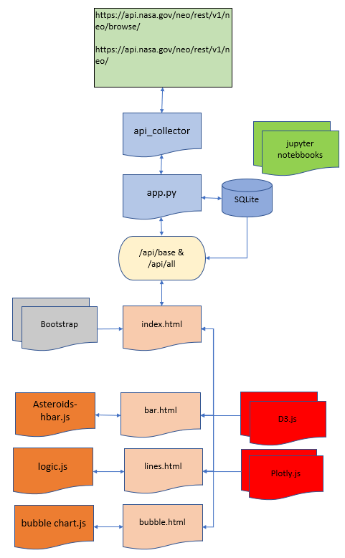
Data-Flow Design

Slide 5
Collecting Data
Using the Nasa API, we were able to collect the data we were interested in and then convert it into some pandas dataframes, where the data types could then be changed and new columns could be added (notably the estimated diameter).
Then, using SQLalchemy, the dataframes were turned into tables on an SQLite database called asteroids.sql, this allows the data to be called upon without making additional requests from the Nasa API.

Slide 6
Flask and Animation
We then used Flask to run a server that ran the html files.
In the Flask server, the database was queried to create pages that contained the data as json files that could be read using d3.
Then the landing page (where all of the links to the charts would be stored) was created, to make it slightly more interesting we adding an animation to the title at the top of the page using anime js.

Slide 7
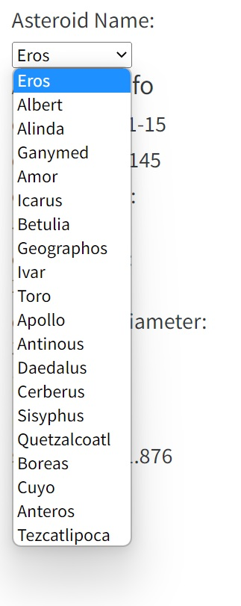
Asteroid Visualisations
Choose asteroid name form a drop-down menu to display:
Asteroid Information (Based on last sighting)
Line chart showing the distance from earth on each sighting
Line chart showing speed of approach on each sighting

Slide 8
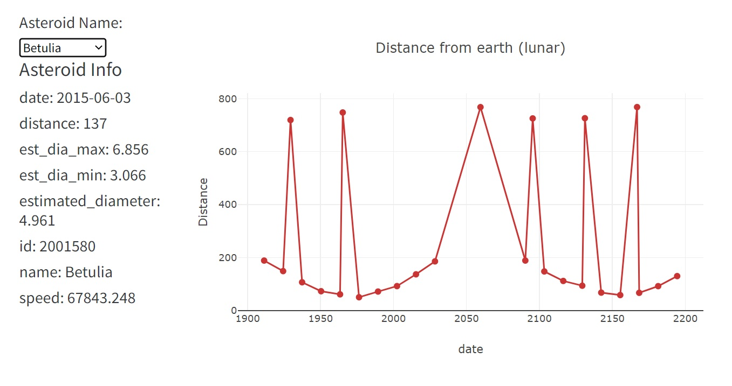
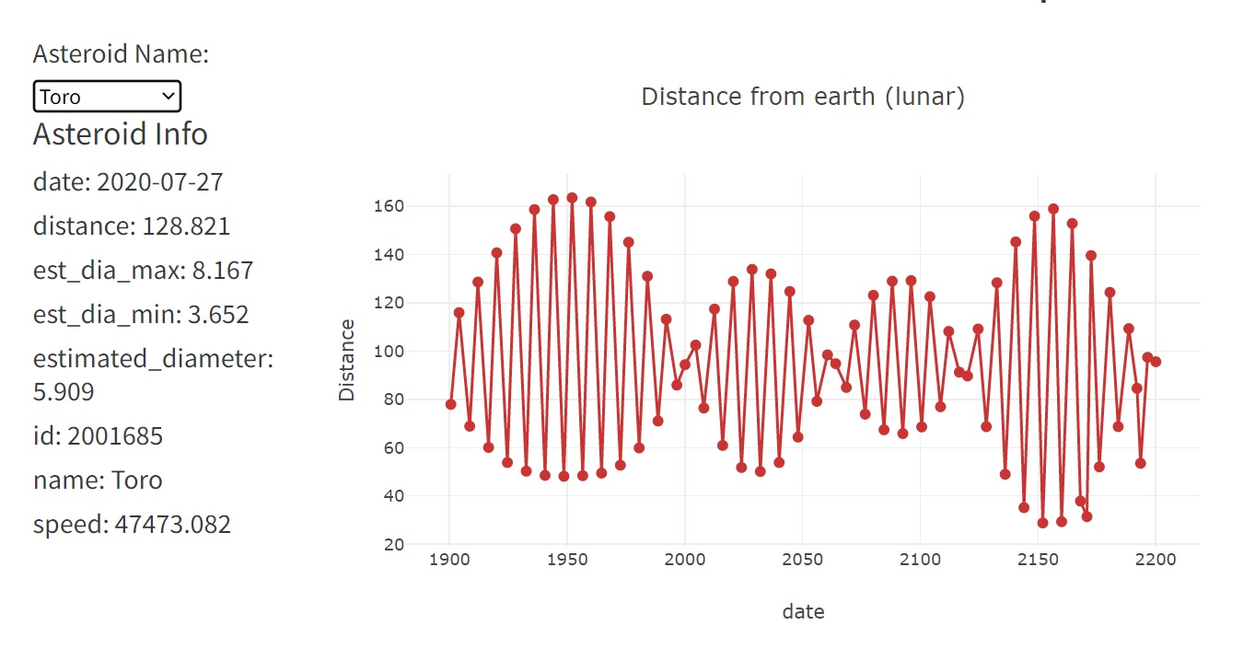
Asteroid Visualisations Line graphs showing distance from earth on approach

Slide 9
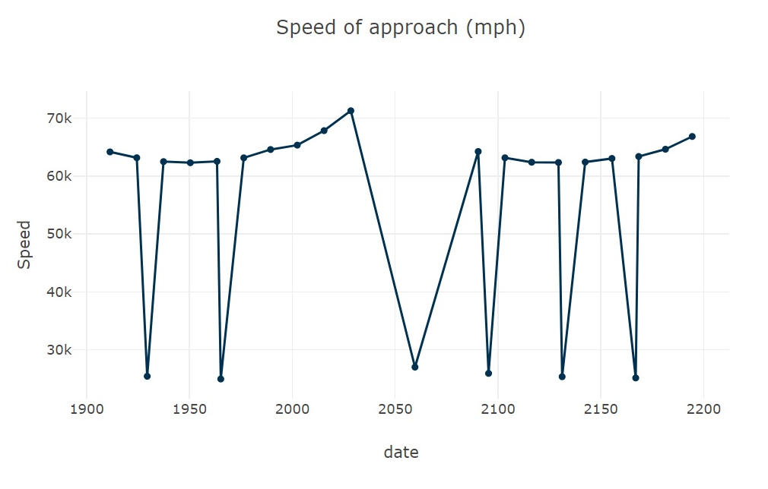
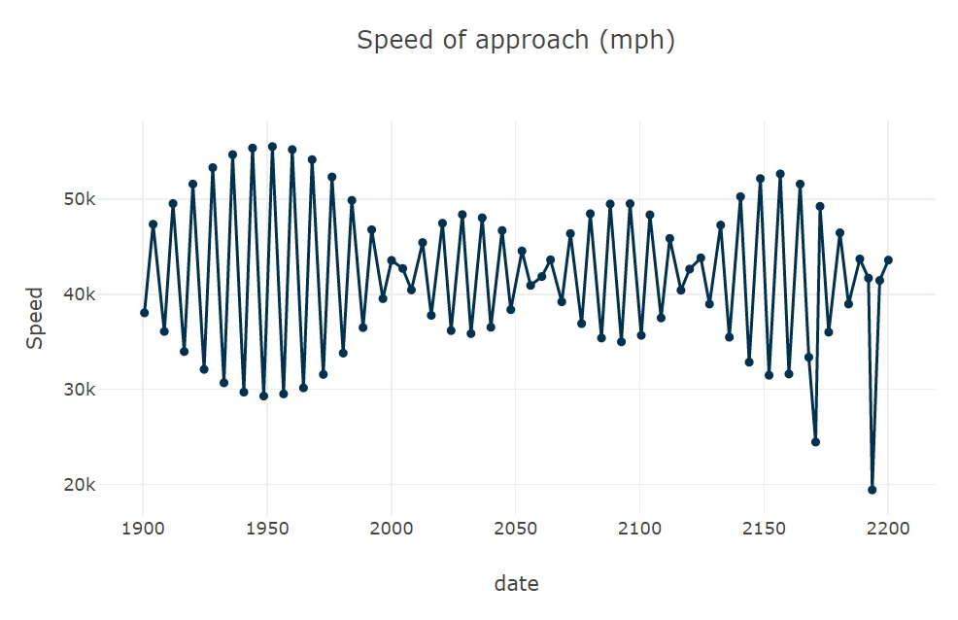
Asteroid Visualisations Line graphs showing speed of approach
Betulia
Toro

Slide 10
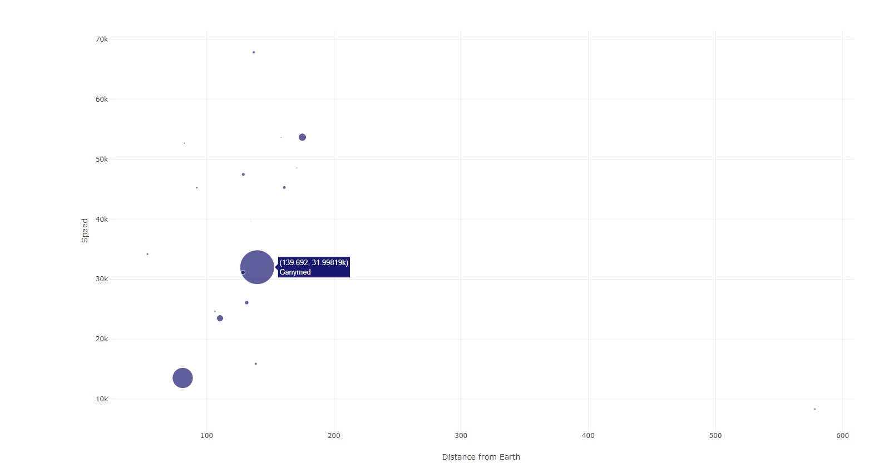
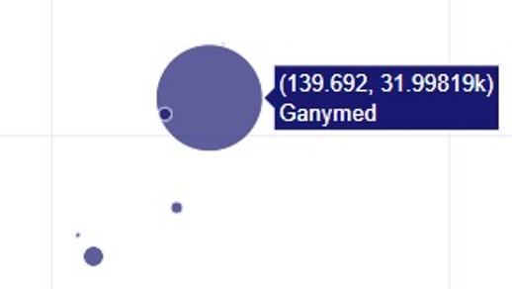
Asteroid Visualisations Bubble Chart
Bubble chart showing Asteroid distance, speed and size based on most recent sighting. Hovering over a bubble displays the asteroid name

Slide 11
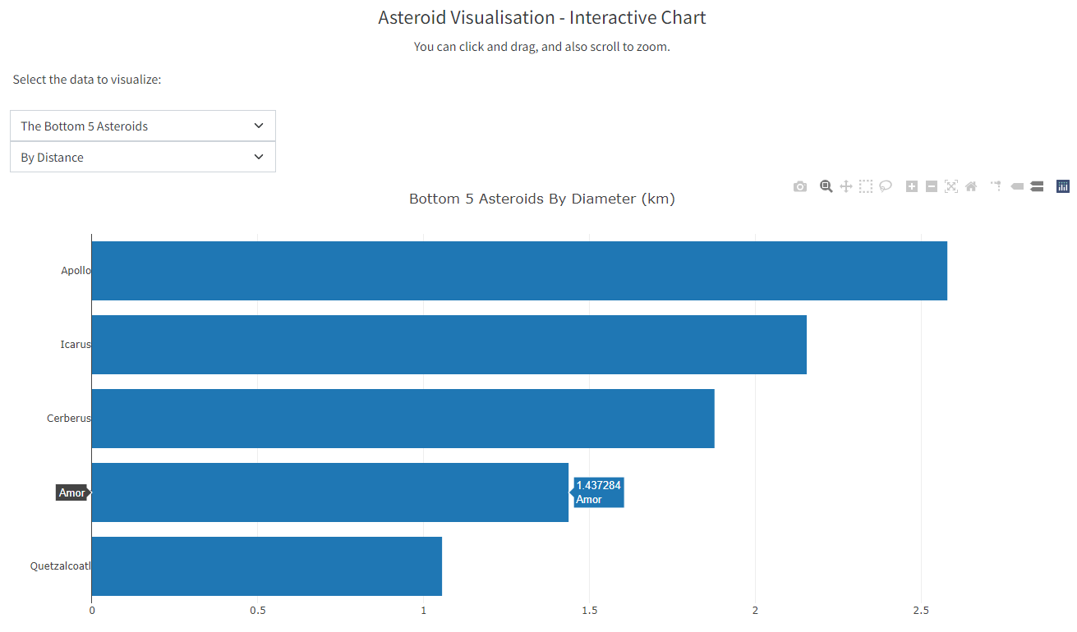
Bar Graph Data Visualisation
HTML calls the javascript code to read in the JSON data.
The data was sorted using a bubble sort method.
The data was then sliced and where necessary reversed to give the highest or lowest according to user selection, initiated by drop down selections.
The data uses D3 and Plotly to display the visualisation
Two Selection User Driven Visualisation
Functionality:
Ability to select the extremes of the dataset (highest or lowest 5)
Ability to select display of Distance or Diameter of the dataset
Mouse activated data labels
Data display link

Slide 12
Demonstration

Slide 13
Thank you

