Slide 1
SHINE BRIGHT LIKE A DIAMOND

Slide 2
TABLE OF CONTENT
PURPOSE OF PROJECT
METHODS
FINDINGS
CONCLUSION

Slide 3
PURPOSE OF PROJECT
CAN WE PREDICT A PRICE OF A DIAMOND BASED ON IT’S PROPERTIES
WHAT KIND OF MODEL CAN PREDICT THE PRICE OF THE DIAMOND THE BEST

Slide 4
METHOD
PANDAS
PG ADMIN
EXCEL
JUPYTER NOTEBOOK

Slide 5
DATA SOURCES
Data is derived via a CSV download from Kaggle (https://www.kaggle.com/datasets/ulrikthygepedersen/diamonds?resource=download

Slide 6
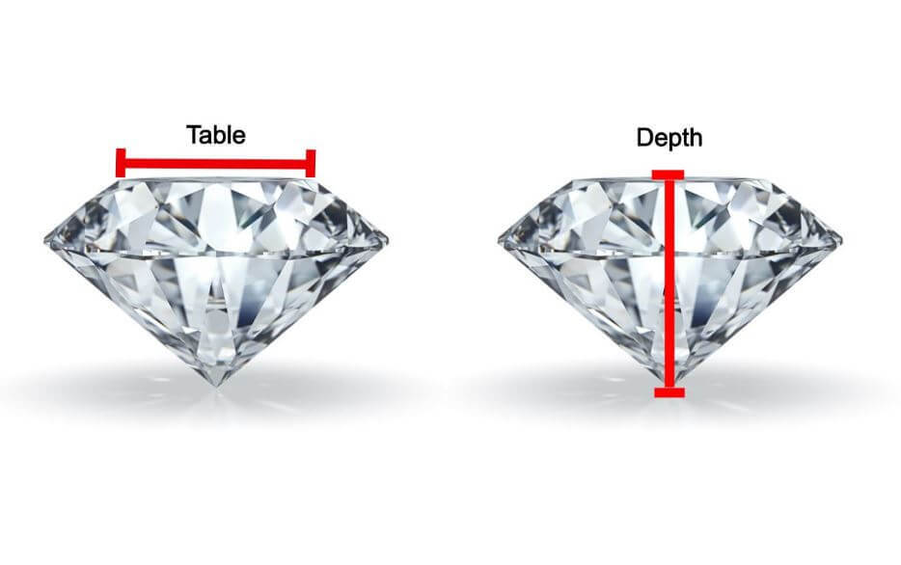
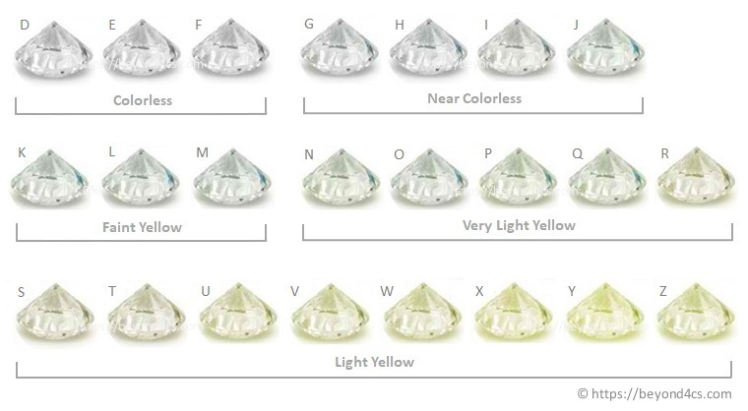
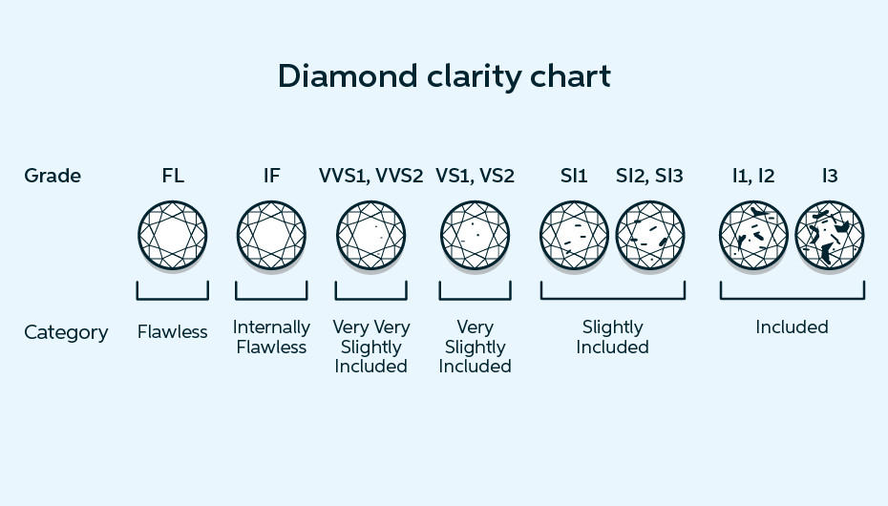
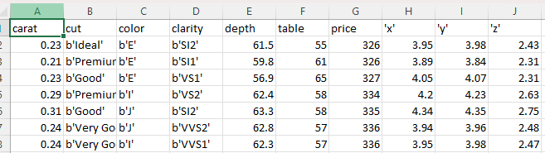
IMAGES

Slide 7
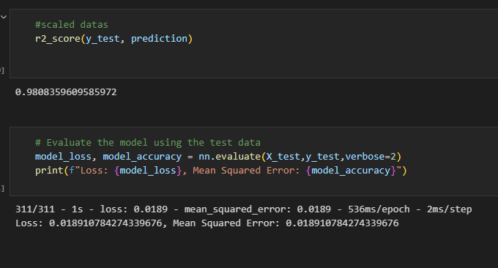
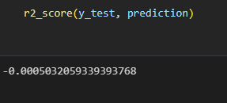
FINDINGS
NEURAL NETWORK MODEL THAT PREDICTS THE CARAT WITHIN A CLEAN DATASET HAS SHOWN, INTERESTINGLY THE SCALED DATASET SHOWS:

Slide 8
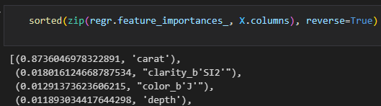
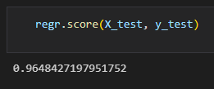

FINDINGS
RANDOM FOREST MODEL (WITH THE SPECIFICATIONS SHOWN) PREDICTED PRICE WITH AN EXTREMELY GOOD ACCURACY. IT ALSO SHOWED THAT THE CARAT WAS BY FAR THE MOST IMPORTANT FACTOR WHEN DETERMINING PRICE

Slide 9
CHALLENGES AND CONCLUSIONS
TRYING TO IMPORT THE CSV FILE TO PG ADMIN
THE DATASET ISN’T SUITABLE FOR NEURAL NETWORK

Slide 10
THE TEAM
JAMES
DALITSO
THARU
JADE

