Slide 1
Multi-hop Reasoning
Jinyi Hu
2020.02.29

Slide 2
Overview
Multi-hop Reasoning
GNN, Language model based Method
Dataset
HotpotQA: CogQA, Transformer-XH
DROP: NumNet, ReNd, extended NMN
ReClor
CLUTRR: predict the relative relationship

Slide 3
Overview on Multi-hop Reasoning
Language model encode the semantic information
GNN propagate the information between nodes
Two basic question:
How to build the graph
Open domain Wiki-based graph
Build the local graph by relation extracting
How to tradeoff between graph structure and language encoder

Slide 4
Case 1: CogQA

Slide 5
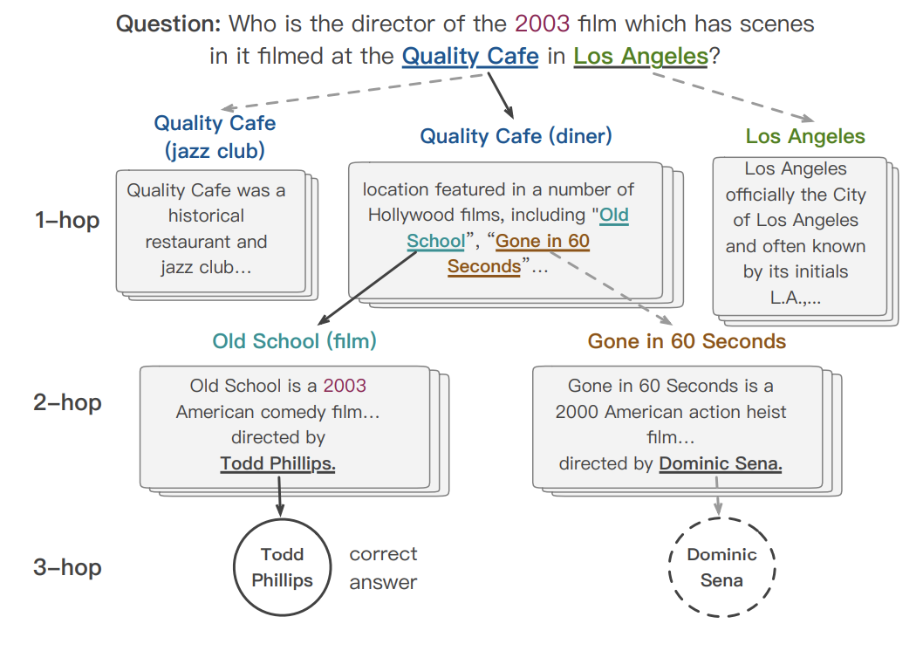
CogQA
System 1 & System 2
System 1: implicit extraction module (Bert)
System 2: explicit reasoning module (GNN)
System 1 extract entities and answer candidates
Organized as a cognitive graph
System 2 conducts the reasoning over the graph
Ding M, et al. Cognitive graph for multi-hop reading comprehension at scale 2019.

Slide 6
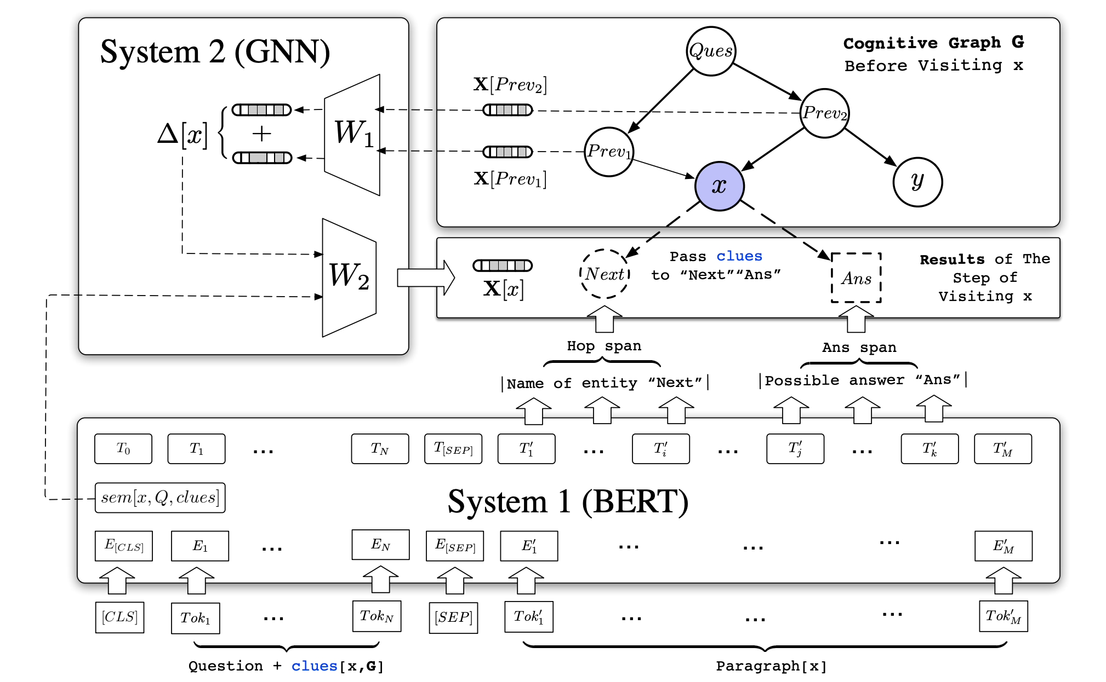
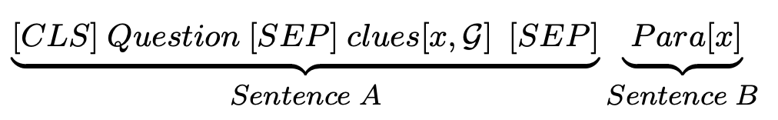
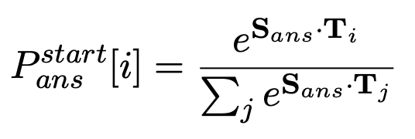
CogQA
Input into bert
Extract the entity span and answer span with pointer vectors
Extract the semantics representation to initialize the node representation (representation of [CLS] in third-to-last layer)
Update the representation with a a propagation step of GNN
FCN layers as the predictor
Ding M, et al. Cognitive graph for multi-hop reading comprehension at scale 2019.

Slide 7
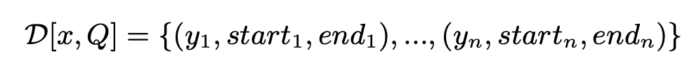
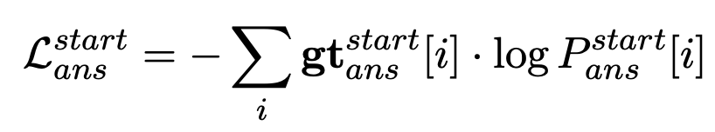
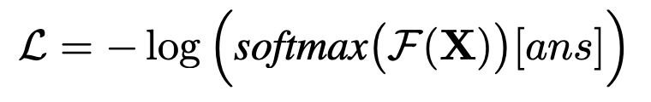
CogQA
Training: Two Tasks
Task 1: Span Extraction
Task 2: Answer Node Prediction
Ding M, et al. Cognitive graph for multi-hop reading comprehension at scale 2019.

Slide 8
Case 2: Transformer-XH

Slide 9
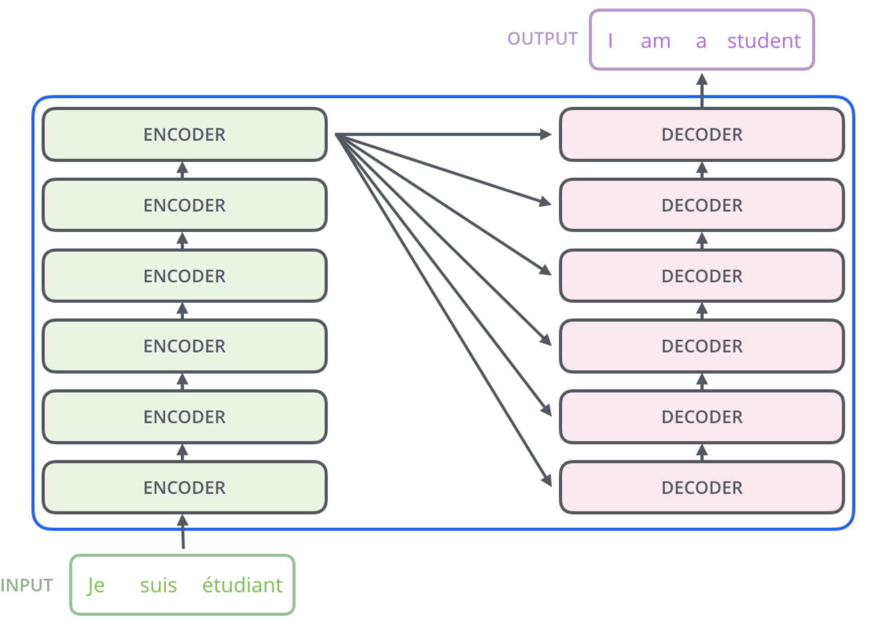
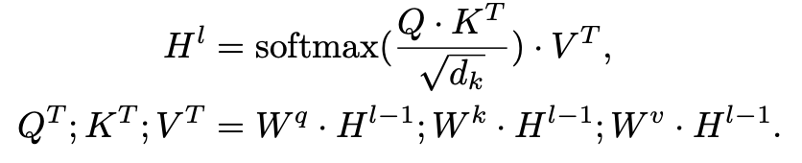
Transformer-XH ICLR 2020
Transformer architecture

Slide 10
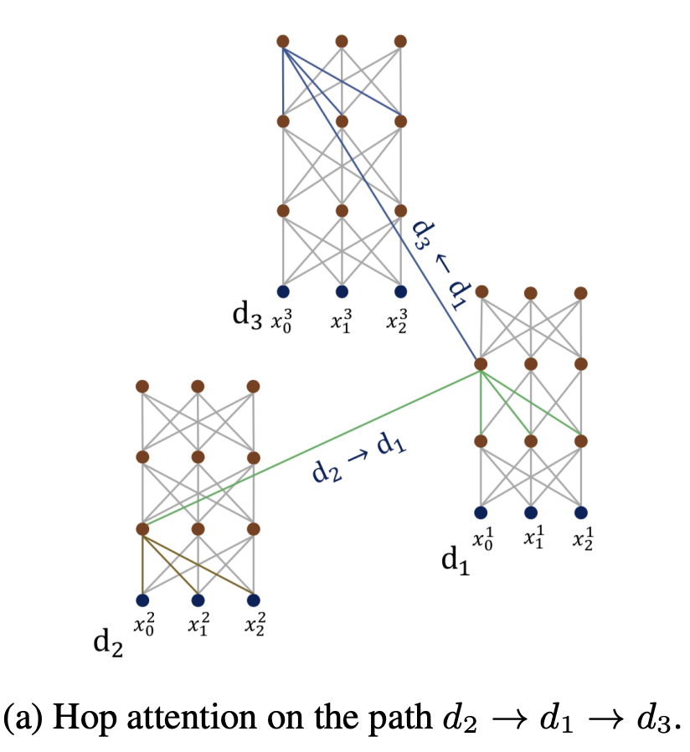
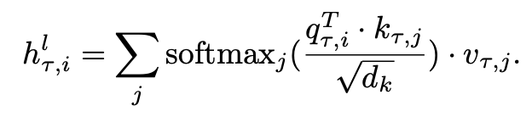
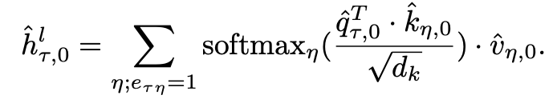
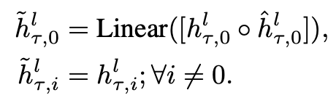
Transformer-XH ICLR 2020
in-sequence attention
eXtra Hop attention
compute the attention between neighbors by [CLS] token
new representation

Slide 11
Transformer-XH ICLR 2020
Transformer-XH VS CogQA
Transformer-XH utilizes the graph during the semantic encoding
CogQA utilizes the graph after encoding
The building of graph in transformer-XH is more comprehensive

Slide 12
Case 3: Retrieve Reasoning Path

Slide 13
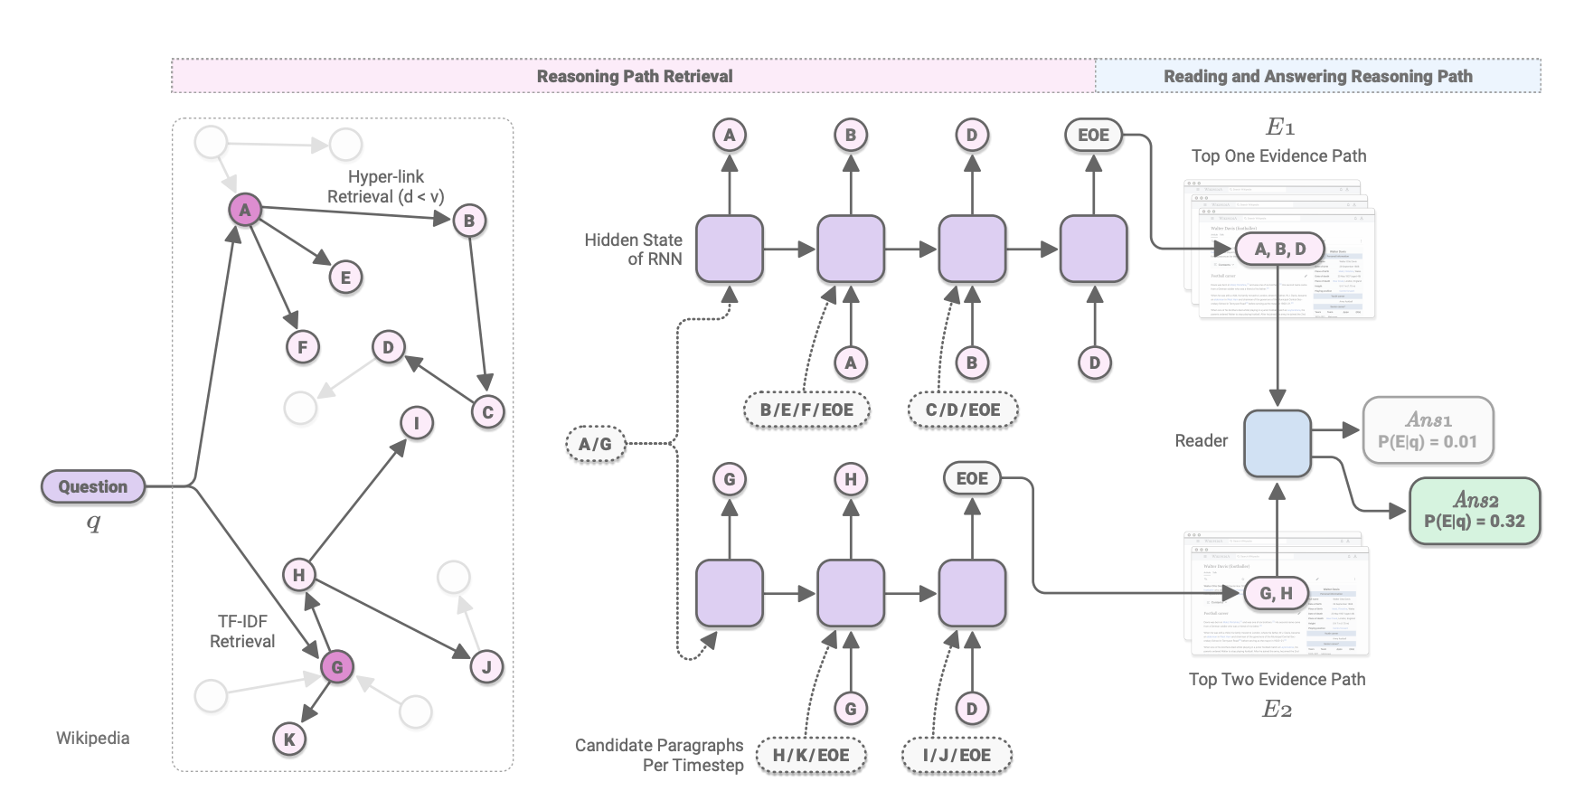
Retrieve Reasoning Paths
Training the retriever to directly find the reasoning path
Using hyperlink to construct the graph offline
Train a retriever and a reader
Akari Asai., et al. Learning to Retrieve Reasoning Paths over Wikipedia Graph for Question Answering. 2020

Slide 14
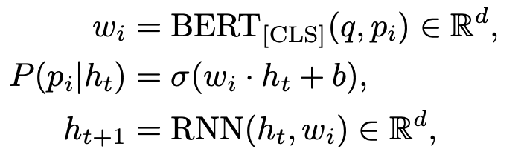
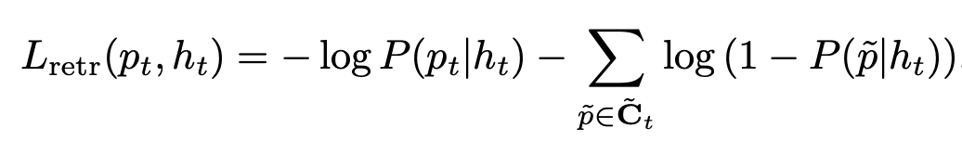
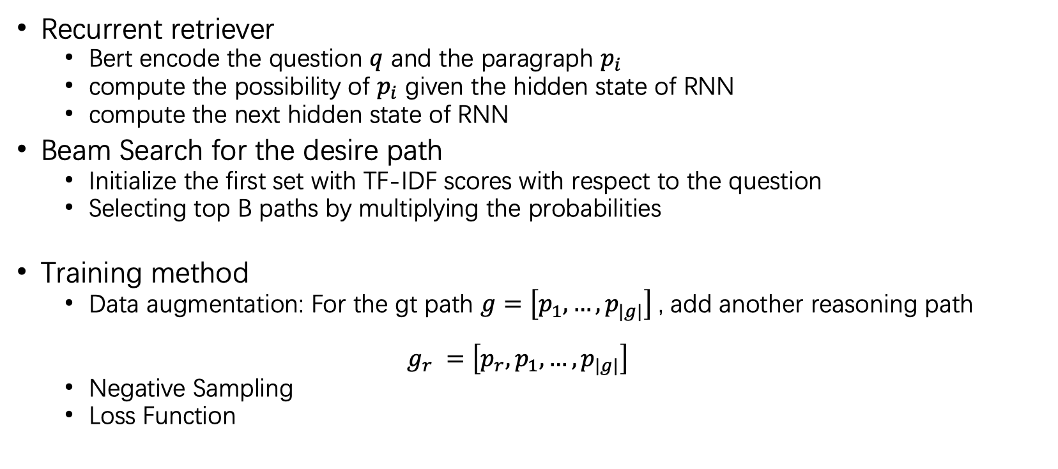
Retrieve Reasoning Paths
Recurrent retriever
Bert encode the question $q$ and the paragraph $p_{i}$
compute the possibility of $p_{i}$ given the hidden state of RNN
compute the next hidden state of RNN
Beam Search for the desire path
Initialize the first set with TF-IDF scores with respect to the question
Selecting top B paths by multiplying the probabilities
Training method
Data augmentation: For the gt path $g=\left[p_{1},…,p_{|g|}\right]$, add another reasoning path
$g_{r} =\left[{p_{r},p}_{1},…,p_{|g|}\right]$
Negative Sampling
Loss Function
$E=\left[p_{i},…,p_{k}\right] P=P(p_{i}|h_{1})$ $…P(p_{k}|h_{|E|})$
Akari Asai., et al. Learning to Retrieve Reasoning Paths over Wikipedia Graph for Question Answering. 2020

Slide 15
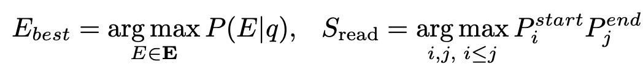
Retrieve Reasoning Paths
Reader: multi-task learning
reading comprehension: concat all para in reasoning path
Re-rank the reasoning path by computing the probabilities
Find the best reasoning path and extract the answer span
Training Method: Negative Sample
Akari Asai., et al. Learning to Retrieve Reasoning Paths over Wikipedia Graph for Question Answering. 2020

Slide 16
Case 4: Dynamically Fused Graph Network

Slide 17
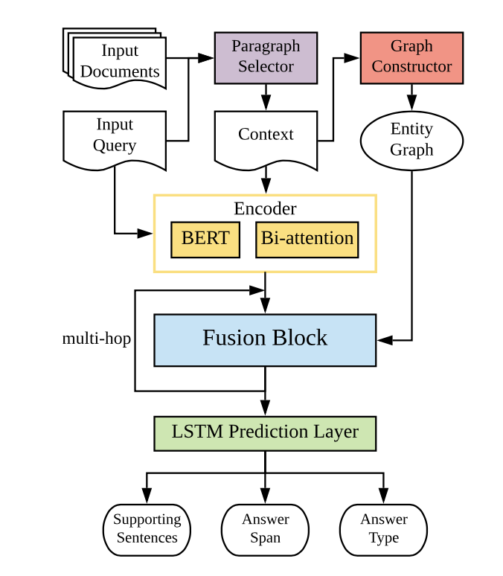
Dynamically Fused Graph Network
No global knowledge base
Construct the entity graph
Edges are added in two cases
Appear in the same sentence
Same mention text in Context
Between a central entity and other
Encoding query and context
Fusing block
Akari Asai., et al. Learning to Retrieve Reasoning Paths over Wikipedia Graph for Question Answering. 2020

Slide 18
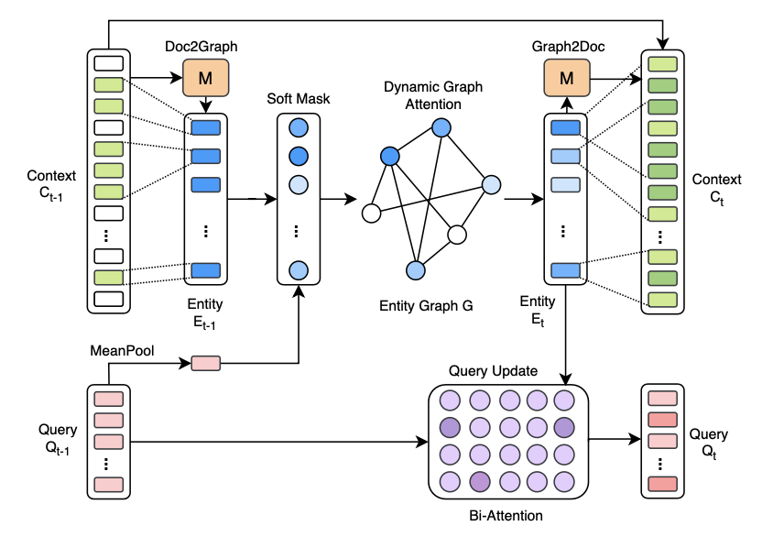
Dynamically Fused Graph Network
Intuition: mimic human reasoning step
Three steps:
Doc2Graph flow (Compute entity embedding)
Propagate the information on graph
Graph2Doc flow(Passing information back to token)
Dynamic Graph Attention
Intuition: in different steps, we use different entity
Use query to mask the entity.
Information propagation is restricted on dynamic sub-graph
Updating the token embedding
Akari Asai., et al. Learning to Retrieve Reasoning Paths over Wikipedia Graph for Question Answering. 2020

Slide 19
Case 5: Rover

Slide 20
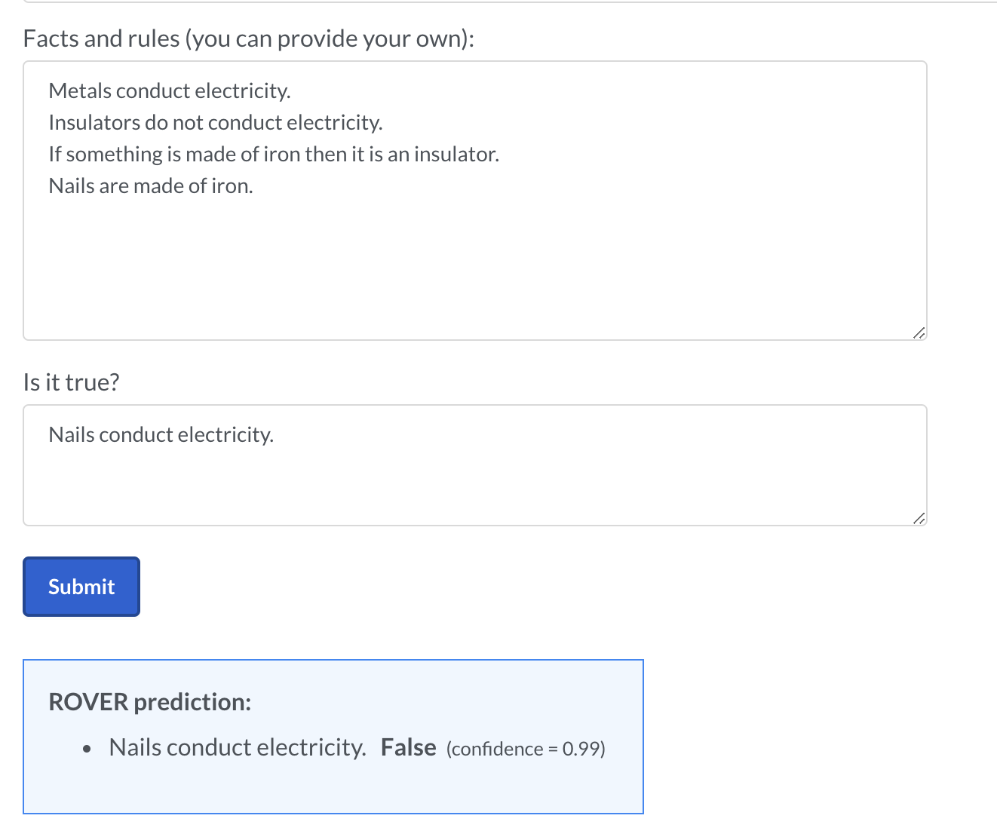
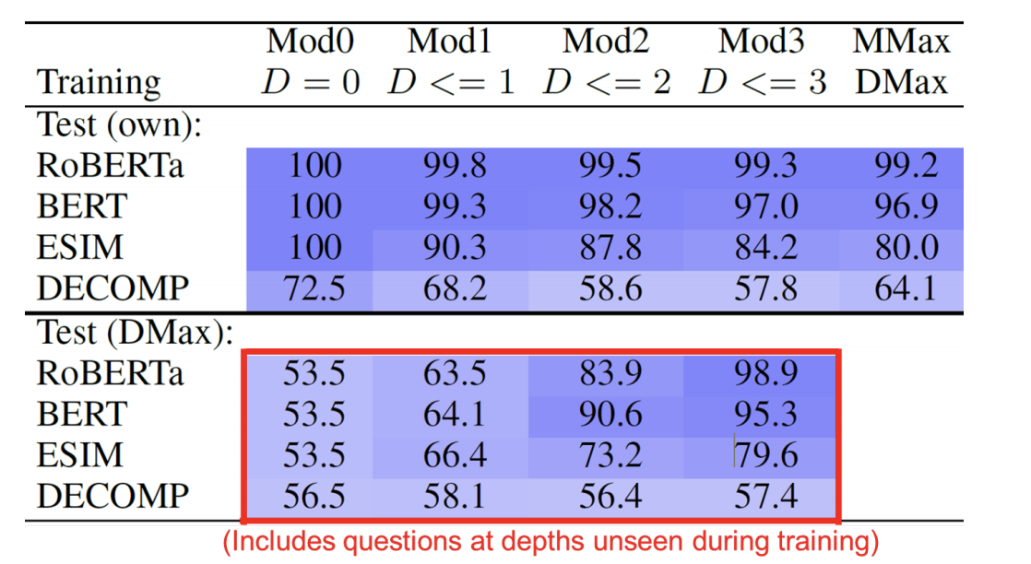
ROVER
ROVER determines whether statements are True or False based on rules given in natural language.
Accuracy of RoBERTa can reach 99%
Clark, P., et al. Transformers as Soft Reasoners over Language. 2020

Slide 21
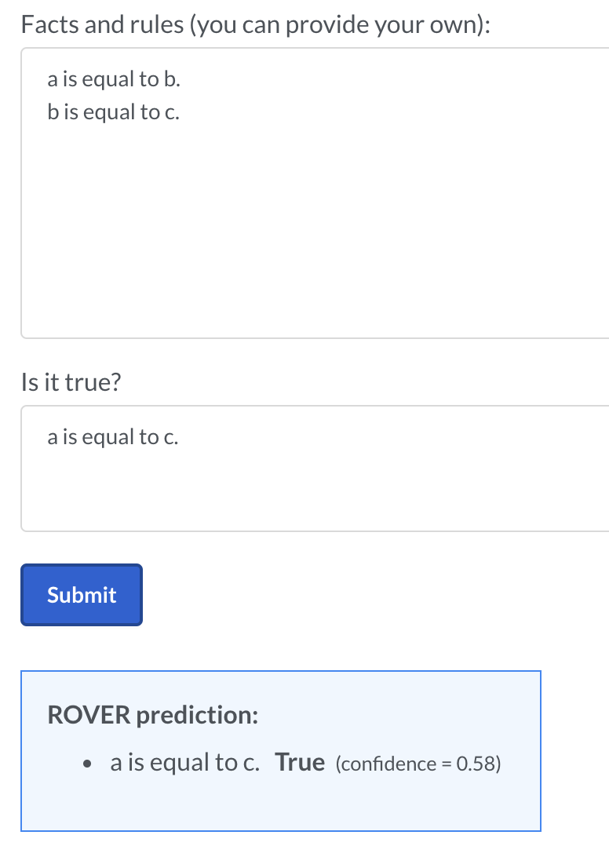
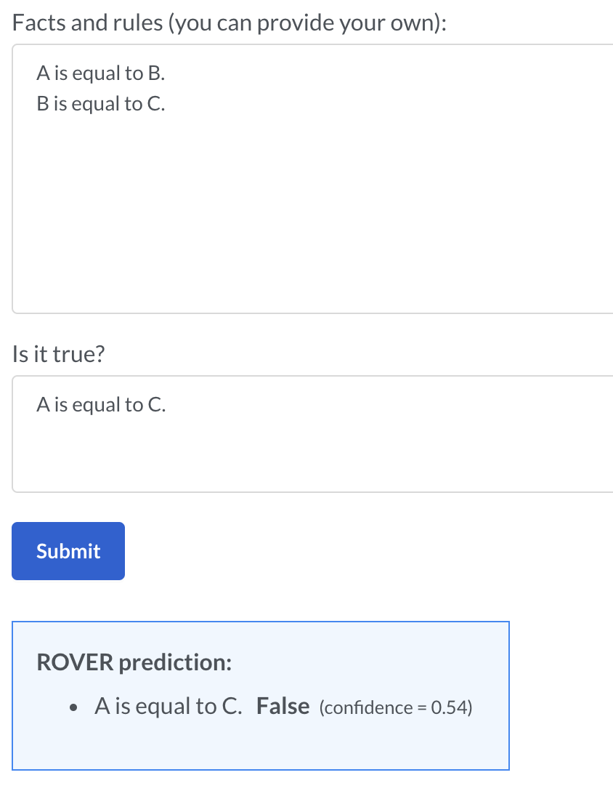
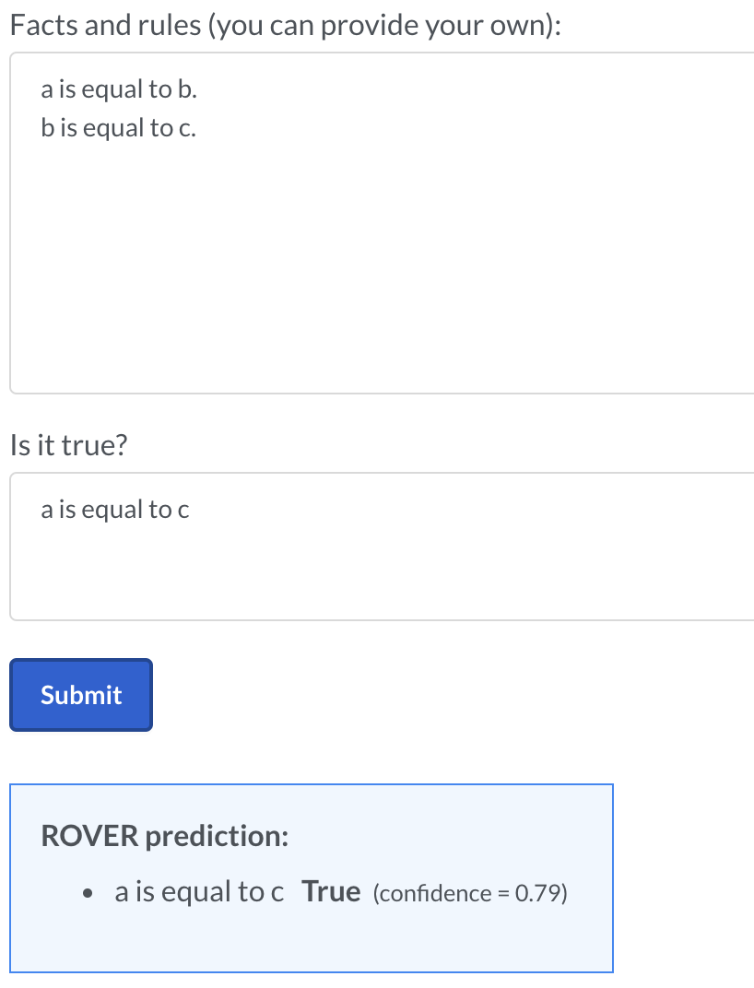
ROVER
Training Dataset is generated based on several fixed form
No proposed specific architecture
Not stable enough
Exploration: reason over rules expressed in languages
Clark, P., et al. Transformers as Soft Reasoners over Language. 2020

Slide 22
Dataset
HotpotQA: Multi-hop Reasoning
Model for Wiki Setting
CogQA:
Bert encode the para and extract the entity to build the cognitive graph
Use GNN to update the semantic representation
Transformer-XH:
Extend the transformer and compute the attention between neighbors
Reasoning Path:
Fine the Top B reasoning paths recurrently
Use Bert the re-rank the path and find the answer span
Model for Distractor Setting
DFGN
First encode text then process on graph
encode text combine with graph
First search on the graph then find the span on path
Akari Asai., et al. Learning to Retrieve Reasoning Paths over Wikipedia Graph for Question Answering. 2020

Slide 23
Dataset
DROP: More mathematical operation
MTMSN
ReNd
Neural Module Networks for Reasoning over Text
Learn the operation case by case
Akari Asai., et al. Learning to Retrieve Reasoning Paths over Wikipedia Graph for Question Answering. 2020

Slide 24
Dataset
ReClor: Logical Question in GMAT
CLUTRR: predict the relative relationship
Akari Asai., et al. Learning to Retrieve Reasoning Paths over Wikipedia Graph for Question Answering. 2020

Slide 25
Ideas
For Reclor
Use fact verification
find support or refute in the given passage to every option
The logic is augment level, much harder than the previous dataset
For Rules-based Inductive
Rules are described by natural language.
How to build a directed graph based on the language model.
Using attention
Using mutual information
Akari Asai., et al. Learning to Retrieve Reasoning Paths over Wikipedia Graph for Question Answering. 2020

