Slide 1
Survey in Local Reasoning
Jinyi Hu
2020.02.29

Slide 2
Aspect
Multi-hop Reasoning
GNN, Language model based Method
Symbolic Method
Neural Symbolic Network; Learn rules; Encode logic;
Dataset
HotpotQA: CogQA, Transformer-XH
DROP: NumNet, ReNd, extended NMN

Slide 3
Multi-hop Reasoning
Language model based
Cognitive Graph for Multi-Hop Reading Comprehension at Scale
Transformer-XH: Multi-Evidence Reasoning with eXtra Hop Attention
Transformers as Soft Reasoners over Language
Graph-based model
Dynamically Fused Graph Network for Multi-hop Reasoning
Learning to Retrieve Reasoning Paths over Wikipedia Graph for Question Answering
Multi-hop Reading Comprehension across Multiple Documents by Reasoning over Heterogeneous Graphs

Slide 4
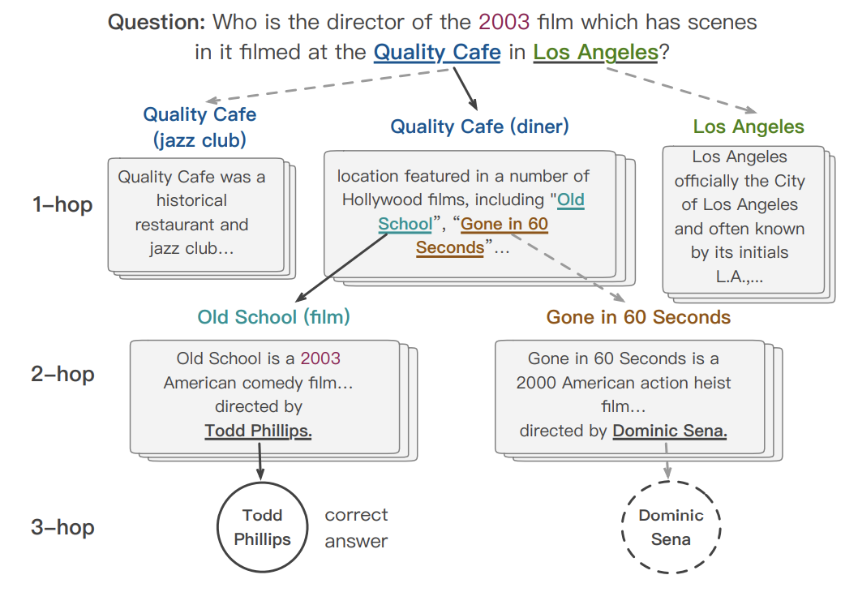
CogQA
System 1 & System 2
System 1: implicit extraction module (Bert)
System 2: explicit reasoning module (GNN)
System 1 extract entities and answer candidates
Organized as a cognitive graph
System 2 conducts the reasoning over the graph
Ding M, et al. Cognitive graph for multi-hop reading comprehension at scale 2019.

Slide 5
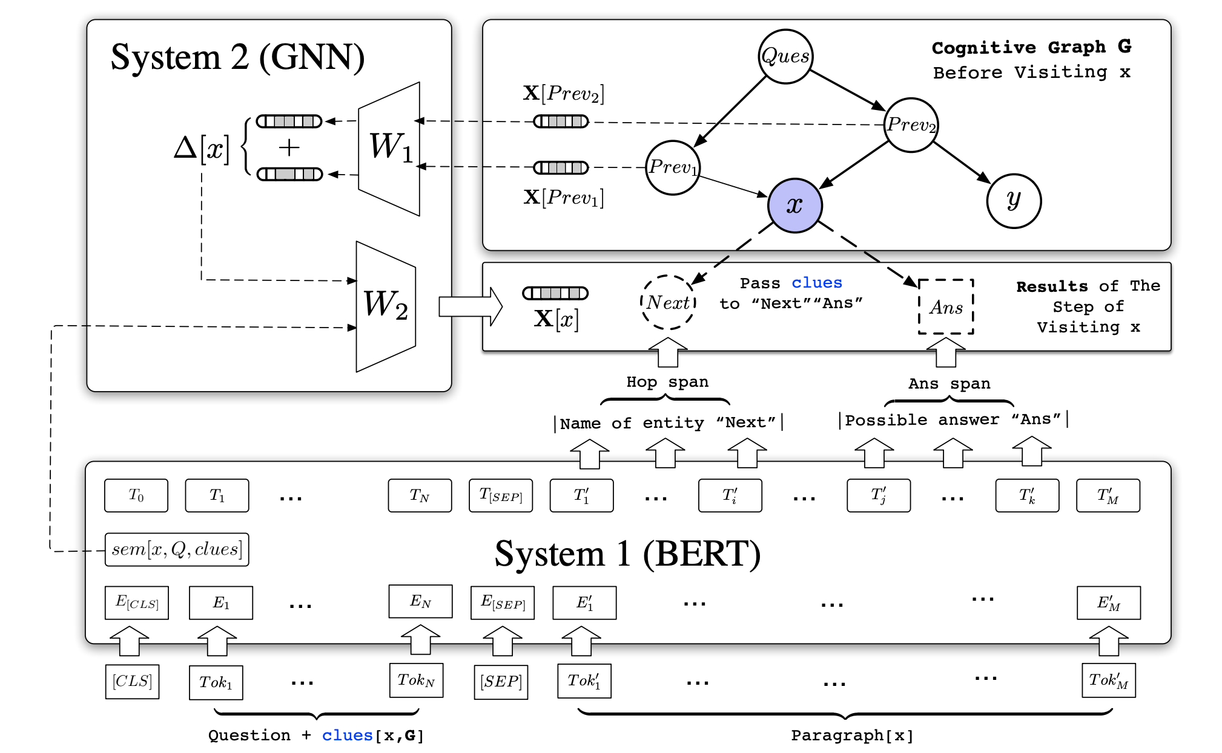
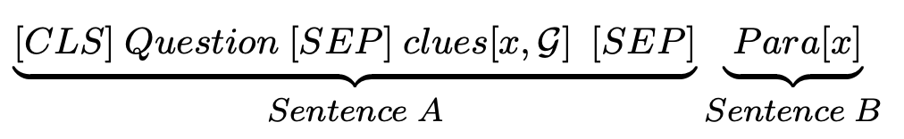
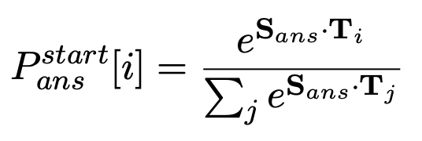
CogQA
Input into bert
Extract the entity span and answer span with pointer vectors
Extract the semantics representation to initialize the node representation (representation of [CLS] in third-to-last layer)
Update the representation with a a propagation step of GNN
FCN layers as the predictor
Ding M, et al. Cognitive graph for multi-hop reading comprehension at scale 2019.

Slide 6
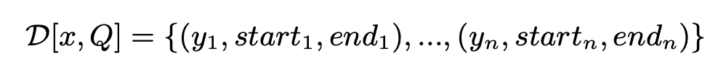
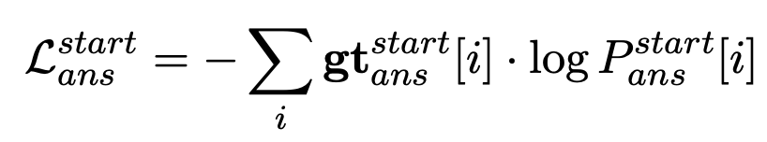
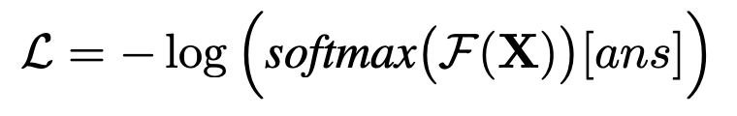
CogQA
Training: Two Tasks
Task 1: Span Extraction
Task 2: Answer Node Prediction
Ding M, et al. Cognitive graph for multi-hop reading comprehension at scale 2019.

Slide 7
CogQA
Training: Two Tasks
Task 1: Span Extraction
Task 2: Answer Node Prediction
Ding M, et al. Cognitive graph for multi-hop reading comprehension at scale 2019.

Slide 8
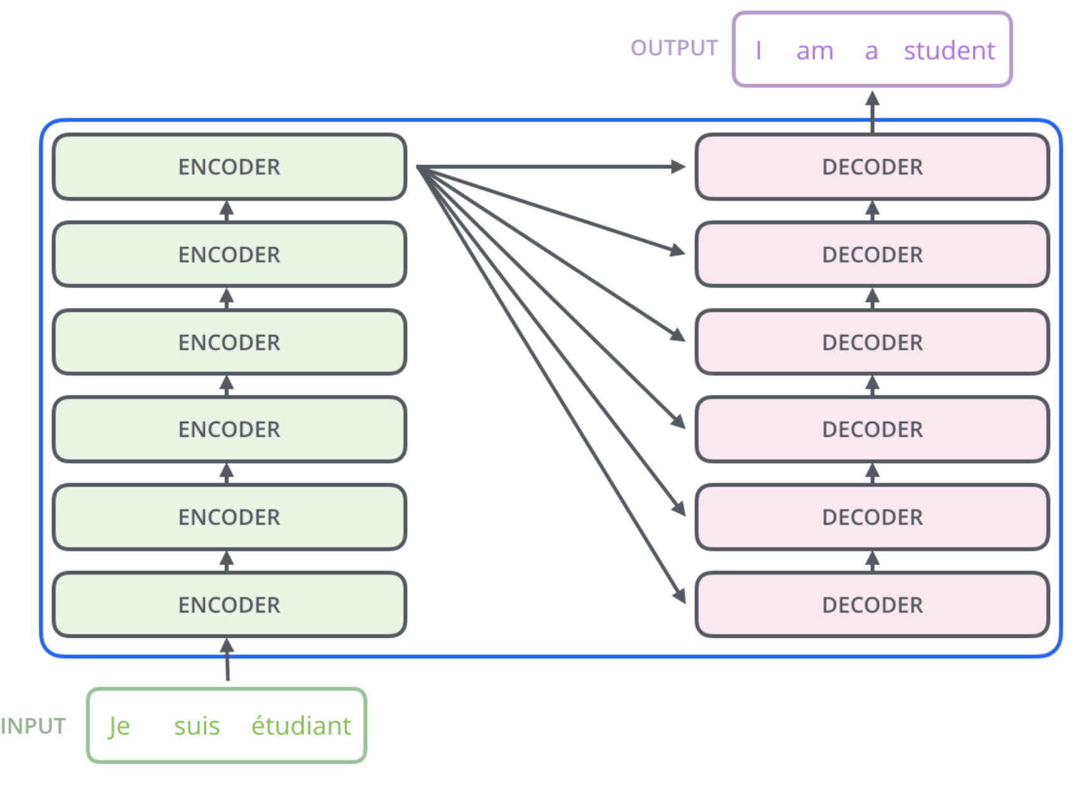
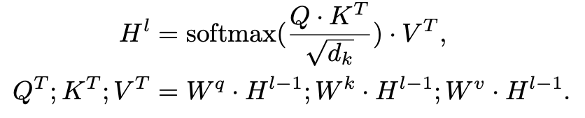
Transformer-XH ICLR 2020
Transformer architecture

Slide 9
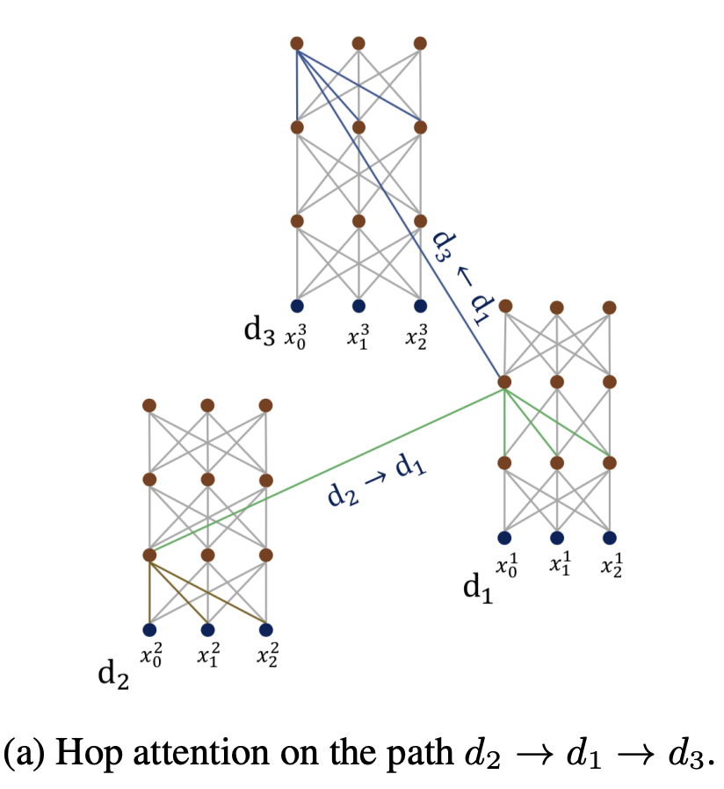
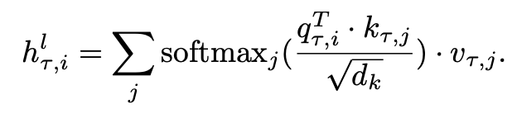
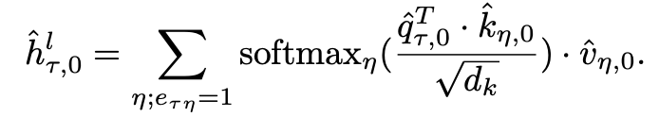
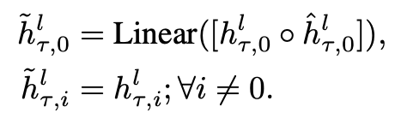
Transformer-XH ICLR 2020
in-sequence attention
eXtra Hop attention
compute the attention between neighbors by [CLS] token
new representation

Slide 10
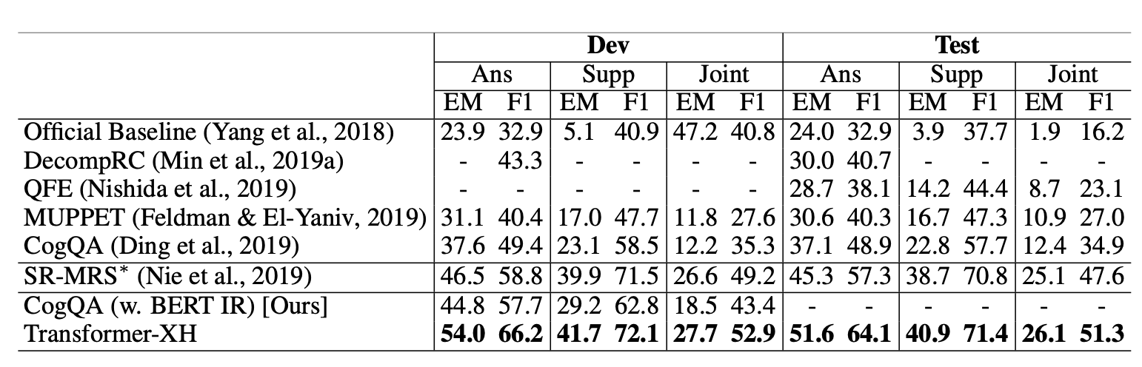
Transformer-XH ICLR 2020
Evaluated on HotpotQA, extended to FEVER
Combine Transformer and GNN

Slide 11
Transformer-XH ICLR 2020
Transformer-XH VS CogQA
Transformer-XH utilizes the graph during the semantic encoding
CogQA utilizes the graph after encoding
The building of graph in transformer-XH is more comprehensive

Slide 12
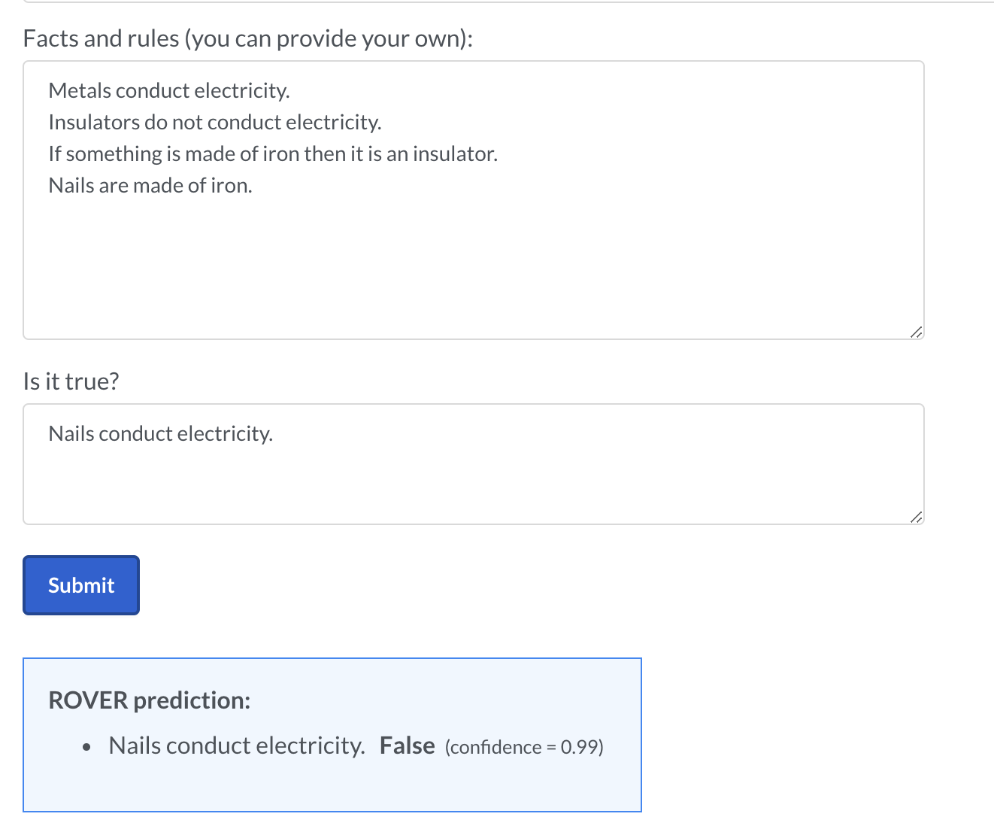
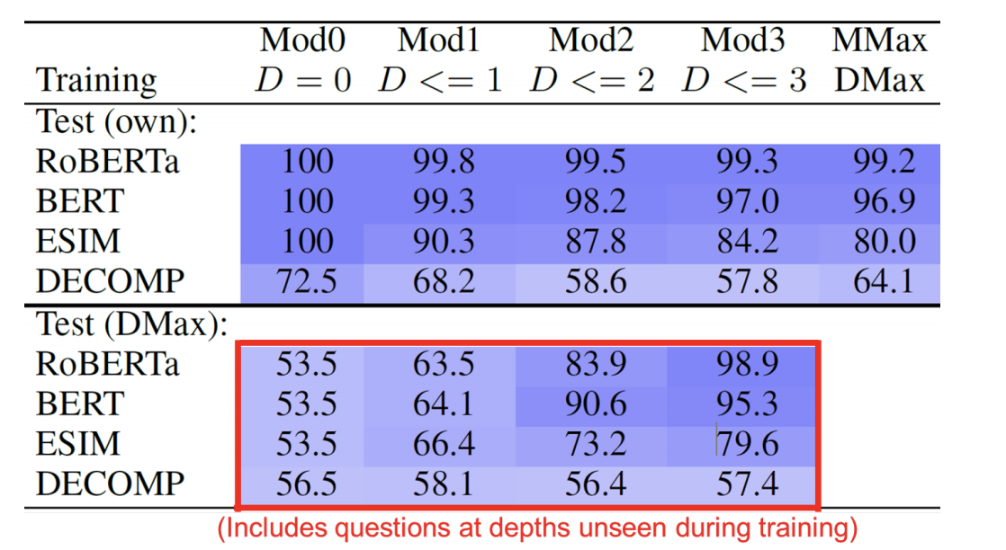
ROVER
ROVER determines whether statements are True or False based on rules given in natural language.
Accuracy of RoBERTa can reach 99%
Clark, P., et al. Transformers as Soft Reasoners over Language. 2020

Slide 13
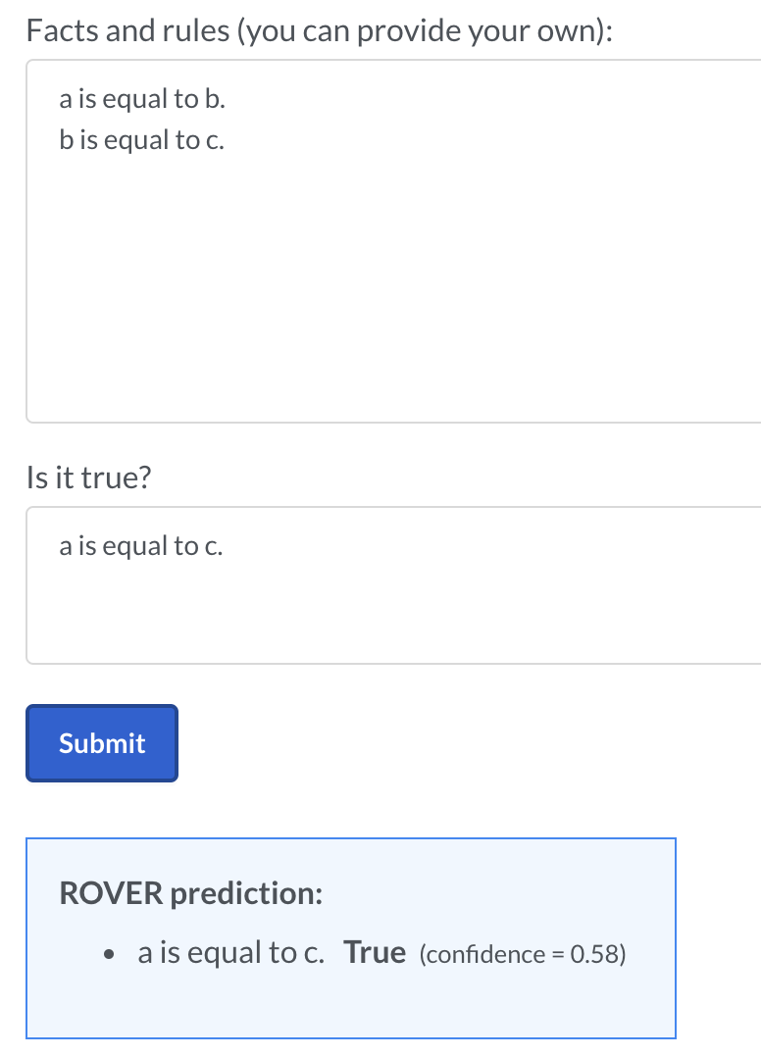
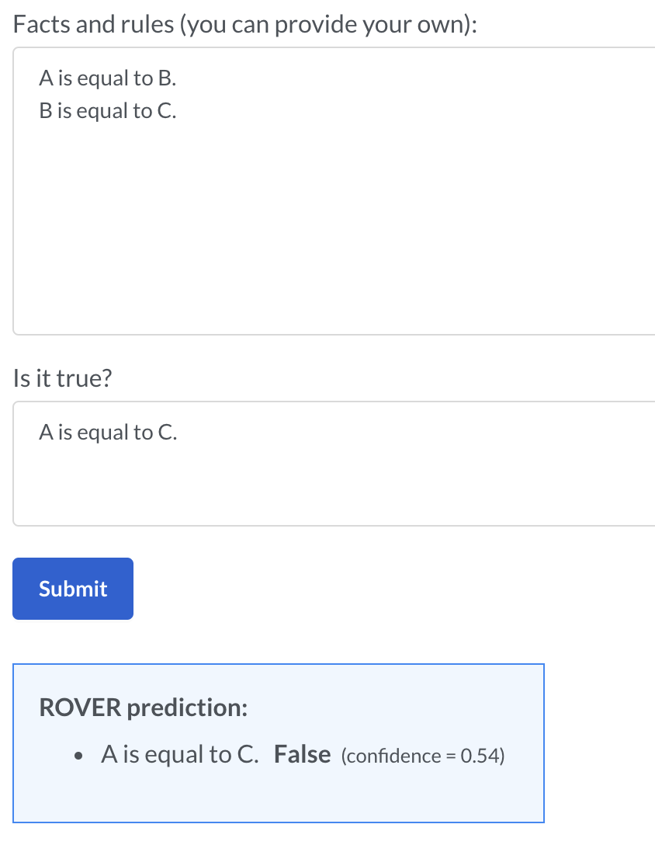
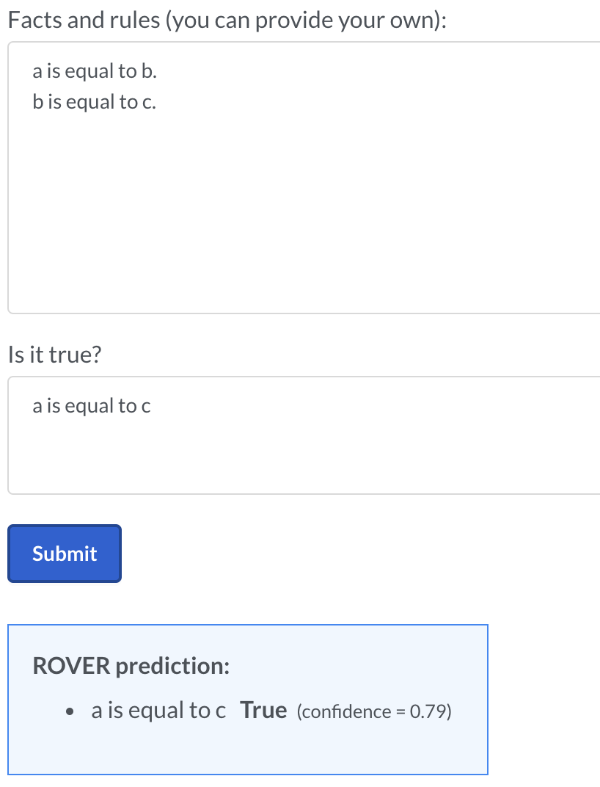
ROVER
Training Dataset is generated based on several fixed form
No proposed specific architecture
Not stable enough
Exploration: reason over rules expressed in languages
Clark, P., et al. Transformers as Soft Reasoners over Language. 2020

Slide 14
DGFN: Dynamically Fused Graph Network for Multi-hop Reasoning
Akari Asai., et al. Learning to Retrieve Reasoning Paths over Wikipedia Graph for Question Answering. 2020

Slide 15
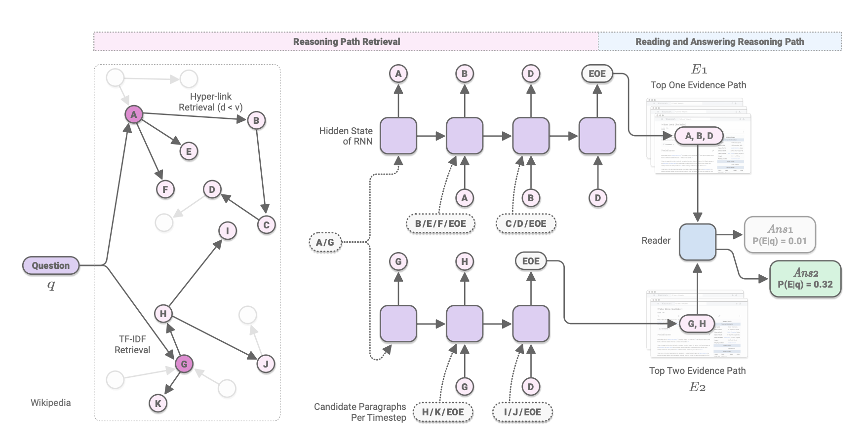
Retrieve Reasoning Paths
Training the retriever to directly find the reasoning path
Using hyperlink to construct the graph offline
Train a retriever and a reader
Akari Asai., et al. Learning to Retrieve Reasoning Paths over Wikipedia Graph for Question Answering. 2020

Slide 16
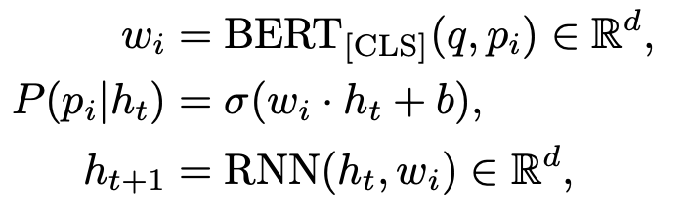
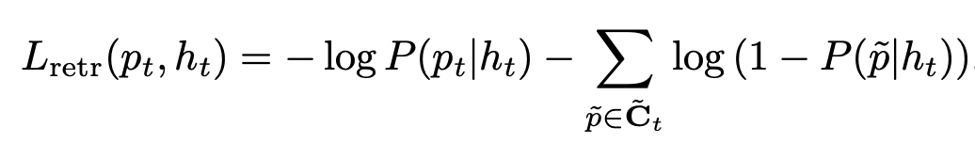
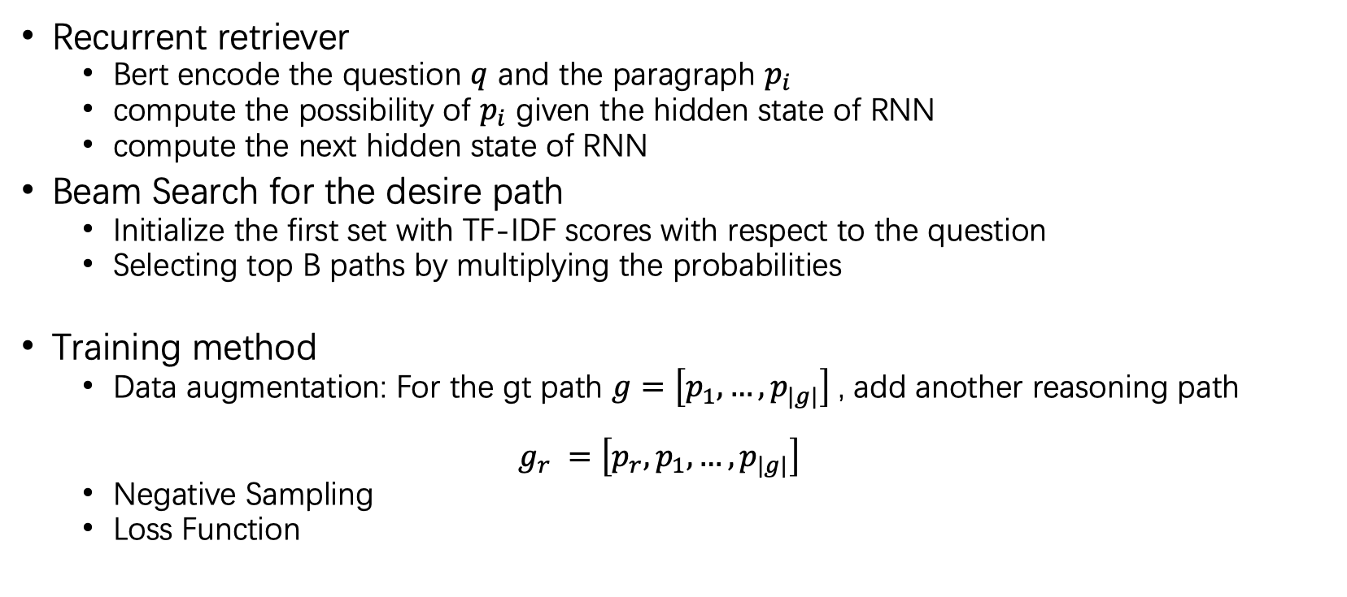
Retrieve Reasoning Paths
Recurrent retriever
Bert encode the question $q$ and the paragraph $p_{i}$
compute the possibility of $p_{i}$ given the hidden state of RNN
compute the next hidden state of RNN
Beam Search for the desire path
Initialize the first set with TF-IDF scores with respect to the question
Selecting top B paths by multiplying the probabilities
Training method
Data augmentation: For the gt path $g=\left[p_{1},…,p_{|g|}\right]$, add another reasoning path
$g_{r} =\left[{p_{r},p}_{1},…,p_{|g|}\right]$
Negative Sampling
Loss Function
$E=\left[p_{i},…,p_{k}\right] P=P(p_{i}|h_{1})$ $…P(p_{k}|h_{|E|})$
Akari Asai., et al. Learning to Retrieve Reasoning Paths over Wikipedia Graph for Question Answering. 2020

Slide 17
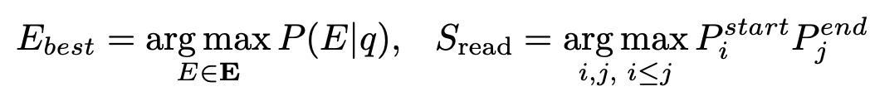
Retrieve Reasoning Paths
Reader: multi-task learning
reading comprehension: concat all para in reasoning path
Re-rank the reasoning path by computing the probabilities
Find the best reasoning path and extract the answer span
Training Method: Negative Sample
Akari Asai., et al. Learning to Retrieve Reasoning Paths over Wikipedia Graph for Question Answering. 2020

Slide 18
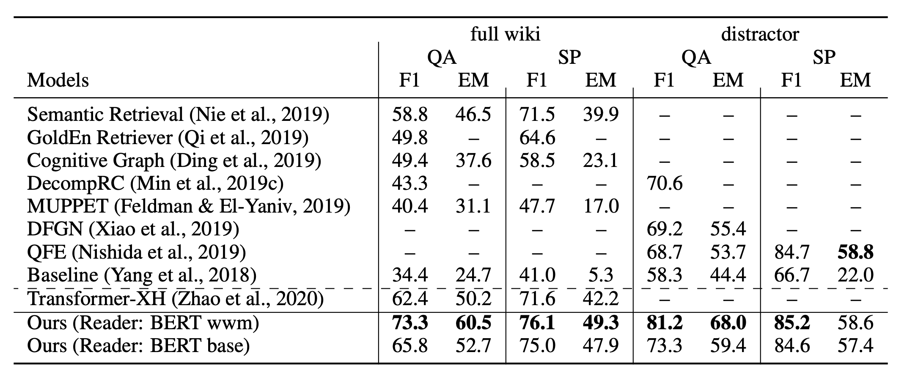
Retrieve Reasoning Paths
Experiment
Akari Asai., et al. Learning to Retrieve Reasoning Paths over Wikipedia Graph for Question Answering. 2020

Slide 19
Dataset
HotpotQA: Multi-hop Reasoning
CogQA:
Bert encode the para and extract the entity to build the cognitive graph
Use GNN to update the semantic representation
Transformer-XH:
Extend the transformer and compute the attention between neighbors
Reasoning Path:
Fine the Top B reasoning paths recurrently
Use Bert the re-rank the path and find the answer span
Summary
First encode text then process on graph
encode text combine with graph
First search on the graph then find the span on path
Akari Asai., et al. Learning to Retrieve Reasoning Paths over Wikipedia Graph for Question Answering. 2020

Slide 20
Dataset
DROP: More mathematical operation
MTMSN
ReNd
Neural Module Networks for Reasoning over Text
Learn the operation case by case
Akari Asai., et al. Learning to Retrieve Reasoning Paths over Wikipedia Graph for Question Answering. 2020

Slide 21
Dataset
ReClor: Logical Question in GMAT
An infant idea inspired by my GRE teacher
Using memory network to memorize the main logical lines
Details do not influence the argument points
Compare the choice and the lines logically
Akari Asai., et al. Learning to Retrieve Reasoning Paths over Wikipedia Graph for Question Answering. 2020

