Slide 1
CS 6476 Project 6
James Dill
jdill34@gatech.edu
jdill34
903779380

Slide 2
Parts 4 & 5: mIoU of different models (9 points)
Add each of the following (keeping the changes as you move to the next row):
all of these were trained at 15 epochs | Training mIoU | Validation mIoU
Simple Segmentation Net (no pretrained weights) | 0.259 | 0.2089
ImageNet-Pretrained backbone | 0.445 | 0.4301
Data augmentation | 0.403 | 0.3985
ImageNet-Pretrained PSPNet w/ Data Aug. without PPM | 0.45 | 0.4806
PSPNet with PPM | 0.439 | 0.4782
PSPNet with auxiliary loss | 0.436 | 0.4652

Slide 3
Parts 4 & 5 (5 points)
1. ImageNet-Pretrained backbone
Using a pretrained backbone provides a strong initialization for the model, allowing our model to start training with a higher general performance, thus saving training time (as you need fewer epochs to reach a specific performance threshold) and significantly increasing the performance of our model.
2. Data augmentation
Employing data augmentation such as the methods we used, random horizontal flipping, random rotation, random cropping, randing scaling, etc. increases the diversity of the dataset and helps to prevent overfitting. In my model, it resulted in a slightly worsened performance. This is probably a result of the lessened overfitting, which causes our model to have a slightly worse performance at the benefit of being less overfitted to the data. This is supported by the fact that the previous model had a greater training mIoU than validation mIoU by a non-trivial margin.
3. PSPNet
PSPNet incorporates a pyrmid pooling module that captures contextual information at various pooling scales (1x1, 2x2, 3x3, 6x6, etc.). This results in a classification model that captures dependencies among features in images at varying scales, thus enabling better segmentation performance overall, thus explaining our improved performance over the previous models.
4. PSPNet with PPM
Adding PPM to PSPNet further enhances the model’s ability to capture contextual information at varying scales and resolutions. This leads to improved segmentation performance, particularly for objects with complex structures and varying structures/scales. It didn’t, however, improve the performance of our model, in fact it slightly decreased (although only slightly). This may be because that using PPM in fact did not capture any further contextual information that we weren’t already capturing with our PSPNet architecture, thus only resulting in our PSPNet + PPM model capturing redundant information.
5. PSPNet with auxiliary loss
Incorporting auxiliary loss into training a PSPNet provides additional supervision. By optimizing both the main loss and auxiliary loss during training, the model can pick up on features that are relevant at different stages of the network, enhancing overall segmentation performance. My training accuracy did not change significantly, however my validation accuracy did go down by over 1%. This might be attributed to the fact that incorporating auxiliary loss into the model’s training put a greater on optimizing feature maps across the all stages of the model as a whole as opposed to just the final result.

Slide 4
Parts 4 & 5: Per class IoUs (1 points)
Report your model’s IoU for the 11 Camvid classes (you can find the order they are listed in at dataset_lists/camvid-11/camvid-11_names.txt):
Class Index | Class name | Simple Segmentation Net Class IoU | PSPNet Class IoU
0 | Building | 0.8431/0.9149 | 0.8743/0.9158
1 | Tree | 0.7969/0.9677 | 0.8316/0.9792
2 | Sky | 0.8789/0.9637 | 0.8886/0.9544
3 | Car | 0.2742/0.8936 | 0.7495/0.8055
4 | SignSymbol | 0.0000/0.0000 | 0.0000/0.0000
5 | Road | 0.7885/0.9670 | 0.9114/0.9349
6 | Pedestrian | 0.0000/0.0000 | 0.1370/0.1571
7 | Fence | 0.0000/0.0000 | 0.4062/0.4637
8 | Column_Pole | 0.0000/0.0000 | 0.0020/0.0020
9 | Sidewalk | 0.2513/0.2794 | 0.7940/0.9201
10 | Bicyclist | 0.0000/0.0000 | 0.4025/0.6964

Slide 5
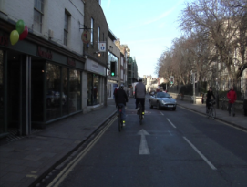
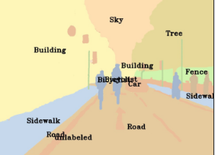
Parts 4 & 5: Most difficult classes (3 points)
[Which classes have the lowest mIoU? Why might they be the most difficult? Provide an example RGB image from Camvid that illustrates your point] SignSymbol and Column_Pole easily have the lowers mIoU. They’re probably the most difficult due to how little of the image they up. Like in this image where the sign symbols and column poles are nearly impossible to make out even as a human being. Other classes like Pedestrian, Fence, Biciclist also have low mIoU. Similar to the SignSymbol and Column pole, they suffer from the fact that they just take up a smaller portion of the images, or are generally harder to distinguish due to overlapping with other sections, and are thus harder to identify compared to the other segments which take up large swathes of the images and are more distinguishable. As we see in this image, they overlap with oversegments and are smaller in comparison to sections such as the Buildings on the left, the sky, the trees on the right, the road, etc.

Slide 6
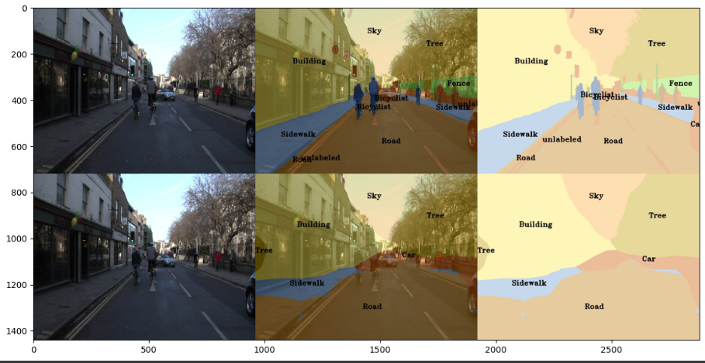
Part 4: Simple segmentation net qualitative results (1 point)
[Paste a figure of the generated semantic segmentation from Colab. It should be a 2x3 grid, with ground truth on the top row, and your predictions on the bottom row.]

Slide 7
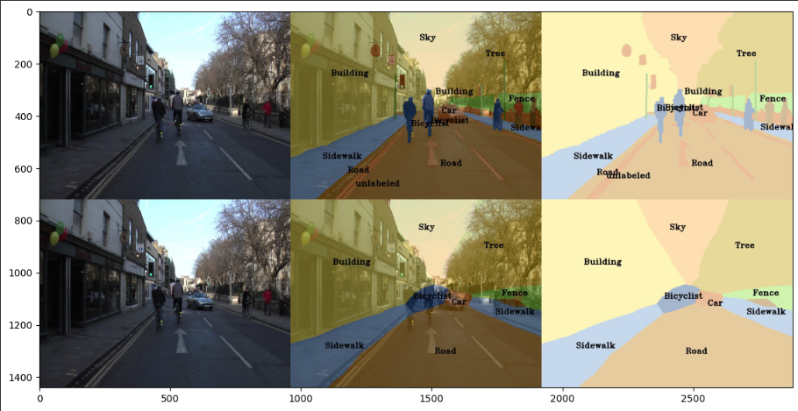
Part 5: PSPNet qualitative results (1 point)
[Paste a figure of the generated semantic segmentation from Colab. It should be a 2x3 grid, with ground truth on the top row, and your predictions on the bottom row.]

Slide 8
Extra Credit: Transfer Learning (1 point)
Report your model’s IoU for the Kitti Dataset.

Slide 9
Extra Credit: Transfer Learning (1 point)
Compare the training loss generated when training on Kitti dataset and Camvid dataset. Which decreases at a faster rate? If Camvid or Kitti training loss decreases at a faster rate than the other, why do you think this happened? Or, if the loss decreases at a similar rate, why do you think that is so?

Slide 10
Extra Credit : WandB (3 points)
Add the link to your WandB project and make sure the project is public

