Slide 1
E-Learning 开发培训
唐明强 / 2015年5月

Slide 2
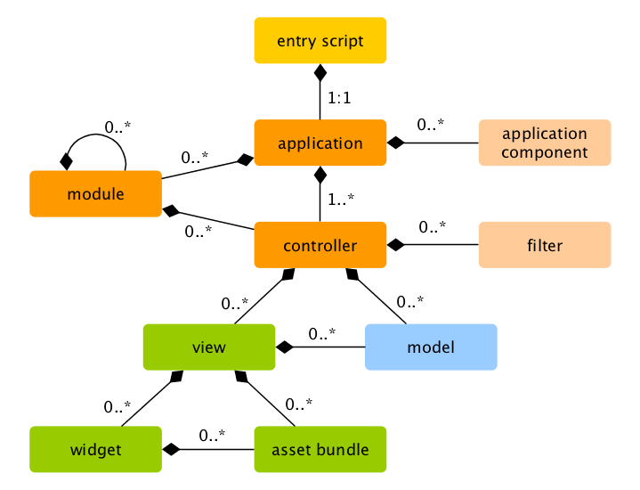
Yii2 Framework Overview
entry scripts: they are PHP scripts that are directly accessible by end users. They are responsible for starting a request handling cycle.
applications: they are globally accessible objects that manage application components and coordinate them to fulfill requests.
application components: they are objects registered with applications and provide various services for fulfilling requests.
modules: they are self-contained packages that contain complete MVC by themselves. An application can be organized in terms of multiple modules.
filters: they represent code that need to be invoked before and after the actual handling of each request by controllers.
widgets: they are objects that can be embedded in views. They may contain controller logic and can be reused in different views.
Notes:
This is a sample Pie Chart slide ideal for communicating product or market information.
To Change Font Color/Size: Select text and adjust the font setting in the Font group in the Home tab. Select desired attributes to change: font, size, boldness, color, etc. Note: many of the same commands can also be accessed from the Mini toolbar.
Edit Chart: Click the chart to edit, right-click and select Edit Data… to access the underlying Excel spreadsheet.
Copying Data From a Separate Excel Spreadsheet: From an existing Excel spreadsheet, select the range of cells to be copied, select copy. In PowerPoint, click the chart, right-click and select Edit Data… to open the spreadsheet for editing. Select all the data in the Chart in Microsoft Office PowerPoint spreadsheet by clicking the top left corner cell, right-click and select Delete. Click in the first empty cell of the spreadsheet and paste (Ctrl V ) to place the data copied from the other Excel file.
Changing Orientation and/or Scale of Data: If no chart elements appear in your chart it is because either 1) the default orientation for pre-made template charts displays data series in rows, not columns, or 2) the axis scale may have to be adjusted
Change Orientation: Click the chart to edit and select the Chart Tools Design tab (or double-click on the chart). Click the Switch Row/Column button. If the Switch Row/Column button is disabled, click the Select Data button and then click the Switch Row/Column button from within the Select Data Source dialog box, click OK.

Slide 3
开发规范与要点
框架目录存放位置介绍（配置文件，控件，多国语言，Model，Demo目录，日志，静态文件等）
框架分层（MVVM模式，面向服务）
代码继承关系介绍（Controller，Model）
基础数据关系思路
基础数据表介绍、数据表设计规范
Gii代码生成工具介绍
通用树管理模块介绍
安装部署介绍（虚拟主机、表结构导入、基础数据导入）
常见错误注意事项（黄色代码区域，垃圾目录，错误调试方式[断点位置，VarDumper, Log]）
样例页面（后台：字典管理、树管理；前台：？）
注意写一些必要的注释，在php里代码类型的判断主要是基于注释的

Slide 4
Thank you
Contact information

