Slide 1
ChadaTech Agile Presentation
What, Why, How, and When to use Agile
By: James Kraatz

Slide 2
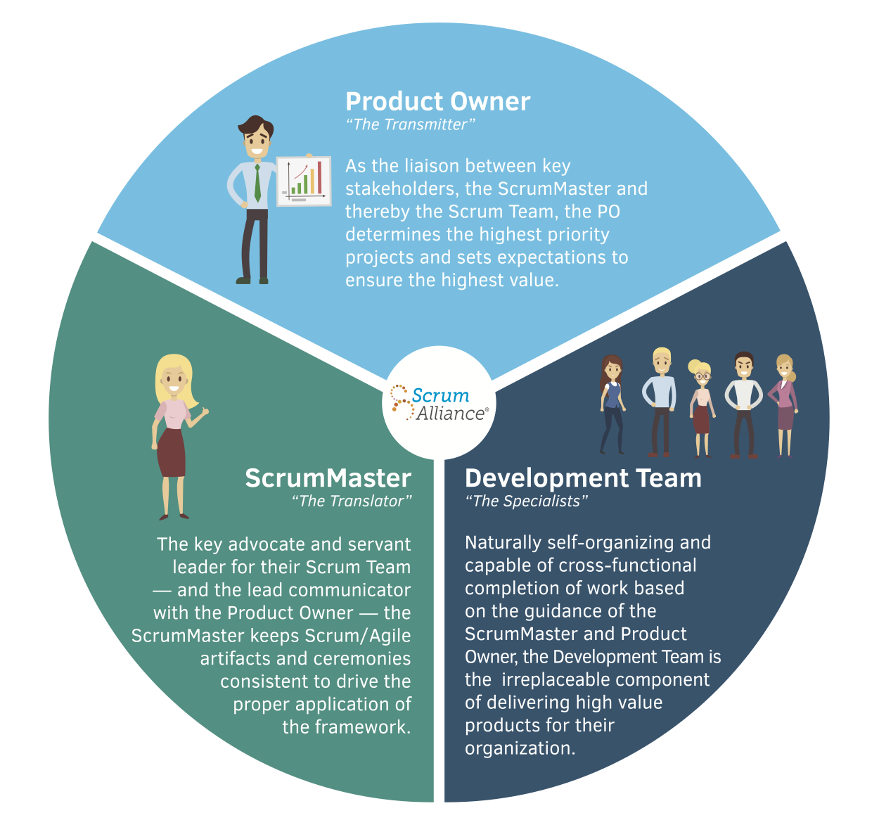
(1)
Notes:
EXPLAIN THE VARIOUS ROLES ON A SCRUM-AGILE TEAM by identifying each role and describing its importance.
Product Owner: The product owner drives what the product will be. This is done by working with the customer, stakeholders, Scrum Master, and Development Team defining and prioritizing the product. The product owner builds, refines, and prioritizes the product backlog from the User Stories constructed from the customer’s product definition.
Scrum Master: The scrum master is the agile method shepherd. Described as a servant/leader the scrum master makes sure the process fits the needs of the team and helps team by removing obstacles to the team to keep the development process moving productively forward. The scrum master also trains the team in the Agile Scrum methods and works to develop the team into a self-sufficient team depending less and less on the scrum master.
Development Team: The development team helps the developer refine the product backlog. Decides what goes into the sprint backlog, participates in the daily stand-ups to report realized and expected daily progress. The developer builds the product, prepares it for potential release each sprint cycle.

Slide 3
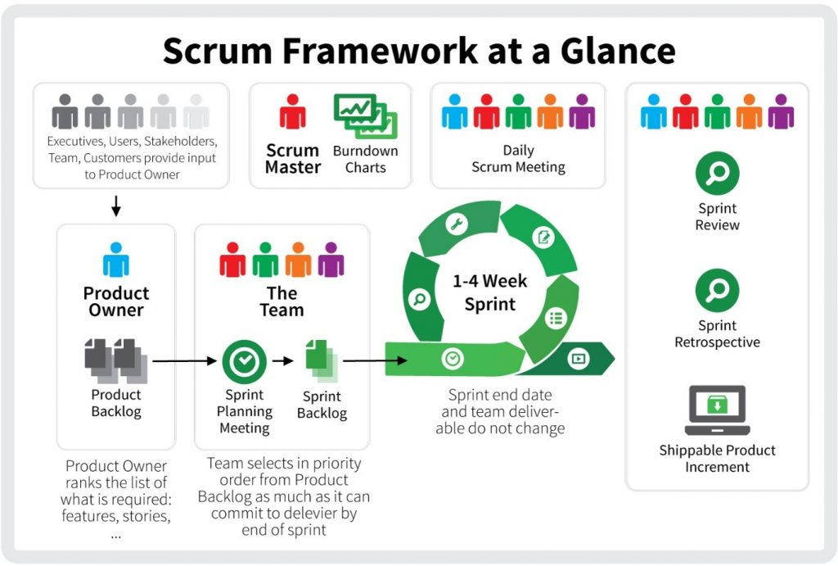
(2)
Notes:
Agile design approach focuses on putting a meaningful product release out as soon as possible. To do this, a short loop cycle is used as an iterative developing process done in quick, short, and repeated loops until the minimal finished product that satisfies the customer is realized. There are actually both continuous and cyclic activities occurring during the project.
Constant Activity:
Product Backlog
The Product Owner is always responsible for the Product Backlog. This is the definition of the product still left to be developed. The Product Owner puts feature requests from the customer on the Product Backlog in the form of User Stories and prioritizes them. The Product Owner also works with team to refine the User Stories breaking them up into smaller tasks until they are refined enough to put into a Sprint Cycle
Cyclic Activity:
Sprint Planning
At the beginning of each sprint cycle there is a Sprint Planning meeting. This meeting is where the team evaluates the items currently on the Product Backlog and commits to completing them in the oncoming Sprint Cycle by putting them on the Sprint Backlog.
Sprint Backlog
This Sprint Backlog contains the tasks committed to be complete by the team during the current Sprint Cycle. This can often be maintained as a Kanban board where the tasks are individual post-it notes and moved from status to another until complete. An example of some status could be {Committed, WIP, Review, Complete}.
Sprint Cycle
A time-boxed period where a committed amount of work is to be done and a potential product release to be made. This is a short period where the work committed to be completed in the Sprint Planning Meeting is done.
Daily Scrum
Short stand-up team meeting held daily to update the team on the daily progress. Each team member updates the team with what they accomplished form the day before, what the will accomplish today, and any obstacles they have.
Sprint Review
Meeting at the end of the Sprint Cycle where the work is reviewed and accepted as complete.
Sprint Retrospective
Meeting after the Sprint Review where the team goes over lessons learned discussing what went wrong and what went right items about the Sprint Process.

Slide 4
WATERFALL METHODOLOGY
Analysis
Requirements
Specification
Design
Implementation
Testing &
Integration
Operation &
Maintenance
Project Timeline
Notes:
Analysis: Requirement Analysis: Typically, when what architecture is decided, how the whole product will look and then set into contract.
Requirements Specification: Project Specification & Brief: Specifications are written describing what the product will be. Product briefs are created describing the product.
Design: Design document & document & Prototype: Product is designed or developed at this stage. The product is “designed” to fulfill the specifications created in the previous stage.
Implementation: Iterations, Demo, & Feedback: The design is given tangible form and demoed. At this point any iterations restart the design cycle.
Testing & Integration: Identify defects & Resolve bugs: Finally tangible product is tested, and integration is confirmed. If the complete product does not pass the the test stage or integrate properly, the process has to go back up the waterfall. This or possibly the previous cycle are the first change the customer would typically see any of the product and as a consequence the first time they could give any meaningful feedback.
Operarion and Maintenance: Product & Technical Support: Product is released to Production/Customer/ etc. and goes into Lifecycle maintenance.

Slide 5
How would the Waterfall Approach have been different?
(3)
Notes:
THE TARGET MOVES!
If SNHU Travel project had followed the traditional waterfall method, customer satisfaction would have suffered. Midway in development, the customer realized they needed to display different information than originally thought. Two things made a difference between the two development methodologies. One, the frequent potential “progress” releases allow the customer to interact with their product as it is being developed allowing them to realize definition shortcomings or changes need sooner and at a lower cost for the change. Two, the short quick design cycles for each potential “progress” releases keep the costs of lower as opposed to the longer release cycle in the traditional waterfall development method.

Slide 6

Agile-Scrum
Waterfall
(4)
Notes:
How well defined or known what the product needs to be.
As the likelihood the intended product will change or evolve decreases the more appealing it is to use the waterfall design approach. The waterfall approach does let you predict your workload and cost burden ahead of time which is an asset to planning, but this comes at a risk and there is an increase in cost to make a change or modification to the end product when compared to using the Agile-Scrum method.
Ability to commit personnel to exclusively to the project.
Not being able to commit personnel to the project inhibits the continuous engagement feature that Agile-Scrum depends on. Priority conflicts would frequently interrupt Sprint cycles and prevent successful progress releases. If the development team members need to work in different projects at a time, then the wider development cycle the waterfall method might be more appropriate.
Size of project being considered.
The project size can force the team to be too large for the Agile Scrum approach to be effective. As the team increases in size the process becomes more difficult to follow and the artifacts are harder to maintain. It is possible that this can be mitigated by breaking a large project up into smaller pieces and assigning the pieces to different teams. The large project would then be developed by a team of teams. This still increases the methodology difficulty but may be manageable enough to not outweigh the benefits of the Agile-Scrum method.

Slide 7
Image References
1) (n.d.). Retrieved from https://www.scrumalliance.org/ScrumRedesignDEVSite/media/Library/Articles/Scrum-Roles.png
2) (n.d.). Retrieved from https://projectresources.cdt.ca.gov/wp-content/uploads/sites/50/2017/08/scrum-framework-at-a-glance-1024x691.jpg
3) (n.d.). Retrieved from http://cl7ipart-library.com/img/1923822.gif
4) http://clipart-library.com/data_images/268992.jpg
Notes:
REFERENCES

