Slide 1

Weekly Status Report #2
Scosoft | Scoto | by Zach

Slide 2

Minimum Viable Product
Demo
First-person player controller
Basic graphics and HUD
Lighting and flashlight effect
Feature placeholder scripts
Launch menu
Level generation
Enemies and pickups
Weapon

Slide 3
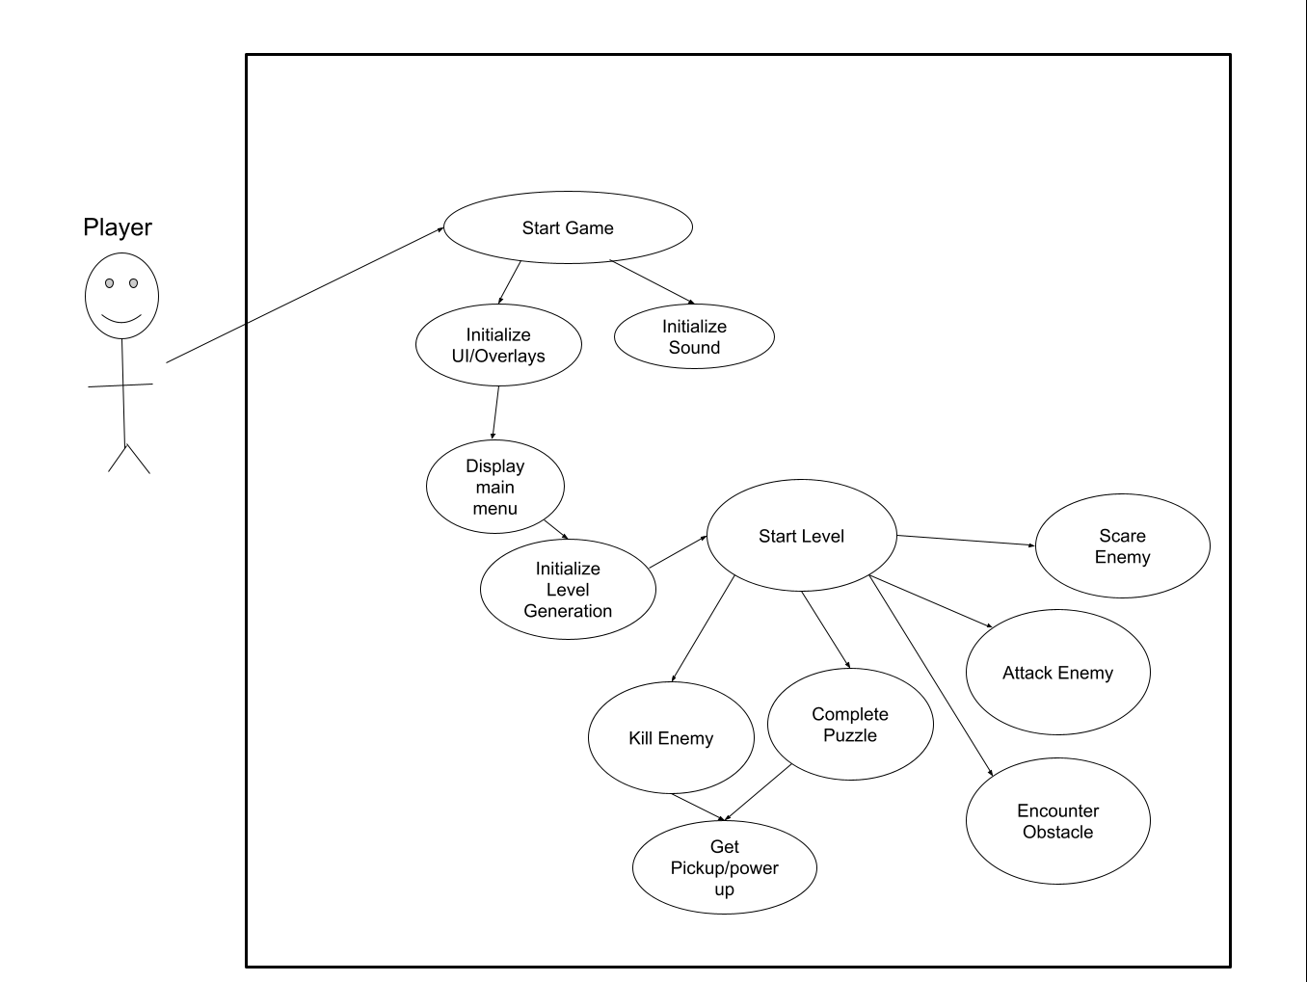

Slide 4
Gantt Chart Progress
Gantt chart
https://docs.google.com/spreadsheets/d/1MngmmV8-a0X1W8UC1jRslRP0WUQywFD5P2dNKDuZbtM/edit#gid=1191123075
Progress
Individual: About 70 hours ($7,000) out of 403 predicted ($40,300)
Meetings: About 49.5 hours ($4,950) out of 60 predicted ($6,000)
SA presentation: About 28 hours ($2,800) out of 26 predicted ($2,600)

