Slide 1
INFSCI 2595 Final Project Interpretation
Jianwei Liu

Slide 2
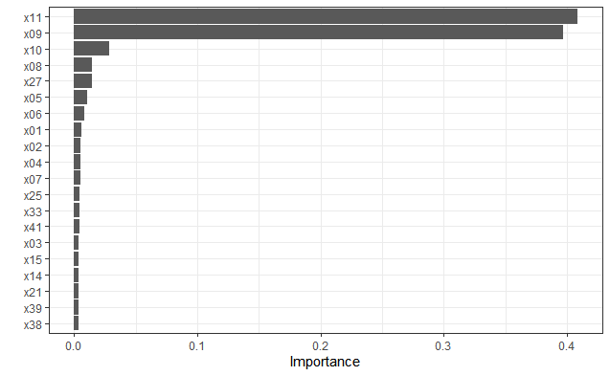
The most important inputs are showed below, starting with regression on x variables:

Slide 3
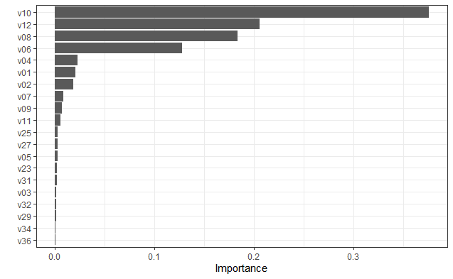
The most important inputs for regression on v variables:

Slide 4
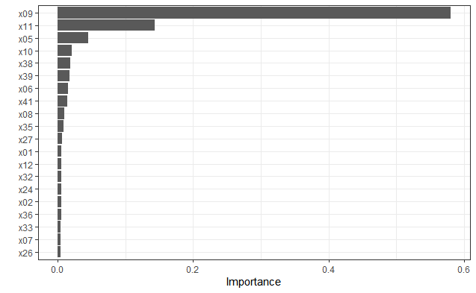
The most important inputs for classification on x variables:

Slide 5
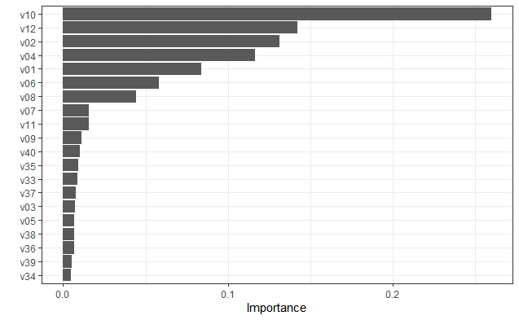
The most important inputs for classification on v variables:

Slide 6
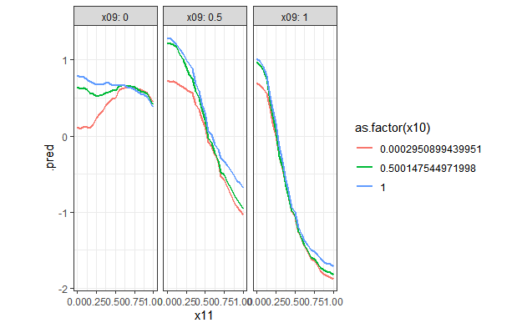
The trends of the continuous response with respect to the most important x inputs are showed below:

Slide 7
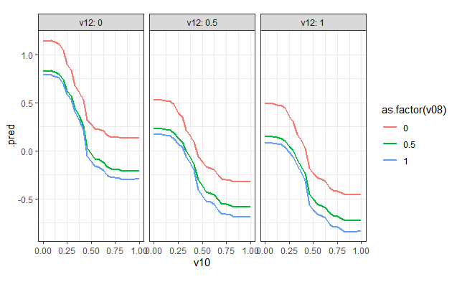
The trends of the continuous response with respect to the most important v inputs are showed below:

Slide 8
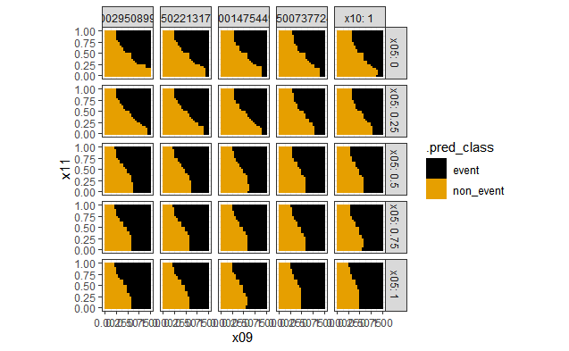
The trends of the event probability with respect to the most important x inputs are showed below:

Slide 9
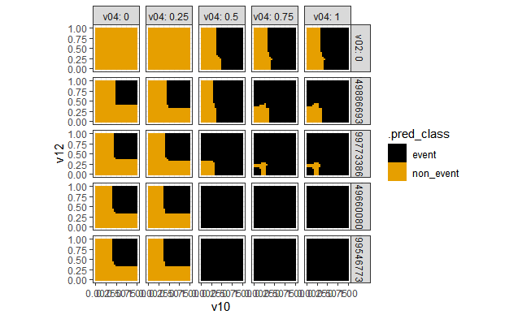
The trends of the event probability with respect to the most important v inputs are showed below:

Slide 10
Recommendation
Comparing the plots of continuous response with respect to the most important inputs, we can see that response changes dramatically with x09 and x11, whereas the v plot has less variation. Also the lowest response for x is around -2, whereas for v it’s around -1. Hence I recommend x09 = 1 and x11 = 1 to minimize the continuous response.
Comparing the plots of event probability with respect to the most important inputs, we can see that event probability changes dramatically with v10, v12, v02 and v04, whereas the x plot has less variation. Also the lowest event probability for v is 0, whereas for x it’s around 1/3. Hence I recommend v02 = 0, v04 = 0 to 0.25, v10 = 0 to 1 and v12 = 0 to1 to minimize the continuous response.

