Slide 1
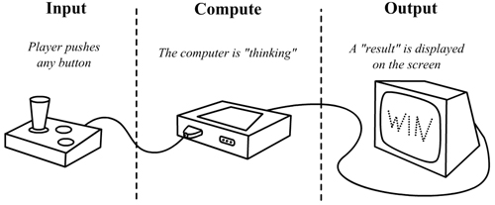
What is a “computer”?

Slide 2
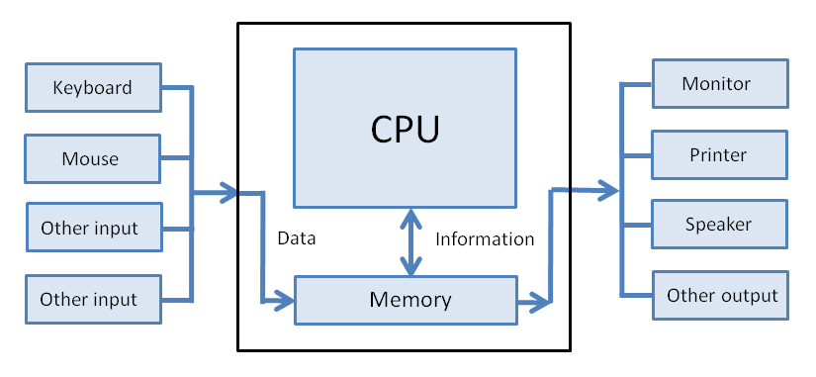

Slide 3
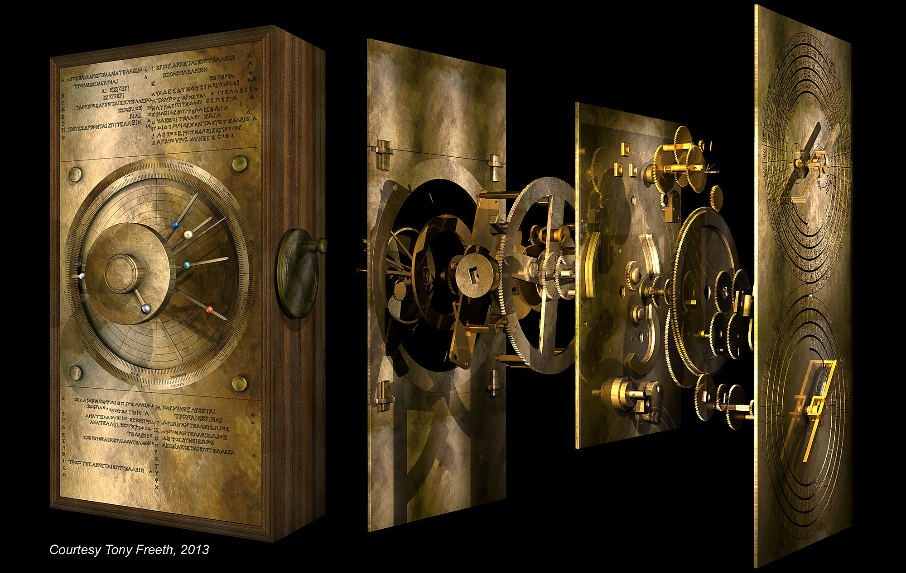
When was the world's first computer built?

Slide 4
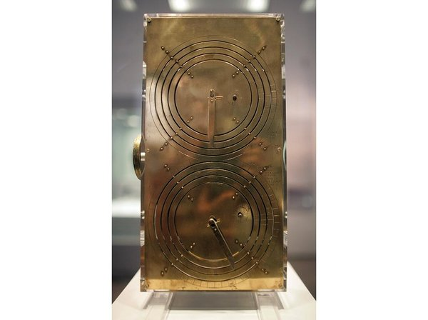
Dial on back tracked eclipses

Slide 5
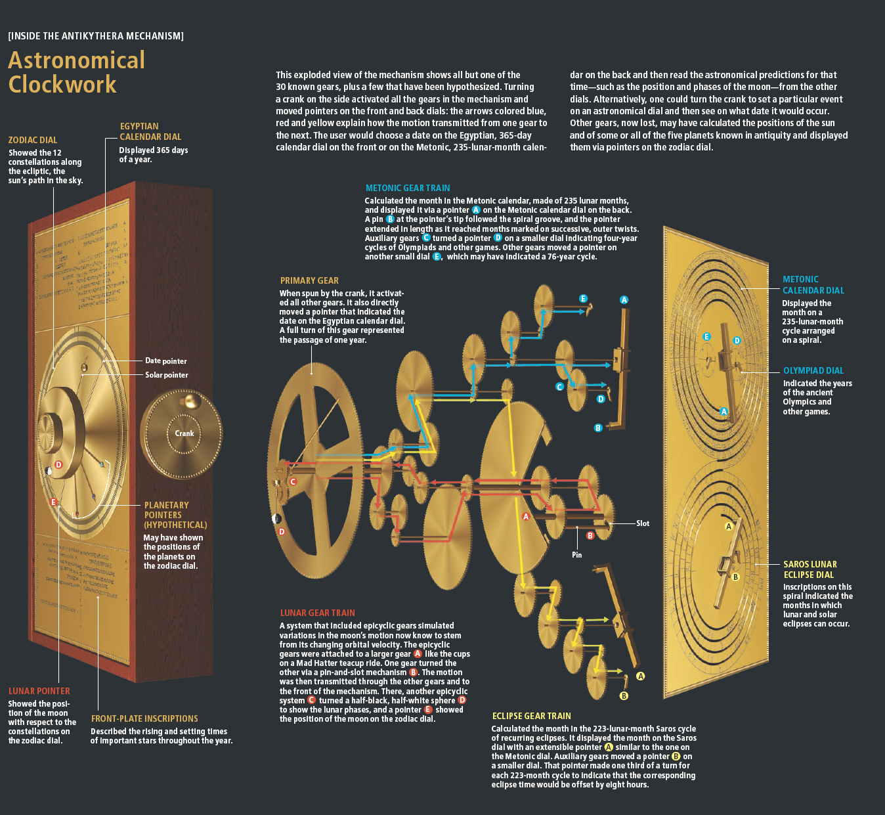

Slide 6
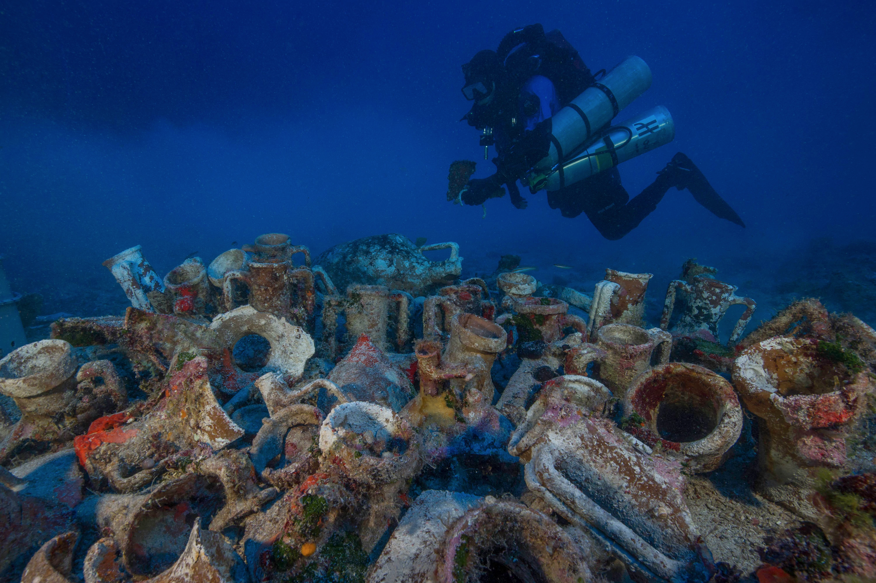
Where was the Antikythera mechanism found?

Slide 7
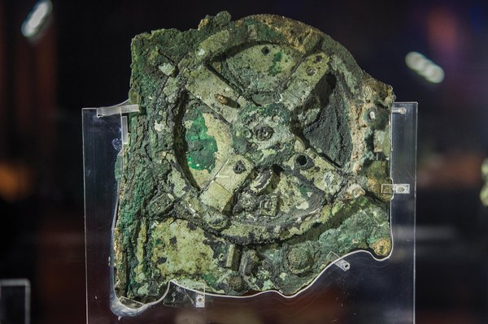
Largest dial rotated once/year

Slide 8
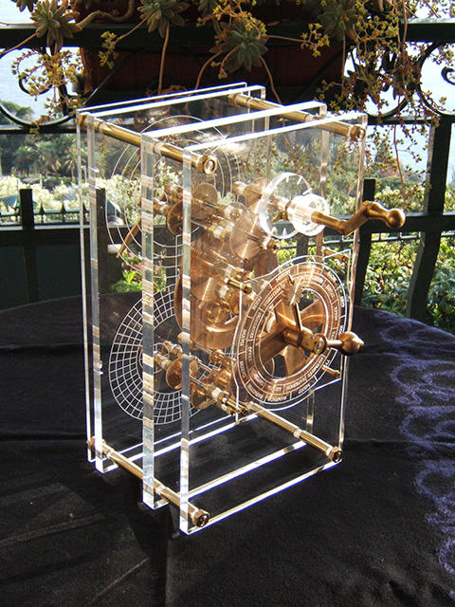
The Antikythera mechanism

Slide 9
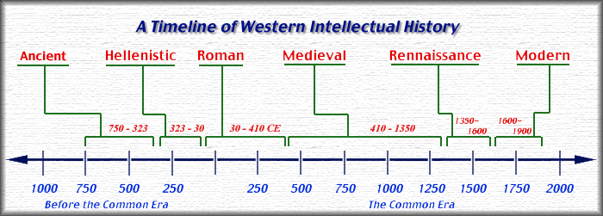

Slide 10
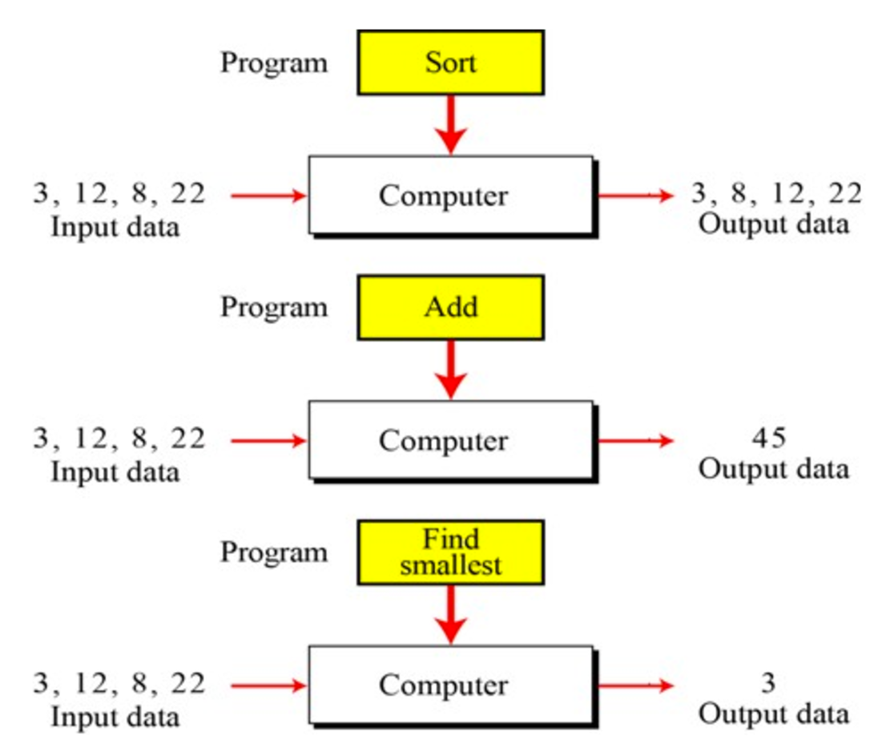
What is “programming”? Was the Antikythera mechanism programmable?

Slide 11
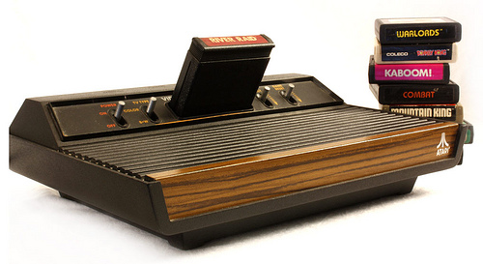
Programs change a computer's behavior

Slide 12
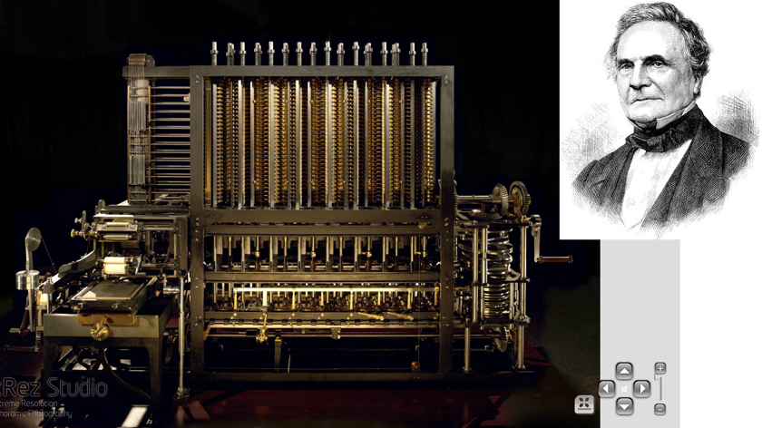
The first programmable computer

Slide 13
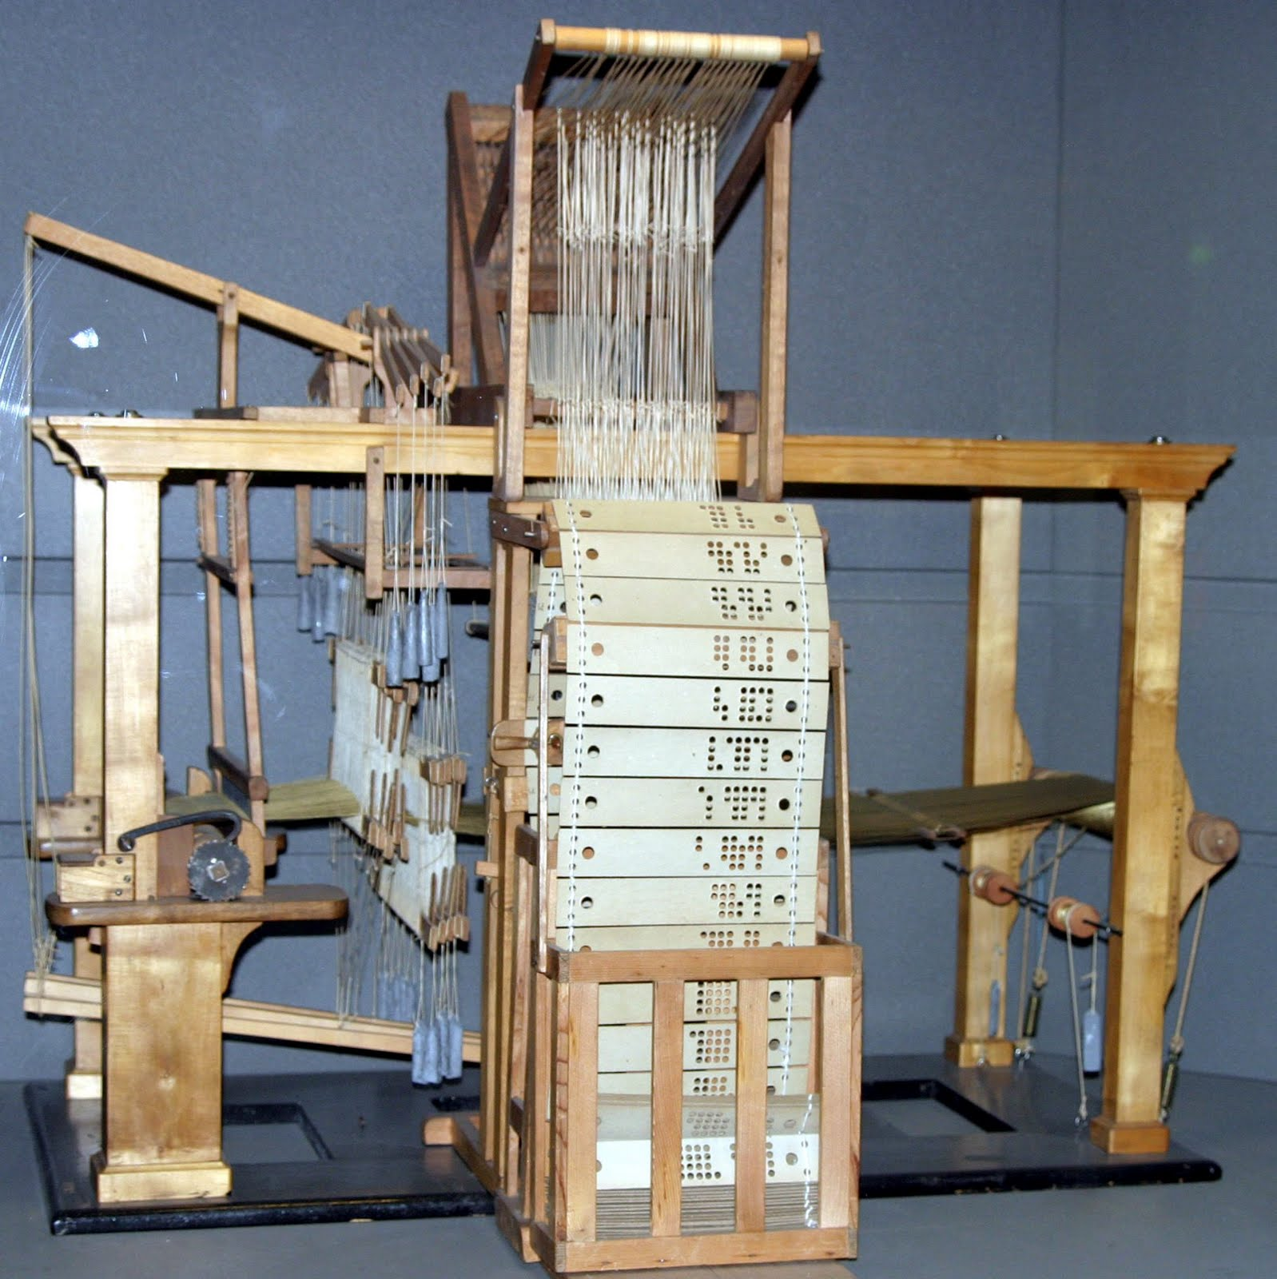
Jacquard's programmable loom

Slide 14
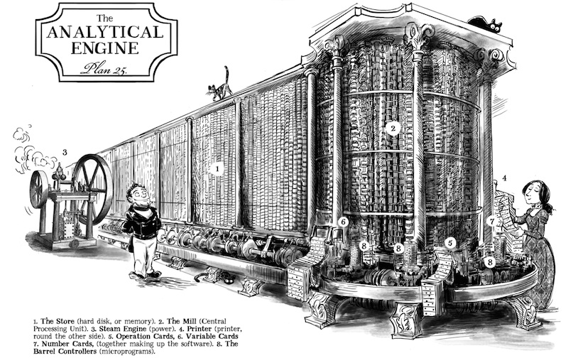
The first general-purpose computer (design)

Slide 15
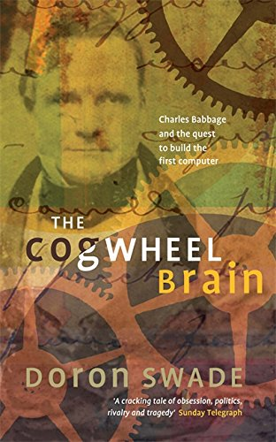
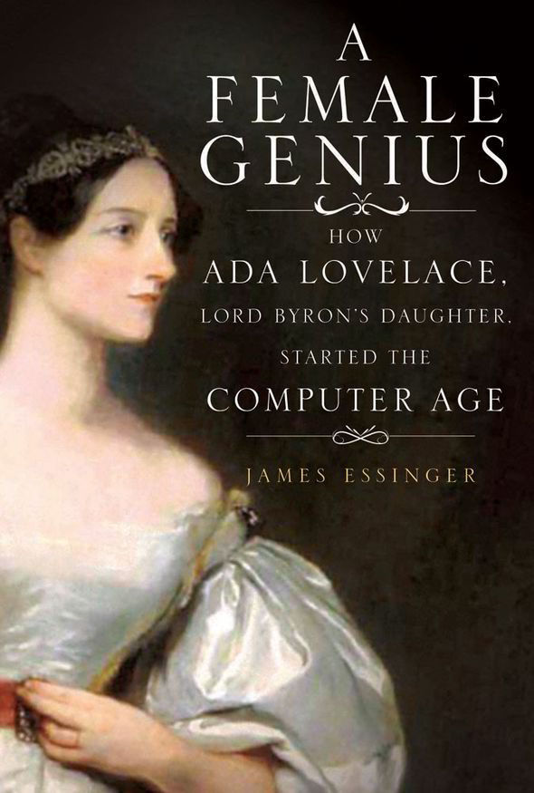
Who were the first programmers?

Slide 16
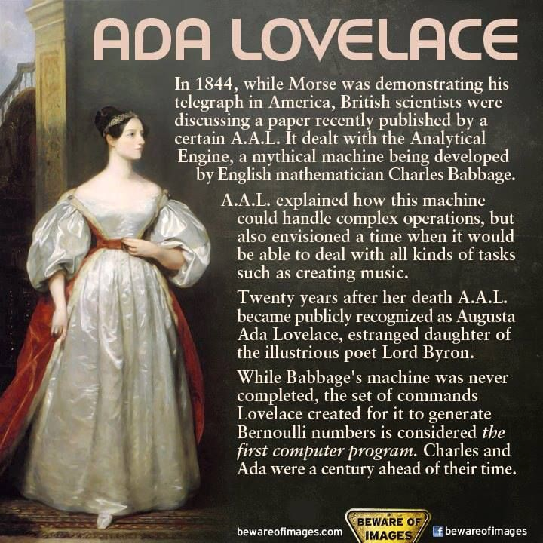

Slide 17
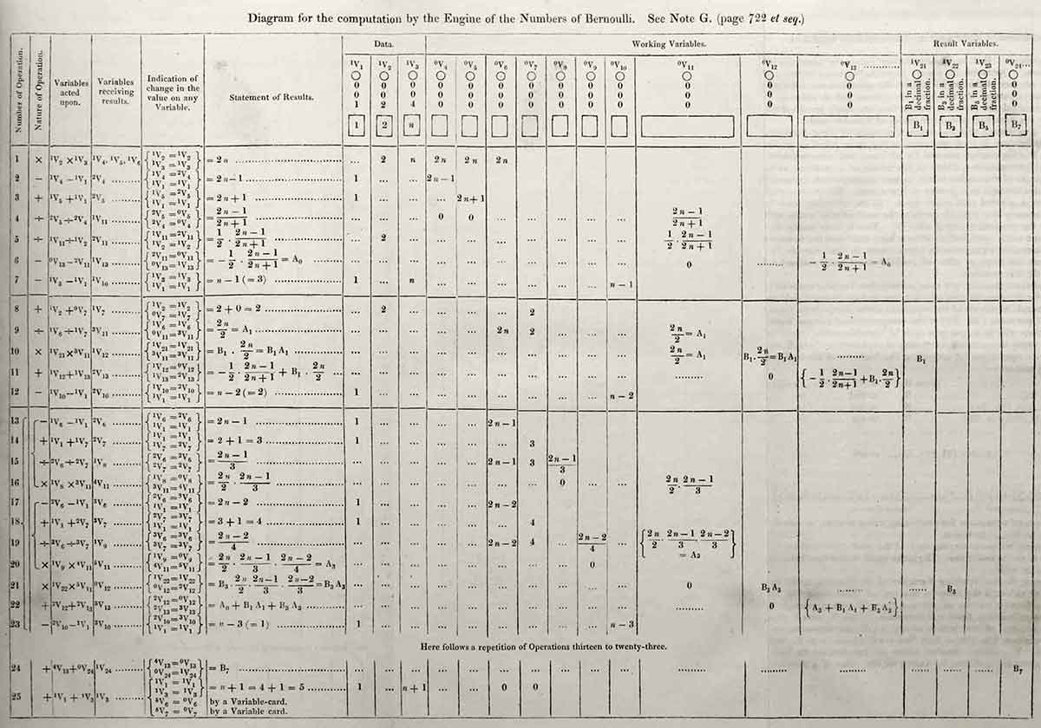

Slide 18
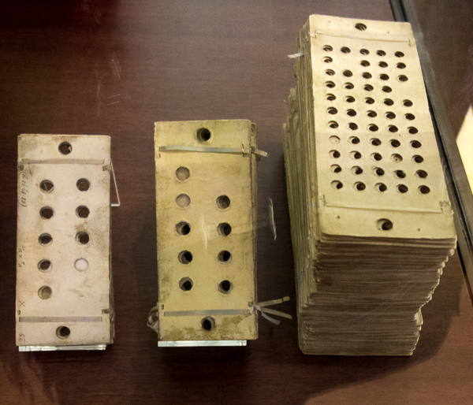
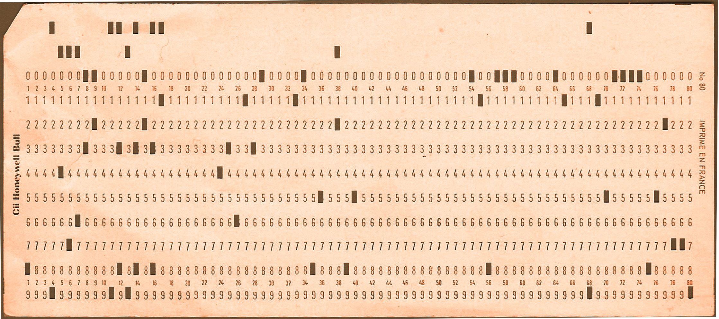

Slide 19
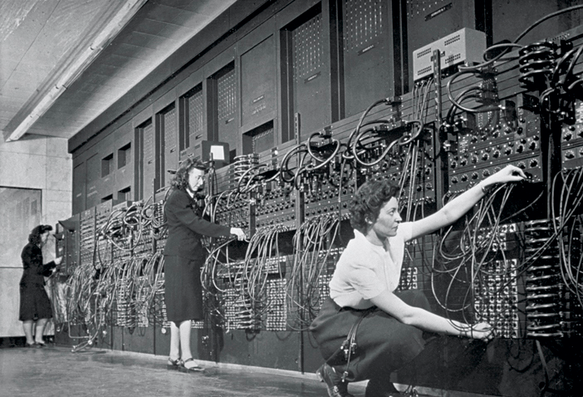
Programming ENIAC in 1946

Slide 20
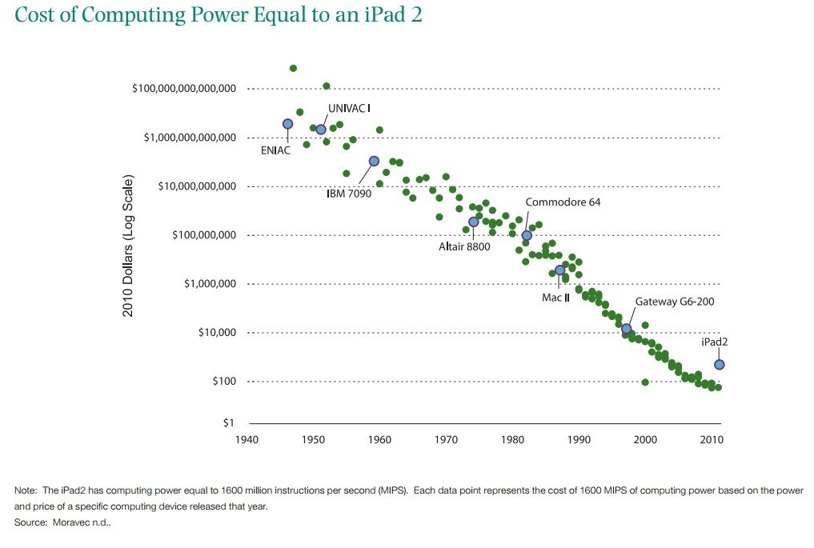

Slide 21
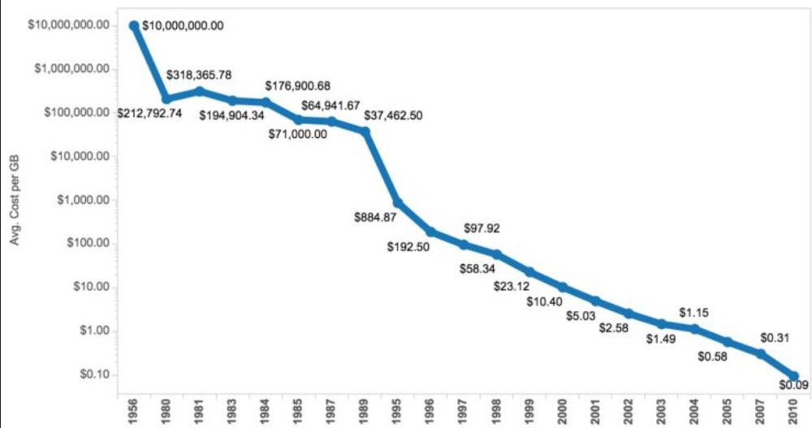
Cost to store 1 gigabyte of data

Slide 22
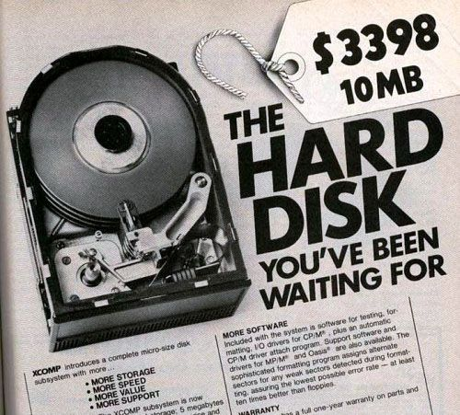

Slide 23
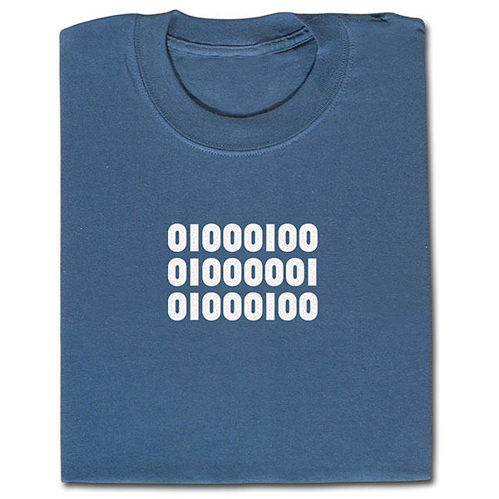

Slide 24
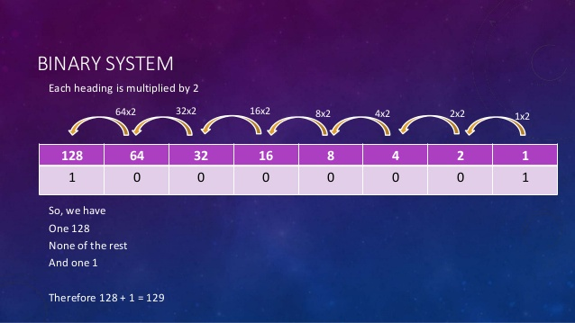

Slide 25
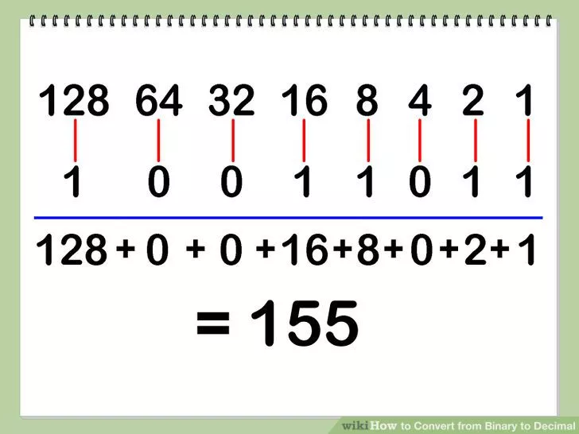

Slide 26
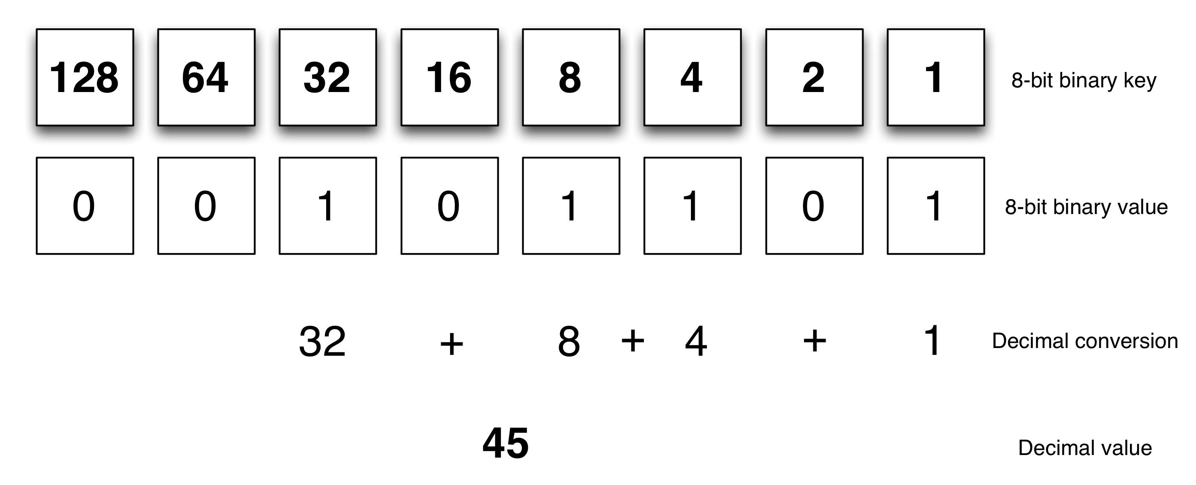

Slide 27
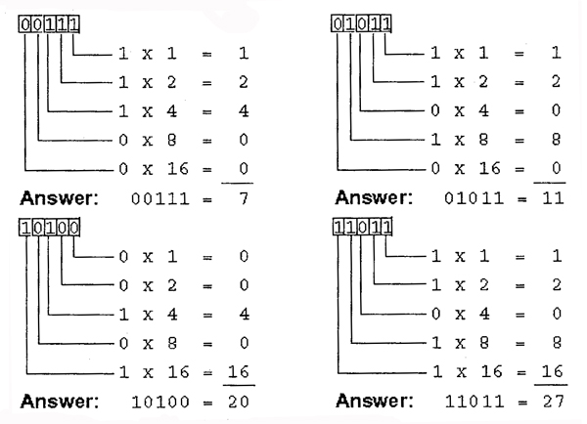

Slide 28
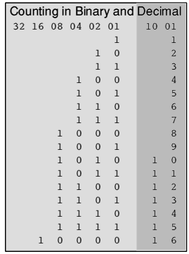

Slide 29
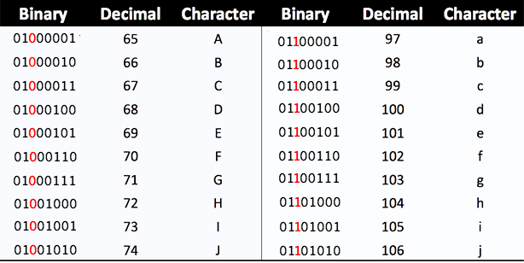

Slide 30
68 => “D”
65 => “A”
68 => “D”

Slide 31
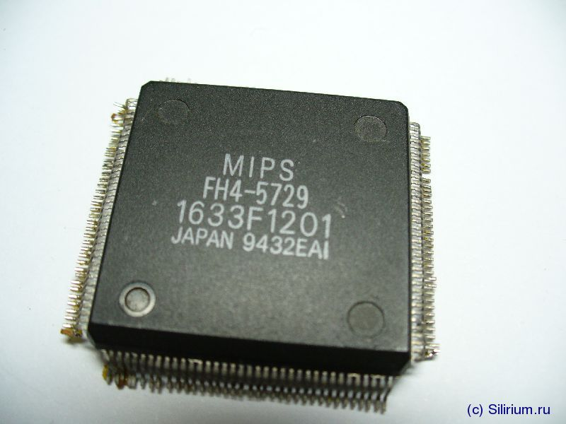

Slide 32
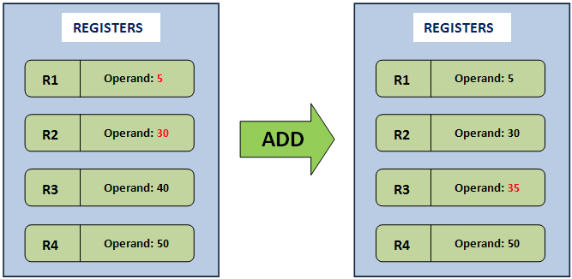

Slide 33
Machine Code (MIPS instruction set)
Add register 1 and register 2 and
place the result in register 3:
[ op | rs | rt | rd |shamt| funct]
0 1 2 3 0 32 decimal
000000 00001 00010 00011 00000 100000 binary
5
30
35

Slide 34
Machine Code (MIPS instruction set)
Get value in memory cell 68 cells after location listed in register 3 and put it in register 8:
[ op | rs | rt | address ]
35 3 8 68 decimal
100011 00011 01000 00000 00001 000100 binary

Slide 35
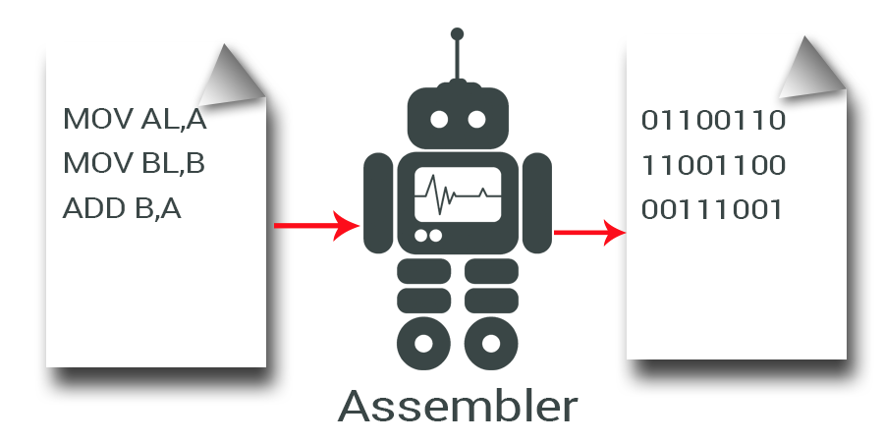

Slide 36
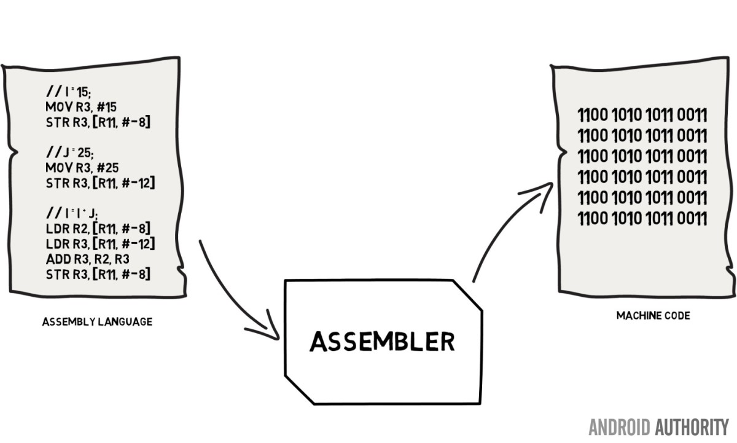

Slide 37
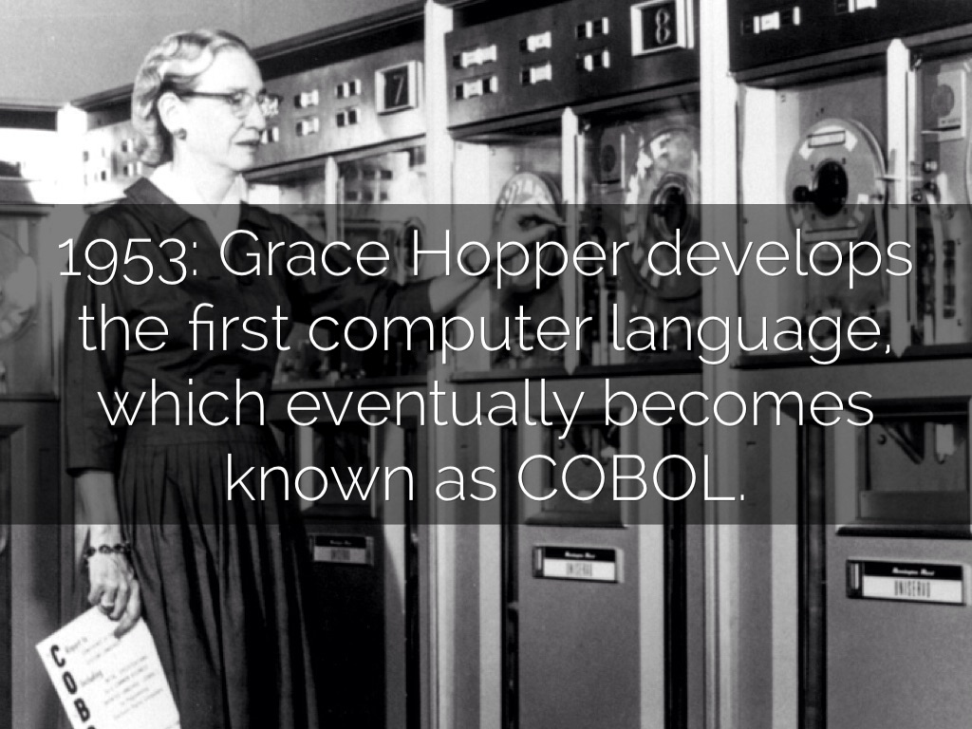

Slide 38
Grace Hopper's FLOW-MATIC (1950s)
(0) INPUT INVENTORY FILE-A PRICE FILE-B ; OUTPUT PRICED-INV FILE-C UNPRICED-INV
FILE-D ; HSP D .
(1) COMPARE PRODUCT-NO (A) WITH PRODUCT-NO (B) ; IF GREATER GO TO OPERATION 10 ;
IF EQUAL GO TO OPERATION 5 ; OTHERWISE GO TO OPERATION 2 .
(2) TRANSFER A TO D .
(3) WRITE-ITEM D .
(4) JUMP TO OPERATION 8 .
(5) TRANSFER A TO C .
(6) MOVE UNIT-PRICE (B) TO UNIT-PRICE (C) .
(7) WRITE-ITEM C .
(8) READ-ITEM A ; IF END OF DATA GO TO OPERATION 14 .
(9) JUMP TO OPERATION 1 .
(10) READ-ITEM B ; IF END OF DATA GO TO OPERATION 12 .
(11) JUMP TO OPERATION 1 .
(12) SET OPERATION 9 TO GO TO OPERATION 2 .
(13) JUMP TO OPERATION 2 .
(14) TEST PRODUCT-NO (B) AGAINST ZZZZZZZZZZZZ ; IF EQUAL GO TO OPERATION 16 ;
OTHERWISE GO TO OPERATION 15 .
(15) REWIND B .
(16) CLOSE-OUT FILES C ; D .
(17) STOP . (END)

Slide 39
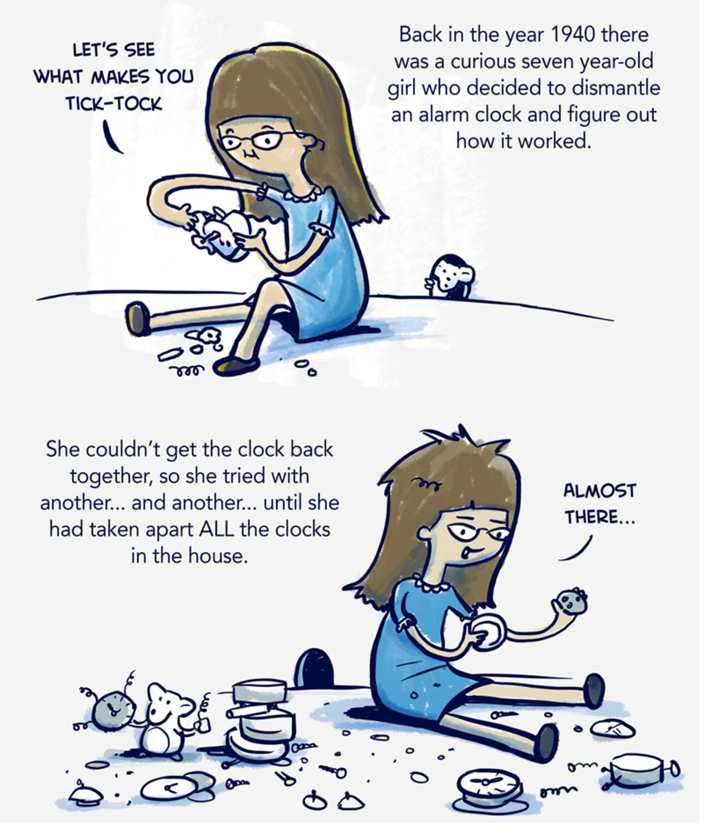
1914

Slide 40
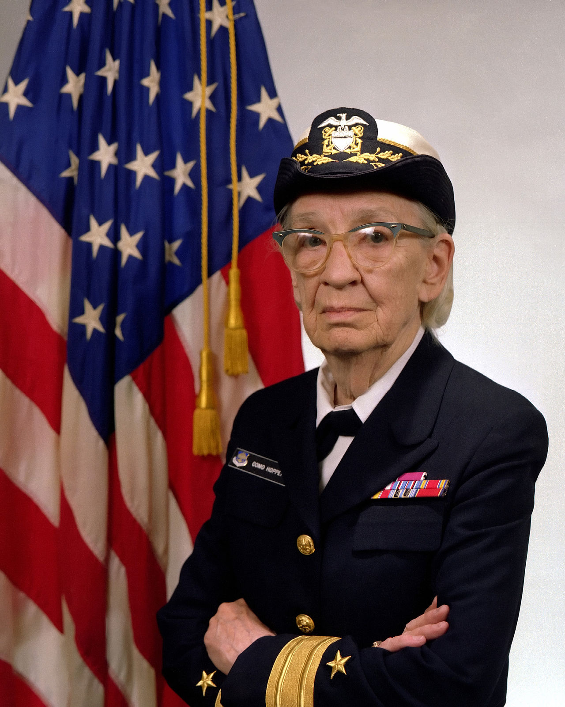
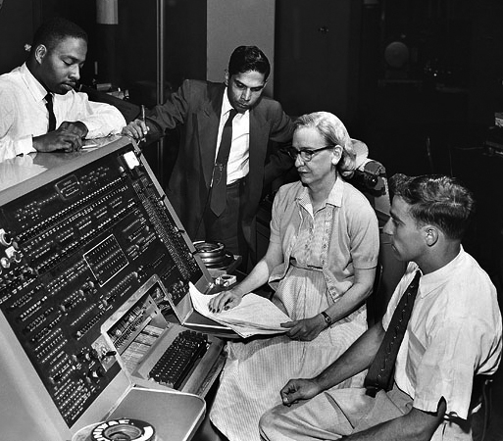
US Navy Admiral Grace Hopper

Slide 41
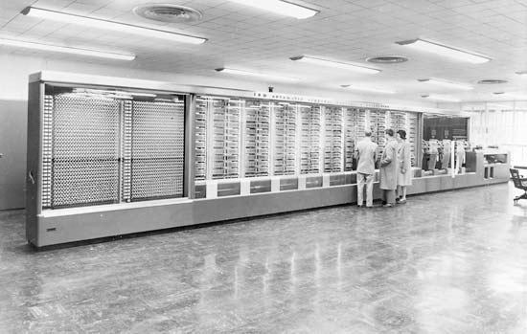
Hopper's first computer:
The Mark I (at Harvard University)

Slide 42
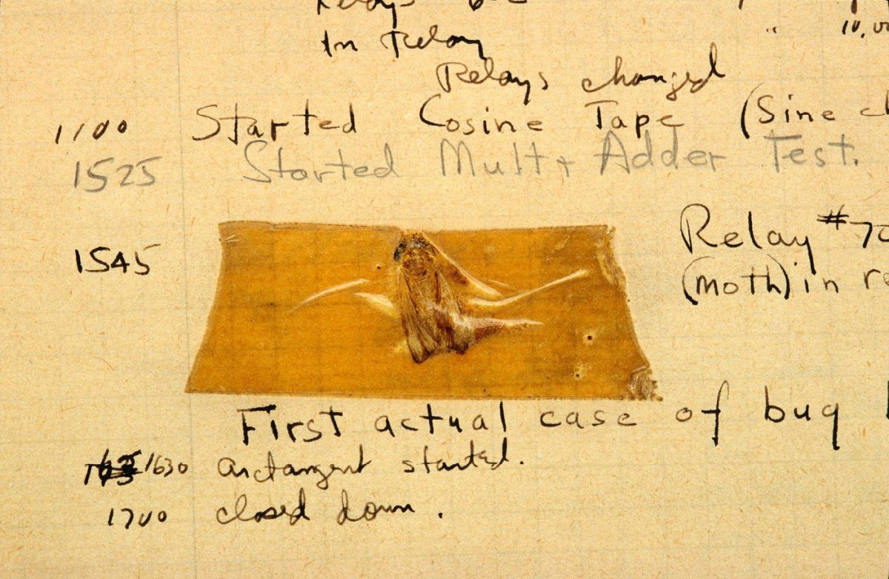

Slide 43
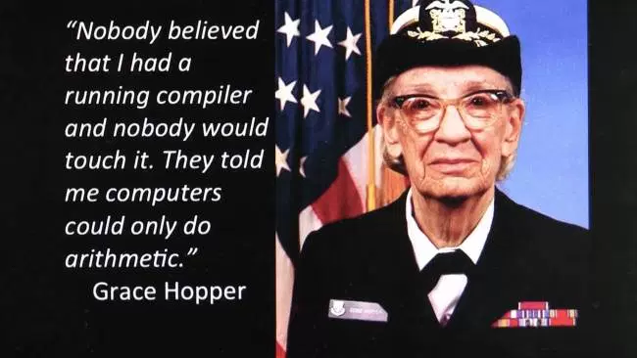

Slide 44
Pursuing her belief that computer programs could be written in English, Admiral Hopper developed the B-O compiler. It was designed to translate a language that could be used for typical business tasks into machine code. Admiral Hopper and her staff were able to make the UNIVAC I and II “understand” twenty statements in English.
When she recommended that an entire programming language be developed using English words, however, she “was told very quickly that [she] couldn't do this because computers didn't understand English.” It was three years before her idea was finally accepted; she published her first compiler paper in 1952.

Slide 45
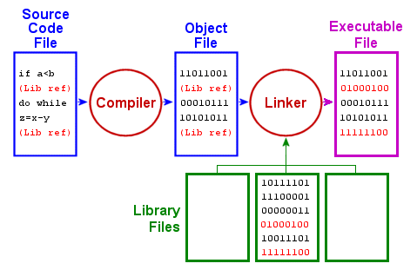

Slide 46
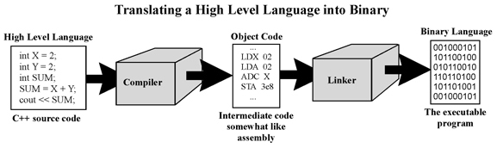

Slide 47
How Many Programming
Languages Exist?
L++, L.in.oleum, LabVIEW, Lambda Prolog, Lang5,
Lasso, LaTeX, LC2200 Assembly, LC3 Assembly,
Leon, LFE, Lhogho, Liberty BASIC, LibreOffice Basic,
Lily, Lilypond, Limbo, Lingo, Lisaac, Lisp, LiveCode,
LiveScript, LLP, LLVM, Lobster, Locomotive Basic, Loglan82, Logo, Logtalk, LOLCODE, Lolli,
Lotus 123 Macro Scripting, LotusScript,
Lout, LSE64, LSL, Lua, Lucid, Luck, Lush, Lygon

Slide 48
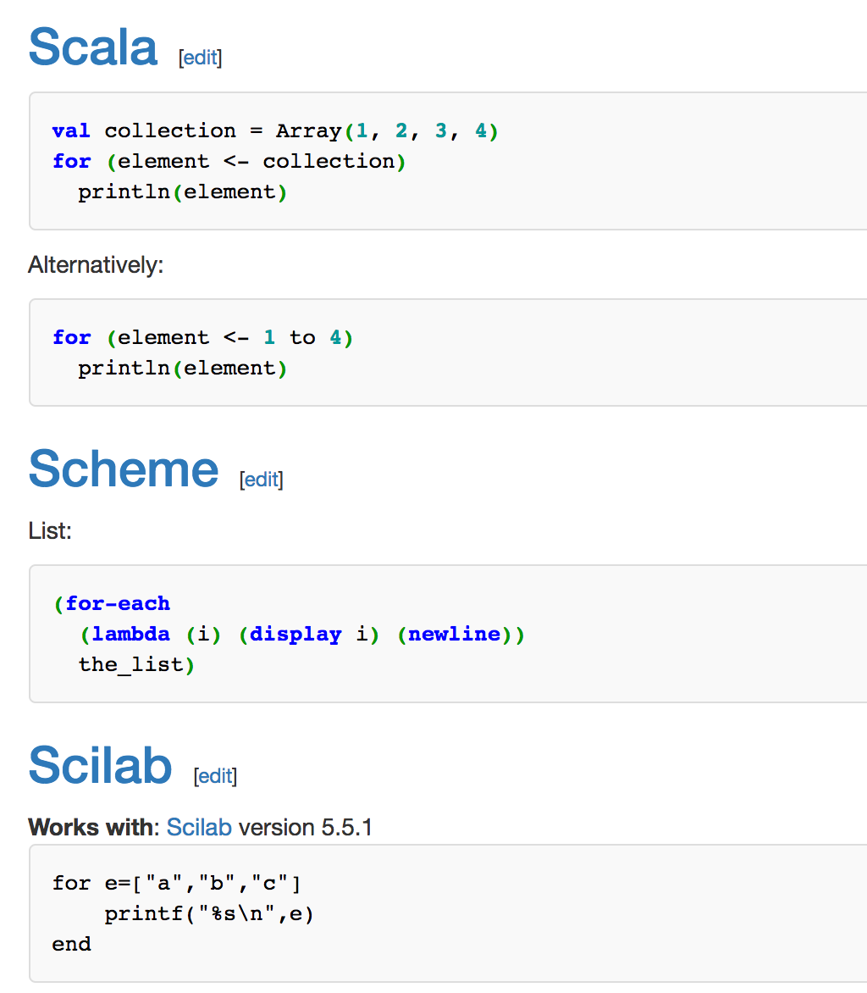
RosettaCode.org

Slide 49
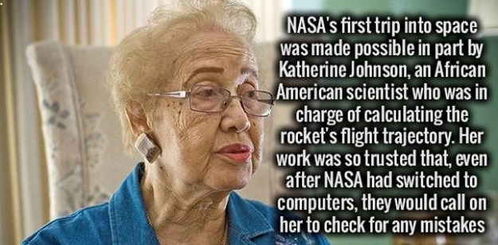

Slide 50
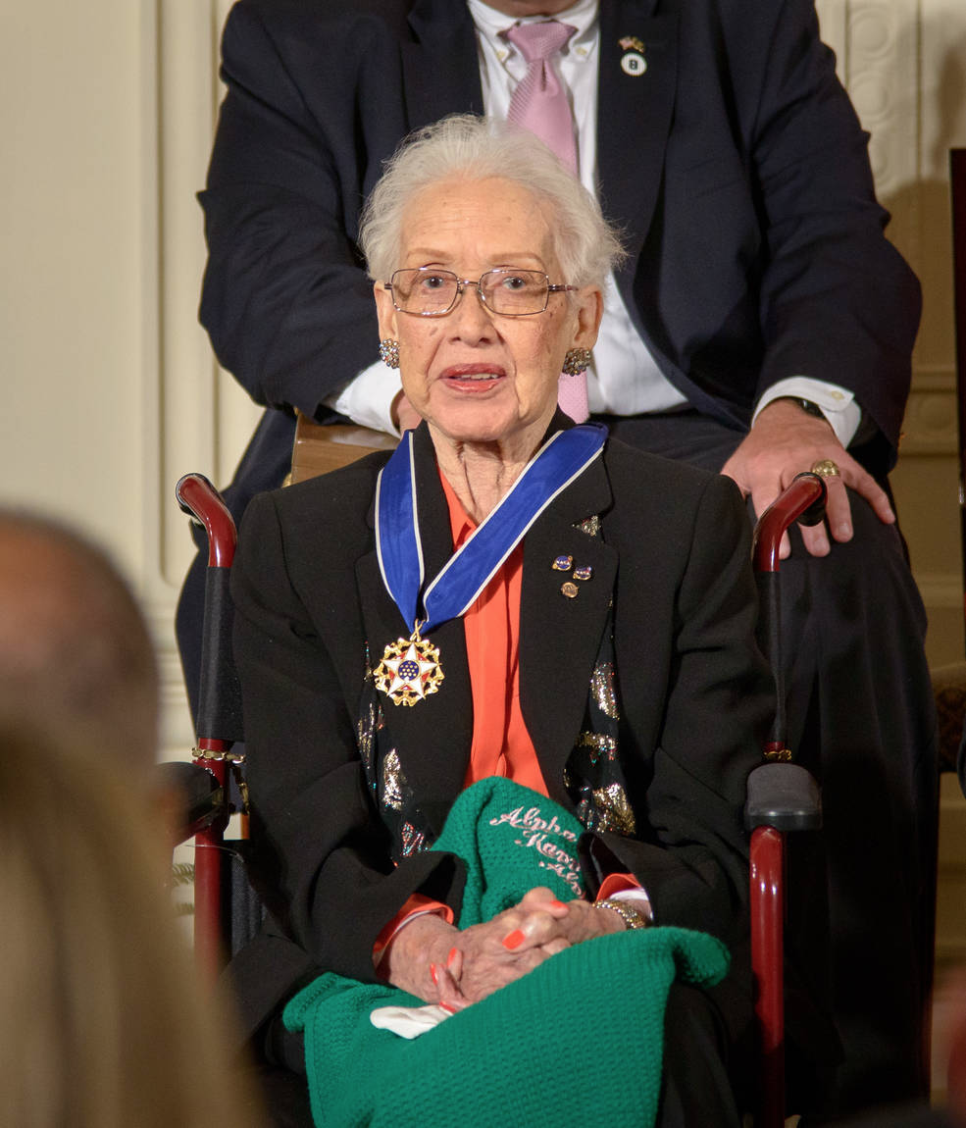
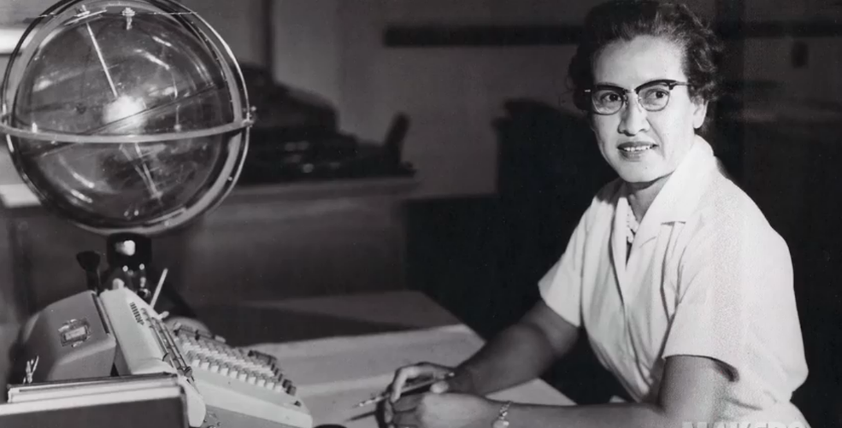

Slide 51
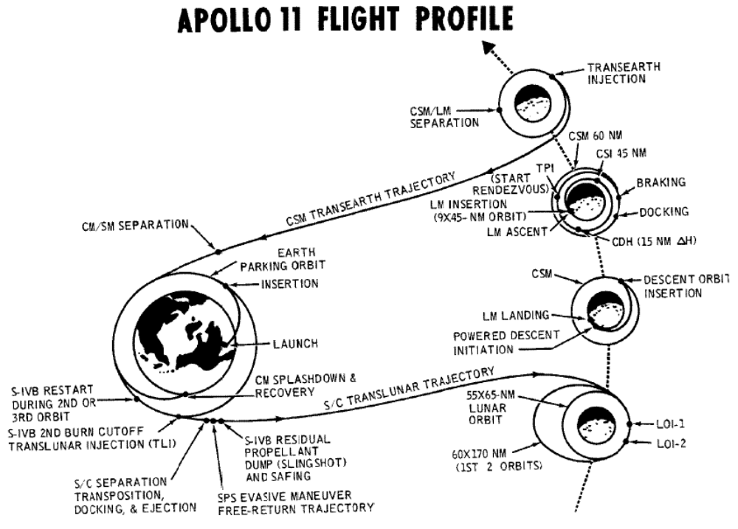

Slide 52


Slide 53
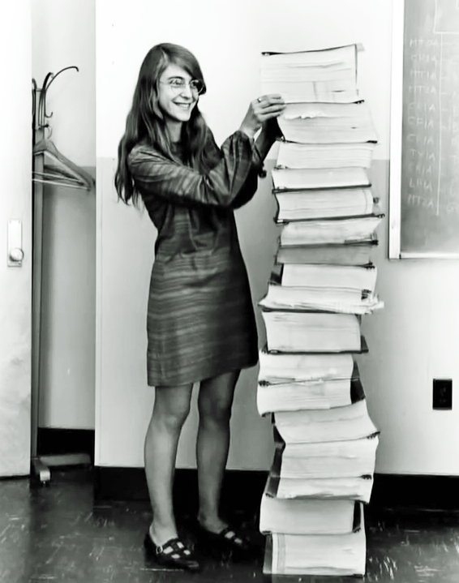

Software engineering & testing: “There was no second chance”

Slide 54



Deep Blue (1997)

Slide 55

Watson & Jeopardy!

Slide 56


Slide 57

Watson & Jeopardy

Slide 58
Watson: Heart Disease
“Watson has identified cases of heart disease previously undiagnosed by human inspection of ultrasonic imaging, clinical tests and case notes.
...Watson was able to automatically spot 25% more heart disease.”

Slide 59

Watson: Cancer

Slide 60

Watson: Cancer

Slide 61

Self-Driving Cars & Trucks

Slide 62


Translation

Slide 63


Slide 64

Computers now recognize images as accurately as humans do (& are still improving)

Slide 65

Computers can even describe photos

Slide 66


Slide 67


Slide 69


Slide 70


Slide 71


Slide 72

Turing Test

Slide 73


