Slide 1
Agricultural Futures Final Project
Systematic corn-futures trading with technical strategy diversification and crop-health regime overlays from NASA vegetation data
Robo Advisors and Systematic Trading
James Lawrence

Slide 2




Project Question
Motivation and hypothesis
Goal: maximize risk-adjusted performance trading agricultural futures.
Primary market: corn futures, with wheat futures used for a relative-value pairs sleeve.
Core question: can crop-health information improve a diversified systematic strategy portfolio?
Method:
Build raw technical sleeves first, then test whether realistic weather-forecast skill adds value.
Leverage modern toolset for rapid development

Slide 3

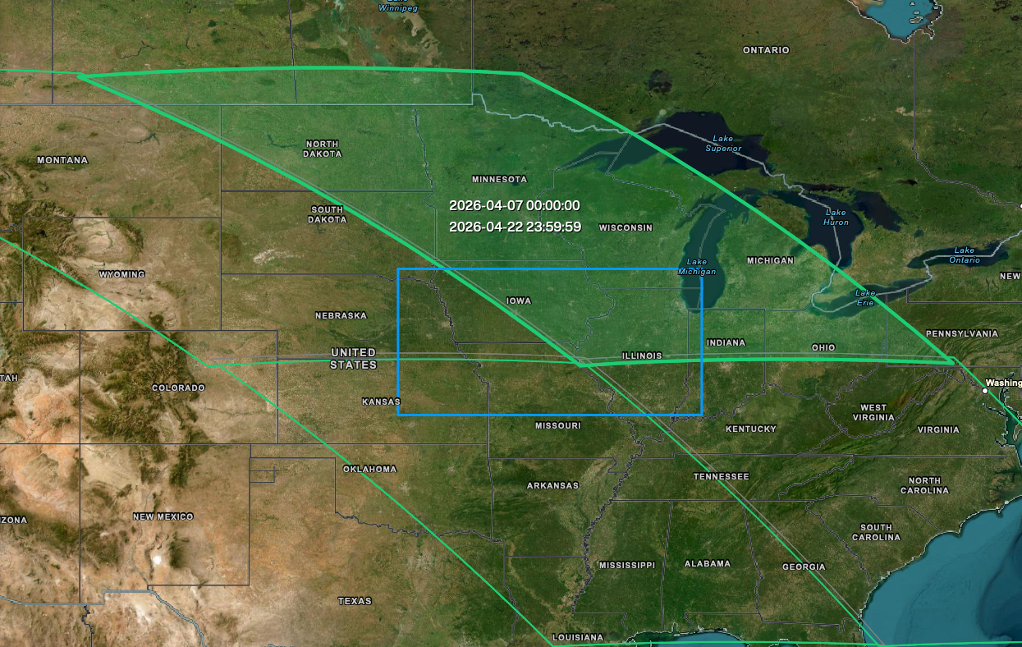
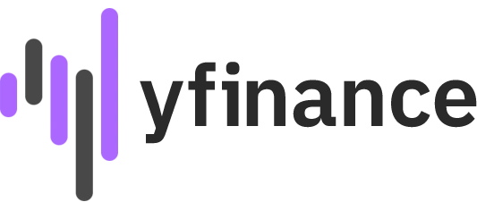
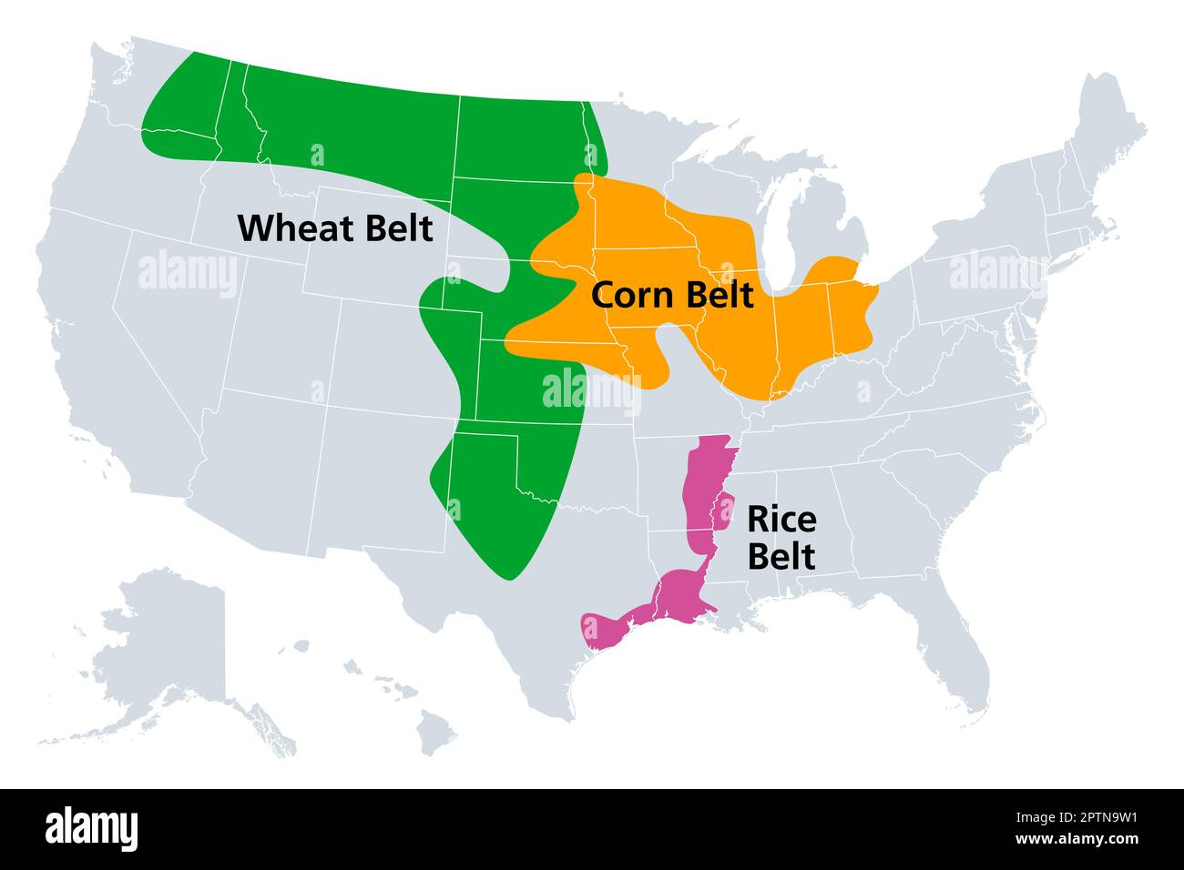
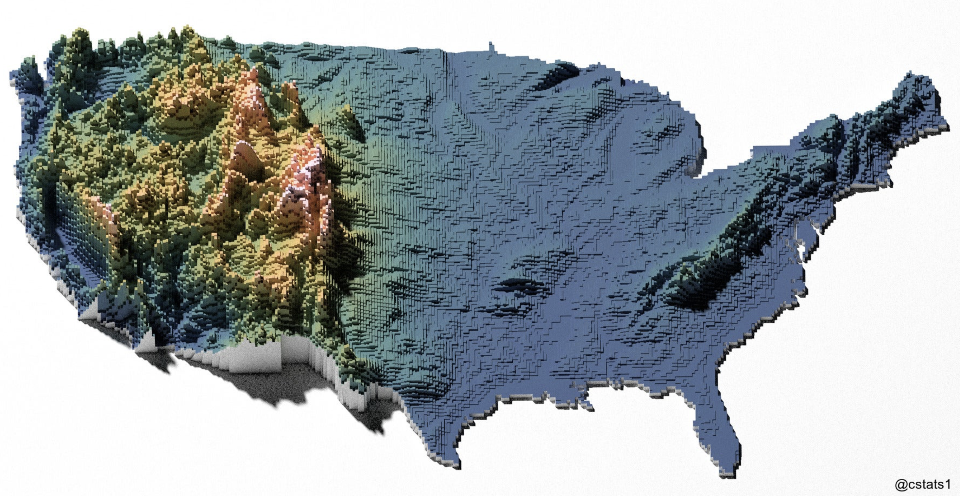
Agricultural Data
Quick look at the data sources and considerations made

Slide 4
Data And Workflow
Prepared caches used by the final notebook
Dataset | Rows | Start | End
Corn futures | 6,452 | 2000-07-17 | 2026-04-30
Wheat futures | 6,464 | 2000-07-17 | 2026-04-30
NDVI daily panel | 9,546 | 2000-02-18 | 2026-04-07
Corn + NDVI overlap | 6,435 | 2000-07-17 | 2026-04-07
Optimization sample | 6,159 | 2001-10-02 | 2026-04-07
The optimization sample is the common NDVI-overlap window where NDVI, futures data, and all raw strategy return series are simultaneously available.

Slide 5
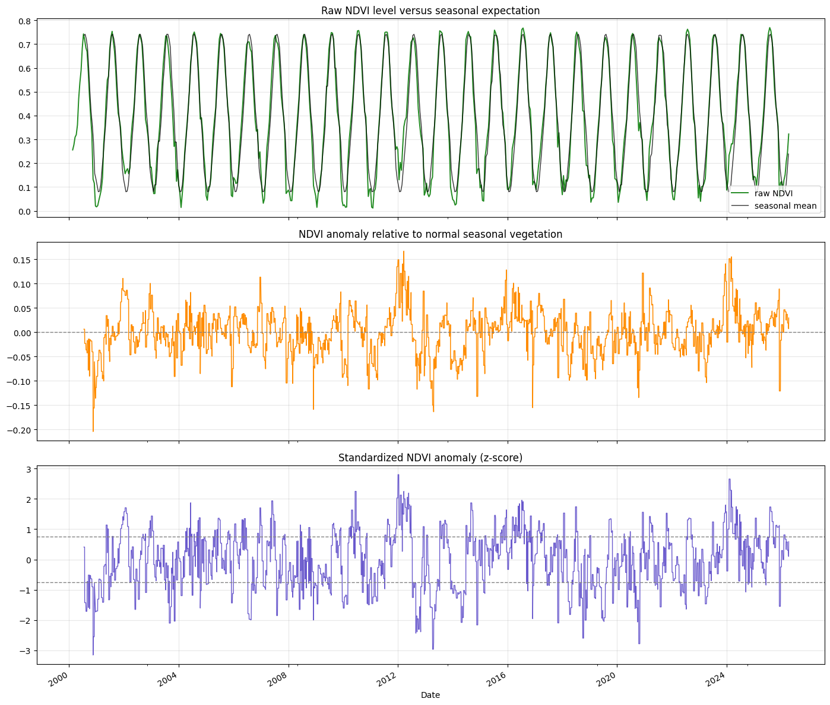
NASA Signal Engineering
Why the project moved from raw NDVI level to seasonal anomaly
Raw NDVI level is too seasonal to trade directly.
Each 16-day MODIS composite is reduced to a regional mean and forward-filled to a daily index for alignment.
The final signal is a seasonally adjusted anomaly: current NDVI relative to its historical norm for the same point in the crop calendar.
Only April through October are treated as active crop-health months.

Slide 6
Strategy Universe
Raw strategies first, weather overlay second
Trend sleeves: moving-average 10/30, 30/100, and 80/160.
Counter-trend sleeve: buy-the-dip rule based on prior highs and average range.
Volatility sleeve: switch exposure according to the current volatility regime in corn futures.
Pairs sleeves: 5-day, 10-day, and 20-day corn-wheat relative-value trades.
Weather overlay: basic 14-day, advanced 45-day, and expert 90-day crop-health lead windows.

Slide 7
Key Standalone Results
Standalone raw strategy sleeves on the common optimization sample
Sleeve | Sharpe | Cum. Return | Vol | Max DD
vol_regime | 0.4671 | 9.6234 | 0.3112 | -0.5660
ma_10_30 | 0.3698 | 4.0804 | 0.3112 | -0.4664
ma_80_160 | 0.1728 | 0.1339 | 0.3113 | -0.8763
pairs_10d | 0.0849 | 0.0737 | 0.1226 | -0.4013
countertrend_p2_2 | -0.0183 | -0.4390 | 0.1999 | -0.7339
ma_30_100 | -0.0985 | -0.8563 | 0.3113 | -0.9389
Corn-wheat spread diagnostics were supportive of a pairs test: ADF statistic = -3.9752, p-value = 0.0015.

Slide 8
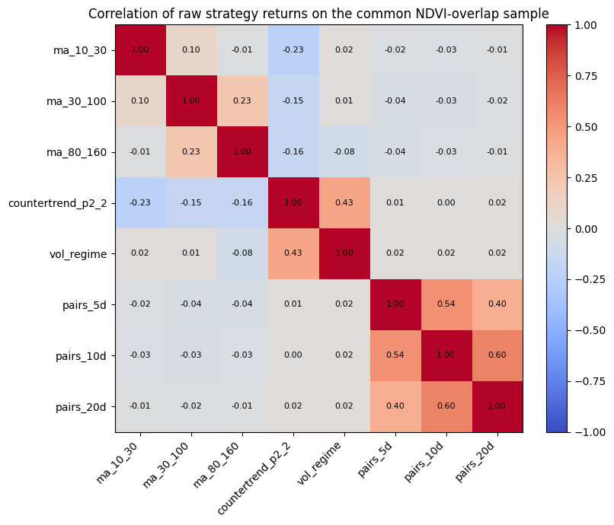
Why Combine Strategies?
Diversification evidence from the raw return streams
This chart is a correlation matrix of daily raw strategy returns on the common evaluation window.
Low or mildly negative correlation means two sleeves can diversify each other.
The pairs sleeve is largely separate from the outright corn sleeves, which makes it useful at the portfolio level.
This is why the project optimizes combinations of strategies instead of picking one winner.

Slide 9
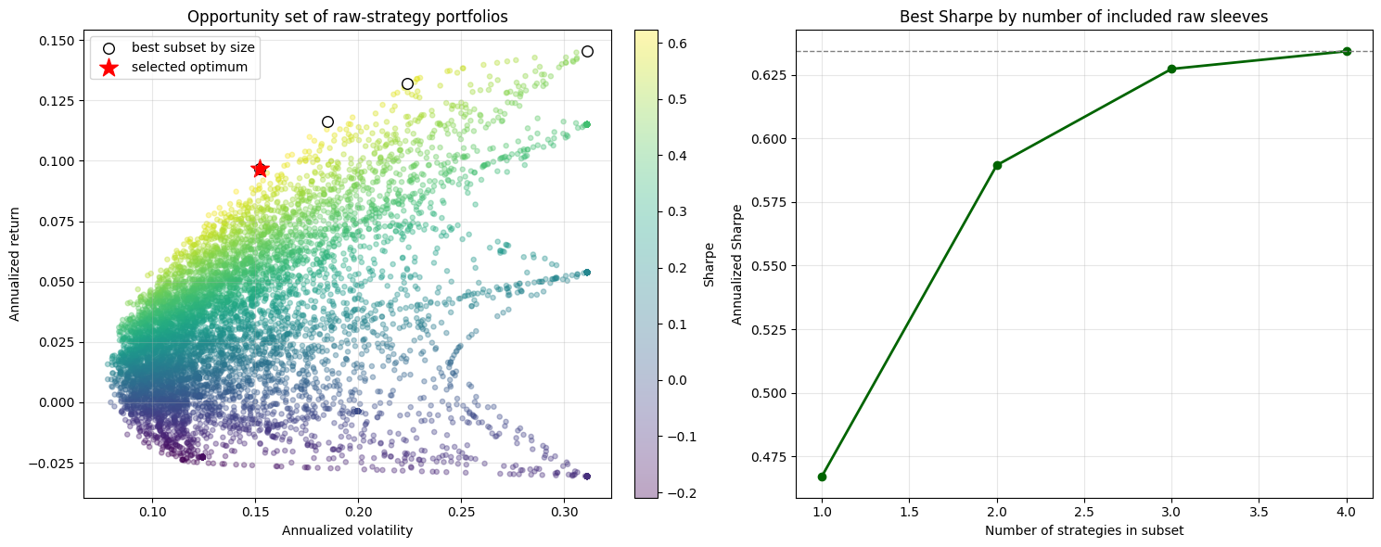
Optimized Raw Combination
Efficient-frontier style search over raw strategy subsets
The optimizer searched all non-empty subsets of the raw strategy universe and selected long-only weights that maximized annualized Sharpe.
Selected sleeves:
vol_regime: 36.71%
ma_10_30: 28.09%
pairs_10d: 18.37%
ma_80_160: 16.83%
Result:
Sharpe 0.6343
cumulative return 6.9749
max drawdown -0.3605.
This outperformed the best raw standalone sleeve (vol_regime at 0.4671 Sharpe).

Slide 10
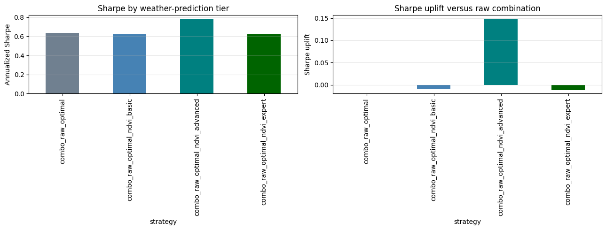
Weather Overlay On The Final Portfolio
Sharpe uplift after applying weather-prediction tiers
The raw portfolio weights were held fixed.
Then the three crop-health forecast tiers were applied as regime overlays.
This isolates the value of weather-model skill from the value of raw strategy diversification.
Only the advanced(45d) lead materially improved the final portfolio.
combo_raw_optimal: Sharpe 0.6343
basic: 0.6245 | uplift -0.0098
advanced: 0.7829 | uplift +0.1486
expert: 0.6225 | uplift -0.0118

Slide 11
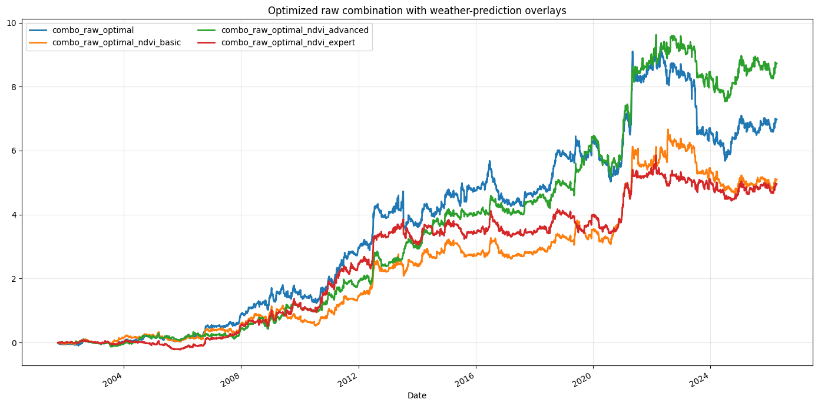
Final Interpretation
What the project suggests about real-world crop-futures trading
A diversified systematic portfolio was the main source of performance improvement.
NASA vegetation data only became useful after seasonal adjustment and crop-calendar filtering.
The best result came from medium-horizon crop-health foresight, not from very short or very long leads.
Economic reading: sub-seasonal weather-model skill appears more actionable than either near-term weather or very long-range seasonal guessing.

Slide 12
Limitations And Next Steps
Academic interpretation and realistic extensions
The NDVI lead tests are oracle-style benchmarks, not directly tradable forecasts.
Transaction costs, slippage, and margin constraints are not modeled.
The project uses NDVI only; soil moisture, temperature, and precipitation could extend the framework.
Future work: replace oracle NDVI leads with explicit weather-model features and test true out-of-sample forecasting.

