Slide 1
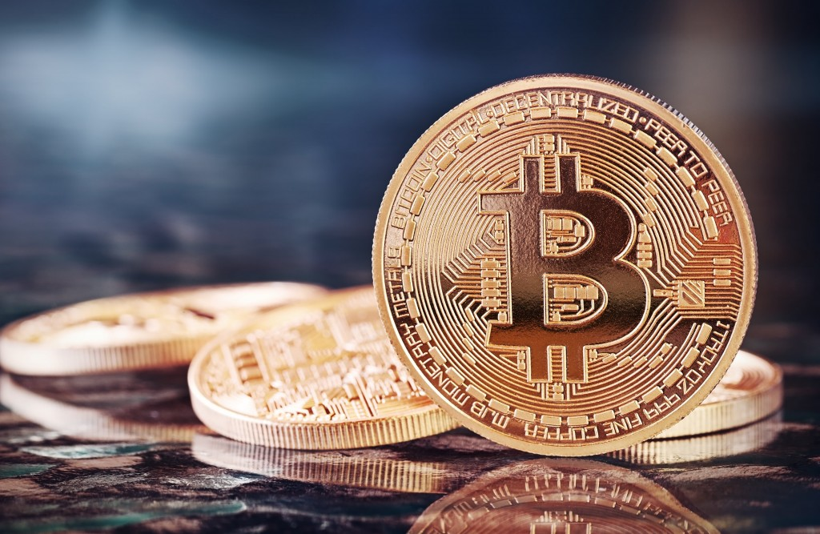

Slide 2
Information about the business
Mission Statement
Key Industry information
Key competitors

Slide 3
Background Information
In October 2008 Sataoshi Nakamoto publishes a paper through a metzdowd.com, a cryptography mailing list
The white paper described the Bitcoin currency a peer to peer electronic cash system
Effectively solves the double spend problem
In November Bitcoin project registered and posted to a public development forum

Slide 4
How to get a Bitcoin
Make one: bitcoin mining
Find someone who has one and trade them for it
Good, Service or Government Currency

Slide 5
Mission Statement
Our mission is to provide a safe and reliable place for customers to exchange currency.

Slide 6
The Crypto Exchange
Trading government currency (e.g., US dollar) for crypto currency (e.g., Bitcoin)
MtGox launched in July 2010
By 2013 handling 70% trading volume
In February 2014 hackers break into exchange and MtGox forced suspended trading

Slide 7
Industry trends
Trading Volume and number of users is growing
New regulation and licensing is encouraging safer practices among exchanges
Governments and Banks around the world developing policies to deal with new currencies

Slide 8
Key Competitors

Slide 9
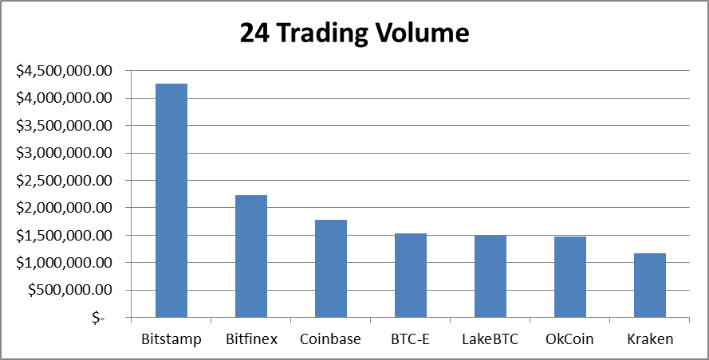
Key Competitors

