Slide 1


Currency Exchange

Slide 2
The Business
Wake of financial meltdown Bitcoin was created
Use of Bitcoin is growing
Our business is to operate a currency exchange
Exchange US Dollars for Bitcoin
Our mission is to provide a safe and reliable place for customers to exchange currency

Slide 3
5 Year Plan
By the end of 5 years we will
Designed the software to operate the exchange
Obtained 1 million users
Created web portal customers can use to interact with the exchange
Open the exchange
Maintain at least 5% total trading volume
Develop and release a smart phone wallet app
Release software merchants can use to except Bitcoin payments

Slide 4
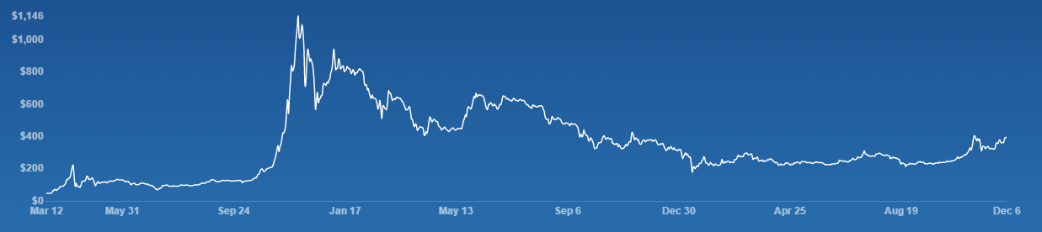
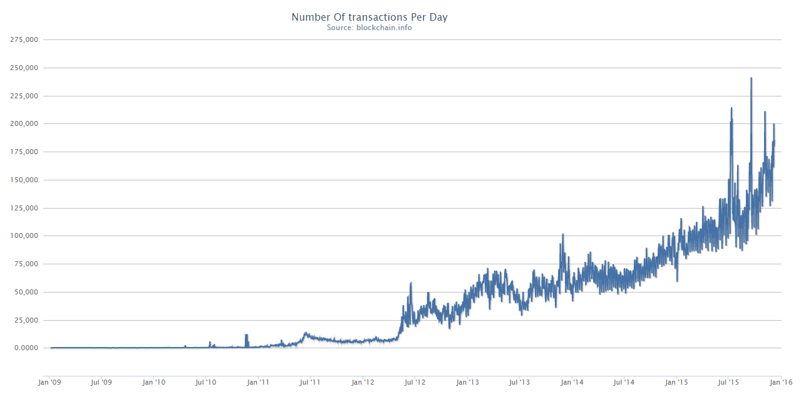
Industry
Summary

Slide 5
STEP
Social
Opportunity: Too Big to Fail
Threat: Silk Road
Economic trends
Opportunity: Growth of online sales
Threat: Poor economy
Technology
Opportunity: Block chain
Threat: Hackers
Political and Regulatory Factors
Opportunity: NYS BitLicense
Threat: Government regulation

Slide 6
The Competition
*http://coinmarketcap.com/currencies/volume/24-hour/
Critical Success Factors: Price, Customer service, Available products, Security

Slide 7
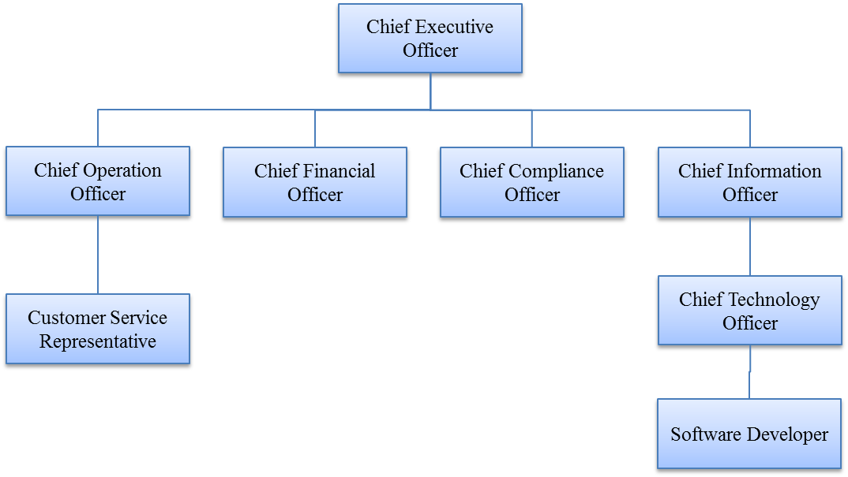
The Team
President and CEO
25 year programming experience
Active trader over 3 years

Slide 8
Segmentation
People who want buy bitcoin
Shoppers, Donations
People who want to sell bitcoin
Miners, Merchants, International transfers
Traders looking for profit
Challenge: Attract users and trading volume

Slide 9
Product
Fund deposits and withdraws
Trading pair BTC/USD
Smart phone wallet app
Merchant wallet / payment application
Full API
Secure cold storage
Two-factor authentication

Slide 10
Place
Main Office
New York, NY
Data Centers
New York
Virginia
Utah
Direct Channel System
Web portal
Mobile app
Web API
In person
Customer Service

Slide 11
Promotion
Social Media
Facebook
Twitter
Reddit
LinkedIn
Bitcoin conferences
Print campaigns
Magazine
Newspaper

Slide 12
Price
No maker fees
Minimum trade $1
Minimum withdraw $1

Slide 13
Operations
Human Resource
Hire employee
Process payroll
Users
Marketing
Add customer
Customer support
Exchange
Deposit funds
Withdraw funds
Post bid / ask
Fill order

Slide 14
Financials
Start-up Funding
$1,000,000 Total
$500,000 debt
$500,000 equity

Slide 15
Help
What we need
Money
Why we need it
Build exchange software
Setup office
Acquire BitLincense
Will we offer
Partial ownership of company

Slide 16
Exit Plan
No plan to leave exchange or give up ownership
Key assets that could be sold
Customers
Exchange software
BitLincense

Slide 17

Questions

