Slide 1
The Business
Currency Exchange
Exchange US Dollars for Bitcoin
Wake of financial melt 2007 bitcoin created
Users and transaction growing
Our mission is to provide a safe and reliable place for customers to exchange currency

Slide 2
5 Year Plan
By the end of 5 years we will have;
Designed the software to operate the exchange
Obtained 1 million users
Created web portal customers can use to interact with the exchanged
Launched the exchange and account for over 5% total trading volume
Developed and released a smart phone wallet app
Release a software merchants can use to except Bitcoin payments

Slide 3
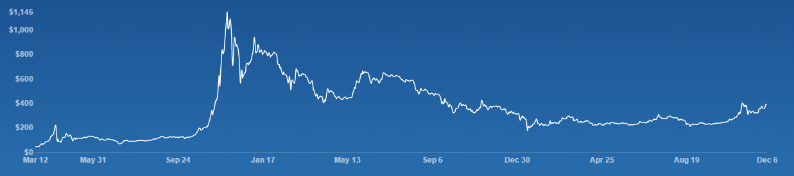
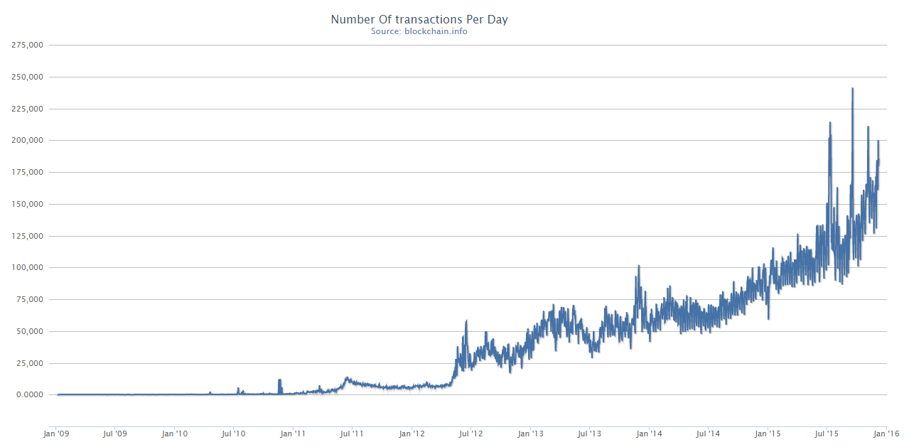
Industry summary

Slide 4
STEP
Social
Opportunity: Distrust of banking industry creating need to alternative
Threat: Mistrust and connection to blank market tarnish image
Technology
Opportunity: Block chain technology make transfering money quicker,safer and less expensive
Threat: Vulnerable to hacking and theft. relies on the unbreakable nature of current encryption systems
Economic trends
Opportunity: Online sales grow, crypto currency very good for online transactions
Threat: Poor economy could limit online sales
Political and Regulatory Factors
Opportunity: New York state established the BitLicense, first of its kind
Threat: Governments through out the world still developing regulatory systems for crypto currencies

Slide 5
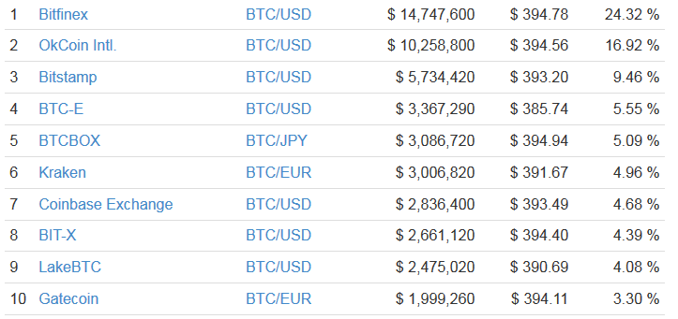
Competitor Analysis, Key Players, Critical Success Factors, Competitors most vulnerable to you
http://coinmarketcap.com/currencies/volume/24-hour/
Critical suscess: Price, Customer service, Available products, Security

Slide 6
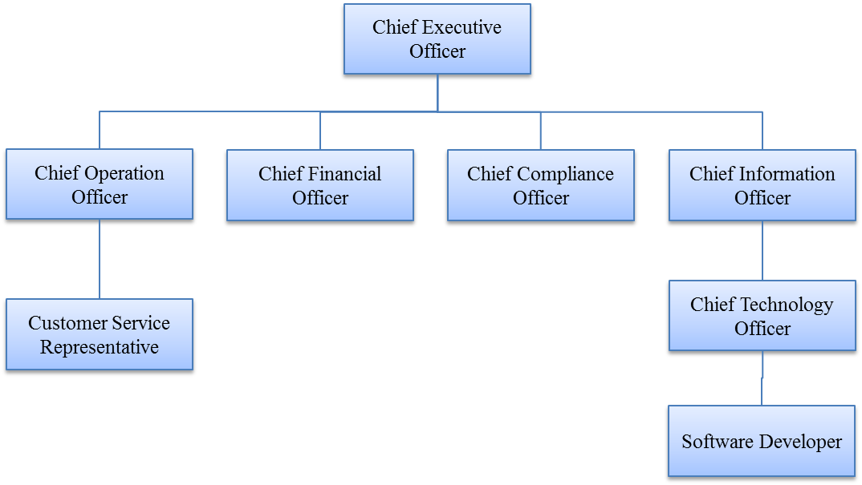
How are you going to create the company (your background) and put team together? Org Charts
Been in the computer industry for 30 plus years.
Watching crypto currency for years
Active day trader on several exchanges

Slide 7
Segmentation - Go through key segments - Challenges? Mold below for key segments:
People who want buy bitcoin
People who want to sell bitcoin
Day traders looking for profit
Challenge: Atract users and trading volume

Slide 8
Product
Deposit and withdraw USD
Deposit and withdraw BTC, LTC
Trading pair BTC/USD, LTC/USD
Full API
Secure cold wallet storage to hold crypto-currencies
Two-factor authentication
Smart phone wallet app
Encrypted hot wallet protection
Multiple deposit / withdraw options; Cash, Linked debit/credit account, wire transfer
Merchant wallet / payment application

Slide 9
Place
Operate in Manhatten NY
Direct channel system, Web portal, mobil apps, in person, web api
Customer service is Key

Slide 10
Promotion - Metrics projection (Lifetime Value e.g.)
Social Media: Facebook, Twitter, Reddit, LinkedIn
Bitcoin conferences
Print campaigns
Chart of customer growth rates and revenue projects
Two key industry trends, price and transaction volume

Slide 11
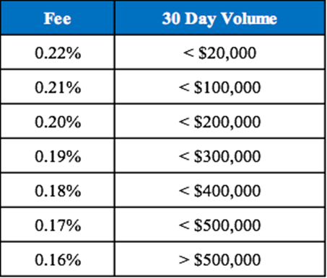
Price - (Break even analysis) (How promotion gets you to break even point)
Minimum trade value $1
No withdraw fees
Minimum withdraw value $1
No maker fees

Slide 12
Operations - Key Processes, Org Charts, Role Descriptions
New Hire
Payrole
Add Customer
Deposit funds
Withdraw funds
Post trade
Customer support
Marketing

Slide 13
Financials - Overview/Highlights (Revenue 3Yr, PL 3 Yrs)
P & L

Slide 14
This is what we need from you (money, expertise), this is what we will be willing to give you
Need startup money to build exchange software, setup office and aquire licencing
Will give owner ship of company

Slide 15
Exit Plan (IPO, Divest) Maybe or maybe not since it may be included in the previous point?
No plan to leave exchange, maintain ownership, slowly lessen daily activities involving exchange
Sell of three key assets;
Customers
Exchange software
Licences (as much as 100,000 in legal / account fees)

