Slide 2
.NET 4.0 Code Contacts

Slide 3
About Me
James Newton-King
Developer at Intergen
Blog: http://james.newtonking.com

Slide 4
Agenda
Validation today
Introduction to Code Contracts
Preconditions & Postconditions
Static Analysis
Invariants
Interface Contracts
The Future

Slide 5
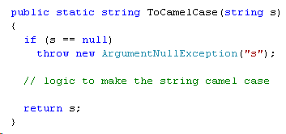
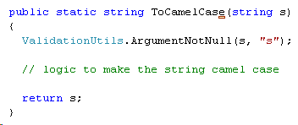
Validation today
Typical validation...

Slide 6
What is wrong with validation today?
Ad-hoc
No way to get validation rules metadata
Runtime only

Slide 7
Introduction to Code Contracts
New API + tools from Microsoft
System.Diagnostics.Contracts
MSIL rewriting
Inspired by Spec#
Included in .NET 4.0 but…
…download available now for .NET 3.5 and VS2008
http://research.microsoft.com/en-us/projects/contracts/

Slide 8
Preconditions & Postconditions
Preconditions – Argument validation
Contract.Requires
Contract.RequiresAlways
Contract.EndContractBlock
Postconditions – Return validation
Contract.Ensures
Contract.Result<T>
Demo!

Slide 9
Static Analysis
Compile time analysis of your code!
Visual Studio Team System only :’(
Good Visual Studio integration
Demo!

Slide 10

Invariants
Invariants – Validation of object state
Contract.Invariant
Demo!

Slide 11
Interface Contracts
You can define contracts against an interface
Preconditions and postconditions inherited
Implementers are warned if they don’t follow the contract
But how does that work?
Contracts are defined in implementation...?
ContractClassAttribute to the rescue!
Demo!

Slide 12
Timelines
Out now
Code Contracts for VS2008 preview
VS2010 Beta 1
Coming up
Ongoing VS2008 updates
VS2010 Beta 2
Year End
VS2008, VS2010 final (hopefully)

Slide 13
The Future!
Entire .NET Framework marked up with contract metadata
Documentation generated from contracts
Hopefully an API to get contract rules
UI validation using code contracts
And more

Slide 14
Questions
Ask now,
Ask me later,
Or email me: james@newtonking.com
Slides
Blog: http://james.newtonking.com

