Slide 1
Causal Survey of Social Movement Models
James Houghton

Slide 2
Why did they use a model?
Why are they showing me their model?
Notes:
I am going to show a whole bunch of models, so I had better be able to answer these questions.
In fact, a survey of models is difficult to do in a presentation.

Slide 3
Reasons to Model
Build Theory
Test Theory
Develop Policy
Make Forecasts
Design Systems
Design Experiments
Frame Research
Learn about Structure
Learn about Behavior
Build Consensus
Art Project
Notes:
The process of learning from other people is always a process of constructing our own models (usually mental models) based upon our teacher’s description of their own models.
So that answers the first question: why do I care. What about the second: why do you care?

Slide 4
Driving Questions
Q: How do existing models of social movements build structurally on each other?
Q: How do they relate to the major theories of social movements?
Notes:
There is no sense making new models until you understand what models have already been developed.
There is a lot to criticize in these models

Slide 5
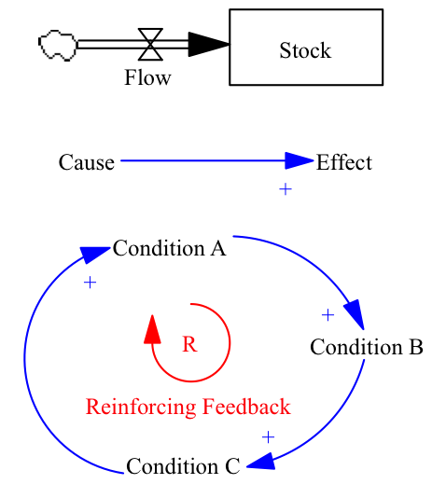
Inclusion Criteria
Structural Models (Macro)
Time scales: weeks-years
State/Dissident interactions (representing the literature)
Notes:
Challenging piece of a survey is knowing when to stop.

Slide 6
Jackson et al. 1978
Notes:
In this model, protest yields increases in

Slide 7
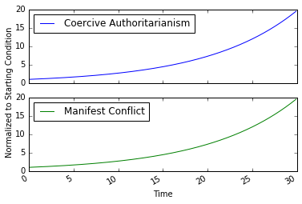
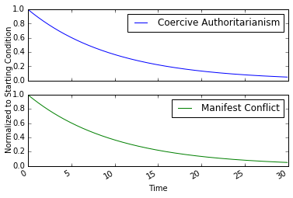
Exponential Growth
Exponential Decay

Slide 8
Tsebelis and Sprague 1989
Notes:
Tsebelis, Sprague (1989)

Slide 9
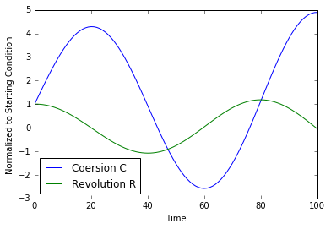
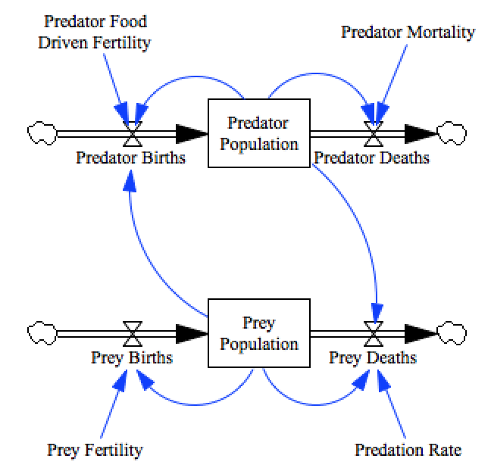
Oscillations
Notes:
In this structure we have the potential for oscillatory behavior.

Slide 10
Tsebelis and Sprague 1989 Full Structure
Notes:
Introduces additional feedback Loops:
- Need for legitimacy
Appeasement

Slide 11
Karmeshu et al 1990

Slide 13
Chong 1991
Notes:
Adds Countermobilization

Slide 14
State Variables

Slide 15
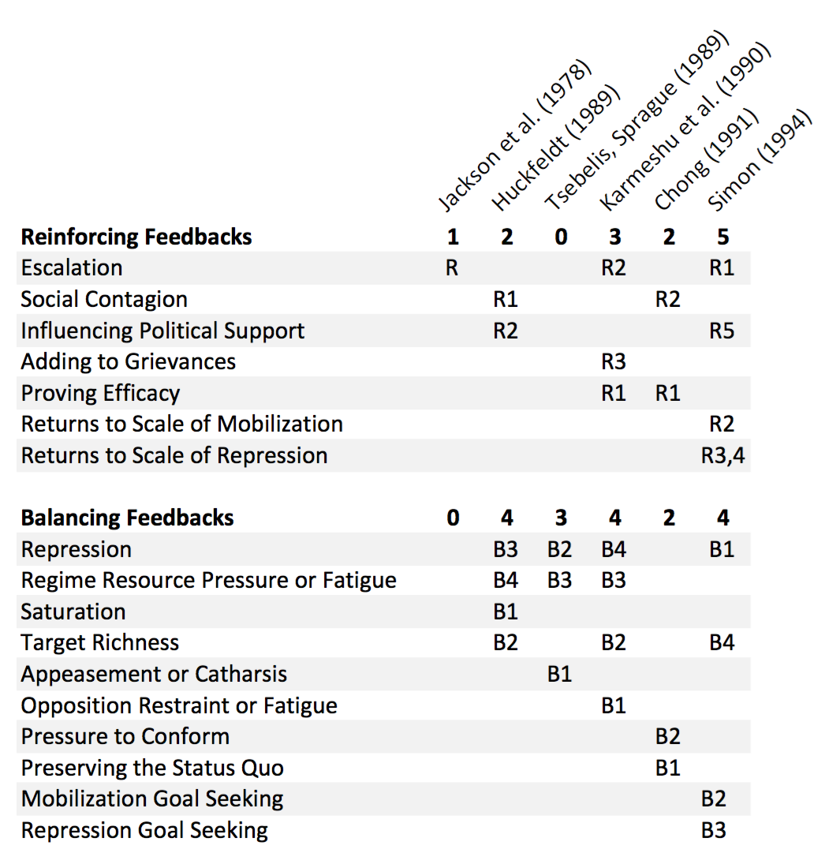
Feedback Loops

Slide 16
Answers to Driving Questions
Q: How do existing models of social movements build on each other?
Structural similarity as forms build on one another
Difference in terminology obscures cumulative development
Q: How do they relate to the major theories of social movements?
Casual use of terminology from verbal theory
Little use of structure, mechanisms from verbal theory
Notes:
There is no sense making new models until you understand what models have already been developed.

Slide 17
Reasons to Model
Build Theory
Test Theory
Develop Policy
Make Forecasts
Design Systems
Design Experiments
Frame Research
Learn about Structure
Learn about Behavior
Build Consensus
Art Project
Notes:
What do verbal theories of social movements say?
Are they structurally consistent?
Can the structure produce the behavior?

Slide 18
Modeling for Theory Development
Ensure Structural Consistency
Ensure Dynamic (Behavioral) Consistency
Generate new Observable Implications of Theory

Slide 19
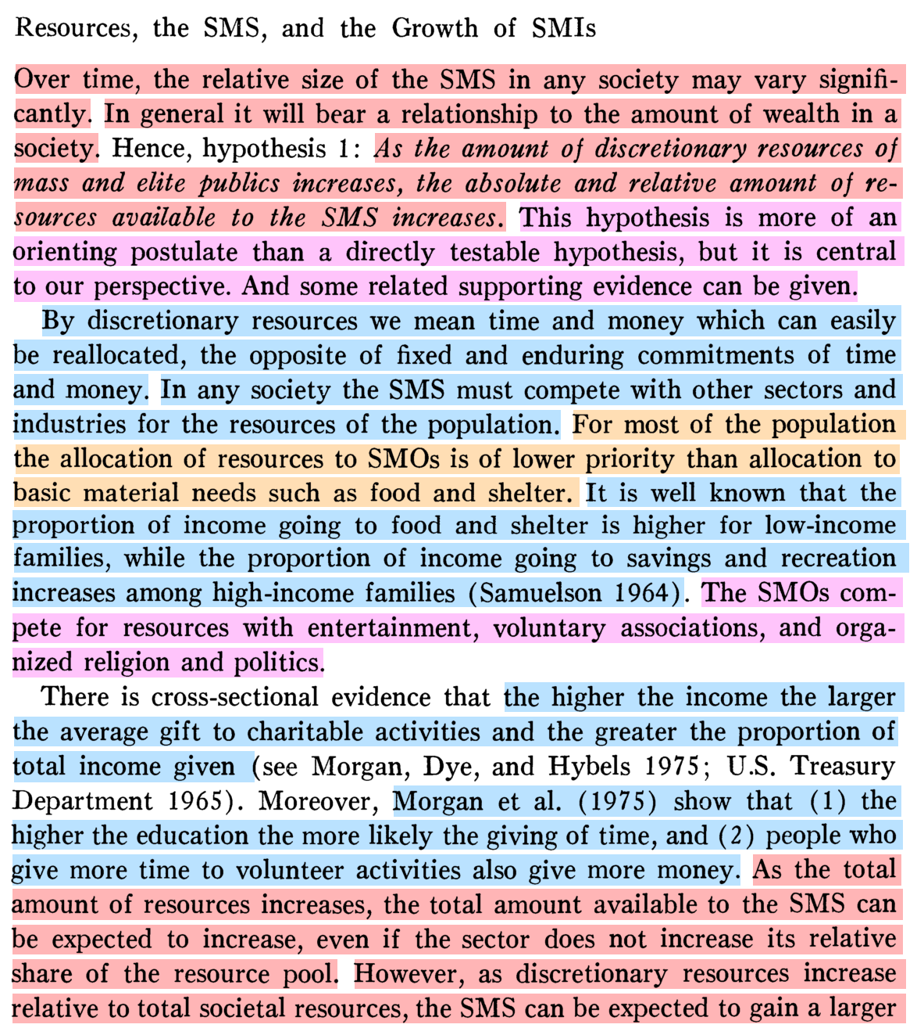
McCarthy and Zald, 1977
Statements of Structure
Statements of Behavior
Assumption or Boundary Condition
Discussion and Framing

Slide 20
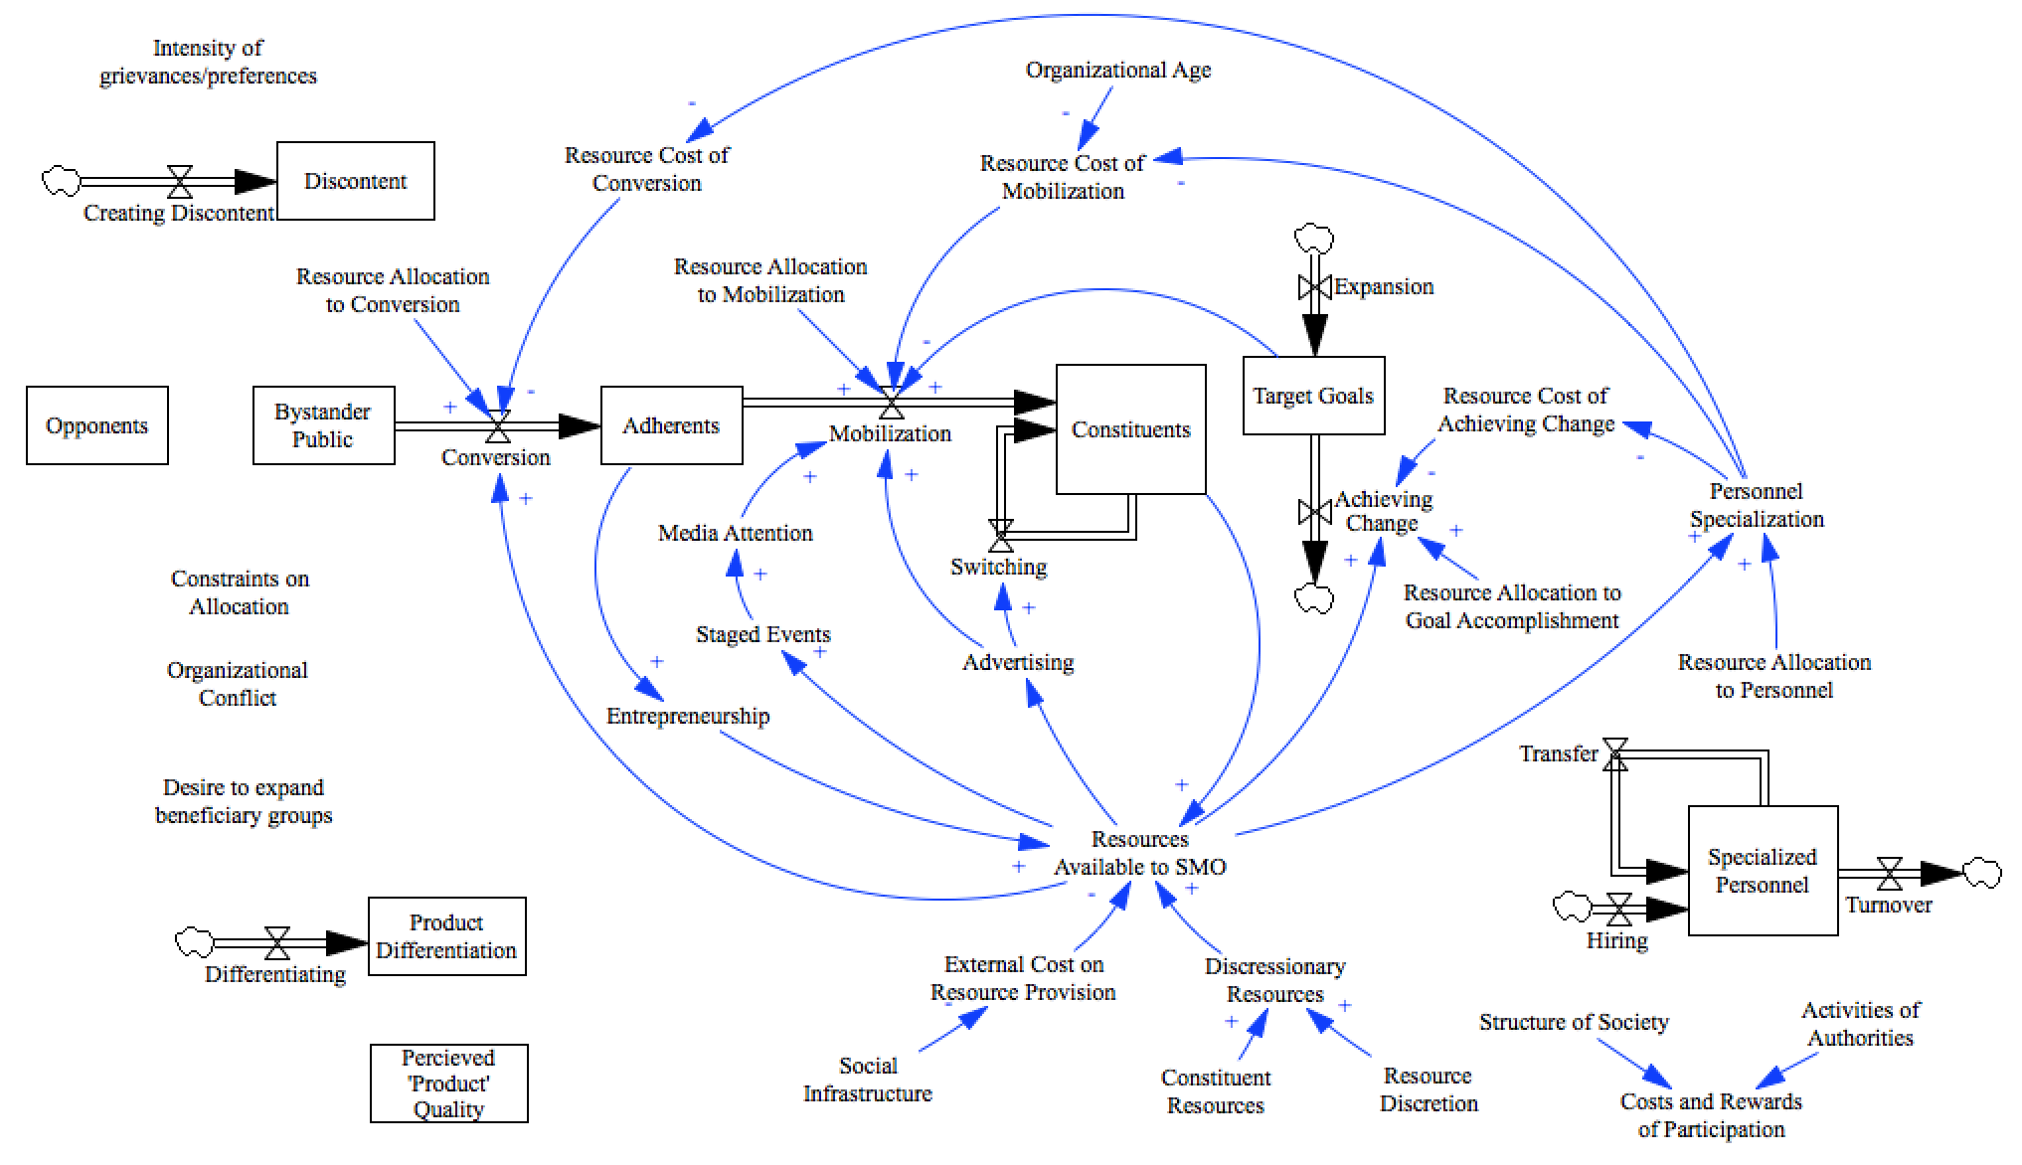
McCarthy and Zald 1977

Slide 21
Why did he (re)use models?
To understand the state of the art in models of social movements
To understand how the state of the art related to the state of general social movement theory
Why did he show me these models?
To argue the need for more engagement with verbal theory as a way to speak to and improve it
Notes:
I am going to show a whole bunch of models, so I had better be able to answer these questions.
In fact, a survey of models is difficult to do in a presentation.

Slide 22
Future Direction
Formalizing Verbal Theory
Turner and Killian 1957
Gurr 1970
McCarthy and Zald 1977
Scott 1990
McAdam, McCarthy, Zald 1996
McAdam, Tarrow, Tilly 2001
Goldstone and Tilly 2001
Others?
Survey other types of formalizations
Agent based models
Network models

Slide 23

Replicate, Remix, Reuse
github.com/JamesPHoughton/Survey_of_Social_Movement_Models
Collaborate? houghton@mit.edu

Slide 24
Models Replicated
Jackson, S., B. Russett, Duncan Snidal, and David Sylvan. 1978. “Conflict and Coercion in Dependent States.” Journal of Conflict Resolution
Tsebelis, G. and J. Sprague. 1989. “Coercion and Revolution: Variations on a Predator-Prey Model.” Mathematical and Computer Modeling.
Karmeshu, M., VP Jain, and AK Mahajan. 1990. “A Dynamic Model of Domestic Political Conflict Process.” Journal of Conflict Resolution.
Huckfeldt, R. 1989. “Noncompliance and the Limits of Coercion: The Problematic Enforcement of Unpopular Laws.” Mathematical and Computer Modeling.
Chong, D. 1991. Collective Action and the Civil Rights Movement. Chicago: University of Chicago Press.
Simon, MV. 1994. “Hawks, Doves, and Civil Conflict Dynamics: A ‘strategic’ Action- reaction Model.” International Interactions.

Slide 25
Huckfeldt 1989
Notes:
Legitimacy carries through in Resource pressure
New loops: social contagion,

Slide 26
Simon 1994

