Slide 1
SecureChat
Group 2

Slide 2
Project Scope
Establish secure and encrypted communication channels
Allow users to send and receive messages securely
Use a key distribution center (KDC)
Mediated authentication protocol for authorized use of key
Use an encryption service to encrypt and decrypt messages
Protect company secrets and sensitive information
Provide traceable chat history log
Set Out-of-Office hours for automatic replies (innovative feature)

Slide 3
Product Functions
Modules | Functions
Authentication Service | Create an account Update and terminate employee registration
KDC Service | Generates session keys Updates keys
Logging Service | Maintains a record of all existing chats Maintains timestamps of messages
Out-Of-Office (OOO) Message | Automates a response based on user’s availability Displays OOO Message

Slide 4
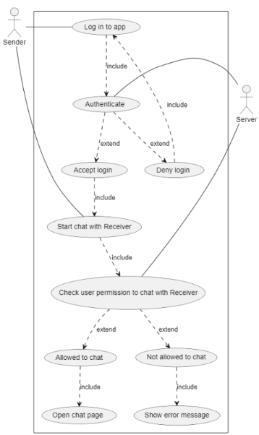
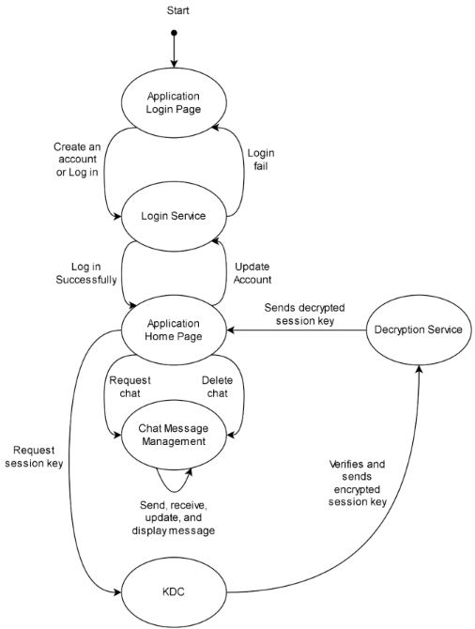
State Diagram and Use Case Diagram

Slide 5
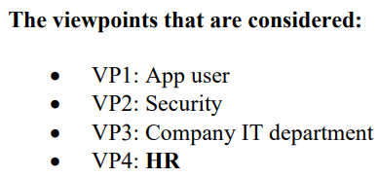
Functional Requirements
BE1: Register/create an account
BE2: User Login
BE3: Start a chat with a colleague
BE4: Set out-of-office hours and generate automated response (innovative feature)
BE5: Delete account/leave company
BE6: Use chat logbook

Slide 6
Non-Functional Requirements
Look and Feel Requirements
Usability and Humanity Requirements
Performance Requirements
Operational and Environmental Requirements
Maintainability and Support Requirements
Security Requirements
Cultural and Political Requirements
Legal Requirements

Slide 7
The app follows the MVC II architecture with the following subsystems in the controller
Subsystem | Purpose | Architectural Style
Account Management | Manages login, account creation, and account deletion | Repository
KDC | Generate, store, and send keys for user communication | Repository
Message Management | Message sending and receiving, logging, and encryption service | Repository

Slide 8
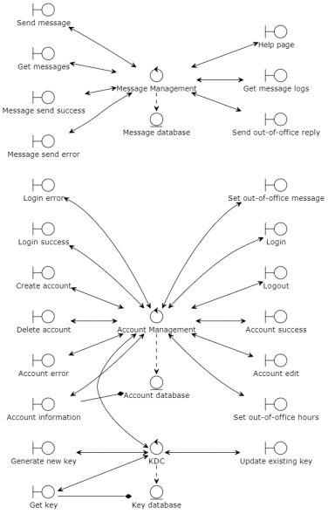
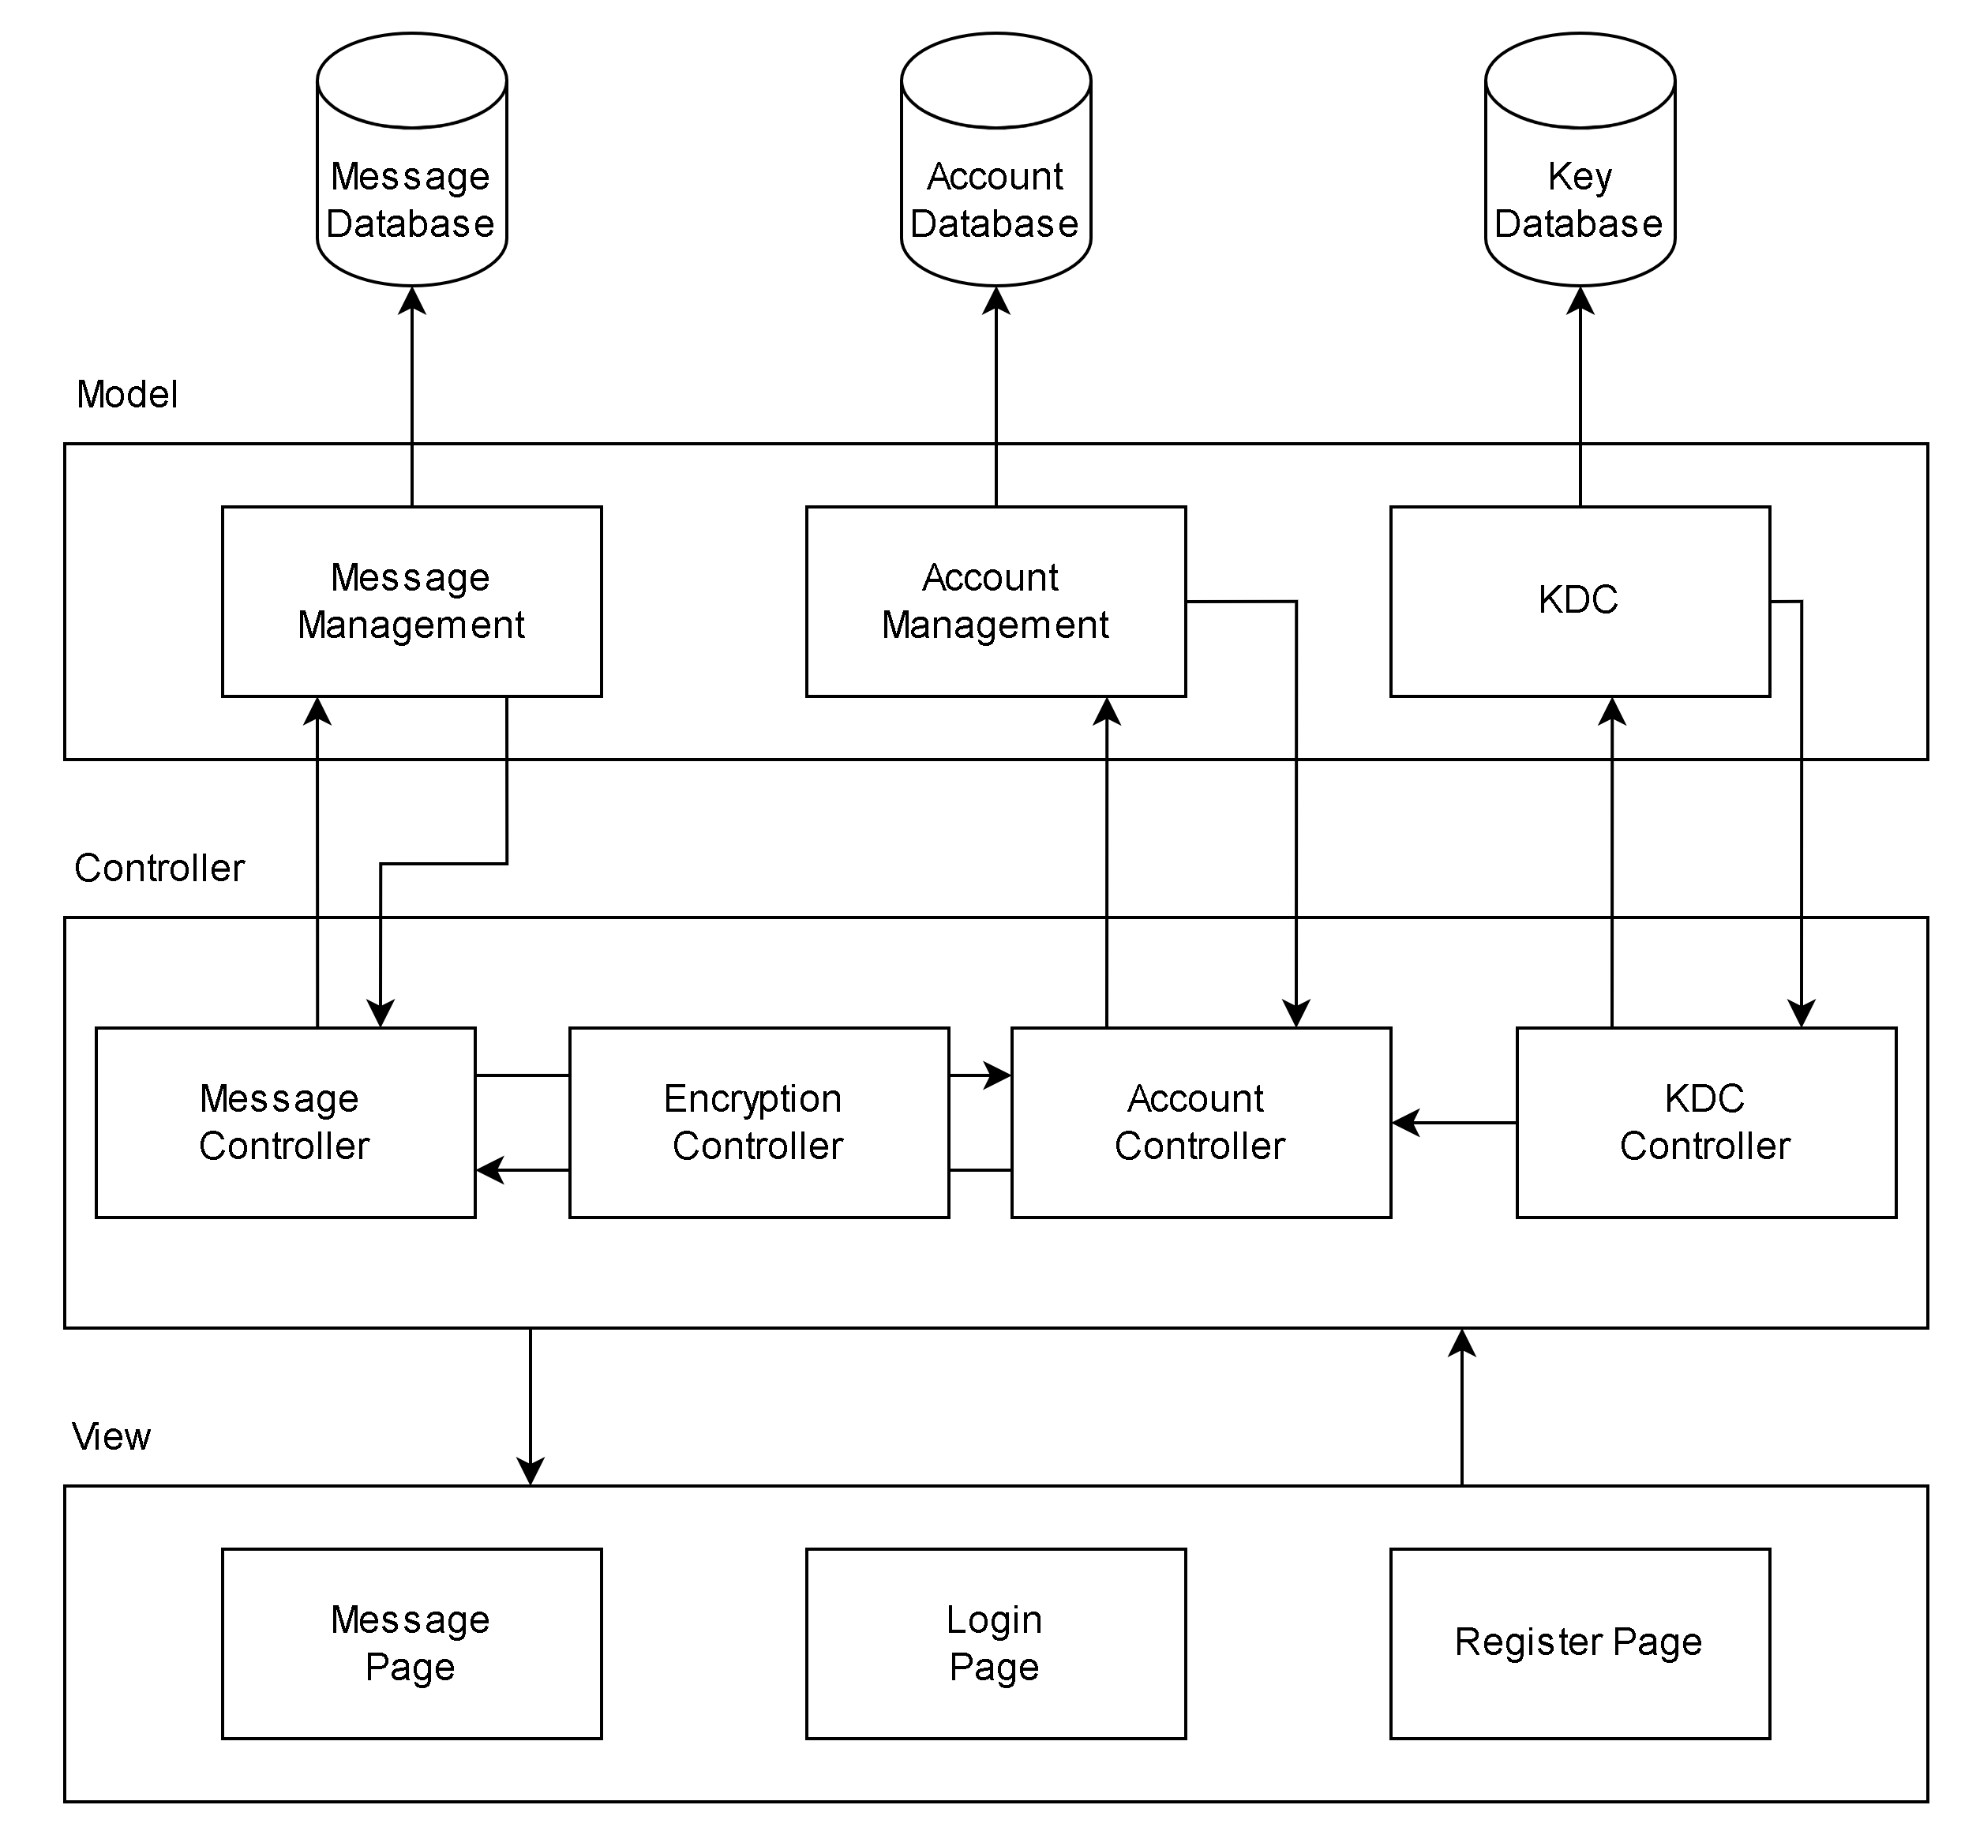
Analysis Class Diagram and System Architecture

Slide 9
Why We Chose MVC-II as Our Architectural Style
Support multiple synchronized views with a volatile GUI with frequency changes in data
Suitable for interactive applications
Focuses on look-and-feel
More user-friendly and easier to use
Easier to add new interfaces or changes to the existing system
Flexible and adaptable to updating the interface views
Many MVC frameworks and support documentations available
Time constraint
Separation of concerns
Making the interaction between modules more stable
High cohesion and low coupling

Slide 10
Why We Chose The Repository Architecture
Streamline the exchange of data between the users and other system components
Allows the agents to initiate interactions in the system
Account Database verifies the account information and proceeds to display error and success messages
KDC server generates and updates new keys actively
Data store is passive, and awaits actions from the agents
Supports reusability of agents, scalable, maintain integrity of messages and account information

Slide 11
Why We Did not Select Certain Architectural Styles
Blackboard
Users are active agents vs data is active
More suitable for sending new data change or alerts to the users
Batch Sequential
Data is not batched
High latency and slows down processes
Pipe and Filter
Data processing, transformation, and other operations are not the main focus
Process Control
Data transformation, or any type of sensor input is not required
PAC
Most applicable for a distributed system
Increased complexity in the design and implementation
Difficulty in determining the exact number of agents and their role due to loose coupling and high independence
Issues with overhead and time constraint

Slide 12
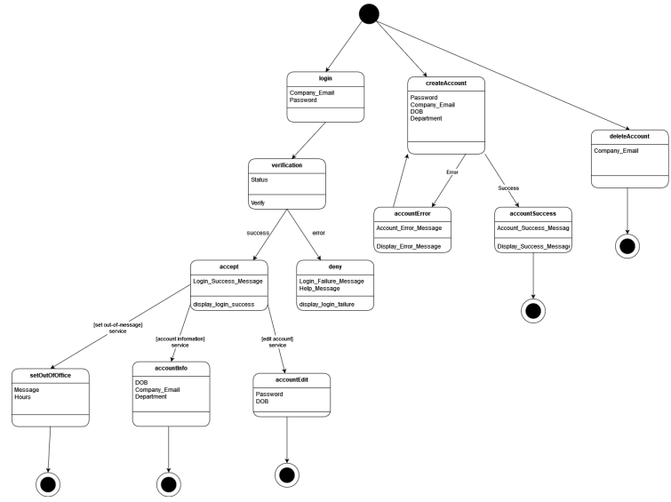
Account Management State Diagram

Slide 13
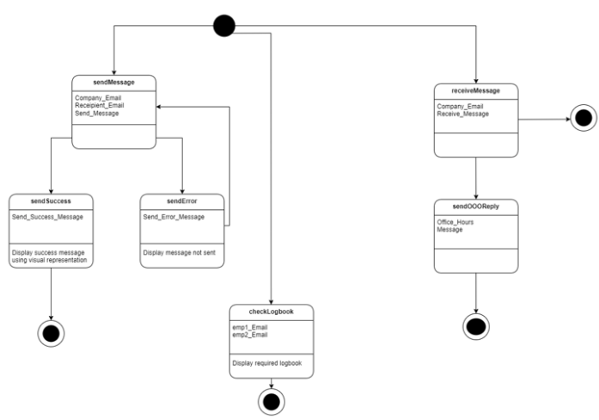
Message Management State Diagram

Slide 14
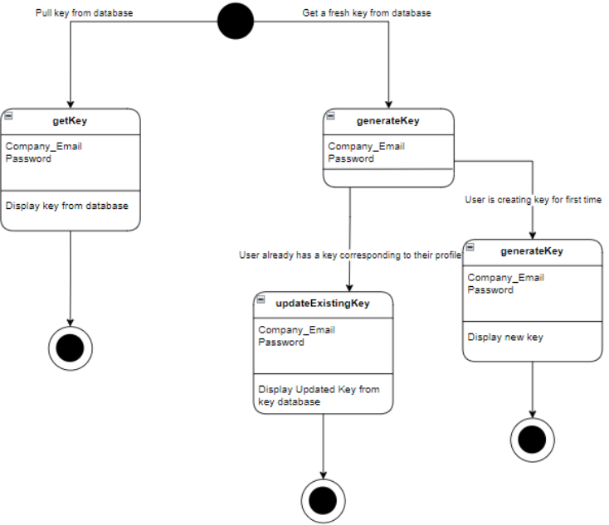
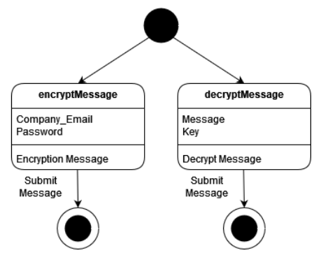
Encryption Management and KDC Manager State Diagram

Slide 15
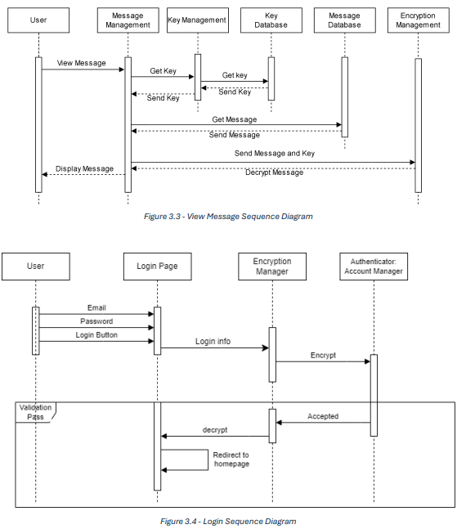
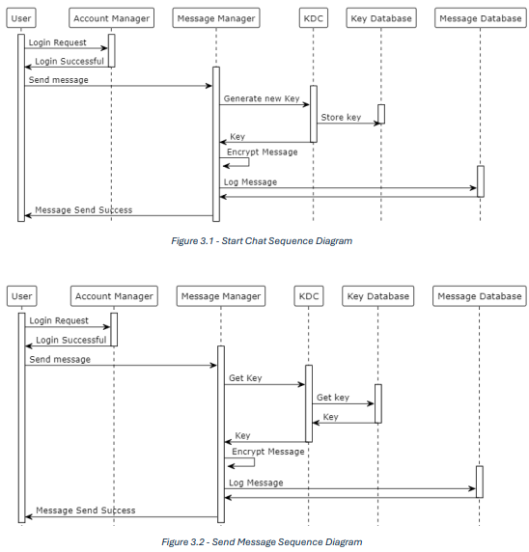
Some Examples of Sequence Diagrams

Slide 16
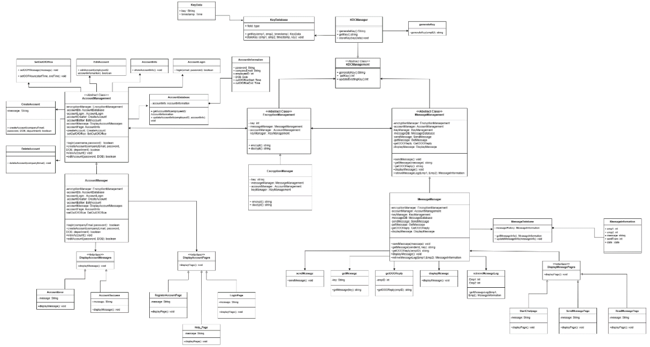
Class Diagram

Slide 17
How Our Program Meets the Requirements and Functionality
Implementation of KDC server with frequent changes and updates of keys
Mediated authentication protocol
Encryption/decryption system
Chat history with date and time
Innovative feature: set OOO hours and send automatic replies

Slide 18
Demo

Slide 19

Thank you Q&A

