Slide 1
CS480
Cryptography and Information Security
8. Mathematics of Cryptography 4
Huiping Guo
Department of Computer Science
California State University, Los Angeles

Slide 2
Outline
Fields
  GF(2^{n})
Polynomial
8. Math4 CS480_S15

Slide 3
GF(2^{n}) fields
In cryptography, we often need to use four operations ( +, - x, /)
  We need to use fields
The positive integers are stored in computers as n-bit words.
  n is usually 8, 16, 32,…
  The range of integers is [0, … 2^{n}-1]
  The modulus is 2^{n}
8. Math4 CS480_S15

Slide 4
GF(2^{n}) fields
Two options if we want to use a field
Option 1
  GF(p) with the set Z_{p}, p is the largest prime number less than 2^{n}
  Problem: it’s inefficient because we cannot use the integers from p to 2^{n}-1
    Ex: n=4, p=13, 13,14,15 cannot be used
    n=8, p=251, we cannot use 251~255
8. Math4 CS480_S15

Slide 5
GF(2^{n}) fields
Option 2
  Use GF(2^{n}) with a set of 2^{n} elements
  The elements in the set are n-bit words
    Ex n=3, the set is {000,001,010,011,100,101,110,111}
  Problem: we cannot interpret each element as an integer in[0,7], because the regular 4 operations cannot be applied
    2^{n} is not a prime
We need to define a set of n-bit words and two new operations that satisfy the properties defined for a field
8. Math4 CS480_S15

Slide 6
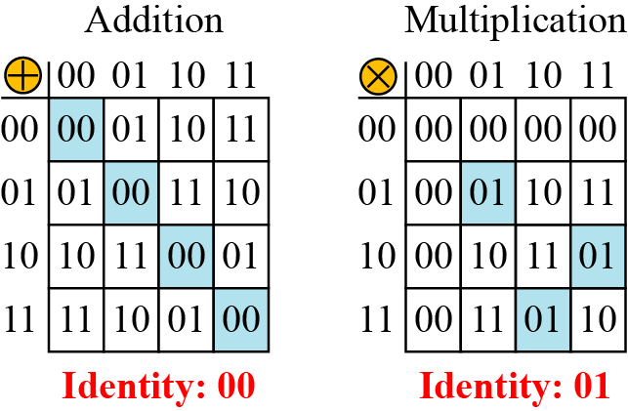
GF(2²)
Let us define a GF(2²) field in which the set has four 2-bit words: {00, 01, 10, 11}
We can redefine addition and multiplication for this field in such a way that all properties of these operations are satisfied
8. Math4 CS480_S15

Slide 7
Polynomial
Why use polynomial
  It’s troublesome to directly define the rules for addition and multiplication operations on n-bit words that satisfy the properties in GF(2^{n})
  It’s easier to work with a representation of n-bit works
  ---- polynomial
A polynomial of degree n − 1 is an expression of the form
  x^{i} is called the ith term
  a_{i} is called coefficient of the ith term
8. Math4 CS480_S15
Notes:
The power of x defines the position of the bit in the n-bit word.
The coefficients of the terms define the value of the bits

Slide 8
Represent a n-bit word by a polynomial
The power of x defines the position of the bit in the n-bit word
  the rightmost bit is at position 0 (related to x⁰)
  The leftmost bit is at position n-1 (related to x^{n-1})
The coefficients of the terms define the value of the bits
  The polynomial coefficients can be either 0 or 1
8. Math4 CS480_S15

Slide 9
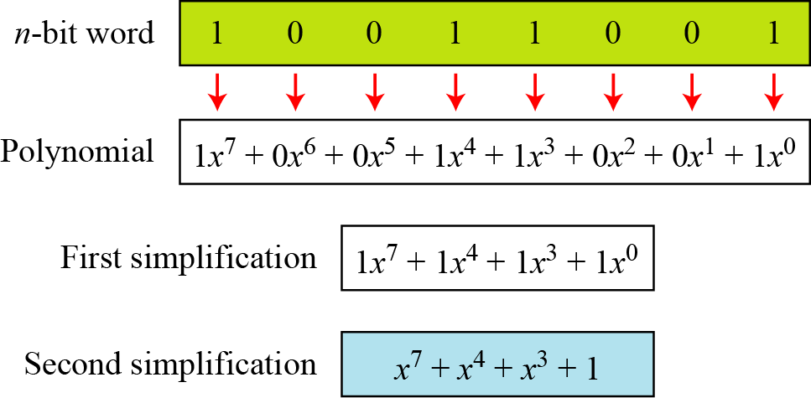
Polynomial example
Represent the 8-bit word (10011001) using a polynomials.
8. Math4 CS480_S15

Slide 10
Polynomial example
Find the 8-bit word related to the polynomial
x⁵ + x² + x
  we first supply the omitted terms
  Since n = 8, it means the polynomial is of degree 7. The expanded polynomial is
This is related to the 8-bit word 00100110
8. Math4 CS480_S15

Slide 11
Operations on polynomial
Any operation on polynomials actually involves two operations
  Operations on coefficients
  Operations on two polynomials
We need to define two sets
  One for the coefficients: GF(2)
  One for the polynomials: GF(2^{n})
Polynomials representing n-bit words use two fields: GF(2) and GF(2^{n})
8. Math4 CS480_S15

Slide 12
Modulus polynomials
Addition of two polynomials never creates a polynomial out of the set
Irreducible polynomials
  Multiplication of two polynomials may create a polynomial with degrees more than n-1
  We need to divide the result by a modulus and keep only the remainder
  The modulus in this case acts as a prime polynomial or irreducible polynomials
    Cannot be factored into a polynomial with degree of less than n
8. Math4 CS480_S15

Slide 13
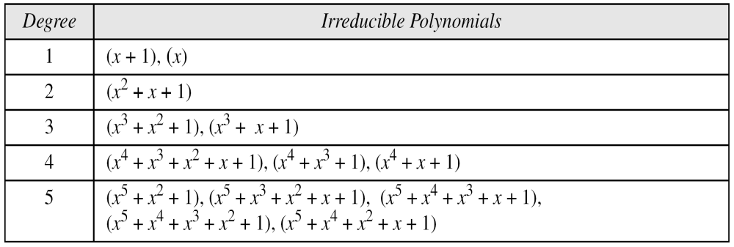
Irreducible polynomials
Table 4.9 List of irreducible polynomials
When we define our GF(2^{n}), we need to declare which irreducible polynomial we are using as the modulus
8. Math4 CS480_S15

Slide 14
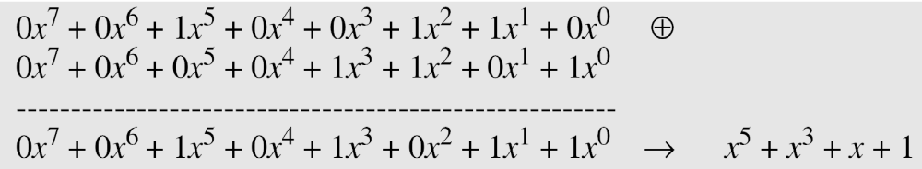
Operations on polynomials: addition
Addition and subtraction operations on polynomials are the same operation
Ex: (x⁵ + x² + x) + (x³ + x² + 1) in GF(2⁸)
8. Math4 CS480_S15

Slide 15
Operations on polynomials: addition
Another method:
  The addition in GF(2) means XOR operation
  So we can exclusive-or the two words, bits by bits, to get the result.
In the previous example
  x⁵ + x² + x is 00100110
  x³ + x² + 1 is 00001101
  The result is 00101011
    or in polynomial notation x⁵ + x³ + x + 1.
8. Math4 CS480_S15

Slide 16
Operations on polynomials: multiplication
The coefficient multiplication is done in GF(2)
The multiplying x^{i} by x^{j} results in x^{i+j}
The multiplication may create terms with degree more than n − 1, which means the result needs to be reduced using a modulus polynomial
8. Math4 CS480_S15

Slide 17
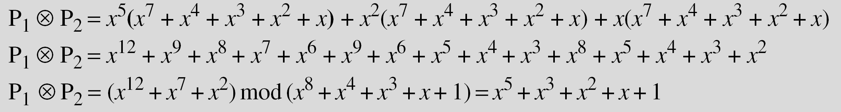
Operations on polynomials: multiplication example
Find the result of (x⁵ + x² + x) ⊗ (x⁷ + x⁴ + x³ + x² + x) in GF(2⁸) with irreducible polynomial (x⁸ + x⁴ + x³ + x + 1). Note that we use the symbol ⊗ to show the multiplication of two polynomials.
Solution
8. Math4 CS480_S15

Slide 18
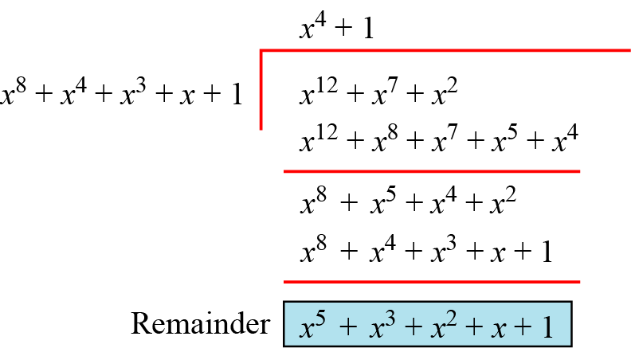
Polynomial division with coefficients in GF(2)
8. Math4 CS480_S15

Slide 19
Operations on polynomials: multiplication
Multiplicative identity
  Always 1
Multiplicative inverse
  Use extended Euclidean algorithm to find the multiplicative inverse
  The process is exactly the same as for integers
8. Math4 CS480_S15

Slide 20
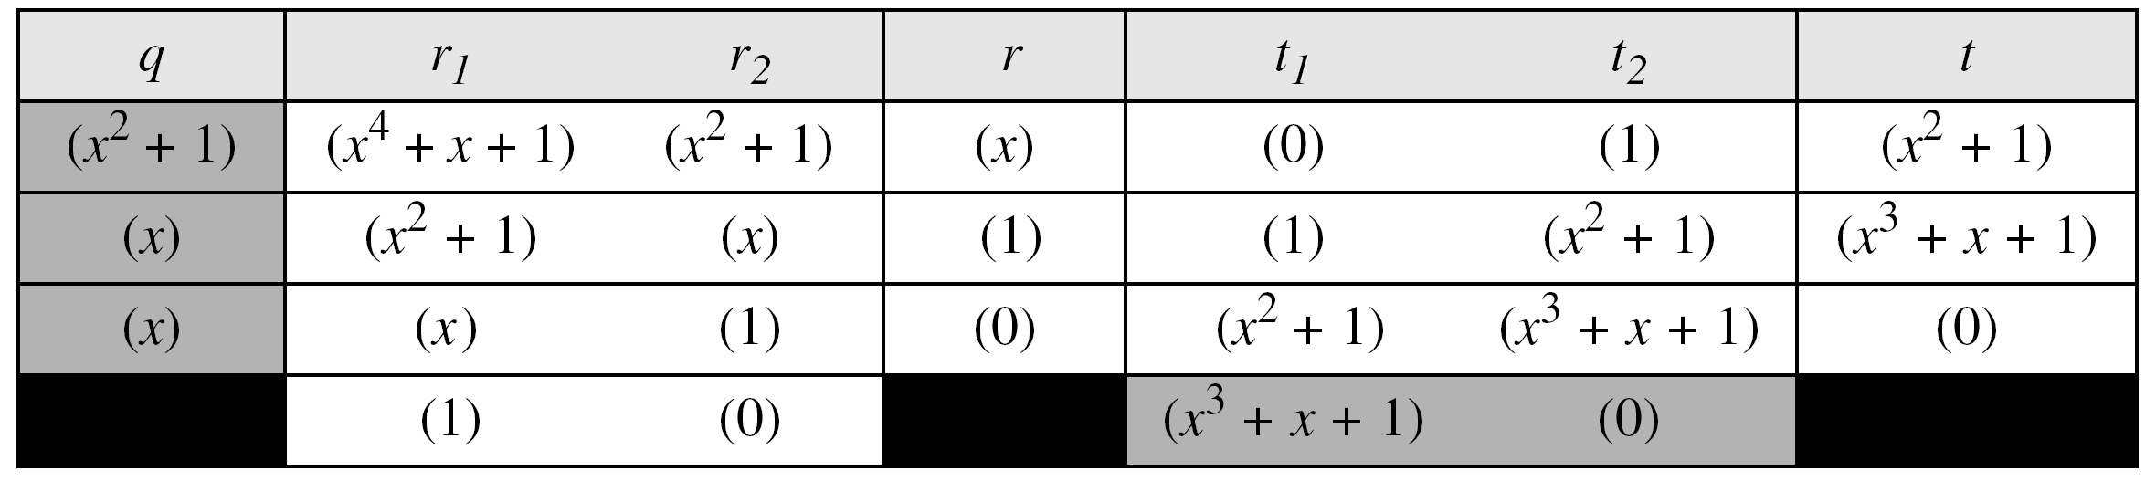
Operations on polynomials: multiplication example
In GF (2⁴), find the inverse of (x² + 1) modulo (x⁴ + x + 1)
Solution
The answer is (x³ + x + 1)
8. Math4 CS480_S15

Slide 21
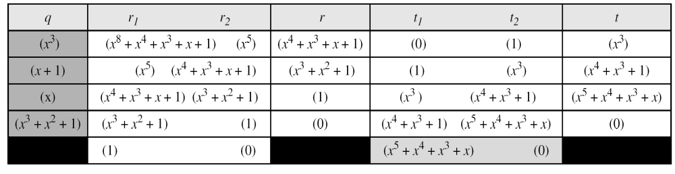
Operations on polynomials: multiplication example
In GF(2⁸), find the inverse of (x⁵) modulo (x⁸ + x⁴ + x³ + x + 1).
Solution
The answer is (x⁵ + x⁴ + x³ + x)
8. Math4 CS480_S15

Slide 22
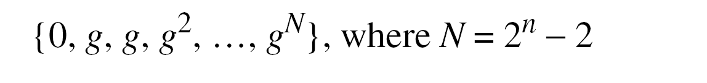
Multiplication using a generator
It’s easier to define the elements of the GF(2^{n}) field using a generator
In GF(2^{n}) with the irreducible polynomial f(x), an element in the field a much satisfy the relation f(a) = 0
Generator
  A generator g of GF(2^n) is an element whose first 2^n- 1 powers generates all the nonzero elements of the field.
  f(g) = 0
0
1
8. Math4 CS480_S15

Slide 23
Multiplication using a generator
Generate the elements of the field GF(2⁴) using the irreducible polynomial ƒ(x) = x⁴ + x + 1.
Solution
The elements 0, g⁰, g¹, g², and g³ can be easily generated, because they are the 4-bit representations of 0, 1, x, x², and x³.
Elements g⁴ through g¹⁴, which represent x⁴ though x¹⁴ need to be divided by the irreducible polynomial.
To avoid the polynomial division, the relation ƒ(g) = g⁴ + g + 1 = 0 can be used
8. Math4 CS480_S15

Slide 24
Using a Generator
8. Math4 CS480_S15

Slide 25
Using a Generator
The main idea is to reduce terms g⁴ to g¹⁴ to a combination of the terms 1, g, g², and g³, using the relation g⁴+g+1=0
After reduction, it’s easy to transform the powers into an n-bit word
Finding inverses using this representation is simple
  Additive inverses
    The additive inverses of each element is the element itself
    Addition and subtraction in this field are the same
      -g⁴=g⁴
  Multiplicative inverse
    The exponents are calculated modulo 2^{n}-1
    Ex: g³⁽⁻¹ ⁾= g⁻³ = g¹² = g³+g²+g+1 → 1111
8. Math4 CS480_S15

Slide 26
Operations
Addition and subtraction
  The same operation
Multiplication and division
  Multiplication is the addition of powers modulo 2^{n}-1
  Division is multiplication using the multiplicative inverse
8. Math4 CS480_S15

Slide 27
Operations
The following show the results of addition and subtraction operations:
8. Math4 CS480_S15

Slide 28
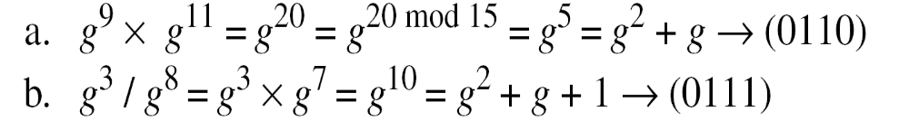
Operations
The following show the result of multiplication and division operations:.
8. Math4 CS480_S15

Slide 29
Operations on polynomials: exercise
In GF(2⁴), find the following results using the irreducible polynomial ƒ(x) = x⁴ + x + 1
(x²+x³) * (x²+x+1) ans: x
(x+1)/(x²+1) ans: x³+x²+x
(x³+1)⁻¹ ans: x
8. Math4 CS480_S15

Slide 30
Summary
The finite field GF(2^{n}) can be used to define four operations of addition, subtraction, multiplication and division over n-bit words.
The only restriction is that division by zero is not defined
Each n-bit word can be represented as a polynomial of degree n-1 with coefficients in GF(2)
8. Math4 CS480_S15

