Slide 1
CS480
Cryptography and Information Security
9. Simplified Advanced Encryption Standard
Huiping Guo
Department of Computer Science
California State University, Los Angeles

Slide 2
Outline
Basic structure of S-AES
  Rounds
  Data units
Transformations
Key expansion
Ciphers
9. S-AES CS480_S15

Slide 3
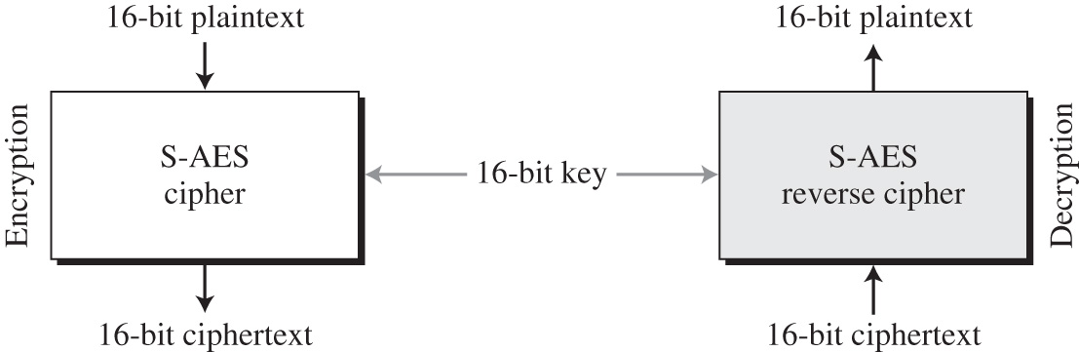
S-AES structure
9. S-AES CS480_S15

Slide 4
Rounds
S-AES is a non-Feistel cipher that encrypts and decrypts a data block of 16 bits
The cipher key is also 16 bits
It uses one pre-round transformation and two rounds
The round keys are created by the key expansion algorithm
  Three round keys
9. S-AES CS480_S15

Slide 5
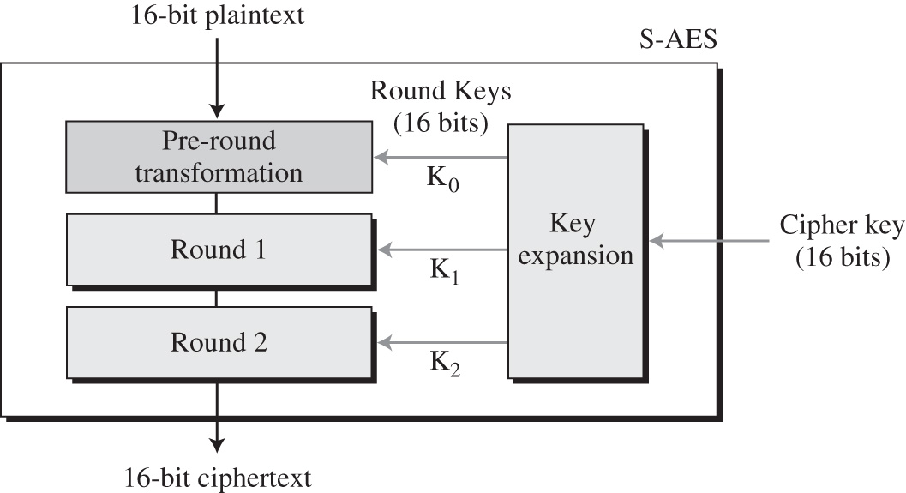
Rounds
9. S-AES CS480_S15

Slide 6
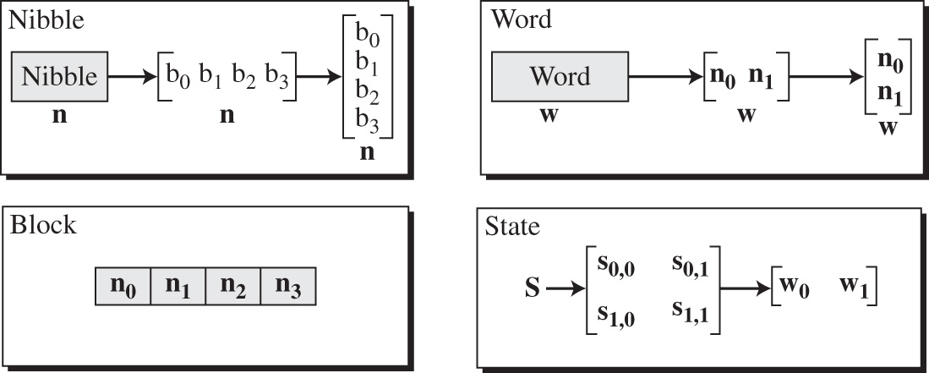
Data units
S-AES uses five units of measurement to refer to data
9. S-AES CS480_S15

Slide 7
Data units
Bits
  A bit is a binary digit with a value of 0 or 1.
  Use a lowercase letter b to refer to a bit
Nibble
  A nibble is a group of 4 bits (a hexadecimal digit)
  a row matrix of 4 bits
    The bits are inserted into the matrix from left to right
  a column matrix of 4 bits
    The bits are inserted into the matrix from top to bottom
  Use a lowercase bold letter n to refer to a nibble
9. S-AES CS480_S15

Slide 8
Data units
Word
  A word is a groups of 8 bits
  A row matrix of two nibbles
    The nibbles are inserted into the matrix from left to right
  A column matrix of 2 nibbles
    The nibbles are inserted into the matrix from top to bottom
  User a lowercase bold letter w to refer to a word
Block
  S-AES encrypts and decrypts data blocks.
  A block in S-AES is a group of 16 bits, or a row matrix of 4 nibbles
9. S-AES CS480_S15

Slide 9
Data units
State
  Also refers to a data block
  Treated as matrices of 4 nibbles
  Represented by an uppercase bold letter S
  Each element of a state is referred to as s_{r,c}
    r(0,1) defines the row and c(0,1) defines the column
  At the beginning of the cipher, nibbles in a data block are inserted into a state column by column, and in each column, from top to bottom
  At the end of the cipher, nibbles in the state are extracted in the same way
9. S-AES CS480_S15

Slide 10
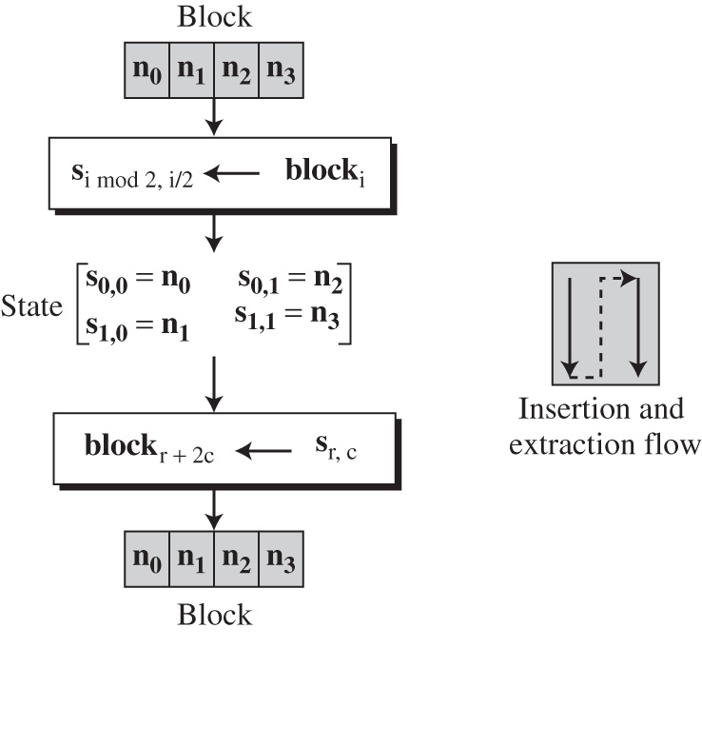
Data units: State
nibble_{i}
nibble_{r+2c}
9. S-AES CS480_S15

Slide 11
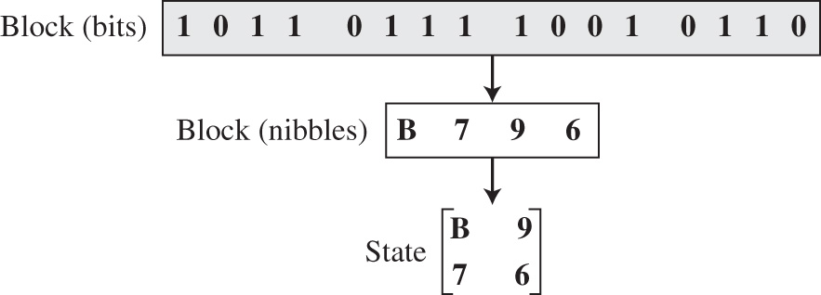
Example
How a 16-bit block can be inserted into a state matrix?
9. S-AES CS480_S15

Slide 12
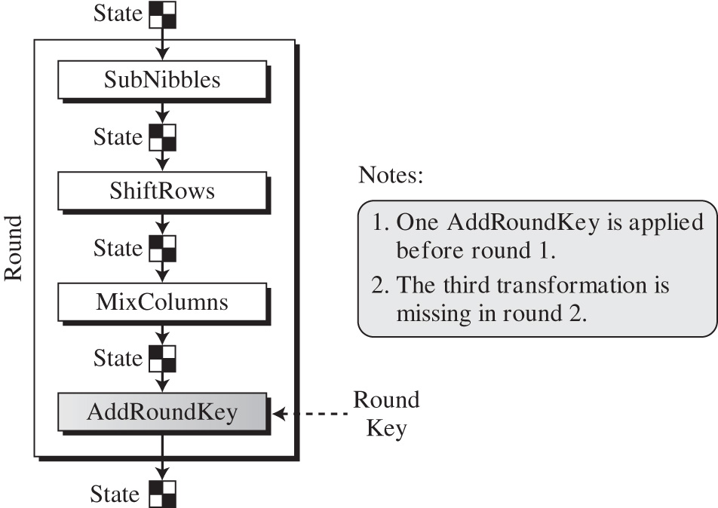
Structure of each round
9. S-AES CS480_S15

Slide 13
Structure of each round
Each transformation takes a state and creates another state to be used for the next transformation or the next round
The pre-round section uses only one transformation (AddRoundKey)
The last round uses only three transformations (MixColumn transformation is missing)
At the decryption side, the inverse transformations are used:
  InvSubNibbles, InvShiftRows, InvMixColumns, and AddRoundKey
9. S-AES CS480_S15

Slide 14
Transformations
To provide security, S-AES uses four types of transformations:
  Substitution, permutation, mixing and key adding
Substitution
  Done for each nibble (4-bit data unit)
  Only one table is used for transformations of every nibble
    If 2 nibbles are the same, the transformation is also the same
  SubNibbles transformation: for encryption
  InvSubNibbles transformation: for decryption
9. S-AES CS480_S15

Slide 15
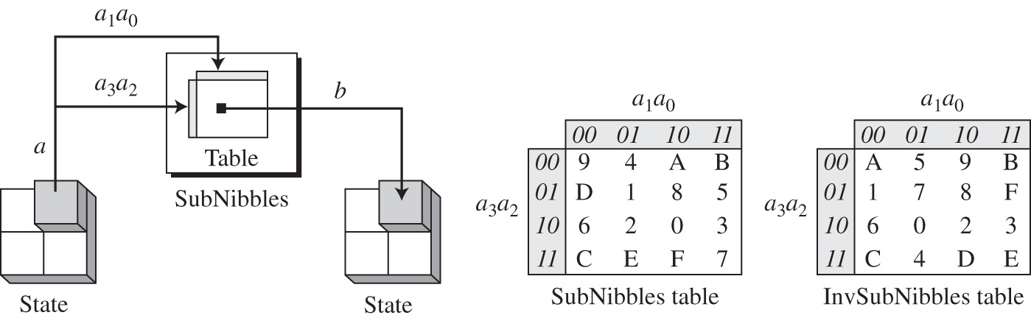
SubNibbles transformation
To substitute a nibble, we interpret the nibbles as 4bits
The left 2 bits define the row and the right 2 bits define the column of the substitution table
The hexadecimal digit at the junction of the row and the column is the new nibble
a₂a₃
a₀a₁
a₂a₃
a₂a₃
a₀a₁
a₀a₁
9. S-AES CS480_S15

Slide 16
SubNibbles transformation
The state is treated as a 2x2 matrix of nibbles
Transformation is done one nibble at a time
The contents of each nibble is changed, but the arrangement of the nibbles in the matrix remains the same
In the process, each nibble is transformed independently
  There are 4 distinct nibble-to-nibble transformations
9. S-AES CS480_S15

Slide 17
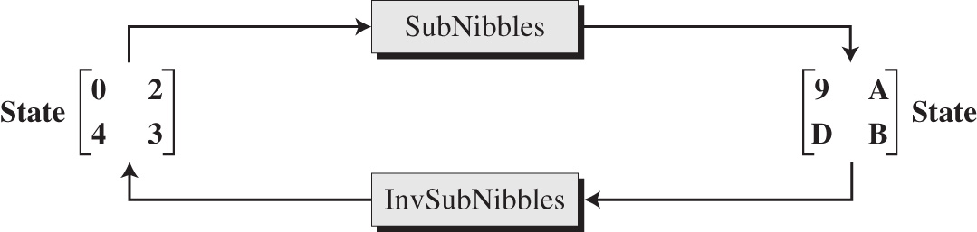
InvSubNibbles transformation
InvSubNibbles is the inverse of SubNibbles
Example
9. S-AES CS480_S15

Slide 18
Permutation
Another transformation is shifting: permutes nibbles
  Done at the nibble level
  The order of the bits in the nibble is not changed
ShiftRows
  Done on the encryption side
  Shifting is to the left
  The number of shifts depends on the row number (0,1)
    Row 0: not shifted
    Row 1: shiftted 1 nibble
InvShiftRows
  Done on the decryption side
  Inverse of ShiftRows
  Shifting is to the right
9. S-AES CS480_S15

Slide 19
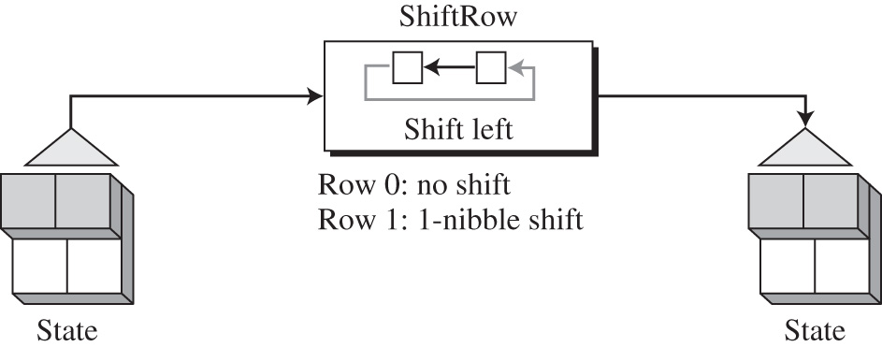
Permutation
9. S-AES CS480_S15

Slide 20
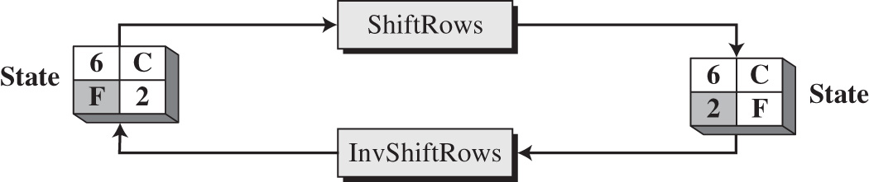
Example
How a state is transformed using ShiftRows and how InvShiftRows creates the original state
9. S-AES CS480_S15

Slide 21
Mixing
SubNibbles is an intra-nibble transform
  The substitution changes the value of the nibble based only on the nibble’s original value and an entry in the table
ShiftRows is a nibble exchange transform
  The transformation exchanges nibbles without permuting the bits inside in bytes
We also need an inter-nibble transformation that changes the bits inside a nibble
  Based on the bits inside the neighboring nibbles
  The nibbles are mixed to provide diffusion at the bit level
9. S-AES CS480_S15

Slide 22
Mixing
The mixing transformation changes the contents of each nibble by taking 2 nibbles at a time and combing them to create 2 new nibbles
How to guarantee that each new nibble is different(even if the old nibbles are the same)?
  First multiply each nibble with a different constant and then mixing them
  The mixing is provided by matrix multiplication
    Multiply a square matrix by a column matrix, the result is a new column matrix
    Each element in the new matrix depends on the two elements of the old matrix after they multiplied by two values in the constant matrix
9. S-AES CS480_S15

Slide 23
MixColumns
MixColumns transformations operates at the column level
It transforms each column of the state into a new column
  The transformation is actually the matrix multiplication of a state column by a constant square matrix
  The nibbles in the state column and constant matrix are interpreted as 4-bit words (or polynomials) with coefficients in GF(2)
  Multiplication of bytes is done in GF(2⁴) with modulus (x⁴ + x + 1) or (10011)
  Addition is the same as XORing of 4-bit words
9. S-AES CS480_S15

Slide 24
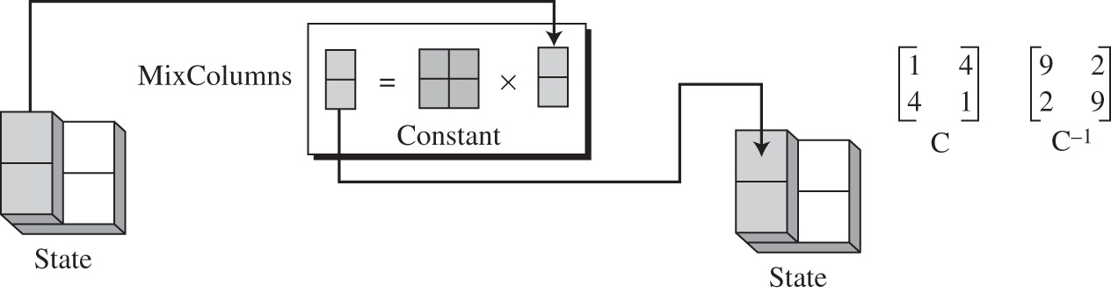
MixColumns
Constant matrix
Inverse of the constant matrix
InvMixColumns transformation is basically the same as the MixColumn except that it uses the inverse of the constant matrix
9. S-AES CS480_S15

Slide 25
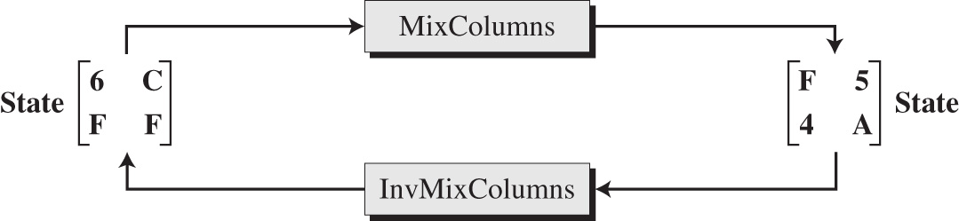
Example
Note:
  Equal bytes in the old state, are not equal in the new state
9. S-AES CS480_S15

Slide 26
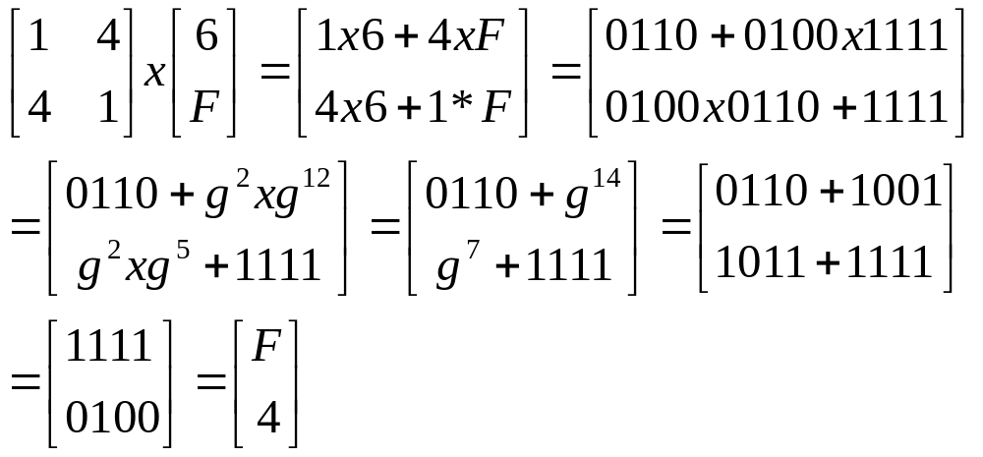
Example
Refer to the slides 8-23 and 8-24
9. S-AES CS480_S15

Slide 27
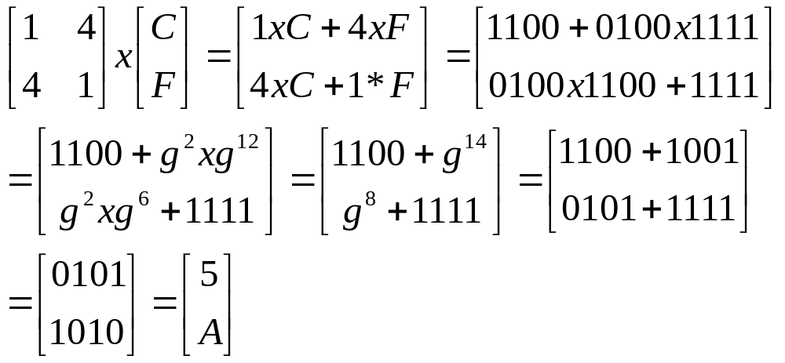
Example
9. S-AES CS480_S15

Slide 28

In-class exercise (group)
Given , how to use invMixColumns to get back
the original state matrix?
9. S-AES CS480_S15

Slide 29
Key adding
All previous transformations use known algorithms that are invertible
Key adding is the transformation that includes the cipher key
S-AES uses a process called key expansion that creates 3 round keys from he cipher key
  Each round key is 16 bits long
  It’s treated as 2 8-bit words
  Each word is considered as a column matrix
9. S-AES CS480_S15

Slide 30
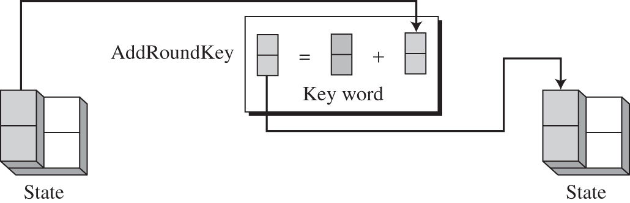
AddRoundKey
AddRoundKey adds a round key word with each state column matrix
9. S-AES CS480_S15

Slide 31
Key expansion
Key expansion routine creates 3 16-bit round keys from one single 16-bit cipher key
  The 1st round key is used for pre-round transformation
  The other 2 round keys are used for the last transformation(AddRoundKey) at the end of round 1 and round 2
Key expansion routine creates round keys word by word
  A word is an array of 2 nibbles
  The routine creates 6 words: w₀,w₁,…, w₅
9. S-AES CS480_S15

Slide 32
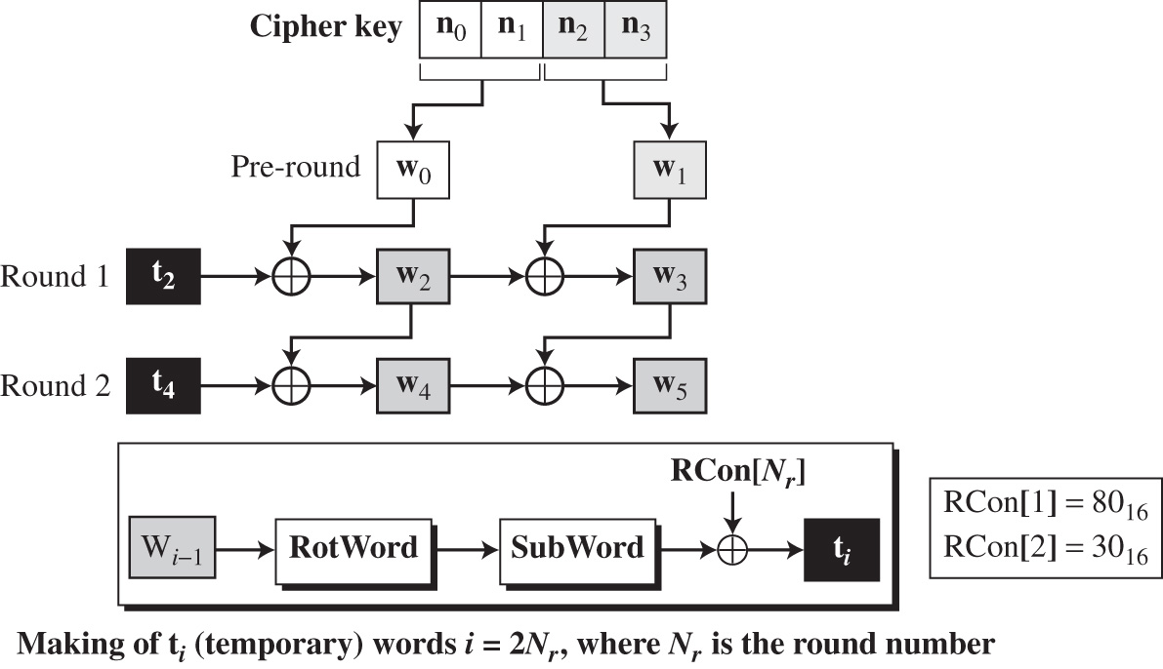
Key expansion
9. S-AES CS480_S15

Slide 33
Key expansion
The 1st two words(w0,w1) are made from the cipher key
  The cipher key is an array of 4 nibbles(n0 to n3)
  The 1st two nibbles(n0 to n1) become w0
  The next two nibbles(n2 to n3) become w1
The rest of words (w_{i} for i=2 to 5) are made as follows
  If (i mod 2 ) = 0, w_{i} = t_{i} ⊕ w_{i-2}
    How to calculate t_{i} ?
  If ( i mod 2)≠0, w_{i} = w_{i-1} ⊕ w_{i-2}
9. S-AES CS480_S15

Slide 34
Calculation of t_{i}
t_{i} is the result of applying two subroutines: Subword and RotWord, on wi-1 and Xoring with the result with a round constant, RC[Nr], where Nr is the round number
t_{i} = SubWord(RotWord(w_{i-1})) ⊕ RCon[Nr]
9. S-AES CS480_S15

Slide 35
Calculation of t_{i}
RotWord
  The RotWord(Rotate word) is similar to the ShiftRows transformation
  It takes a word as an array of 2 nibbles and swaps them
SubWord
  The SubWord(substitue word) routine is similar to the SubNibble, but it’s applied to only 2 nibbles
  It takes each nibble in the word and substitues another nibble for using the same SubNibble table
Round Constants
  Each round constant RC is a 2-nibble value
  The rightmost nibble is always 0
9. S-AES CS480_S15

Slide 36
Example
If the cipher key is 2475₁₆, how to generate the 3 round keys?
Round | Values of t’s | 1st word in the round | 2nd word in the round | Round key
0 |  | w0=24 | w1=75 | k0=2475
1 | t2=95 | W2=95 ⊕24=B1 | w3=B1 ⊕75=C4 | k1=B1C4
2 | t4=EC | W4=B1 ⊕EC=5D | W5=5D ⊕C4=99 | k2=5D99
RotWord(75)=57 →SubWord(57)=15 →t₂=15 ⊕ RC[1] = 15 ⊕ 80 = 95
RotWord(C4)=4C →SubWord(4C)=DC →t₄=DC ⊕ RC[2] = DC ⊕ 30 = EC
9. S-AES CS480_S15

Slide 37
Ciphers
S-AES uses the 4 types of transformations for encryption and decryption
  The encryption algorithm is cipher
  The decryption algorithm is the inverse cipher
S-AES is non-Feistel cipher
  Each transformation or group of transformations must be invertible
  The cipher and the inverse cipher must use these operations in such a way that they cancel each
  The round keys must also be used in the reverse order
9. S-AES CS480_S15

Slide 38
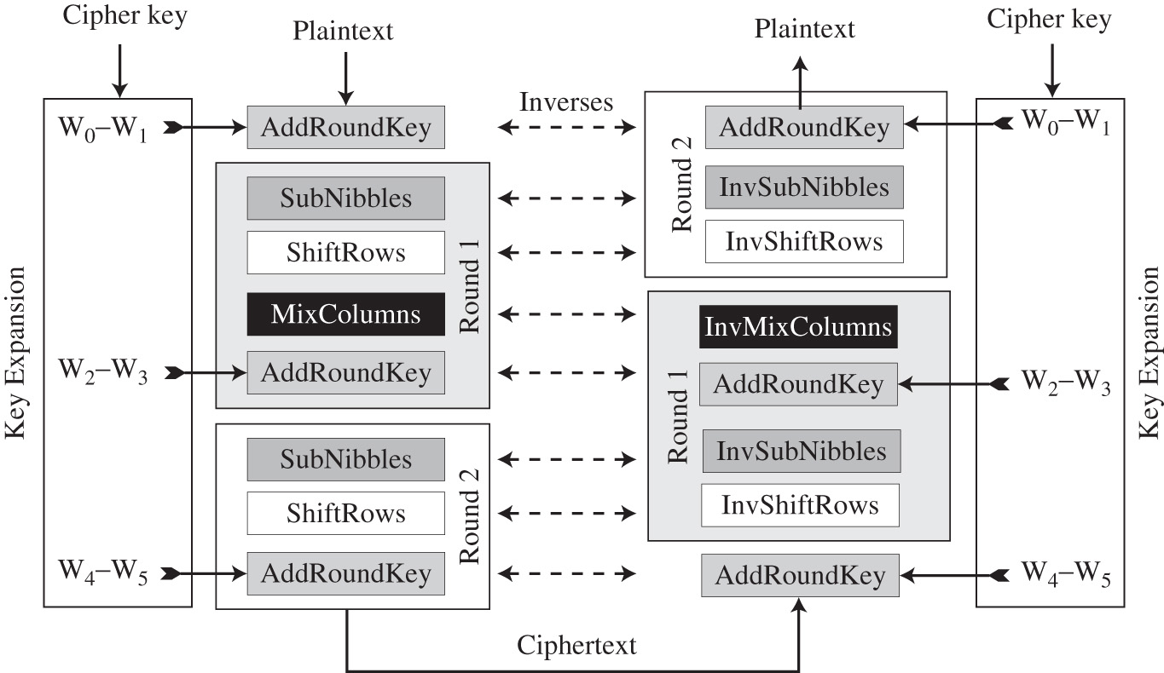
Ciphers
9. S-AES CS480_S15

Slide 39
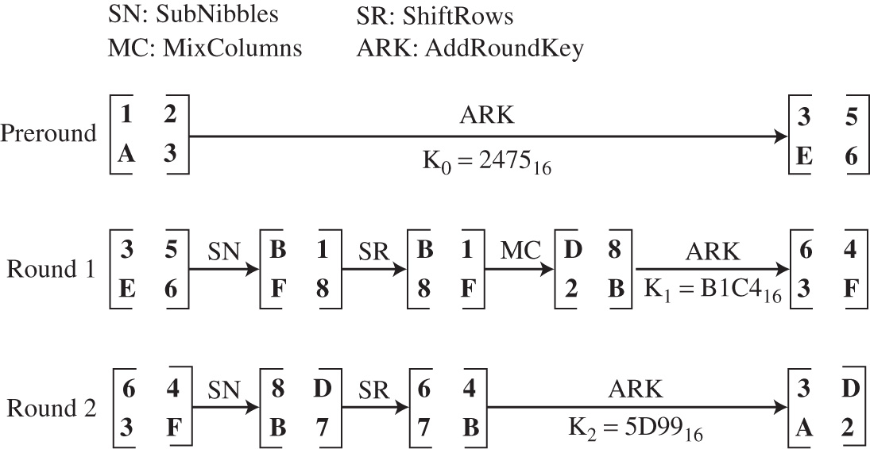




Example
9. S-AES CS480_S15

