Slide 1
CS480
Cryptography and Information Security
10. Encipherment using modern
symmetric key ciphers
Huiping Guo
Department of Computer Science
California State University, Los Angeles

Slide 2
Outline
Use of modern standard ciphers( DES/AES)
  Electronic Codebook (ECB) Mode
  Cipher Block Chaining (CBC) Mode
  Cipher Feedback (CFB) Mode
  Output Feedback (OFB) Mode
  Counter (CTR) Mode
10. Encipher CS480_S15

Slide 3
Use of modern standard ciphers
Modern block ciphers (DES/AES) are designed to encipher and decipher a block of text of fixed size
  DES encrypts and decrypts a block of 64 bits
  AES encrypts and decrypts a block of 128 bits
In real life applications, the text to be enciphered is of variable size
  Normally larger than 64 or 128 bits
Modes of operation are devised to encipher text of any size employing either DES or AES
10. Encipher CS480_S15

Slide 4
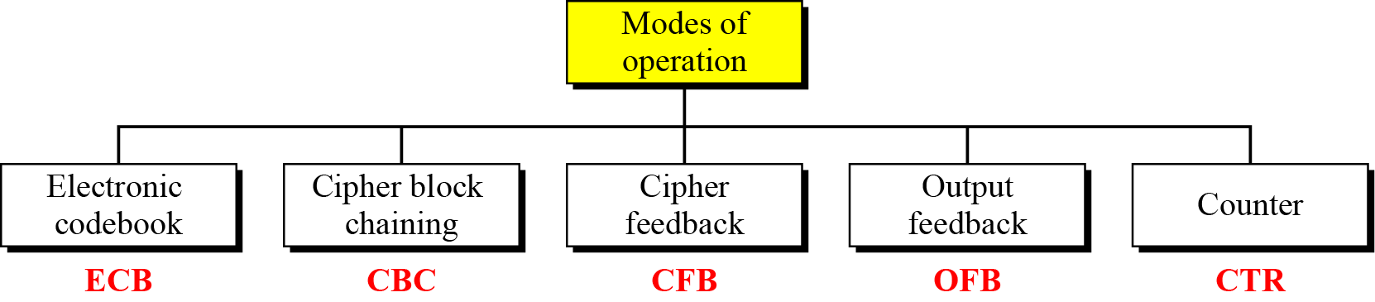
Modes of operation
10. Encipher CS480_S15

Slide 5
Electronic Codebook (ECB) Mode
The simplest mode of operation is called the electronic codebook (ECB) mode
The plaintext is divided into N blocks
  The block size is n bits
  If the plaintext size is not a multiple of the block size, the text is padded to make the last block the same size as the other blocks
The same key is used to encrypt and decrypt each block
10. Encipher CS480_S15

Slide 6
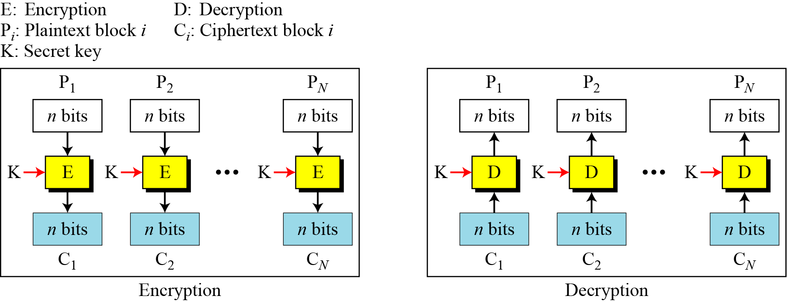
Electronic Codebook (ECB) Mode
Figure 8.2 Electronic codebook (ECB) mode
10. Encipher CS480_S15

Slide 7
Security issues
Patterns at the block level are preserved
  Equal blocks in the plaintext become equal blocks in the ciphertext
The block independency creates opportunities for Eve to exchange some ciphertext block without knowing the key
10. Encipher CS480_S15

Slide 8
Error propagation
A single bit error in transmission can create errors in many bits in the corresponding block
However, the error does not have any effect on the other blocks
10. Encipher CS480_S15

Slide 9
Ciphertext Stealing
In ECB mode, padding must be added to the last block if it is not n bits long
Padding is not always possible
Ciphertext stealing (CTS) can make it possible to use ECB mode without padding
In this technique the last two plaintext blocks, P_{N−1} and P_{N} , are encrypted differently and out of order
10. Encipher CS480_S15

Slide 10
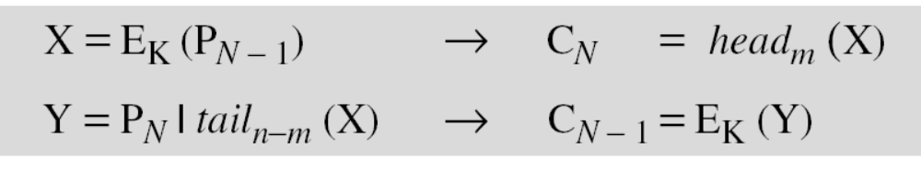
Ciphertext Stealing
Assuming that P_{N−1} has n bits and P_{N} has m bits, where m ≤ n
  Head_{m} (X) selects the leftmost m bits
  Tail_{n-m} selects the rightmost n-m bits
10. Encipher CS480_S15

Slide 11
Applications
The ECB mode of operation is not recommended for encryption of messages of more than one block to be transferred through an insecure channel
Encryption of databases
  Records are encryption before they are stored in a database or decrypted before they are retrieved
  Because the order of encryption and decryption is not important in this mode, access to the database can be random if each record is a block or multiple blocks
  A record can be retrieved from the middle, decrypted and encrypted after modification without affecting other records
We can use parallel processing if we need to create a very huge encrypted database
10. Encipher CS480_S15

Slide 12
Cipher Block Chaining (CBC) Mode
In CBC mode, each plaintext block is exclusive-ored with the previous ciphertext block before being encrypted
When a block is enciphered, the block is sent, but a copy of it is kept in memory to be used in the encryption of the next block
To encipher the first block, a phony block called initialization vector (IV) us used
  The sender and the receiver agreed on IV
10. Encipher CS480_S15

Slide 13
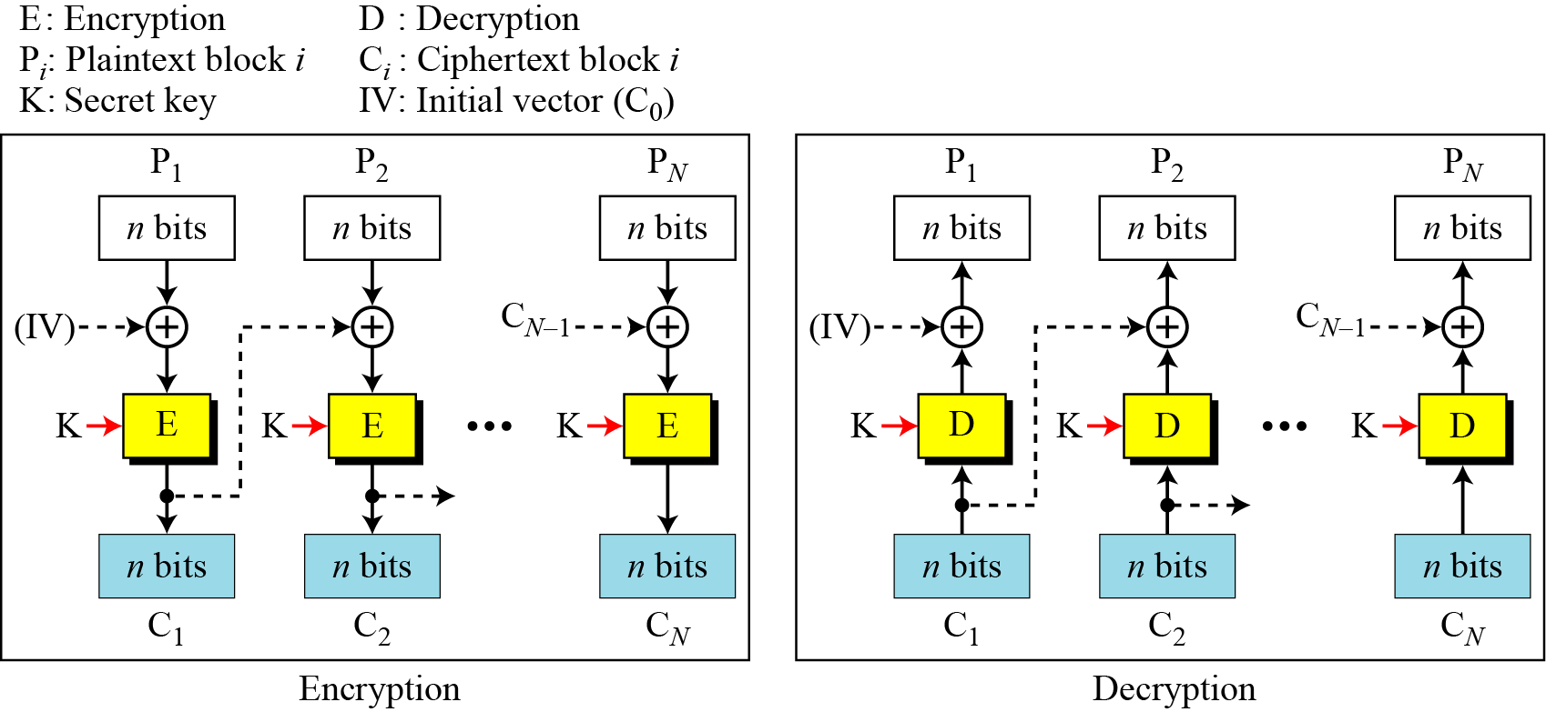
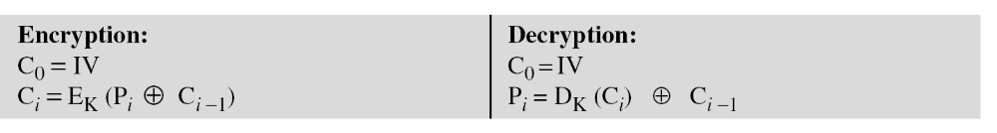
Cipher Block Chaining (CBC) Mode
10. Encipher CS480_S15

Slide 14
Cipher Block Chaining (CBC) Mode
It can be proved that each plaintext block at Alice’s site is recovered exactly at Bob’s site
Because encryption and decryption are inverses of each other
10. Encipher CS480_S15

Slide 15
Security issues
In CBC mode, equal plaintext blocks belong to the same message are enciphered into different ciphertext blocks
  The patterns at the block levels are not preserved
However, if the two messages are equal, their encipherment is the same if they use the same IV
  It’s recommended to use a timestamp as an IV
Eve can add some ciphertext blocks to the end of the ciphertext stream
10. Encipher CS480_S15

Slide 16
Error Propagation
In CBC mode, a single bit error in ciphertext block C_{j} during transmission may create error in most bits in plaintext block P_{j} during decryption
However, this single error toggles only one bit in plaintext block P_{j+1}
  the bit in the same location
Plaintext P_{j+2} to P_{N} are not affected by this single bit error
A single bit error in ciphertext is self-recovered
10. Encipher CS480_S15

Slide 17
Applications
The CBC mode of operation can be used to encipher messages
Because of the chaining mechanism, parallel processing is not possible
CBC mode is not used to encrypt and decrypt random-access files records
CBC mode is also used for authentication
10. Encipher CS480_S15

Slide 18
Cipher Feedback (CFB) Mode
ECB and CBC modes encrypt and decrypt blocks of the message
The block size is predetermined by the underlying cipher
In some situations, we need to use DES or AES as secure ciphers, but the plaintext or ciphertext block sizes are to be smaller
The solution: use DES or AES in cipher feedback mode (CFB)
10. Encipher CS480_S15

Slide 19
Cipher Feedback (CFB) Mode
In CFB mode, encipherment and decipherment use the encryption function of the underlying block cipher
DES or AES is not used for encrypting/decrypting plaintext
DES/AES is used for encrypting/decrypting the contents of a shift register S of size n
Encryption is done exclusive-oring an r-bit plaintext block with r bits of the shift register
For each block, the shift register S_{i} is made by shifting S_{i-1} r bits to the left and filling the rightmost r bits with C_{i-1}.
10. Encipher CS480_S15

Slide 20
Cipher Feedback (CFB) Mode
S_{i} is then encrypted to T_{i}
Only the leftmost r bits of T_{i} are exclusive-ored with the plain text block P_{i} to make the C_{i}
S₁ is set to the IV for the first block
No padding is needed
The relation between plaintext and ciphertext blocks is shown below:
10. Encipher CS480_S15

Slide 21
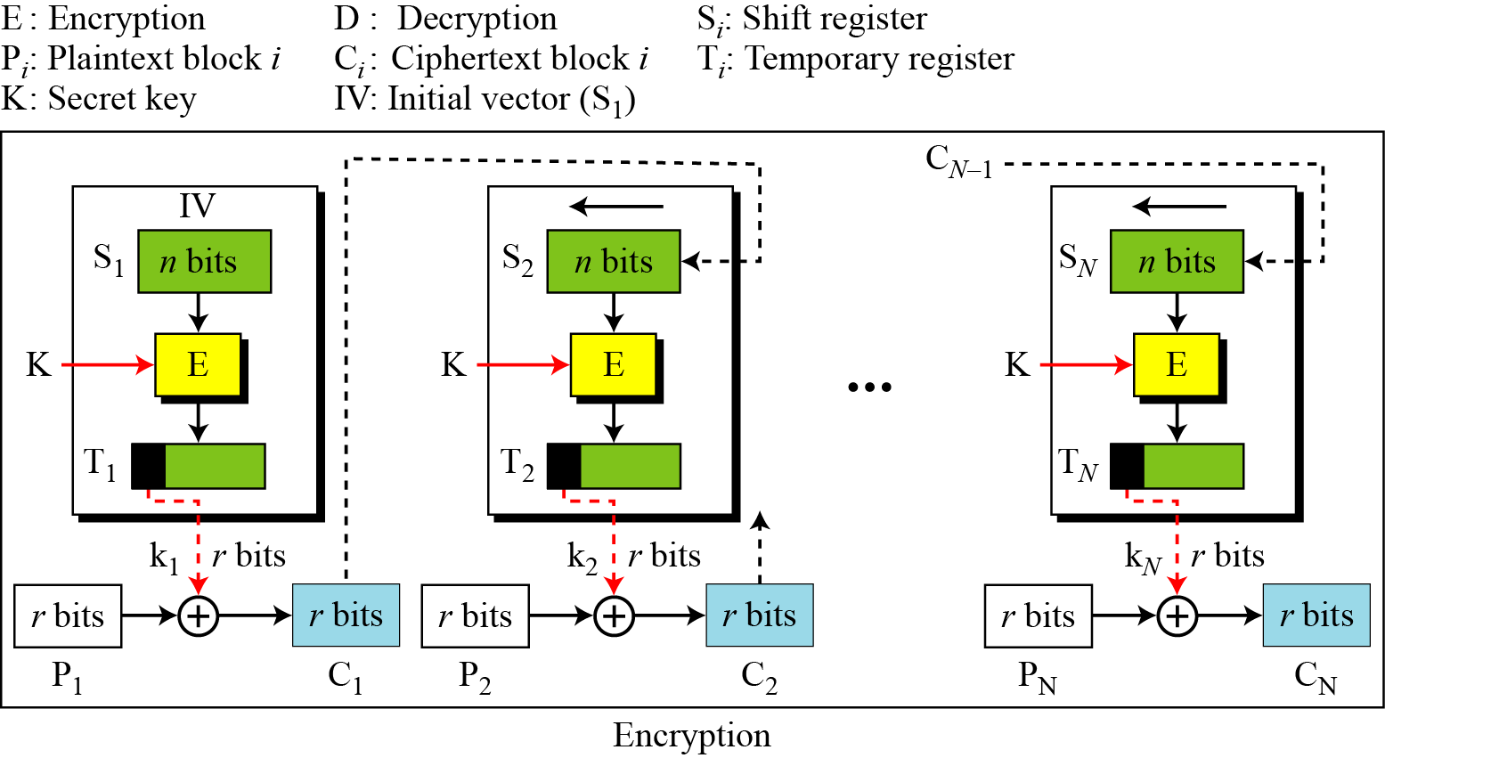
Cipher Feedback (CFB) Mode
10. Encipher CS480_S15

Slide 22
Security issues
Just like CBC, the patterns at the block level are not preserved
More than one message can be encrypted with the same key, but the value of the IV should be changed for each message
Eve can add some ciphertext block to the end of the ciphertext stream
10. Encipher CS480_S15

Slide 23
Error propagation
In CFB, a single bit error in ciphertext block Cj during transmission creates a single bit error (at the same position) in plaintext block Pj
However, most of the bits in the following plaintext blocks are in error as long as some bits of Cj are still in the shift register
10. Encipher CS480_S15

Slide 24
Applications
The CFB mode of operation can be used to encipher blocks of small size
  Such as one character or bit at a time
There is no need for padding because the size of the plaintext block is normally fixed.
10. Encipher CS480_S15

Slide 25
Output Feedback (OFB) Mode
OFB is very similar to CFB
There is only one difference: each bit in the ciphertext is independent of the previous bits
  This avoids error propagation
  If an error occurs in transmission, it does not affect the bits that follow
Like CFB, both the sender and the receiver use the encryption algorithm
10. Encipher CS480_S15

Slide 26
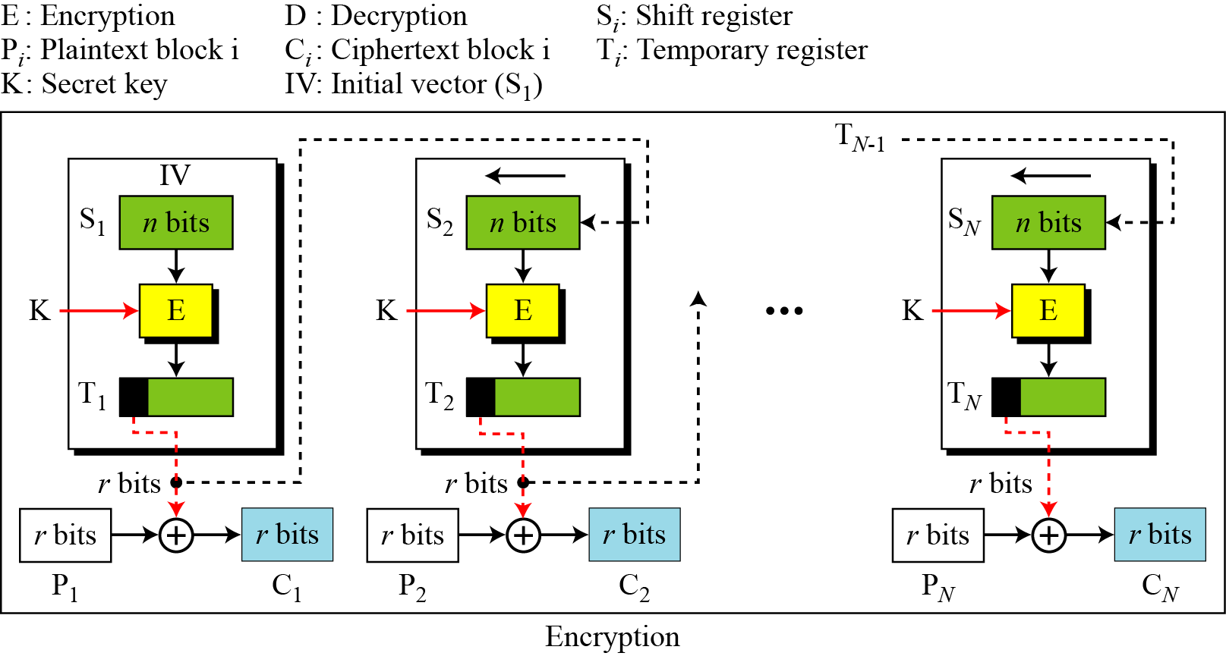
Output Feedback (OFB) Mode
10. Encipher CS480_S15

Slide 27
Output Feedback (OFB) Mode
Security issues
  Just like CFB, patterns at the block level are not preserved
Error propagation
  A single error in the ciphertext affects only the corresponding bit in the plaintext
10. Encipher CS480_S15

Slide 28
Counter (CTR) Mode
In CTR mode, there is no feedback
The pseudorandomness in the key stream is achieved using a counter
An n-bit counter is initialized to a pre-determined value (IV) and incremented based on a predefined rule (mod 2^{n})
To provide a better randomness, the increment value can depend on the block number to be incremented
10. Encipher CS480_S15

Slide 29
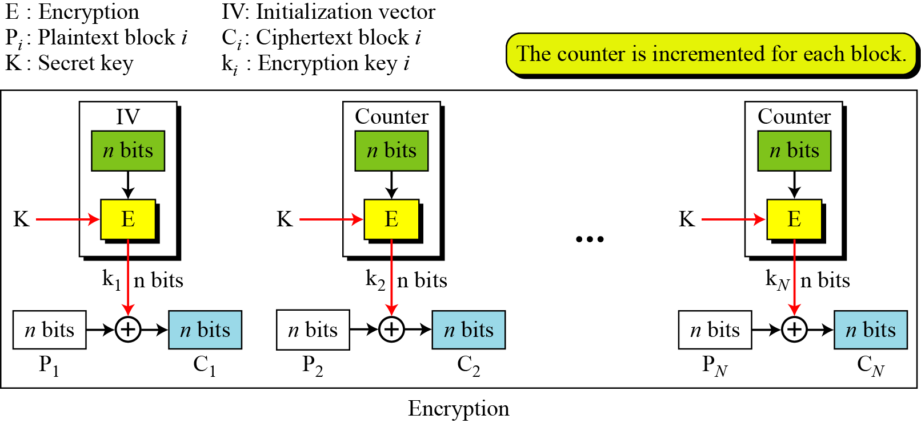
Counter (CTR) Mode
10. Encipher CS480_S15

Slide 30
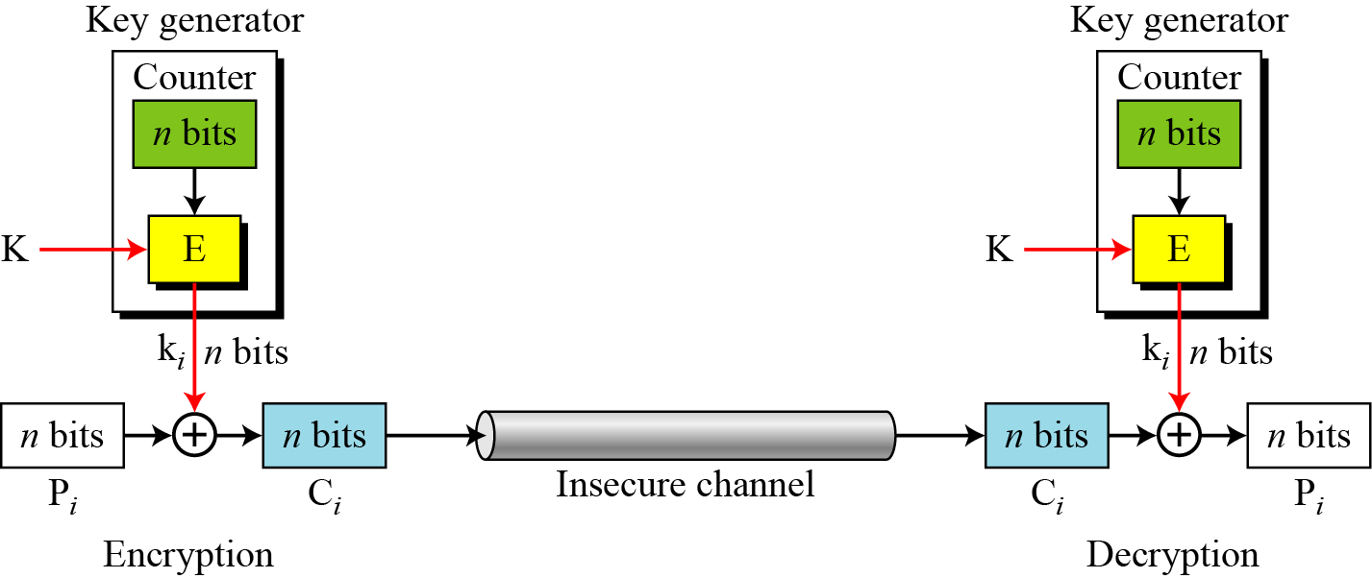
CTR Mode as a stream cipher
10. Encipher CS480_S15

Slide 31
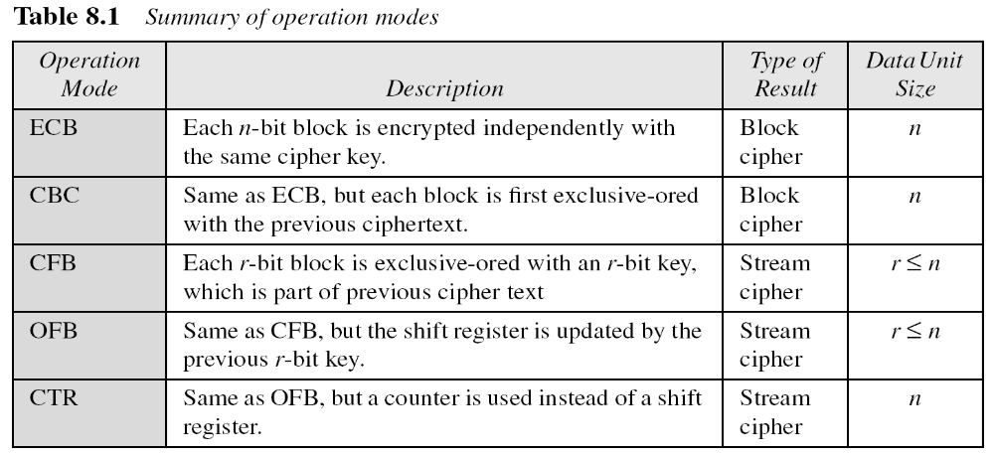
Comparison of Different Modes
10. Encipher CS480_S15

