Slide 1
CS480
Cryptography and Information Security
11. Mathematics of Cryptography 5
Huiping Guo
Department of Computer Science
California State University, Los Angeles

Slide 2
Outline
Prime numbers
Primality testing
Euler’s Phi-Function
Fermat’s Little Theorem
Euler’s Theorem
Chinese remainder theorem and its application
Quadratic congruence
11. Math 5 CS480_S15

Slide 3
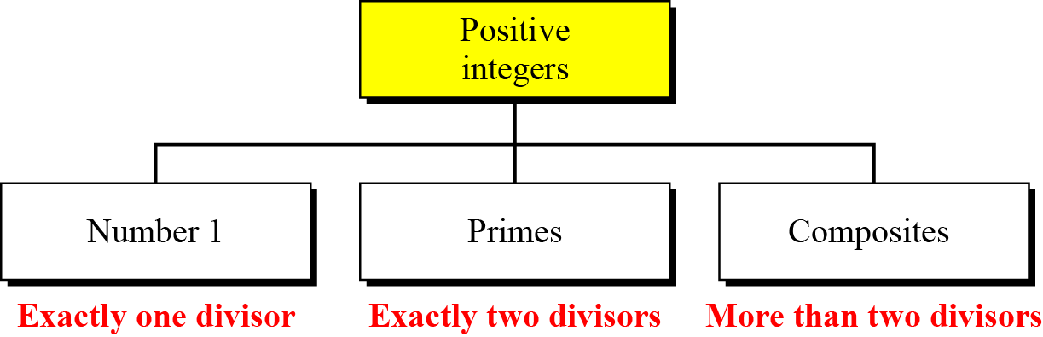
Definition
A prime is divisible only by itself and 1
Figure 9.1 Three groups of positive integers
11. Math 5 CS480_S15

Slide 4
Examples
Example 9.1
What is the smallest prime?
Solution
The smallest prime is 2, which is divisible by 2 (itself) and 1.
Question: Is the integer 1 a prime?
  A prime must be divisible by 2 different integers
  1 is divisible only by itself
  1 is NOT a prime
11. Math 5 CS480_S15

Slide 5
Examples
Example 9.2
List the primes smaller than 10.
Solution
There are four primes less than 10: 2, 3, 5, and 7.
The percentage of primes in the range 1 to 10 is 40%.
The percentage decreases as the range increases.
11. Math 5 CS480_S15

Slide 6
Relatively prime (coprime)
Two positive integers a and b are relatively prime, or coprime, if gcd(a,b) = 1
1 is relatively prime with any integer
If p is prime, all integers between 1 and p-1 are relatively prime to p
  Z_{p*} = { 1, … , p-1}
11. Math 5 CS480_S15

Slide 7
Relatively prime
Examples
gcd(3,5) = 1 3 and 5 are relatively prime
gcd(11, 17) = 1 11 and 17 are relatively prime
gcd(12,16) = 4 12 and 14 are not relatively prime
Exercise: are they relatively prime?
  12 and 19
  3 and 15
  14 and 18
  9 and 13
11. Math 5 CS480_S15

Slide 8
Relatively prime
Are the following statements correct?
  If two integers are relatively prime, they are both prime numbers
  If two integers are relatively prime, at least one of them is a prime number
  If two integers are prime numbers, they are relatively prime
  If two integers are odd numbers, they are relatively prime
  If two integers are relatively prime, they are both odd numbers
  If two integers are relatively prime, at least one of them is an odd number
11. Math 5 CS480_S15

Slide 9

Checking for Primeness
There is an infinite number of primes
Given a number n, how to determine if n is a prime?
A simple approach
  Check if the number is divisible by all primes less than
Example 9.5
  Is 97 a prime?
  The floor of 97^{1/2} = 9
  The primes less than 9 are 2,3,5,7
  97 is not divisible by any one of them
  97 is a prime
11. Math 5 CS480_S15

Slide 10
Euler’s Phi-Function
Also called Euler’s totient function φ(n)
  The number of integers that are both smaller than n and relatively prime to n
Some rules
  φ(1) = 0
  φ(p) = p-1 if p is a prime
  φ(m × n) = φ(m) × φ(n) if m and n are relatively primes
  φ(p^{e}) = p^{e}-p^{e-1} if p is a prime
11. Math 5 CS480_S15

Slide 11
Euler’s Phi-Function
The four rules can be combined
  If n can be factored as n=p₁^{e1}×p₂^{e2}×… × p_{k}^{ek} , then
  φ(n) = (p₁^{e1}-p₁^{e1-1}) × (p₂^{e2}-p₂^{e2-1}) ×… ×(p_{k}^{ek}-p_{k}^{ek-1})
The value of φ(n) for large n can be found only if n can be factored into primes
The difficulty of finding φ(n) depends on the difficulty of finding the factorization of n
Factorization of large n is VERY DIFFICULT!
11. Math 5 CS480_S15

Slide 12
Examples
Example 9.7
  What is the value of φ(13)?
  Because 13 is a prime, φ(13) = (13 −1) = 12
Example 9.8
  What is the value of φ(10)?
  φ(10) = φ(2) × φ(5) = 1 × 4 = 4
Example 9.9
  What is the value of φ(240)?
  240 = 2⁴ × 3¹ × 5¹
  φ(240) = (2⁴ −2³) × (3¹ − 3⁰) × (5¹ − 5⁰) = 64
11. Math 5 CS480_S15

Slide 13
Examples
Example 9.10
  What is the value of φ(49)?
  φ(49) = φ(7) × φ(7) = 6 × 6 = 36
  Wrong! The third rule applies when m and n are relatively prime
  49 = 7², φ(49) =7² – 7¹ = 42
Example 9.11
  How many elements are there in Z_{14*}?
  φ(14) = φ(2) × φ(7) = 6
  The members in the set are: 1, 3, 5, 9, 11, 13
An interesting point
  If n > 2, the value of φ(n) is even
11. Math 5 CS480_S15

Slide 14
Exercise
  What is the value of φ(49)?
  What is the value of φ(180)?
What’s the order of group <Z_{280*},x>?
11. Math 5 CS480_S15

Slide 15
Fermat’s Little Theorem
First version
  If p is a prime and a is an integer
  And Gcd(a, p) = 1
  then a^{p-1} ≡ 1 mod p
Exercise
  Which of the followings are correct?
  10⁵⁻¹ ≡ 1 mod 5
  10³⁻¹ ≡ 1 mod 3
  11⁶⁻¹ ≡ 1 mod 6
  12⁶⁻¹ ≡ 1 mod 6
  12⁷⁻¹ ≡ 1 mod 7
11. Math 5 CS480_S15

Slide 16
Fermat’s Little Theorem
Second version
  If p is a prime and a is an integer
  a^{p} ≡ a mod p
  the 2nd condition on is removed!
Exercise
  Which of the followings are correct?
  3⁴ ≡ 3 mod 4
  3⁵ ≡ 3 mod 5
  4⁸ ≡ 4 mod 8
  5⁸ ≡ 5 mod 11
11. Math 5 CS480_S15

Slide 17
Examples
Example 9.12
  Find the result of 6¹⁰ mod 11
  6¹⁰ mod 11 ≡ 6^{11 – 1} mod 11 ≡ 1 mod 11
Example 9.13
  Find the result of 3¹² mod 11
  3¹² mod 11 ≡ 3x 3¹¹ ≡ (3 mod 11) x (3¹¹ mod 11) ≡ 9 mod 11
Exercise
  Use Fermat’s theorem to find a number x between 0 and 28 with x⁸⁵ congruent to 6 modulo 29
11. Math 5 CS480_S15

Slide 18
Multiplicative inverse
Fermat’s theorem can be used to find some multiplicative inverses quickly if the modulus is a prime
a x a⁻¹ ≡ 1 mod p
= a^{p-1} mod p (by Fermat’s theorem)
= a x a^{p-2} mod p
a⁻¹ ≡ a^{p-2} mod p
The conditions on a and p
  p is prime
  Gcd(a,p) = 1
11. Math 5 CS480_S15

Slide 19
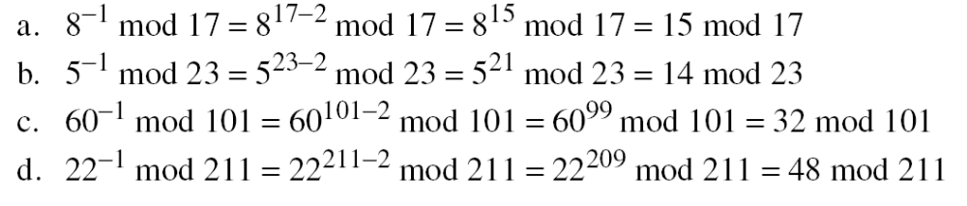
Multiplicative inverse
Examples
11. Math 5 CS480_S15

Slide 20
Euler’s Theorem
Euler’s theorem is a generalization of Fermat’s little theorem
  The modulus in the Fermat theorem is a prime
  The modulus in Euler’s theorem is an integer
First version: a ^{φ(n)} ≡ 1 (mod n)
  Condition: gcd(a, n) = 1
Second version: a ^{k ×} ^{φ(n)} ⁺ ¹ ≡ a (mod n)
  k is an integer
  The condition gcd(a,n) = 1 is removed!
  The theorem is used in RSA cryptosystem in Chapter 10
11. Math 5 CS480_S15

Slide 21
Examples
Example 9.15
  Find the result of 6²⁴ mod 35
  φ(35) φ(5) x φ(7) = 4 x 6 = 24
  6²⁴ mod 35 ≡ 6^{φ(35)} mod 35 ≡ 1 mod 35
Example 9.15
  Find the result of 20⁶² mod 77
  φ(77) = φ(7) x φ(11) =6 x 10 = 60
  20⁶² mod 77 ≡ 20² x 20⁶⁰ mod 77
  ≡ (20² mod 77) x (20⁶⁰ mod 77)
  ≡ 20² mod 77
  ≡ 15 mod 77
11. Math 5 CS480_S15

Slide 22
Exercise
Use Euler’s theorem to find a number a between 0 and 9 such that a is congruent to 7¹⁰⁰¹ modulo 10
11. Math 5 CS480_S15

Slide 23
Multiplicative inverse
Fermat’s theorem can be used to find some multiplicative inverses quickly if the modulus is a prime
Euler’s theorem can be used to find multiplicative inverse modulo a composite
a x a⁻¹ mod n = 1 mod n
a x a⁻¹ mod n = a^{φ(n)} mod n = 1 mod n
a⁻¹ ≡ a^{φ(n)-1} mod n
The conditions on a and n
  Gcd(a,n) = 1
11. Math 5 CS480_S15

Slide 24
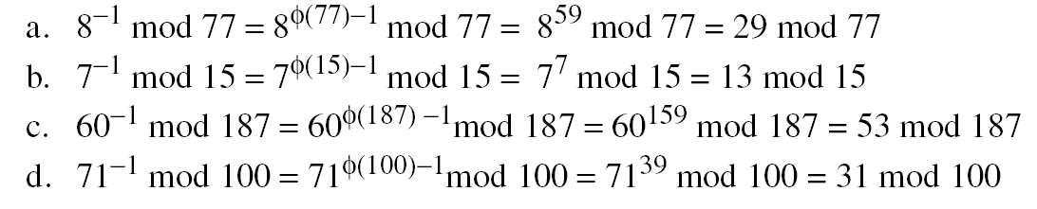
Multiplicative inverse
The answers to multiplicative inverses modulo a composite can be found without using the extended Euclidean algorithm if we know the factorization of the composite:
11. Math 5 CS480_S15

Slide 25

Factorization
Fundamental theorem of arithmetic
  Any positive integer greater than one can be written uniquely in the following prime factorization form
  p₁, p₂,….p_{k} are primes, e1, e2, … e3 are integers
Examples:
  18 = 2 x 3²
  280 = 2³ x 5 x 7
  450 = ?
  12452325432321235423523420340554342213123590=?
11. Math 5 CS480_S15

Slide 26
Factorization method
Factoring large composite numbers has been a research area
No perfect algorithm has been found
Several algorithms can factor a number, but none are capable of factoring a very large number in a reasonable amount of time
  This is good for cryptography
The security of several public key systems relies on the fact that factorization is time consuming
11. Math 5 CS480_S15

Slide 27
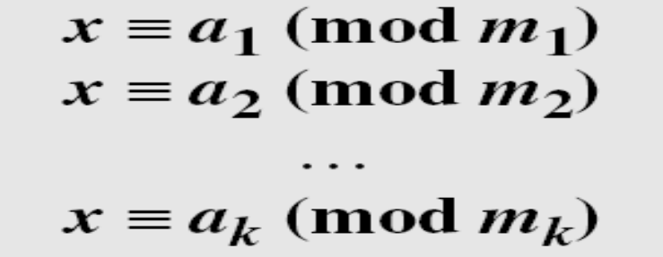
Chinese Remainder Theorem (CRT)
The Chinese remainder theorem (CRT) is used to solve a set of congruent equations with one variable but different moduli, which are relatively prime, as shown below:
The Chinese remainder theorem states that the above equations have a unique solution if the moduli are relatively prime
11. Math 5 CS480_S15

Slide 28
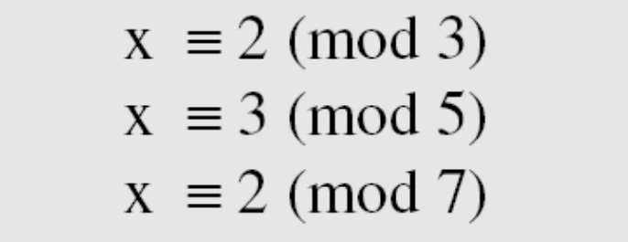
CRT example
The answer is x=23
23 satisfies the three equations
11. Math 5 CS480_S15

Slide 29
Solution To Chinese Remainder Theorem
Find M = m₁ × m₂ × … × m_{k}. This is the common modulus.
Find M₁ = M/m₁, M₂ = M/m₂, …, M_{k} = M/m_{k}
Find the multiplicative inverse of M₁, M₂, …, M_{k} using the corresponding moduli (m₁, m₂, …, m_{k}). Call the inverses
M₁⁻¹, M₂⁻¹, …, M_{k} ⁻¹.
The solution to the simultaneous equations is
11. Math 5 CS480_S15

Slide 30
Example
Find the solution to the simultaneous equations
M = 3 × 5 × 7 = 105
M₁ = 105 / 3 = 35, M₂ = 105 / 5 = 21, M₃ = 105 / 7 = 15
The inverses are M₁⁻¹ = 2 mod 3, M₂⁻¹ = 1 mod 5, M₃ ⁻¹ = 1 mod 7
x = (2 × 35 × 2 + 3 × 21 × 1 + 2 × 15 × 1) mod 105 = 23 mod 105
11. Math 5 CS480_S15

Slide 31
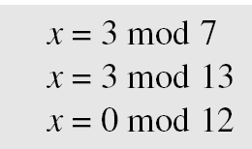
Exercise
Find an integer that has a remainder of 3 when divided by 7 and 13, but is divisible by 12
This is a CRT problem. We can form three equations and solve them to find the value of x
The answer is: x = 276
11. Math 5 CS480_S15
Notes:
m = 7x13x12 = 1092
M1 = 156 M2 = 84
M1^-1 = 156 ^ 5 mod 7 = 4
M2^-1 = 84^11 mod 13 = 11
X = (3x156x4+3x84x11)mod 1092=276

Slide 32
Quadratic congruence
Quadratic equations are equations of the form
a₂x² + a₁x + a₀ ≡ 0 (mod n)
We only consider the equations with a₂=1, a₁ = 0
  x² ≡ a (mod n)
Quadratic congruence modulo a prime
  x² ≡ a (mod p)
  p is a prime
  The equation either has no solutions or exactly two solutions
11. Math 5 CS480_S15

Slide 33
Quadratic congruence modulo a prime
Example 9.39
  x² ≡ 3 (mod 11)
  Two solutions: x ≡ 5 (mod 11), x ≡ -5 (mod 11)
Example 9.40
  x² ≡ 2 (mod 11)
  No solutions
  No integer x can be found such that its square is 2 mod 11.
11. Math 5 CS480_S15

Slide 34
Quadratic Residues and Nonresidue
x² ≡ a (mod p)
a is called quadratic residue (QR) if the equation has two solutions
a is called quadratic nonresidue(QNR) if the equation has no solutions
In Z_{p*} with p-1 elements, exactly (p-1)/2 elements are quadratic residues and (p-1)/2 are quadratic nonresidues
11. Math 5 CS480_S15

Slide 35
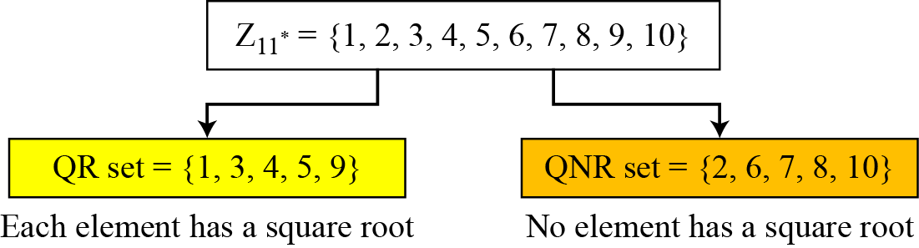
Quadratic Residues and Nonresidues
Example 9.41
  Z_{11*} has 10 elements. 5 are QRs, 5 are QNRs
11. Math 5 CS480_S15

Slide 36
Euler’s Criterion
Used to tell whether an integer is a QR or NQR
If a^{(p−1)/2} ≡ 1 (mod p), a is a quadratic residue
modulo p
If a^{(p−1)/2} ≡ −1 (mod p), a is a quadratic nonresidue modulo p
Example 9.42
  find out if 14 or 16 is a QR in Z_{23*},
  14 ^{(23−1)/2} mod 23 → 22 mod 23 → −1 mod 23 nonresidue
  16 ^{(23−1)/2} mod 23 → 1 mod 23 residue
11. Math 5 CS480_S15

Slide 37
Solving Quadratic Equation Modulo a Prime
A prime can be either p=4k+1 or p=4k+3
  k is a positive integer
If p is in the form 4k+3 and a is a QR in Z_{p}*, then
x ≡ a^{(p+1)/4} (mod p) and x ≡ -a^{(p+1)/4} (mod p)
11. Math 5 CS480_S15

Slide 38
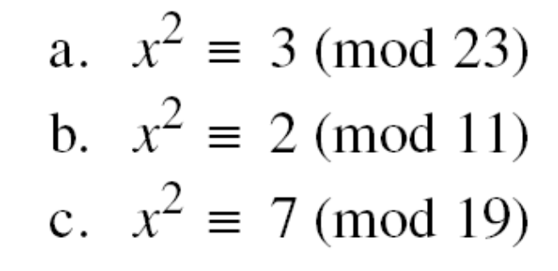
Solving Quadratic Equation Modulo a Prime
Solve the following quadratic equations:
a. x ≡ ± 16 (mod 23) √3 ≡ ± 16 (mod 23).
b. There is no solution for √2 in Z11.
c. x ≡ ± 11 (mod 19). √7 ≡ ± 11 (mod 19).
11. Math 5 CS480_S15

Slide 39
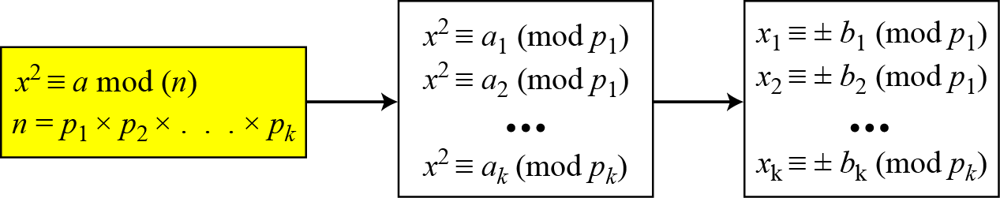
Quadratic Congruence Modulo a Composite
Figure 9.5 Decomposition of congruence modulo a composite
11. Math 5 CS480_S15

Slide 40
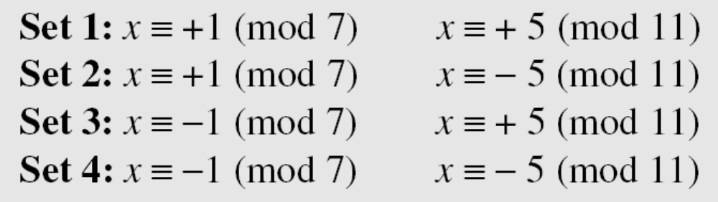
Quadratic Congruence Modulo a Composite
Assume that x² ≡ 36 (mod 77). We know that 77 = 7 × 11. We can write
The answers are x ≡ +1 (mod 7), x ≡ − 1 (mod 7), x ≡ + 5 (mod 11), and x ≡ − 5 (mod 11). Now we can make four sets of equations out of these:
The answers are x = ± 6 and ± 27.
11. Math 5 CS480_S15

