Slide 1
CS480
Cryptography and Information Security
12. Asymmetric Key Cryptography
Huiping Guo
Department of Computer Science
California State University, Los Angeles

Slide 2
Outline
The differences between two cryptosystems: symmetric-key and asymmetric-key
Trapdoor one-way functions
RSA cryptosystem
Rabin cryptosystem
ElGamal cryptosystem

Slide 3
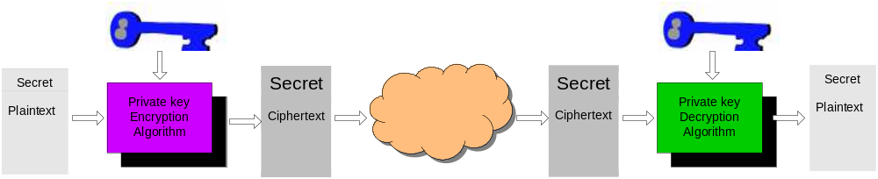
Symmetric-Key Cryptography
Symmetric-Key cryptography uses one key
The same key is used for both encryption and decryption
The key is shared by the sender and the receiver
Problems
  It’s hard for the sender and the receiver to agree on a key before the communication
  Large number of keys are needed
    If N persons need secure communication with each other, how many keys are needed? How many keys each person needs to keep
Notes:
First, let’s have a short overview of private key cryptograph. The diagram shows how it works.
A sender wants to send a message to a recipient. First, the sender encrypts the message using a key, the encrypted message is then sent over the internet. After the recipient receives the message, he uses the same key to decrypt the message.
From the diagram, we can see that in private key cryptography:
Only one key is used
The same key is used for both encryption and decryption
shared by both sender and receiver
so the sender and the receiver have to agree on the key in advance. The problem is that it’s very difficult for them to do so. How can the sender make the known only to the recipient?

Slide 4
Symmetric-Key Cryptography
F
A
E
B
D
C
N = 6
The number of total keys: N*(N-1)/2 = 18
The number of keys each person need to keep: N-1=5

Slide 5
Asymmetric-Key Cryptography
Probably most significant advance in the 3000 year history of cryptography
Also called public key cryptography
Asymmetric-Key Cryptography uses two keys – a public & a private key
Asymmetric since parties are not equal
  The sender uses either key to encrypt a message
  The receiver must use the other key to decrypt the message
Notes:
Will now discuss the radically different public key systems, in which two keys are used. The development of public-key cryptography is the greatest and perhaps the only true revolution in the entire history of cryptography. It is asymmetric, involving the use of two separate keys, in contrast to symmetric encryption,which uses only one key. Anyone knowing the public key can encrypt messages or verify signatures, but cannot decrypt messages or create signatures, counter-intuitive though this may seem. It works by the clever use of number theory problems that are easy one way but hard the other. Note that public key schemes are neither more nor less secure than private key (security depends on the key size for both), nor do they replace private key schemes (they are too slow to do so), rather they complement them. Both also have issues with key distribution, requiring the use of some suitable protocol.

Slide 6
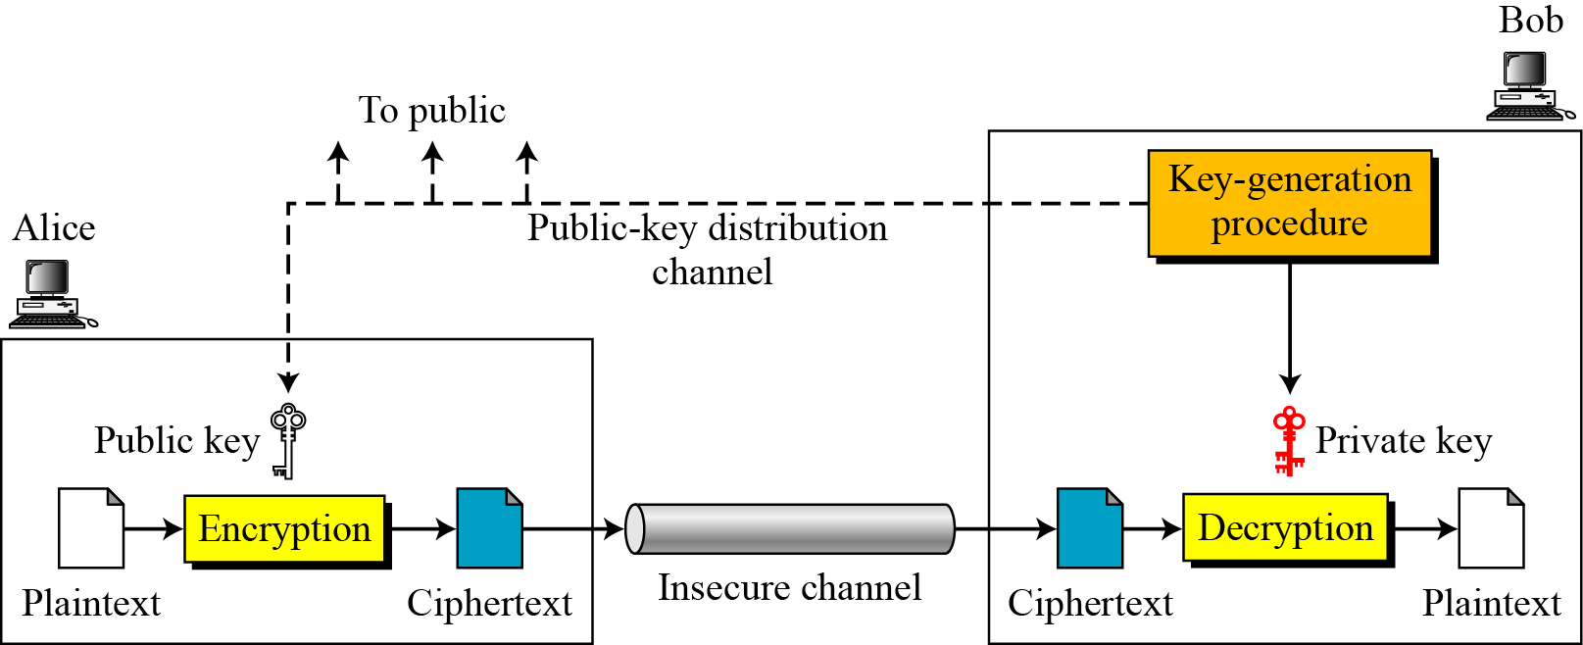
General idea of asymmetric-key cryptosystem

Slide 7
General idea of asymmetric-key cryptosystem
Plaintext/Ciphertext
  plaintext and ciphertext are treated as integers in asymmetric-key cryptography
Encryption/decryption
  Kpublic/Kprivate: Receiver’s public/private key
C = f (K_{public} , P)
P = g(K_{private} , C)

Slide 8
Asymmetric-Key Cryptography
    If N persons need secure communication with each other,
      how many keys are needed?
      How many keys each person needs to keep?

Slide 9
Need for Both
The advent of asymmetric-key cryptography does not eliminate the need for symmetric-key cryptography
Asymmetric key cryptography complements rather than replaces symmetric key crypto
  Asymmetric key algorithms are SLOWER than symmetric key algorithms
    Encryption/decryption in symmetric key crypto: p-boxes, s-boxes
    Encryption/decryption in asymmetric key crypto: mathematical calculation
  Symmetric key cryptography is used to encrypt large messages
  Asymmetric key cryptography is used for
    Encrypt the secret key for symmetric key cryptography
    Digital signature

Slide 10
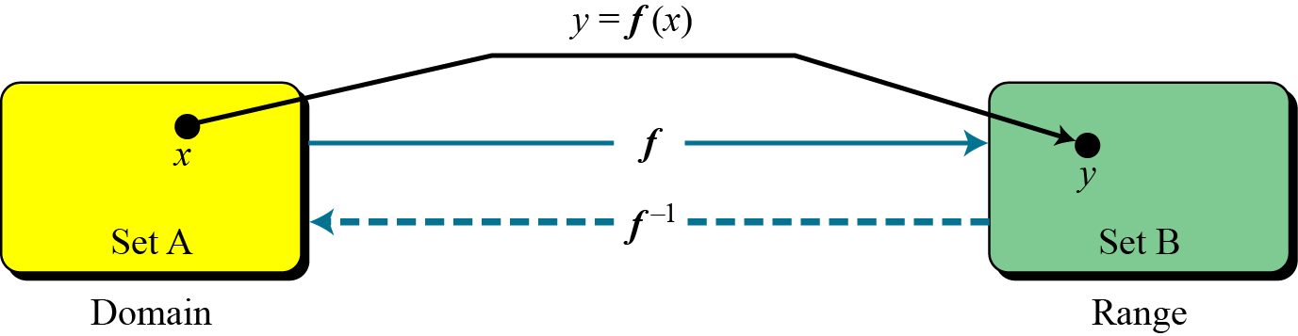
Trapdoor One-Way Function
The main idea behind asymmetric-key cryptography is the concept of the trapdoor one-way function
One way functions
  One to one mapping
  Y=f(x): Given x, easy to get y
  X=f ⁻¹(y) : Given y, infeasible to get x

Slide 11
Trapdoor One-Way Function
Trapdoor One-Way Function
  One to one mapping
  Y=f_{k}(x): easy if k and x are known
  X=f_{k}⁻¹(y): easy if k and y are known
  X=f_{k}⁻¹(y): infeasible if y is known and k is unknown
Designing a public key algorithm is to find appropriate trapdoor one way function

Slide 12
Example
Example 1
  When n is large, n = p × q is a one-way function.
  Given p and q , it is always easy to calculate n ;
  given n, it is very difficult to compute p and q.
  This is the factorization problem
Example 2
  When n is large, the function y = x^{k} mod n is a trapdoor one-way function.
  Given x, k, and n, it is easy to calculate y.
  Given y, k, and n, it is very difficult to calculate x.
  This is the discrete logarithm problem.
  However, if we know the trapdoor, k′ such that k × k ′ = 1 mod φ(n), we can use x = y^{k′} mod n to find x. (why?)

Slide 13
RSA algorithm
by Rivest, Shamir & Adleman of MIT in 1977
best known & widely used public-key scheme
Uses modular exponentiation for encryption/decryption
uses large integers (eg. 1024 bits)
Security basis
  factorization of large integers is hard

Slide 14
RSA algorithm
Three steps
  Key generation
    Only need to do once
  Encryption
  Decryption
Suppose Alice sends a message to Bob
  Bob needs to do key generation before the communication

Slide 15
Key generation
Bob picks two large primes p and q
Calculate n = p x q
Calculate ø(n)
  ø(n) = ( p-1)x(q-1) discard p and q
Select an integer e
  gcd(ø(n),e)=1; 1<e<ø(n)
Calculate d=e⁻¹ mod ø(n)
Bob publishes his Public key KU={e,n}
Bob keeps his private key KR={d,n}

Slide 16
Encryption and decryption
Encryption
  Alice gets Bob’s public key PU={e,n}
  Alice wants to send P to Bob, P < n
  P is encrypted to C
  C=P^{e} mod n
Decryption
  Bob has his private key PR={d,e}
  After Bob gets C, he decrypts C
  C^{d} mod n = P

Slide 17
RSA trivial example
Bob generates a Key pair
  Selects p and q
    Bob picks p=7, q=17
  Calculates n
    n = pq = 119
  Calculates ø(n)
    φ(119) = φ(7) x φ(17) = 96
  Select e
    Bob picks e = 5, gcd(5, 96 ) =1
  Calculate d
    d = e⁻¹ mod ø(n) = 5⁻¹ mod 96 = 5³¹ mod 96 = 77
  Public key PU = (5, 119)
  Private key PR = (77, 119)

Slide 18
RSA trivial example
Alice gets Bob’s public key KU=(5,119)
Alice send a plaintext P=25 to Bob
  Alice encrypts P using Bob’s public KU=(5,119)
  C=P^{e} mod 119 = 25⁵ mod 119 = 9
Bob receives the ciphertext C=9
  Bob decrypts C using his own private key KR=(77, 119)
  C^{d} mod 119 = 9⁷⁷ mod 119 = 25

Slide 19
RSA trivial example
Suppose another person, John, need to send a plaintext P=61 to Bob
John gets Bob’s public key PU={5,119}
John encrypts P
  C = P^{e} mod n = 61⁵ mod 119 = 108
Bob receives the ciphertext C=108
  Bob decrypts C using his own private key KR=(77, 119)
  C^{d} mod 119 = 108⁷⁷ mod 119 = 61

Slide 20
RSA trivial example
Question: What if Bob wants to send P to Alice?
Alice needs to generate a key pair and publishes her public key
Bob encrypts P with Alice’s public key
Alice decrypts it with her private key

Slide 21
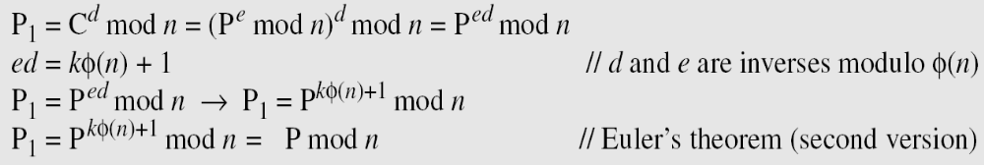
Proof of RSA
Euler’s theorem: a ^{k ×} ^{φ(n)} ⁺ ¹ ≡ a (mod n)

Slide 22
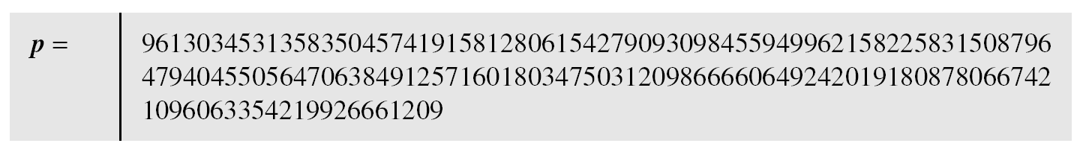
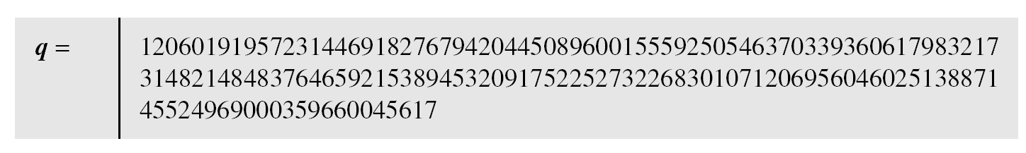
RSA realistic example
p is a 159-digit number, q is a 160-digit number

Slide 23
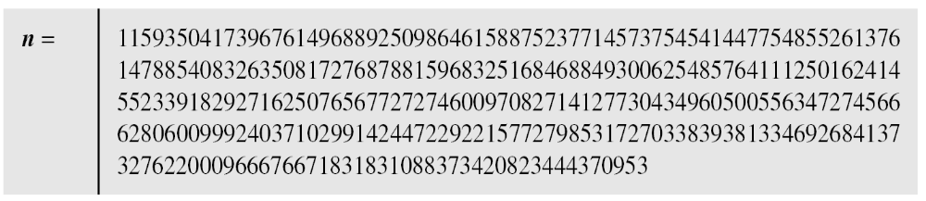
RSA realistic example
The modulus n = p × q. It has 309 digits.

Slide 24
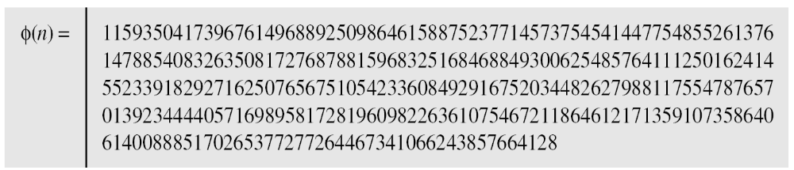
RSA realistic example
φ(n) = (p − 1)(q − 1) has 309 digits.

Slide 25
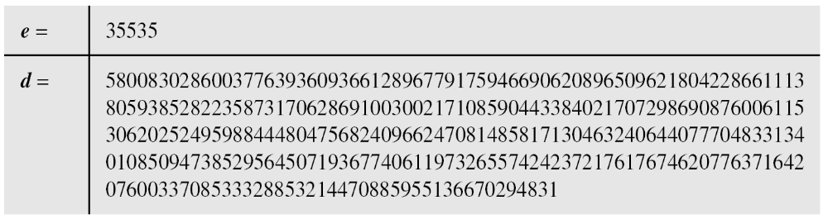
RSA realistic example
Bob chooses e = 35535 and tests it to make sure it is relatively prime with φ(n).
He then finds the inverse of e modulo φ(n) and calls it d

Slide 26
RSA realistic example
Alice wants to send the message “THIS IS A TEST”, which can be changed to a numeric value using the 00−26 encoding scheme (26 is the space character)

Slide 27
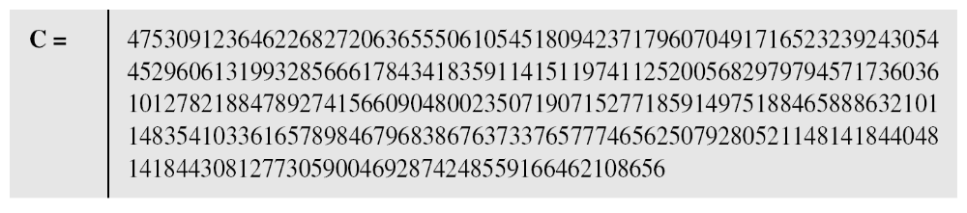
RSA realistic example
The ciphertext calculated by Alice is C = P^{e}

Slide 28
RSA realistic example
Bob can recover the plaintext from the ciphertext using P = C^{d}, which is
The recovered plaintext is “THIS IS A TEST” after decoding.

Slide 29
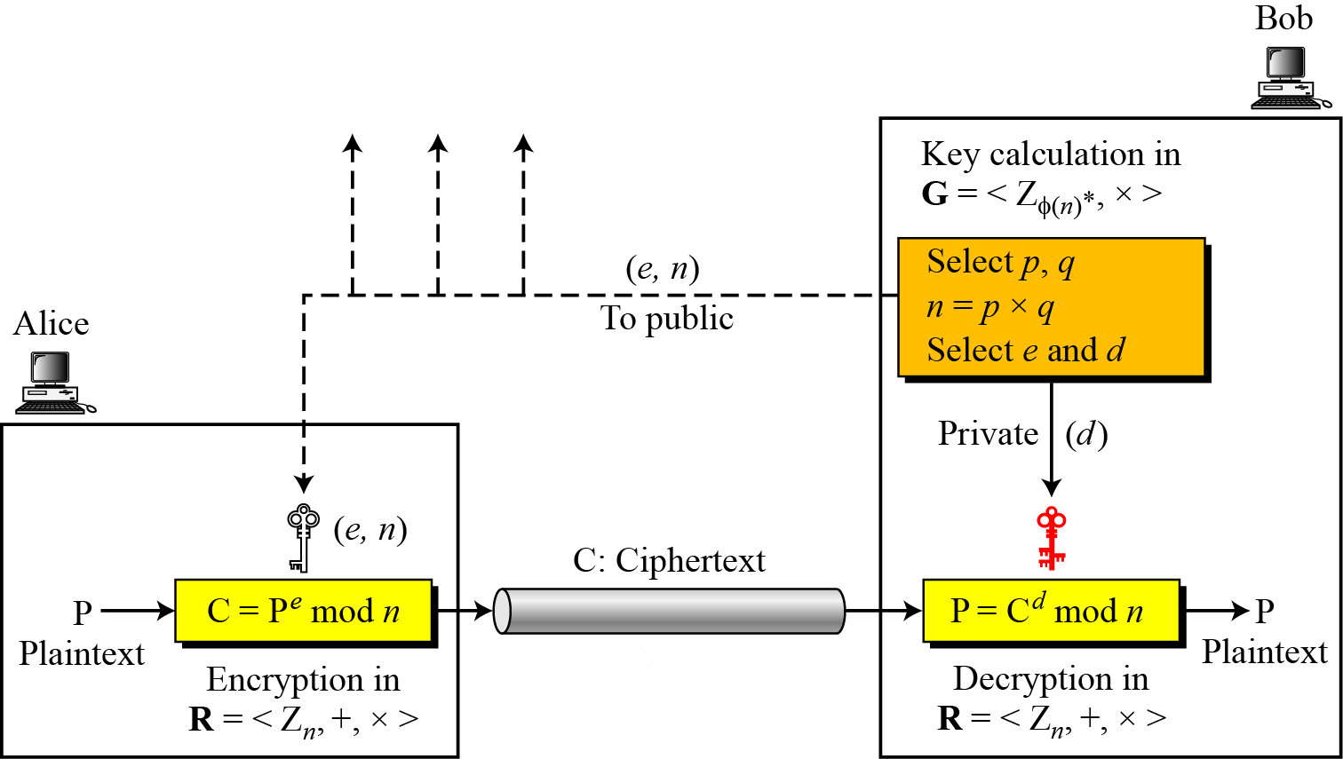
RSA summary
Figure 10.6 Encryption, decryption, and key generation in RSA

Slide 30
RSA: discussions
Both p and q should be large(>512 bits)
Given public key, it’s infeasible to compute the private key
    Public key(e,n)
    Factor n into p,q
    ø(n) = (p-1) x (q-1)
    Private key d = e⁻¹ mod n
Its security relies on the difficulty of calculating factors of large numbers
Implementation is slow
Notes:
The longer the key, the more difficult it is. The level of efforts is measured in MIPS-years: a million-instructions-per-second processor running for one years. A 200-MHx Pentium is about 50-MIPS machine. If a key is 428 bits long, I would take 5000 MIPS-years to break the algorithm. The result was reported in 1994.

Slide 31
Attacks on RSA
  Bob’s Public key PU = (5, 119)
  Eve intercepts C = 9
  How does Eve find out the corresponding plaintext?

Slide 32
Rabin cryptosystem
The Rabin cryptosystem can be thought of as an RSA cryptosystem in which the value of e and d are fixed
The encryption is C ≡ P² (mod n)
The decryption is P ≡ C^{1/2} (mod n)
The Rabin cryptosystem is not deterministic: Decryption creates four plaintexts

Slide 33
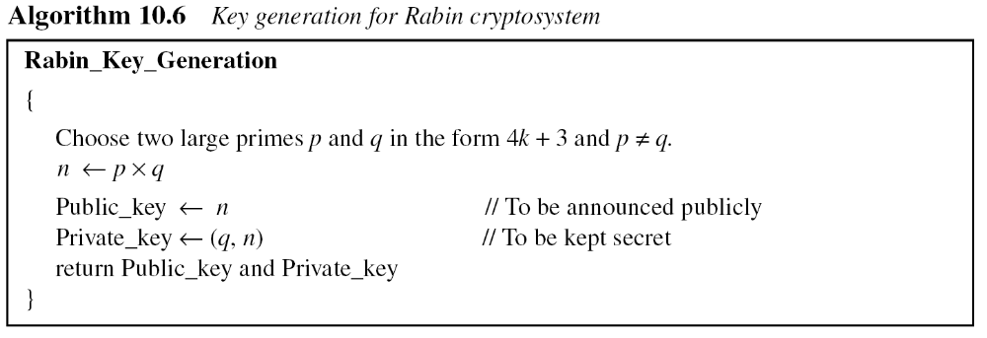
Rabin cryptosystem
Key Generation

Slide 34
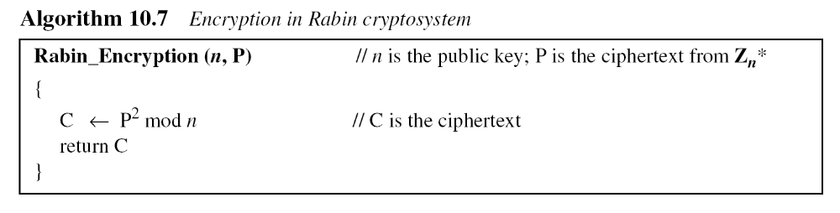
Rabin cryptosystem
Encryption

Slide 35
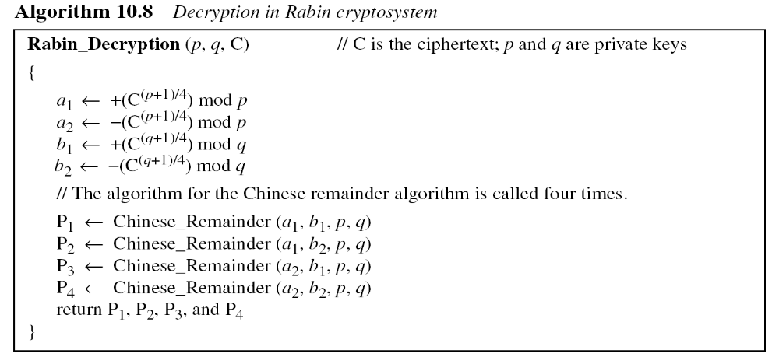
Rabin cryptosystem
Decryption

Slide 36
Rabin cryptosystem
Bob selects p = 23 and q = 7
  Note that both are in the form 4k+3
Bob calculates n = p × q = 161
Bob announces n publicly; he keeps p and q private.
Alice wants to send the plaintext P = 24.
  Note that 161 and 24 are relatively prime;
  24 is in Z₁₆₁*.
  She calculates C = 24² = 93 mod 161
  She sends the ciphertext 93 to Bob.

Slide 37
Rabin cryptosystem
Bob receives 93 and calculates four values:
a1 = +(93 ^{(23+1)/4}) mod 23 = 1 mod 23
a2 = −(93 ^{(23+1)/4)} mod 23 = 22 mod 23
b1 = +(93 ^{(7+1)/4}) mod 7 = 4 mod 7
b2 = −(93 ^{(7+1)/4)} mod 7 = 3 mod 7
Bob takes four possible answers
  (a1, b1), (a1, b2), (a2, b1), and (a2, b2)
Bob uses the Chinese remainder theorem to find four possible plaintexts
  116, 24, 137, and 45
  only the second answer is Alice’s plaintext

Slide 38
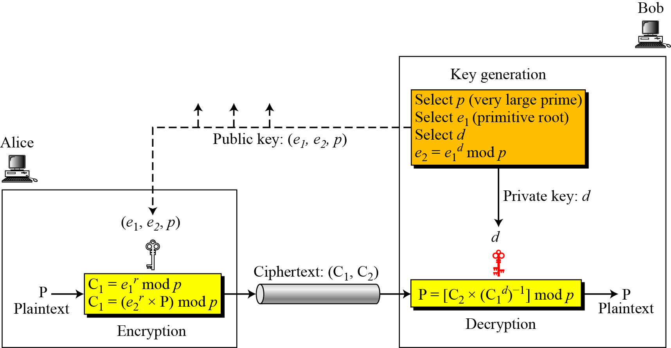
ElGamal cryptosystem
ElGamal is based on the discrete logarithm problem

Slide 39
ElGamal cryptosystem

Slide 40
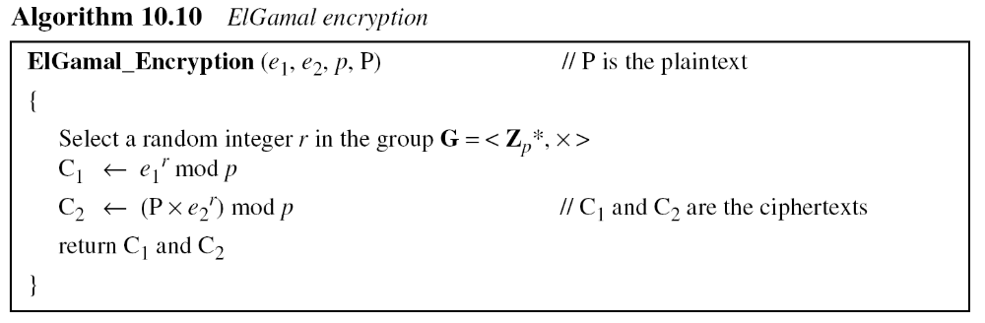
ElGamal cryptosystem

Slide 41
ElGamal cryptosystem

Slide 42
ElGamal cryptosystem proof
C₂ x (c₁^{d})⁻¹ mod p
= C₂ x (e₁rd)⁻¹ mod p //c₁= e₁^{r} mod p
= P x e₂^{r} x (e₁rd)⁻¹ mod p //c₂= P x e₂^{r} mod p
= P x e₁^{dr} x (e₁rd)⁻¹ mod p //e₂ = e₁^{d} mod p
= P mod p
Notes:
c₁^{d} x c₁^{-d} = 1 mod p
= c₁^{p-1} mod p
c₁^{-d} x c₁^{d} x c₁^{-d =} c₁^{-d} x c₁^{p-1} mod p
c₁^{-d =}c₁^{p-1-d} mod p

Slide 43
ElGamal cryptosystem example
Bob chooses p = 11, e1 = 2 and d = 3
e2 = e1^{d} mod p= 8
So the public keys are (2, 8, 11)
The private key is 3
To encrypt plaintex 7, Alice chooses r=4
calculates C1 and C2 for the plaintext 7

Slide 44
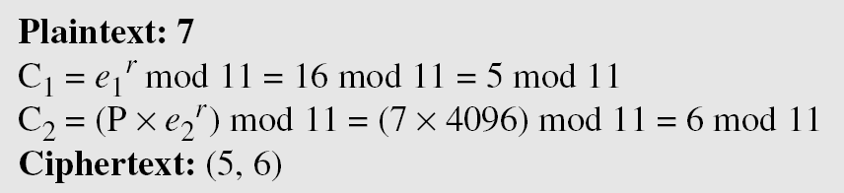
ElGamal cryptosystem example
Bob receives the ciphertexts (5 and 6) and calculates the plaintext.

Slide 45
ElGamal cryptosystem example
Instead of using P = [C₂ × (C₁^{d}) ⁻¹] mod p for decryption, we can avoid the calculation of multiplicative inverse and use P = [C₂ × C₁ ^{p−1−d}] mod p
  see Fermat’s little theorem
In the previous example, we can calculate
  P = [6 × 5 ¹¹⁻¹⁻³] mod 11 = 7 mod 11.
Notes:
C₁^{d} * C₁ ^{p−1−d} mod p = C₁ ^{p−1} mod p = 1

