Slide 1
CS480
Cryptography and Information Security
13.Message Authentication and Hash Function
Huiping Guo
Department of Computer Science
California State University, Los Angeles

Slide 2
Outline
Introduction to message integrity and authentication
MDC and MAC
General ideas behind cryptographic hash functions
Merkle-Damgard scheme as the basis for iterated hash functions
A cryptographic hash function: SHA-512

Slide 3
Message integrity
The cryptography systems that we have studied so far provide secrecy, or confidentiality, but not integrity.
However, there are occasions where we may not even need secrecy but instead must have integrity
  Everyone is allowed to read a message
  But no one is allowed to modify it

Slide 4
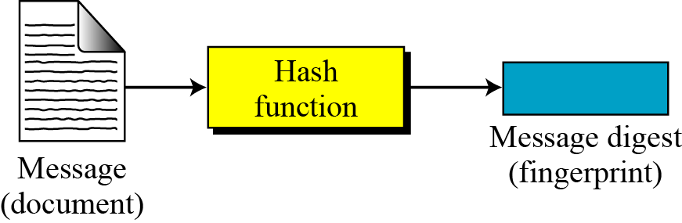
Message and Message Digest
The message is passed through a cryptographic hash function
The function creates a compressed image of the message
The compressed image, called message digest, can be used like a fingerprint

Slide 5
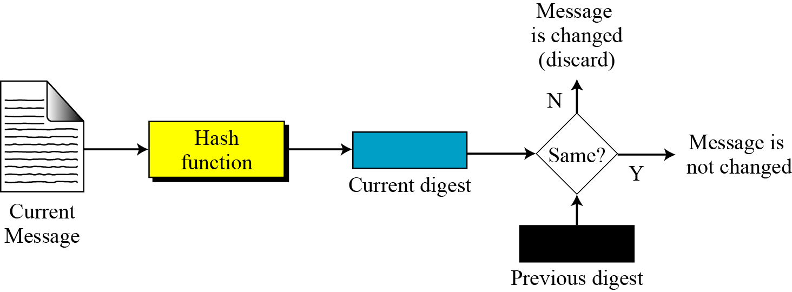
Checking Integrity
Run the cryptographic hash function again
Compare the new message digest with the previous one
  If the they match, the original message is not modified

Slide 6
Cryptographic Hash Function Criteria
A cryptographic hash function must satisfy three criteria:
  preimage resistance
  second preimage resistance
  collision resistance.

Slide 7
Message authentication
The digest created by a cryptographic hash function is normally called a modification detection code (MDC)
A message digest does not authenticate the sender of the message
To provide message authentication, Alice needs to provide proof that it is Alice sending the message and not an impostor.
What we need for message authentication is a message authentication code (MAC).

Slide 8
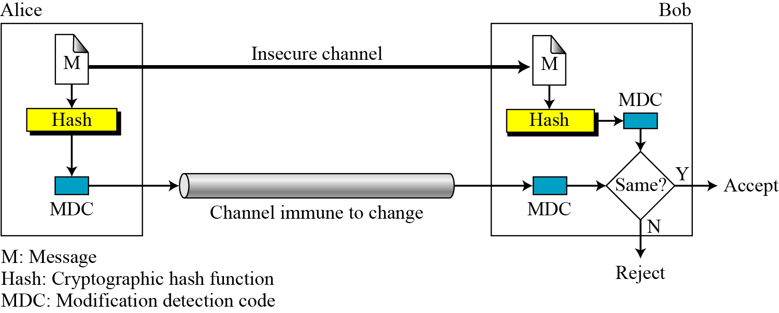
Modification Detection Code (MDC)

Slide 9
Message Authentication Code (MAC)
To ensure the integrity of the message and the data origin authentication, we need to use MAC
The difference between MDC and MAC is
  MAC includes a key shared between Alice and Bob

Slide 10
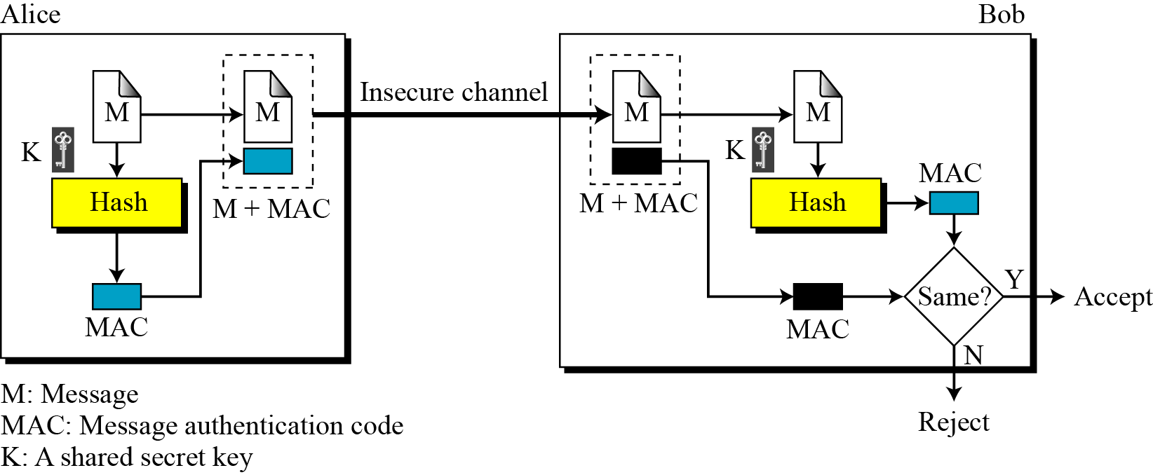
Message Authentication Code (MAC)

Slide 11
Nested MAC
Nested MACs are designed to improve the security of a MAC
Two steps
  The key is concatenated with the message and is hashed to create an intermediate digest
  The key is concatenated with the intermediate digest to create the final digest

Slide 12
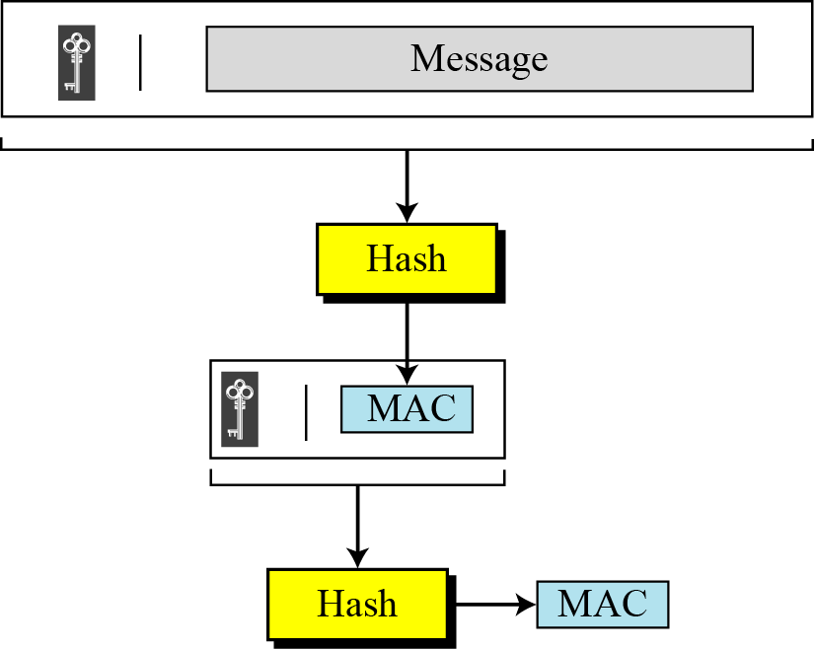
Nested MAC

Slide 13
HMAC
HMAC is a standard for a nested MAC
Steps
  The message is divided into N blocks, each of b bits
  K is left padded with 0’s to create a b-bit key
  The result of step 2 is XORed with a constant (ipad) to create a b-bit block
    Ipad is b/8 repetition of 00110110
  The resulting block is prepended to N-block message. The result is N+1 blocks
  The result of step 4 is hashed to create an n-bit digest
  The result of step 5 is left padded with 0s to make a b-bit block (b>n)
  Steps 2 and 3 are repeated by a different constant opad. The value of opad is b/8 repetition of the sequence 0101100
  The result of step 7 is prepended to the block of step 6
  The result of step 8 is hashed with the same hashing algorithm to create the final n-bit HMAC

Slide 14
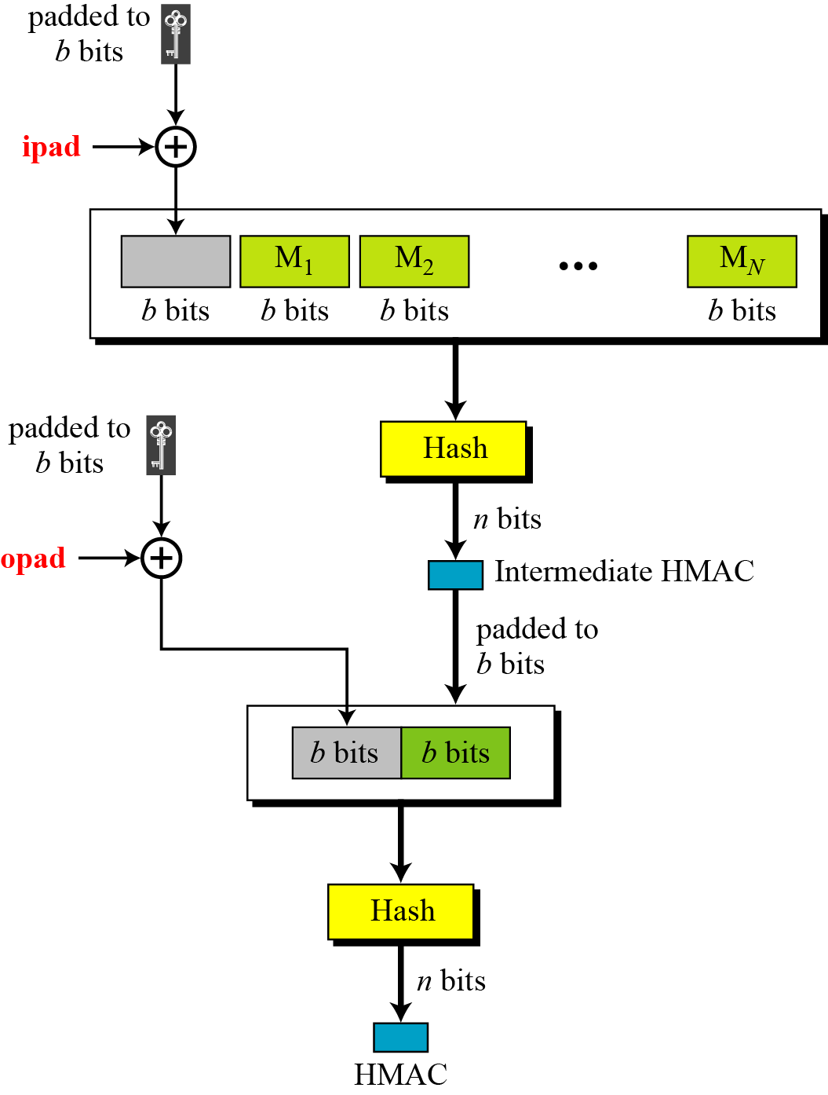
HMAC

Slide 15
Iterated Hash Function
A cryptographic hash function takes a message of arbitrary length and creates a message digest of fixed length
Iteration is used to implement the function
  We don’t need a function with variable-size input
  A function with fixed-size input is created and is used a necessary number of times
  The fixed-size input function is called a compression function
The scheme is referred to as an iterated cryptographic hash function

Slide 16
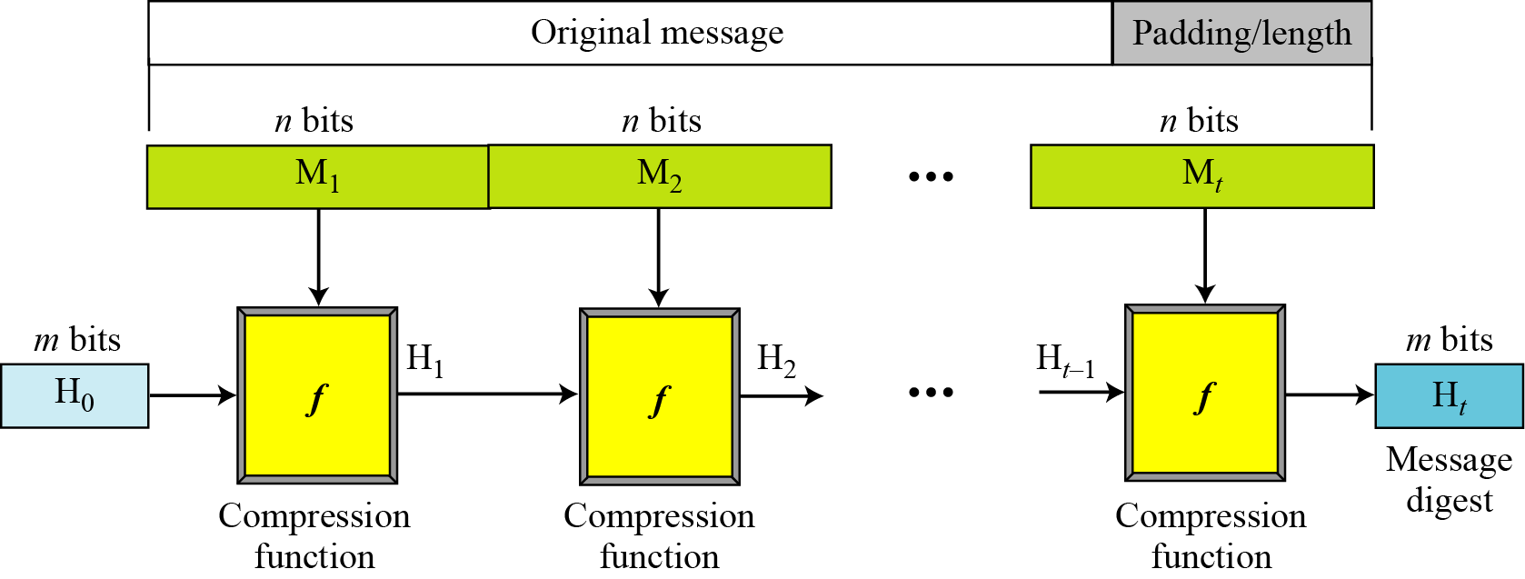
Merkle-Damgard Scheme
An iterated hash function
Collision resistant if the compression function is collision resistant

Slide 17
Merkle-Damgard Scheme
The message is padded to be evenly divided into t blocks of n bits, M1, M2, … Mt
The digest created at t iterations are called H1, H2,…, Ht
Before starting the iteration, the digest H0 is set to a fixed value, called Initialization Vector (IV)
The compression function at each iteration operates on H_{i-1} and M_{i} to create a new H_{i}.
  H_{i} = f(H_{i-1} , M_{i} )
H_{t} is the cryptographic hash function of the original message

Slide 18
Two Groups of Compression Functions
The Merkel-Damgard scheme is the basis for many cryptographic hash functions
The only thing we need to do is to design a compression function that is collision resistant
Two different approaches
  The compression function is made from scratch
  A symmetric-key block cipher serves as a compression function

Slide 19
Hash functions made from scratch
Message Digest (MD)
  MD2, MD4, MD5
  Designed by Ron Rivest
Secure Hash Algorithms (SHA)
  A standard developed by NIST
  Also referred to as Secure Hash Standard (SHS)
  SHA224, SHA256, SHA-384 and SHA-512

Slide 20
Hash functions based on bock ciphers
An iterated cyptographic hash function can use a symmetric-key block cipher as a compression function
The block cipher is used to make a one-way hash function instead of creating a new one
The block cipher only performs encryption
Example: Whirlpool (not discussed)

Slide 21
Hash functions based on bock ciphers
Rabin scheme
Davies-Meyer scheme
Matyas-Meyer-Oseas scheme
Miyaguchi-Preneel Scheme
  Whirlpool is based on this scheme

Slide 22
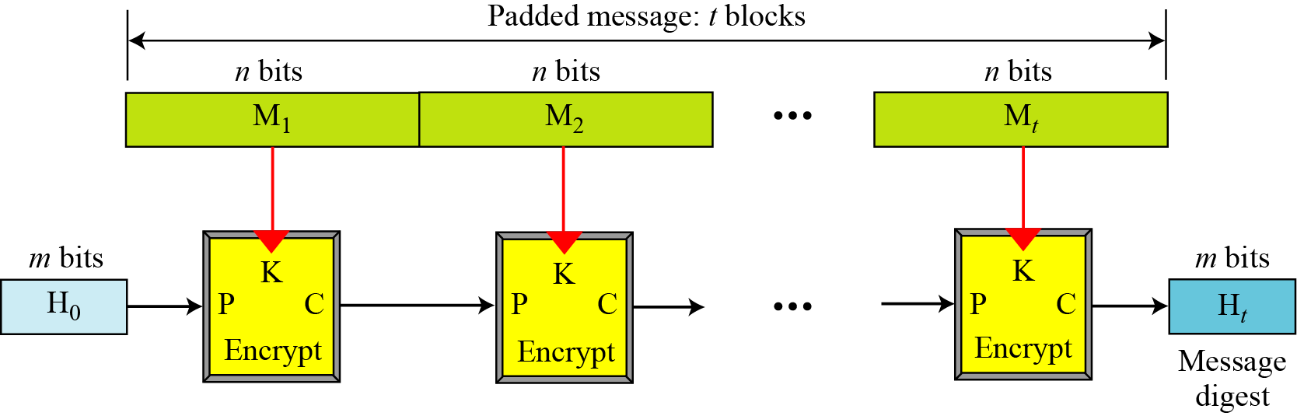
Rabin Scheme

Slide 23
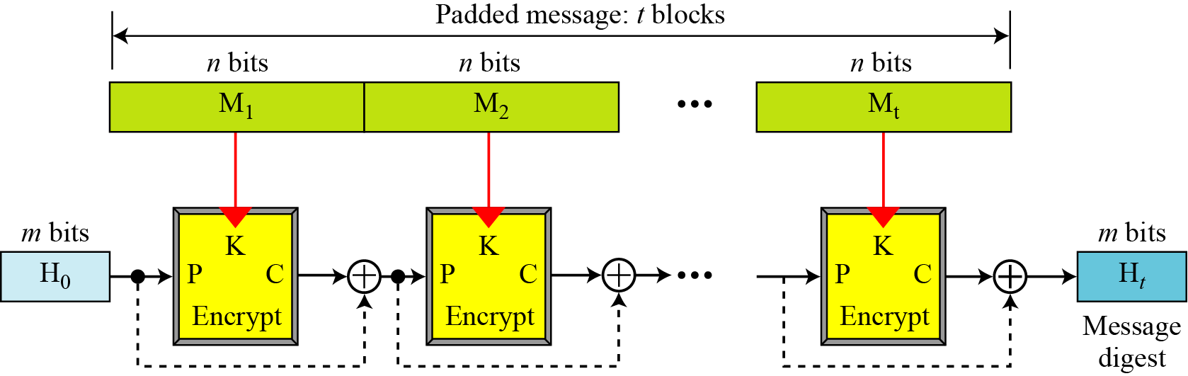
Davies-Meyer Scheme

Slide 24
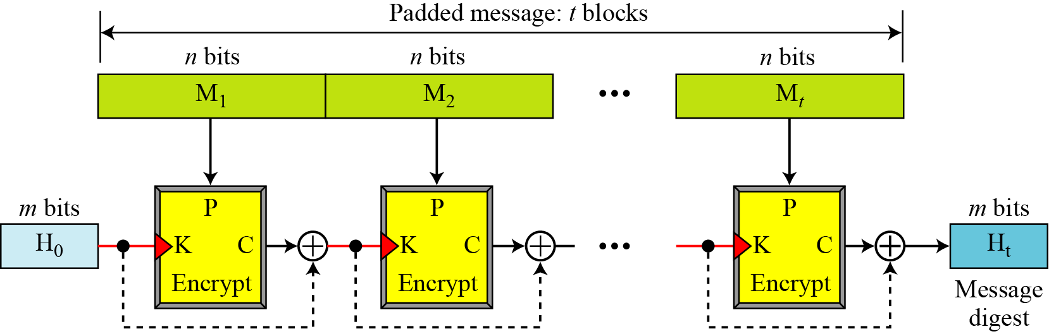
Matyas-Meyer-Oseas Scheme

Slide 25
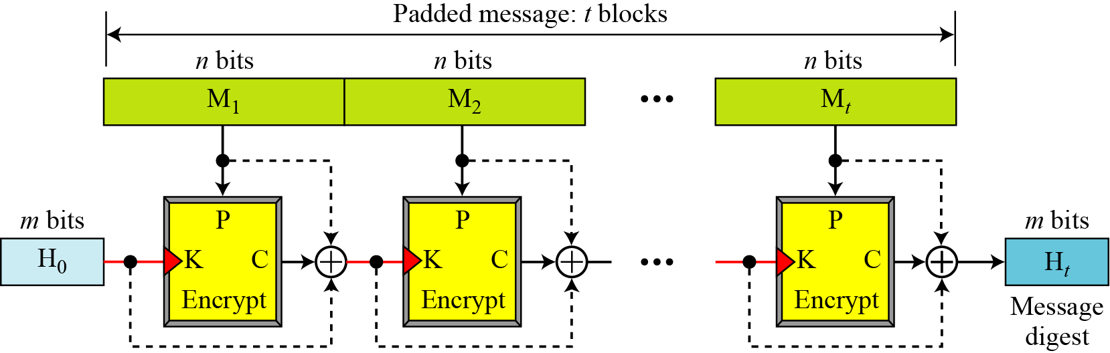
Miyaguchi-Preneel Scheme

Slide 26
SHA-512
SHA-512 is the version of SHA with a 512-bit message digest
This version, like the others in the SHA family of algorithms, is based on the Merkle-Damgard scheme

Slide 27
Introduction
SHA-512 creates a digest of 512 bits from a multiple-block message
Each message is 1024 bits in length
The digest is initialized to an initial value
The algorithm mixes the initial value with the 1st block of the message to create the first intermediate message digest
The digest is the mixed with the 2nd block to create the second intermediate message digest
Finally, the (N-1)th the digest is mixed with the Nth block to create the final message digest for the entire message

Slide 28
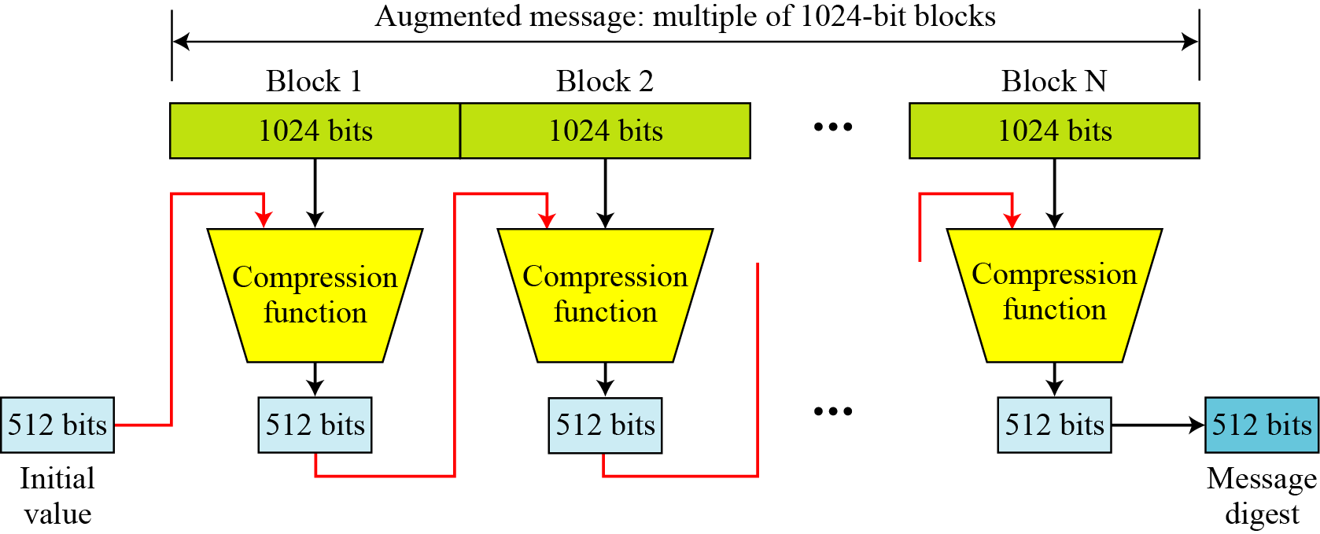
Introduction

Slide 29
Message Preparation
SHA-512 creates a 512-bit message digest out of a message less than 2¹²⁸
The message length limitation of SHA-512 is not a serious problem
  Suppose we need to send a message that is 2¹²⁸ bits in length.
  How long does it take for a communications network with a data rate of 2⁶⁴ bits per second to send this message?
    A communications network that can send 2⁶⁴ bits per second is not yet available
    Several years if such network is available

Slide 30
Message Preparation
How many pages are occupied by a message of 2¹²⁸ bits?
  Suppose that a character is 32, or 2⁵, bits.
  Each page contains less than 2048, or approximately 2¹¹, characters.
  So 2¹²⁸ bits need at least 2¹²⁸ / 2¹⁶, or 2¹¹², pages
  This again shows that we need not worry about the message length restriction.

Slide 31
Length field and Padding
Before the message digest can be created, SHA-512 requires the addition of a 128-bit unsigned-integer length field to the message
  defines the length of the original message in bits
  The length is for the message before padding or adding the length field
Before the addition of the length field, the message is padded
  Make the length a multiple of 1024 bits
128 bits are reserved for the length field

Slide 32
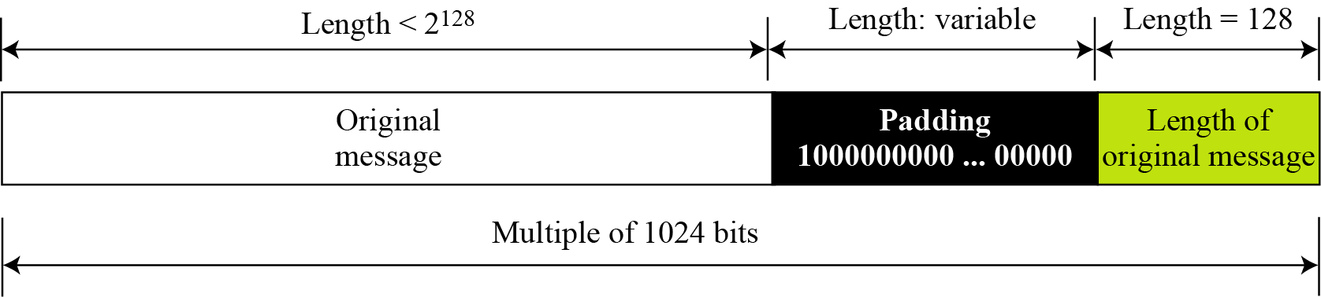
Length field and Padding
Let |M| be the length of the message and |P| be the length of the padding
  (|M| + |P| +128) = 0 mod 1024 or |P| = (- (|M|-128) mod 1024
The format of padding is one 1 followed by the necessary number of 0s

Slide 33
Example
What is the number of padding bits if the length of the original message is 2590 bits?
We can calculate the number of padding bits as follows:
  |P| = (-2590-128) mod 1024 = -2718 mod 1024 = 354
  The padding consists of one 1 followed by 353 0’s

Slide 34
Length field and Padding
What is the minimum and maximum number of padding bits that can be added to a message?
  The minimum length of padding is 0
  It happens when
  (−M − 128) mod 1024 is 0.
  This means that |M| = −128 mod 1024 = 896 mod 1024 bits.
  In other words, the last block in the original message is 896 bits.
  We add a 128-bit length field to make the block complete.

Slide 35
Length field and Padding
The maximum length of padding is 1023
it happens when (−|M| −128) = 1023 mod 1024
This means that the length of the original message is |M| = (−128 −1023) mod 1024 or the length is |M| = 897 mod 1024.
In this case, we cannot just add the length field because the length of the last block exceeds one bit more than 1024.
So we need to add 127 bits to complete this block and create a second block of 896 padding bits
Now the length can be added to make this block complete.

Slide 36
Length field and Padding
Block 1
Block 2
897
127
896
128
Message
Padding
Length field

Slide 37
Words
SHA-512 is word-oriented
A word contains 64 bits
After the padding and adding the length field, each block of the message consists of 16 64-bit words
The message digest contains 8 words
  From A to H

Slide 38
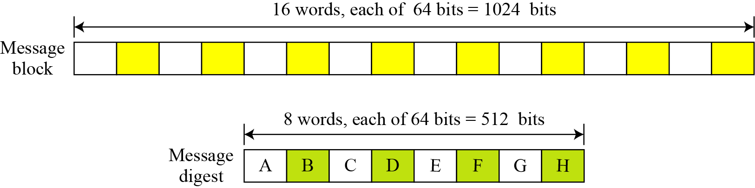
Words

Slide 39
Word expansion
Before processing, each message block must be expanded
We need 80 words in the processing phase
16 words are expanded to 80 words
  From W₀ to W₇₉
The 1024-bit message becomes the first 16 words
The rest of words come from already-made words according to some operations

Slide 40
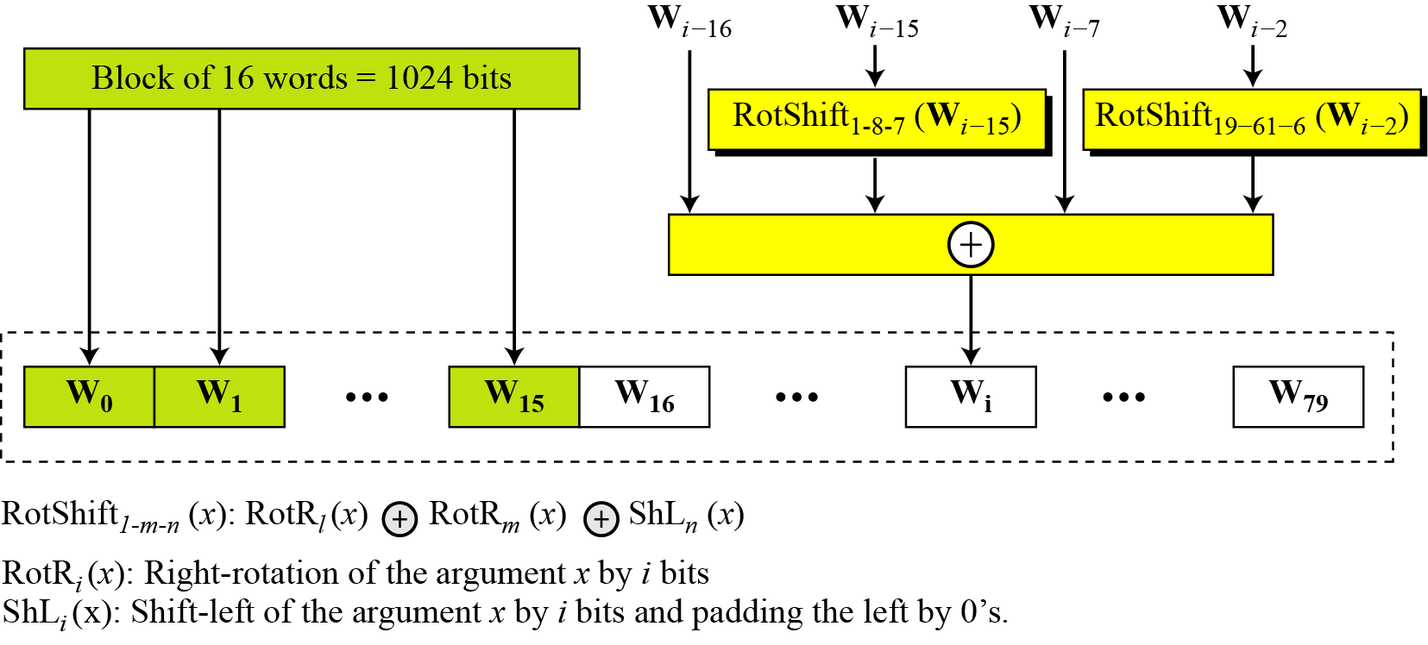
Word Expansion
right by 0’s.

Slide 41
Word Expansion
Show how W60 is made
Each word in the range W16 to W59 is made from four previously-made words. W60 is made as

Slide 42
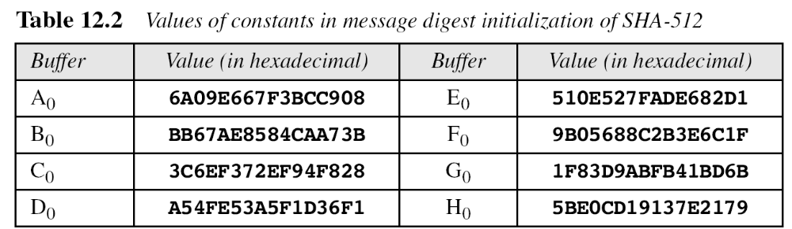
Message Digest Initialization

Slide 43
Compression function
SHA-512 creates a 512 bit message digest from a multiple-block message
  Each block is 1024 bits
The processing of each block involves 80 rounds
In each round, the following 3 components are mixed together and are operated on to create a new set of buffers
  the contents of 8 previous buffers
  one word from the expanded block(Wi)
  one 64-bit constant (Ki)

Slide 44
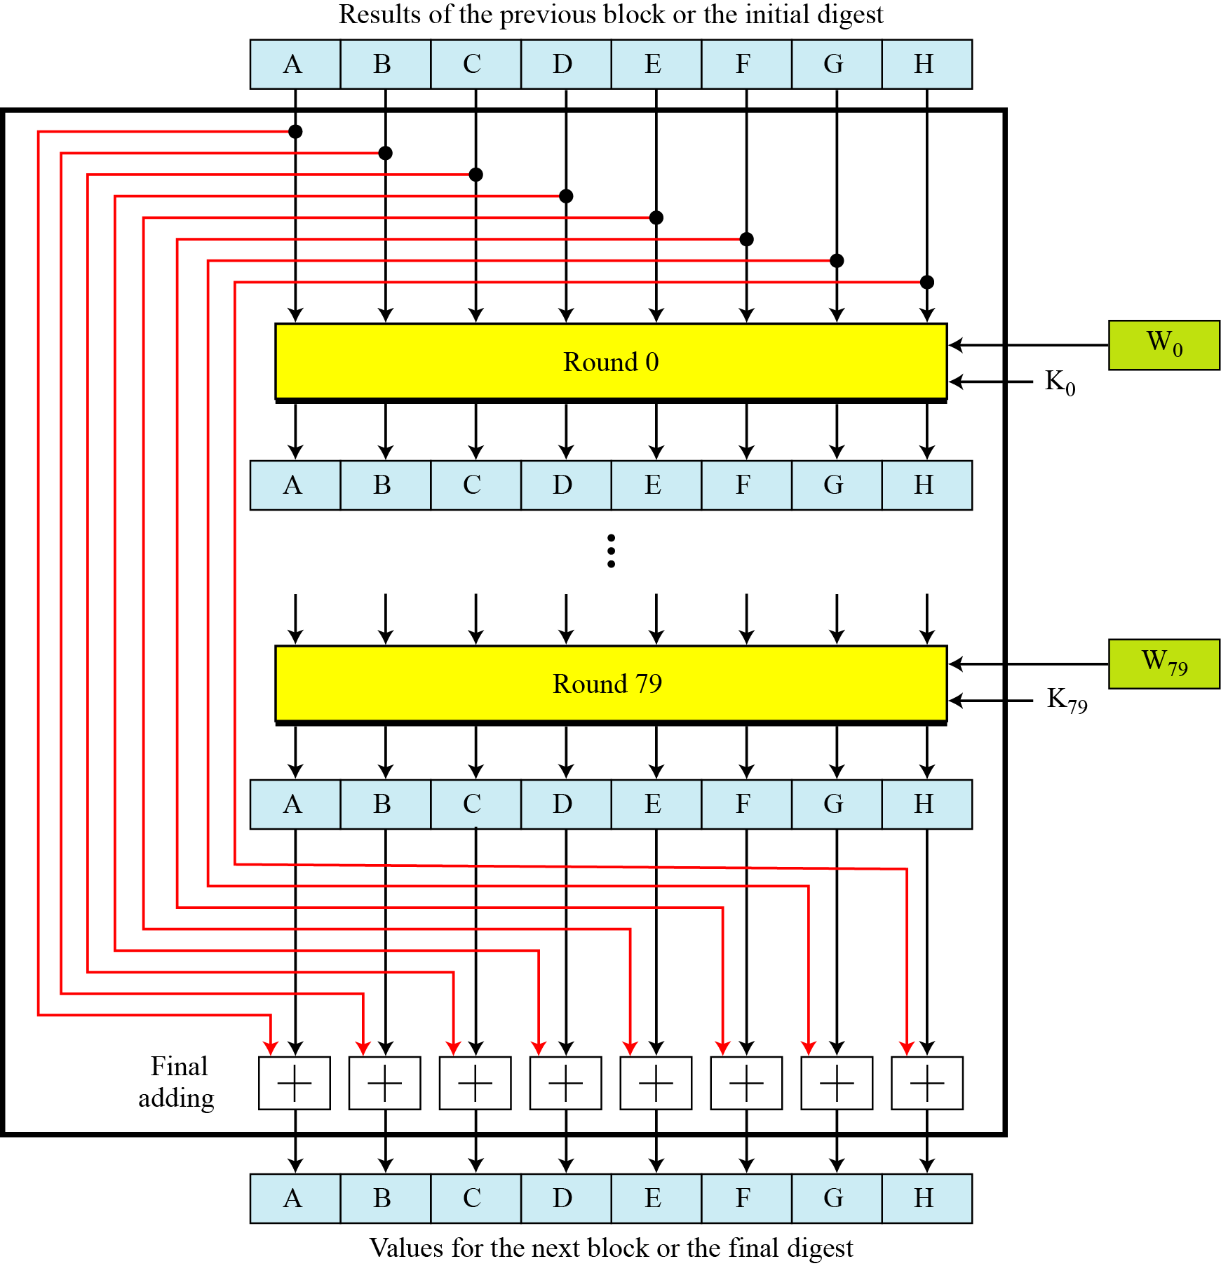
Compression Function
K0 – K79 are 80 constants

Slide 45
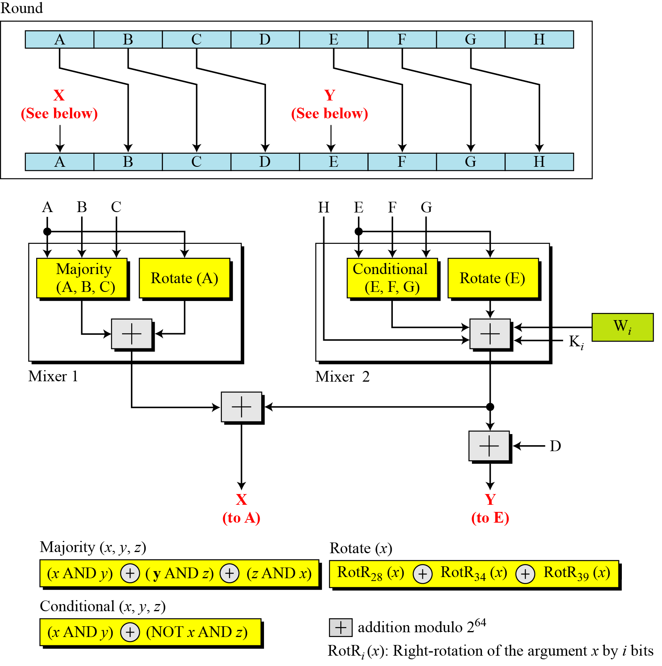
Structure of each round in SHA-512
80 rounds!

Slide 46

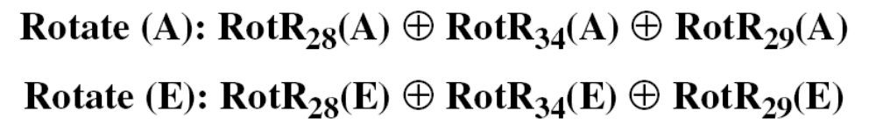

Structure of each round in SHA-512
Majority Function
Conditional Function
Rotate Functions

Slide 47
Structure of each round in SHA-512
We apply the Majority function on buffers A, B, and C. If the leftmost hexadecimal digits of these buffers are 0x7, 0xA, and 0xE, respectively, what is the leftmost digit of the result?
The digits in binary are 0111, 1010, and 1110
  The first bits are 0, 1, and 1. The majority is 1
  The second bits are 1, 0, and 1 The majority is 1
  The third bits are 1, 1, and 1. The majority is 1
  The fourth bits are 1, 0, and 0. The majority is 0
The result is 1110, or 0xE in hexadecimal

Slide 48
Structure of each round in SHA-512
We apply the Conditional function on E, F, and G buffers. If the leftmost hexadecimal digits of these buffers are 0x9, 0xA, and 0xF respectively, what is the leftmost digit of the result?
The digits in binary are 1001, 1010, and 1111
  The first bits are 1, 1, and 1. since E₁ is 1, the result is F₁, which is 1
  The second bits are 0, 0, and 1. since E₂ is 0, the result is G₂, which is 1
  The third bits are 0, 1, and 1. since E₃ is 0, the result is G₃, which is 1
  The fourth bits are 1, 0, and 1. since E₄ is 1, the result is F₄, which is 0
The result is 1110, or 0xE in hexadecimal

