Slide 1
CS480
Cryptography and Information Security
14. Digital signature
Huiping Guo
Department of Computer Science
California State University, Los Angeles

Slide 2
Outline
Conventional signatures and digital signatures
Services provided by signature
Some digital signature schemes
Diffie-Hellman Key exchange algorithm

Slide 3
Conventional signatures and digital signatures
Conventional signature
  Signature on a document
  Signature on a check, …
  A signature, when verified, is a sign of authentication
    The document is authentic
    It’s originated from the right person
    What else?
Digital signature
  Electronic signature used to prove the authenticity of a digital message and its sender

Slide 4
Differences between conventional signatures and digital signatures
Inclusion
Verification method
Relationship
duplicity

Slide 5
Inclusion
A conventional signature is included in the document
It is part of the document
But when we sign a document digitally, we send the signature as a separate document

Slide 6
Verification method
For a conventional signature, when the recipient receives a document, she compares the signature on the document with the signature on file
  The recipient needs to have a copy of this signature on file
For a digital signature, the recipient receives the message and the signature. The recipient needs to apply a verification technique to the combination of the message and the signature to verify the authenticity
  A copy of signature is not stored anywhere

Slide 7
Relationship
For a conventional signature, there is normally a one-to-many relationship between a signature and documents
  The same signature can be used in many documents
For a digital signature, there is a one-to-one relationship between a signature and a message.
  The signature of one message cannot be used in another message

Slide 8
Duplicity
In conventional signature, a copy of the signed document can be distinguished from the original one on file
In digital signature, there is no such distinction unless there is a factor of time on the document
  Digital signature is subject to replay attack

Slide 9
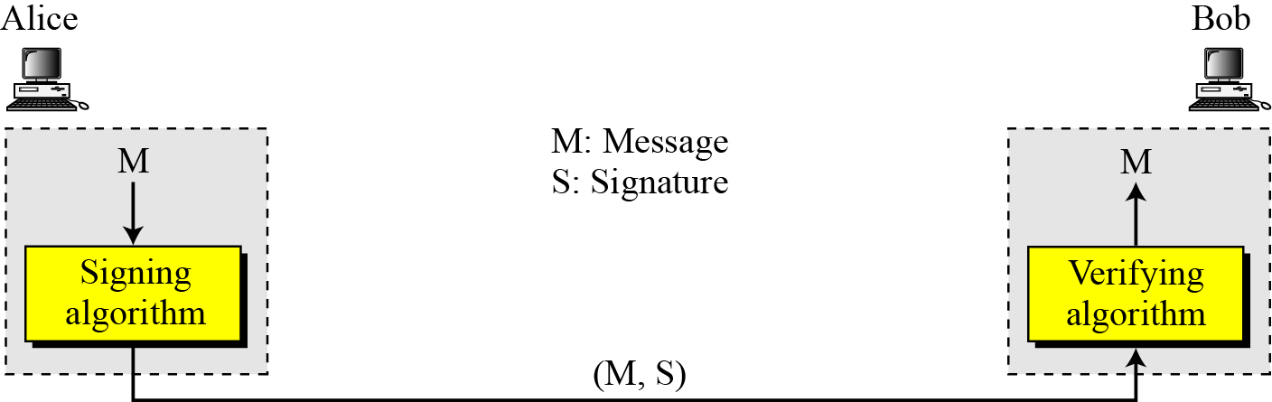
Digital signature process
The sender uses a signing algorithm to sign the message
The message and the signature are sent to the receiver
The receiver receives the message and the signature and applies the verifying algorithm to the combination
If the result is true, the message is accepted; otherwise, it is rejected.

Slide 10
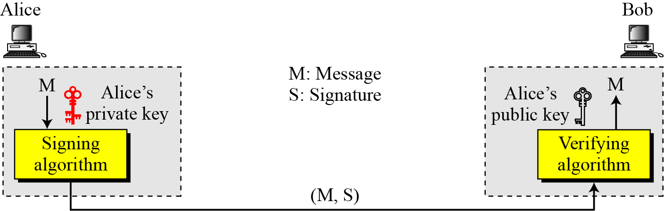
Need for Keys
A digital signature needs a public-key system
The signer signs with her private key; the verifier verifies with the signer’s public key.

Slide 11
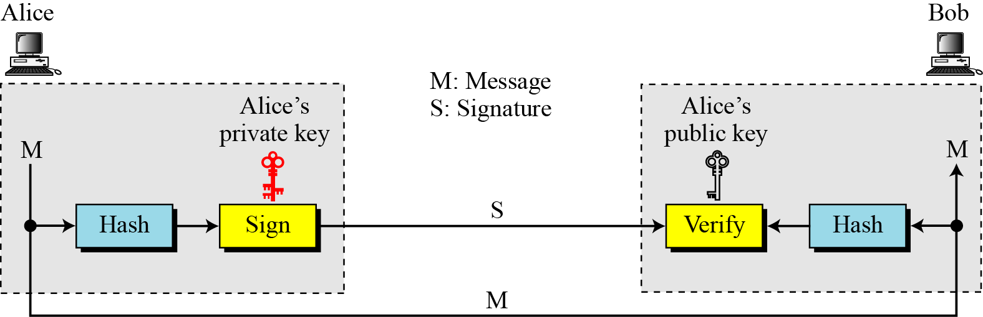
Signing the Digest
A cryptosystem uses the private and public keys of the receiver: a digital signature uses the private and public keys of the sender

Slide 12
Services provided by signature
Authentication
Message integrity
  The integrity of the message is preserved even if we sign the whole message because we cannot get the same signature if the message is changed
Nonrepudiation
  The digital signature is created using the sender’s private key
  Only the sender knows his private key
  He cannot deny the fact that he signed the message

Slide 13
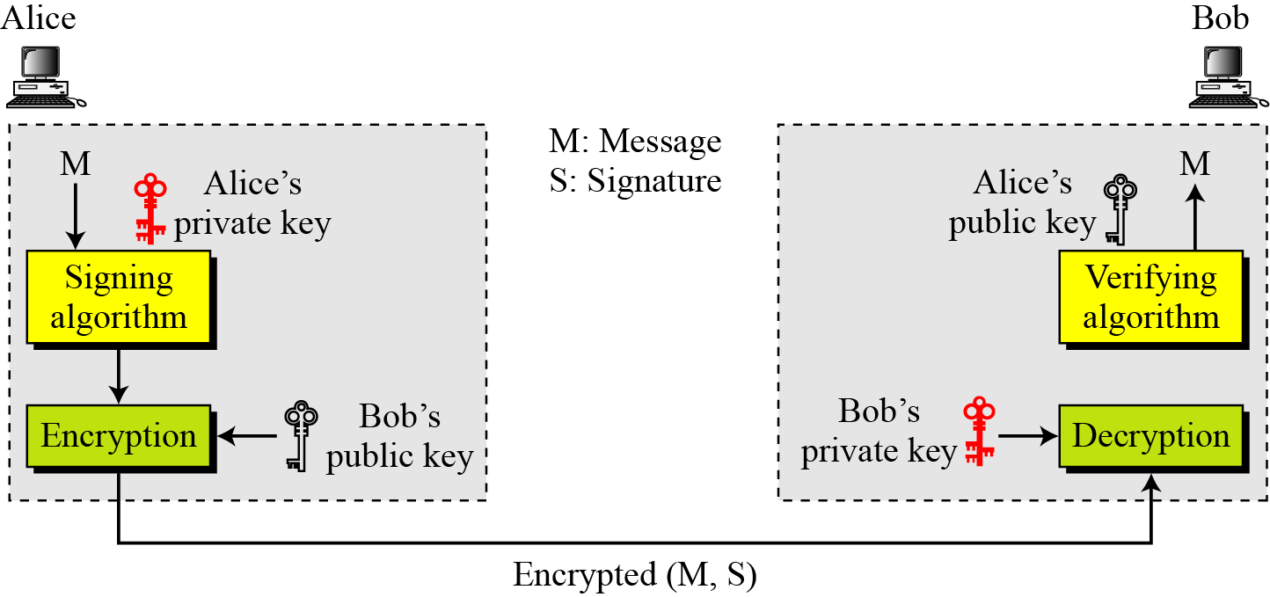
Adding confidentiality to a digital signature scheme
A digital signature does not provide privacy.
If there is a need for privacy, another layer of encryption/decryption must be applied.

Slide 14
The differences between MAC and digital signature
They are based on different kinds of key schemes
  MAC is symmetric key based
  Digital signature is asymmetric key based
MAC can provide authentication and integrity
Digital signature can provide authentication, integrity and nonrepudiation

Slide 15
Digital signature schemes
RSA Digital Signature Scheme
ElGamal Digital Signature Scheme
Digital Signature Standard (DSS)

Slide 16
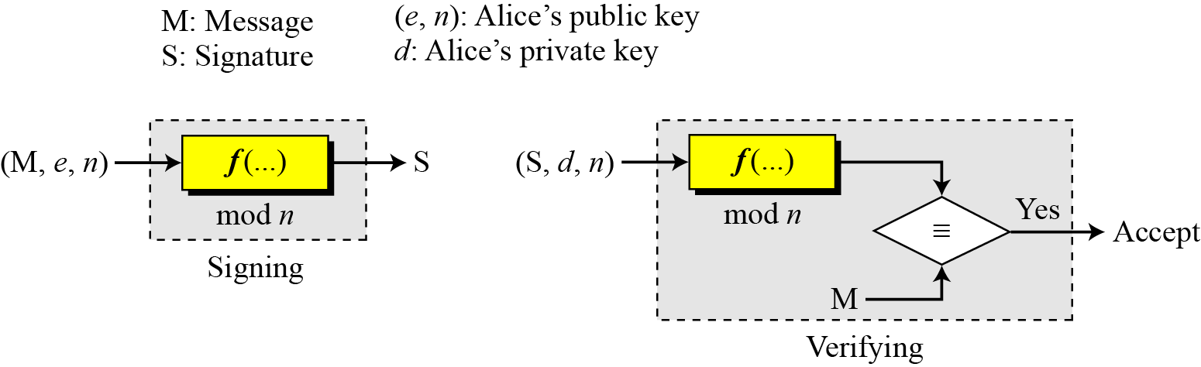
RSA Digital Signature Scheme
d
e

Slide 17
Key Generation
Key generation in the RSA digital signature scheme is exactly the same as key generation in the RSA
In the RSA digital signature scheme
  d is private
  e and n are public.

Slide 18
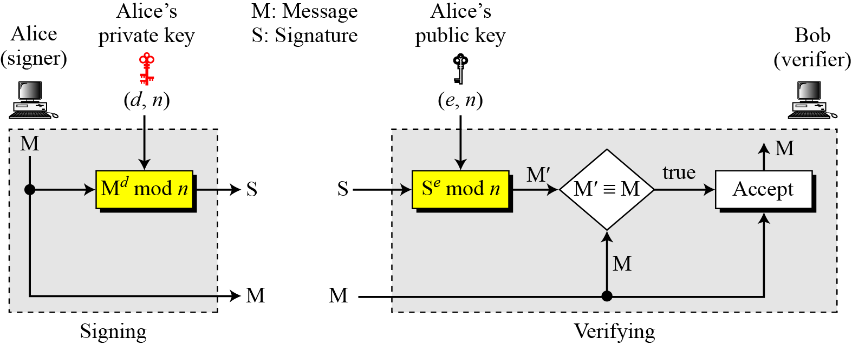
Signing and Verifying

Slide 19
Example
suppose that Alice chooses p = 823 and q = 953, and calculates n = 784319.
The value of ø(n) is 782544
Now she chooses e = 313 and calculates d = 160009.
At this point key generation is complete
Now imagine that Alice wants to send a message with the value of M = 19070 to Bob
She uses her private exponent, 160009, to sign the message
Notes:
19070^16009 mod 784319
= 19070^(160*1000+9) mod 784319
= [(19070^160 mod 784319)^1000 mod 784319] * [19070^9 mod 784319] mod 784319
= (402516^1000 mod 784319) * 529814 mod 784319
= 528703 * 529814 mod 784319
= 210625

Slide 20
Example
Alice sends the message and the signature to Bob. Bob receives the message and the signature. He calculates
Bob accepts the message because he has verified Alice’s signature.

Slide 21
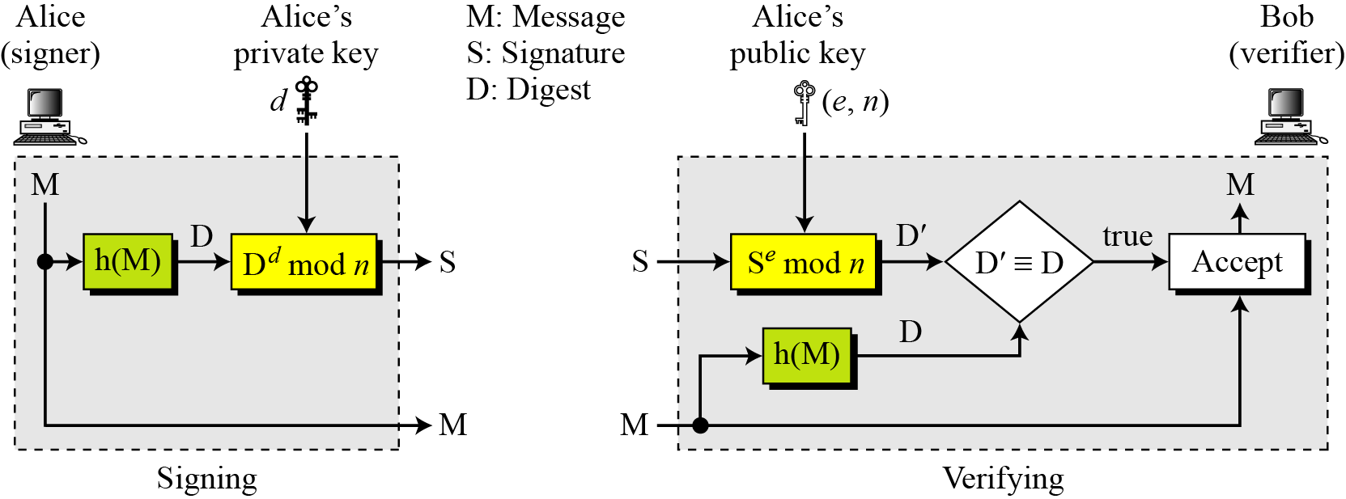
RSA Signature on the Message Digest
When the digest is signed instead of the message itself, the susceptibility of the RSA digital signature scheme depends on the strength of the hash algorithm.

Slide 22
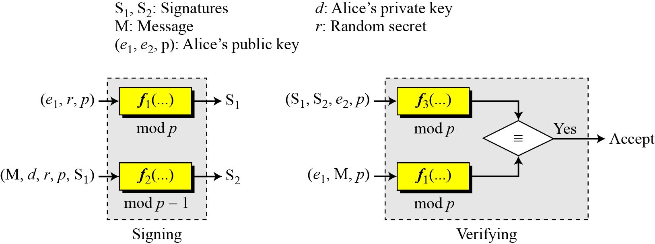
ElGamal Digital Signature Scheme
Figure 13.9 General idea behind the ElGamal digital signature scheme

Slide 23
Key Generation
The key generation procedure here is exactly the same as the one used in the cryptosystem
In ElGamal digital signature scheme, (e1, e2, p) is Alice’s public key; d is her private key.

Slide 24
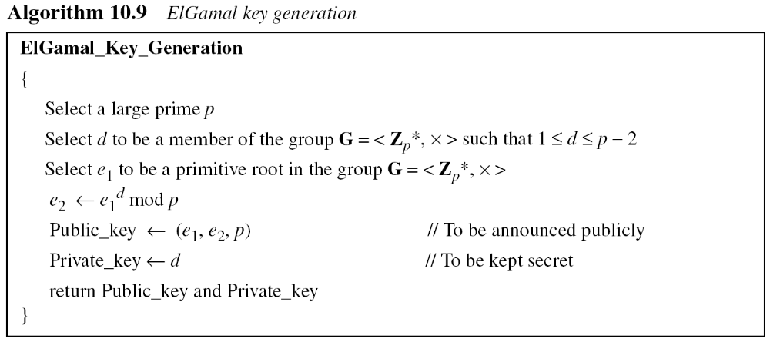
ElGamal Digital Signature Scheme: key generation

Slide 25
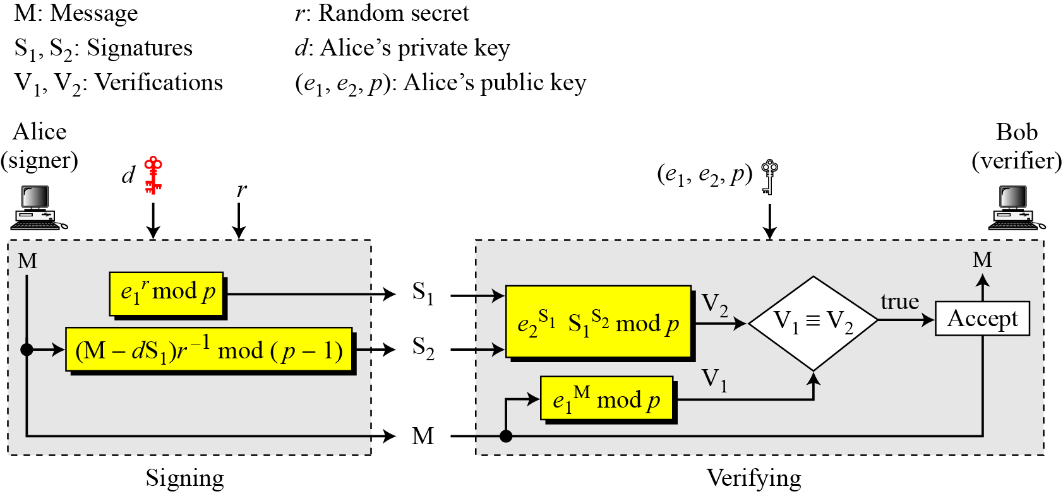
Verifying and Signing
r should be relative prime to p-1

Slide 26
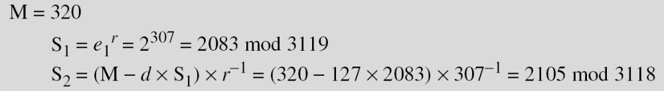
Example
Here is a trivial example. Alice chooses p = 3119, e₁ = 2, d = 127 and calculates e₂ = 2¹²⁷ mod 3119 = 1702. She also chooses r to be 307. She announces e1, e2, and p publicly; she keeps d secret. The following shows how Alice can sign a message.
Notes:
3118 = 2 x 1559
Phi(3118) = 1558
307^-1 mod 3118 = 307^1557 mod 3118 = 2793
320-327x2083 = -264221 mod 3118 = 3118x85-264221 = 809

Slide 27
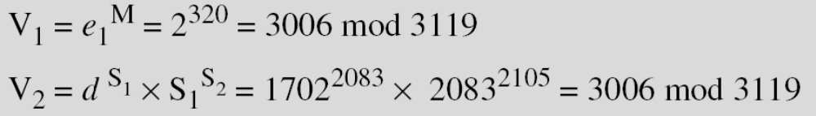
Example
Alice sends M, S₁, and S₂ to Bob. Bob uses the public key to calculate V₁ and V₂.
e₂^{S1}

Slide 28
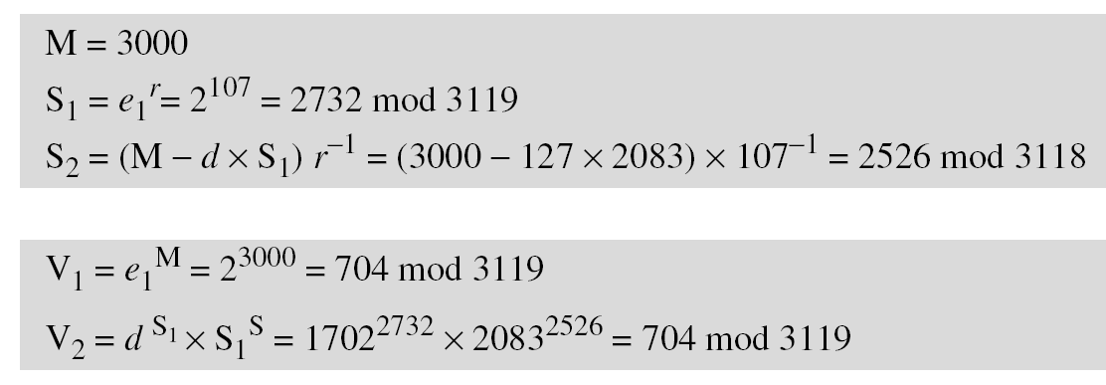
Example
Now imagine that Alice wants to send another message, M = 3000, to Ted. She chooses a new r, 107. Alice sends M, S₁, and S₂ to Ted. Ted uses the public keys to calculate V₁ and V₂.
e₂^{S1}
2

Slide 29
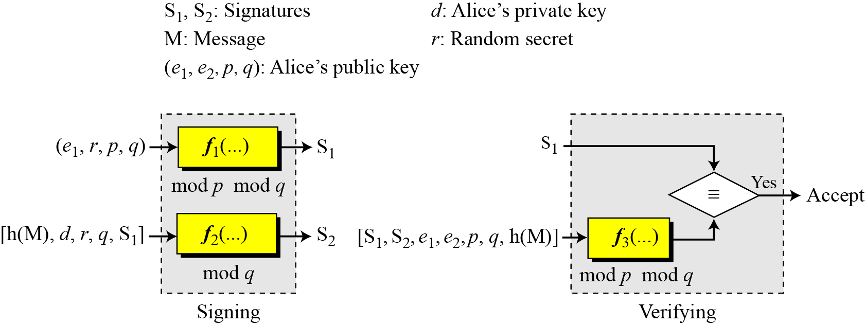
Digital Signature Standard (DSS)

Slide 30
Key Generation
Alice chooses a primes p, between 512 and 1024 bits in length. The number of bits in p must be a multiple of 64
Alice chooses a 160-bit prime q in such way that q divides (p-1).
Alice uses <Zp*, × > and <Zq*, ×>.
  <Zq*, ×> is a subgroup of <Zp*, × >
Alice creates e₁ to be the qth root of 1 mod p (e₁^{q} = 1 mod p).
  To do so, Alice chooses a primitive element e₀ in Zp,
  Calculates e₁ = e₀^{(p-1)/q} mod p
Alice chooses d as the private key and calculates e₂ = e₁^{d} mod p.
Alice’s public key is (e₁, e₂, p, q)
Her private key is (d).

Slide 31
Signing
Alice chooses a random number r(1<=r<=q)
Alice calculates the first signature
  S₁ = (e₁^{r} mod p) mod q
  Note: S₁ does not depend on M, the message
Alice creates a digest of M, h(M)
Alice calculates the second signature
  S2 = ( h(M) + dS₁)r⁻¹ mod q
Alice sends M, S₁ and S₂ to Bob

Slide 32
Verifying
Bob checks to see if 0 < S1 < q
Bob checks to see if 0 < s2 <q
Bob calculates a digest of M, h(M)
Bob calculates V = [(e₁^{h(M)S2^-1} e₂^{S1S2^-1}) mod p] mod q
If S1 = V, M is accepted

Slide 33
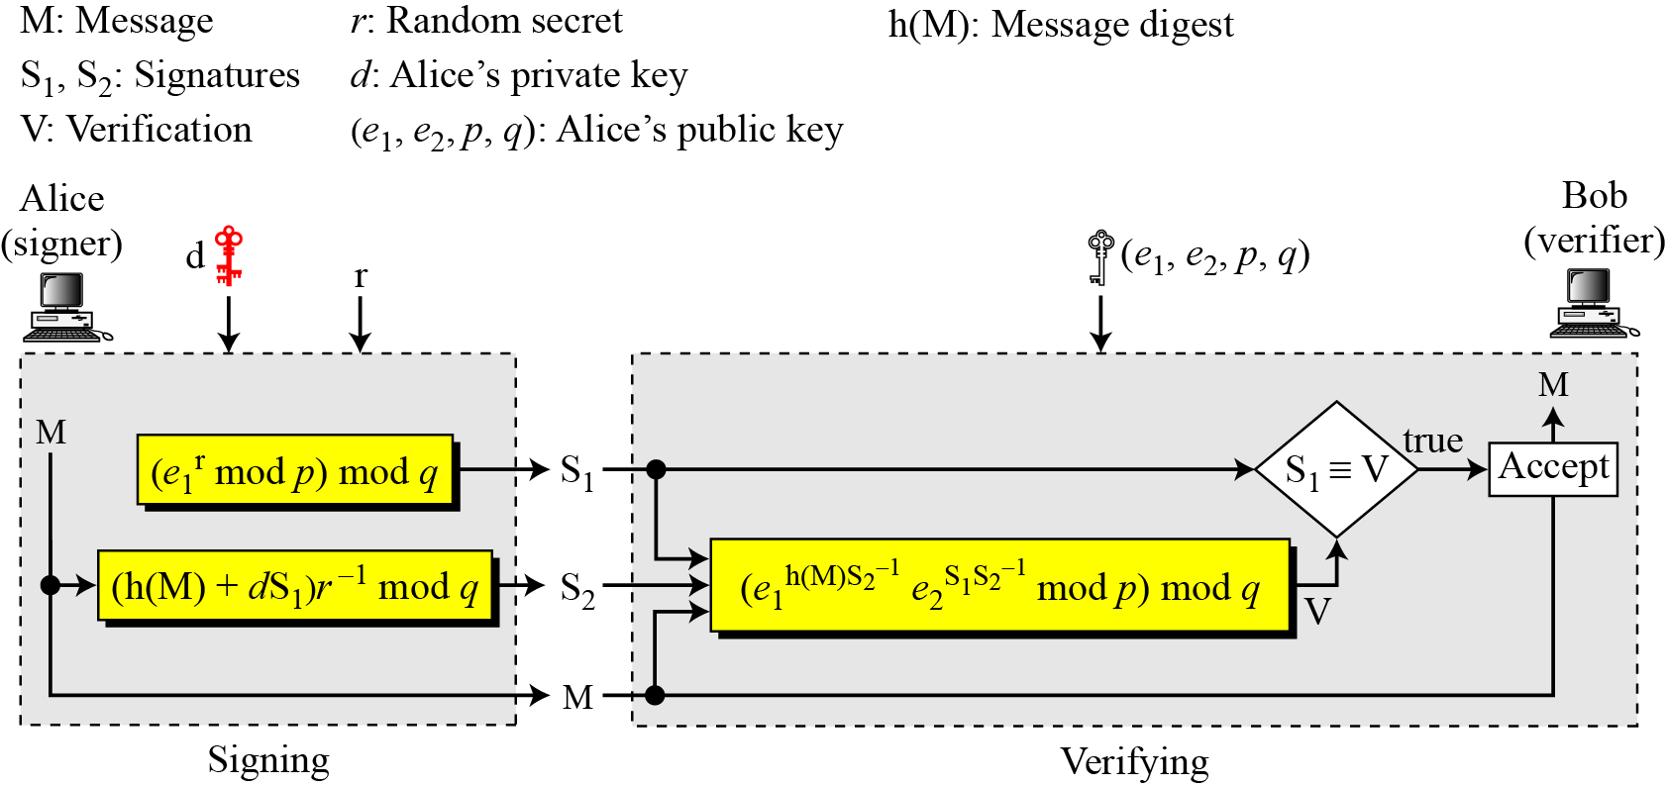
Verifying and Signing

Slide 34
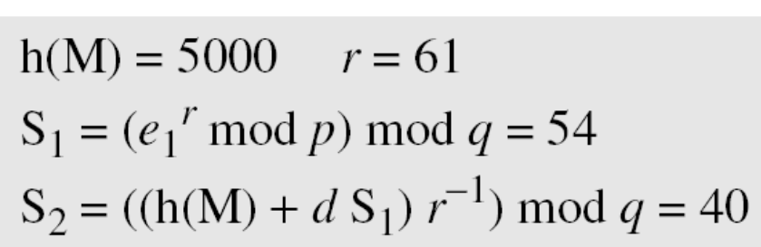
Example
Alice chooses q = 101 and p = 8081. Alice selects e₀ = 3 and calculates e¹ = e₀ ^{(p−1)/q} mod p = 6968. Alice chooses d = 61 as the private key and calculates e₂ = e₁^{d} mod p = 2038. Now Alice can send a message to Bob. Assume that h(M) = 5000 and Alice chooses r = 71:
71
Notes:
S1 = (6968^71 mod 8081) mod 101 = 54
S2 = (5000 + 61*54) * 71^-1 mod 101
= 8294 * 71^99 mod 101
= 8294 * 37 mod 101
= 40

Slide 35
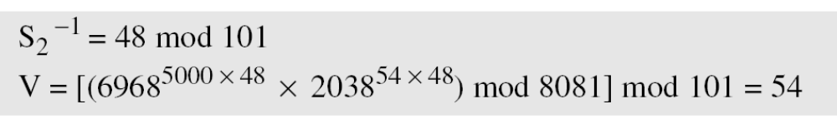
Example
Alice sends M, S₁, and S₂ to Bob. Bob uses the public keys to calculate V.
Notes:
S2⁻¹ mod q
= 40⁻¹ mod 101
= 40⁹⁹ mod 101 = 48
V = [(e₁^{h(M)S2^-1mod q} e₂^{S1S2^-1 mod q})
= [ (6968^{5000*48 mod 101} * 2038^{54*48 mod 101}) mod 8081] mod 101
= [ (6968^{240000 mod 101} * 2038^{2592 mod 101}) mod 8081] mod 101
=[ (6968²⁴ mod 8081) * (2038⁶⁷ mod 8081)] mod 101
= [ ( 383 * 7637 ) mod 8081 ] mod 101
= 54

Slide 36
Comparison
DSS Versus RSA
  Computation of DSS signatures is faster than computation of RSA signatures when using the same p.
DSS Versus ElGamal
  DSS signatures are smaller than ElGamal signatures because q is smaller than p.

Slide 37
Symmetric key agreement
Alice and Bob can create a session key between themselves
This method of session-key creation is referred to as the symmetric-key agreement
  Diffie-Hellman Key Agreement

Slide 38
Diffie-Hellman Key Agreement
Alice and Bob agree on global parameters:
  Large prime integer p
  g: a primitive root
Alice generates a key pair
  chooses a private key (number): x < p
  Compute her public key: R1 = g^{x} mod p
  A sends R1 to Bob
Bob generates a key pair
  chooses a private key (number): y < p
  Compute his public key: R2 = g^{y} mod p
  Bob sends R2 to Alice

Slide 39
Diffie-Hellman Key Agreement
The Shared session key for Alice and Bob is K_{AB}:
  Alice computes
  K_{AB} = R2 ^{x} mod p
  Bob Computes
  K_{AB} = R1 ^{y} mod p
If Alice and Bob subsequently communicate, they will have the same key as before, unless they choose new public-keys

Slide 40
Example
Alice & Bob wish to set up a session key:
They Agree on prime p=353 and g=3
Alice
  Chooses: x = 97
  Computes: R1= g^{x} = 3⁹⁷ mod 353 = 40
  Publishes: R1 = 40
Bob
  chooses y = 233
  Computes: R2 = g^{y} = 3²³³ mod 353 = 248
  Publishes: R2 = 248
Compute the shared session key
  Alice: K_{AB}= R2^{x} mod 353 = 248⁹⁷ mod 353 = 160
  Bob: K_{AB}= R1^{y} mod 353 = 40²³³ mod 353= 160

