Slide 1
CS480
Cryptography and Information Security
Course administration
Huiping Guo
Department of Computer Science
California State University, Los Angeles

Slide 2
Course administration
Lectures
  Monday 1:00– 4:50pm, ET A309
Instructor: Huiping Guo
  Email: hpguo@calstatela.edu
  Phone: (323) 343-6673
  Office: ET-A318
  Office hours: Mon: 11:00 - 1:00 PM
Course infor
  www.calstatela.edu/faculty/hpguo/Teaching/Summer15/CS480/CS480_S15.htm
  The lectures will be video recorded
  The class will be partially flipped!
1. Introduction CS480_S15
1-<number>

Slide 3
Course administration (Cont.)
Textbook
  Behrouz A. Forouzan, Cryptography and Network Security, McGraw Hill ISBN: 0072870222
Reference(s):
  Kaufman, Perlman and Speciner, Network Security: Private Communications in a Public World, second edition (Prentice Hall, 2002).
  Menezes, Van Oorschot and Vanstone, Handbook of Applied Cryptography (CRC Press, 1997)
  Bishop, Computer Security: Art and Science (Addison-Wesley, 2002).
  Pfleeger and Pfleeger, Security in Computing, 4th edition (Prentice Hall, 2006).
1. Introduction CS480_S15
1-<number>

Slide 4
Course administration (Cont.)
Grading policy
  Midterm (50%)
    TBD(tentative)
  Final exam (50%)
    TBD
  Both exams are closed book!
Final letter grade
  A 90-100 A- 85-89
  B+ 80-84 B 70 - 79
  C 60-69 D 50-59 F < 50
1. Introduction CS480_S15
1-<number>

Slide 5
Course administration (Cont.)
Note:
  The grading policy is for all students in the class
  No extra homework for individual students
  No make up exams
    DO NOT take this class if you cannot attend the midterm/final exam!
  You’ll be graded based ONLY on your performance!
    NOT on your immigration status
    NOT on your graduation status
    NOT on your work status
    NOT on your request
1. Introduction CS480_S15
1-<number>

Slide 6
Course administration (Cont.)
CSNS webpage
  http://csns.calstatela.edu/index.html
  Every student enrolled in the class has an account
  both of your username and password are your CIN.
  When you first sign in, you will be asked to choose a different username and password.
  If you already used the system in other classes, your username and password are the same as before.
Make sure you give the correct email address
How to check your grade
  You’ll receive an email about your grade if your email address in CSNS is correct
  Log into CSNS to check
1. Introduction CS480_S15
1-<number>

Slide 7
Course administration (Cont.)
Important date
  Thursday, 08/06 Drop Deadline
Academic integrity
  DON’T COPY OTHER’S WORK!
  DON’T GIVE YOUR SOLUTIONS TO ANYONE!
  If plagiarism is found, ALL parties involved will get F
1. Introduction CS480_S15
1-<number>

Slide 8
Other policies
Please turn off your cell phone during the lecture
DO NOT talk in class during lectures
After lecture, leave the classroom.
  Students are not allowed to stay in the classroom alone without the presence of the instructor
1. Introduction CS480_S15
1-<number>

Slide 9
1. Introduction

Slide 10
Outline
Security goals
Security attacks
  threaten security goals
Security services
  how they are related to the security goals
Security mechanisms
  provide security services
Security techniques
  implement security mechanisms
  cryptography and steganography
1. Introduction CS480_S15
1-<number>

Slide 11
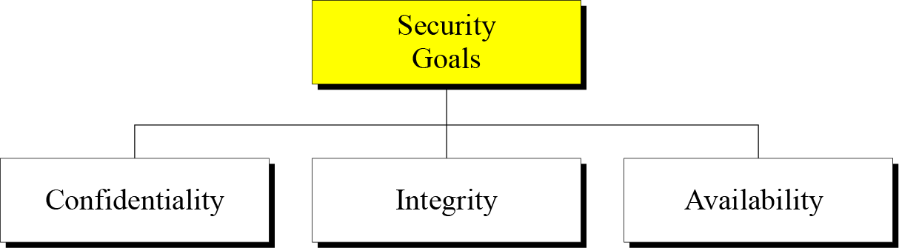
Three Security Goals
1. Introduction CS480_S15
1-<number>

Slide 12
Security Goals
Confidentiality, also known as secrecy:
  The most common aspect of information security
  Only authorized person can get access to the secret information
  Applies to both the storage of the information and the transmission of the information
Integrity
  Modifications need to be done
    By authorized entities
    AND through authorized mechanism
Availability
  The information created and stored by an organization needs to be available to authorized entities
1. Introduction CS480_S15
1-<number>

Slide 13
Security attacks
The three goals of security: confidentiality, integrity, and availability can be threatened by security attacks.
  Attacks Threatening Confidentiality
  Attacks Threatening Integrity
  Attacks Threatening Availability
Category
  Passive attacks
  Active attacks
1. Introduction CS480_S15
1-<number>

Slide 14
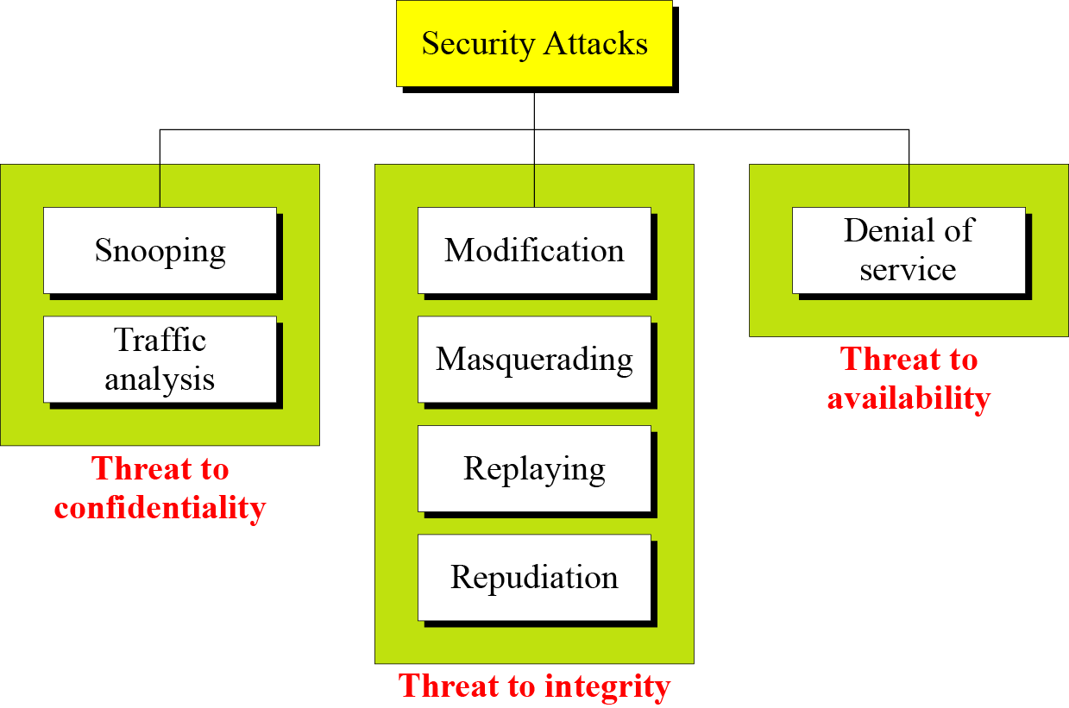
Figure 1.2 Taxonomy of attacks with relation to security goals
1. Introduction CS480_S15
1-<number>

Slide 15
Passive versus Active Attacks
Passive attacks
  Snooping
    refers to unauthorized access to or interception of data.
  Traffic analysis
    refers to obtaining some other type of information by monitoring online traffic
  Goal
    Obtain information that is being transmitted.
  Difficult to detect
    They do not involve any alteration of the data
    The emphasis in dealing with passive attacks is on prevention rather than detection
1. Introduction CS480_S15
1-<number>

Slide 16



Passive attack: Snooping and Traffic Analysis
Wiring, eavesdrop
1. Introduction CS480_S15
1-<number>

Slide 17
Attacks
Active attacks
  Interruption, modification, fabrication
    Masquerade
    Replay
    Modification
    repudiation
    Denial of service
  Are easier to detect than to prevent
1. Introduction CS480_S15
1-<number>

Slide 18
Attack: Masquerade
Tom
Mike
Attacker
Masquerading or spoofing happens when the attacker impersonates somebody else.
I am Mike!
1. Introduction CS480_S15
1-<number>

Slide 19
Attack: Replay
Tom
Mike
message
Same message
Attacker
Replaying means the attacker obtains a copy
of a message sent by a user and later tries to replay it.
1. Introduction CS480_S15
1-<number>

Slide 20
Attack: Modification
Modification means that the attacker intercepts the message and changes it.
Replaced info
intercept
1. Introduction CS480_S15
1-<number>

Slide 21
Attack: repudiation
Repudiation means that sender of the message might later deny that she has sent the message; the receiver of the message might later deny that he has received the message.
Send a message
I didn’t send it!
1. Introduction CS480_S15
1-<number>

Slide 22

Attack: Denial of Service
Server
Denial of service (DoS) is a very common attack. It may slow down or totally interrupt the service of a system.
1. Introduction CS480_S15
1-<number>

Slide 23
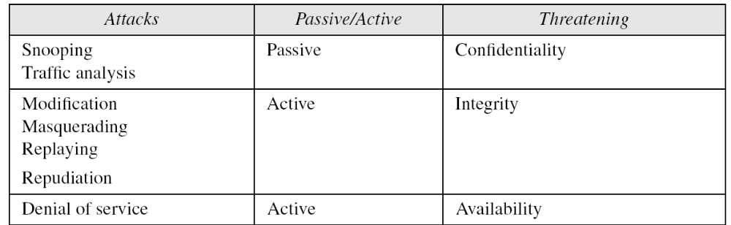
Table 1.1 Categorization of passive and active attacks
1. Introduction CS480_S15
1-<number>

Slide 24
Services and Mechanism
ITU-T provides some security services and some mechanisms to implement those services
Security services and mechanisms are closely related
  A mechanism or combination of mechanisms are used to provide a service
  One mechanism can be used in one or more services
1. Introduction CS480_S15
1-<number>

Slide 25
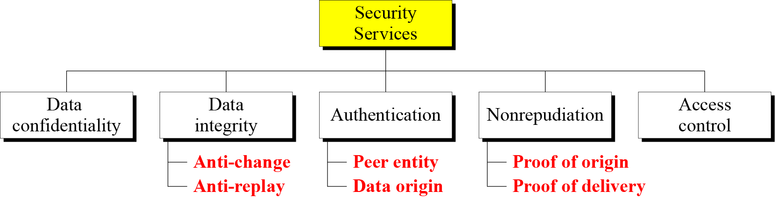
Security Services
1. Introduction CS480_S15
1-<number>

Slide 26
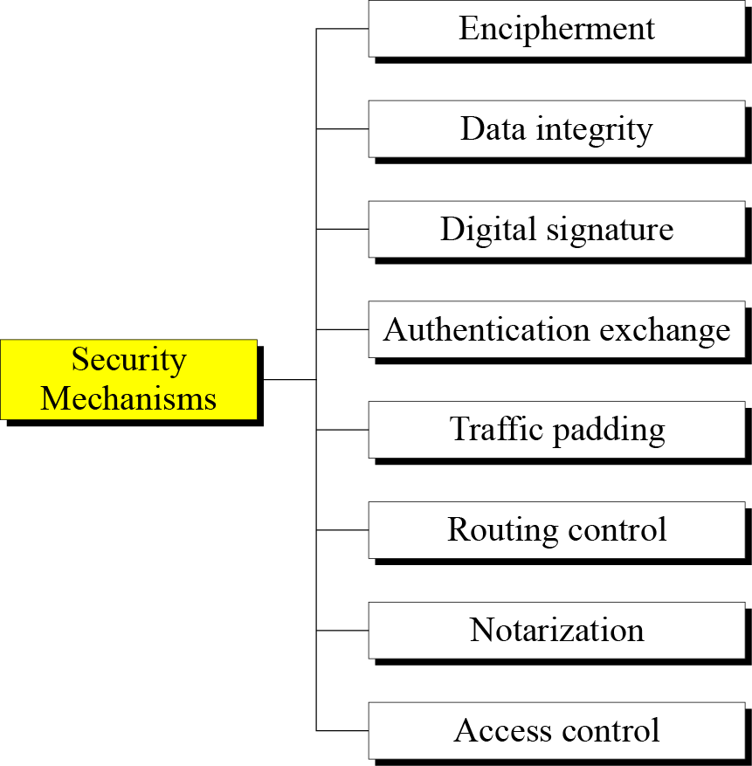
Security Mechanisms
1. Introduction CS480_S15
1-<number>

Slide 27
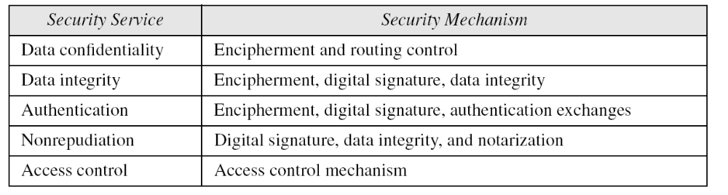
Relation between Services and Mechanisms
1. Introduction CS480_S15
1-<number>

Slide 28
Security techniques
Mechanisms are only theoretical recipes to implement security
The actual implementation of security goals needs some techniques.
Two techniques are prevalent today
  cryptography
  steganography
1. Introduction CS480_S15
1-<number>

Slide 29
Cryptography
Cryptography is the study of
  Secret (crypto-) writing (-graphy)
  science and art of transforming messages to make them secure and immune to attacks.
Concerned with developing algorithms:
  Conceal the context of some message from all except the sender and recipient (privacy or secrecy), and/or
  Verify the correctness of a message to the recipient (authentication)
  Form the basis of many technological solutions to computer and communications security problems
1. Introduction CS480_S15
1-<number>

Slide 30
Basic Concepts
Plaintext
  The original intelligible message
Ciphertext
  The transformed message
Message
  Is treated as a non-negative integer hereafter
1. Introduction CS480_S15
1-<number>

Slide 31
Basic Concepts
Key
  Some critical information used by the cipher, known only to the sender & receiver
cipher
  an algorithm for encryption and decryption. The exact operation of ciphers is normally controlled by a key — some secret piece of information that customizes how the ciphertext is produced
Encipher (encode)
  The process of converting plaintext to ciphertext
Decipher (decode)
  The process of converting ciphertext back into plaintext
1. Introduction CS480_S15
1-<number>

Slide 32
Basic Concepts
Protocols
  specify the details of how ciphers (and other cryptographic primitives) are to be used to achieve specific tasks.
  A suite of protocols, ciphers, key management, user-prescribed actions implemented together as a system constitute a cryptosystem;
  this is what an end-user interacts with, e.g. PGP
1. Introduction CS480_S15
1-<number>

Slide 33

Encryption and Decryption
Decipher P = D_{(K2)}(C)
Plaintext
ciphertext
Encipher C = E_{(K1)}(P)
K1, K2: from keyspace
1. Introduction CS480_S15
1-<number>

Slide 34

Steganography
means “covered writing,”
  in contrast with cryptography, which means “secret writing.”
Example: covering data with text
1. Introduction CS480_S15
1-<number>

Slide 35
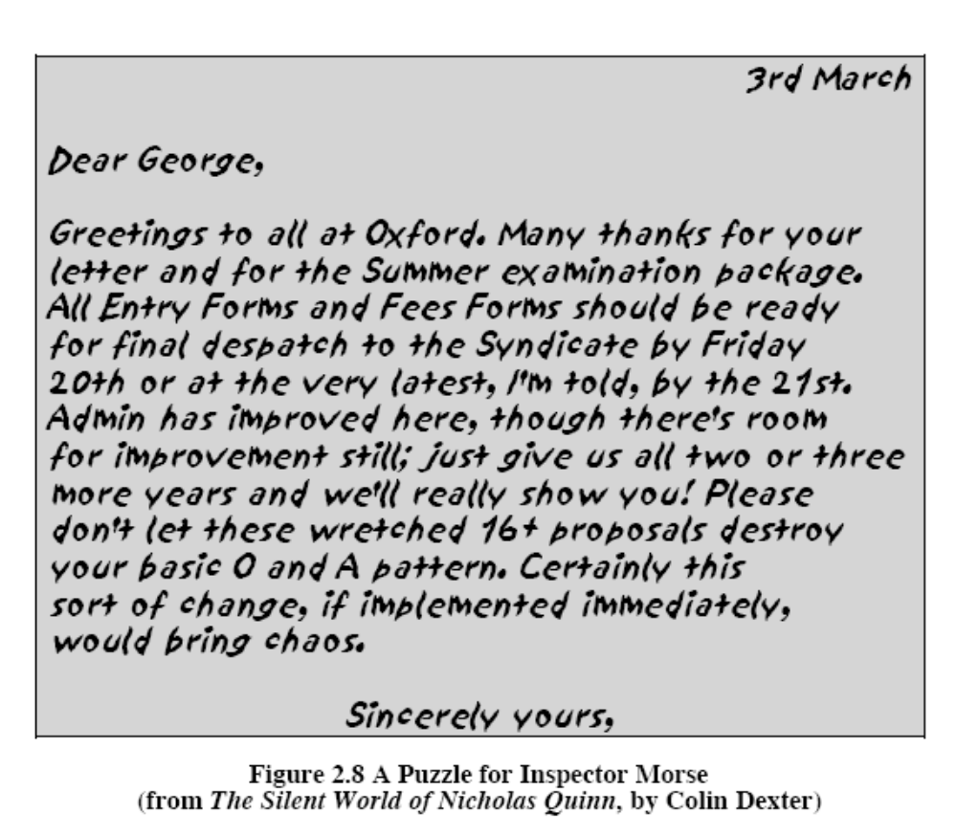
Can you find the hidden message?
1. Introduction CS480_S15
1-<number>

