Slide 1
CS480
Cryptography and Information Security
2. Mathematics of Cryptography
Huiping Guo
Department of Computer Science
California State University, Los Angeles

Slide 2
Outline
Integer arithmetic
Euclidean algorithm
Modular arithmetic
2. Math CS480_S15
2-<number>

Slide 3
Integer arithmetic
Set of Integers
Binary Operations
Integer Division
Divisibility
2. Math CS480_S15
2-<number>

Slide 4

Set of Integers
The set of integers, denoted by Z, contains all integral numbers (with no fraction) from negative infinity to positive infinity.
2. Math CS480_S15
2-<number>

Slide 5
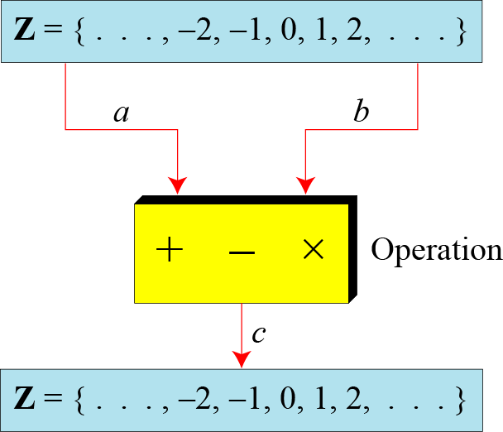
Binary Operations
In cryptography, we are interested in three binary operations applied to the set of integers. A binary operation takes two inputs and creates one output
2. Math CS480_S15
2-<number>

Slide 6
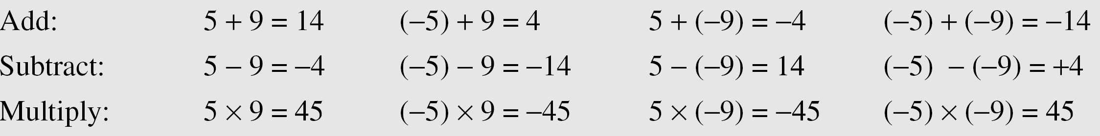
Binary Operations (Cont.)
The following shows the results of the three binary operations on two integers. Because each input can be either positive or negative, we can have four cases for each operation.
Is division a binary operation?
2. Math CS480_S15
2-<number>

Slide 7
Integer division
In integer arithmetic, if we divide a by n, we can get q(quotient) and r(remainder) . The relationship between these four integers can be shown as:
dividend
divisor
a = q × n + r
quotient
remainder
2. Math CS480_S15
2-<number>

Slide 8
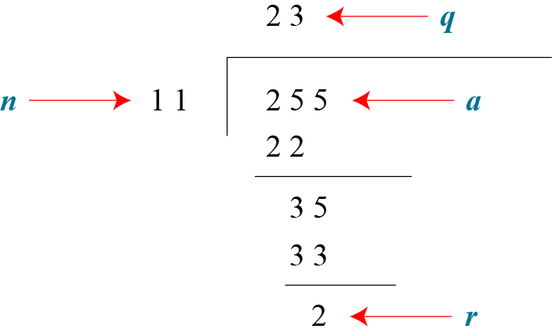
Integer division (cont.)
For example
  Assume that a = 255 and n = 11. We can find q = 23 and R = 2 using the division algorithm
2. Math CS480_S15
2-<number>

Slide 9
Integer division (cont.)
When we use a computer or a calculator, r and q are negative when a is negative.
How can we apply the restriction that r needs to be positive?
  The solution is simple, we decrement the value of q by 1 and we add the value of n to r to make it positive
2. Math CS480_S15
2-<number>

Slide 10
Divisibility
If a is not zero and we let r = 0 in the division relation, we get
a = q × n
If the remainder is zero, n | a
  n divides a
  n is a divisor of a
  a is divisible by n
If the remainder is not zero n | a
2. Math CS480_S15
2-<number>

Slide 11
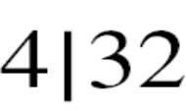
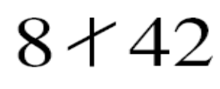
Divisibility (cont.)
The integer 4 divides the integer 32 because 32 = 8 × 4. We show this as
The number 8 does not divide the number 42 because 42 = 5 × 8 + 2
  There is a remainder, the number 2, in the equation. We show this as
2. Math CS480_S15
2-<number>

Slide 12
Divisibility (cont.)
Property 1: if n|1, then n = ±1.
Property 2: if n|a and a|n, then n = ±a.
Property 3: if n|a and a|b, then n|b.
Property 4: if n|a and n|b, then
n|(c1 × a + c2 × b)
where c1 and c2 are arbitrary integers
2. Math CS480_S15
2-<number>

Slide 13

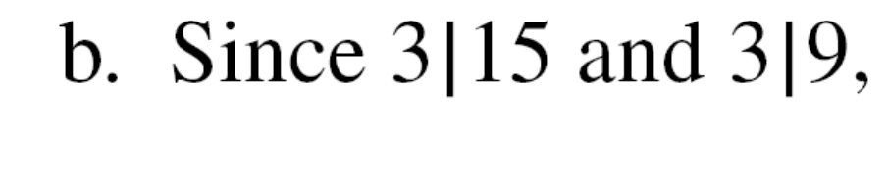
Divisibility (cont.)
2. Math CS480_S15
2-<number>

Slide 14
All divisors
A positive integer can have more than one divisor
  Eg. 32 has 6 divisors: 1,2,4,8,16 and 32
Two facts
  Fact 1: The integer 1 has only one divisor, itself.
  Fact 2: Any positive integer has at least two divisors, 1 and itself (but it can have more).
2. Math CS480_S15
2-<number>

Slide 15
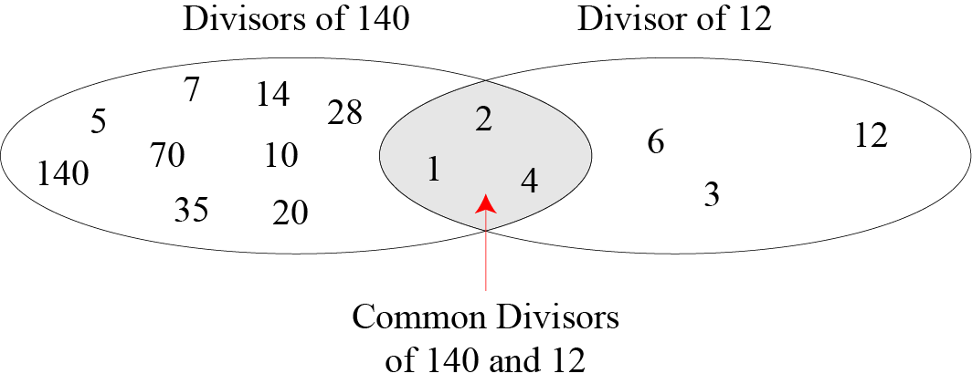
Common divisors of two integers
2. Math CS480_S15
2-<number>

Slide 16
Greatest Common Divisor(gcd)
The greatest common divisor of two positive integers is the largest integer that can divide both integers
Ex: gcd(12,16) = 4
  12 (1,2,3,4,6,12) 16 (1,2,4,8,16)
Questions
gcd(28, 56) = ?
Gcd(36, 81) = ?
Gcd(11223344, 494345634) = ?
2. Math CS480_S15
2-<number>

Slide 17
Euclidean Algorithm
How to find the greatest common divisor (gcd) of two positive integers?
Euclidean Algorithm
  Fact 1: gcd (a, 0) = a
  Fact 2: gcd (a, b) = gcd (b, r)
where r is the remainder of dividing a by b
  eg. Gcd(16, 14) = gcd(14,2)=gcd(2,0)=2
2. Math CS480_S15
2-<number>

Slide 18
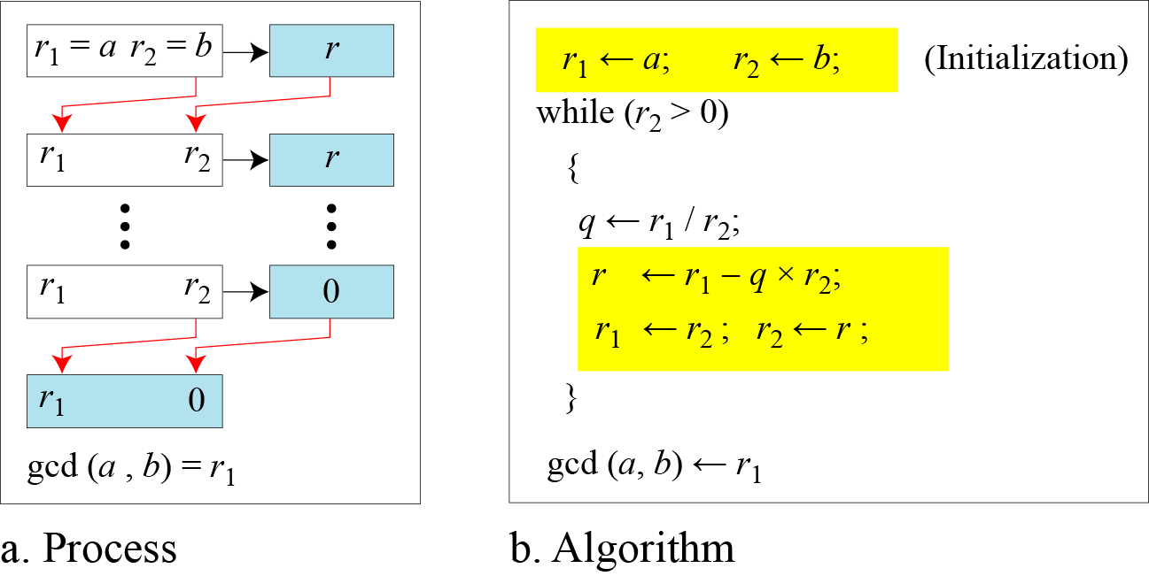
Euclidean Algorithm
2. Math CS480_S15
2-<number>

Slide 19
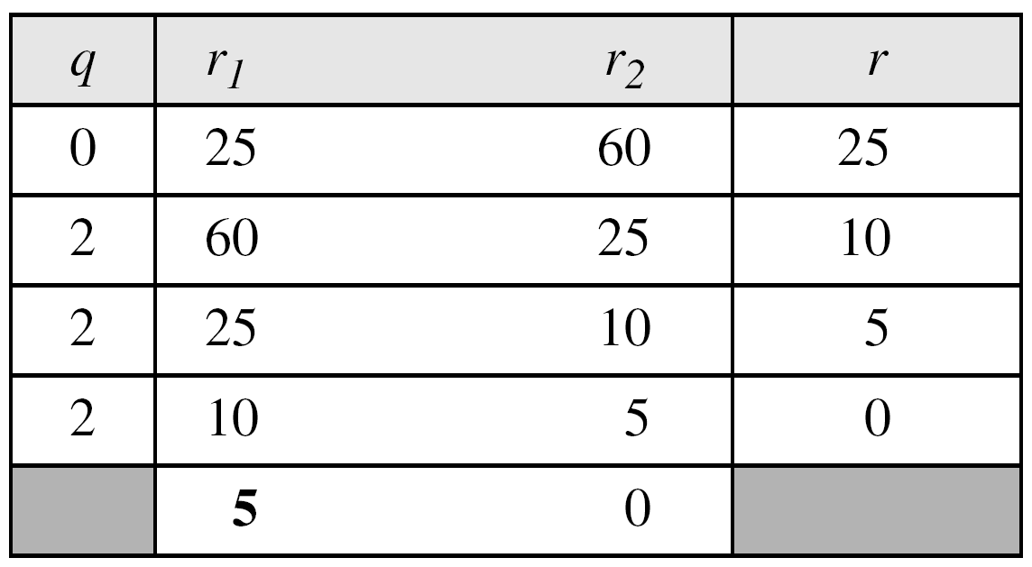
Euclidean Algorithm (cont.)
Find the greatest common divisor of 25 and 60.
Solution
We have gcd (25, 65) = 5.
2. Math CS480_S15
2-<number>

Slide 20
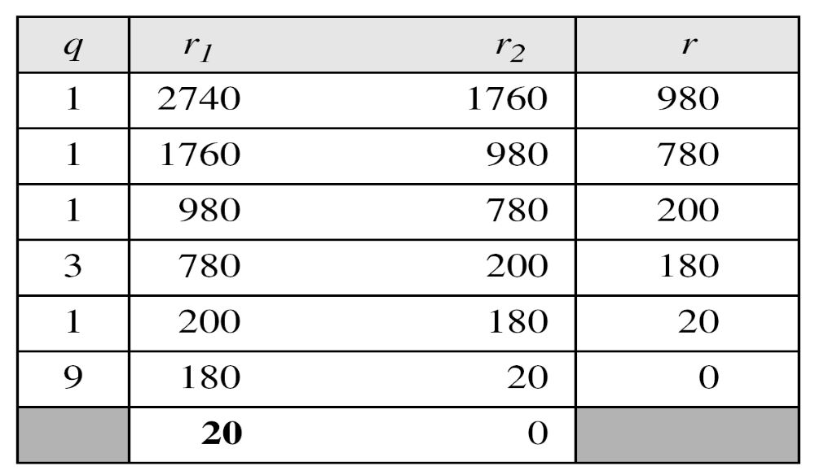
Euclidean Algorithm (cont.)
Find the greatest common divisor of 2740 and 1760
Solution
We have gcd (2740, 1760) = 20
2. Math CS480_S15
2-<number>

Slide 21
Modular arithmetic
Modular Operator
Set of Residues
Congruence
Operations in Zn
Inverses
Different Sets
2. Math CS480_S15
2-<number>

Slide 22
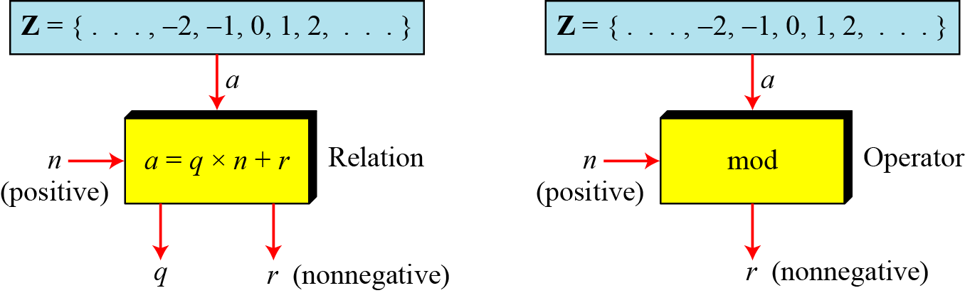
Modular operator
The modulo operator is shown as mod
  a mod n = r
  The second input (n) is called the modulus
  The output r is called the residue
2. Math CS480_S15
2-<number>

Slide 23
Modular operator (cont.)
Find the result of the following operations:
a. 27 mod 5 b. 36 mod 12
c. −18 mod 14 d. −7 mod 10
Solution
Dividing 27 by 5 results in r = 2
Dividing 36 by 12 results in r = 0.
c. Dividing −18 by 14 results in r = −4. After adding the modulus r = 10
d. Dividing −7 by 10 results in r = −7. After adding the modulus to −7, r = 3.
2. Math CS480_S15
2-<number>

Slide 24
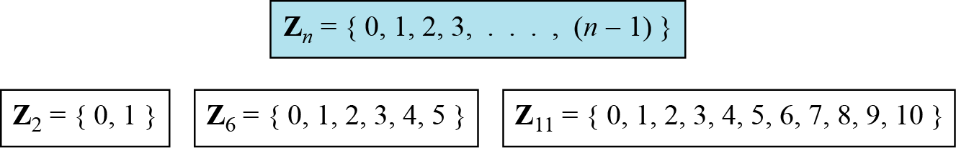
Set of Residues
The result of the modulo operation with modulus n is always an integer between 0 and n-1
The modulo operation creates a set, which in modular arithmetic is referred to as the set of least residues modulo n, or Z_{n}
Figure 2.10 Some Z_{n} sets
2. Math CS480_S15
2-<number>

Slide 25
Congruence
In cryptography, we often use congruence instead of equality
Infinite member of Z can map to one member of Z_{n}
  Ex. 2 mod 10 = 2, 12 mod 10 = 2, 22 mod 10 = 2
  In modular arithmetic, 2, 12 and 22 are called congruent mod 10
2. Math CS480_S15
2-<number>

Slide 26
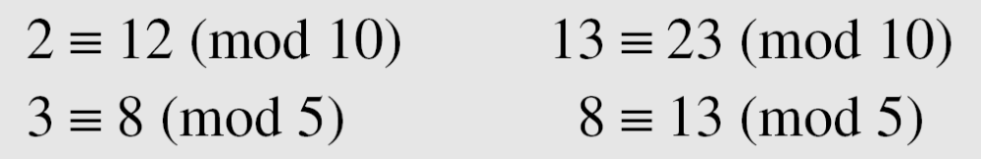
Congruence (cont.)
To show that two integers are congruent, we use the congruence operator ( ≡ ).
For example, we write:
2. Math CS480_S15
2-<number>

Slide 27
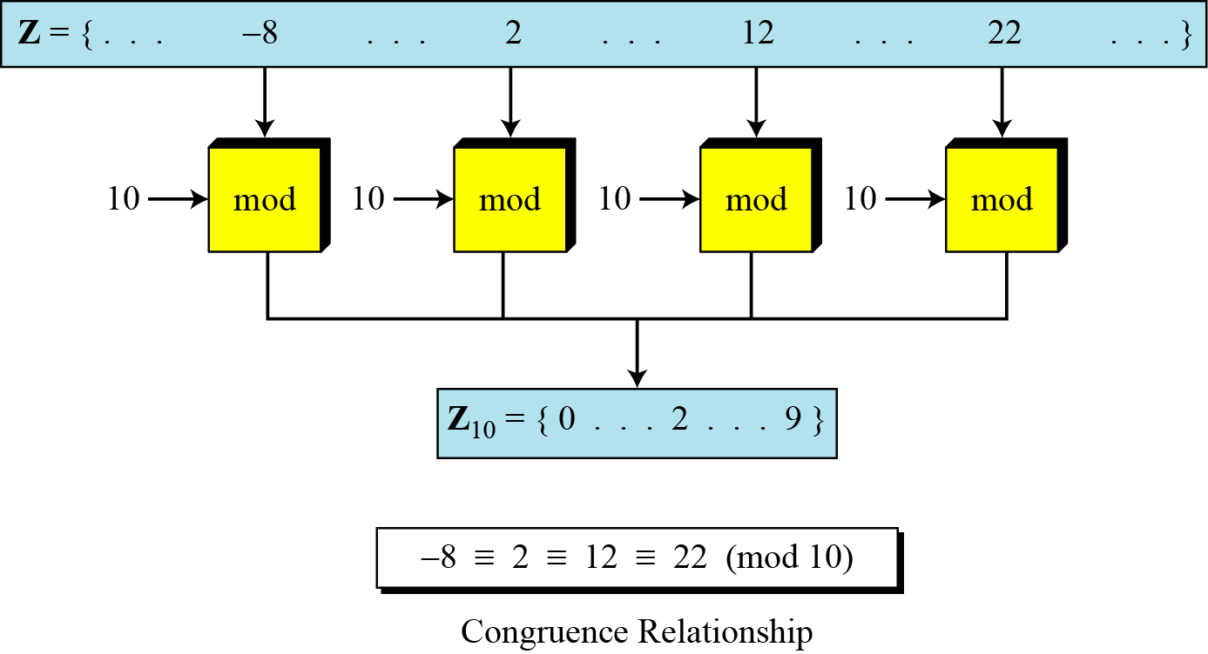
Congruence (cont.)
2. Math CS480_S15
2-<number>

Slide 28
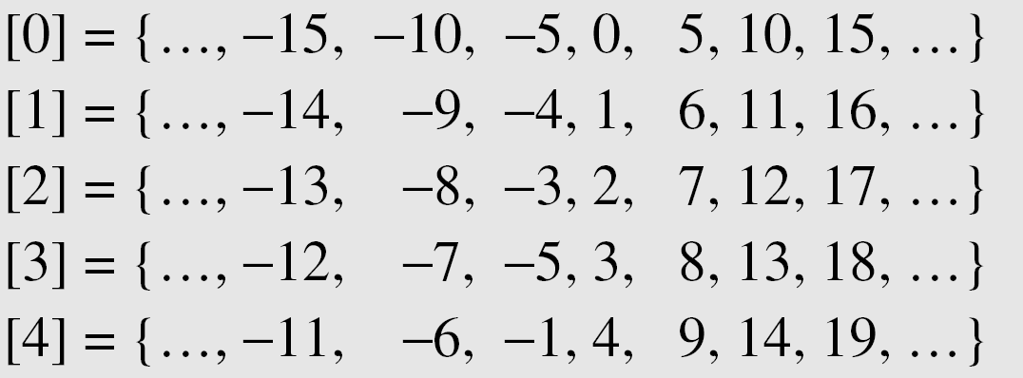
Residue class
A residue class [a] or [a]_{n} is the set of integers congruent modulo n.
It’s the set of all integers congruent modulo n
  The set of all integers such that x Ξ a (mod n)
  Ex: if n=5, we have 5 sets
In each set, there is one element called the least residue (non negative)
Zn is the set of all least residue modulo n
2. Math CS480_S15
2-<number>
Notes:
The integers in the set [0] are all reduced to 0 when we apply modulo 5 operation on them, and so on

Slide 29
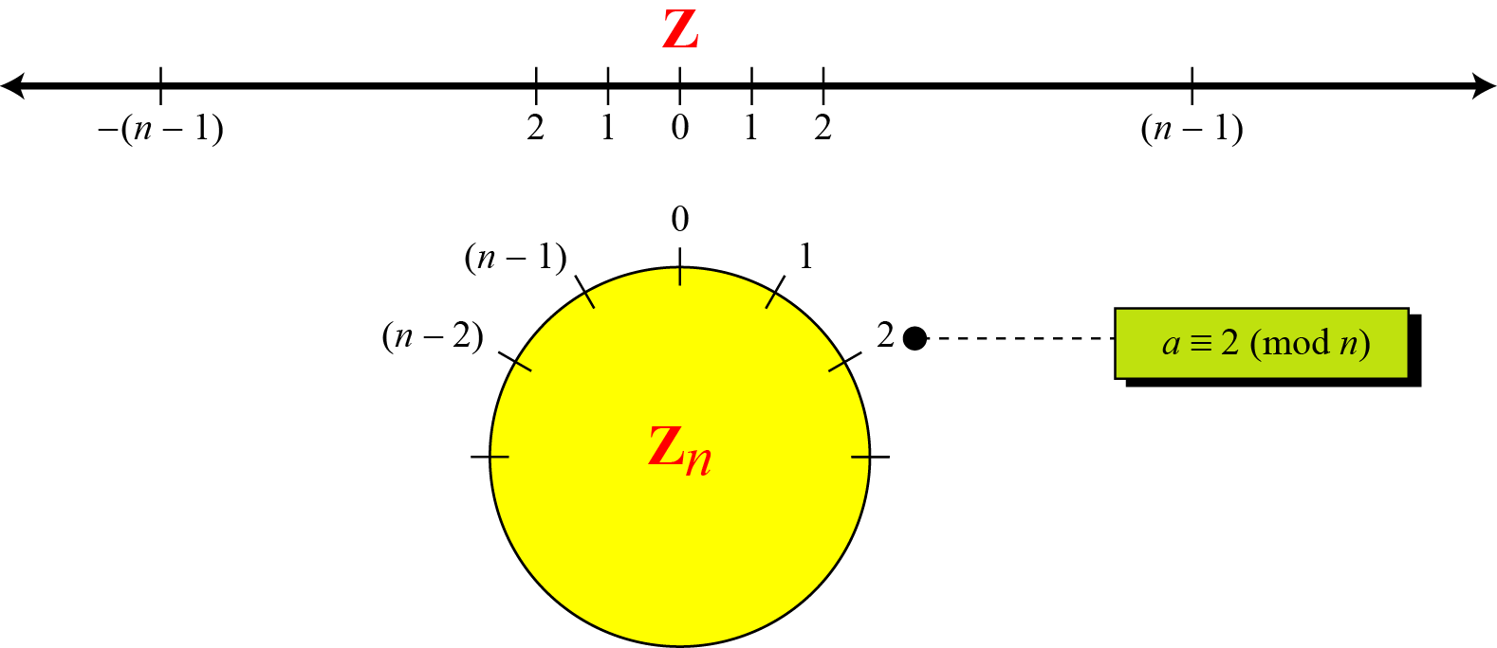
Comparison of Z and Zn
2. Math CS480_S15
2-<number>
Notes:
We use modular arithmetic in our daily life; for example, we use a clock to measure time. Our clock system uses modulo 12 arithmetic. However, instead of a 0 we use the number 12.

Slide 30
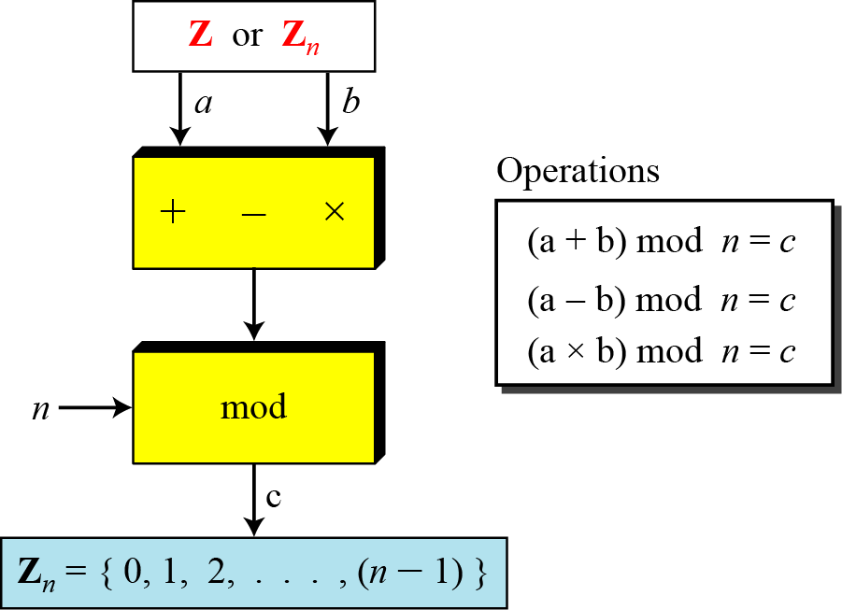
Binary operation in Zn
The three binary operations that we discussed for the set Z can also be defined for the set Zn. The result may need to be mapped to Zn using the mod operator
2. Math CS480_S15
2-<number>

Slide 31
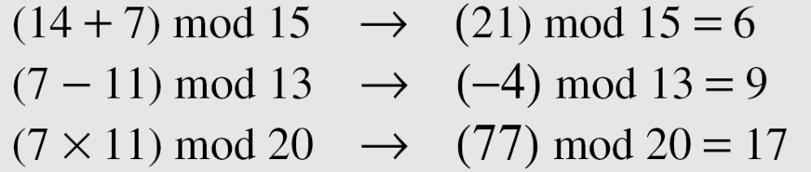
Binary operation in Zn (cont.)
Perform the following operations (the inputs come from Zn):
a. Add 7 to 14 in Z15.
b. Subtract 11 from 7 in Z13.
c. Multiply 11 by 7 in Z20.
Solution
2. Math CS480_S15
2-<number>

Slide 32
Binary operation in Zn (cont.)
Perform the following operations (the inputs come from either Z or Z_{n}):
a. Add 17 to 27 in Z₁₄.
b. Subtract 43 from 12 in Z₁₃.
c. Multiply 123 by −10 in Z₁₉.
Solution ?
2
8
5
2. Math CS480_S15
2-<number>

Slide 33
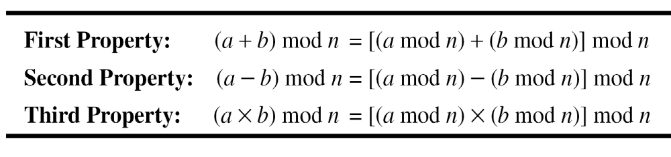
Properties
2. Math CS480_S15
2-<number>

Slide 34
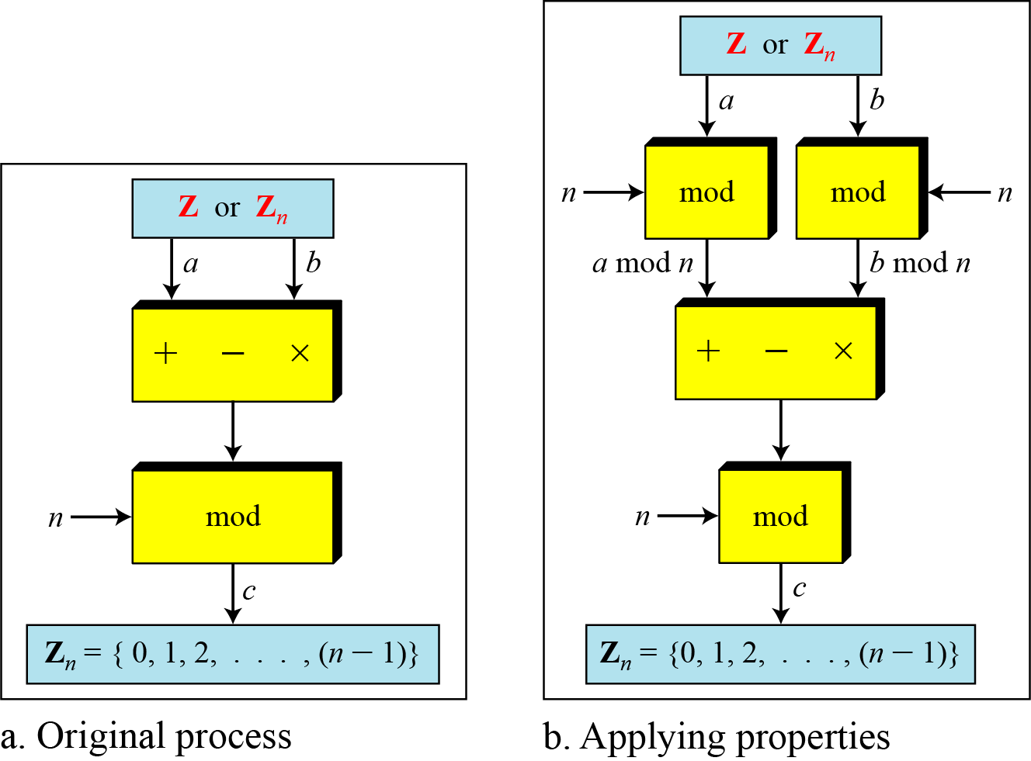
Properties (cont.)
2. Math CS480_S15
2-<number>

Slide 35
Properties (cont.)
The following shows the application of the above properties:
1. (1,723,345 + 2,124,945) mod 11 = (8 + 9) mod 11 = 6
2. (1,723,345 − 2,124,945) mod 11 = (8 − 9) mod 11 = 10
3. (1,723,345 × 2,124,945) mod 11 = (8 × 9) mod 11 = 6
2. Math CS480_S15
2-<number>

Slide 36
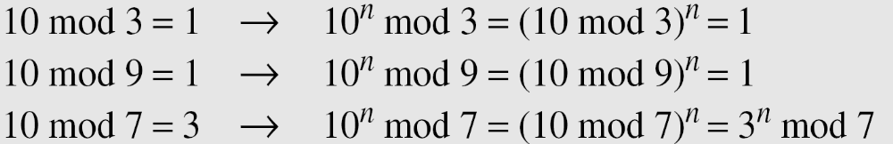
Properties (cont.)
In arithmetic, we often need to find the remainder of powers of 10 when divided by an integer.
2. Math CS480_S15
2-<number>

Slide 37
Inverses
In modular arithmetic, we often need to find the inverse of a number relative to an operation.
  Additive inverse
    relative to an addition operation
  Multiplicative inverse
    relative to a multiplication operation
2. Math CS480_S15
2-<number>

Slide 38

Additive inverse
In Z_{n}, two numbers a and b are additive inverses of each other if
In modular arithmetic, each integer has an additive inverse.
The sum of an integer and its additive inverse is congruent to 0 modulo n
2. Math CS480_S15
2-<number>

Slide 39
Additive inverse (cont.)
Find all additive inverse pairs in Z₁₀.
Solution
The six pairs of additive inverses are:
(0, 0), (1, 9), (2, 8), (3, 7), (4, 6), and (5, 5).
2. Math CS480_S15
2-<number>

