Slide 1
CS480
Cryptography and Information Security
3. Mathematics of Cryptography (2)
Huiping Guo
Department of Computer Science
California State University, Los Angeles

Slide 2
Review
Z and Zn
Modular operation
Gcd and Euclidean Algorithm
Additive inerveses
3. Math_2 CS480_S15

Slide 3
Exercise 1:
Prove the following property:
if n|a and a|b, then n|b
n|a, so a = k1* n k1:any integer
a|b, so b = k2* a k2:any integer
= k2*k1*n
K2*k1 is an integer, so n|b
3. Math_2 CS480_S15

Slide 4
Exercise 2:
Find the greatest common divisor of 4740 and 1760
Answer: 20
3. Math_2 CS480_S15

Slide 5
Exercise 3:
Subtract 14 from 8 in Z15
Multiply 12 by -3 in Z14
a) 8-14 = -6 mod 15 = 9 mod 15
b) -36 mod 14 = 6 mod 14
3. Math_2 CS480_S15

Slide 6
Exercise 4:
Find the additive inverses of the following integers:
5 in Z12 7
5 in Z15 10
4 in Z8 4
4 in Z10 6
3. Math_2 CS480_S15

Slide 7
Outline
Multiplicative inverse
Extended Euclidean algorithm
Matrices
Linear congruence
3. Math_2 CS480_S15

Slide 8

Multiplicative inverse
In Z_{n}, two numbers a and b are the multiplicative inverse of each other if
a ≡ b⁻¹ mod n or a⁻¹ ≡ b mod n
In modular arithmetic, an integer may or may not have a multiplicative inverse.
When it does, the product of the integer and its multiplicative inverse is congruent to 1 modulo n.
3. Math_2 CS480_S15

Slide 9
Multiplicative inverse (cont.)
Example:
Find the multiplicative inverse of 7 in Z₁₀.
3 * 7 mod 10 = 21 mod 10 = 1
So 7⁻¹ ≡ 3 mod 10
3. Math_2 CS480_S15

Slide 10
Multiplicative inverse (cont.)
Example:
Find the multiplicative inverse of 8 in Z₁₀.
There is no multiplicative inverse
we cannot find any number between 0 and 9 such that when multiplied by 8, the result is congruent to 1
3. Math_2 CS480_S15

Slide 11
Multiplicative inverse (cont.)
Find all multiplicative inverses in Z₁₀.
There are only three pairs:
(1, 1), (3, 7) and (9, 9)
The numbers 0, 2, 4, 5, 6, and 8 do not have a multiplicative inverse.
3. Math_2 CS480_S15

Slide 12
Multiplicative inverse (cont.)
Find all multiplicative inverse pairs in Z₁₁.
Solution
We have seven pairs:
(1, 1), (2, 6), (3, 4), (5, 9), (7, 8), and (10, 10)
3. Math_2 CS480_S15

Slide 13
Multiplicative inverse (cont.)
How to know whether an integer b has a multiplicative inverse in Z_{n} ?
  If gcd(n,b) = 1, b has a multiplicative inverse
  If gcd(n,b)≠ 1, b doesn’t have a multiplicative inverse
If b has a multiplicative inverse, how to find it?
  Use extended Euclidean algorithm
3. Math_2 CS480_S15

Slide 14
Extended Euclidean algorithm
The extended Euclidean algorithm finds the multiplicative inverses of b in Zn
  when n and b are given
  and gcd (n, b) = 1.
3. Math_2 CS480_S15

Slide 15
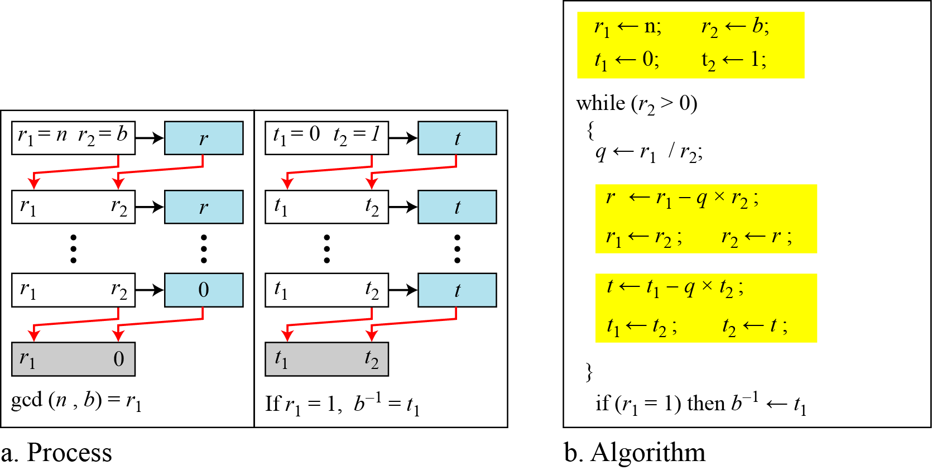
Extended Euclidean algorithm (cont.)
3. Math_2 CS480_S15

Slide 16
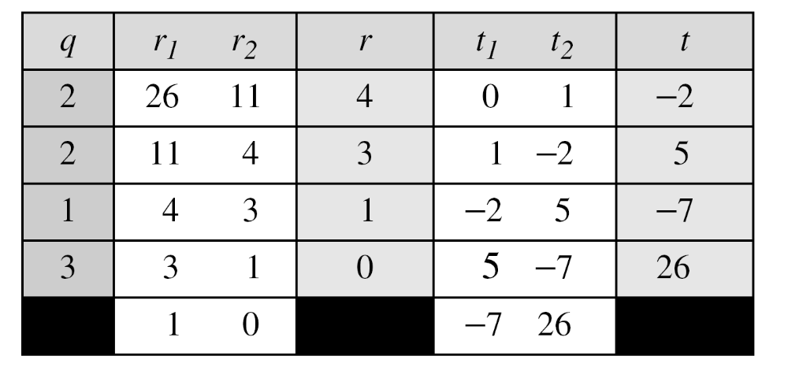
Extended Euclidean algorithm (cont.)
Find the multiplicative inverse of 11 in Z₂₆.
The gcd (26, 11) is 1; the inverse of 11 is −7 or 19.
3. Math_2 CS480_S15

Slide 17
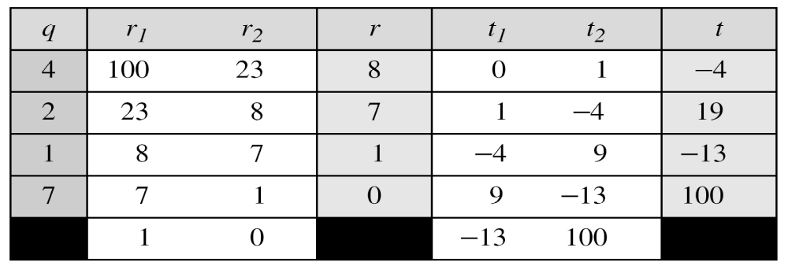
Extended Euclidean algorithm (cont.)
Find the multiplicative inverse of 23 in Z₁₀₀.
The gcd (100, 23) is 1; the inverse of 23 is −13 or 87.
3. Math_2 CS480_S15

Slide 18
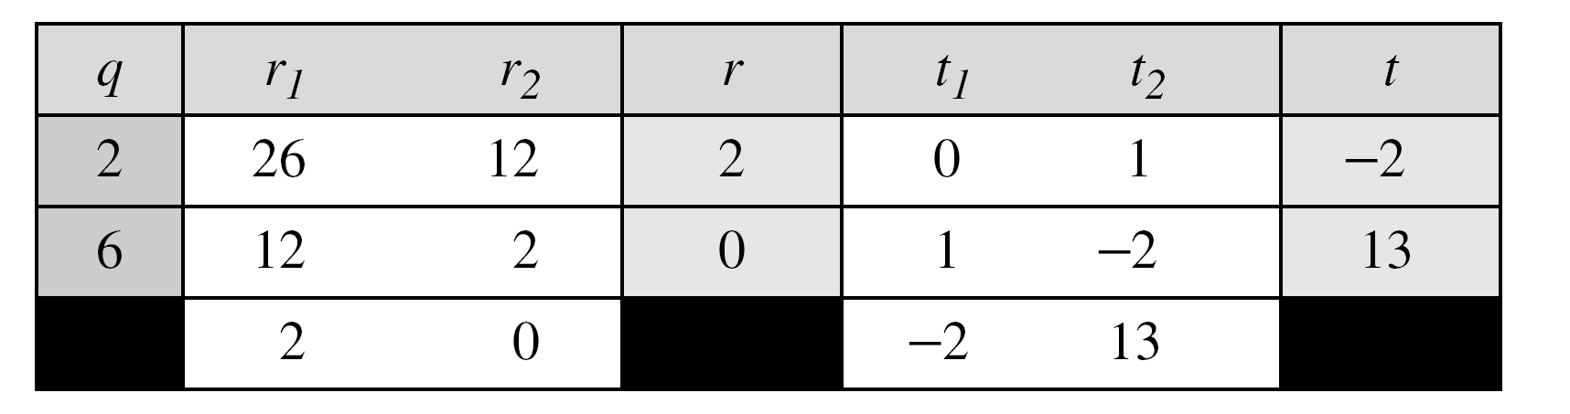
Extended Euclidean algorithm (cont.)
Find the inverse of 12 in Z₂₆.
The gcd (26, 12) is 2; the inverse does not exist.
3. Math_2 CS480_S15

Slide 19
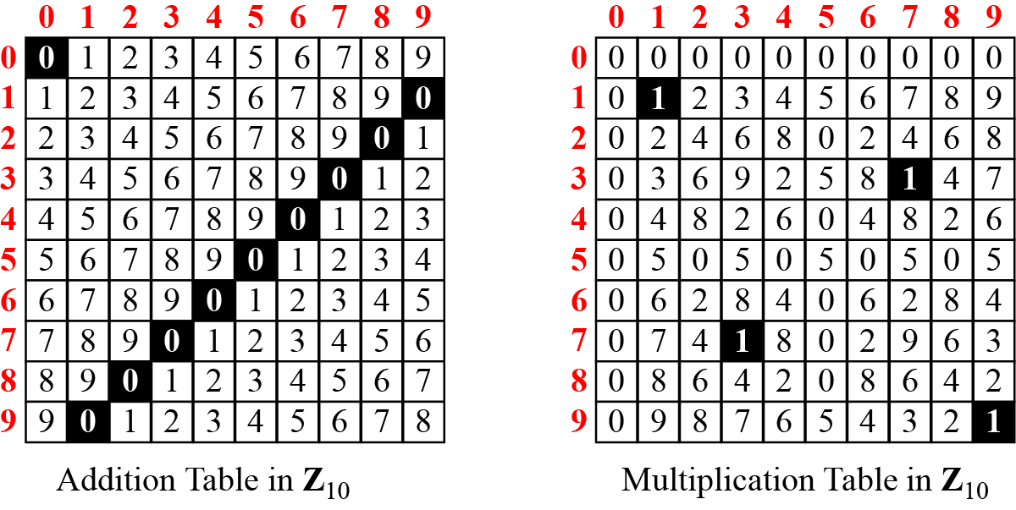
Addition and Multiplication Tables
3. Math_2 CS480_S15

Slide 20
Different sets for addition and multiplication
In cryptography, we often work with inverses
  If the sender uses an integer as the encryption key, the receiver uses the inverse of that integer as the decryption key.
  If the operation (encryption/decryption) is addition, Z_{n} can be used as the set of possible keys
    Each integer in Zn has an additive inverse
  If the operation (encryption/decryption) is multiplication, Z_{n} can NOT be used as the set of possible keys
    ONLY SOME integer in Z_{n} has an multiplicative inverse
We need a new set Z_{n*}
  a subset of Z_{n}
  All members in Z_{n*} have a multiplicative inverse
3. Math_2 CS480_S15

Slide 21
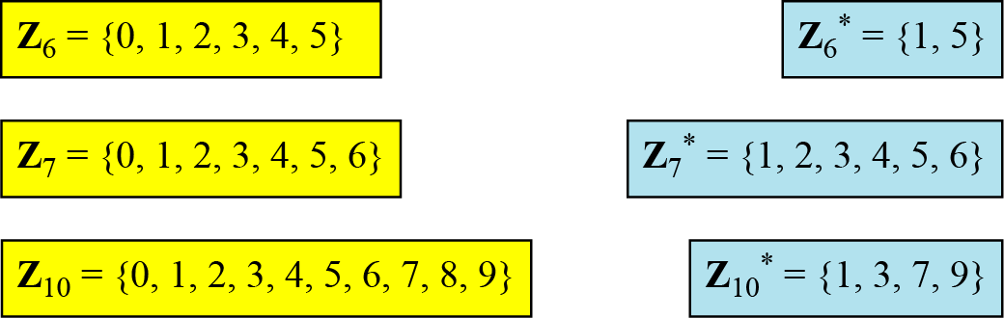
Different sets for addition and multiplication
We need to use Zn when additive inverses are needed
we need to use Zn* when multiplicative inverses are needed
3. Math_2 CS480_S15

Slide 22
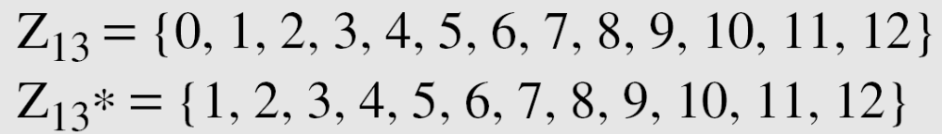
Two more sets
Cryptography often uses two more sets:
  Zp and Zp*, p is a prime
The modulus in these two sets is a prime number
3. Math_2 CS480_S15

Slide 23
Matrices
In cryptography we need to handle matrices.
A brief review of matrices is necessary preparation for the study of cryptography
  Definitions
  Operations and Relations
  Determinants
  Residue Matrices
3. Math_2 CS480_S15

Slide 24
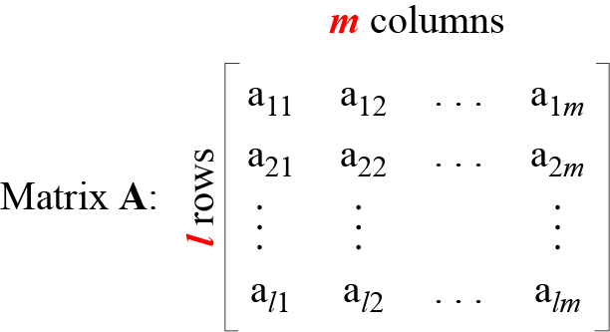
Definition
A matrix is a rectangular array of l x m elements
A matrix is normally denoted with boldface uppercase letters
The element a_{ij} is located in the ith row and jth column
3. Math_2 CS480_S15

Slide 25
Definition
Row matrix
  A matrix that has only one row
Column matrix
  A matrix that has only one column
Square matrix
  A matrix with the same number of rows and columns
Identity matrix I
  A square matrix with 1s on the main diagonal and 0s elsewhere
Additive identity matrix 0
  A matrix with all rows and columns set to 0’s
3. Math_2 CS480_S15

Slide 26
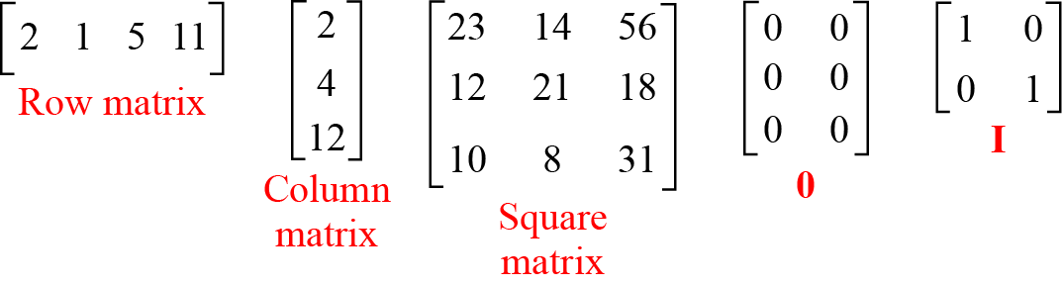
Example
Figure 2.19 Examples of matrices
3. Math_2 CS480_S15

Slide 27
Operations and Relations
Equality
  Two matrices are equal if they have the same number of rows and columns and the corresponding elements are equal
  A = B if we have a_{ij} = b_{ij} for all i’s and j’s
Addition
  Two matrices can be added if they have the same number of columns and rows
  C = A+B, c_{ij} = a_{ij}+b_{ij}
Subtraction
  Subtraction is the same except that each element of B is subtracted from the corresponding element of A
  D = A-B, d_{ij} = a_{ij}- b_{ij}
3. Math_2 CS480_S15

Slide 28
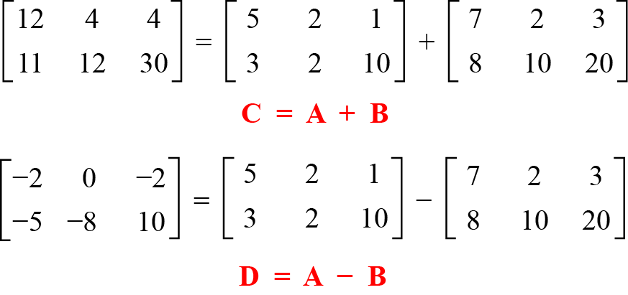
Operations and Relations
Figure 2.20 Addition and subtraction of matrices
3. Math_2 CS480_S15

Slide 29
Operations and Relations
Multiplication (C = A x B)
  Two matrices can be multiplied if the number of columns of the first matrix is the same as the number of rows of the second matrix
  If A is an l x m matrix and B is an m x p matrix, C is of size l x p
  C_{ij} = a_{i1} x b_{1j} + a_{i2} x b_{2j} + … +a_{im} x b_{mj}
3. Math_2 CS480_S15

Slide 30
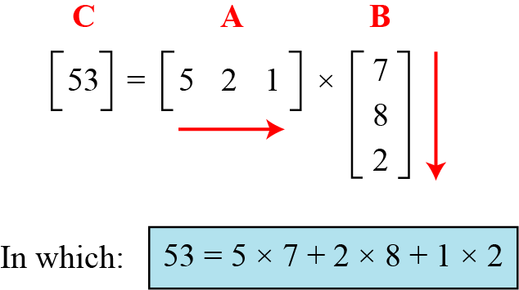
Operations and Relations
Figure 2.21 Multiplication of a row matrix by a column matrix
3. Math_2 CS480_S15

Slide 31
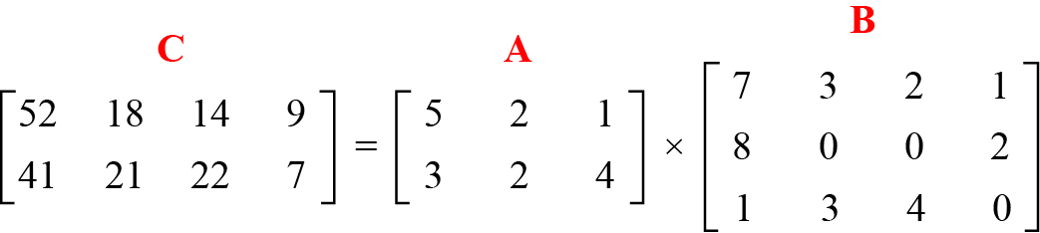
Operations and Relations
Figure 2.22 Multiplication of a 2 × 3 matrix by a 3 × 4 matrix
3. Math_2 CS480_S15

Slide 32
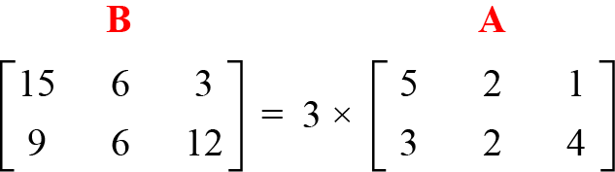
Operations and Relations
Scalar multiplication
Figure 2.23 Scalar multiplication
3. Math_2 CS480_S15

Slide 33
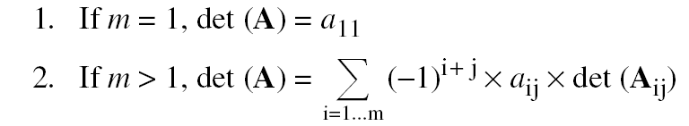
Determinant
The determinant of a square matrix A of size m × m denoted as det (A) is a scalar calculated recursively as shown below:
3. Math_2 CS480_S15

Slide 34
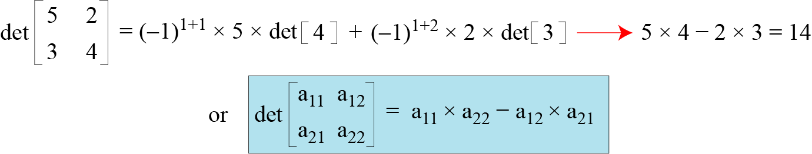
Determinant
An example of how we can calculate the determinant of a 2 × 2 matrix based on the determinant of a 1 × 1 matrix
3. Math_2 CS480_S15

Slide 35
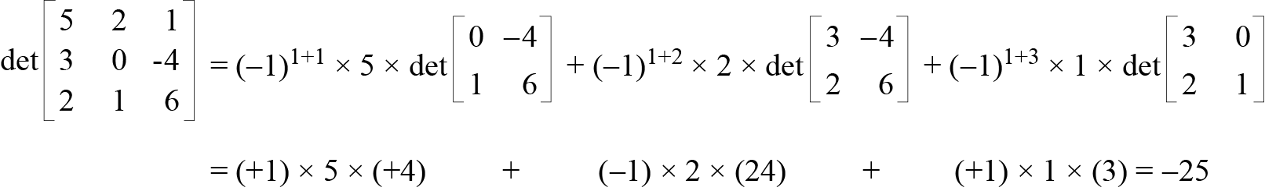
Determinant
An example of how we can calculate the determinant of a 3 × 3 matrix
26
29
3. Math_2 CS480_S15

Slide 36
Inverses
Additive inverse
  The additive inverse of A is another matrix B such that A+B=0.
  B = -A
Multiplicative inverse
  The multiplicative inverse is only defined for square matrices
  The multiplicative inverse of a square matrix A is a square matrix B such that A x B = B x A = I
  B = A⁻¹
  No multiplicative inverse of a matrix in Z
3. Math_2 CS480_S15

Slide 37
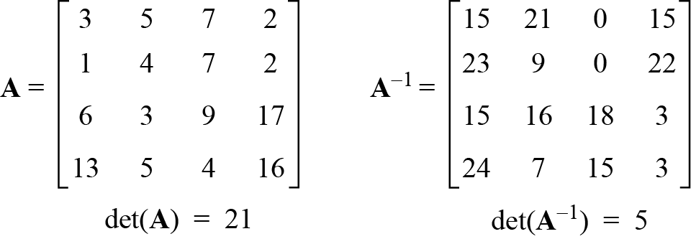
Residue Matrices
Cryptography uses residue matrices: matrices where all elements are in Zn.
A residue matrix has a multiplicative inverse if gcd (det(A), n) = 1.
Figure 2.26 A residue matrix and its multiplicative inverse in Z₂₆
3. Math_2 CS480_S15

Slide 38
Linear congruence
Congruence
  Two matrices are congruent modulo n, written as A≡B(mod n) if
    They have the same number of rows and columns
    All corresponding elements are congruent modulo n
  A ≡ B (mod n) if a_{ij} ≡ b_{ij} (mod n) for all i’s and j’s
Cryptography often involves solving an equation or a set of equations of one or more variables with coefficient in Zn
How to solve equations when the power of each variable is 1 (linear equation)
  Single-Variable Linear Equations
  Set of Linear Equations
3. Math_2 CS480_S15

Slide 39



Single-Variable Linear Equations
Equations of the form ax ≡ b (mod n ) might have no solution or a limited number of solutions
Reduce the equation by dividing both sides of the equation (including the modulus) by d
Multiply both sides of the reduced equation by the multiplicative inverse of a to find the particular solution x₀
The general solutions are x=x₀ + k(n/d), for k=0,1,…, d-1
3. Math_2 CS480_S15

Slide 40
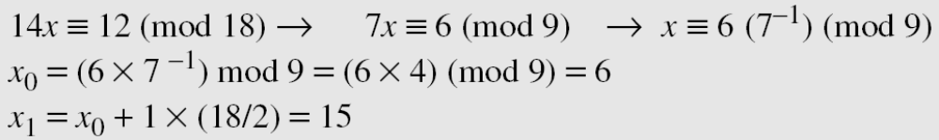
Single-Variable Linear Equations
Example 1: Solve the equation 10 x ≡ 2(mod 15)
  Solution: First we find the gcd (10 and 15) = 5. Since 5 does not divide 2, we have no solution.
Example 2: Solve the equation 14 x ≡ 12 (mod 18)
3. Math_2 CS480_S15

Slide 41
Single-Variable Linear Equations
Example 3: Solve the equation 3x + 4 ≡ 6 (mod 13)
Solution
First we change the equation to the form ax ≡ b (mod n).
We add −4 (the additive inverse of 4) to both sides, which give
3x ≡ 2 (mod 13).
Because gcd (3, 13) = 1, the equation has only one solution, which is x0 = (2 × 3⁻¹) mod 13 = 18 mod 13 = 5.
We can see that the answer satisfies the original equation:
3 × 5 + 4 ≡ 6 (mod 13).
3. Math_2 CS480_S15

