Slide 1
CS480
Cryptography and Information Security
4. Traditional and Modern Symmetric Key Ciphers
Huiping Guo
Department of Computer Science
California State University, Los Angeles

Slide 2
Outline
Symmetric key ciphers
Substitution and transposition ciphers
Stream ciphers and block ciphers
Modern block ciphers
4. Traditional ciphers CS480_S15

Slide 3
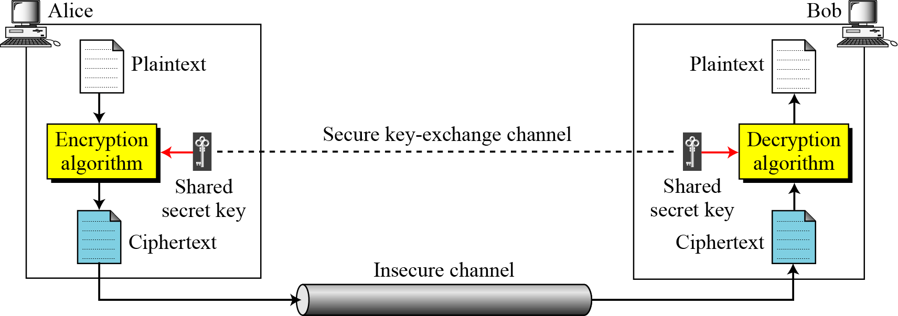
Symmetric Cipher
4. Traditional ciphers CS480_S15
Notes:
Figure 3.1 shows the general idea behind a symmetric-key cipher. The original message from Alice to Bob is called plaintext; the message that is sent through the channel is called the ciphertext. To create the ciphertext from the plaintext, Alice uses an encryption algorithm and a shared secret key. To create the plaintext from ciphertext, Bob uses a decryption algorithm and the same secret key.

Slide 4
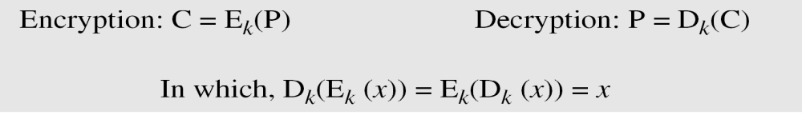
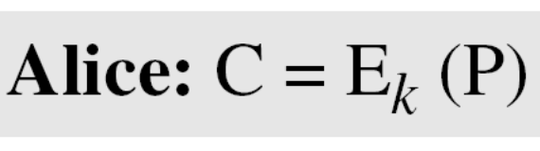
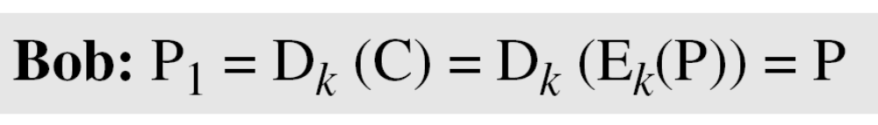
Symmetric Cipher (cont.)
If P is the plaintext, C is the ciphertext, and K is the key
We assume that Bob creates P₁; we prove that P₁ = P:
4. Traditional ciphers CS480_S15

Slide 5
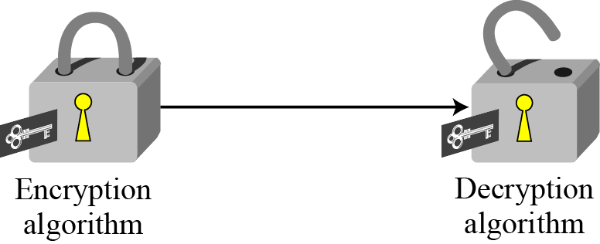
Symmetric Cipher (cont.)
Figure 3.2 Locking and unlocking with the same key
4. Traditional ciphers CS480_S15

Slide 6
Kerckhoff’s Principle
Based on Kerckhoff’s principle, one should always assume that the adversary, Eve, knows the encryption/decryption algorithm. The resistance of the cipher to attack must be based only on the secrecy of the key.
4. Traditional ciphers CS480_S15

Slide 7
Categories of traditional ciphers
Substitution ciphers
  Replace one symbol with another symbol
Transposition ciphers
  Reorder the position of symbols in the plaintext
4. Traditional ciphers CS480_S15

Slide 8
Substitution cipher
A substitution cipher replaces one symbol with another
  Monoalphabetic Ciphers
  Polyalphabetic Ciphers
4. Traditional ciphers CS480_S15

Slide 9
Monoalphabetic Ciphers
A character in the plaintext is always changed to the same character in the ciphertext regardless of its position in the text
the relationship between a symbol in the plaintext to a symbol in the ciphertext is always one-to-one
categories
  Additive cipher
  Muliplicative cipher
  Affine cipher
  Mononalphabetic substitution cipher
4. Traditional ciphers CS480_S15

Slide 10
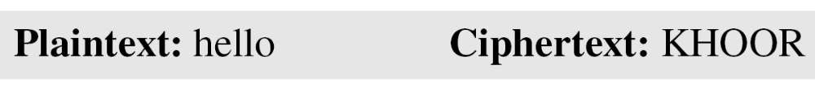
Monoalphabetic Ciphers
Example:
The following shows a plaintext and its corresponding ciphertext. The cipher is probably monoalphabetic because both l’s (els) are encrypted as O’s.
4. Traditional ciphers CS480_S15

Slide 11
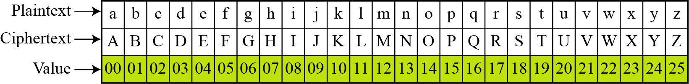
Additive Cipher
The simplest monoalphabetic cipher is the additive cipher. This cipher is sometimes called a shift cipher and sometimes a Caesar cipher, but the term additive cipher better reveals its mathematical nature.
4. Traditional ciphers CS480_S15

Slide 12
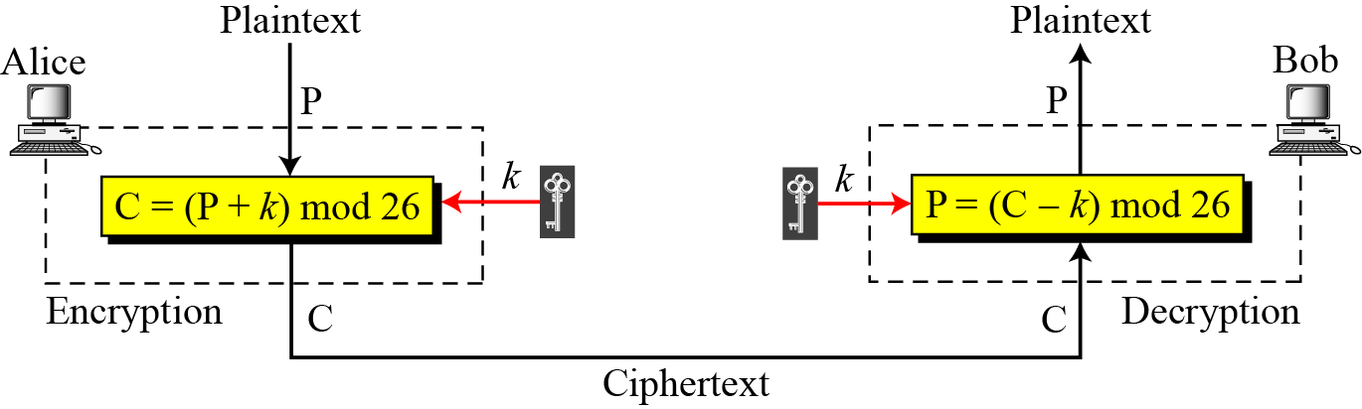
Additive Cipher
When the cipher is additive, the plaintext, ciphertext, and key are integers in Z₂₆
4. Traditional ciphers CS480_S15

Slide 13
Additive Cipher
Use the additive cipher with key = 15 to encrypt the message “hello”.
Solution
We apply the encryption algorithm to the plaintext, character by character:
4. Traditional ciphers CS480_S15

Slide 14
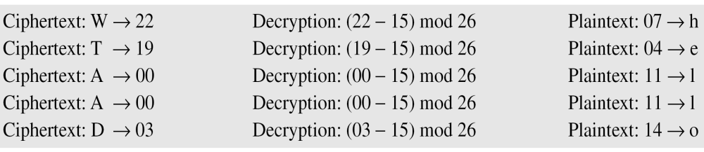
Additive Cipher
Use the additive cipher with key = 15 to decrypt the message “WTAAD”.
Solution
We apply the decryption algorithm to the plaintext character by character:
4. Traditional ciphers CS480_S15

Slide 15
Additive Cipher
Eve has intercepted the ciphertext “UVACLYFZLJBYL”. Show how she can use a brute-force attack to break the cipher.
Solution
Eve tries keys from 1 to 7. With a key of 7, the plaintext is “not very secure”, which makes sense.
4. Traditional ciphers CS480_S15

Slide 16
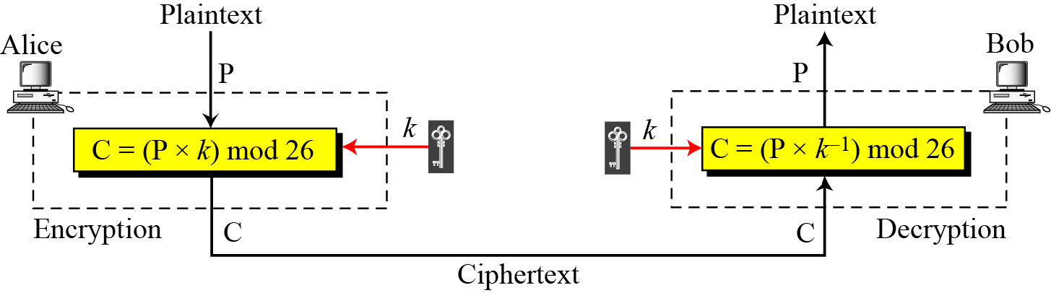
Multiplicative Ciphers
The plaintext and ciphertext are integers in Z₂₆
The key is an integer in Z_{26*}
P
C
4. Traditional ciphers CS480_S15

Slide 17
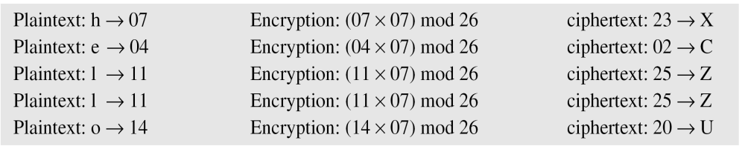
Multiplicative Ciphers
What is the key domain for the multiplicative cipher?
The key needs to be in Z₂₆*. This set has only 12 members: 1, 3, 5, 7, 9, 11, 15, 17, 19, 21, 23, 25.
We use a multiplicative cipher to encrypt the message “hello” with a key of 7. The ciphertext is “XCZZU”.
4. Traditional ciphers CS480_S15

Slide 18
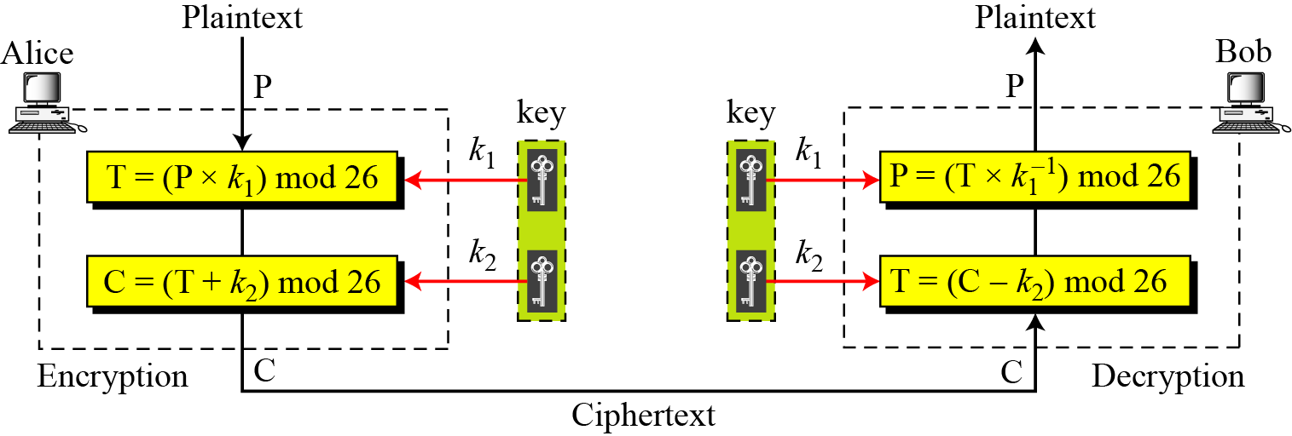
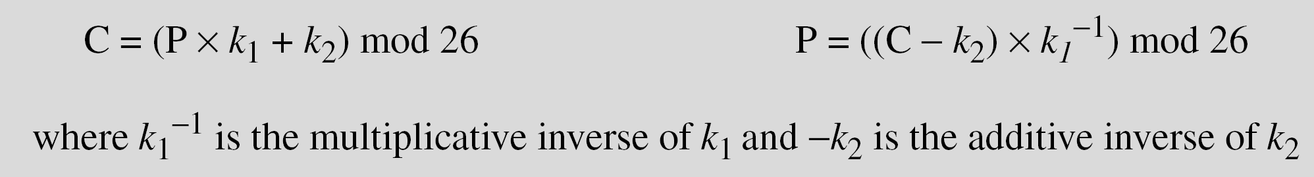
Affine ciphers
4. Traditional ciphers CS480_S15

Slide 19
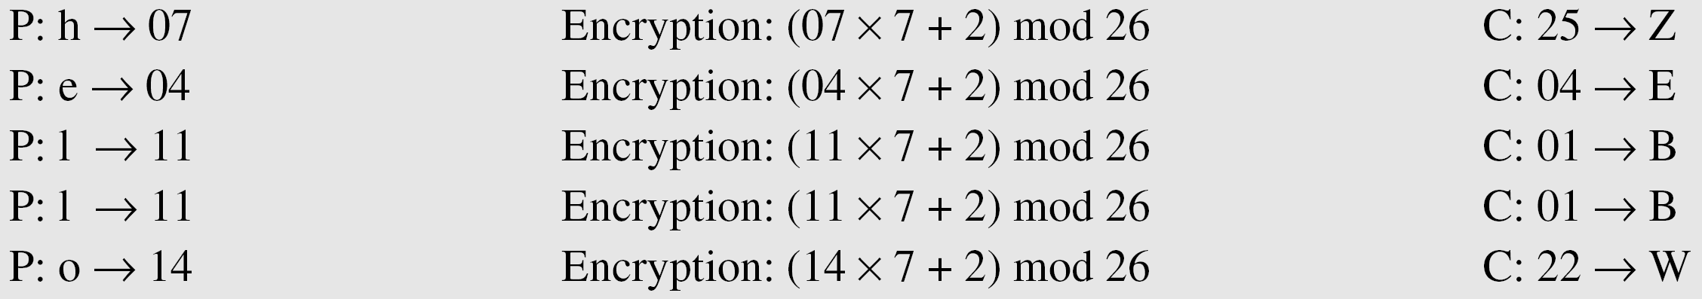
Affine ciphers
The affine cipher uses a pair of keys in which the first key is from Z₂₆* and the second is from Z₂₆. The size of the key domain is 26 × 12 = 312.
Use an affine cipher to encrypt the message “hello” with the key pair (7, 2).
4. Traditional ciphers CS480_S15

Slide 20
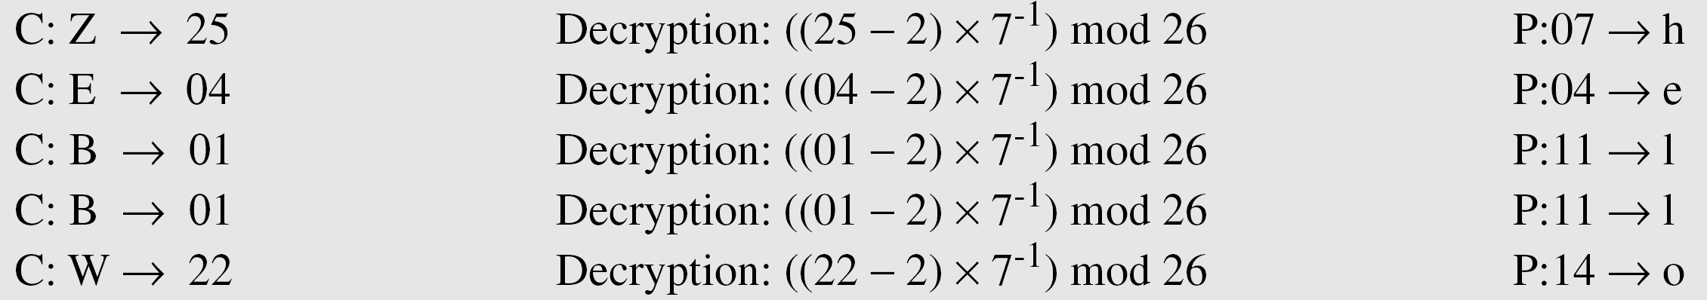
Affine ciphers
Use the affine cipher to decrypt the message “ZEBBW” with the key pair (7, 2) in modulus 26.
Solution
4. Traditional ciphers CS480_S15

Slide 21
Monoalphabetic Substitution Cipher
Because additive, multiplicative, and affine ciphers have small key domains, they are very vulnerable to brute-force attack
  Brute-force attack: an attacker tries all possible keys to find the correct one.
A better solution is to create a mapping between each plaintext character and the corresponding ciphertext character
  Alice and Bob can agree on a table showing the mapping for each character.
4. Traditional ciphers CS480_S15

Slide 22
Monoalphabetic Substitution Cipher
Figure 3.12 An example key for monoalphabetic substitution cipher
We can use the key in Figure 3.12 to encrypt the message
The ciphertext is
4. Traditional ciphers CS480_S15

Slide 23
Monoalphabetic Substitution Cipher Security
now have a total of 26! keys
with so many keys, might think is secure
but would be !!!WRONG!!!
problem is language characteristics
4. Traditional ciphers CS480_S15
Notes:
Note that even given the very large number of keys, being 10 orders of magnitude greater than the key space for DES, the monoalphabetic substitution cipher is not secure, because it does not sufficiently obscure the underlying language characteristics.

Slide 24
Statistics attacks
Human languages are redundant
Letters are not equally commonly used
In English E is by far the most common letter
  followed by T,R,N,I,O,A,S
Other letters like Z,J,K,Q,X are fairly rare
Attackers can make use of the statistic information to launch attacks
4. Traditional ciphers CS480_S15

Slide 25

English Letter Frequencies
4. Traditional ciphers CS480_S15

Slide 26
Statistics attacks
Eve has intercepted the following ciphertext. Using a statistical attack, find the plaintext.
Solution
When Eve tabulates the frequency of letters in this ciphertext, she gets: I =14, V =13, S =12, and so on. The most common character is I with 14 occurrences.
4. Traditional ciphers CS480_S15

Slide 27
Polyalphabetic Ciphers
Each occurrence of a character may have a different substitute
The relationship between a character in the plaintext to a character in the ciphertext is one-to-many
4. Traditional ciphers CS480_S15

Slide 28
Polyalphabetic Ciphers
AutoKey cipher
Playfair cipher
4. Traditional ciphers CS480_S15

Slide 29
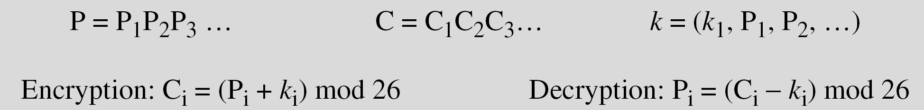
AutoKey cipher
Key is concatenated with the plaintext itself to provide a running key
knowing keyword can recover the first few letters
use these in turn on the rest of the message
4. Traditional ciphers CS480_S15

Slide 30
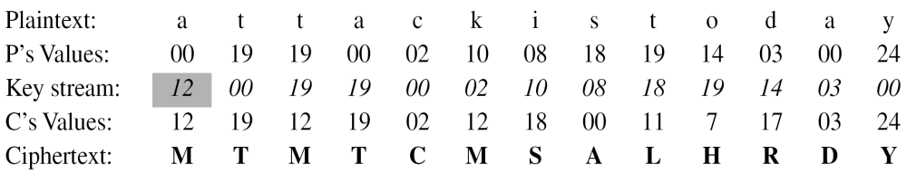
AutoKey cipher
Assume that Alice and Bob agreed to use an autokey cipher with initial key value k1 = 12.
Now Alice wants to send Bob the message “Attack is today”
Enciphering is done character by character.
4. Traditional ciphers CS480_S15

Slide 31
Playfair Key Matrix
a 5X5 matrix of letters based on a keyword
fill in letters of keyword (minus duplicates)
fill rest of matrix with other letters in alphabetical order
eg. using the keyword MONARCHY
M | O | N | A | R
C | H | Y | B | D
E | F | G | I/J | K
L | P | Q | S | T
U | V | W | X | Z
4. Traditional ciphers CS480_S15
Notes:
The best-known multiple-letter encryption cipher is the Playfair, which treats digrams in the plaintext as single units and translates these units into ciphertext digrams. The Playfair algorithm is based on the use of a 5x5 matrix of letters constructed using a keyword. The rules for filling in this 5x5 matrix are: L to R, top to bottom, first with keyword after duplicate letters have been removed, and then with the remain letters, with I/J used as a single letter. This example comes from Dorothy Sayer's book "Have His Carcase", in which Lord Peter Wimsey solves it, and describes the use of a probably word attack.

Slide 32
Encrypting and Decrypting
plaintext is encrypted two letters at a time
  if a pair is a repeated letter, insert filler like 'X’
  e.g balloon is treated as ba lx lo on
  if both letters fall in the same row, replace each with letter to right (wrapping back to start from end)
  e.g ar is encrypted as RM
  if both letters fall in the same column, replace each with the letter below it (again wrapping to top from bottom)
  e.g mu is encrypted as CM
  otherwise each letter is replaced by the letter in the same row and in the column of the other letter of the pair
  e.g hs is encrytped as BP, ea is encrypted as IM(or JM)
4. Traditional ciphers CS480_S15
Notes:
Plaintext is encrypted two letters at a time,according to the rules as shown. Note how you wrap from right side back to left, or from bottom back to top.
if a pair is a repeated letter, insert a filler like 'X', eg. "balloon" encrypts as "ba lx lo on"
if both letters fall in the same row, replace each with letter to right (wrapping back to start from end), eg. “ar" encrypts as "RM"
if both letters fall in the same column, replace each with the letter below it (again wrapping to top from bottom), eg. “mu" encrypts to "CM"
otherwise each letter is replaced by the one in its row in the column of the other letter of the pair, eg. “hs" encrypts to "BP", and “ea" to "IM" or "JM" (as desired)
Decrypting of course works exactly in reverse. Can see this by working the example pairs shown, backwards.

Slide 33
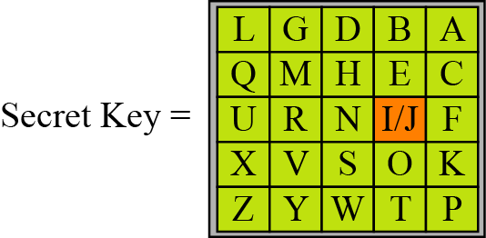
In class exercise
Encrypt the plaintext “hello” using the key in the above Figure
he: EX lx : QZ lo: BX
4. Traditional ciphers CS480_S15

Slide 34
One-Time Pad
if a truly random key as long as the message is used, the cipher will be secure
called a One-Time pad
is unbreakable since ciphertext bears no statistical relationship to the plaintext
since for any plaintext & any ciphertext there exists a key mapping one to other
can only use the key once though
problems in generation & safe distribution of key
4. Traditional ciphers CS480_S15
Notes:
The One-Time Pad is an evolution of the Vernham cipher, which was invented by Gilbert Vernham in 1918, and used a long tape of random letters to encrypt the message. An Army Signal Corp officer, Joseph Mauborgne, proposed an improvement using a random key that was truly as long as the message, with no repetitions, which thus totally obscures the original message. It produces random output that bears no statistical relationship to the plaintext. Because the ciphertext contains no information whatsoever about the plaintext, there is simply no way to break the code, since any plaintext can be mapped to any ciphertext given some key.
The one-time pad offers complete security but, in practice, has two fundamental difficulties:
There is the practical problem of making large quantities of random keys.
2. And the problem of key distribution and protection, where for every message to be sent, a key of equal length is needed by both sender and receiver.
Because of these difficulties, the one-time pad is of limited utility, and is useful primarily for low-bandwidth channels requiring very high security.

Slide 35
Transposition cipher
A transposition cipher does not substitute one symbol for another
Instead it changes the location of the symbols
  Reorder the symbols
Category
  Keyless Transposition Ciphers
  Keyed Transposition Cipher
  Combining Two Approaches
4. Traditional ciphers CS480_S15

Slide 36
Keyless Transposition Ciphers
There are two methods:
The text is written into a table column by column and then transmitted into the table row by row
The text is written into the table row by row and then transmitted column by column
4. Traditional ciphers CS480_S15

Slide 37
Rail fence cipher
The plaintext is arranged in two lines as a zigzag pattern (column by column)
Then read off cipher row by row
For example, to send the message
“Meet me at the park” to Bob
Alice writes:
She then creates the ciphertext “MEMATEAKETETHPR”
4. Traditional ciphers CS480_S15

Slide 38
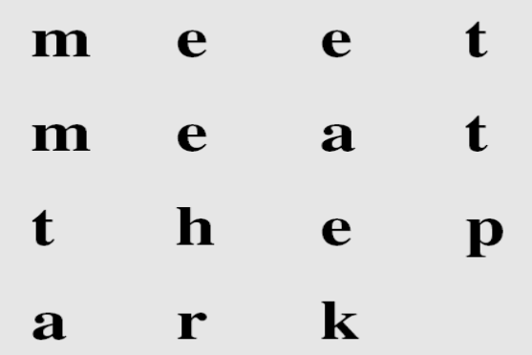
Rail fence cipher
Alice and Bob can also agree on the number of columns and. Alice writes the same plaintext, row by row, in a table of four columns.
She then creates the ciphertext “MMTAEEHREAEKTTP”.
4. Traditional ciphers CS480_S15

Slide 39
Keyed Transposition Ciphers
The keyless ciphers permute the characters by writing plaintext in one way and reading it in another way
  The permutation is done on the whole plaintext to create the whole ciphertext
Keyed transposition cipher
  Divide the plaintext into groups of predetermined size, called blocks
  and then use a key to permute the characters in each block separately
4. Traditional ciphers CS480_S15

Slide 40
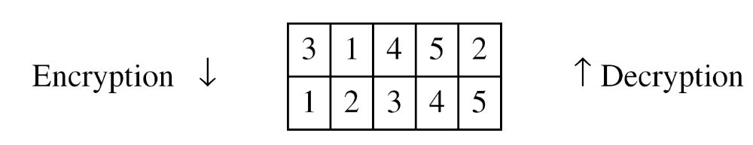
Keyed Transposition Ciphers
Alice needs to send the message “Enemy attacks tonight” to Bob..
The key used for encryption and decryption is a permutation key, which shows how the character are permuted.
The permutation yields
4. Traditional ciphers CS480_S15

Slide 41
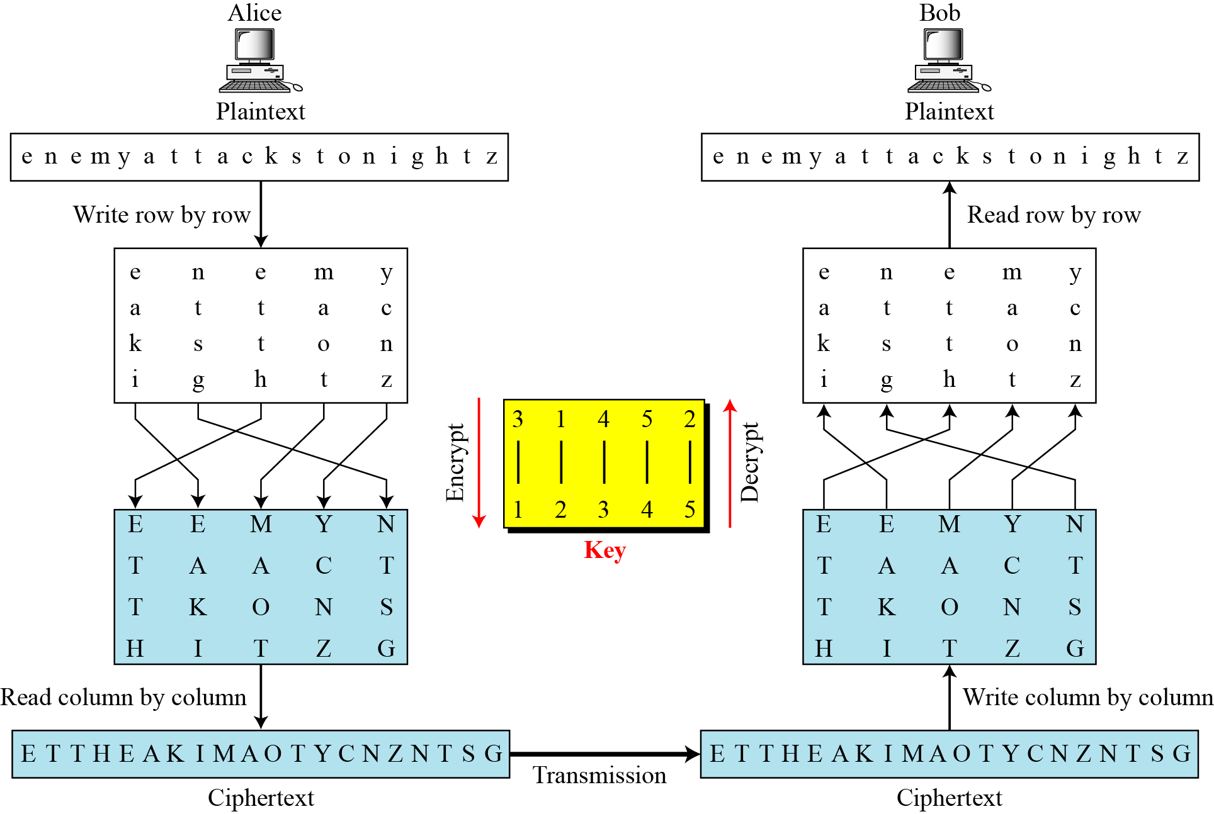
Combining two approaches
4. Traditional ciphers CS480_S15

Slide 42
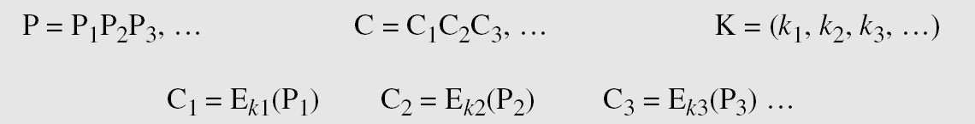
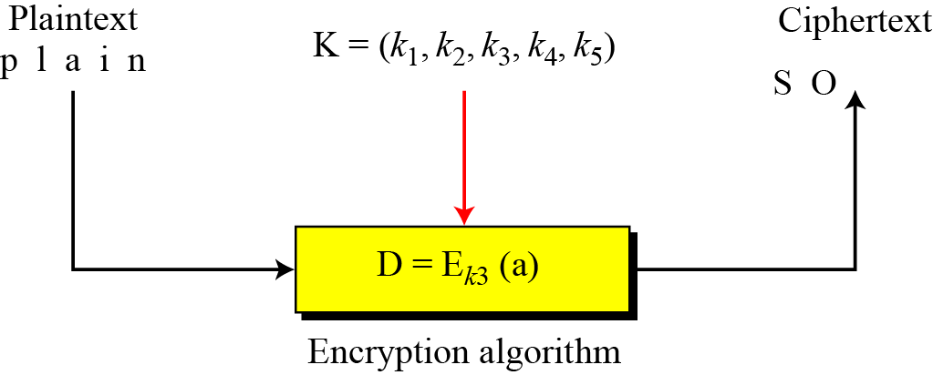
Stream cipher
Call the plaintext stream P, the ciphertext stream C, and the key stream K
4. Traditional ciphers CS480_S15

Slide 43
Stream cipher
Additive ciphers can be categorized as stream ciphers
The key stream is the repeated value of the key
In other words, the key stream is considered as a predetermined stream of keys or
K = (k, k, …, k)
In this cipher, however, each character in the ciphertext depends only on the corresponding character in the plaintext
  because the key stream is generated independently.
4. Traditional ciphers CS480_S15

Slide 44
Stream cipher
The monoalphabetic substitution ciphers are also stream ciphers
However, each value of the key stream in this case is the mapping of the current plaintext character to the corresponding ciphertext character in the mapping table.
4. Traditional ciphers CS480_S15

Slide 45
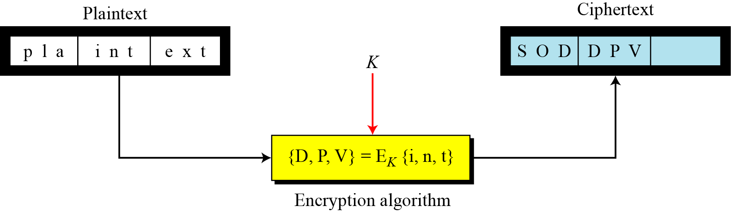
Block cipher
In a block cipher, a group of plaintext symbols of size m (m > 1) are encrypted together creating a group of ciphertext of the same size.
A single key is used to encrypt the whole block even if the key is made of multiple values.
4. Traditional ciphers CS480_S15

Slide 46
Block cipher
Playfair ciphers are block ciphers. The size of the block is m = 2. Two characters are encrypted together
From the definition of the block cipher, it is clear that every block cipher is a polyalphabetic cipher because each character in a ciphertext block depends on all characters in the plaintext block.
4. Traditional ciphers CS480_S15

Slide 47
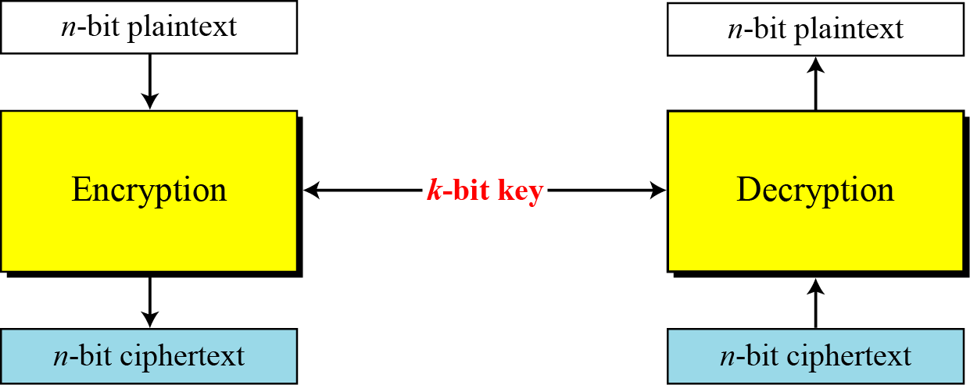
Modern block cipher
A symmetric-key modern block cipher encrypts an n-bit block of plaintext or decrypts an n-bit block of ciphertext
The encryption or decryption algorithm uses a k-bit key
The decryption algorithm must be the inverse of the encryption algorithm
4. Traditional ciphers CS480_S15

Slide 48
Modern block cipher
If the message has fewer than n bits, padding must be added to make it an n-bit block
If the message has more than n bits, it should be divided into n bit blocks and the appropriate padding must be added to the last block if necessary
4. Traditional ciphers CS480_S15

Slide 49
Example
How many padding bits must be added to a message of 100 characters if 8-bit ASCII is used for encoding and the block cipher accepts blocks of 64 bits?
Solution
Encoding 100 characters using 8-bit ASCII results in an 800-bit message. The plaintext must be divisible by 64. If | M | and |Pad| are the length of the message and the length of the padding,
4. Traditional ciphers CS480_S15

