Slide 1
CS480
Cryptography and Information Security
6. Data Encryption Standard (DES)
Huiping Guo
Department of Computer Science
California State University, Los Angeles

Slide 2
Outline
Basic structure of DES
Building elements of DES
The round keys generation process
DES analysis
Multiple DES
6. DES CS480_S15

Slide 3

Encryption and decryption with DES
6. DES CS480_S15

Slide 4
DES Structure
The encryption process is made of
  Two permutations (P-boxes)
    initial and final permutations
  16 Feistel rounds
The initial and final permutations are keyless straight P-boxes that are inverses of each other.
  They have no cryptography significance in DES.
6. DES CS480_S15

Slide 5

DES Structure
6. DES CS480_S15

Slide 6

Initial and Final Permutations
6. DES CS480_S15

Slide 7
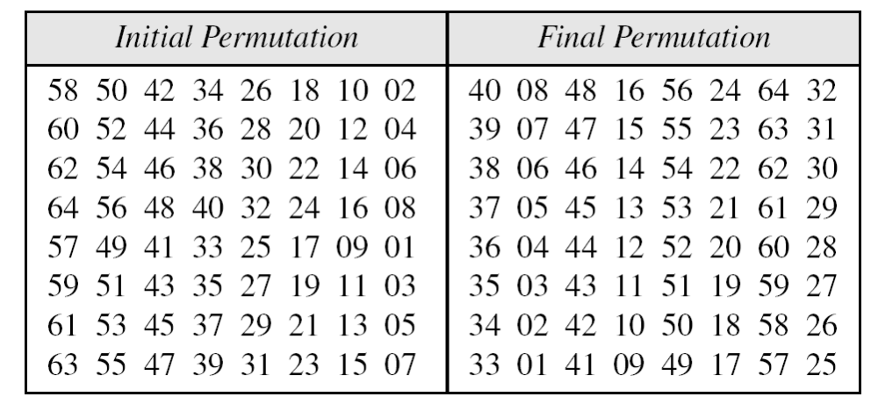
Initial and final permutation tables
6. DES CS480_S15

Slide 8
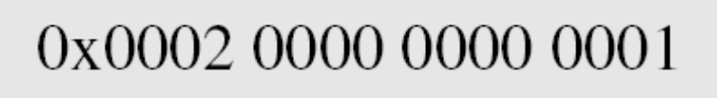

Example
Find the output of the initial permutation box when the input is given in hexadecimal as:
Solution
The input has only two 1s; the output must also have only two 1s. Using the initial permutation table, we can find the output related to these two bits. Bit 15 in the input becomes bit 63 in the output. Bit 64 in the input becomes bit 25 in the output. So the output has only two 1s, bit 25 and bit 63. The result in hexadecimal is
6. DES CS480_S15

Slide 9
Example
Prove that the initial and final permutations are the inverse of each other by finding the output of the final permutation if the input is
Solution
Only bit 25 and bit 63 are 1s; the other bits are 0s. In the final permutation, bit 25 becomes bit 64 and bit 63 becomes bit 15. The result is
6. DES CS480_S15

Slide 10

Rounds
DES uses 16 rounds. Each round of DES is a Feistel cipher
A round in DES
(encryption site)
6. DES CS480_S15

Slide 11
Rounds
The round takes Li-1 and Ri-1 from previous round (or the initial permutation box) and create Li and Ri for the next round
Each round has two cipher element (mixer and swapper)
  The swapper is obviously invertible
  The mixer is invertible because of the XOR operation
  All noninvertible elements are collected inside the DES function f(Ri-1, Ki)
6. DES CS480_S15

Slide 12

DES function
The heart of DES is the DES function.
The DES function applies a 48-bit key to the rightmost 32 bits to produce a 32-bit output
The function is made of 4 sections
6. DES CS480_S15

Slide 13

Expansion P-box
Since R_{i−1} is a 32-bit input and K_{i} is a 48-bit key, we first need to expand R_{i−1} to 48 bits
  Ri-1 is divided into 8 4-bit sections
  Each section is expanded to 6 bits based on a predetermined rule
    For each section, input bits 1,2,3,4 are copied to output bits 2,3,4 and 5, respectively.
    Output bit 1 comes from the bit 4 of the previous section
    Output bit 6 comes from bit 1 of the next section
Expansion permutation
6. DES CS480_S15

Slide 14
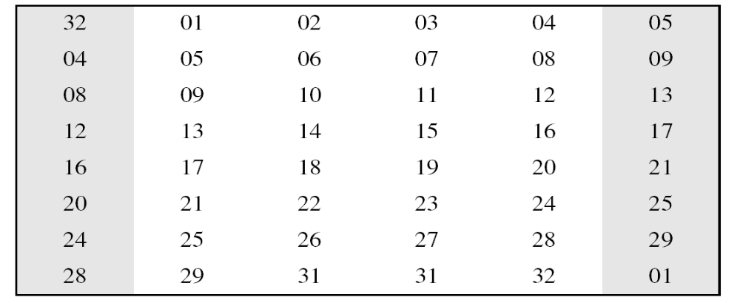
Expansion P-box
Although the relationship between the input and output can be defined mathematically, DES uses the table to define this P-box
30
6. DES CS480_S15

Slide 15
Whitener (XOR)
After the expansion permutation, DES uses the XOR operation on the expanded right section and the round key.
Note that both the right section and the key are 48-bits in length
Also note that the round key is used only in this operation.
6. DES CS480_S15

Slide 16

S-Boxes
The S-boxes do the real mixing (confusion)
DES uses 8 S-boxes, each with a 6-bit input and a 4-bit output
6. DES CS480_S15

Slide 17
S-Boxes
The 48-bit input is divided into 8 6-bit chunks and each chunk is fed into a box
The result of each box is a 4-bit chunk
The substitution in each box follows a pre-determined rule based on a 4-row by 16-column table
  The combination of bits 1 and 6 of the input defines one of the four rows
  The combination of bits 2 through 5 defines one of the sixteen columns
6. DES CS480_S15

Slide 18

S-box rule
6. DES CS480_S15

Slide 19

S-box 1
For the rest of the boxes , check the link: https://www.gyyv.vd.ch/branches/mathematique/cryptographie/textes/s_boxes.htm
6. DES CS480_S15

Slide 20
S-Box example
The input to S-box 1 is 100011. What is the output?
Solution
If we write the first and the sixth bits together, we get 11 in binary, which is 3 in decimal.
The remaining bits are 0001 in binary, which is 1 in decimal. We look for the value in row 3, column 1, in Table (S-box 1). The result is 12 in decimal, which in binary is 1100.
So the input 100011 yields the output 1100.
6. DES CS480_S15

Slide 21
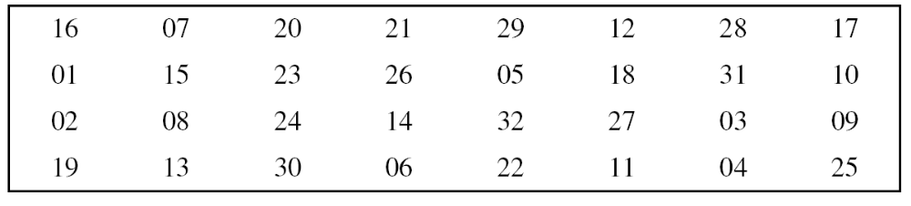
Straight permutation table
The final permutation table
6. DES CS480_S15

Slide 22
Cipher and Reverse Cipher
Using mixers and swappers, we can create the cipher and reverse cipher, each having 16 rounds
First approach
  To achieve this goal, one approach is to make the last round (round 16) different from the others; it has only a mixer and no swapper
Alternate approach
  We can make all 16 rounds the same by including one swapper to the 16th round and add an extra swapper after that
  Two swappers cancel the effect of each other
6. DES CS480_S15

Slide 23

Figure 6.9 DES cipher and reverse cipher for the first approach
6. DES CS480_S15

Slide 24
Key generation
The round key generator creates 16 48-bit keys out of a 56-bit key
However, they cipher key is normally given as a 64-bit key
  8 extra bits are the parity bits
    Bits 8, 16, 24, 32,…64
  The 8 bits are dropped before the actual key-generation process
6. DES CS480_S15

Slide 25

6. DES CS480_S15

Slide 26
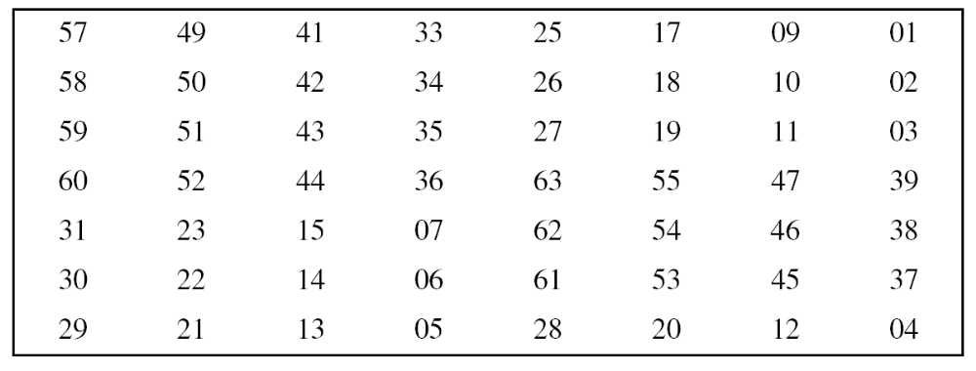
Table: Parity-bit drop table
6. DES CS480_S15

Slide 27
Shift left
After the parity-bit drop, the key is divided into two 28-bit parts
Each part is shifted left one or two bits
  In rounds 1,2,9 and 16, shifting is one bit
  In the other rounds, shifting is two bits
The two parts are then combined to form a 56-bit part
Table: Number of bits shifts
6. DES CS480_S15

Slide 28
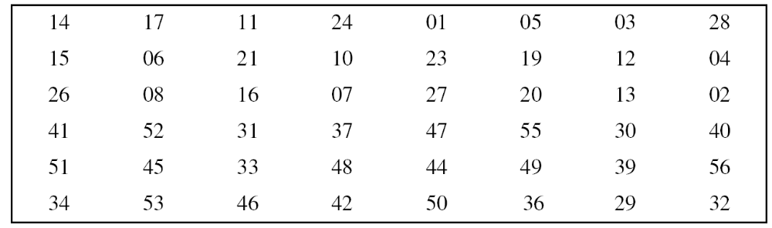
Compression Permutation
The compression permutation changes the 56 bits to 48 bits, which are used as a key for a round
Key-compression table
6. DES CS480_S15

Slide 29
Example
We choose a random plaintext block and a random key, and determine what the ciphertext block would be (all in hexadecimal):
6. DES CS480_S15

Slide 30
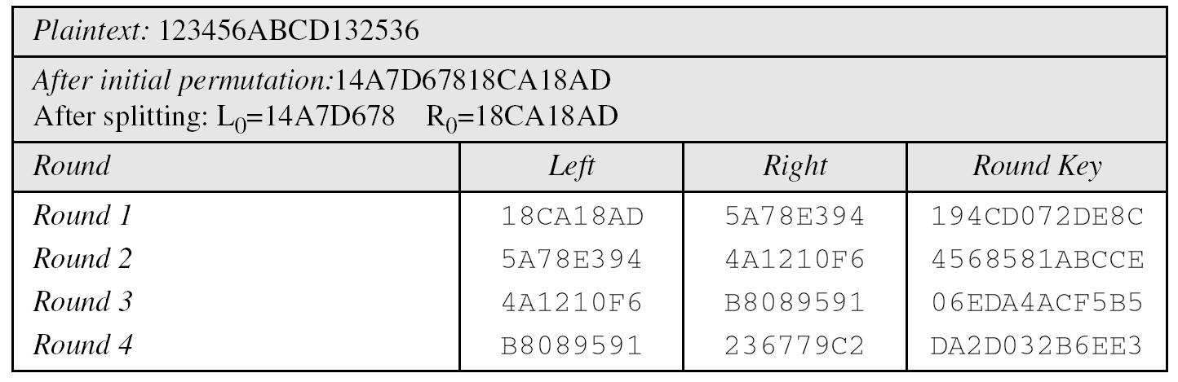
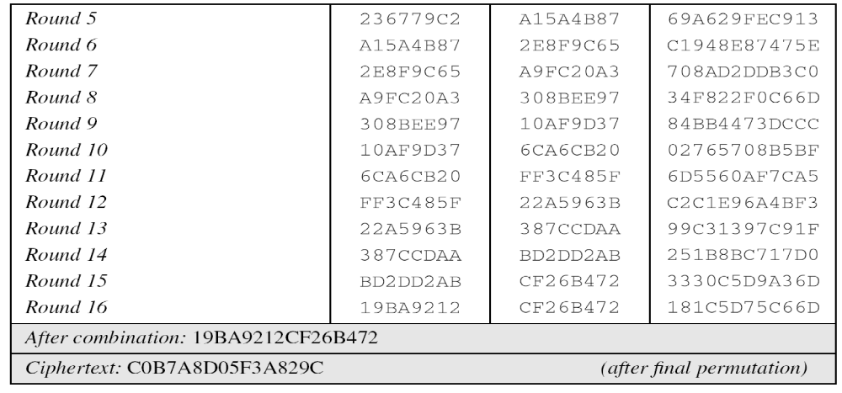
6. DES CS480_S15

Slide 31
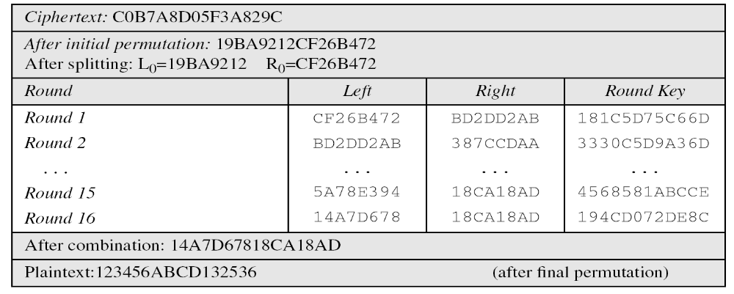
Example
Bob, at the destination, can decipher the ciphertext received from Alice using the same key
6. DES CS480_S15

Slide 32
DES Analysis
Two desired properties of a block cipher are:
  avalanche effect
  Completeness
Avalanche effect
  A small change in the plaintext (key) should create a significant change in the ciphertext
  DES has been proved to be strong with regard to this property
6. DES CS480_S15

Slide 33
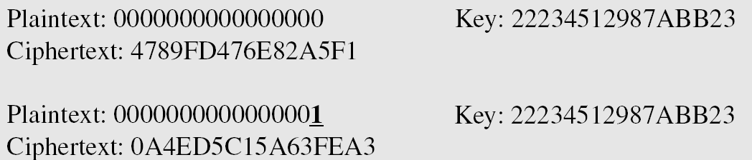
Example
To check the avalanche effect in DES, let us encrypt two plaintext blocks (with the same key) that differ only in one bit and observe the differences in the number of bits in each round
6. DES CS480_S15

Slide 34
Example
Although the two plaintext blocks differ only in the rightmost bit, the ciphertext blocks differ in 29 bits
This means that changing approximately 1.5 percent of the plaintext creates a change of approximately 45 percent in the ciphertext.
Number of bit differences for the Example
6. DES CS480_S15

Slide 35
Completeness effect
Completeness effect means that each bit of the ciphertext needs to depend on many bits on the plaintext
The diffusion and confusion produced by P-boxes and S-boxes in DES, show a very strong completeness effect
6. DES CS480_S15

Slide 36
Design criteria
S-Box
  The design provides confusion and diffusion of bits from each round to the next
P-Box
  They provide diffusion of bits
Number of Rounds
DES uses sixteen rounds of Feistel ciphers. the ciphertext is thoroughly a random function of plaintext and ciphertext
6. DES CS480_S15

Slide 37
Multiple DES
The major criticism of DES regards its key length.
A brute-force attack on DES is feasible with available technology the possibility of parallel processing
Solutions
  Design a new one: AES
  Use multiple (cascaded) instances of DES with multiple keys
    Does not require an investment in new software and hardware
6. DES CS480_S15

Slide 38
Double DES
In this approach, we use two instances of DES ciphers for encryption and two instances of reverse ciphers for decryption
Each instance uses a different key
  The size of the key is doubled
However, double DES is vulnerable to meet-in-the-middle attack
6. DES CS480_S15

Slide 39
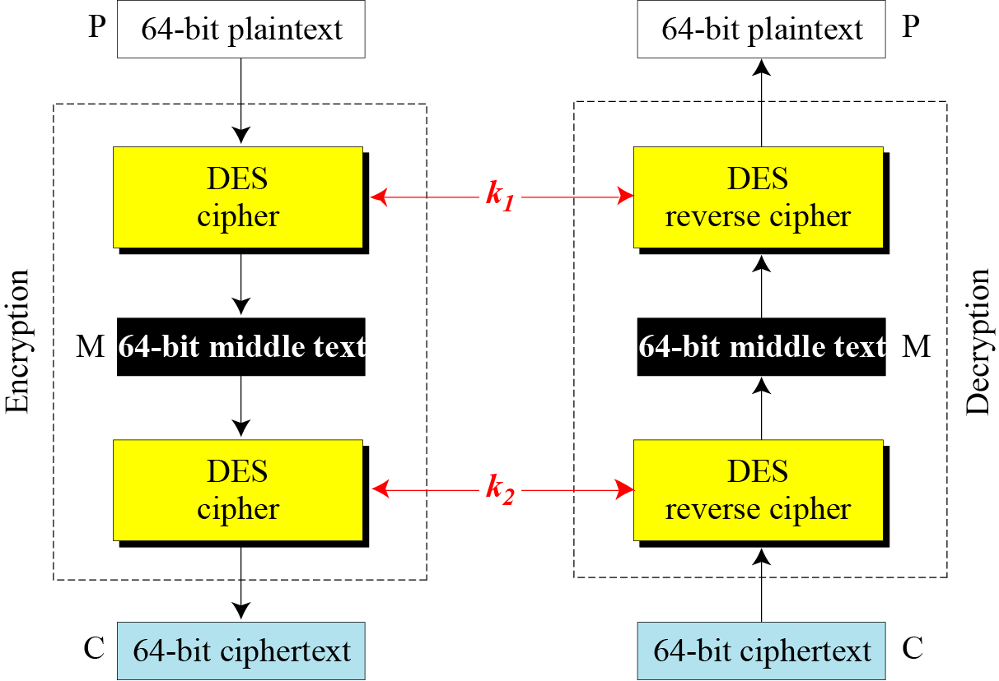
Meet-in-the-middle attack
6. DES CS480_S15

Slide 40
Meet-in-the-middle attack
The middle text, the text created by the first encryption or the first decryption, M, should be the same
M = E_{k1}(P) M = D_{k2}(C)
Assume that Eve has intercepted a previous pair P and C
Eve encrypts P using all possible values of K1 and records all values obtained for M
Eve decrypts C using all possible values of k2 and records all values obtained for M
Eve creates two tables sorted by M values
She compares the values for M until she finds those pairs of k2 and k2 for which the value of M is the same in both tables
6. DES CS480_S15

Slide 41
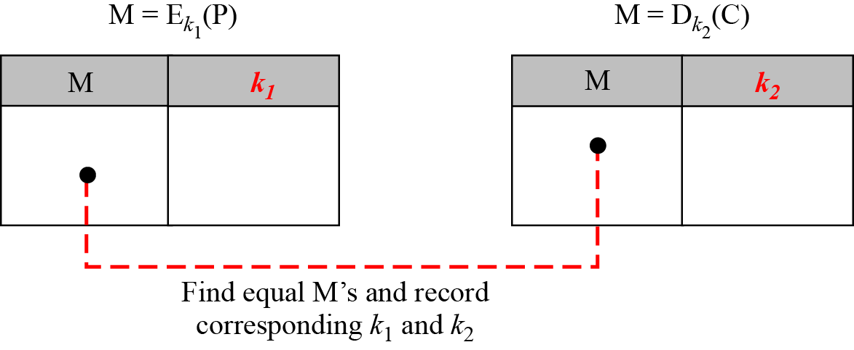
Meet-in-the-middle attack
Instead of using 2¹¹² key-search tests, Eve use 2⁵⁶ key search tests two times
Moving from a single DES to double DES, se have increased the strength from 2⁵⁶ to 2⁵⁷
6. DES CS480_S15

Slide 42
Triple DES with two keys
Use three stages of DES for encryption and decryption
The 1st, 3rd stage use k1 and the 2nd stage use k2
To make triple DES compatible with single DES, the middle stage uses decryption in the encryption side and encryption in the decryption side
It’s much stronger than double DES
6. DES CS480_S15

Slide 43
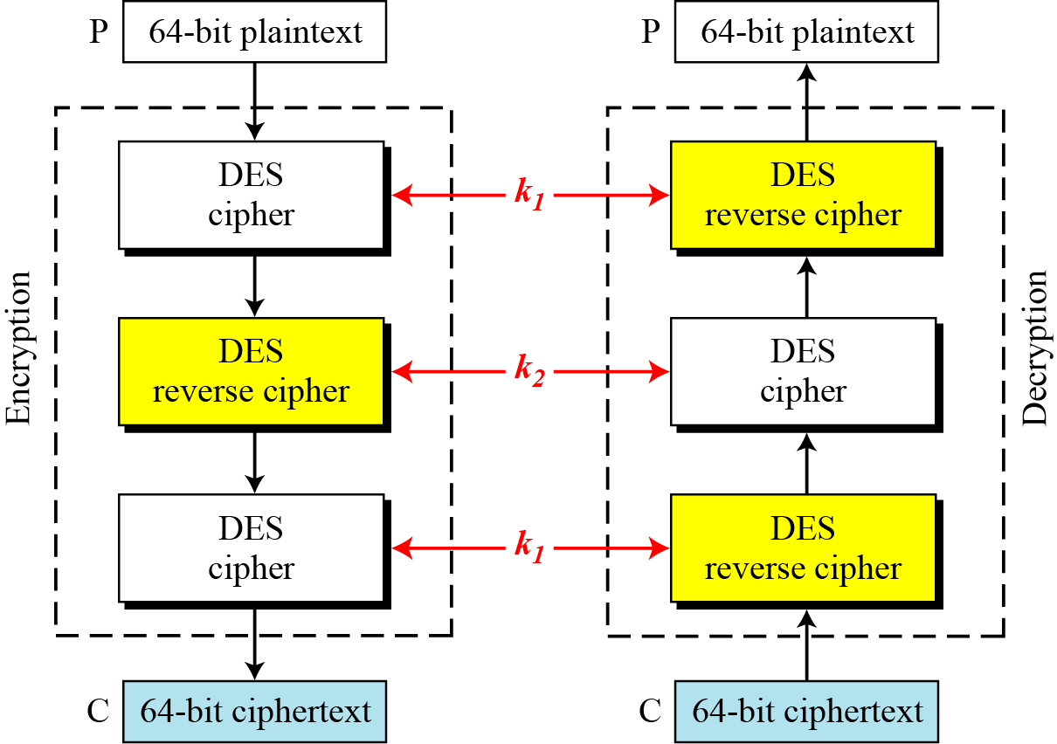
Triple DES with two keys
6. DES CS480_S15

