Slide 1
CS480
Cryptography and Information Security
7. Mathematics of Cryptography 3
Huiping Guo
Department of Computer Science
California State University, Los Angeles

Slide 2
Outline
Concept of algebraic structures
Groups
Rings
Fields
7. math3 CS480_S15

Slide 3
Algebraic structures
Cryptography requires
  sets of integers
  specific operations that are defined for those sets
The combination of the set and the operations that are applied to the elements of the set is called an algebraic structure
7. math3 CS480_S15

Slide 4
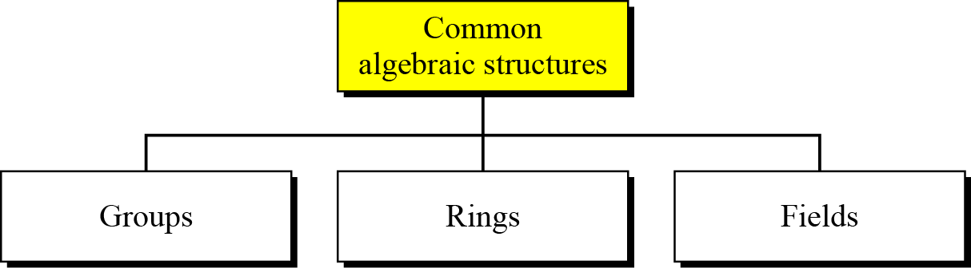
Common Algebraic structures
7. math3 CS480_S15

Slide 5
Groups
group (G) is a set of elements with a binary operation (•) that satisfies four properties
  Closure
    If a and b of G, then c= a•b is also an element an element of G
  Associativity
    If a ,b, and c are elements of G then (a•b) •c =a•(b•c)
  Existence of identity
    For all a in G, there exists an element e, called the identity element, such that e•a=a•e=a
  Existence of inverse
    For each a in G, there exists an element a’, called the inverse of a, such that a•a’=a’ •a = e
7. math3 CS480_S15

Slide 6
Groups
Commutative group (abelian group)
  A group in which the operator satisfies the our properties for groups plus an extra property:
  Commutativity
    For all a and b in G, we have a•b = b•a
Application
  Though a group involves a single operation, the properties imposed on the operation allow the use of a pair of two operations as long as they are inverses of each other
    Subtraction is addition using additive inverse
    Division is multiplication using multiplicative inverse
7. math3 CS480_S15

Slide 7
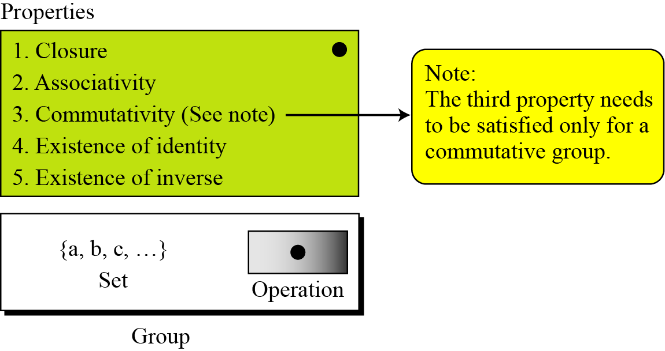
Groups
7. math3 CS480_S15

Slide 8
Groups: example 1
The set of residue integers with the addition operator G = < Zn , +>, is an abelian group? Why?
7. math3 CS480_S15

Slide 9
Groups: example 2
Is <Zn, x> is an abelian group?
7. math3 CS480_S15

Slide 10
Groups: example 3
Is G = <Zn*, ×> an abelian group?
7. math3 CS480_S15

Slide 11
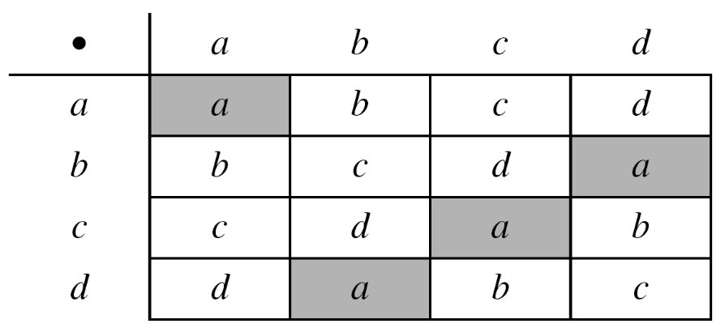
Groups: example 4
Usually, a group is a set of numbers with regular operations
A group can be any set of objects and an operation that satisfy the properties
Ex: Let us define a set G = < {a, b, c, d}, •> and the operation as shown
Is G an abelian group?
Operation table
7. math3 CS480_S15

Slide 12
Groups: example 3
Closure?
Associativity?
Commutativity?
An identity element?
Does each element have an inverse?
7. math3 CS480_S15

Slide 13
Groups: example 4
The elements in a group do not have to be numbers or objects
They can be rules, mappings, functions or actions
Ex: permutation group
  The set of all permutations
  The operation is composition
    Apply one permutation after another
7. math3 CS480_S15

Slide 14
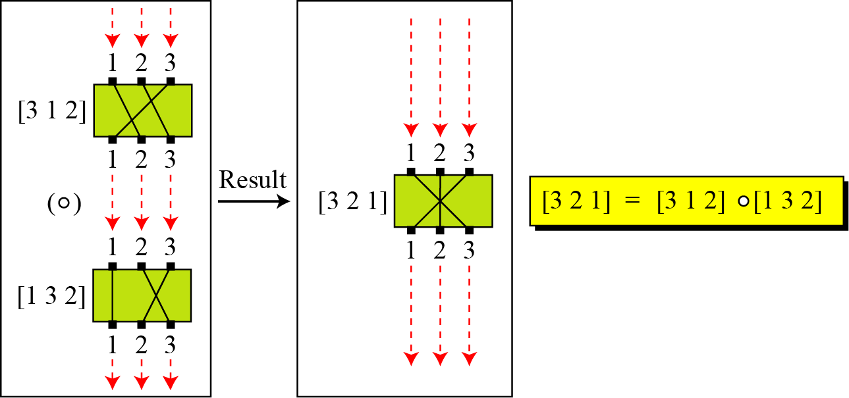
Permutation group
7. math3 CS480_S15

Slide 15
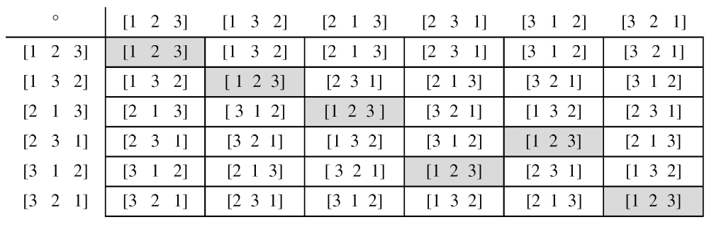
Operation table for permutation group
Column: first operand
Row: second operand
7. math3 CS480_S15

Slide 16
Permutation group
Is this group an abelian group?
  Is closure is satisfied? Yes
  Is associativity satisfied? Yes
  Is commutative property satisfied? NO
  Does the set have an identity element?
  Does each element have an inverse?
It’s just a group, NOT an abelian group
What can we learn?
  Using two permutations one after another cannot strengthen the security of a cipher
  Because we can always find a permutation that can do the same job due to the closure property
7. math3 CS480_S15

Slide 17
More concepts on groups
Finite group
  A finite group has a finite number of elements
Order of a group |G|
  |G| = number of elements in the group
Subgroups
  If G = <S, •> is a group,
  H = <T. •> is a group under the same operation
  and T is a nonempty subset of S
  then H is a subgroup of G
7. math3 CS480_S15

Slide 18
Some facts about subgroups
If a and b are members of both groups, then c=a•b is also a member of both groups
The groups share the same identity element
If a is a member of both groups, the inverse of a is also a member of both groups
The group made of the identity element of G,
H=<{e}, •>, is a subgroup of G
Each group is subgroup of itself
7. math3 CS480_S15

Slide 19
Subgroup
Is the group H = <Z₁₀, +> a subgroup of the group G = <Z₁₂, +>?
NO
Though H is a subset of G, the operation defined for these two groups are different
  The operation in H is addition modulo 10
  The operation in G is addition modulo 12
7. math3 CS480_S15

Slide 20
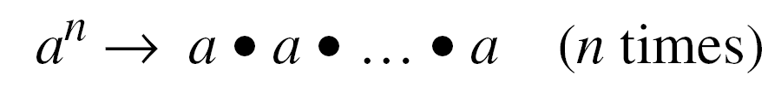
Cyclic Subgroups
If a subgroup of a group can be generated using the power of an element, the subgroup is called the cyclic subgroup
The term power means repeatedly applying the group operation to the element
a⁰ = e
7. math3 CS480_S15

Slide 21
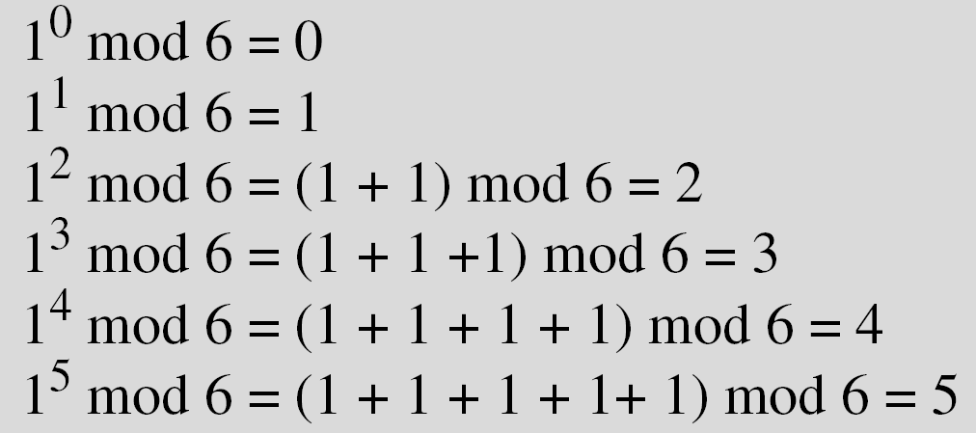
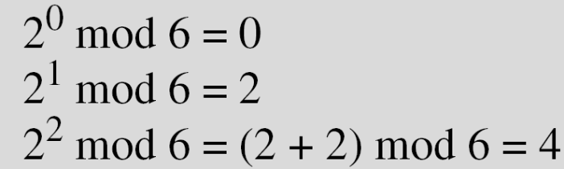
Cyclic Subgroup example
Four cyclic subgroups can be made from the group G = <Z₆, +>. They are H₁ = <{0}, +>, H₂ = <{0, 2, 4}, +>, H₃ = <{0, 3}, +>, and H₄ = G.
a:
H_{1:} 0⁰ mod 6 = 0
b:
H₄
c:
H₂
7. math3 CS480_S15

Slide 22
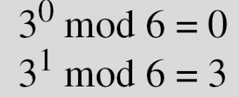
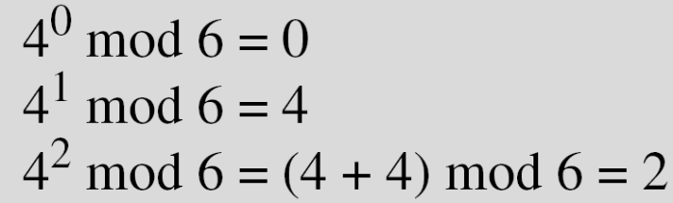
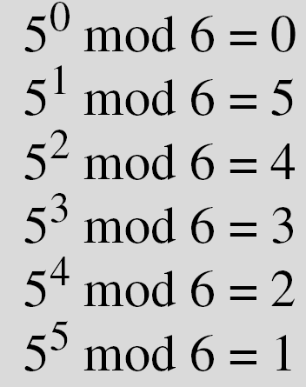
Cyclic Subgroup example
d:
H₃
e:
H₂
f:
H₄
Note:
  when the operation is addition, a^{n} means multiplying n by a
  In all of these groups, the operation is addition modulo 6
7. math3 CS480_S15

Slide 23
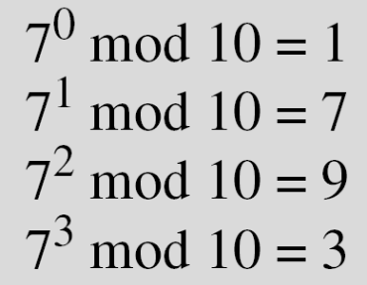

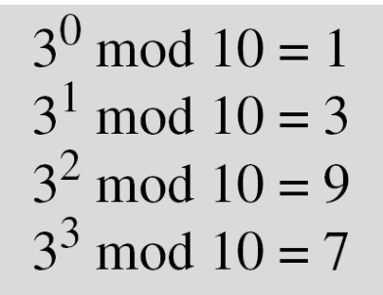
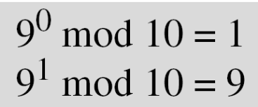
Cyclic Subgroup example
Three cyclic subgroups can be made from the group
G = <Z₁₀∗, ×>. G has only four elements: 1, 3, 7, and 9. The cyclic subgroups are H₁ = <{1}, ×>, H₂ = <{1, 9}, ×>, and H₃ = G.
7. math3 CS480_S15

Slide 24
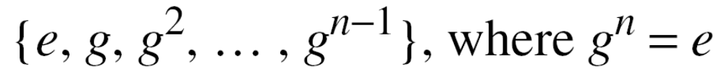
Cyclic Groups
A cyclic group is a group that is its own cyclic subgroup
The element that generates the cyclic group itself is called a generator
  g is a generator, e is an identity element
Note: a cyclic group can have many generators
7. math3 CS480_S15

Slide 25
Cyclic Group examples
The group G = <Z_{10∗}, ×> is a cyclic group
  G has only four elements: 1, 3, 7, and 9.
  Three cyclic subgroups can be made from the group G = <Z_{10∗}, ×>
  H1 = <{1}, ×>, H2 = <{1, 9}, ×>, and H3 = G
    2 generators, g = 3 and g = 7.
The group G = <Z₆, +> is a cyclic group
    2 generators, g = 1 and g = 5.
7. math3 CS480_S15

Slide 26
Lagrange’s Theorem
The theorem relates the order of a cyclic group to the order of its subgroup
Assume that G is a group, and H is a subgroup of G. If the order of G and H are |G| and |H|, respectively, then, |H| divides |G|
The theorem can be used to determine the subgroup of a group
  Example:
  G = < Z₁₇, +> |G| = 17
  the only divisors of 17 are 1 and 17
  This means G has at least two subgroups
    H1 with the identity element
    and H2=G
7. math3 CS480_S15

Slide 27
Order of an Element
The order of an element a in a group, ord(a), is the smallest integer n (>0) such that a^{n} = e
  Or The order of an element is the order of the cyclic subgroup it generates
Examples
In the group G = <Z₆, +>, the orders of the elements are:
ord(0) = 1, ord(1) = 6, ord(2) = 3, ord(3) = 2, ord(4) = 3,
ord(5) = 6
In the group G = <Z_{10*}, ×>, the orders of the elements are:
ord(1) = 1, ord(3) = 4, ord(7) = 4, ord(9) = 2
7. math3 CS480_S15

Slide 28
Ring
A ring, R = <{…}, •, ▫>, is an algebraic structure with two operations
  The first operation must satisfy all five properties required for an abelian group
  The second operation must satisfy only the first two
  The second operation must be distributed over the first
Distributivity
  For all a, b and c elements of
  a ▫ ( b • c) = (a ▫ b) • (a ▫ c)
  And (a • b) ▫ c = (a ▫ b) • (b ▫ c)
7. math3 CS480_S15

Slide 29
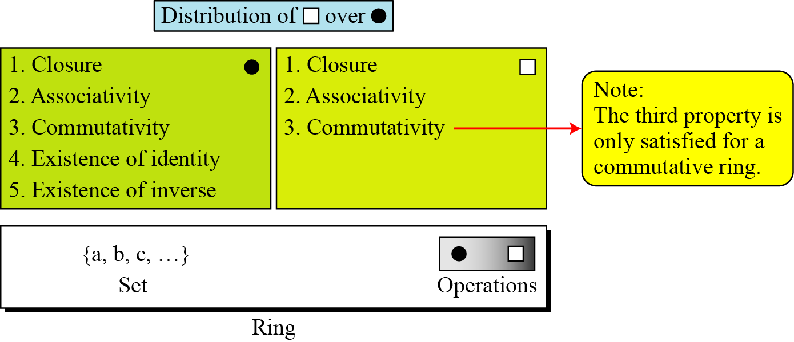
Ring (cont.)
7. math3 CS480_S15

Slide 30
Ring: example
The set Z with two operations, addition and multiplication, R = <Z, +, ×>, is a commutative ring
  Addition satisfies all of the five properties
  Multiplication satisfies only three properties
  Multiplication also distributes over addition
  Which operations are allowed in this set?
    Addition
    Subtraction
    Multiplication
    division
7. math3 CS480_S15

Slide 31
Field
A field, denoted by F = <{…}, •, ▫ > is a commutative ring
The second operation satisfies all five properties defined for the first operation
Identity of the first operation has no inverse with respect to the second operation.
7. math3 CS480_S15

Slide 32
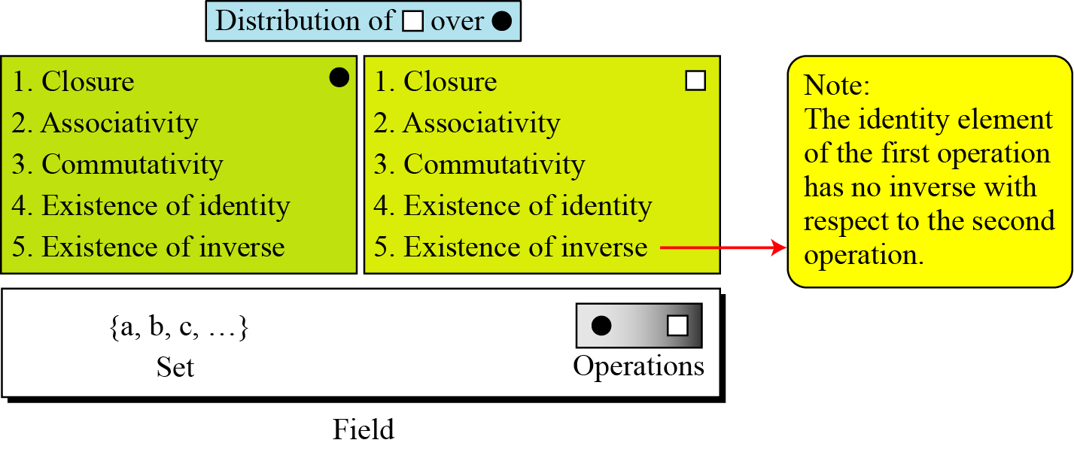
Field
7. math3 CS480_S15

Slide 33
Field: application
A field is a structure that supports two pairs of operations in mathematics:
  addition/subtraction and multiplication/division
  One exception: division by zero is not allowed
7. math3 CS480_S15

Slide 34
Galois field
Finite field
  A finite field is a field with a finite number of elements
The finite fields are usually called Galois fields
  Galois showed that for a field to be finite, the number of elements should be p^{n}
  Denoted as GF(p^{n})
    p is a prime
7. math3 CS480_S15

Slide 35
Galois field
Which of the following is a valid Galois field?
  GF(12)
  GF(13)
  GF(16)
  GF(17)
7. math3 CS480_S15

Slide 36
GF(p) field
When n=1, we have GF(p) field
Example: <Z_{p}, +, x >
  Zp: {0, 1, … p-1}
  In this set, every element has an additive inverse
  Every nonzero element have a multiplicative inverse
  No multiplicative inverse for 0
7. math3 CS480_S15

Slide 37
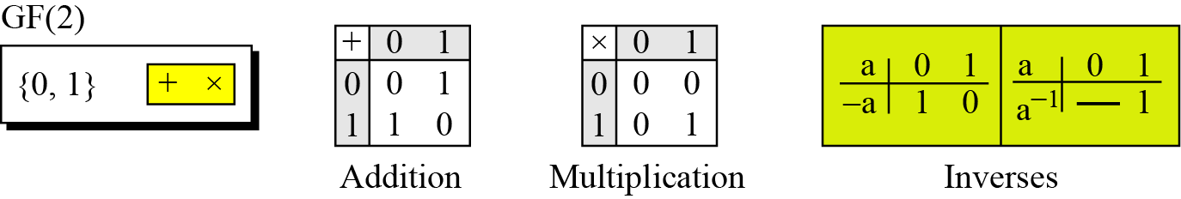
GF(2)
A very common field in this category is GF(2) with the set {0, 1} and two operations, addition and multiplication
0
1
7. math3 CS480_S15

Slide 38
GF(2)
The set has only two elements: 0 and 1
The addition operation is actually the XOR operation
The multiplication operation is AND operation
Addition and subtraction operations are the same (XOR)
Multiplication and division operations are the same (AND)
7. math3 CS480_S15

Slide 39
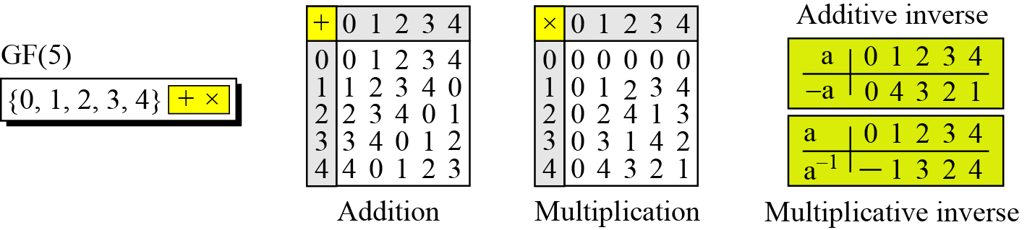
GF(5)
We can define GF(5) on the set Z₅ (5 is a prime) with addition and multiplication operators
7. math3 CS480_S15

Slide 40
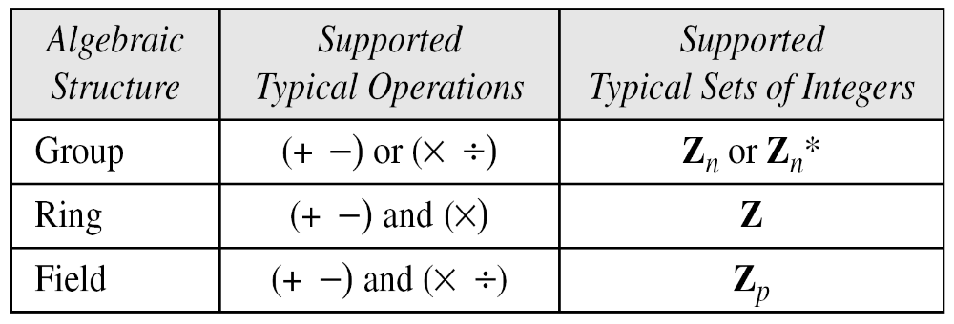
Summary
7. math3 CS480_S15

