Slide 1
CS580
Internet Security Protocols
1. Review 1
Huiping Guo
Department of Computer Science
California State University, Los Angeles

Slide 2
Outline
Modular arithmetic
Additive/Multiplicative inverse
Algebraic structures
  Groups
  Rings
  Fields
Polynomial
Primes
1. Review 1 CS580_F15

Slide 3
Greatest Common Divisor
The greatest common divisor of two positive integers is the largest integer that can divide both integers
Ex: gcd(12,16) = 4
  12 (1,2,3,4,6,12) 16 (1,2,4,8,16)
1. Review 1 CS580_F15

Slide 4
Euclidean Algorithm
How to find the greatest common divisor (gcd) of two positive integers?
Euclidean Algorithm
  Fact 1: gcd (a, 0) = a
  Fact 2: gcd (a, b) = gcd (b, r)
where r is the remainder of dividing a by b
  eg. Gcd(16, 14) = gcd(14,2)=gcd(2,0)=2
1. Review 1 CS580_F15

Slide 5
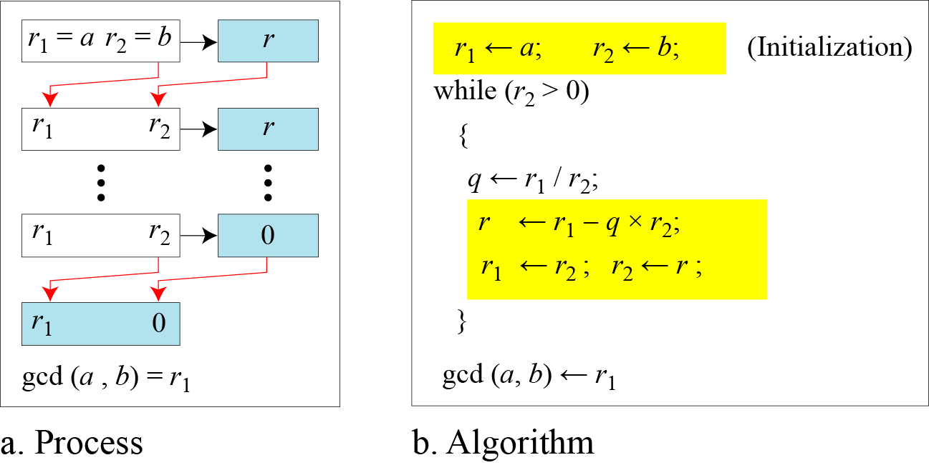
Euclidean Algorithm
1. Review 1 CS580_F15

Slide 6
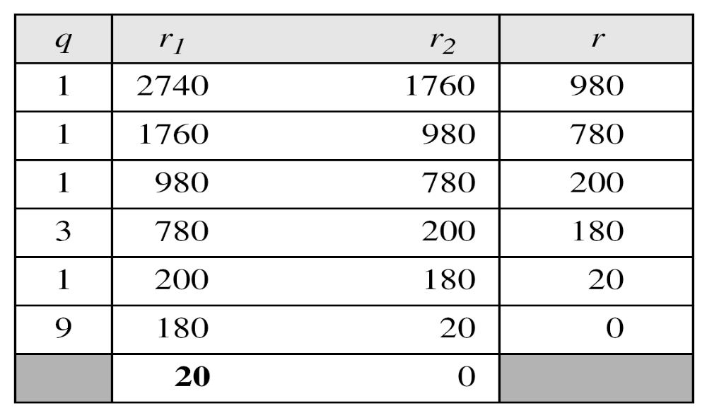
Euclidean Algorithm (cont.)
Find the greatest common divisor of 2740 and 1760
Solution
We have gcd (2740, 1760) = 20
1. Review 1 CS580_F15

Slide 7
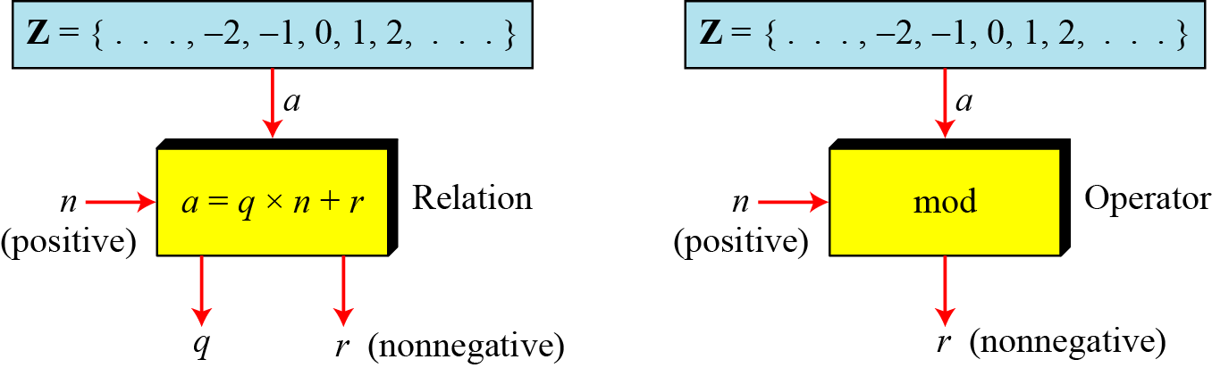
Modular operator
The modulo operator is shown as mod
  The second input (n) is called the modulus
  The output r is called the residue
1. Review 1 CS580_F15

Slide 8
Modular operator (cont.)
Find the result of the following operations:
a. 27 mod 5 b. 36 mod 12
c. −18 mod 14 d. −7 mod 10
Solution
Dividing 27 by 5 results in r = 2
Dividing 36 by 12 results in r = 0.
c. Dividing −18 by 14 results in r = −4. After adding the modulus r = 10
d. Dividing −7 by 10 results in r = −7. After adding the modulus to −7, r = 3.
1. Review 1 CS580_F15

Slide 9
Congruence
In cryptography, we often use congruence instead of equality
Infinite member of Z can map to one member of Z_{n}
  Ex. 2 mod 10 = 2, 12 mod 10 = 2, 22 mod 10 = 2
  In modular arithmetic, 2, 12 and 22 are called congruent mod 10
1. Review 1 CS580_F15

Slide 10
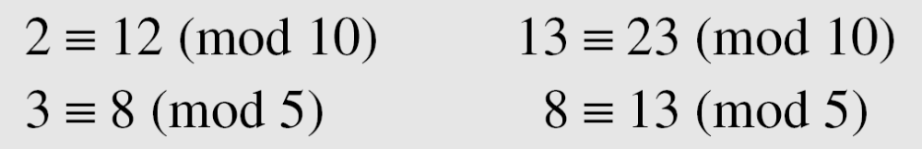
Congruence (cont.)
To show that two integers are congruent, we use the congruence operator ( ≡ ).
For example, we write:
1. Review 1 CS580_F15

Slide 11
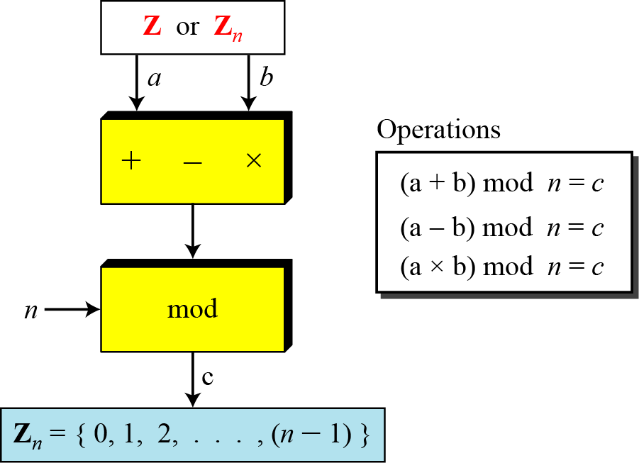
Binary operation in Zn
The three binary for the set Z can also be defined for the set Zn. The result may need to be mapped to Zn using the mod operator
1. Review 1 CS580_F15

Slide 12
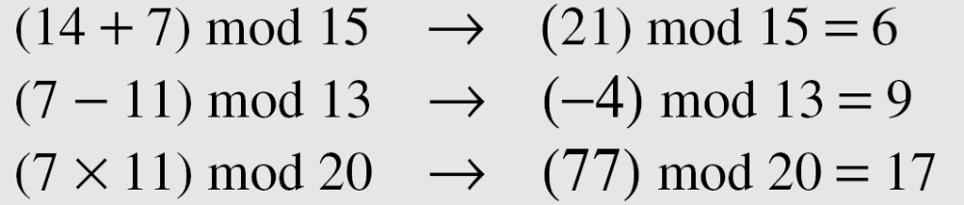
Binary operation in Zn (cont.)
Perform the following operations (the inputs come from Zn):
a. Add 7 to 14 in Z15.
b. Subtract 11 from 7 in Z13.
c. Multiply 11 by 7 in Z20.
Solution
1. Review 1 CS580_F15

Slide 13
Inverses
In modular arithmetic, we often need to find the inverse of a number relative to an operation.
  Additive inverse
    relative to an addition operation
  Multiplicative inverse
    relative to a multiplication operation
1. Review 1 CS580_F15

Slide 14

Additive inverse
In Z_{n}, two numbers a and b are additive inverses of each other if
In modular arithmetic, each integer has an additive inverse.
The sum of an integer and its additive inverse is congruent to 0 modulo n
1. Review 1 CS580_F15

Slide 15
Additive inverse (cont.)
Find all additive inverse pairs in Z₁₀.
Solution
The six pairs of additive inverses are:
(0, 0), (1, 9), (2, 8), (3, 7), (4, 6), and (5, 5).
1. Review 1 CS580_F15

Slide 16

Multiplicative inverse
In Z_{n}, two numbers a and b are the multiplicative inverse of each other if
In modular arithmetic, an integer may or may not have a multiplicative inverse.
When it does, the product of the integer and its multiplicative inverse is congruent to 1 modulo n.
1. Review 1 CS580_F15

Slide 17
Multiplicative inverse (cont.)
Example:
Find the multiplicative inverse of 8 in Z₁₀.
There is no multiplicative inverse
we cannot find any number between 0 and 9 such that when multiplied by 8, the result is congruent to 1
1. Review 1 CS580_F15

Slide 18
Multiplicative inverse (cont.)
How to know whether an integer b has a multiplicative inverse in Z_{n} ?
  If gcd(n,b) = 1, b has a multiplicative inverse
  If gcd(n,b)≠ 1, b doesn’t have a multiplicative inverse
If b has a multiplicative inverse, how to find it?
  Use extended Euclidean algorithm
1. Review 1 CS580_F15

Slide 19
Extended Euclidean algorithm
The extended Euclidean algorithm finds the multiplicative inverses of b in Zn
  when n and b are given
  and gcd (n, b) = 1.
1. Review 1 CS580_F15

Slide 20
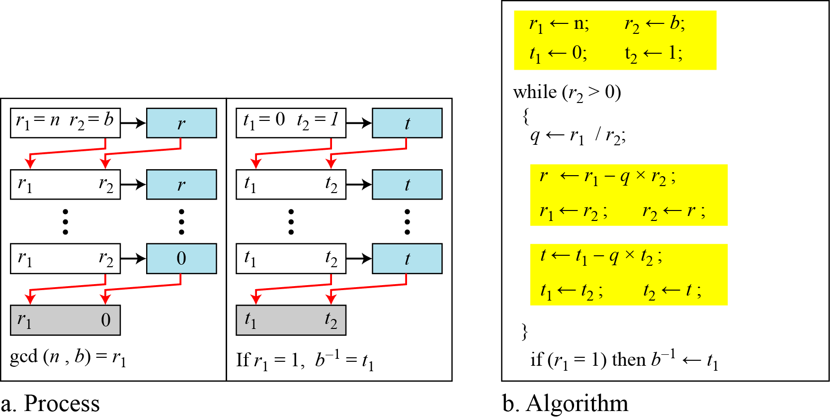
Extended Euclidean algorithm (cont.)
1. Review 1 CS580_F15

Slide 21
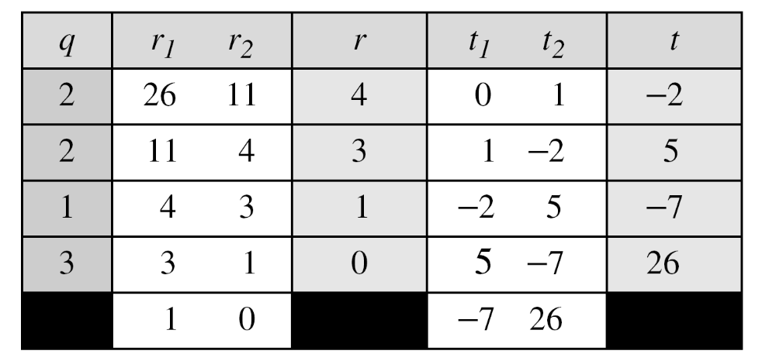
Extended Euclidean algorithm (cont.)
Find the multiplicative inverse of 11 in Z₂₆.
The gcd (26, 11) is 1; the inverse of 11 is −7 or 19.
1. Review 1 CS580_F15

Slide 22
Different sets for addition and multiplication
In cryptography, we often work with inverses
  If the sender uses an integer as the encryption key, the receiver uses the inverse of that integer as the decryption key.
  If the operation (encryption/decryption) is addition, Z_{n} can be used as the set of possible keys
    Each integer in Zn has an additive inverse
  If the operation (encryption/decryption) is multiplication, Z_{n} can NOT be used as the set of possible keys
    ONLY SOME integer in Z_{n} has an multiplicative inverse
We need a new set Z_{n*}
  a subset of Z_{n}
  All members in Z_{n*} has a multiplicative inverse
1. Review 1 CS580_F15

Slide 23
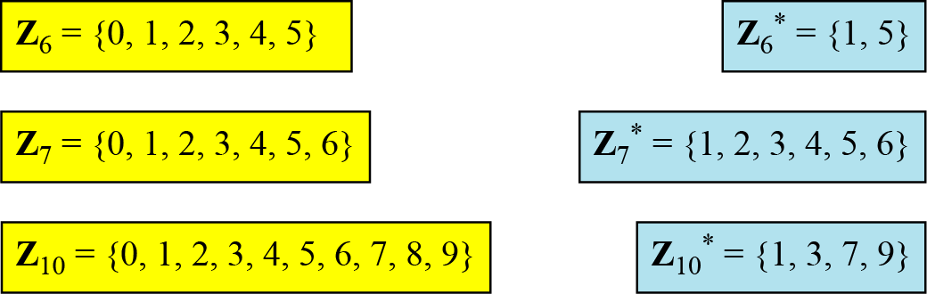
Different sets for addition and multiplication
We need to use Zn when additive inverses are needed
we need to use Zn* when multiplicative inverses are needed
1. Review 1 CS580_F15

Slide 24
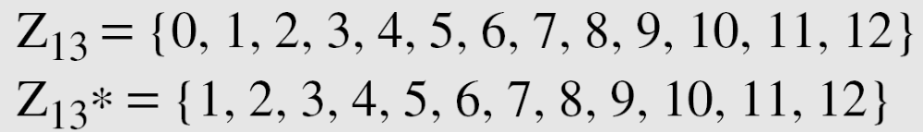
Two more sets
Cryptography often uses two more sets:
  Zp and Zp*, p is a prime
The modulus in these two sets is a prime number
1. Review 1 CS580_F15

Slide 25
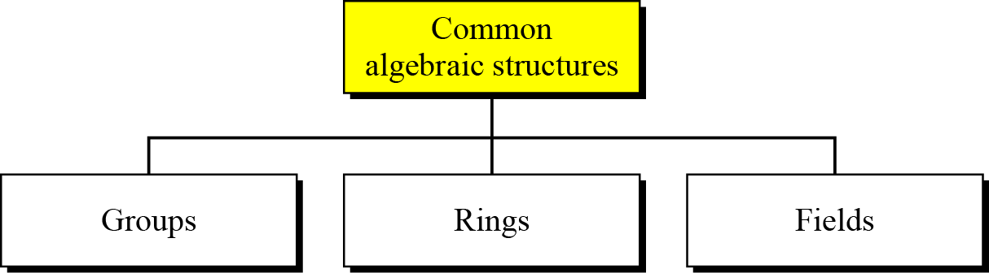
Common Algebraic structures
1. Review 1 CS580_F15

Slide 26
Groups
group (G) is a set of elements with a binary operation (•) that satisfies four properties
  Closure
    If a and b of G, then c= a•b is also are elements an element of G
  Associativity
    If a ,b, and c are elements of G then (a•b) •c =a•(b•c)
  Existence of identity
    For all a in G, there exists an element e, called the identity element, such that e•a=a•e=a
  Existence of inverse
    For each a in G, there exists an element a’, called the inverse of a, such that a•a’=a’ •a = e
1. Review 1 CS580_F15

Slide 27
Groups
Commutative group (abelian group)
  A group in which the operator satisfies the our properties for groups plus an extra property:
  Commutativity
    For all a and b in G, we have a•b = b•a
Application
  Though a group involves a single operation, the properties imposed on the operation allow the use of a pair of two operations as long as they are inverses of each other
    Subtraction is addition using additive inverse
    Division is multiplication using multiplicative inverse
1. Review 1 CS580_F15

Slide 28
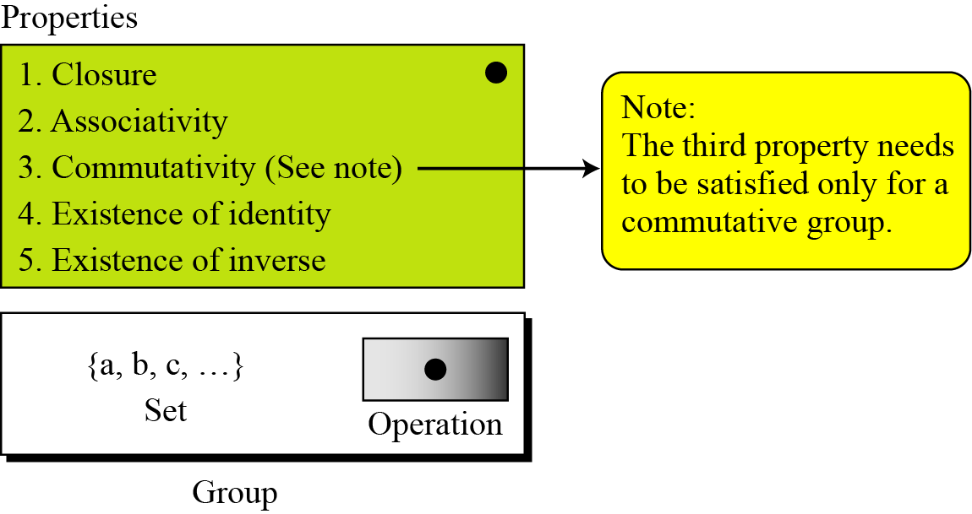
Groups
1. Review 1 CS580_F15

Slide 29
Groups: example
The set of residue integers with the addition operator
G = < Zn , +>,
is a abelian group.
  Why?
Question: is <Zn, x> is a group? Is it an abelian group?
1. Review 1 CS580_F15

Slide 30
More concepts on groups
Finite group
  A finite group has a finite number of elements
Order of a group |G|
  |G| = number of elements in the group
Subgroups
  If G = <S, •> is a group,
  H = <T. •> is a group under the same operation
  and T is a nonempty subset of S
  then H is a subgroup of H
1. Review 1 CS580_F15

Slide 31
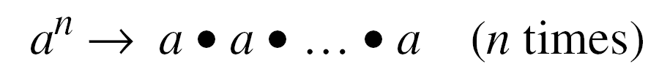
Cyclic Subgroups
If a subgroup of a group can be generated using the power of an element, the subgroup is called the cyclic subgroup
The term power means repeatedly applying the group operation to the element
a⁰ = e
1. Review 1 CS580_F15

Slide 32
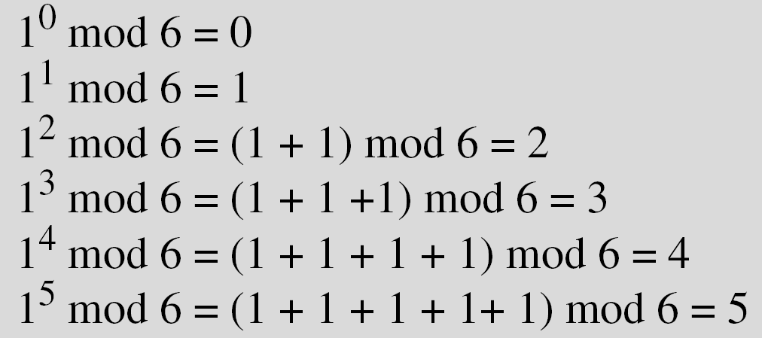
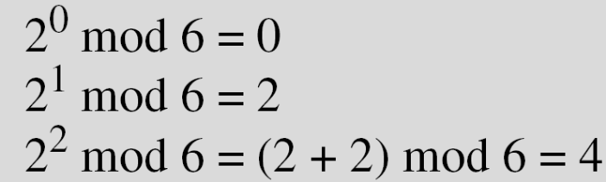
Cyclic Subgroup example
Four cyclic subgroups can be made from the group G = <Z₆, +>. They are H₁ = <{0}, +>, H₂ = <{0, 2, 4}, +>, H₃ = <{0, 3}, +>, and H₄ = G.
a:
H_{1:} 0⁰ mod 6 = 0
b:
H₄
c:
H₂
1. Review 1 CS580_F15

Slide 33
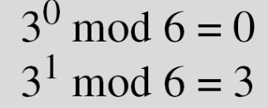
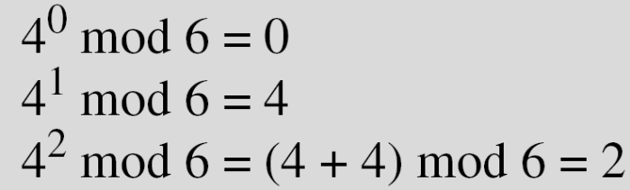
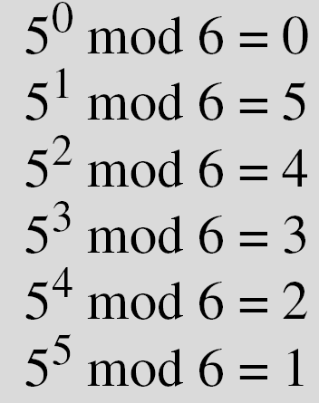
Cyclic Subgroup example
d:
H₃
e:
H₂
f:
H₄
Note:
  when the operation is addition, a^{n} means multiplying n by a
  In all of these groups, the operation is addition modulo 6
1. Review 1 CS580_F15

Slide 34
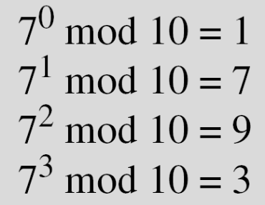

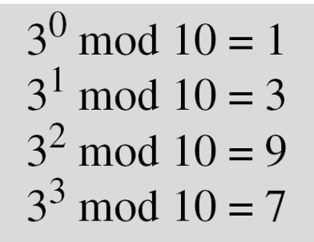
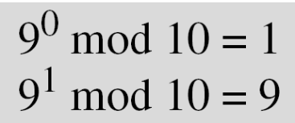
Cyclic Subgroup example
Three cyclic subgroups can be made from the group
G = <Z₁₀∗, ×>. G has only four elements: 1, 3, 7, and 9. The cyclic subgroups are H₁ = <{1}, ×>, H₂ = <{1, 9}, ×>, and H₃ = G.
1. Review 1 CS580_F15

Slide 35
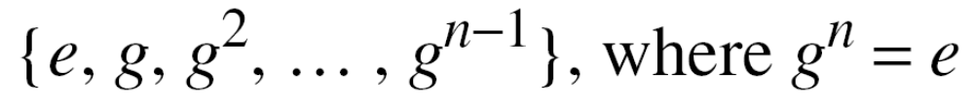
Cyclic Groups
A cyclic group is a group that is its own cyclic subgroup
The element that generates the cyclic group itself is called a generator
  g is a generator, e is an identity element
Note: a cyclic group can have many generators
1. Review 1 CS580_F15

Slide 36
Cyclic Group examples
The group G = <Z_{10∗}, ×> is a cyclic group
  G has only four elements: 1, 3, 7, and 9.
  Three cyclic subgroups can be made from the group G = <Z_{10∗}, ×>
  H1 = <{1}, ×>, H2 = <{1, 9}, ×>, and H3 = G
    2 generators, g = 3 and g = 7.
The group G = <Z₆, +> is a cyclic group
    2 generators, g = 1 and g = 5.
1. Review 1 CS580_F15

Slide 37
Order of an Element
The order of an element a in a group, ord(a), is the smallest integer n such that a^{n} = e
  Or The order of an element is the order of the cyclic group it generates
Examples
In the group G = <Z₆, +>, the orders of the elements are:
ord(0) = 1, ord(1) = 6, ord(2) = 3, ord(3) = 2, ord(4) = 3,
ord(5) = 6
In the group G = <Z_{10*}, ×>, the orders of the elements are:
ord(1) = 1, ord(3) = 4, ord(7) = 4, ord(9) = 2
1. Review 1 CS580_F15

Slide 38
Ring
A ring, R = <{…}, •, ▫>, is an algebraic structure with two operations
  The first operation must satisfy all five properties required for an abelian group
  The second operation must satisfy only the first two
  The second operation must be distributed over the first
Distributivity
  For all a, b and c elements of
  a ▫ ( b • c) = (a ▫ b) • (a ▫ c)
  And (a • b) ▫ c = (a ▫ c) • (b ▫ c)
1. Review 1 CS580_F15

Slide 39
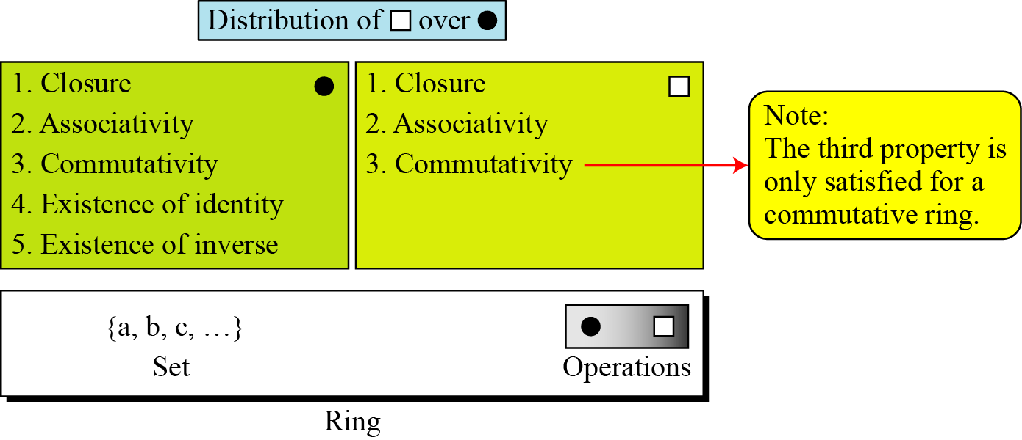
Ring (cont.)
1. Review 1 CS580_F15

Slide 40
Ring: example
The set Z with two operations, addition and multiplication, R = <Z, +, ×>, is a commutative ring
  Addition satisfies all of the five properties
  Multiplication satisfies only three properties
  Multiplication also distributes over addition
  Which operations are allowed in this set?
    Addition
    Subtraction
    Multiplicatiin
    division
1. Review 1 CS580_F15

Slide 41
Field
A field, denoted by F = <{…}, •, ▫ > is a commutative ring
The second operation satisfies all five properties defined for the first operation
Identity of the first operation has no inverse with respect to the second peration.
1. Review 1 CS580_F15

Slide 42
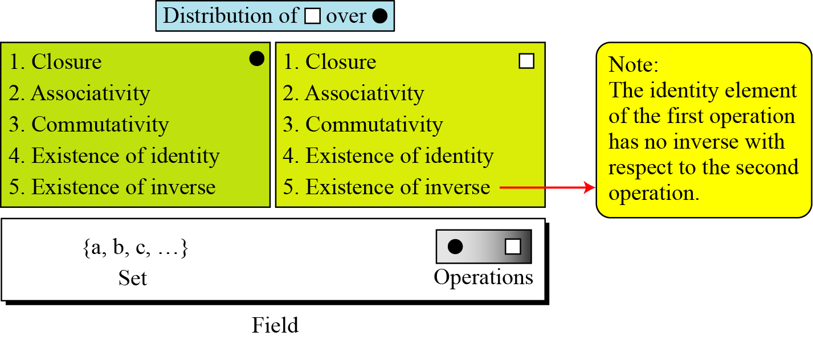
Field
1. Review 1 CS580_F15

Slide 43
Field: application
A field is a structure that supports two pairs of operations in mathematics:
  addition/subtraction and multiplication/division
  One exception: division by zero is not allowed
1. Review 1 CS580_F15

Slide 44
Galois field
Finite field
  A finite field is a field with a finite number of elements
The finite fields are usually called Galois fields
  Galois showed that for a field to be finite, the number of elements should be p^{n}
  Denoted as GF(p^{n})
    p is a prime
1. Review 1 CS580_F15

Slide 45
GF(p) field
When n=1, we have GF(p) field
Example: <Z_{p}, +, x >
  Zp: {0, 1, … p-1}
  In this set, every element has an additive inverse
  Every nonzero element have a multiplicative inverse
  No multiplicative inverse for 0
1. Review 1 CS580_F15

Slide 46
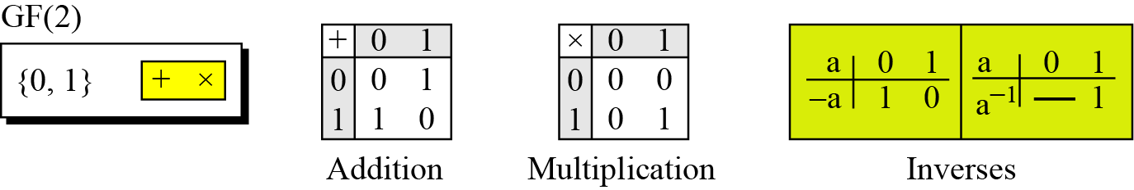
GF(2)
A very common field in this category is GF(2) with the set {0, 1} and two operations, addition and multiplication
0
1
1. Review 1 CS580_F15

Slide 47
GF(2)
The set has only two elements: 0 and 1
The addition operation is actually the XOR operation
The multiplication operation is AND operation
Addition and subtraction operations are the same (XOR)
Multiplication and division operations are the same (AND)
1. Review 1 CS580_F15

Slide 48
GF(2^{n}) fields
In cryptography, we often need to use four operations ( +, - x, /)
  We need to use fields
The positive integers are stored in computers as n-bit words.
  n is usually 8, 16, 32,…
  The range of integers is [0, … 2^{n}-1]
  The modulus is 2^{n}
1. Review 1 CS580_F15

Slide 49
GF(2^{n}) fields
Two options if we want to use a field
Option 1
  GF(p) with the set Z_{p}, p is the largest prime number less than 2^{n}
  Problem: it’s inefficient because we cannot use the integers from p to 2^{n}-1
    Ex: n=4, p=13, 13,14,15 cannot be used
    n=8, p=251, we cannot use 251~255
1. Review 1 CS580_F15

Slide 50
GF(2^{n}) fields
Option 2
  Use GF(2^{n}) with a set of 2^{n} elements
  The elements in the set are n-bit words
    Ex n=3, the set is {000,001,010,011,100,101,110,111}
  Problem: we cannot interpret each element as an integer in[0,7], because the regular 4 operations cannot be applied
    2^{n} is not a prime
We need to define a set of n-bit words and two new operations that satisfy the properties defined for a field
1. Review 1 CS580_F15

Slide 51
Polynomial
Why use polynomial
  It’s troublesome to directly define the rules for addition and multiplication operations on n-bit words that satisfy the properties in GF(2^{n})
  It’s easier to work with a representation of n-bit words
  ---- polynomial
A polynomial of degree n − 1 is an expression of the form
  x^{i} is called the ith term
  a_{i} is called coefficient of the ith term
1. Review 1 CS580_F15
Notes:
The power of x defines the position of the bit in the n-bit word.
The coefficients of the terms define the value of the bits

Slide 52
Represent a n-bit word by a polynomial
The power of x defines the position of the bit in the n-bit word
  the rightmost bit is at position 0 (related to x⁰)
  The leftmost bit is at position n-1 (related to x^{n-1})
The coefficients of the terms define the value of the bits
  The polynomial coefficients can be either 0 or 1
1. Review 1 CS580_F15

Slide 53
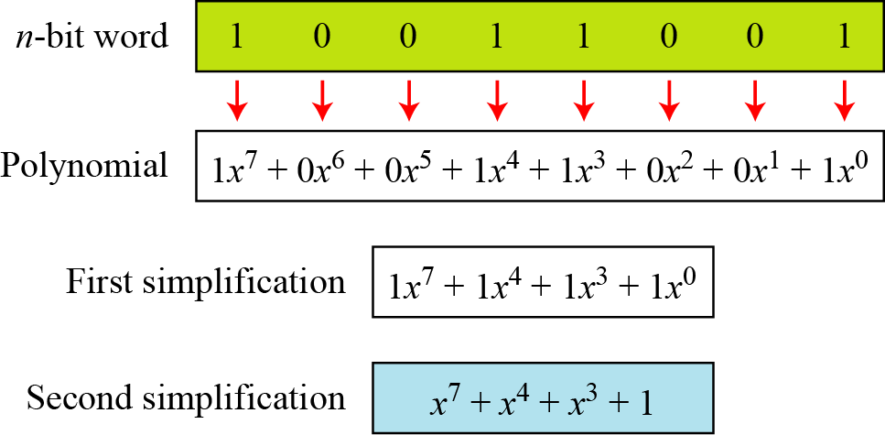
Polynomial example
Represent the 8-bit word (10011001) using a polynomials.
1. Review 1 CS580_F15

Slide 54
Polynomial example
Find the 8-bit word related to the polynomial
x⁵ + x² + x
  we first supply the omitted terms
  Since n = 8, it means the polynomial is of degree 7. The expanded polynomial is
This is related to the 8-bit word 00100110
1. Review 1 CS580_F15

Slide 55
Operations on polynomial
Any operation on polynomials actually involves two operations
  Operations on coefficients
  Operations on two polynomials
We need to define two sets
  One for the coefficients: GF(2)
  One for the polynomials: GF(2^{n})
Polynomials representing n-bit words use two fields: GF(2) and GF(2^{n})
1. Review 1 CS580_F15

Slide 56
Modulus polynomials
Addition of two polynomials never creates a polynomial out of the set
Irreducible polynomials
  Multiplication of two polynomials cay create a polynomial with degrees more than n-1
  We need to divide the result by a modulus and keep only the remainder
  The modulus in this case acts as a prime polynomial or irreducible polynomials
    Cannot be factored into a polynomial with degree of less than n
1. Review 1 CS580_F15

Slide 57
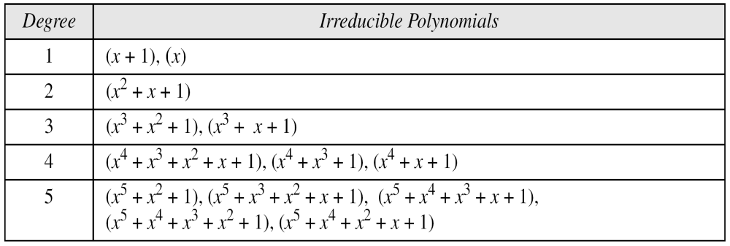
Irreducible polynomials
Table 4.9 List of irreducible polynomials
When we define our GF(2^{n}), we need to declare which irreducible polynomial we are using as the modulus
1. Review 1 CS580_F15

Slide 58
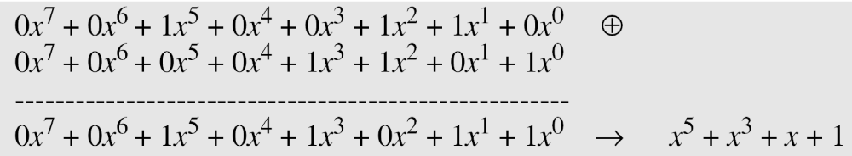
Operations on polynomials: addition
Addition and subtraction operations on polynomials are the same operation
Ex: (x⁵ + x² + x) + (x³ + x² + 1) in GF(2⁸)
1. Review 1 CS580_F15

Slide 59
Operations on polynomials: multiplication
The coefficient multiplication is done in GF(2)
The multiplying x^{i} by x^{j} results in x^{i+j}
The multiplication may create terms with degree more than n − 1, which means the result needs to be reduced using a modulus polynomial
1. Review 1 CS580_F15

Slide 60
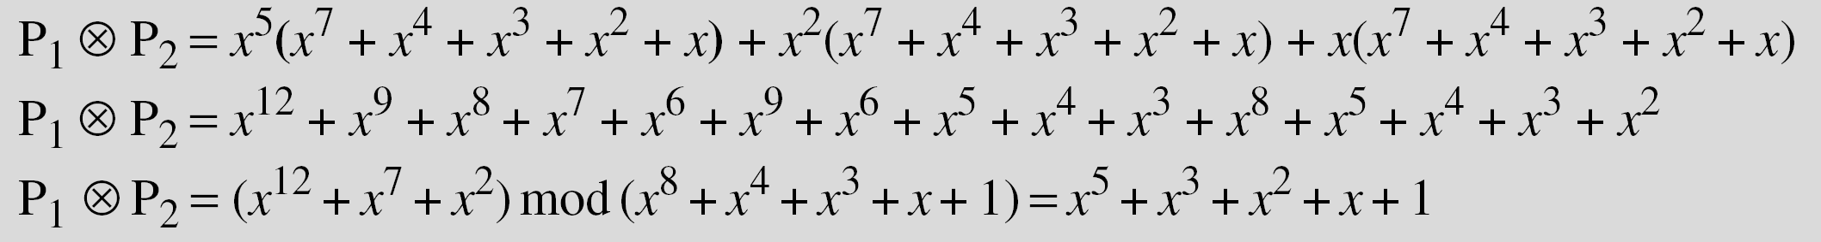
Operations on polynomials: multiplication example
Find the result of (x⁵ + x² + x) ⊗ (x⁷ + x⁴ + x³ + x² + x) in GF(2⁸) with irreducible polynomial (x⁸ + x⁴ + x³ + x + 1). Note that we use the symbol ⊗ to show the multiplication of two polynomials.
Solution
1. Review 1 CS580_F15

Slide 61
Operations on polynomials: multiplication
Multiplicative identity
  Always 1
Multiplicative inverse
  Use extended Euclidean algorithm to find the multiplicative inverse
  The process is exactly the same as for integers
1. Review 1 CS580_F15

Slide 62
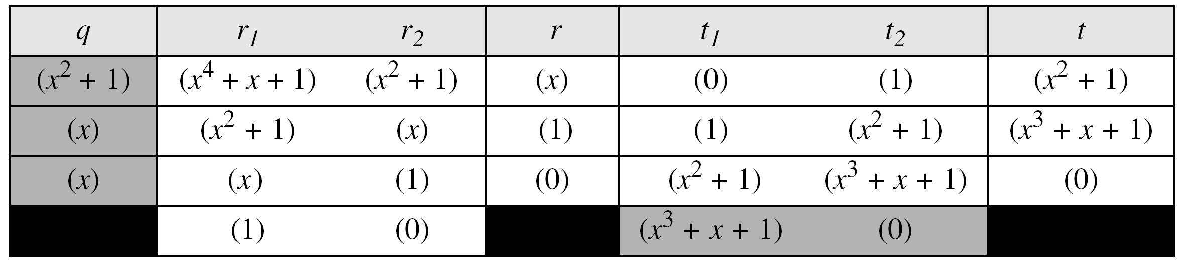
Operations on polynomials: multiplication example
In GF (2⁴), find the inverse of (x² + 1) modulo (x⁴ + x + 1)
Solution
The answer is (x³ + x + 1)
1. Review 1 CS580_F15

Slide 63
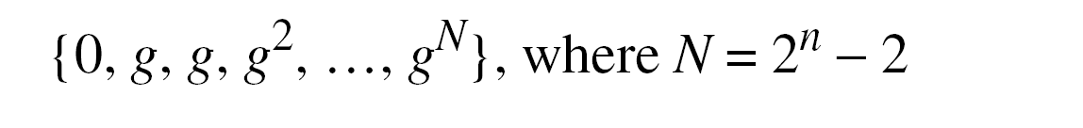
Multiplication using a generator
It’s easier to define the elements of the GF(2^{n}) field using a generator
In GF(2^{n}) with the irreducible polynomial f(x), an element in the field a much satisfy the relation f(a) = 0
Generator
  A generator g of GF(2^n) is an element whose first 2^n- 1 powers generates all the nonzero elements of the field.
  f(g) = 0
0
1
1. Review 1 CS580_F15

Slide 64
Multiplication using a generator
Generate the elements of the field GF(2⁴) using the irreducible polynomial ƒ(x) = x⁴ + x + 1.
Solution
The elements 0, g⁰, g¹, g², and g³ can be easily generated, because they are the 4-bit representations of 0, 1, x, x², and x³.
Elements g⁴ through g¹⁴, which represent x⁴ though x¹⁴ need to be divided by the irreducible polynomial.
To avoid the polynomial division, the relation ƒ(g) = g⁴ + g + 1 = 0 can be used
1. Review 1 CS580_F15

Slide 65
Using a Generator
1. Review 1 CS580_F15

Slide 66
Using a Generator
The main idea is to reduce terms g⁴ to g¹⁴ to a combination of the terms 1, g, g², and g³, using the relation g⁴+g+1=0
After reduction, it’s easy to transform the powers into an n-bit word
Finding inverses using this representation is simple
  Additive inverses
    The additive inverses of each element is the element itself
    Addition and subtraction in this field are the same
      -g⁴=g⁴
  Multiplicative inverse
    The exponents are calculated modulo 2^{n}-1
    Ex: g³⁽⁻¹ ⁾= g⁻³ = g¹² = g³+g²+g+1 → 1111
1. Review 1 CS580_F15

Slide 67
Operations
The following show the results of addition and subtraction operations:
1. Review 1 CS580_F15

Slide 68
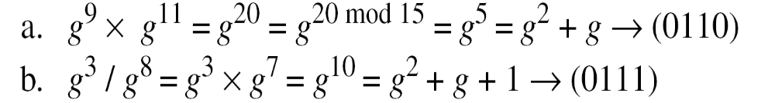
Operations
The following show the result of multiplication and division operations:.
1. Review 1 CS580_F15

Slide 69
Binary operation in Zn
Perform the following operations (the inputs come from either Z or Z_{n}):
a. Add 17 to 27 in Z₁₄.
b. Subtract 43 from 12 in Z₁₃.
c. Multiply 123 by −10 in Z₁₉.
Solution ?
2
8
5
1. Review 1 CS580_F15

Slide 70
Multiplicative inverse
Find all multiplicative inverses in Z₁₀.
(1, 1), (3, 7) and (9, 9)
(1, 1), (3, 7) and (9, 9)
The numbers 0, 2, 4, 5, 6, and 8 do not have a multiplicative inverse.
Find all multiplicative inverse pairs in Z11.
(1, 1), (2, 6), (3, 4), (5, 9), (7, 8), and (10, 10)
1. Review 1 CS580_F15

Slide 71
Extended Euclidean algorithm
Find the multiplicative inverse of 23 in Z₁₀₀.
87
Find the inverse of 12 in Z₂₆.
Does not exist.
1. Review 1 CS580_F15

Slide 72
Galois field
Which of the following is a valid Galois field?
  GF(12)
  GF(13) yes
  GF(16) yes
  GF(17) yes
1. Review 1 CS580_F15

Slide 73
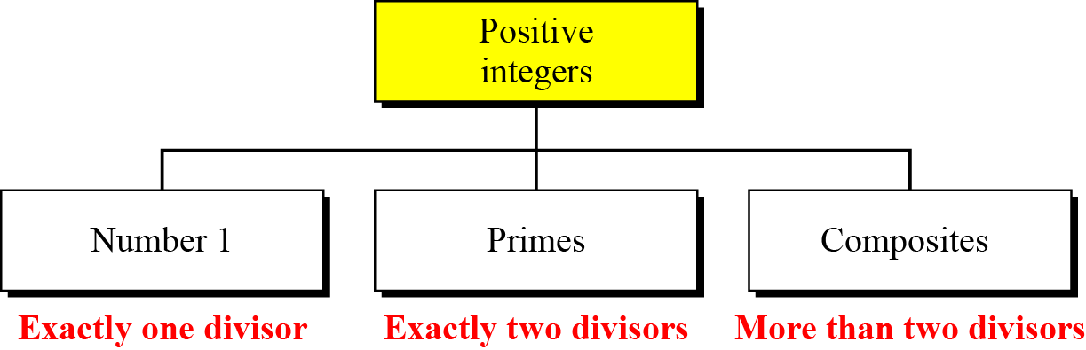
Definition
A prime is divisible only by itself and 1
Figure 9.1 Three groups of positive integers
1. Review 1 CS580_F15

Slide 74
Examples
Example 9.2
List the primes smaller than 10.
Solution
There are four primes less than 10: 2, 3, 5, and 7.
The percentage of primes in the range 1 to 10 is 40%.
The percentage decreases as the range increases.
1. Review 1 CS580_F15

Slide 75
Relatively prime (coprime)
Two positive integers a and b are relatively prime, or coprime, if gcd(a,b) = 1
1 is relatively prime with any integer
If p is prime, all integers between 1 and p-1 are relatively prime to p
  Z_{p*} = { 1, … , p-1}
1. Review 1 CS580_F15

Slide 76
Relatively prime
Examples
gcd(3,5) = 1 3 and 5 are relatively prime
gcd(11, 17) = 1 11 and 17 are relatively prime
gcd(12,16) = 4 12 and 14 are not relatively prime
Are the following statements correct?
  If two integers are relatively prime, they are both prime numbers
  If two integers are relatively prime, at least one of them is a prime number
  If two integers are prime numbers, they are relatively prime
1. Review 1 CS580_F15

Slide 77
Euler’s Phi-Function
Also called Euler’s totient function φ(n)
  The number of integers that are both smaller than n and relatively prime to n
  The same as the number of elements in Zn*
Some rules
  φ(1) = 0
  φ(p) = p-1 if p is a prime
  φ(m × n) = φ(m) × φ(n) if m and n are relatively primes
  φ(p^{e}) = p^{e}-p^{e-1} if p is a prime
1. Review 1 CS580_F15

Slide 78
Euler’s Phi-Function
The four rules can be combined
  If n can be factored as n=p₁^{e1}×p₂^{e2}×… × p_{k}^{ek} , then
  φ(n) = (p₁^{e1}-p₁^{e1-1}) × (p₂^{e2}-p₂^{e2-1}) ×… ×(p_{k}^{ek}-p_{k}^{ek-1})
The value of φ(n) for large n can be found only if n can be factored into primes
The difficulty of finding φ(n) depends on the difficulty of finding the factorization of n
Factorization of large n is VERY DIFFICULT!
1. Review 1 CS580_F15

Slide 79
Examples
What is the value of φ(13)? 12
What is the value of φ(10)? 4
What is the value of φ(240)? 64
How many elements are there in Z_{14*}? 6
1. Review 1 CS580_F15

Slide 80
Fermat’s Little Theorem
First version
  If p is a prime and a is an integer
  And Gcd(a, p) = 1
  then a^{p-1} ≡ 1 mod p
Exercise
  Which of the followings are correct?
  10⁵⁻¹ ≡ 1 mod 5 x
  10³⁻¹ ≡ 1 mod 3
  11⁶⁻¹ ≡ 1 mod 6 x
  12⁶⁻¹ ≡ 1 mod 6 x
  12⁷⁻¹ ≡ 1 mod 7
1. Review 1 CS580_F15

Slide 81
Fermat’s Little Theorem
Second version
  If p is a prime and a is an integer
  a^{p} ≡ a mod p
  the 2nd condition on is removed!
Exercise
  Which of the followings are correct?
  3⁴ ≡ 3 mod 4 x
  3⁵ ≡ 3 mod 5
  4⁸ ≡ 4 mod 8 x
  5⁸ ≡ 5 mod 8 x
1. Review 1 CS580_F15

Slide 82
Multiplicative inverse
Fermat’s theorem can be used to find some multiplicative inverses quickly if the modulus is a prime
a x a⁻¹ ≡ 1 mod p
= a^{p-1} mod p (by Fermat’s theorem)
= a x a^{p-2} mod p
a⁻¹ ≡ a^{p-2} mod p
The conditions on a and p
  p is prime
  Gcd(a,p) = 1
1. Review 1 CS580_F15

Slide 83
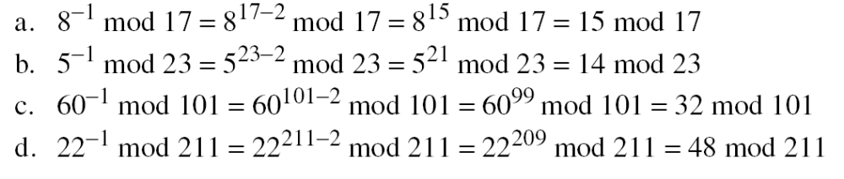
Multiplicative inverse
Examples
1. Review 1 CS580_F15

Slide 84
Euler’s Theorem
Euler’s theorem is a generalization of Fermat’s little theorem
  The modulus in the Fermat theorem is a prime
  The modulus in Euler’s theorem is an integer
First version: a ^{φ(n)} ≡ 1 (mod n)
  Condition: gcd(a, n) = 1
Second version: a ^{k ×} ^{φ(n)} ⁺ ¹ ≡ a (mod n)
  k is an integer
  The condition gcd(a,n) = 1 is removed!
  The theorem is used in RSA cryptosystem
1. Review 1 CS580_F15

Slide 85
Examples
Example 9.15
  Find the result of 6²⁴ mod 35
  φ(35) φ(5) x φ(7) = 4 x 6 = 24
  6²⁴ mod 35 ≡ 6^{φ(35)} mod 35 ≡ 1 mod 35
Example 9.15
  Find the result of 20⁶² mod 77
  φ(77) = φ(7) x φ(11) =6 x 10 = 60
  20⁶² mod 77 ≡ 20² x 20⁶⁰ mod 77
  ≡ (20² mod 77) x (20⁶⁰ mod 77)
  ≡ 20² mod 77
  ≡ 15 mod 77
1. Review 1 CS580_F15

Slide 86
Multiplicative inverse
Fermat’s theorem can be used to find some multiplicative inverses quickly if the modulus is a prime
Euler’s theorem can be used to find multiplicative inverse modulo a composite
a x a⁻¹ mod n = 1 mod n
a x a-¹ mod n = a^{φ(n)} mod n = 1 mod n
a⁻¹ ≡ a^{φ(n)-1} mod n
The conditions on a and n
  Gcd(a,n) = 1
1. Review 1 CS580_F15

Slide 87
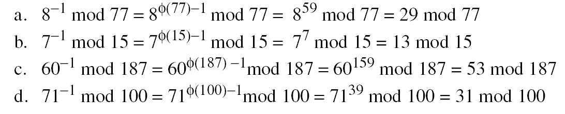
Multiplicative inverse
The answers to multiplicative inverses modulo a composite can be found without using the extended Euclidean algorithm if we know the factorization of the composite:
1. Review 1 CS580_F15

Slide 88

Factorization
Fundamental theorem of arithmetic
  Any positive integer greater than one can be written uniquely in the following prime factorization form
  p₁, p₂,….p_{k} are primes, e1, e2, … e3 are integers
Examples:
  18 = 2 x 3²
  280 = 2³ x 5 x 7
  450 = ?
  12452325432321235423523420340554342213123590=?
1. Review 1 CS580_F15

