Slide 1
CS580
Internet Security Protocols
2. Review 2
Huiping Guo
Department of Computer Science
California State University, Los Angeles

Slide 2
Outline
Modern Block Ciphers
  Components
  DES
  S-AES
Modes of operation
Asymmetric Key Cryptography
  RSA, ElGamal
Message authentication
Digital signature
Key management
16. Review 2 CS580_F15

Slide 3
Components of a Modern Block Cipher
P-boxes
S-boxes
XOR operation
Circular shift
Split and combine
16. Review 2 CS580_F15

Slide 4
Product ciphers
A product cipher is a complex cipher combining substitution, permutation, and other components discussed in previous sections
Diffusion
  The idea of diffusion is to hide the relationship between the ciphertext and the plaintext
  Each symbol in the ciphertext is dependent on some or all symbols in the plaintext
Confusion
  The idea of confusion is to hide the relationship between the ciphertext and the key
  If a single bit in the key is changed, most or all bits in the ciphertext will also be changed
16. Review 2 CS580_F15

Slide 5
Product ciphers
Rounds
  Diffusion and confusion can be achieved using iterated product ciphers where each iteration is a combination of S-boxes, P-boxes, and other components
  Each iteration is called a round
  All rounds have the same structure
Key generator
  Creates different keys for each round from the cipher key
16. Review 2 CS580_F15

Slide 6
Feistel ciphers
A Feistel cipher can have three types of components:
  self-invertible, invertible, and noninvertible
A feistel cipher combines all noninvertible elements in a unit and uses the same unit in the encryption and decryption algorithm
Question: how the encryption and decryption algorithms are inverses of each other if each has a non-invertible unit?
  They can be cancelled out!
Typical Feistel cipher: DES
16. Review 2 CS580_F15

Slide 7
Non-Feistel Ciphers
A non-Feistel cipher uses only invertible components.
A component in the encryption cipher has the corresponding component in the decryption cipher
Typical non-Feistel cipher: AES
16. Review 2 CS580_F15

Slide 8
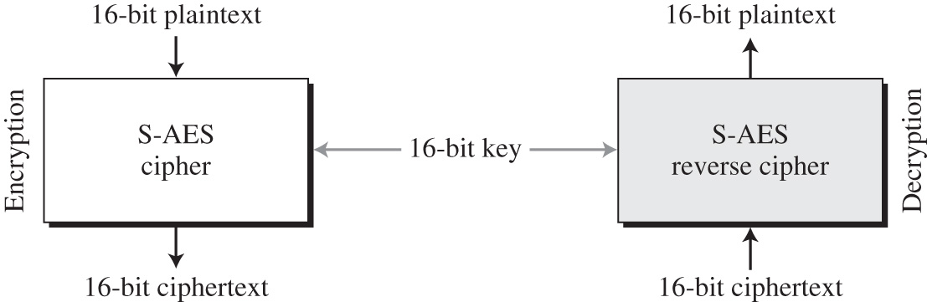
S-AES structure
16. Review 2 CS580_F15

Slide 9
Rounds
S-AES is a non-Feistel cipher that encrypts and decrypts a data block of 16 bits
The cipher key is also 16 bits
It uses one per-round transformation and two rounds
The round keys are created by the key expansion algorithm
  Three round keys
16. Review 2 CS580_F15

Slide 10
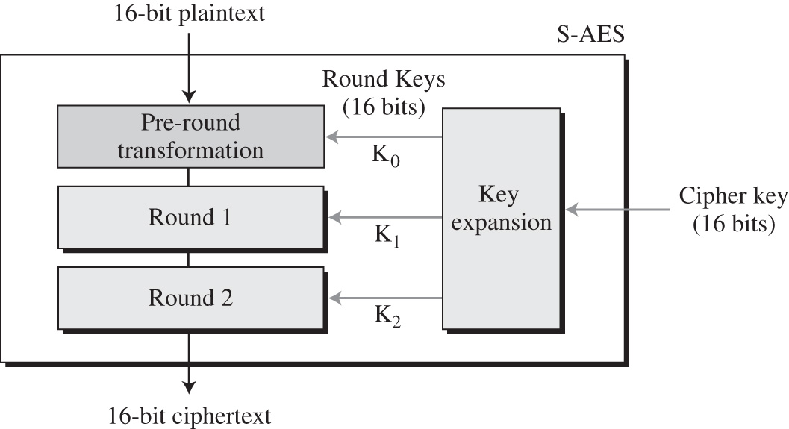
Rounds
16. Review 2 CS580_F15

Slide 11
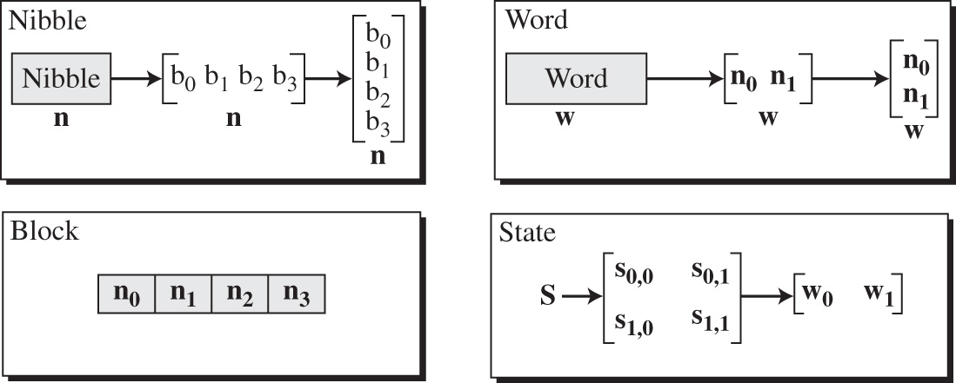
Data units
S-AES uses five units of measurement to refer to data
16. Review 2 CS580_F15

Slide 12
Data units
S-AES uses five units of measurement to refer to data
16. Review 2 CS580_F15

Slide 13
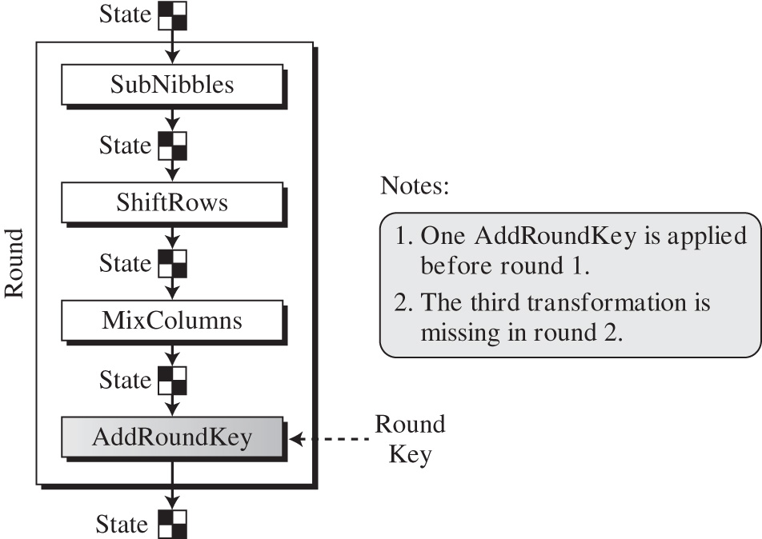
Structure of each round
16. Review 2 CS580_F15

Slide 14
Structure of each round
Each transformation takes a state and creates another state to be used for the next transformation or the next round
The per-round section uses only one transformation (AddRoundKey)
The last round uses only three transformations (MixColumn transformation is missing)
At the decryption side, the inverse transformations are used:
  InvSubNibbles, InvShiftRows, InvMixColumns, and AddRoundKey
16. Review 2 CS580_F15

Slide 15
Transformations
To provide security, S-AES uses four types of transformations:
  Substitution, permutation, mixing and key adding
Substitution
  Done for each nibble (4-bit data unit)
  Only one table is used for transformations of every nibble
    If 2 nibbles are the same, the transformation is also the same
  SubNibbles transformation: for encryption
  InvSubNibbles transformation: for decryption
16. Review 2 CS580_F15

Slide 16
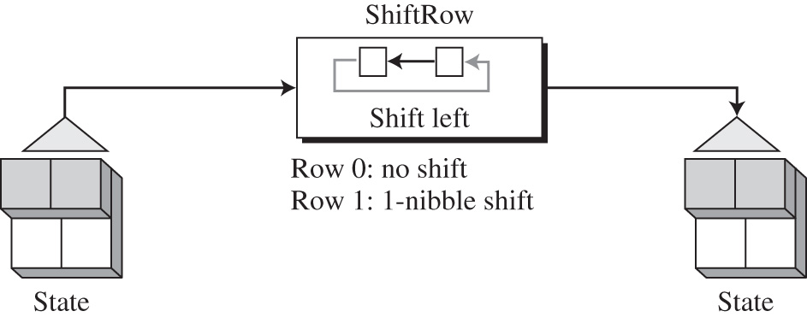
Permutation
16. Review 2 CS580_F15

Slide 17
MixColumns
MixColumns transformations operates at the column level
It transforms each column of the state into a new column
  The transformation is actually the matrix multiplication of a state column by a constant square matrix
  The nibbles in the state column and constant matrix are interpreted as 4-bit words (or polynomials) with coefficients in GF(2)
  Multiplication of bytes is done in GF(2⁴) with modulus (x⁴ + x + 1) or (10011)
  Addition is the same as XORing of 4-bit words
16. Review 2 CS580_F15

Slide 18
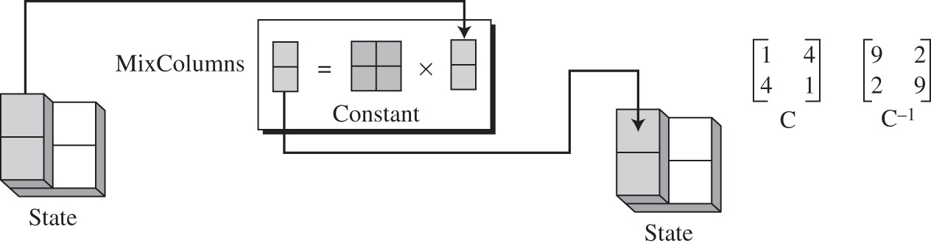
MixColumns
Constant matrix
Inverse of the constant matrix
InvMixColumns transformation is basically the same as the MixColumn except that it uses the inverse of the constant matrix
16. Review 2 CS580_F15

Slide 19
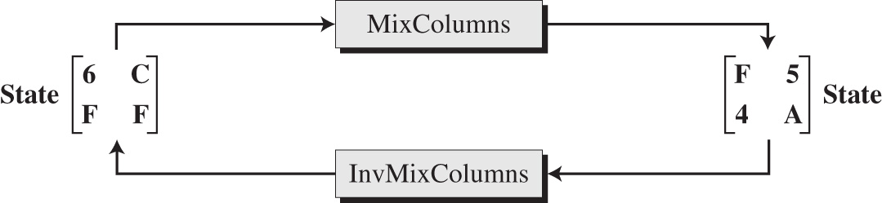
Example
Note:
  Equal bytes in the old state, are not equal in the new state
16. Review 2 CS580_F15

Slide 20
Key adding
All previous transformations use known algorithms that are invertible
Key adding is the transformation that includes the cipher key
S-AES uses a process called key expansion that creates 3 round keys from he cipher key
  Each round key is 16 bits long
  It’s treated as 2 8-bit words
  Each word is considered as a column matrix
16. Review 2 CS580_F15

Slide 21
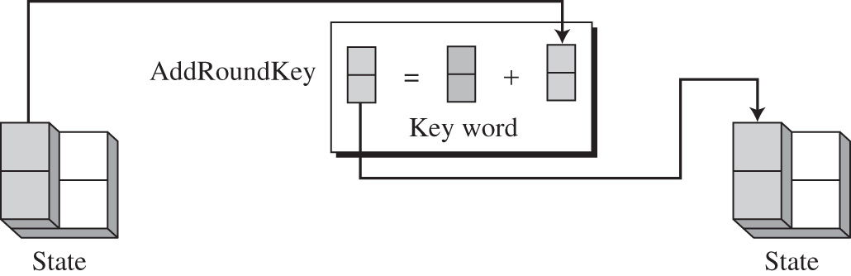
AddRoundKey
AddRoundKey adds a round key word with each state column matrix
16. Review 2 CS580_F15

Slide 22
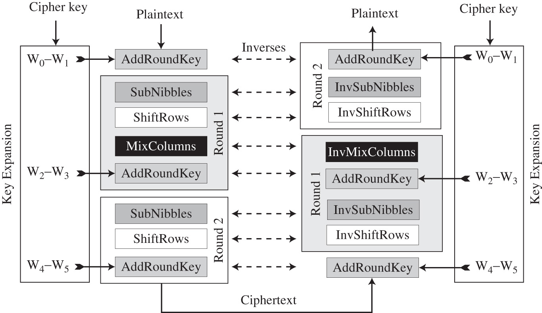
Ciphers
16. Review 2 CS580_F15

Slide 23
Use of modern standard ciphers
Modern block ciphers (DES/AES) are designed to encipher and decipher a block of text of fixed size
  DES encrypts and decrypts a block of 64 bits
  AES encrypts and decrypts a block of 128 bits
In real life applications, the text to be enciphered is of variable size
  Normally larger than 64 or 128 bits
Modes of operation are devised to encipher text of any size employing either DES or AES
16. Review 2 CS580_F15

Slide 24
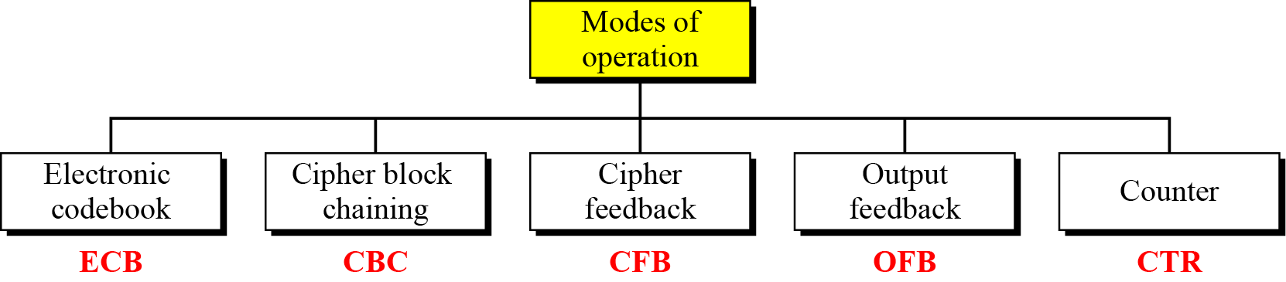
Modes of operation
16. Review 2 CS580_F15

Slide 25
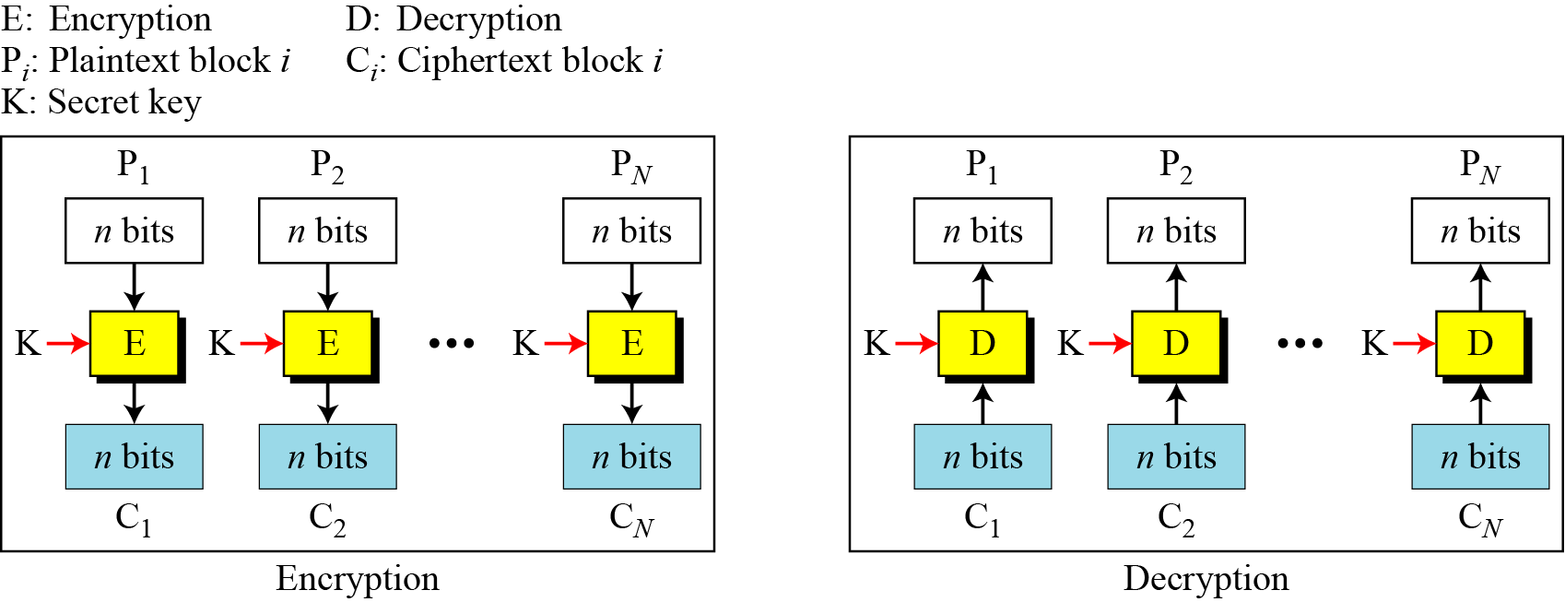
Electronic Codebook (ECB) Mode
Figure 8.2 Electronic codebook (ECB) mode
16. Review 2 CS580_F15

Slide 26
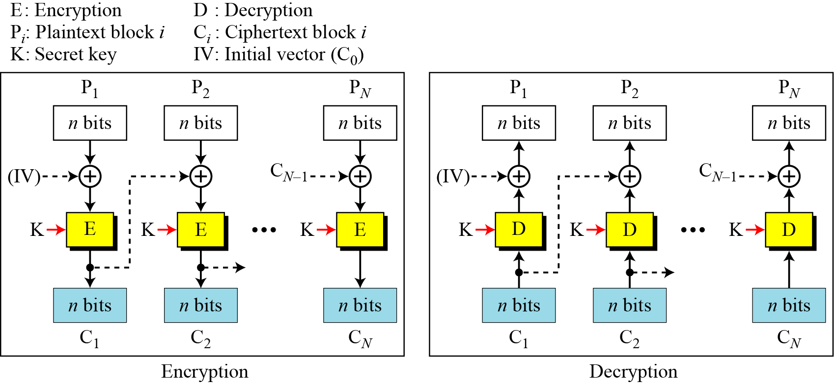
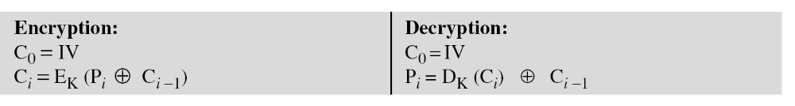
Cipher Block Chaining (CBC) Mode
16. Review 2 CS580_F15

Slide 27
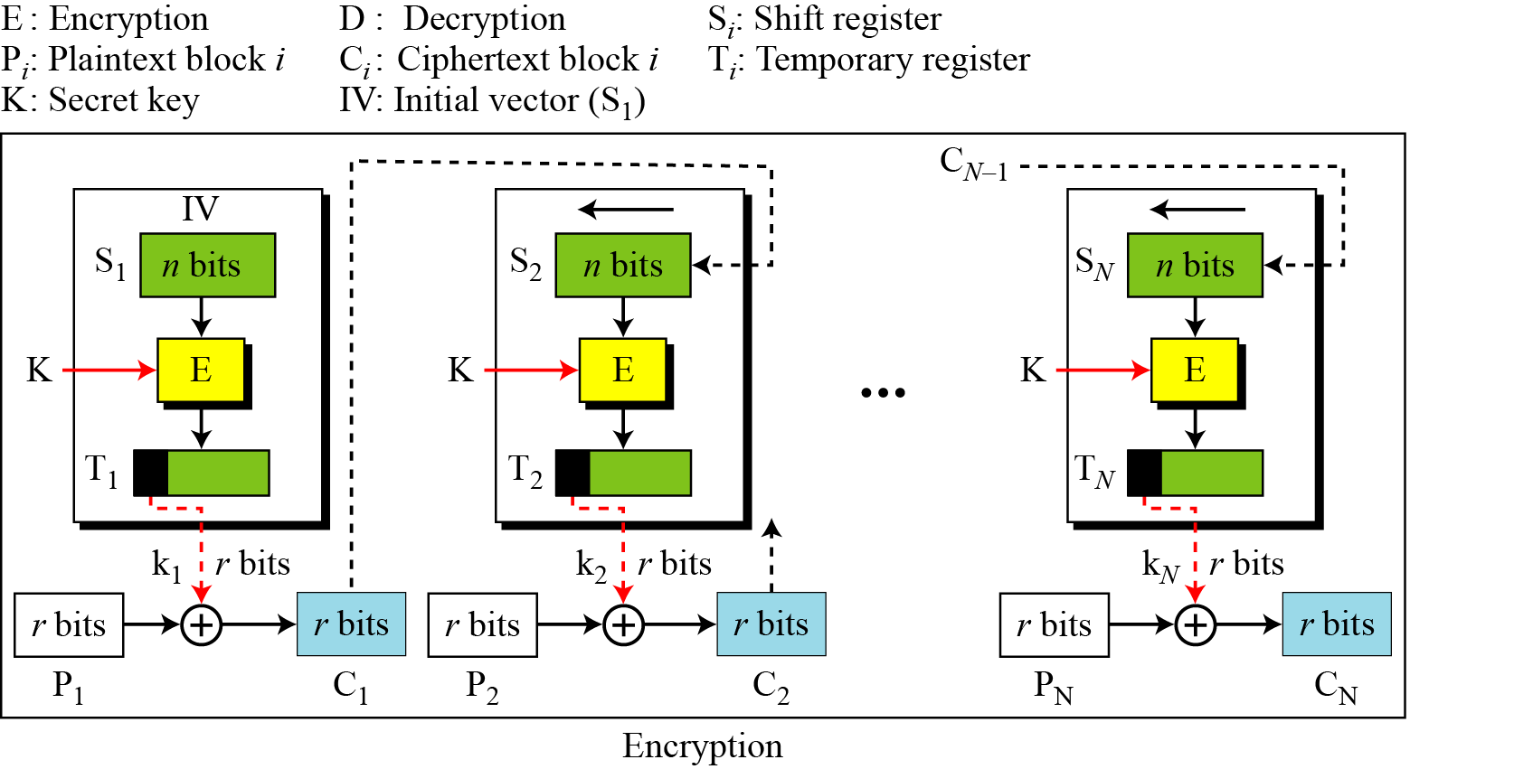
Cipher Feedback (CFB) Mode
16. Review 2 CS580_F15

Slide 28
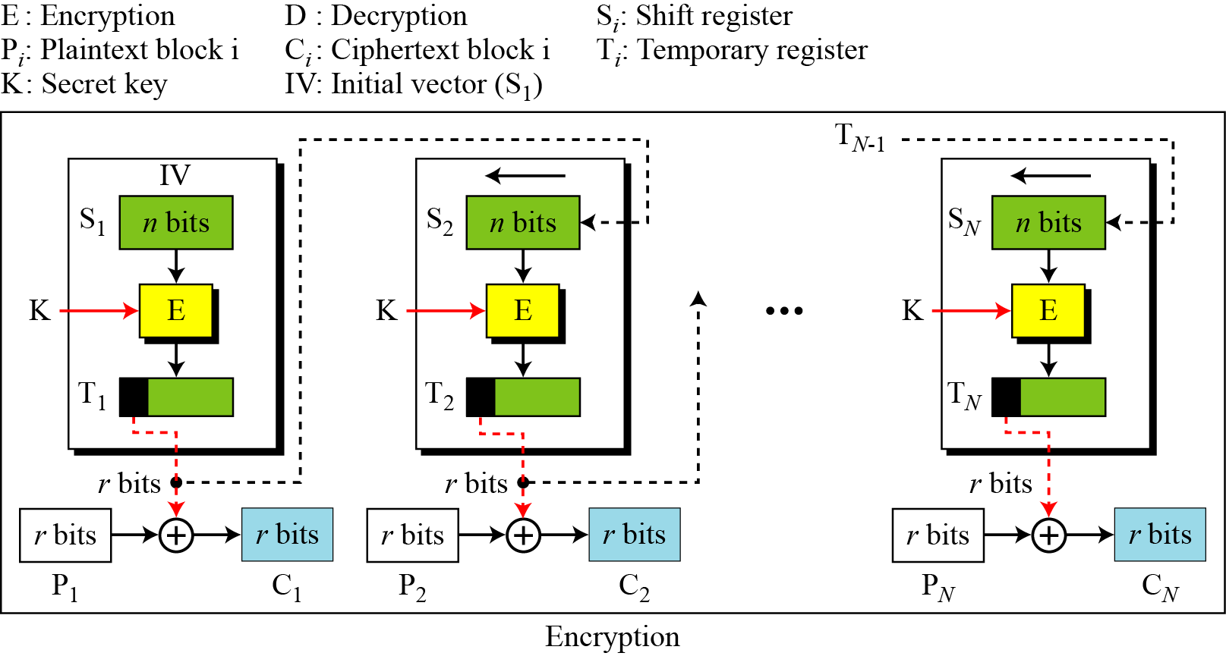
Output Feedback (OFB) Mode
16. Review 2 CS580_F15

Slide 29
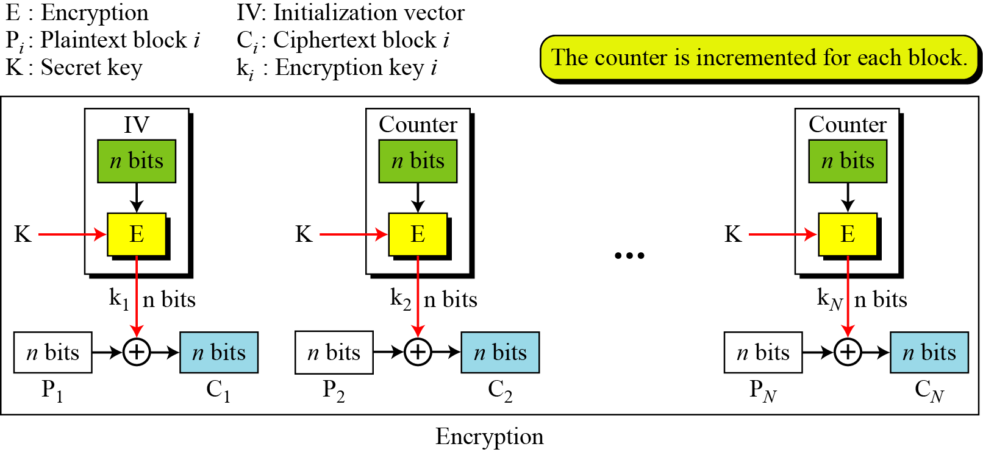
Counter (CTR) Mode
16. Review 2 CS580_F15

Slide 30
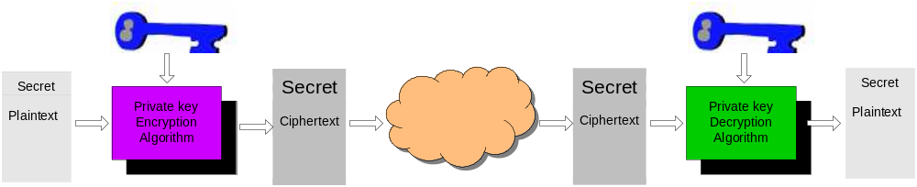
Symmetric-Key Cryptography
Symmetric-Key cryptography uses one key
The same key is used for both encryption and decryption
The key is shared by the sender and the receiver
Problems
  It’s hard for the sender and the receiver to agree on a key before the communication
  Large number of keys are needed
    If N persons need secure communication with each other, how many keys are needed? How many keys each person needs to keep
16. Review 2 CS580_F15
Notes:
First, let’s have a short overview of private key cryptograph. The diagram shows how it works.
A sender wants to send a message to a recipient. First, the sender encrypts the message using a key, the encrypted message is then sent over the internet. After the recipient receives the message, he uses the same key to decrypt the message.
From the diagram, we can see that in private key cryptography:
Only one key is used
The same key is used for both encryption and decryption
shared by both sender and receiver
so the sender and the receiver have to agree on the key in advance. The problem is that it’s very difficult for them to do so. How can the sender make the known only to the recipient?

Slide 31
Asymmetric-Key Cryptography
Probably most significant advance in the 3000 year history of cryptography
Also called public key cryptography
Asymmetric-Key Cryptography uses two keys – a public & a private key
Asymmetric since parties are not equal
  The sender use either one key to encrypt a message
  The receiver must use the other key to decrypt the message
16. Review 2 CS580_F15
Notes:
Will now discuss the radically different public key systems, in which two keys are used. The development of public-key cryptography is the greatest and perhaps the only true revolution in the entire history of cryptography. It is asymmetric, involving the use of two separate keys, in contrast to symmetric encryption,which uses only one key. Anyone knowing the public key can encrypt messages or verify signatures, but cannot decrypt messages or create signatures, counter-intuitive though this may seem. It works by the clever use of number theory problems that are easy one way but hard the other. Note that public key schemes are neither more nor less secure than private key (security depends on the key size for both), nor do they replace private key schemes (they are too slow to do so), rather they complement them. Both also have issues with key distribution, requiring the use of some suitable protocol.

Slide 32
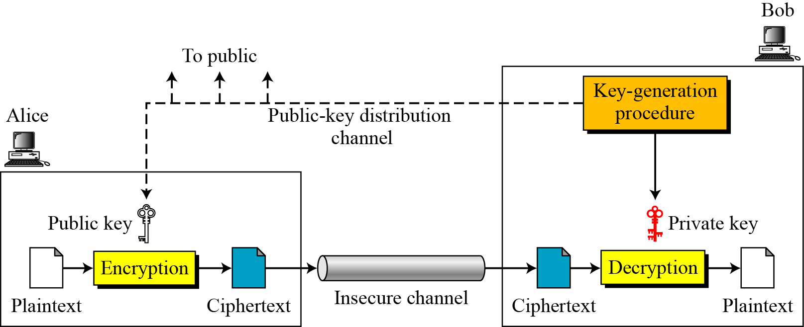
General idea of asymmetric-key cryptosystem
16. Review 2 CS580_F15

Slide 33
RSA algorithm
by Rivest, Shamir & Adleman of MIT in 1977
best known & widely used public-key scheme
Uses modular exponentiation for encryption/decryption
uses large integers (eg. 1024 bits)
Security basis
  factorization of large integers is hard
16. Review 2 CS580_F15

Slide 34
RSA algorithm
Three steps
  Key generation
    Only need to do once
  Encryption
  Decryption
Suppose Alice sends a message to Bob
  Bob needs to do key generation before the communication
16. Review 2 CS580_F15

Slide 35
Key generation
Bob picks two large primes p and q
Calculate n = p x q
Calculate ø(n)
  ø(n) = ( p-1)x(q-1) discard p and q
Select an integer e
  gcd(ø(n),e)=1; 1<e<ø(n)
Calculate d=e⁻¹ mod ø(n)
Bob publishes his Public key KU={e,n}
Bob keeps his private key KR={d,n}
16. Review 2 CS580_F15

Slide 36
Encryption and decryption
Encryption
  Alice gets Bob’s public key PU={e,n}
  Alice wants to send P to Bob, P < n
  P is encrypted to C
  C=P^{e} mod n
Decryption
  Bob has his private key PR={d,e}
  After Bob gets C, he decrypts C
  C^{d} mod n = P
16. Review 2 CS580_F15

Slide 37
RSA trivial example
Bob generates a Key pair
  Selects p and q
    Bob picks p=7, q=17
  Calculates n
    n = pq = 119
  Calculates ø(n)
    φ(119) = φ(7) x φ(17) = 96
  Select e
    Bob picks e = 5, gcd(5, 96 ) =1
  Calculate d
    d = e⁻¹ mod ø(n) = 5⁻¹ mod 96 = 5³¹ mod 96 = 77
  Public key PU = (5, 119)
  Private key PR = (77, 119)
16. Review 2 CS580_F15

Slide 38
RSA trivial example
Alice gets Bob’s public key KU=(5,119)
Alice send a plaintext P=25 to Bob
  Alice encrypts P using Bob’s public KU=(5,119)
  C=P^{e} mod 119 = 25⁵ mod 119 = 9
Bob receives the ciphertext C=9
  Bob decrypts C using his own private key KR=(77, 119)
  C^{d} mod 119 = 9⁷⁷ mod 119 = 25
16. Review 2 CS580_F15

Slide 39
RSA trivial example
Suppose another person, John, need to send a plaintext P=61 to Bob
John gets Bob’s public key PU={5,119}
John encrypts P
  C = P^{e} mod n = 61⁵ mod 119 = 108
Bob receives the ciphertext C=108
  Bob decrypts C using his own private key KR=(77, 119)
  C^{d} mod 119 = 108⁷⁷ mod 119 = 61
16. Review 2 CS580_F15

Slide 40
RSA trivial example
Question: What if Bob wants to send P to Alice?
Alice needs to generate a key pair and publishes her public key
Bob encrypts P with Alice’s public key
Alice decrypts it with her private key
16. Review 2 CS580_F15

Slide 41
RSA: discussions
Both p and q should be large(>512 bits)
Given public key, it’s infeasible to compute the private key
    Public key(e,n)
    Factor n into p,q
    ø(n) = (p-1) x (q-1)
    Private key d = e⁻¹ mod ø(n)
Its security relies on the difficulty of calculating factors of large numbers
Implementation is slow
16. Review 2 CS580_F15
Notes:
The longer the key, the more difficult it is. The level of efforts is measured in MIPS-years: a million-instructions-per-second processor running for one years. A 200-MHx Pentium is about 50-MIPS machine. If a key is 428 bits long, I would take 5000 MIPS-years to break the algorithm. The result was reported in 1994.

Slide 42
Attacks on RSA
  Bob’s Public key PU = (5, 119)
  Eve intercepts C = 9
  How does Eve find out the corresponding plaintext?
16. Review 2 CS580_F15

Slide 43
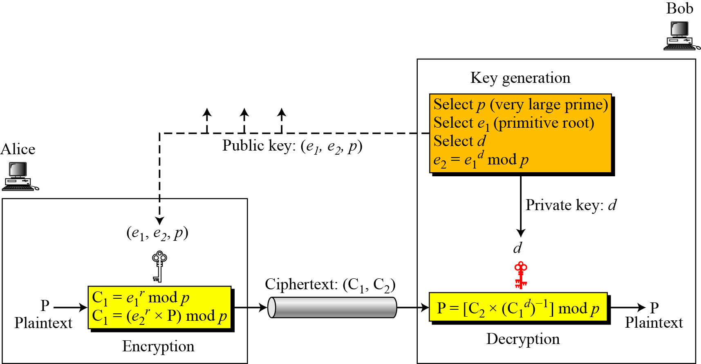
ElGamal cryptosystem
ElGamal is based on the discrete logarithm problem
16. Review 2 CS580_F15

Slide 44
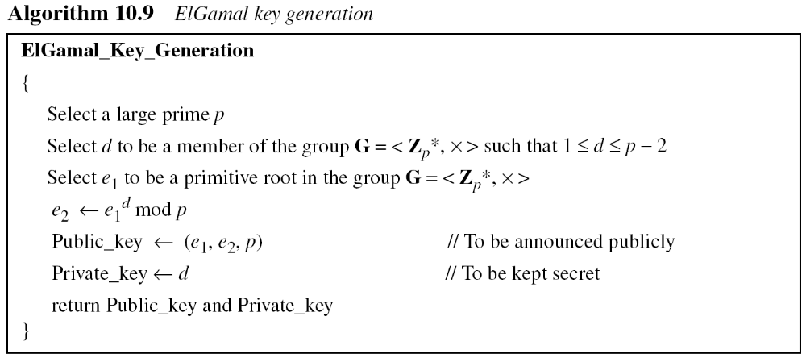
ElGamal cryptosystem
16. Review 2 CS580_F15

Slide 45
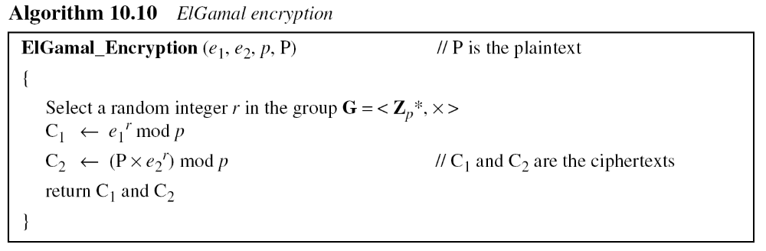
ElGamal cryptosystem
16. Review 2 CS580_F15

Slide 46
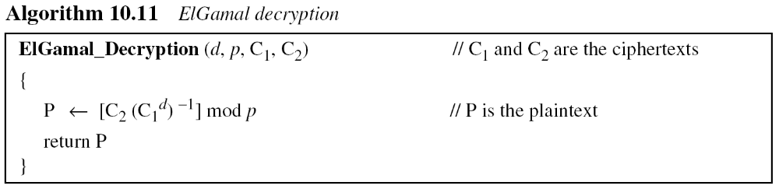
ElGamal cryptosystem
16. Review 2 CS580_F15

Slide 47
ElGamal cryptosystem example
Bob chooses p = 11, e1 = 2 and d = 3
e2 = e1^{d} mod p= 8
So the public keys are (2, 8, 11)
The private key is 3
To encrypt plaintex 7, Alice chooses r=4
calculates C1 and C2 for the plaintext 7
16. Review 2 CS580_F15

Slide 48
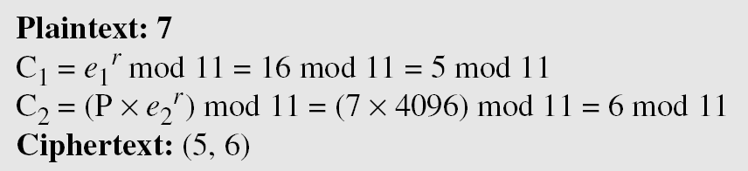
ElGamal cryptosystem example
Bob receives the ciphertexts (5 and 6) and calculates the plaintext.
16. Review 2 CS580_F15

Slide 49
ElGamal cryptosystem example
Instead of using P = [C₂ × (C₁^{d}) ⁻¹] mod p for decryption, we can avoid the calculation of multiplicative inverse and use P = [C₂ × C₁ ^{p−1−d}] mod p
  see Fermat’s little theorem
In the previous example, we can calculate
  P = [6 × 5 ¹¹⁻¹⁻³] mod 11 = 7 mod 11.
16. Review 2 CS580_F15

Slide 50
Message integrity
The cryptography systems that we have studied so far provide secrecy, or confidentiality, but not integrity.
However, there are occasions where we may not even need secrecy but instead must have integrity
  Everyone is allowed to read a message
  But no one is allowed to modify it
16. Review 2 CS580_F15

Slide 51
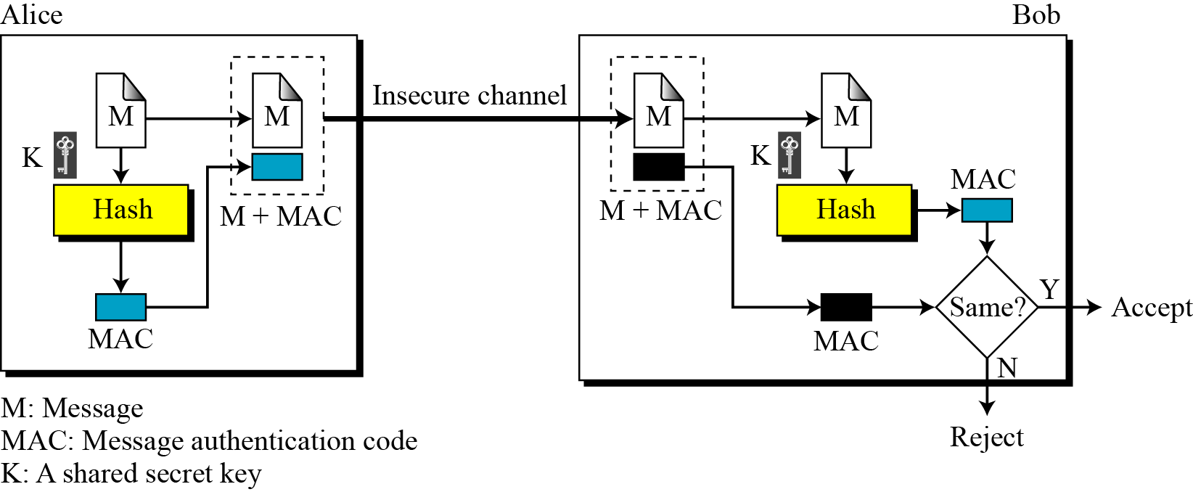
Message Authentication Code (MAC)
To ensure the integrity of the message and the data origin authentication, we need to use MAC
16. Review 2 CS580_F15

Slide 52
Nested MAC
Nested MACs are designed to improve the security of a MAC
Two steps
  The key is concatenated with the message and is hashed to create an intermediate digest
  The key is concatenated with the intermediate digest to create the final digest
16. Review 2 CS580_F15

Slide 53
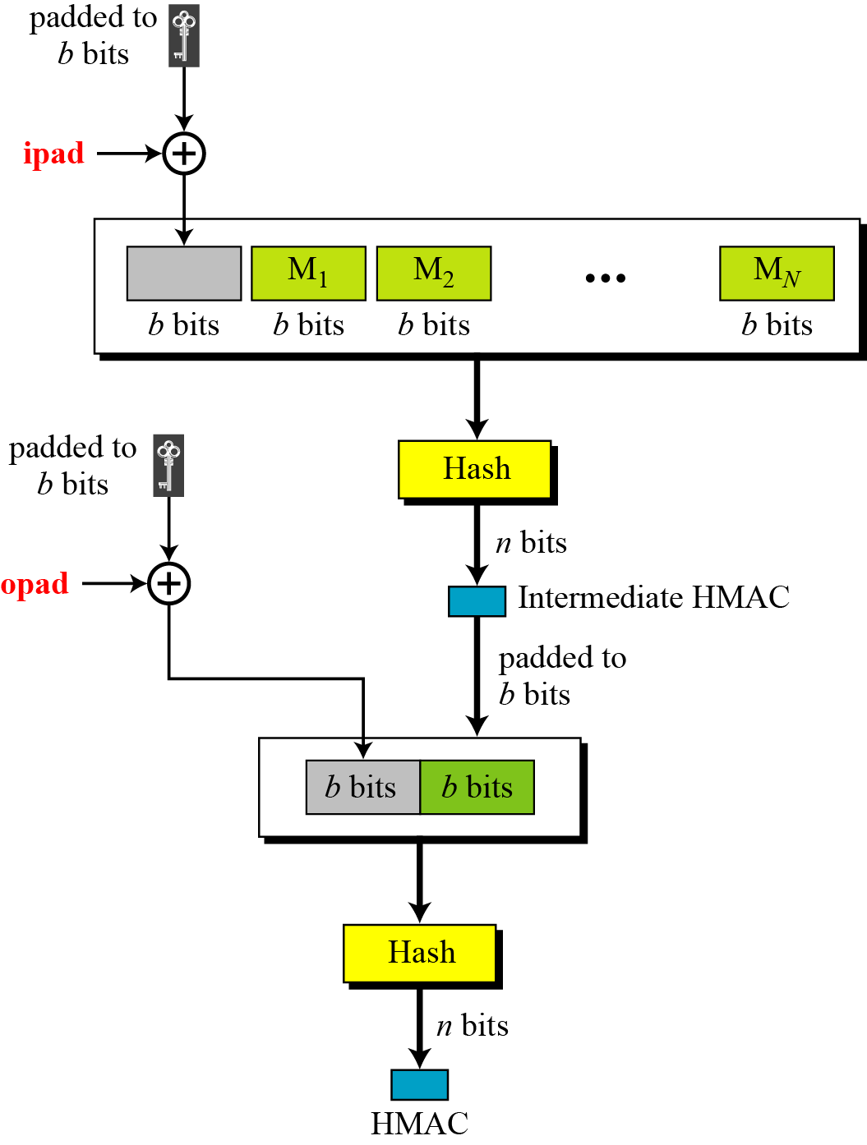
HMAC
16. Review 2 CS580_F15

Slide 54
Iterated Hash Function
A cryptographic hash function takes a message of arbitrary length and creates a message digest of fixed length
Iteration is used to implement the function
  We don’t need a function with variable-size input
  A function with fixed-size input is created and is used a necessary number of times
  The fixed-size input function is called a compression function
The scheme is referred to as an iterated cryptographic hash function
16. Review 2 CS580_F15

Slide 55
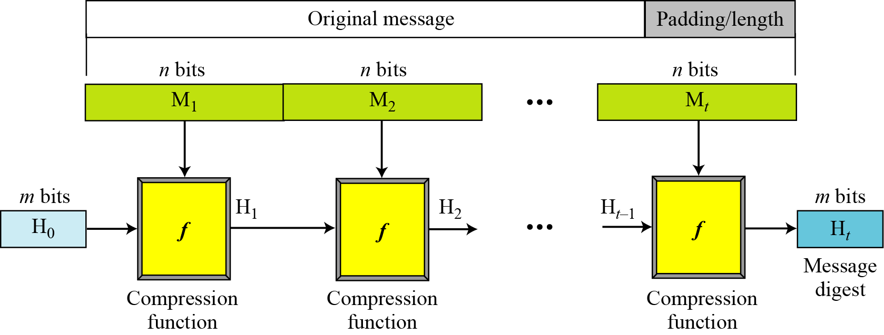
Merkle-Damgard Scheme
An iterated hash function
Collision resistant if the compression function is collision resistant
16. Review 2 CS580_F15

Slide 56
Merkle-Damgard Scheme
The message is padded to be evenly divided into t blocks of n bits, M1, M2, … Mt
The digest created at t iterations are called H1, H2,…, Ht
Before starting the iteration, the digest H0 is set to a fixed value, called Initialization Vector (IV)
The compression function at each iteration operates on H_{i-1} and M_{i} to create a new H_{i}.
  H_{i} = f(H_{i-1} , M_{i} )
H_{t} is the cryptographic hash function of the original message
16. Review 2 CS580_F15

Slide 57
Two Groups of Compression Functions
The Merkel-Damgard scheme is the basis for many cryptographic hash functions
The only thing we need to do is to design a compression function that is collision resistant
Two different approaches
  The compression function is made from scratch
  A symmetric-key block cipher serves as a compression function
16. Review 2 CS580_F15

Slide 58
Hash functions made from scratch
Message Digest (MD)
  MD2, MD4, MD5
  Designed by Ron Rivest
Secure Hash Algorithms (SHA)
  A standard developed by NIST
  Also referred to as Secure Hash Standard (SHS)
  SHA224, SHA256, SHA-384 and SHA-512
16. Review 2 CS580_F15

Slide 59
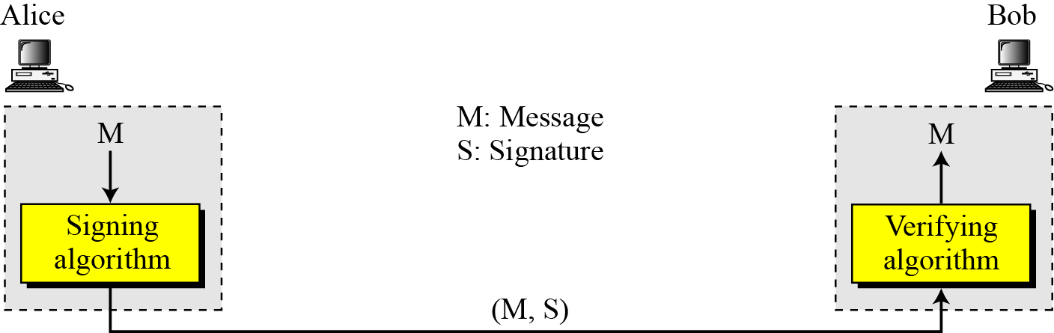
Digital signature process
The sender uses a signing algorithm to sign the message
The message and the signature are sent to the receiver
The receiver receives the message and the signature and applies the verifying algorithm to the combination
If the result is true, the message is accepted; otherwise, it is rejected.
16. Review 2 CS580_F15

Slide 60
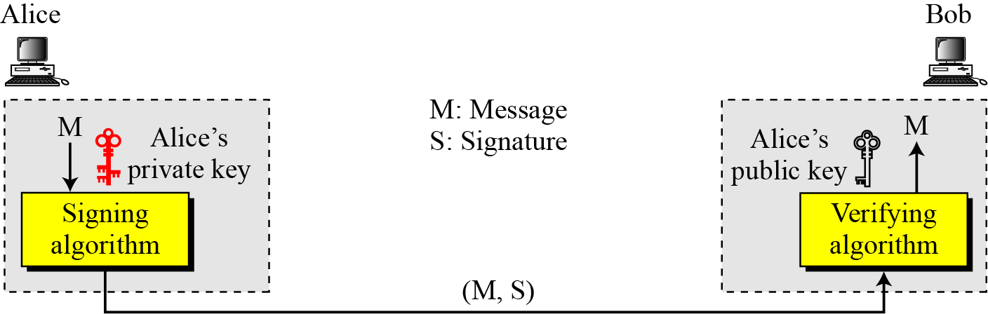
Need for Keys
A digital signature needs a public-key system
The signer signs with her private key; the verifier verifies with the signer’s public key.
16. Review 2 CS580_F15

Slide 61
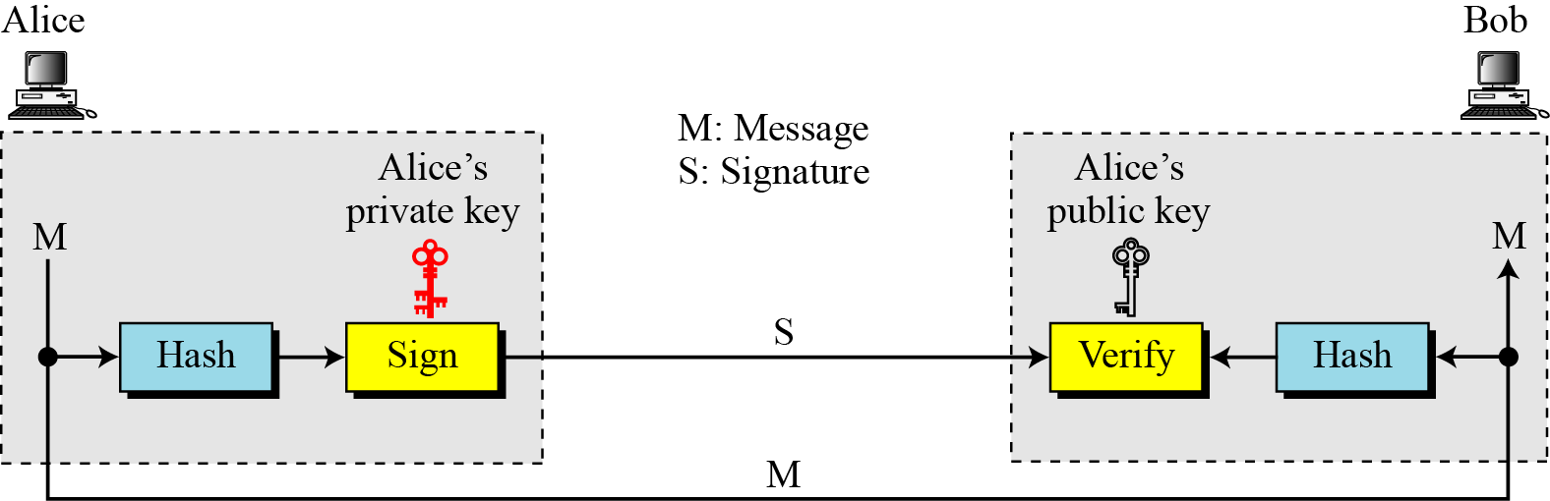
Signing the Digest
A cryptosystem uses the private and public keys of the receiver: a digital signature uses the private and public keys of the sender
16. Review 2 CS580_F15

Slide 62
Services provided by signature
Authentication
Message integrity
  The integrity of the message is preserved even if we sign the whole message because we cannot get the same signature if the message is changed
Nonrepudiation
  The digital signature is created using the sender’s private key
  Only the sender knows his private key
  He cannot deny the fact that he signed the message
16. Review 2 CS580_F15

Slide 63
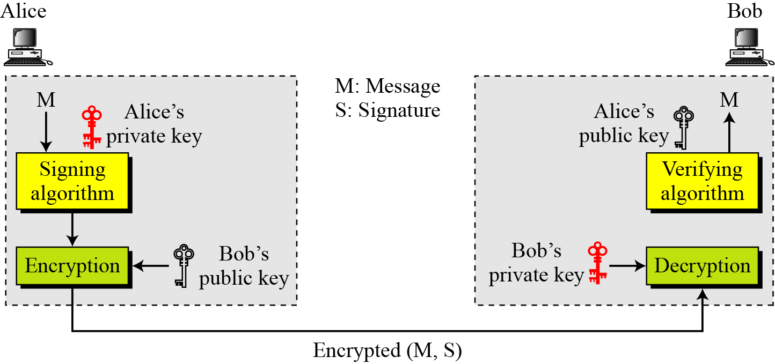
Adding confidentiality to a digital signature scheme
A digital signature does not provide privacy.
If there is a need for privacy, another layer of encryption/decryption must be applied.
16. Review 2 CS580_F15

Slide 64
The differences between MAC and digital signature
They are based on different kinds of key schemes
  MAC is symmetric key based
  Digital signature is asymmetric key based
MAC can provide authentication and integrity
Digital signature can provide authentication, integrity and nonrepudiation
16. Review 2 CS580_F15

Slide 65
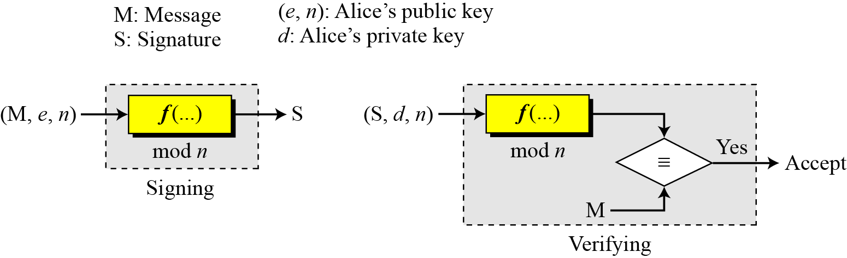
RSA Digital Signature Scheme
d
e
16. Review 2 CS580_F15

Slide 66
Key Generation
Key generation in the RSA digital signature scheme is exactly the same as key generation in the RSA
In the RSA digital signature scheme
  d is private
  e and n are public.
16. Review 2 CS580_F15

Slide 67
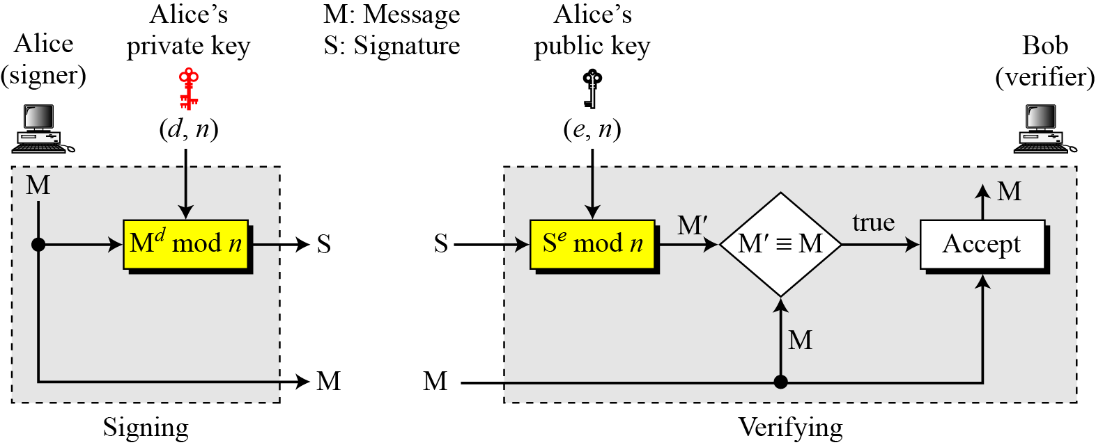
Signing and Verifying
16. Review 2 CS580_F15

Slide 68
Example
suppose that Alice chooses p = 823 and q = 953, and calculates n = 784319.
The value of ø(n) is 782544
Now she chooses e = 313 and calculates d = 160009.
At this point key generation is complete
Now imagine that Alice wants to send a message with the value of M = 19070 to Bob
She uses her private exponent, 160009, to sign the message
16. Review 2 CS580_F15

Slide 69
Example
Alice sends the message and the signature to Bob. Bob receives the message and the signature. He calculates
Bob accepts the message because he has verified Alice’s signature.
16. Review 2 CS580_F15

Slide 70
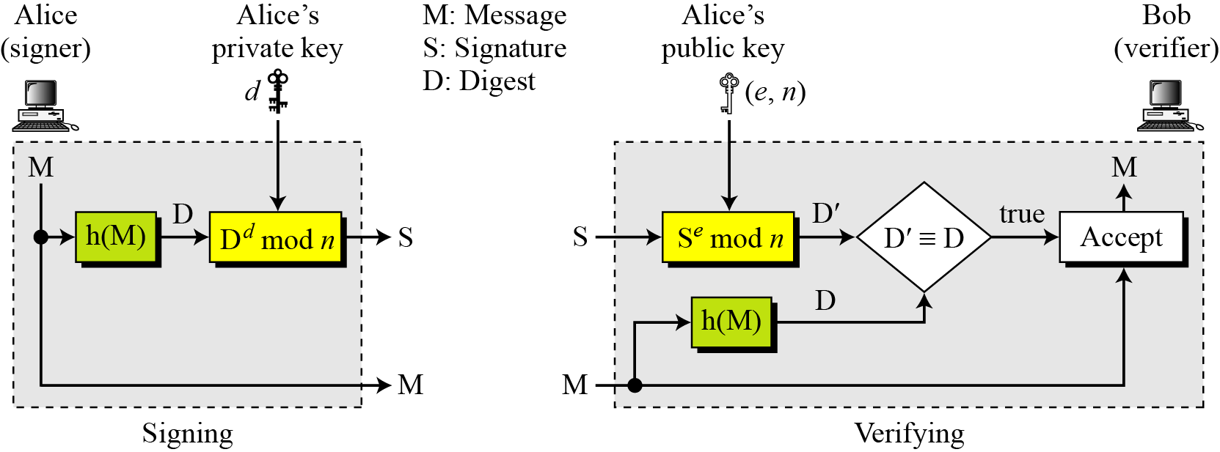
RSA Signature on the Message Digest
When the digest is signed instead of the message itself, the susceptibility of the RSA digital signature scheme depends on the strength of the hash algorithm.
16. Review 2 CS580_F15

Slide 71
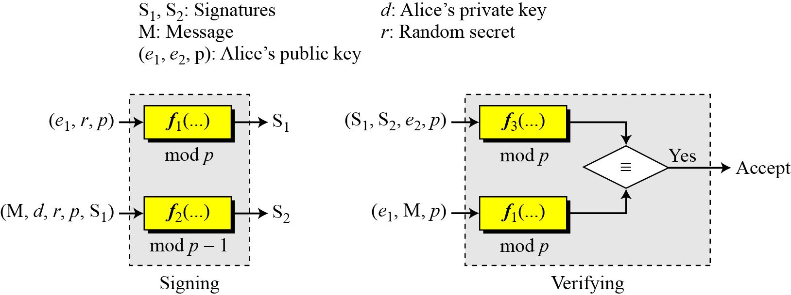
ElGamal Digital Signature Scheme
Figure 13.9 General idea behind the ElGamal digital signature scheme
16. Review 2 CS580_F15

Slide 72
Key Generation
The key generation procedure here is exactly the same as the one used in the cryptosystem
In ElGamal digital signature scheme, (e1, e2, p) is Alice’s public key; d is her private key.
16. Review 2 CS580_F15

Slide 73
ElGamal Digital Signature Scheme: key generation
16. Review 2 CS580_F15

Slide 74
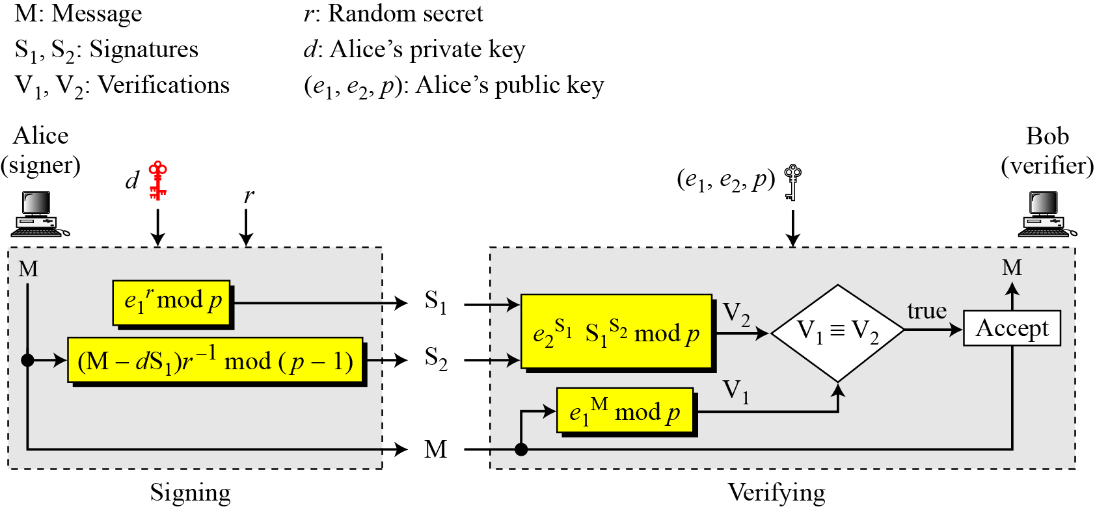
Verifying and Signing
r should be relative prime to p-1
16. Review 2 CS580_F15

Slide 75
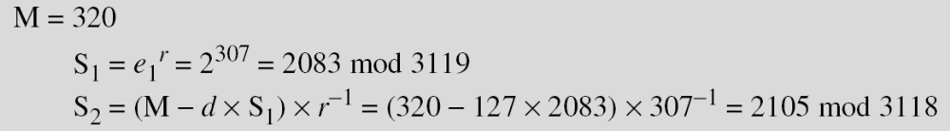
Example
Here is a trivial example. Alice chooses p = 3119, e₁ = 2, d = 127 and calculates e₂ = 2¹²⁷ mod 3119 = 1702. She also chooses r to be 307. She announces e1, e2, and p publicly; she keeps d secret. The following shows how Alice can sign a message.
16. Review 2 CS580_F15
Notes:
3118 = 2 x 1559
Phi(3118) = 1558
307^-1 mod 3118 = 307^1557 mod 3118 = 2793
320-327x2083 = -264221 mod 3118 = 3118x85-264221 = 809

Slide 76
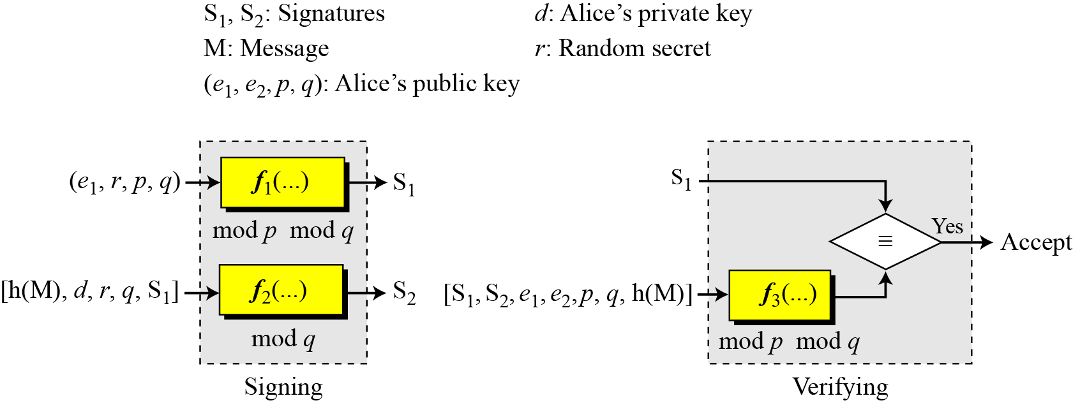
Digital Signature Standard (DSS)
16. Review 2 CS580_F15

Slide 77
Key Generation
Alice chooses a primes p, between 512 and 1024 bits in length. The number of bits in p must be a multiple of 64
Alice chooses a 160-bit prime q in such way that q divides (p-1).
Alice uses <Zp*, × > and <Zq*, ×>.
  <Zq*, ×> is a subgroup of <Zp*, × >
Alice creates e₁ to be the qth root of 1 mod p (e₁^{q} = 1 mod p).
  To do so, Alice chooses a primitive element e₀ in Zp,
  Calculates e₁ = e₀^{(p-1)/q} mod p
Alice chooses d as the private key and calculates e₂ = e₁^{d}.
Alice’s public key is (e₁, e₂, p, q)
Her private key is (d).
16. Review 2 CS580_F15

Slide 78
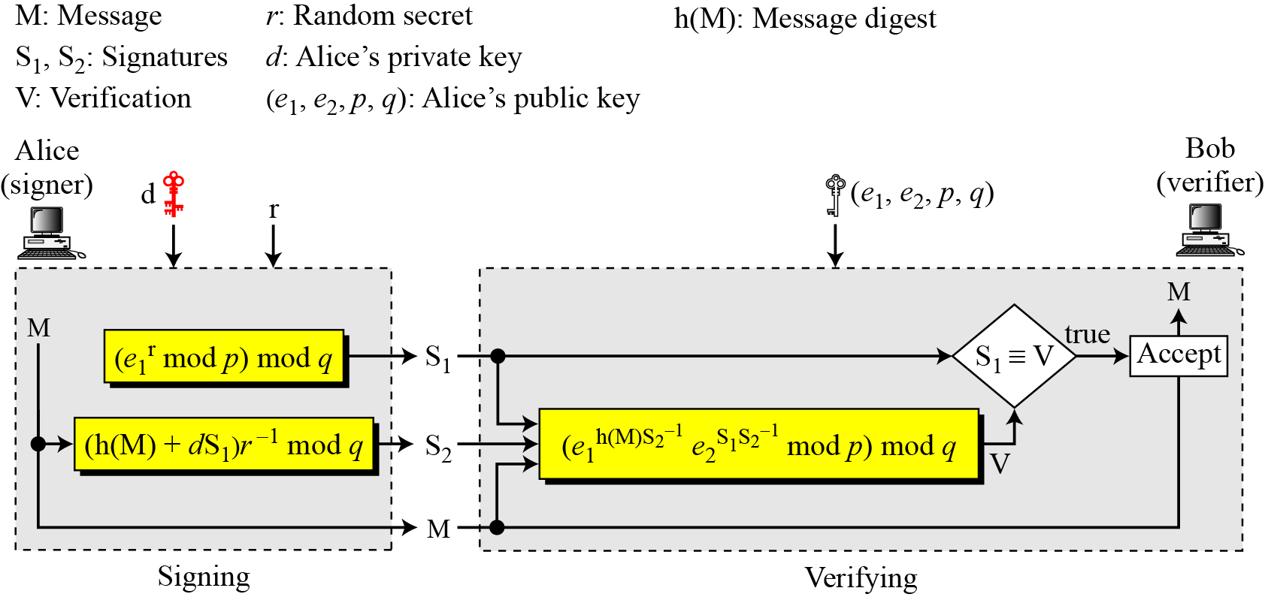
Verifying and Signing
16. Review 2 CS580_F15

Slide 79
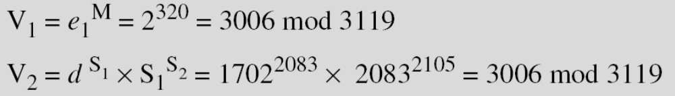
Example
Alice sends M, S₁, and S₂ to Bob. Bob uses the public key to calculate V₁ and V₂.
e₂^{S1}
16. Review 2 CS580_F15

Slide 80
Symmetric key agreement
Alice and Bob can create a session key between themselves without using a KDC
This method of session-key creation is referred to as the symmetric-key agreement
  Diffie-Hellman Key Agreement
16. Review 2 CS580_F15

Slide 81
Diffie-Hellman Key Agreement
Alice and Bob agree on global parameters:
  Large prime integer p
  g: a primitive root
Alice generates a key pair
  chooses a private key (number): x < p
  Compute her public key: R1 = g^{x} mod p
  A sends R1 to Bob
Bob generates a key pair
  chooses a private key (number): y < p
  Compute his public key: R2 = g^{y} mod p
  Bob sends R2 to Alice
16. Review 2 CS580_F15

Slide 82
Diffie-Hellman Key Agreement
The Shared session key for Alice and Bob is K_{AB}:
  Alice computes
  K_{AB} = R2 ^{x} mod p = g^{xy} mod p
  Bob Computes
  K_{AB} = R1 ^{y} mod p = g^{xy} mod p
If Alice and Bob subsequently communicate, they will have the same key as before, unless they choose new public-keys
16. Review 2 CS580_F15

Slide 83
Example
Alice & Bob wish to set up a session key:
They Agree on prime p=353 and g=3
Alice
  Chooses: x = 97
  Computes: R1= g^{x} = 3⁹⁷ mod 353 = 40
  Publishes: R1 = 40
Bob
  chooses y = 233
  Computes: R2 = g^{y} = 3²³³ mod 353 = 248
  Publishes: R2 = 248
Compute the shared session key
  Alice: K_{AB}= R2^{x} mod 353 = 248⁹⁷ mod 353 = 160
  Bob: K_{AB}= R1^{y} mod 353 = 40²³³ mod 353= 160
16. Review 2 CS580_F15

