Slide 1
CS580
Internet Security Protocols
3. SSL and SET
Huiping Guo
Department of Computer Science
California State University, Los Angeles

Slide 2
Outline
PKI
SSL
  Web Security services
  General architecture of SSL
  Four protocols in SSL
    Handshake Protocol
    ChangeCipher Spec Protocol
    Alert Protocol
    Record Protocol
SET
3. SSL CS580_F15

Slide 3
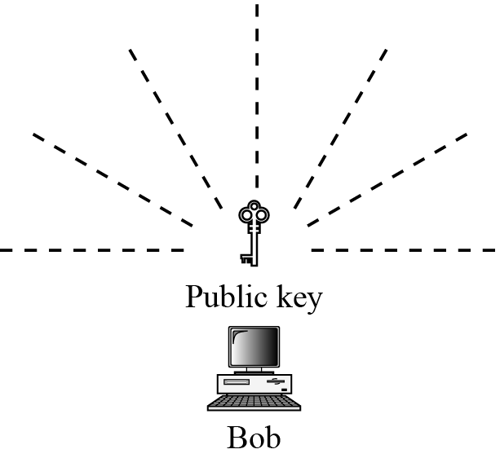
Public key distribution
In asymmetric-key cryptography, people do not need to know a symmetric shared key
Everyone shields a private key and advertises a public key
Announcing a public key
3. SSL CS580_F15

Slide 4
Public key distribution
Problems
  It’s subject to forgery
Eve creates a key pair and publicly announced the public key as Bob’s public key
  Eve can fool Alice into sending her a message that is intended for Bob
  Eve can also sign a document with the corresponding forged private key and make everyone believe it was signed by Bob
3. SSL CS580_F15

Slide 5
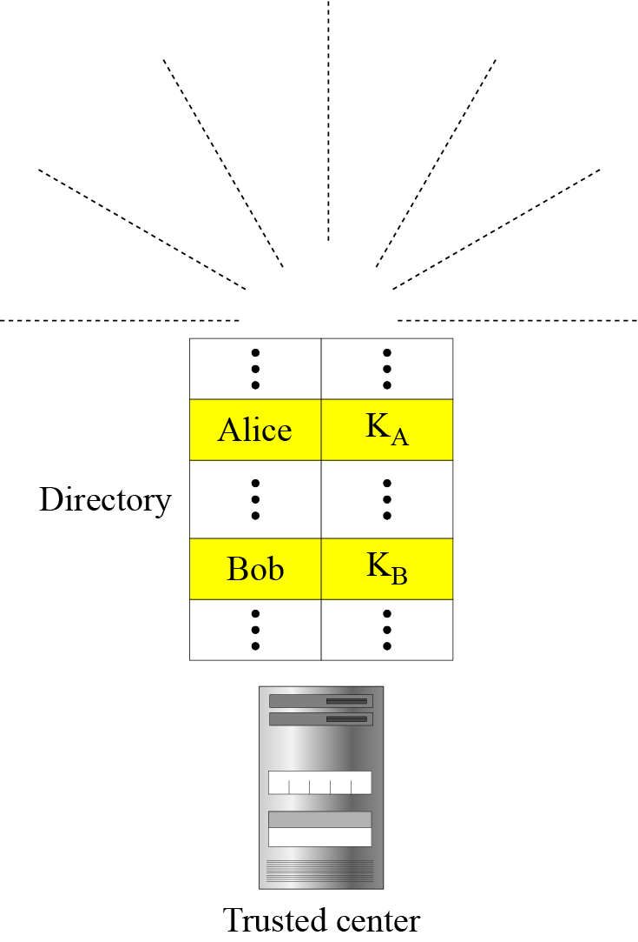
Trusted center
A more secure approach is to have a trusted center retain a directory of public keys
The directory is dynamically changed
Each user registers in the center, prove his/her identity and inserts his/her public key into the directory
The center publicly advises the directory
The center also responds inquiry about a public key
3. SSL CS580_F15

Slide 6
Controlled Trusted Center
Controls are added on the distribution of the public keys to achieve a higher level of security
The public-key announcements can
  include a timestamp
  be signed by an authority to prevent interception and modification of the response
3. SSL CS580_F15

Slide 7
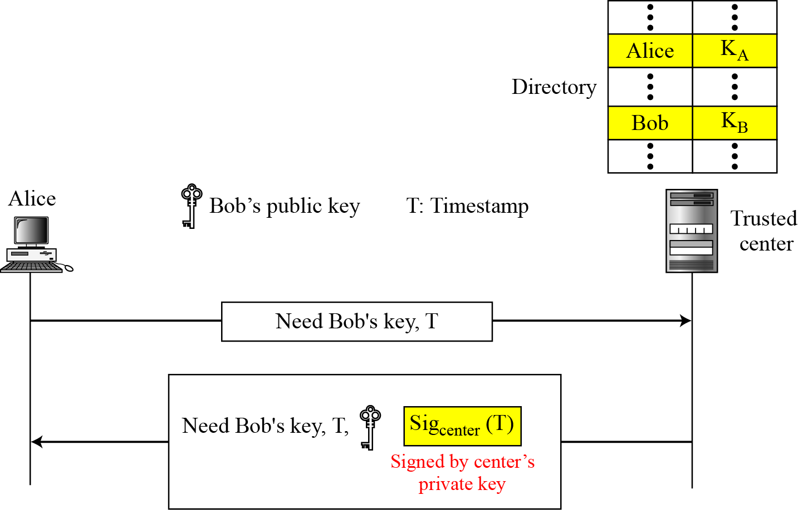
Controlled Trusted Center
Sig_{center}(T||PU_{Bob})
3. SSL CS580_F15

Slide 8
Certification Authority
The previous approach can create a heavy load on the center if the number of requests is large
The alternative is to create public-key certificates
Bob wants two things
  Everyone knows his public key
  No one accepts a forged public key as his
3. SSL CS580_F15

Slide 9
Certification Authority
Bob goes to a certification authority (CA)
  CA binds a public key to an entity and issues a certificate
  The CA has a well-known public key
The CA checks Bob’s identification
It asks for Bob’s public key and writes it on the certificate
The CA signs the certificate with his private key
Bob can now publish his certificate
Anyone can use CA’s public key to verify CA’s signature
The public key on the certificate is Bob’s public key
3. SSL CS580_F15

Slide 10
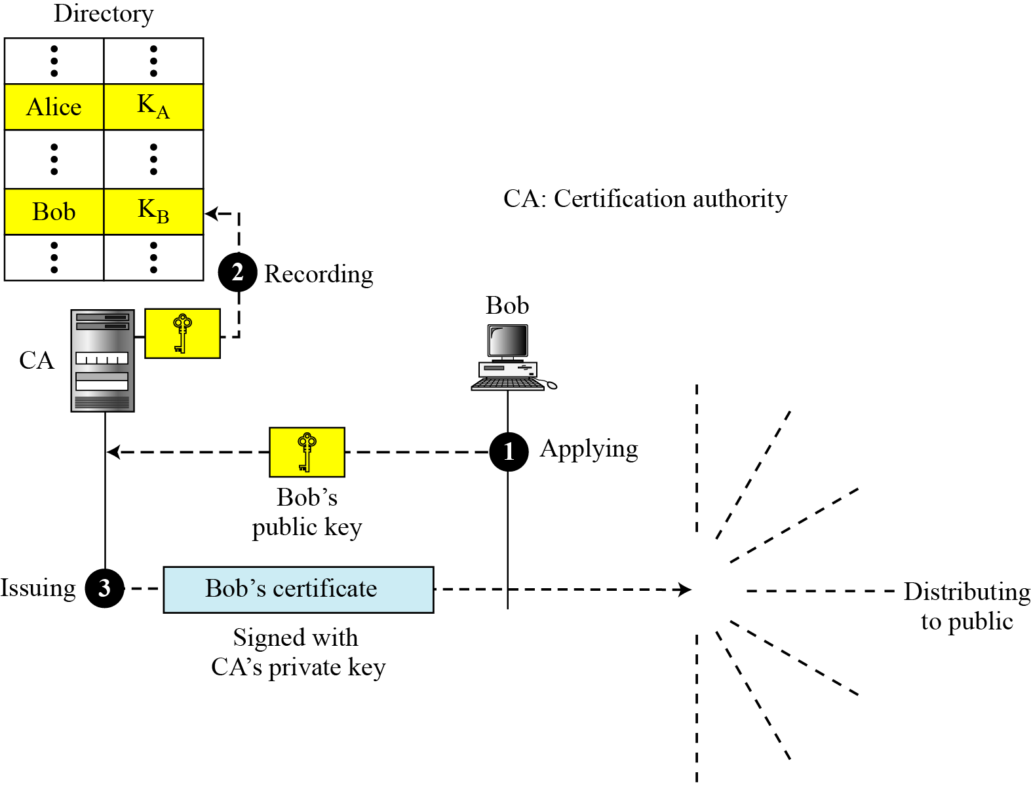
Certification Authority
3. SSL CS580_F15

Slide 11
X.509
Although the use of a CA solves the problem of public-key fraud, it has created a side-effect
Each certificate may have a different format
X.509 is used to remove the side-effect
X.509 is a way to describe the certificate in a structured way
3. SSL CS580_F15

Slide 12
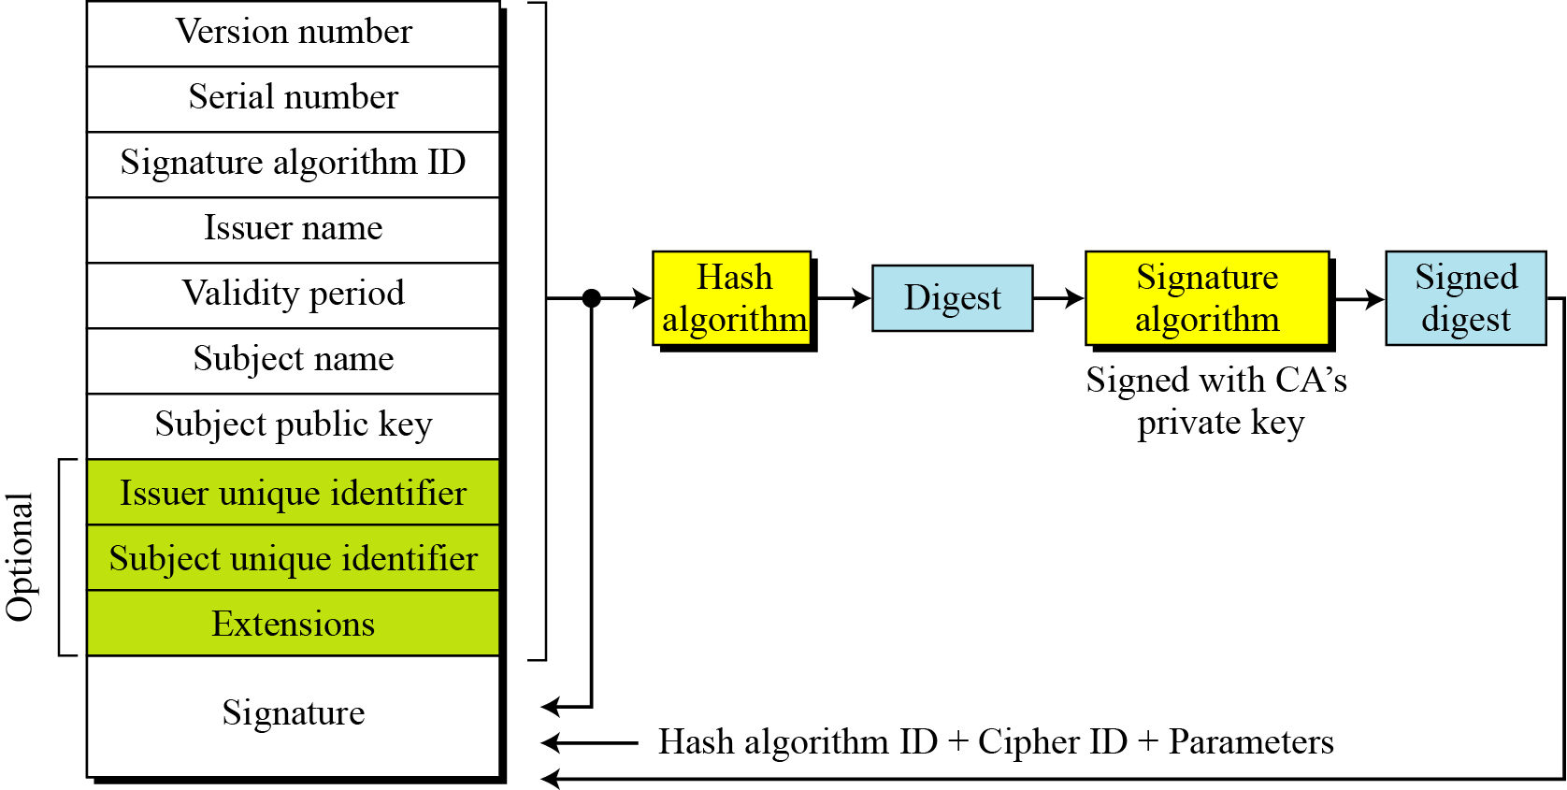
X.509
format of a certificate
3. SSL CS580_F15

Slide 13
X.509
Certificate Renewal
  Each certificate has a period of validity
  If there is no problem with the certificate, the CA issues a new certificate before the old one expires.
  In some cases a certificate must be revoked before its expiration
3. SSL CS580_F15

Slide 14
X.509
Certificate Revocation
  In some cases a certificate must be revoked before its expiration
The revocation is done by periodically issuing a certificate revocation list (CRL)
The list contains all revoked certificates that are not expired on the date the CRL is issued
When a user wants to use a certificate, she first needs to check the directory of the corresponding CA for the last certification revocation list
3. SSL CS580_F15

Slide 15
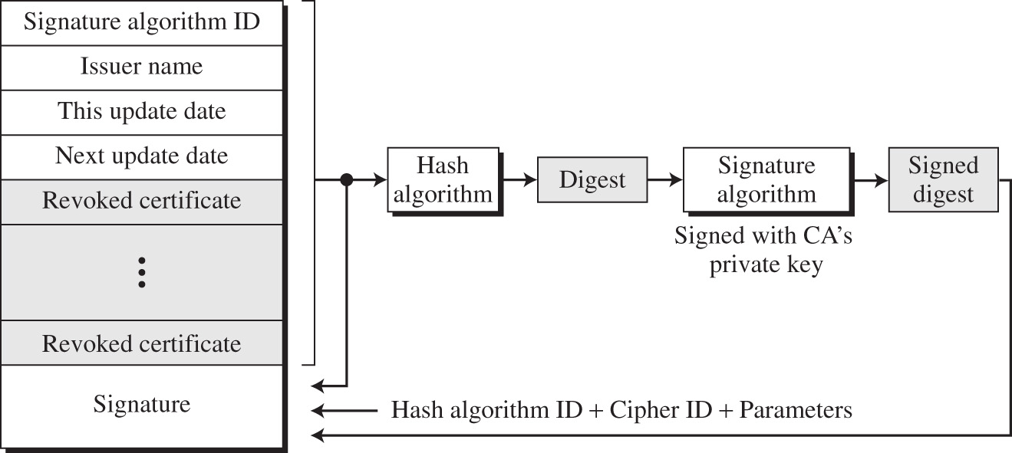
Certificate revocation format
3. SSL CS580_F15

Slide 16
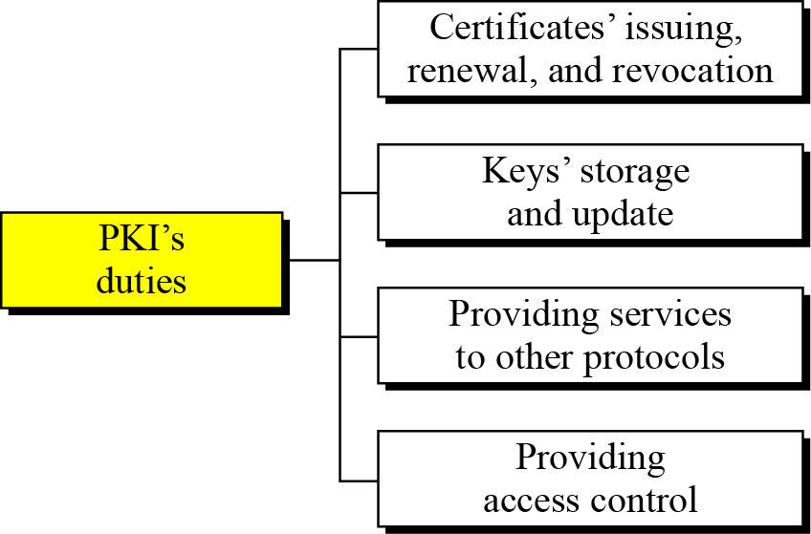
Public-Key Infrastructures (PKI)
PKI is a model for creating, distributing and revoking certificates based on X.509
3. SSL CS580_F15

Slide 17
Trust Model
It’s not possible to have just one CA issuing al certificates for all users in the world
There should be many CAs, each responsible for creating, storing, issuing and revoking a limited number of certificates.
The trust model defines rules that specify how a user can verify a certificate received from a CA
3. SSL CS580_F15

Slide 18
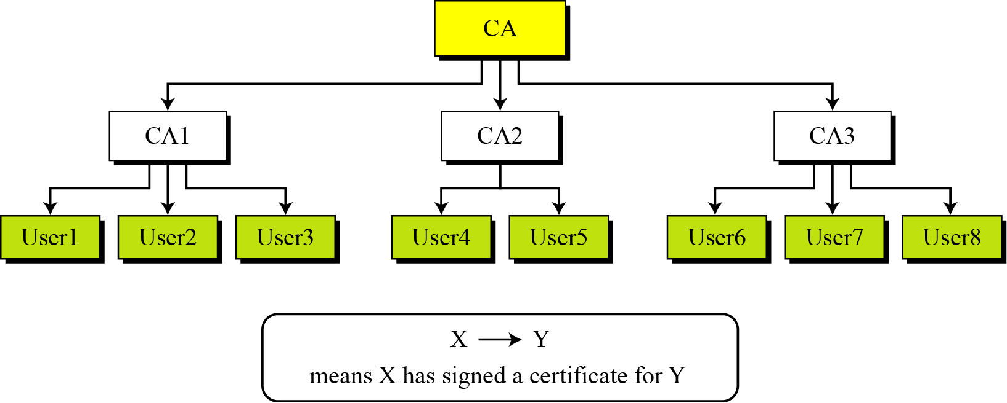
Trust Model
PKI hierarchical model
3. SSL CS580_F15

Slide 19
PKI hierarchical model
There is a tree-type structure with a root CA
The root CA has a self-signed, self-issued certificate
The root CA is trusted by other CAs and users for the system to work
PKI uses the following notation to mean the certificate issued by an authority X for entity Y
X<<Y>>
3. SSL CS580_F15

Slide 20
CA Hierarchy Use
A obtained a certificate from CA X₁
  X₁ <<A>>
B obtained a certificate from CA X₂
  X₂ <<B>>
If A doesn’t know the public key of X₂, A cannot verify B’s certificate.
If the two CAs have securely exchanged their public keys, A can verify X₂’s public key
  X1<<X2>>, X2<<X1>>
  A gets the certificate of X₂ signed by X₁.
  A gets the certificate of B signed by X₂
  A uses a chain of certificates to obtain B’s public key
  X₁ <<X₂>> X₂ <<B>>
3. SSL CS580_F15
Notes:
Stallings Figure 14.5 illustrates the use of an X.509 hierarchy to mutually verify clients certificates.
Track chains of certificates:
A acquires B certificate using chain: X<<W>>W<<V>>V<<Y>>Y<<Z>>Z<<B>>
B acquires A certificate using chain: Z<<Y>>Y<<V>>V<<W>>W<<X>>X<<A>>

Slide 21
Mesh model
The hierarchical model may work for an organization or a small community
A larger community may need several hierarchical structures connected together
One method is to use a mesh model to connect the roots together
  Each root is connected to every other root
Each root has its own hierarchical structure
The certifications between the roots are cross-certificates
  Each root certifies all other roots
3. SSL CS580_F15

Slide 22
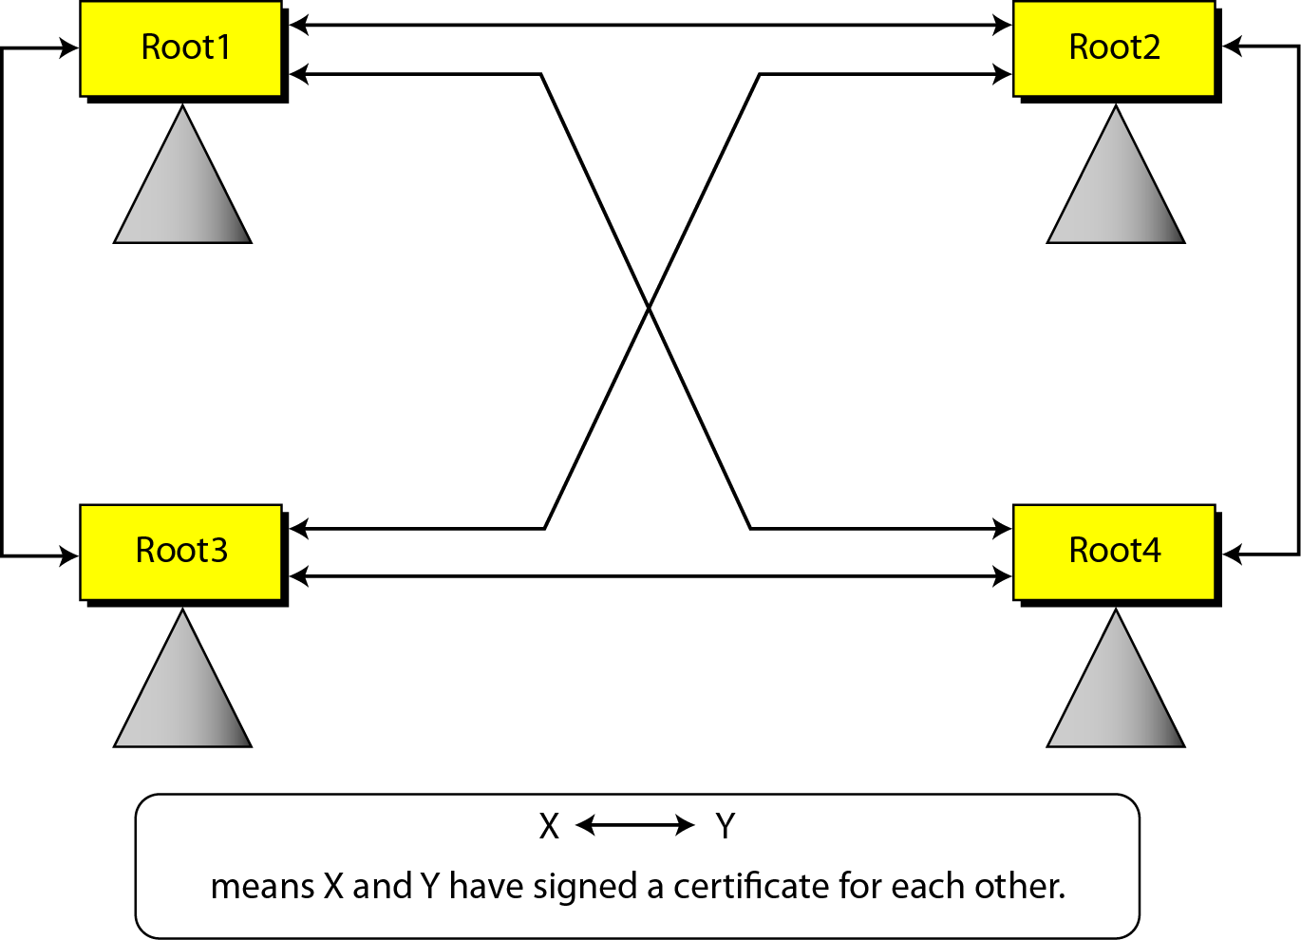
Mesh model
3. SSL CS580_F15

Slide 23
Web Security
Web now widely used by business, government, individuals
but Internet & Web are vulnerable
A variety of threats
  integrity
  confidentiality
  denial of service
  authentication
Need added security mechanisms
3. SSL CS580_F15
Notes:
The World Wide Web is widely used by businesses, government agencies, and many individuals. But the Internet and the Web are extremely vulnerable to compromises of various sorts, with a range of threats as shown. These can be described as passive attacks including eavesdropping on network traffic between browser and server and gaining access to information on a Web site that is supposed to be restricted, and active attacks including impersonating another user, altering messages in transit between client and server, and altering information on a Web site. The web needs added security mechanisms to address these threats.

Slide 24
The Internet model
5
Application
Application
4
Transport
Transport
3
Network
Network
Network
2
Data link
Data link
Data link
1
Physical
Physical
Physical
3. SSL CS580_F15

Slide 25
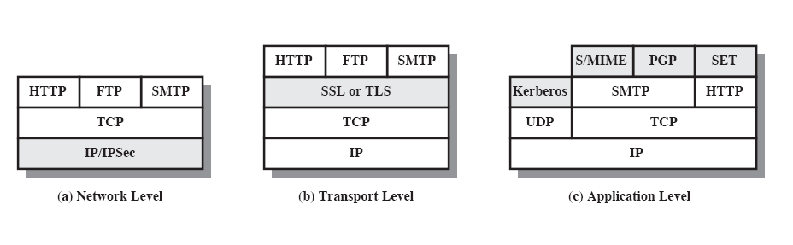
Web security approaches
3. SSL CS580_F15

Slide 26
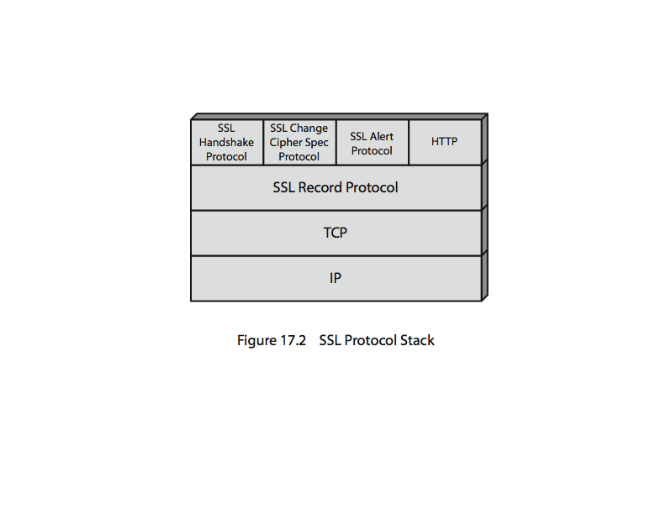
SSL (Secure Socket Layer)
Transport layer security service
  To provide security service for transactions on the Internet
Uses TCP to provide a reliable end-to-end service
SSL has two layers of protocols
3. SSL CS580_F15
Notes:
SSL probably most widely used Web security mechanism. Its implemented at the Transport layer; cf IPSec at Network layer; or various Application layer mechanisms eg. S/MIME & SET (later).
SSL is designed to make use of TCP to provide a reliable end-to-end secure service. Netscape originated SSL. Version 3 of the protocol was designed with public review and input from industry and was published as an Internet draft document. Subsequently, the IETF TLS working group was formed to develop a common standard. SSL is not a single protocol but rather two layers of protocol, as shown next.

Slide 27
SSL architecture
SSL is designed to provide security and compression services to data generated from the application layer
SSL can receive data from any application layer protocol, but usually the protocol is HTTP
  https://....
The data received from the application layer is
  Compressed (optional)
  Signed
  Encrypted
The data is then passed to TCP
3. SSL CS580_F15

Slide 28
Services provided by SSL
Fragmentation
  First, SSL divides the data into blocks of 2¹⁴ or less
Compression
Message integrity
  SSL uses keyed hash function to create a MAC
Confidentiality
  The original data and the MAC are encrypted using symmetric key cryptography
Framing
  A header is added to the encrypted payload which is passed to TCP
3. SSL CS580_F15

Slide 29
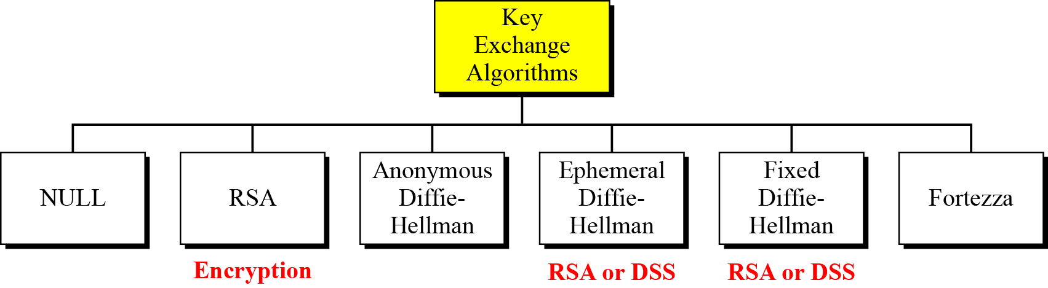
Key exchange algorithms
To exchange an authenticated and confidential message, the client and the server each need 6 cryptographic secrets
To create these secrets, one pre-master secret must be established
SSL defines 6 key-exchange methods to establish this pre-master secret
3. SSL CS580_F15

Slide 30
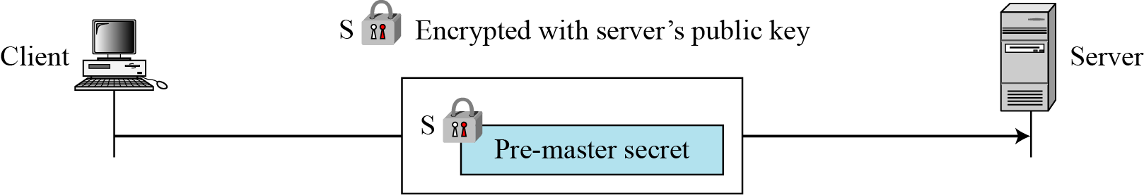
RSA key exchange: server public key
In this method, the pre-master secret is a 48-byte random number created by the client, encrypted with the server’s RSA public key
3. SSL CS580_F15

Slide 31
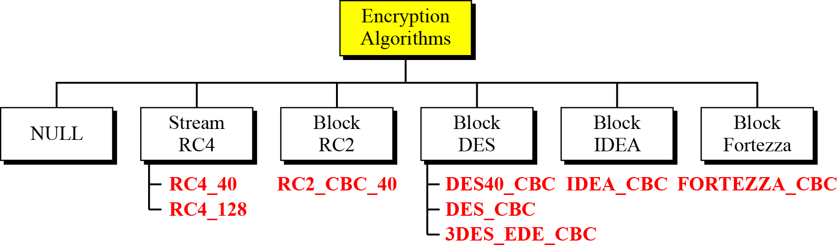
Encryption/Decryption Algorithms
There are several choices for the encryption/decryption algorithms.
3. SSL CS580_F15

Slide 32
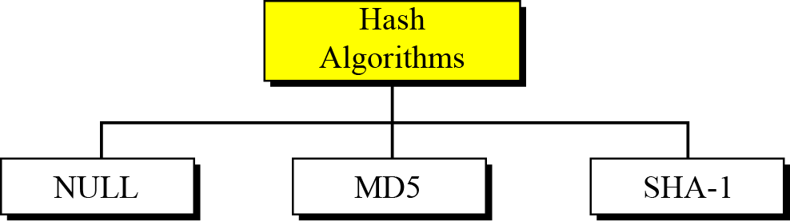
Hash algorithms for message integrity
SSl uses hash algorithm to provide message integrity.
3. SSL CS580_F15

Slide 33
Cipher Suite
The combination of key exchange, hash, and encryption algorithms defines a cipher suite for each SSL session
  Each suite starts with “SSL”
  Followed by the key exchange algorithm
  “with” separates the key change algorithm from the encryption and hash algorithms
3. SSL CS580_F15

Slide 34
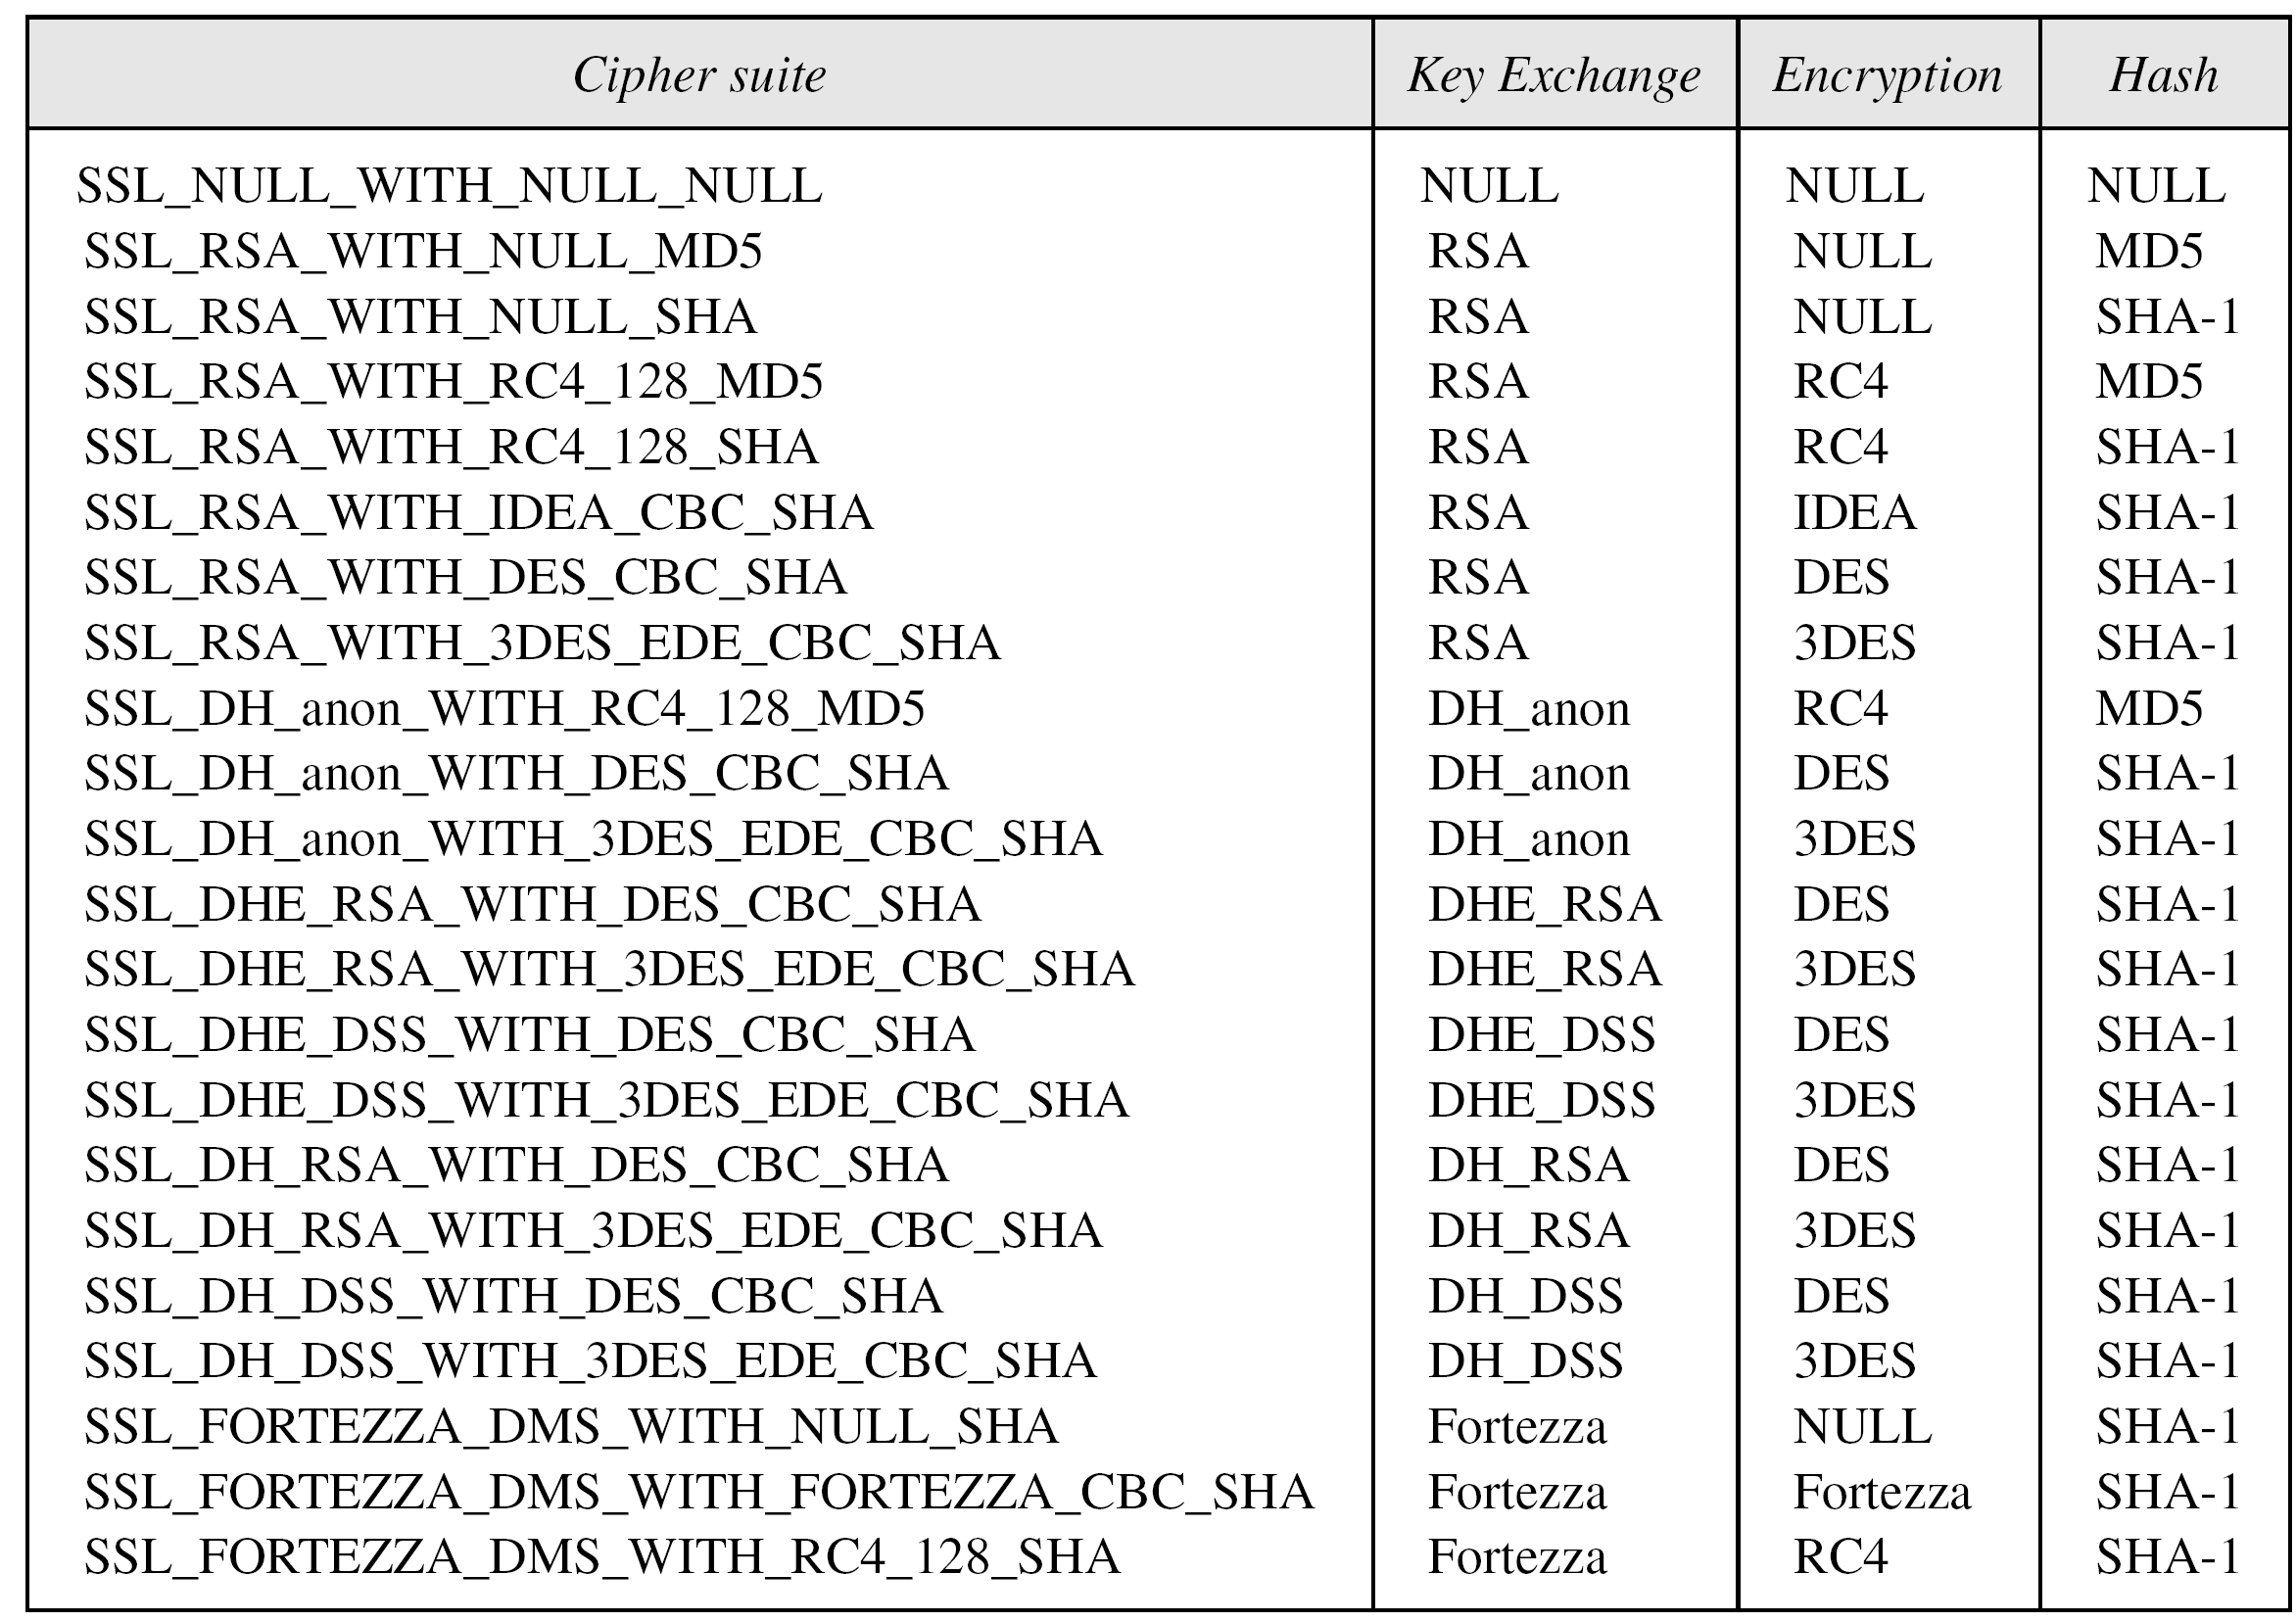
SSL cipher suite list
3. SSL CS580_F15

Slide 35
Compression Algorithms
Compression is optional in SSLv3.
No specific compression algorithm is defined for SSLv3.
Therefore, the default compression method is NULL.
3. SSL CS580_F15

Slide 36
Cryptographic Parameter Generation
SSL requires that the keys for one direction be different from those for the other direction
Both the client and the sever need 6 secrets
  three read secrets
  three write secrets
  The read secrets for the client are the same as the write secrets for the server and vice versa
The 12 secrets are computed according to the master secret, CR and SR
3. SSL CS580_F15

Slide 37
Cryptographic Parameter Generation
The client and server exchange two random numbers
  CR: created by the client
  SR: created by the server
Pre-master secret
  The client and the server agree on a pre-master secret using one of the key exchange algorithms
Master secret
  Computed according to the pre-master secret, CR an SR
3. SSL CS580_F15

Slide 38
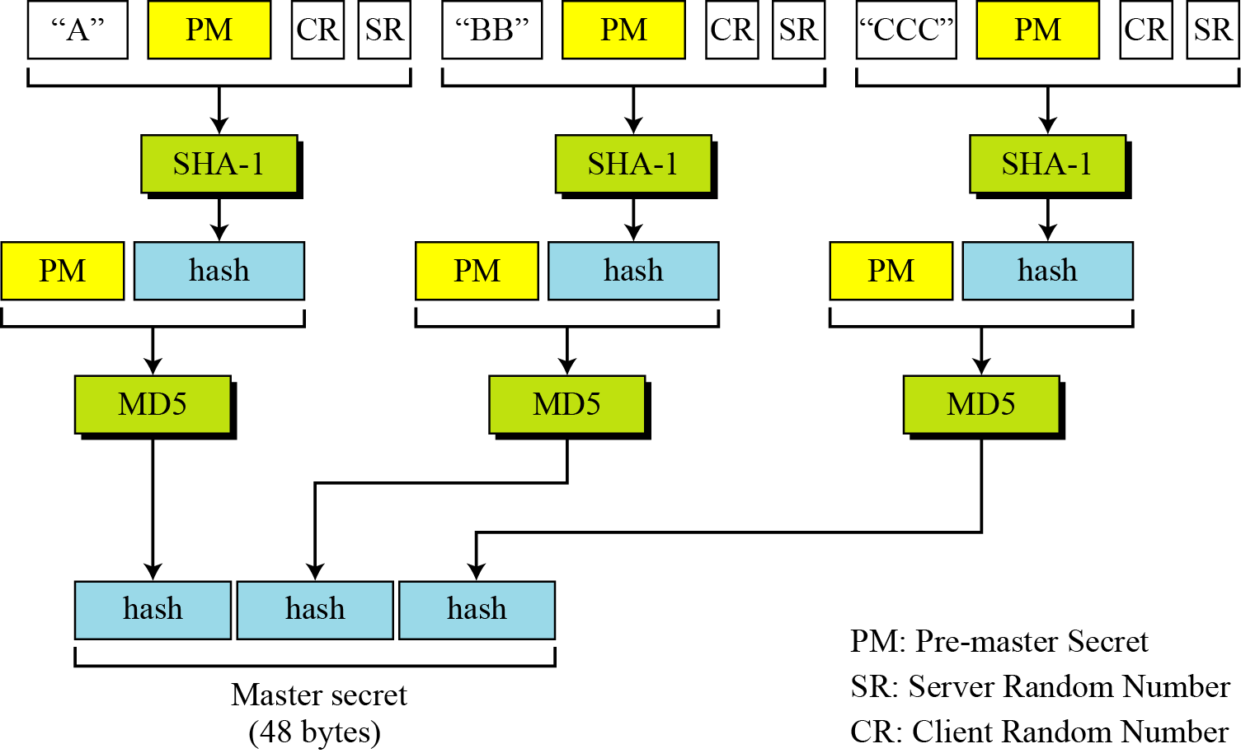
Calculation of master secret from pre-master secret
3. SSL CS580_F15

Slide 39
Calculation of key material from master secret
The master secret is used to create variable-length key material by applying the same set of hash functions and prepending with different constants
3. SSL CS580_F15

Slide 40
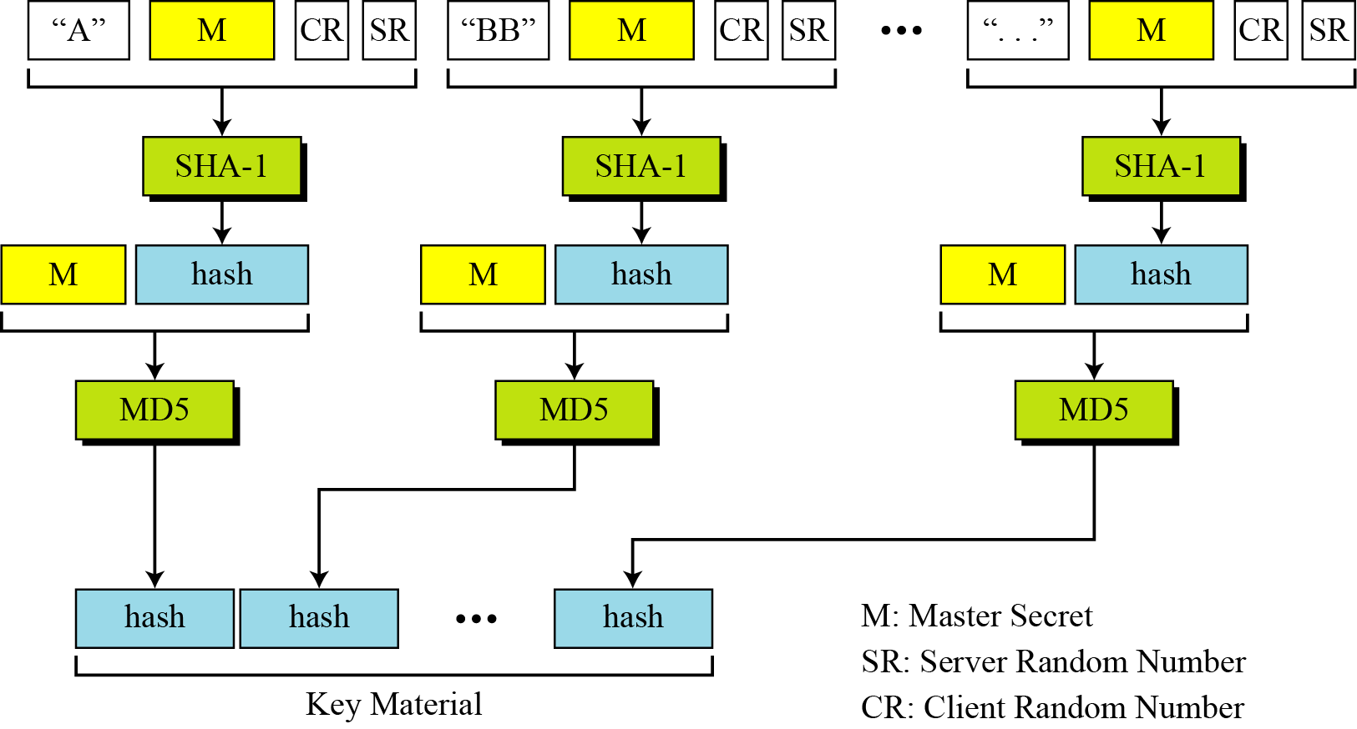
Calculation of key material from master secret
3. SSL CS580_F15

Slide 41
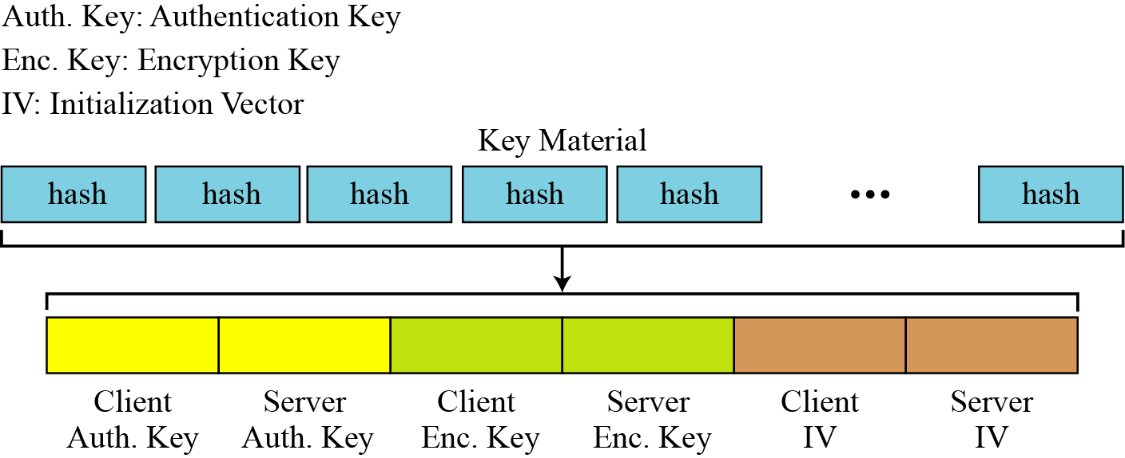
Extractions of cryptographic secrets
6 different keys are extracted from the key material
3. SSL CS580_F15

Slide 42
Sessions and connections
A session is an association between a client and a server
After a session is established, the two parties have common information
  Session identifier, the cipher suite etc
They also need to create a connection
A session can consist of many connections
A connection between two parties can be terminated and reestablished within the same sesssion
3. SSL CS580_F15

Slide 43
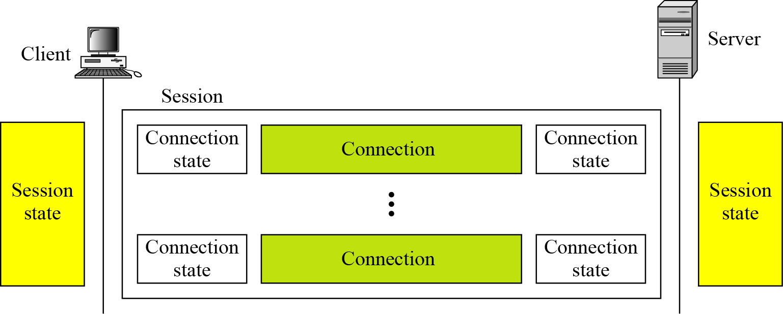
A session and connections
3. SSL CS580_F15

Slide 44
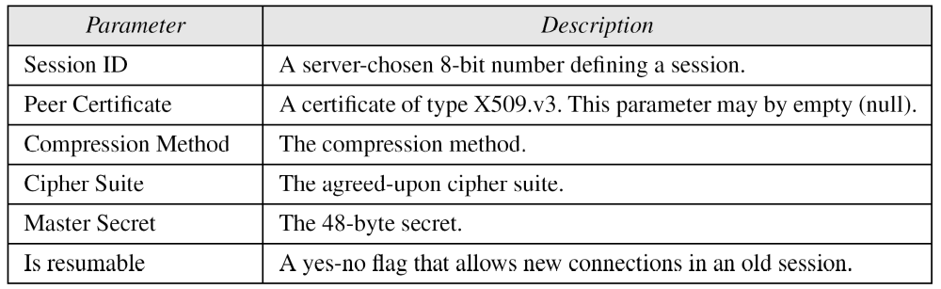
Session state parameters
3. SSL CS580_F15

Slide 45
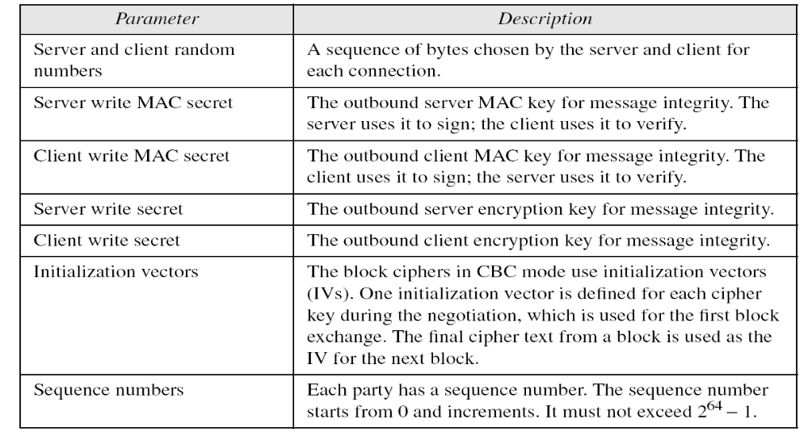
Connection state parameters
3. SSL CS580_F15

Slide 46
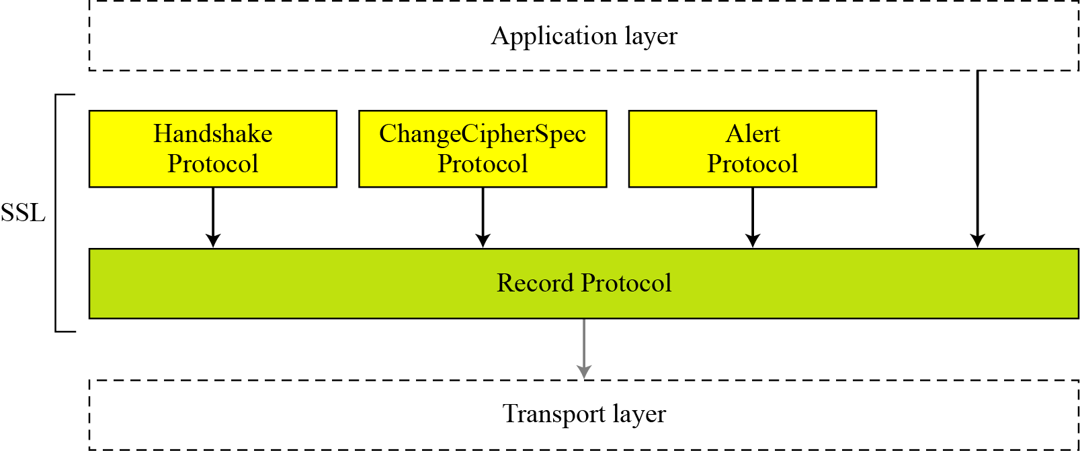
Four protocols
SSL defines four protocols in two layers
3. SSL CS580_F15

Slide 47
SSL Handshake Protocol
allows server & client to:
  authenticate each other
  to negotiate encryption & MAC algorithms
  to negotiate cryptographic keys to be used
comprises a series of messages in 4 phases
  Establish Security Capabilities
  Server Authentication and Key Exchange
  Client Authentication and Key Exchange
  Finish
3. SSL CS580_F15
Notes:
The most complex part of SSL is the Handshake Protocol. This protocol allows the server and client to authenticate each other and to negotiate an encryption and MAC algorithm and cryptographic keys to be used to protect data sent in an SSL record. The Handshake Protocol is used before any application data is transmitted. The Handshake Protocol consists of a series of messages exchanged by client and server, which can be viewed in 4 phases:
Phase 1. Establish Security Capabilities - this phase is used by the client to initiate a logical connection and to establish the security capabilities that will be associated with it
Phase 2. Server Authentication and Key Exchange - the server begins this phase by sending its certificate if it needs to be authenticated.
Phase 3. Client Authentication and Key Exchange - the client should verify that the server provided a valid certificate if required and check that the server_hello parameters are acceptable
Phase 4. Finish - this phase completes the setting up of a secure connection. The client sends a change_cipher_spec message and copies the pending CipherSpec into the current CipherSpec

Slide 48
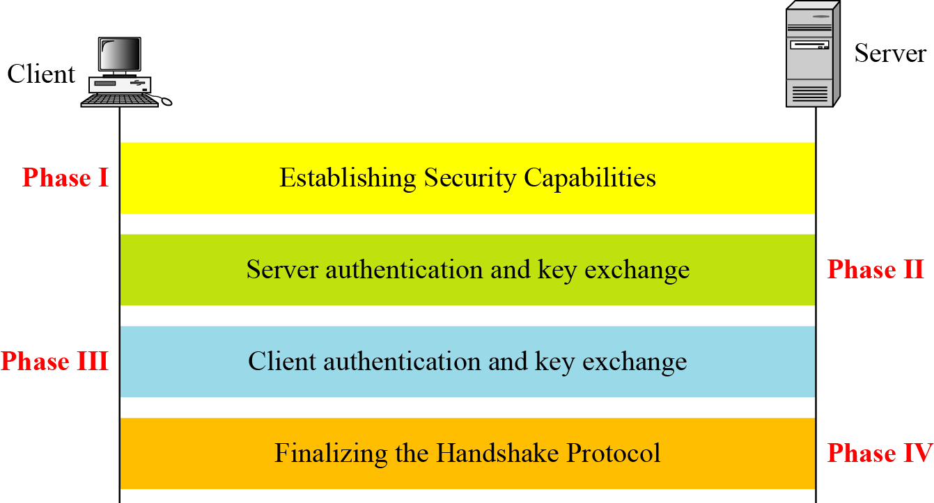
Handshake Protocol
3. SSL CS580_F15

Slide 49
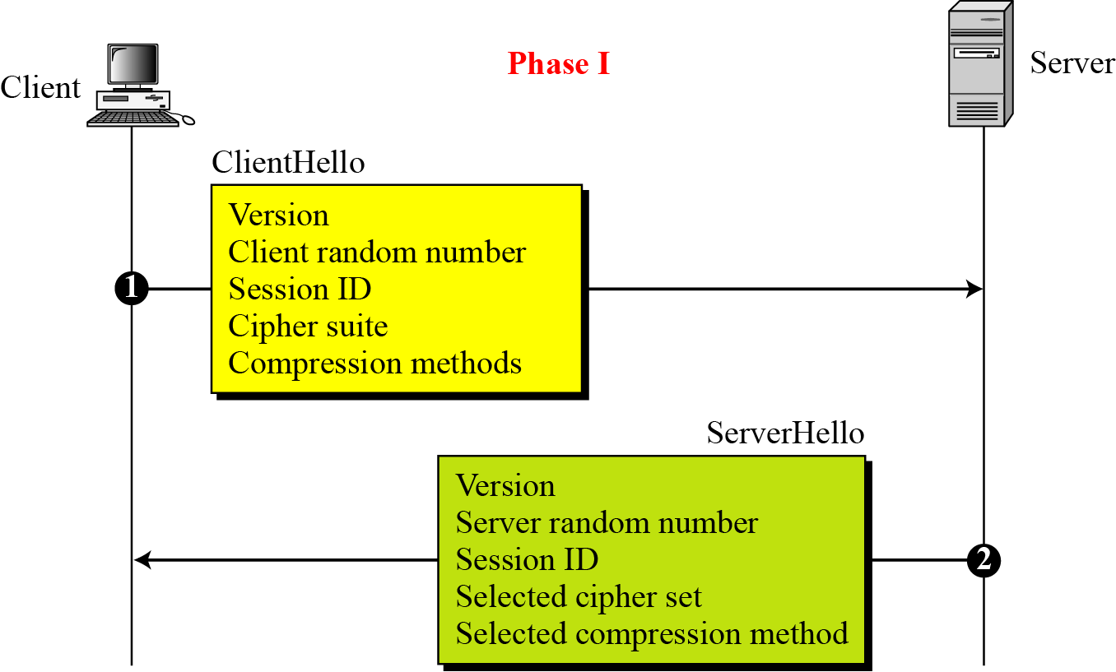
Phase I of Handshake Protocol
3. SSL CS580_F15

Slide 50
Phase I of Handshake Protocol
After Phase I, the client and server know the following:
  The version of SSL
  The algorithms for key exchange, message authentication, and encryption
  The compression method
  The two random numbers for key generation
3. SSL CS580_F15

Slide 51
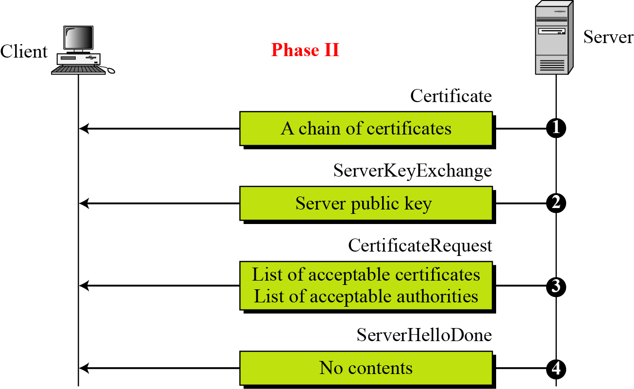
Phase II of Handshake Protocol
3. SSL CS580_F15

Slide 52
Phase II of Handshake Protocol
After Phase II
The server is authenticated to the client.
The client knows the public key of the server if required.
3. SSL CS580_F15

Slide 53
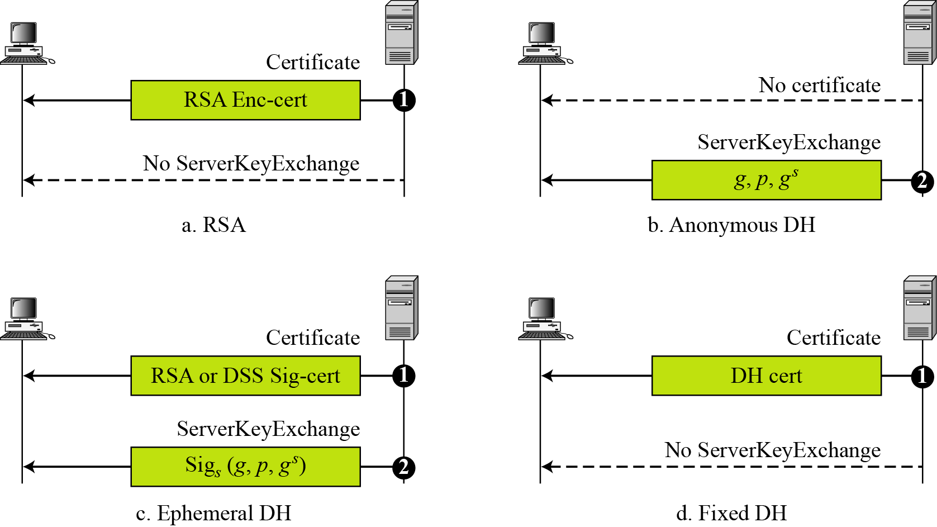
Four cases in phase II
3. SSL CS580_F15

Slide 54
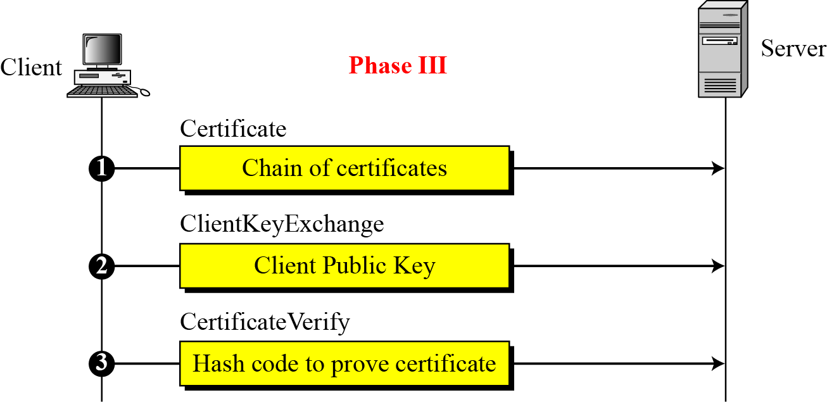
Phase III of Handshake Protocol
3. SSL CS580_F15

Slide 55
Phase III of Handshake Protocol
After Phase III,
The client is authenticated to the server.
Both the client and the server know the pre-master secret
3. SSL CS580_F15

Slide 56
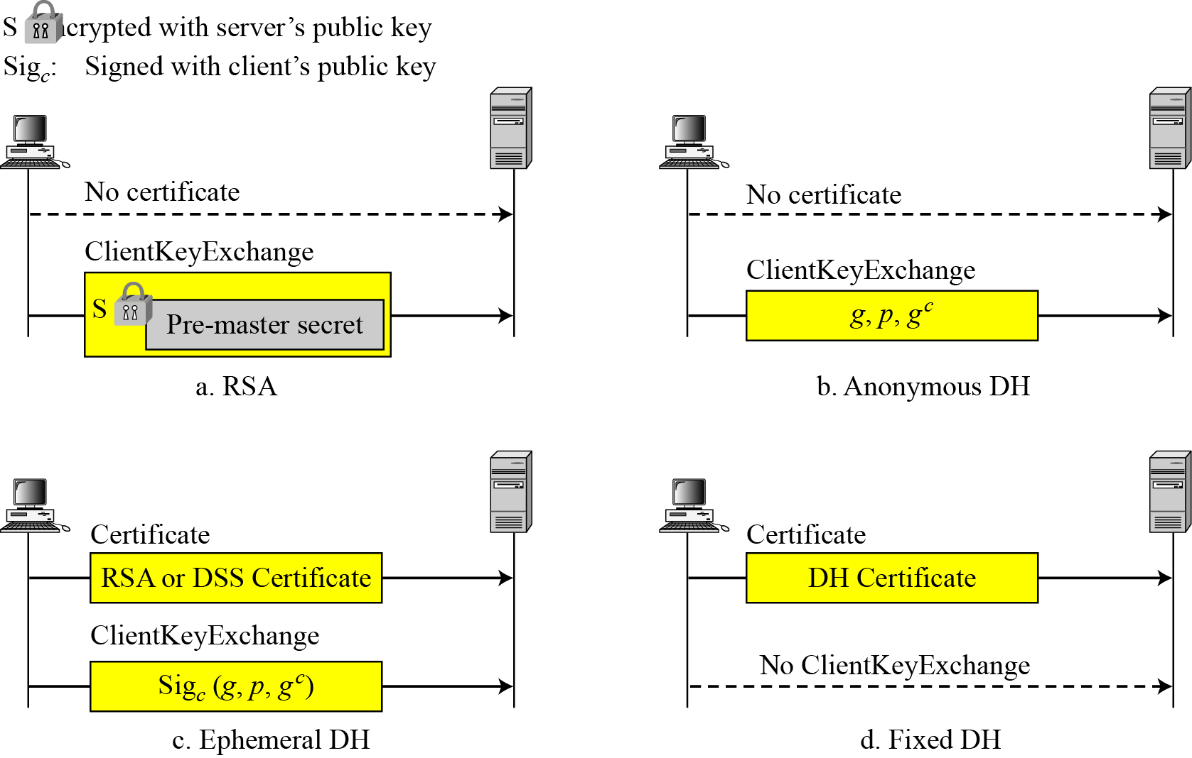
Four cases in Phase III
3. SSL CS580_F15

Slide 57
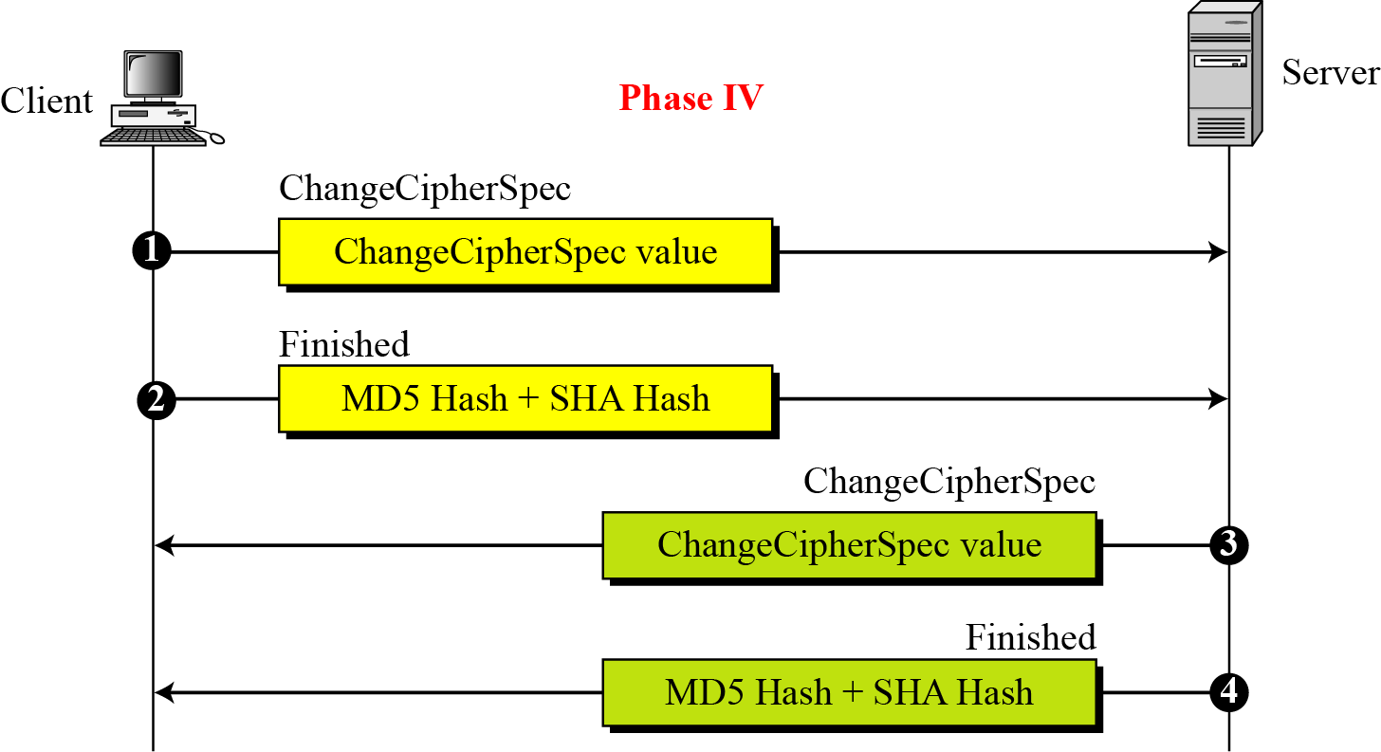
Phase IV of Handshake Protocol
3. SSL CS580_F15

Slide 58
Phase IV of Handshake Protocol
After Phase IV, the client and server are ready to exchange data
3. SSL CS580_F15

Slide 59
SSL Change Cipher Spec Protocol
One of 3 SSL specific protocols which use the SSL Record protocol
a single message
causes pending state to become current
hence updating the cipher suite in use
3. SSL CS580_F15
Notes:
The Change Cipher Spec Protocol is one of the three SSL-specific protocols that use the SSL Record Protocol, and it is the simplest, consisting of a single message. Its purpose is to cause the pending state to be copied into the current state, which updates the cipher suite to be used on this connection.

Slide 60
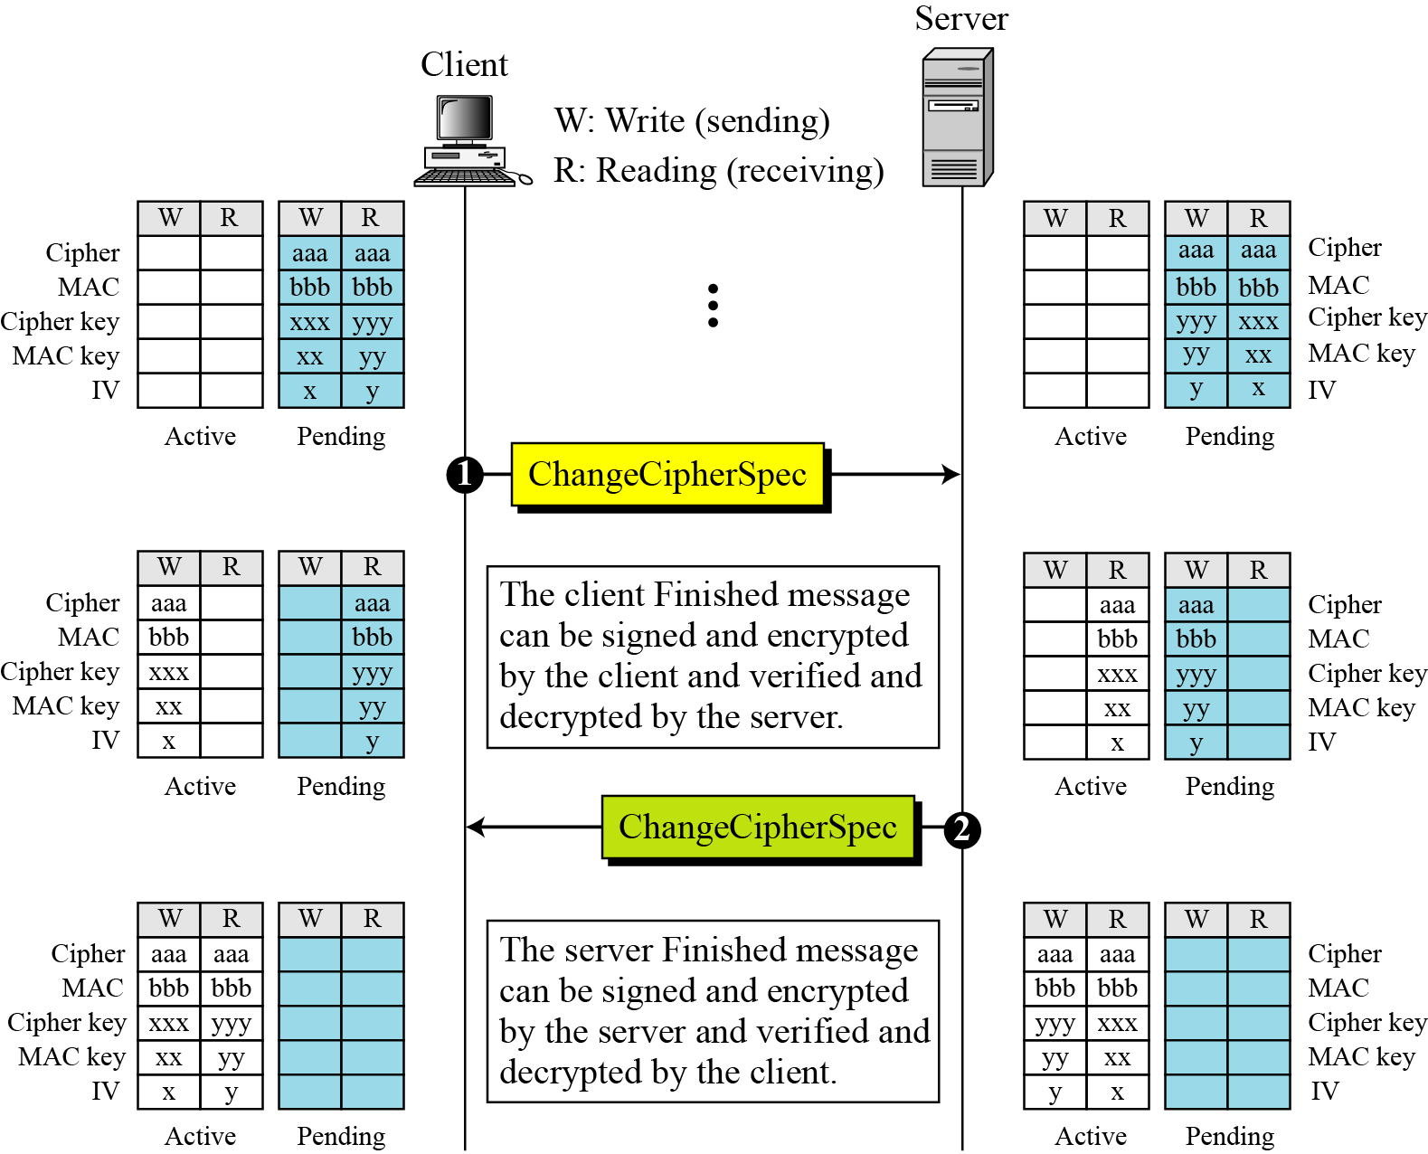
Change Cipher Spec Protocol
3. SSL CS580_F15

Slide 61
SSL Alert Protocol
conveys SSL-related alerts to peer entity
severity
    warning or fatal
specific alert
    fatal: unexpected message, bad record mac, decompression failure, handshake failure, illegal parameter
    warning: close notify, no certificate, bad certificate, unsupported certificate, certificate revoked, certificate expired, certificate unknown
compressed & encrypted like all SSL data
3. SSL CS580_F15
Notes:
The Alert Protocol is used to convey SSL-related alerts to the peer entity. As with other applications that use SSL, alert messages are compressed and encrypted, as specified by the current state.
Each message in this protocol consists of two bytes, the first takes the value warning(1) or fatal(2) to convey the severity of the message. The second byte contains a code that indicates the specific alert. The first group shown are the fatal alerts, the others are warnings.

Slide 62
SSL Record Protocol Services
Message integrity
  using a MAC with shared secret key
  similar to HMAC but with different padding
Confidentiality
  using symmetric encryption with a shared secret key defined by Handshake Protocol
  AES, IDEA, RC2-40, DES-40, DES, 3DES, Fortezza, RC4-40, RC4-128
  message may be compressed before encryption
3. SSL CS580_F15
Notes:
SSL Record Protocol defines two services for SSL connections:
• Message Integrity: The Handshake Protocol also defines a shared secret key that is used to form a message authentication code (MAC), which is similar to HMAC
• Confidentiality: The Handshake Protocol defines a shared secret key that is used for conventional encryption of SSL payloads. The message is compressed before being concatenated with the MAC and encrypted, with a range of ciphers being supported as shown.

Slide 63
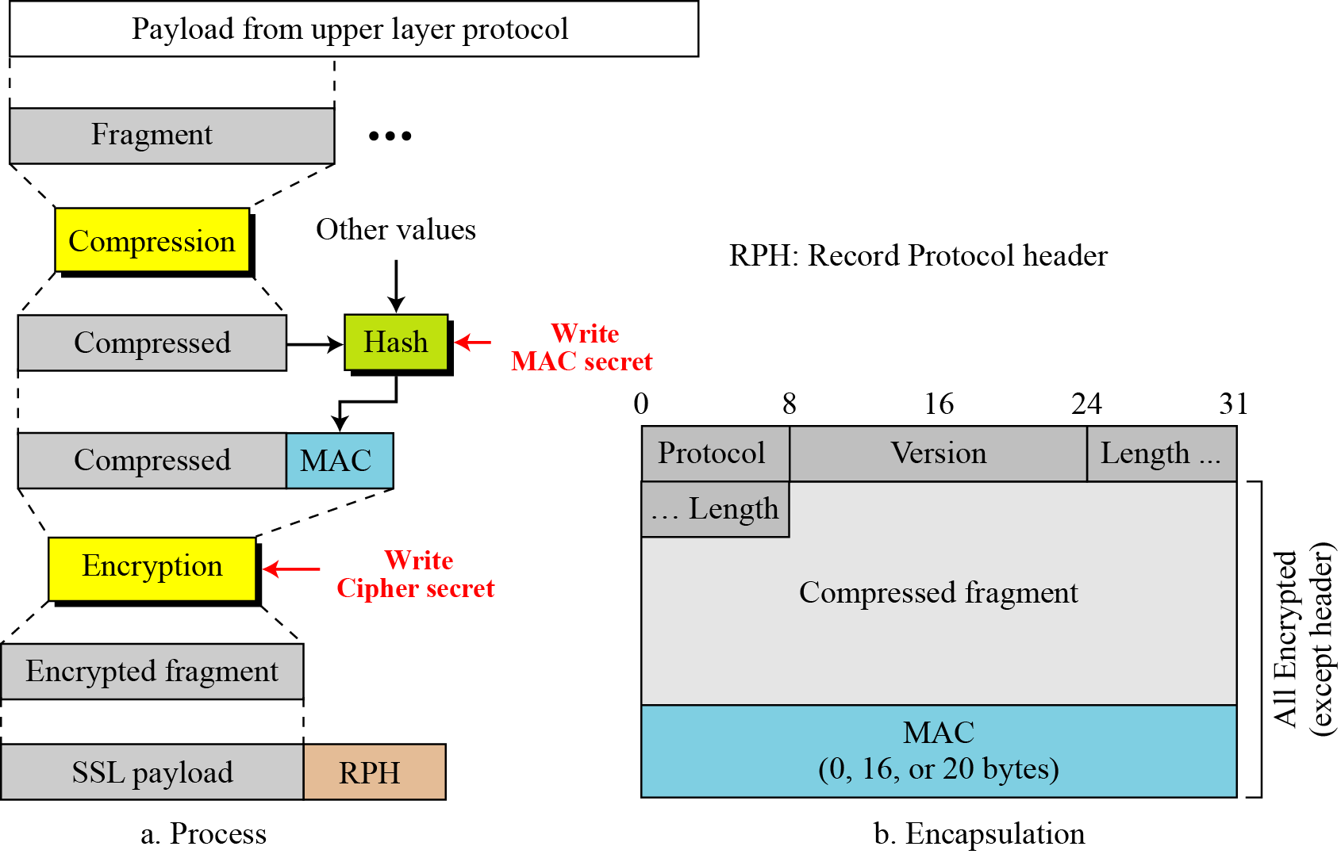
Record Protocol
3. SSL CS580_F15

Slide 64
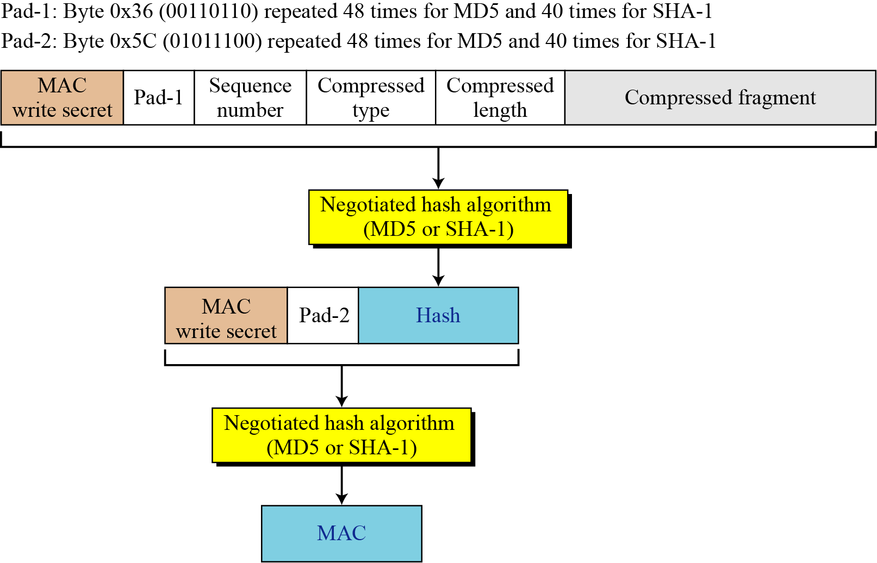
Calculation of MAC
3. SSL CS580_F15

Slide 65
Secure Electronic Transactions (SET)
open encryption & security specification
developed in 1996 by Mastercard, Visa etc
to protect Internet credit card transactions
not a payment system
a set of security protocols & formats
  secure communications amongst parties
  trust from use of X.509v3 certificates
  privacy by restricted info to those who need it
3. SSL CS580_F15
Notes:
SET is an open encryption and security specification designed to protect credit card transactions on the Internet. SETv1 emerged from a call for security standards by MasterCard and Visa in 1996. Beginning in 1996, there have been numerous tests of the concept, and by 1998 the first wave of SET-compliant products was available. SET is not itself a payment system, rather it is a set of security protocols and formats that enables users to employ the existing credit card payment infrastructure on an open network, such as the Internet, in a secure fashion, by providing:
• a secure communications channel among all parties involved in a transaction
• trust through the use of X.509v3 digital certificates
• privacy because the information is only available to parties in a transaction when and where necessary.

Slide 66
Key features of SET
Confidentiality of information
  Use DES
Integrity of information
  RSA Digital signatures with SHA-1 hash codes
Cardholder account authentication
  X.509v3 digital certificates with RSA digital signatures
Merchant authentication
  X.509v3 digital certificates RSA digital signatures
Privacy
  separation of order and payment information using dual signatures
3. SSL CS580_F15

Slide 67
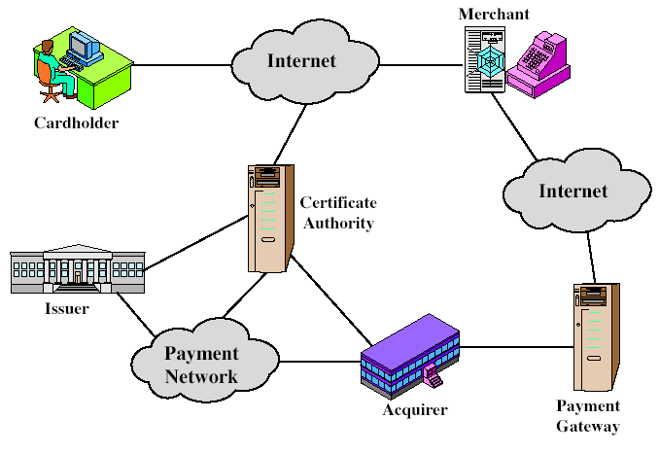
SET Components
3. SSL CS580_F15
Notes:
Stallings Figure17.8 indicates the participants in the SET system, being:
• Cardholder: purchasers interact with merchants from personal computers over the Internet
• Merchant: a person or organization that has goods or services to sell to the cardholder
• Issuer: a financial institution, such as a bank, that provides the cardholder with the payment card.
• Acquirer: a financial institution that establishes an account with a merchant and processes payment card authorizations and payments
• Payment gateway: a function operated by the acquirer or a designated third party that processes merchant payment messages
• Certification authority (CA): an entity that is trusted to issue X.509v3 public-key certificates for cardholders, merchants, and payment gateways

Slide 68
SET participates
Cardholder: consumer
Merchant
  Has goods or services to sell to the cardholder
Issuer
  A financial institution that provides the cardholder with the payment card
Acquirer
  A financial institution that establishes an account with a merchant and processes payment card authorizations and payments
Payment gateway
  A function operated by the acquirer that processes merchant payment messages
Certificate Authority (CA)
3. SSL CS580_F15

Slide 69
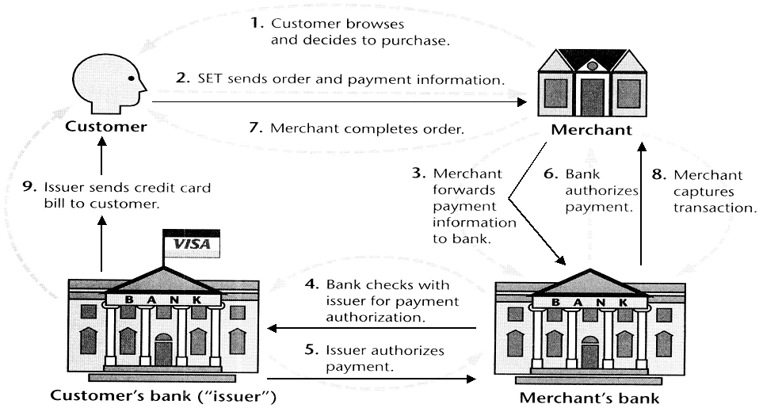
SET Transaction
3. SSL CS580_F15

Slide 70
SET Transaction
The customer opens an account with a card issuer.
  MasterCard, Visa, etc.
The customer receives a X.509 V3 certificate signed by a bank.
  X.509 V3
A merchant who accepts a certain brand of card must possess two X.509 V3 certificates.
  One for signing & one for key exchange
The customer places an order for a product or service with a merchant.
The merchant sends a copy of its certificate for verification.
3. SSL CS580_F15
Notes:
Now briefly detail the sequence of events that are required for a transaction as shown, details in text.

Slide 71
SET Transaction
The customer sends order and payment information to the merchant
The merchant requests payment authorization from the payment gateway prior to shipment.
The merchant confirms order to the customer.
The merchant provides the goods or service to the customer.
The merchant requests payment from the payment gateway.
3. SSL CS580_F15
Notes:
Now briefly detail the sequence of events that are required for a transaction as shown, details in text.

Slide 72
Dual Signature
Link two messages that are intended for two different recipients
customer creates dual messages
  order information (OI) for merchant
  payment information (PI) for bank
neither party needs details of the other
but must know they are linked
use a dual signature for this
  signed concatenated hashes of OI & PI
    DS=E(PR_{c}, [H(H(PI)||H(OI))])
3. SSL CS580_F15
Notes:
The purpose of the SET dual signature is to link two messages that are intended for two different recipients, the order information (OI) for the merchant and the payment information (PI) for the bank. The merchant does not need to know the customer’s credit card number, and the bank does not need to know the details of the customer’s order, however the two items must be linked in a way that can be used to resolve disputes if necessary. The customer takes the hash (using SHA-1) of the PI and the hash of the OI, concatenates them, and hashes the result. Finally,the customer encrypts the final hash with his or her private signature key, creating the dual signature. This can be summarized as: DS=E(PRc, [H(H(PI)||H(OI))])

Slide 73
Why Dual Signature?
Suppose that customers send the merchant two messages:
  The signed order information (OI).
  The signed payment information (PI).
The merchant passes the payment information (PI) to the bank.
If the merchant can capture another order information (OI) from this customer, the merchant could claim this order goes with the payment information (PI) rather than the original.
3. SSL CS580_F15

Slide 74
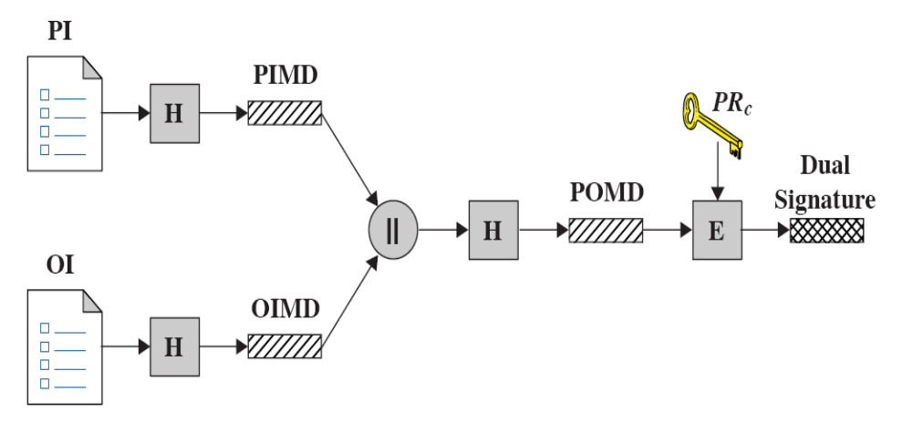
Construction of dual signature
3. SSL CS580_F15

Slide 75
Verify dual signature
Merchant
  OI, PIMD, DS
H[(PIMD) || H(OI)]; D(PUc, DS)
Bank
PI, OIMD, DS
H[H(PI) || OIMD]; D(PUc, DS)
3. SSL CS580_F15

Slide 76
What did we accomplish?
The merchant has received OI and verified the signature.
The bank has received PI and verified the signature.
The customer has linked the OI and PI and can prove the linkage.
3. SSL CS580_F15

Slide 77
SET Purchase Request
SET purchase request exchange consists of four messages
  Initiate Request - get certificates
  Initiate Response - signed response
  Purchase Request - of OI & PI
  Purchase Response - ack order
3. SSL CS580_F15
Notes:
The purchase request exchange consists of four messages: Initiate Request, Initiate Response, Purchase Request, and Purchase Response. In order to send SET messages to the merchant, the cardholder must have a copy of the certificates of the merchant and the payment gateway. The customer requests the certificates in the Initiate Request message, sent to the merchant. The merchant generates a response and signs it with its private signature key. The cardholder verifies the merchant and gateway certificates by means of their respective CA signatures and then creates the OI and PI. Next, the cardholder prepares the Purchase Request message with Purchase-related information & Order-related information. The Purchase Response message includes a response block that acknowledges the order and references the corresponding transaction number.

Slide 78
Purchase Request: Initiate Request
Basic Requirements:
  Cardholder Must Have Copy of Certificates for Merchant and Payment Gateway
Customer Requests the Certificates in the Initiate Request Message to Merchant
  Brand of Credit Card
  ID Assigned to this Request/response pair by customer
  Nonce
3. SSL CS580_F15
Notes:
The purchase request exchange consists of four messages: Initiate Request, Initiate Response, Purchase Request, and Purchase Response. In order to send SET messages to the merchant, the cardholder must have a copy of the certificates of the merchant and the payment gateway. The customer requests the certificates in the Initiate Request message, sent to the merchant. The merchant generates a response and signs it with its private signature key. The cardholder verifies the merchant and gateway certificates by means of their respective CA signatures and then creates the OI and PI. Next, the cardholder prepares the Purchase Request message with Purchase-related information & Order-related information. The Purchase Response message includes a response block that acknowledges the order and references the corresponding transaction number.

Slide 79
Purchase Request: Initiate Response
Merchant Generates a Response
  Signs with Private Signature Key
  Include Customer Nonce
  Include Merchant Nonce (Returned in Next Message)
  Transaction ID for Purchase Transaction
In Addition …
  Merchant’s Signature Certificate
  Payment Gateway’s Key Exchange Certificate
3. SSL CS580_F15
Notes:
The purchase request exchange consists of four messages: Initiate Request, Initiate Response, Purchase Request, and Purchase Response. In order to send SET messages to the merchant, the cardholder must have a copy of the certificates of the merchant and the payment gateway. The customer requests the certificates in the Initiate Request message, sent to the merchant. The merchant generates a response and signs it with its private signature key. The cardholder verifies the merchant and gateway certificates by means of their respective CA signatures and then creates the OI and PI. Next, the cardholder prepares the Purchase Request message with Purchase-related information & Order-related information. The Purchase Response message includes a response block that acknowledges the order and references the corresponding transaction number.

Slide 80
Purchase Request – Customer
Cardholder Verifies Two Certificates Using Their CAs and Creates the OI and PI.
Message Includes:
  Purchase-related Information
  Order-related Information
  Cardholder Certificate
3. SSL CS580_F15
Notes:
Stallings Figure 17.10 shows the details of the contents of the Purchase Request message generated b y the customer.
The message includes the following:
Purchase-related information, which will be forwarded to the payment gateway by the merchant and consists of: PI, dual signature, & OI message digest (OIMD).
2. Order-related information, needed by the merchant and consists of: OI, dual signature, PI message digest (PIMD).
3. Cardholder certificate. This contains the cardholder’s public signature key.

Slide 81
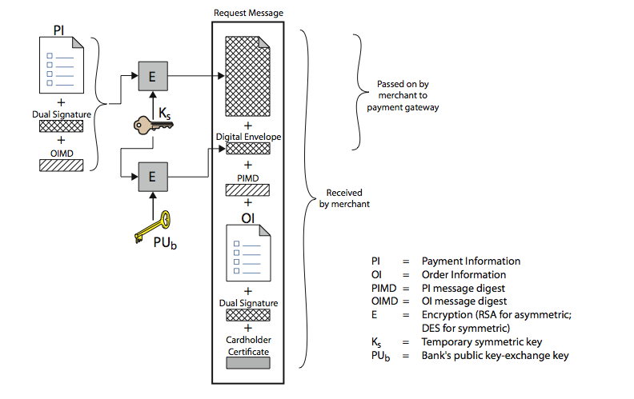
Purchase Request – Customer
3. SSL CS580_F15
Notes:
Stallings Figure 17.10 shows the details of the contents of the Purchase Request message generated b y the customer.
The message includes the following:
Purchase-related information, which will be forwarded to the payment gateway by the merchant and consists of: PI, dual signature, & OI message digest (OIMD).
2. Order-related information, needed by the merchant and consists of: OI, dual signature, PI message digest (PIMD).
3. Cardholder certificate. This contains the cardholder’s public signature key.

Slide 82
Merchant Verifies Purchase Request
verifies cardholder certificates using CA signatures
verifies dual signature using customer's public signature key to ensure order has not been tampered with in transit & that it was signed using cardholder's private signature key
processes order and forwards the payment information to the payment gateway for authorization (described later)
sends a purchase response to cardholder
3. SSL CS580_F15
Notes:
When the merchant receives the Purchase Request message, the actions listed are performed.
Details of the request verification are shown on the next slide; and of the payment authorization on the following slide.
The Purchase Response message includes a response block that acknowledges the order and references the corresponding transaction number. This block is signed by the merchant using its private signature key.The block and its signature are sent to the customer, along with the merchant’s signature certificate.

Slide 83
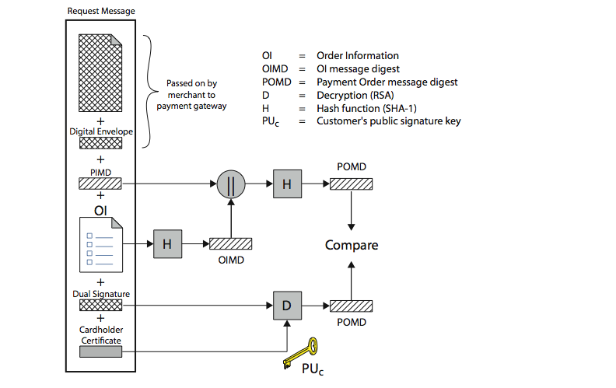
Merchant Verifies Purchase Request
3. SSL CS580_F15
Notes:
Stallings Fig 17.11 illustrates the crypto processes used by the merchant to verify the customer’s purchase request order (step 2 on previous slide).

Slide 84
Payment Process
The payment process is broken down into two steps:
  Payment authorization
  Payment capture
3. SSL CS580_F15

Slide 85
Payment authorization
The merchant sends an Authorization Request message to the payment gateway
  Purchase-related information
    PI
    Dual signature
    The OI message digest (OIMD)
    The digital envelope
  Authorization-related information
    Generated by the merchant
    An authorization block that includes the transaction ID, signed with merchant’s private key and encrypted with a one-time key generated by the merchant
    A digital envelope
  Certificates (Customer’s , 2 merchant’s )
3. SSL CS580_F15

Slide 86
Payment Gateway Authorization
verifies all certificates
decrypts digital envelope of authorization block to obtain symmetric key & then decrypts authorization block
verifies merchant's signature on authorization block
verifies dual signature on payment block
verifies that transaction ID received from merchant matches that in PI received (indirectly) from customer
requests & receives an authorization from issuer(decrypts digital envelope of payment block to obtain symmetric key & then decrypts payment block)
sends authorization response back to merchant
3. SSL CS580_F15
Notes:
During the processing of an order from a cardholder, the merchant authorizes the transaction with the payment gateway (step 3 in merchants list previously).
The payment authorization ensures that the transaction was approved by the issuer, guarantees the merchant will receive payment, so merchant can provide services or goods to customer.
The payment authorization exchange consists of two messages: Authorization Request and Authorization response.
The payment gateway performs the tasks shown on receiving the Authorization Request message.

Slide 87
Payment Capture
merchant sends payment gateway a payment capture request
gateway checks request
then causes funds to be transferred to merchants account
notifies merchant using capture response
3. SSL CS580_F15
Notes:
To obtain payment, the merchant sends a capture request message to the payment gateway, for which the merchant generates, signs, and encrypts
a capture request block, including payment amount and transaction ID.
The payment gateway receives the capture request message, decrypts and verifies the capture request block and decrypts and verifies the capture token block. It then checks for consistency between the capture request and capture token.
It then creates a clearing request sent to the issuer over the private payment network, which causes funds to be transferred to the merchant’s account.
The gateway then notifies the merchant of payment in a Capture Response message, which includes a capture response block that the gateway signs
and encrypts, plus the gateway’s signature key certificate. The merchant software stores the capture response to be used for reconciliation with payment received from the acquirer.

