Slide 1
CS580
Internet Security Protocols
4. PGP and Secure Electronic Election
Huiping Guo
Department of Computer Science
California State University, Los Angeles

Slide 2
Outline
PGP
All –Or-Nothing Disclosure of Secrets (ANDOS)
Some secure election protocols
4. E-Voting CS580_F15

Slide 3
Pretty Good Privacy (PGP)
PGP can be used to create a secure e-mail message or to store a file securely for future retrieval
Scenarios
Key Rings
PGP Certificates
Extracting Information from Rings
4. E-Voting CS580_F15

Slide 4
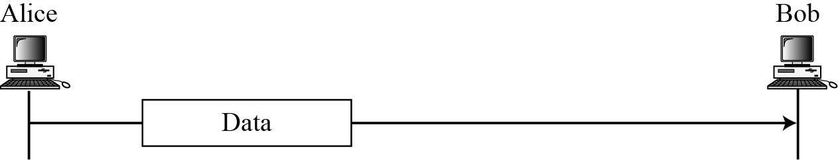
Scenarios
A plaintext message
4. E-Voting CS580_F15

Slide 5
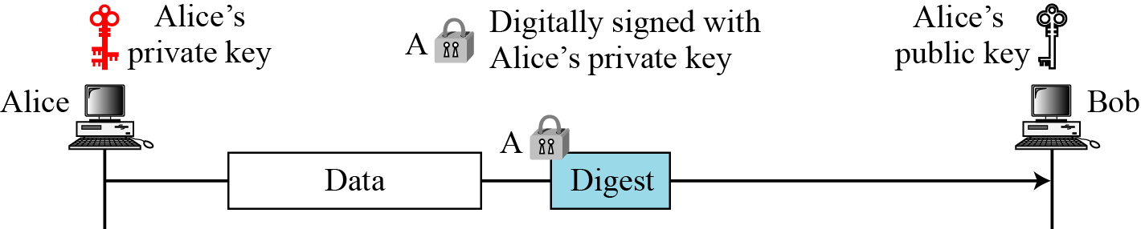
Scenarios: Message Integrity
An authenticated message
Digest: the hash value of data
4. E-Voting CS580_F15

Slide 6
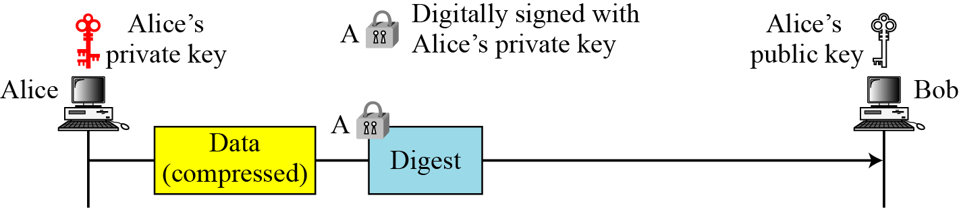
Scenarios: Compression
A compressed message
4. E-Voting CS580_F15

Slide 7
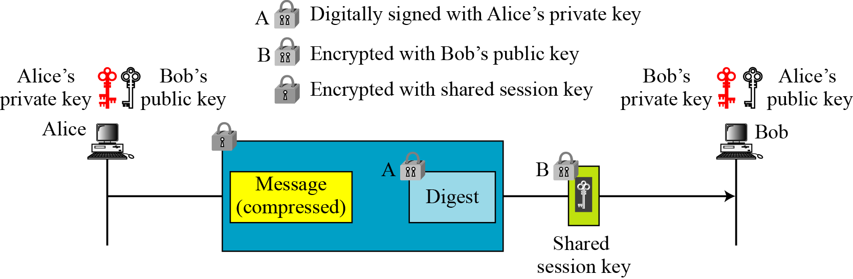
Scenarios: Confidentiality with One-Time Session Key
A confidential message
4. E-Voting CS580_F15

Slide 8
Key Rings in PGP
Public key rings
  Alice may need to send a message to many people
  Each public key corresponds to a receiver
Private key rings
  Alice may wish to change here pair of keys from time to time
  Alic may need to correspond with different groups of people and use a different key pair for each group
So, each user needs to have two sets of rings
  A ring of private(public) keys
  A ring of public keys of other users
4. E-Voting CS580_F15

Slide 9
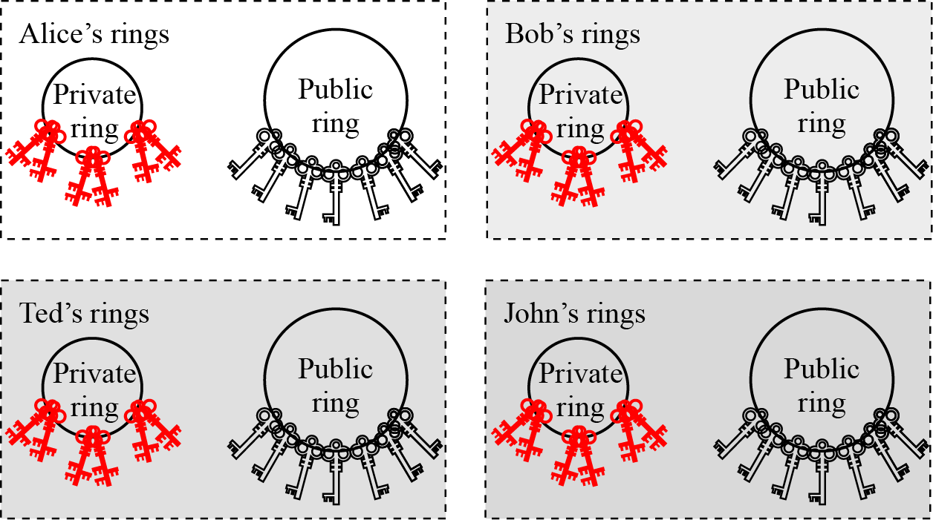
Key Rings in PGP
4. E-Voting CS580_F15

Slide 10
Key Rings in PGP: example
Alice needs to send a message to another person in the community
  She uses her private key to sign the digest
  She uses the receiver’s public key to encrypt a newly created session key
  She encrypts the message and the singed digest with the session key created
Alice receives a message from another person in the community
  She uses her private key to decrypt the session key
  She uses the session key to decrypt the message and digest
  She uses the sender’s public key to verify the signature
4. E-Voting CS580_F15

Slide 11
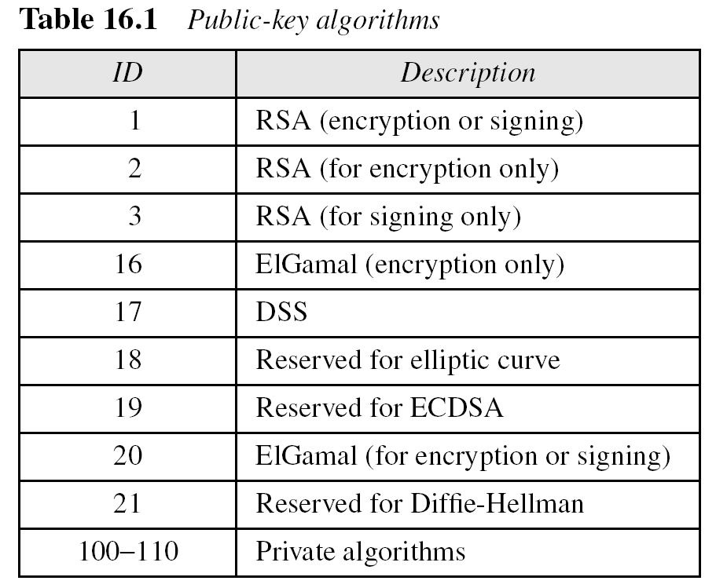
PGP Algorithms
4. E-Voting CS580_F15

Slide 12
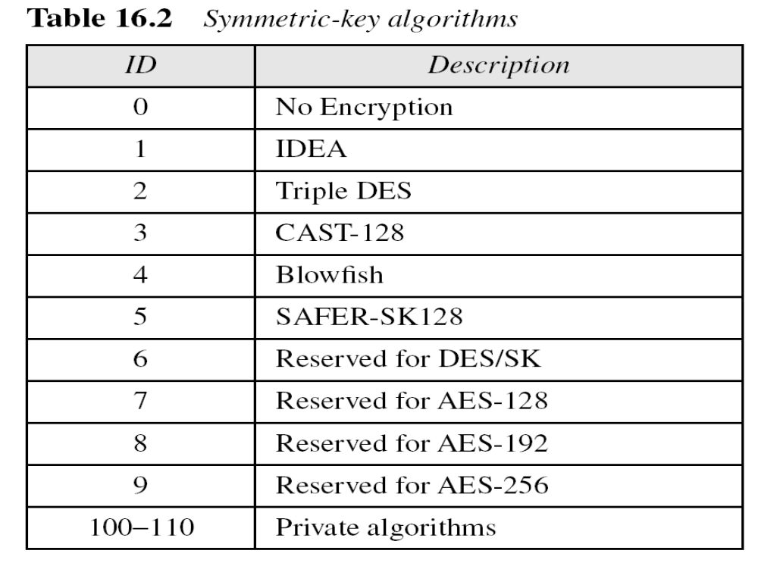
PGP Algorithms
4. E-Voting CS580_F15

Slide 13
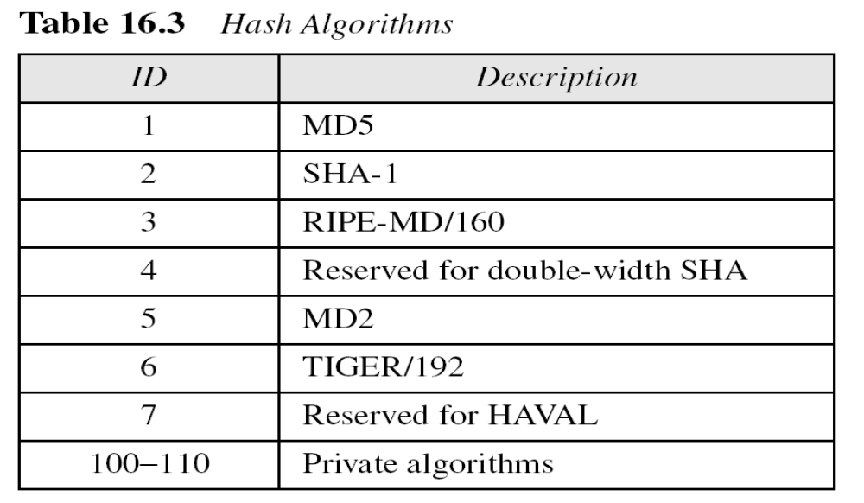
PGP Algorithms
4. E-Voting CS580_F15

Slide 14
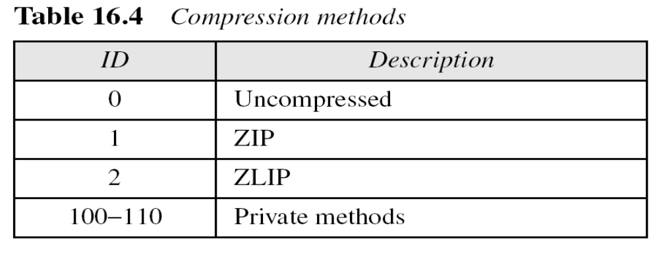
PGP compression methods
4. E-Voting CS580_F15

Slide 15
PGP Certificate
X.509 Certificates
  Protocols that use X.509 certificates depend on the hierarchical structure of the trust
  In X.509, there is a single path from the fully trusted authority to any certificate
PGP Certificates
  In PGP, there is no need for CAs
  Anyone in the ring can sign a certificate for anyone else in the ring
  There can be multiple paths from fully or partially trusted authorities to any subject
  Introducer: the issuer of a certificate
4. E-Voting CS580_F15

Slide 16
Trust and legitimacy
The entire operation of PGP is based on producer trust, the certificate trust and the legitimacy of the public keys
Producer trust levels
  Specifies the trust levels of a person
  PGP allows different levels of trust: none, partial and full
Certificate trust levels
  When Alice receives a certificate signed by Bob , she stores the certificate under the name of the certified entity
  She assigns a level of trust to this certificate
  The certificate trust level is the same as the producer trust level of Bob
4. E-Voting CS580_F15

Slide 17
Example
Alice full trusts Bob, partially trusts Anne and Jane, and has no trust in John
  Scenario 1
    Bob issues two certificates, one for Linda and one for Lesley
    Alice stores the public key and certificate for Linda under Linda’s name and assigns full level of trust to this certificate
    Alice stores the public key and certificate for Lesley under Lesley’s name and assigns full level of trust to this certificate
  Scenario 2
    Anne issues a certification for John.
    Alice stores this certification and public key under John’s name, but assigns a partial level for this certificate
4. E-Voting CS580_F15

Slide 18
Example
Scenario 3
  Jane issues two certificates , one for John and one for Lee
  Alice stores John’s certificate under his name and Lee’s certificate under his name, each with a partial level of trust
  Now John has two certificates, one from Anne and one from Jane, each with a partial level of trust
Scenario 4
  John issues a certificate for Liz.
  Alice can discard or keep this certificate with a signature trust of none
4. E-Voting CS580_F15

Slide 19
Key legitimacy
The purpose of using producer and certificate trust is to determine the legitimacy of a public key
The level of the key legitimacy for a user is the weighted trust levels of that user
  A weight of 0 to a nontrusted certificate
  A weight of 0.5 to a certificate with partial trust
  A weight of 1 to a certificate with fully trust
Ex: to fully trust an entity, Alice needs one fully trusted certificate or two partially trusted certificates for that entity
  Alice can use John’s public key because both Anne and Jane have issued a certificate for John, each with certificate trust level of 1/2
4. E-Voting CS580_F15

Slide 20
Key legitimacy: Note
The legitimacy of a public key belonging to an entity does not have anything to do with the trust level of that person
Ex:
  Though Alice can use John’s public key to send a message to him, Alice cannot accept any certificate issued by John
  For Alice, John has a trust level of none
4. E-Voting CS580_F15

Slide 21
Starting the ring
What if nobody sends a certificate for a fully or partially trusted entity?
The key legitimacy of a trusted or partially trusted entity can be also determined by other methods
  Alice can physically obtain Bob’s public key
  Alice can call Bob to get his key
  Bob sends his public key to Alice by email
4. E-Voting CS580_F15

Slide 22
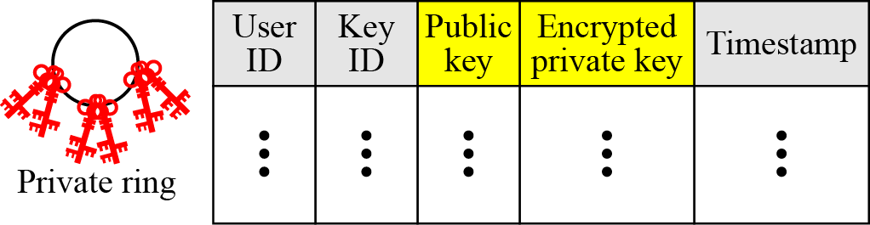
Key ring tables
Format of private key ring table
4. E-Voting CS580_F15

Slide 23
Private key ring table
User ID
  The email address of the user
Key ID
  The first 64 bits of the public key
  Uniquely defines a public key among the user’s public keys
  Sent with the message and enables the receiver to find the corresponding public key
Public key
Encrypted private key
  PGP saves only encrypted version of the private key
Timestamp
  The date and time of the key pair creation
4. E-Voting CS580_F15

Slide 24
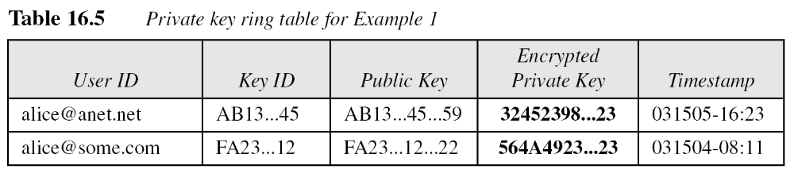
Example
We assume that Alice has only two user IDs, aalice@some.com and alice@anet.net.
We also assume that Alice has two sets of private/public keys, one for each user ID.
4. E-Voting CS580_F15

Slide 25
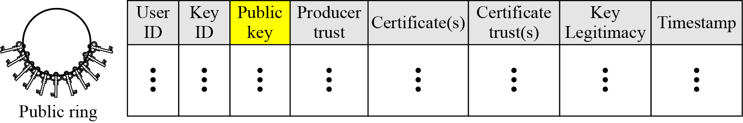
Key ring tables
Format of a public key ring table
4. E-Voting CS580_F15

Slide 26
Public key ring table
Producer Trust
  Defines the producer level of trust
Certificates
  Holds the certificate signed by other entities for this entity
  A user ID may have more than one certificate
Certificate trust
  If Anne sends a certificate for John, PGP searches the row entry for Anne, finds the value of the producer trust for Anne, copies that value, and inserts it in the certificate trust field in the entry for John
Key legitimacy
  Calculated by PGP based on the value of the certificate trust and the predefined weight for each certificate trust
4. E-Voting CS580_F15

Slide 27
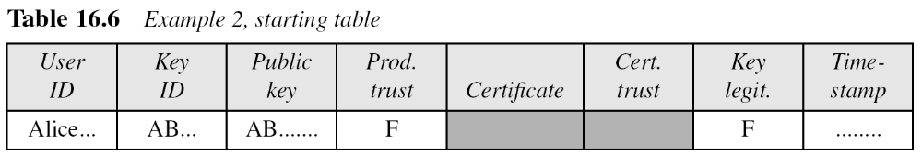
Example: form a public key ring table
Start with one row, Alice herself.
  Use N (none), P (partial), and F (full) for the levels of trust
4. E-Voting CS580_F15

Slide 28
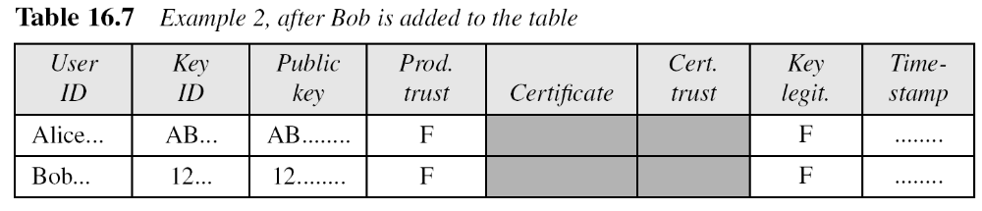
Example: form a public key ring table
Alice adds Bob to the table.
  Alice fully trusts Bob and gets his pubic key by email
  The value of certificate is empty, which shows that this key has been received indirectly and not by a certificate
4. E-Voting CS580_F15

Slide 29
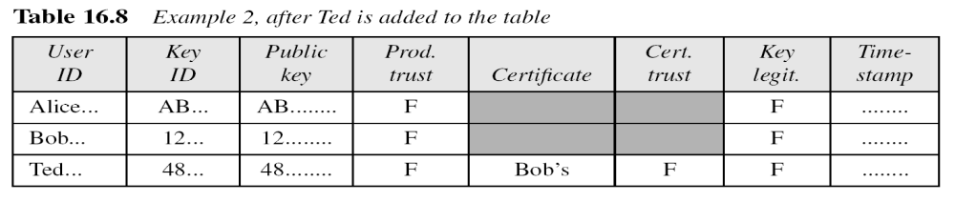
Example: form a public key ring table
3. Alice adds Ted to the table
  Ted is fully trusted
  Bob, who knows Ted’s public key, sends Alice a certificate that includes Ted’s public key
  The value of the certificate trust is copied by PGP from Bob’s producer trust field
  The value of the key legitimacy field is the value of the certificate trust multiplied by 1 (weight)
4. E-Voting CS580_F15

Slide 30
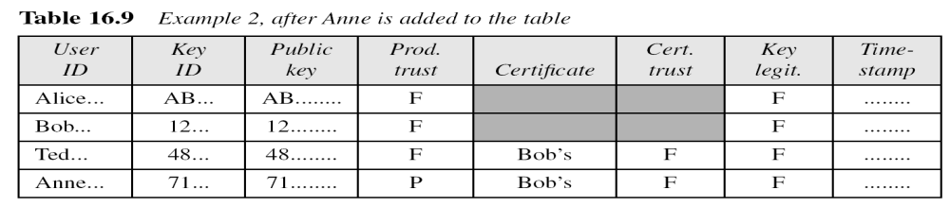
Example: form a public key ring table
4. Alice adds Anne to the list
  Alice partially trusts Anne
  Bob, who is fully trusted, sends a certificate for Anne
  The producer trust for Anne is partial, but the certificate trust and key legitimacy is full
4. E-Voting CS580_F15

Slide 31
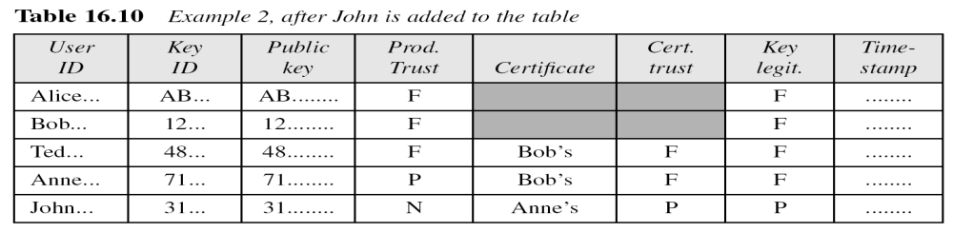
Example: form a public key ring table
5. Anne introduces John, who is not trusted by Alice
  The value of the key legitimacy for John is ½(P)
  Alice must not use John’s key until it changes to 1
4. E-Voting CS580_F15

Slide 32
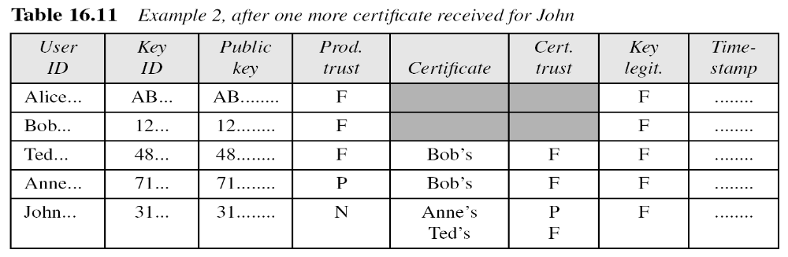
Example: form a public key ring table
6. Ted sends a certificate for John
  Alice looks at the table and finds John’s user ID with the corresponding Key ID and public key
  She modifies the table
    Because John has two certificates in Alice’s table and his key legitimacy value is 1
  Alice can use his key, but John is still untrustworthy
4. E-Voting CS580_F15

Slide 33
Extracting Information from Rings: sender site
Assuming Alice is sending an email to Bob, Alice needs
  The key ID of the public key she is using
  Her private key
  The session key
  Bob’s public key ID
  Bob’s public key
Alice selects the user ID (her email address) she wants to use as an index to her private key ring table
PGP extracts the key ID and the encrypted private key
PGP uses the predefined decryption algorithm and her hashed passphrase (as the key) to decrypt this private key
4. E-Voting CS580_F15

Slide 34
Extracting Information from Rings: sender site
4. PGP uses a random number generator to create a random session key
  The seed is a set of arbitrary keystrokes typed by Alice on her keyboard
5. Alice extracts Bob’s key ID (to be sent with the message) and Bob’s public key (to encrypt the session key) from her public ring table using Bob’s user ID (email address)
4. E-Voting CS580_F15

Slide 35
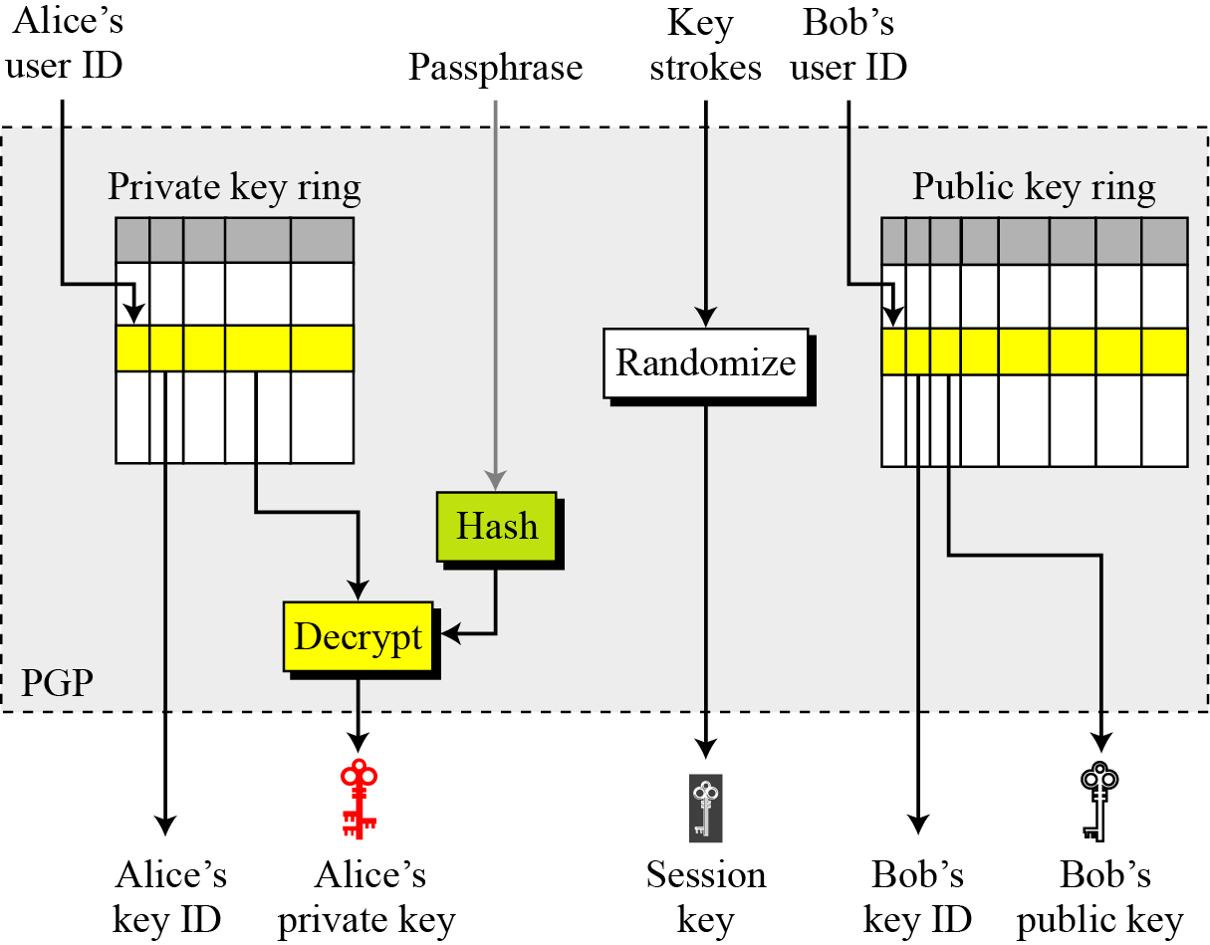
Extracting Information from Rings: sender site
4. E-Voting CS580_F15

Slide 36
Extracting Information from Rings: receiver site
Bob needs tree pieces of information
  Bob’s private key (to decrypt the session key)
  The session key ( to decrypt the data)
  Alice’s public key (to verify the signature)
Bob uses the key ID of his public key sent by Alice to find his corresponding private key needed to decrypt the session key from Bob’s private key ring table
Bob uses his passphrase and the hash function to decrypt his private key
Bob decrypts the session key with his private key
Bob uses Alice’s key ID sent with the message to extract Alice’s public key, which is stored in Bob’s public key ring table
4. E-Voting CS580_F15

Slide 37
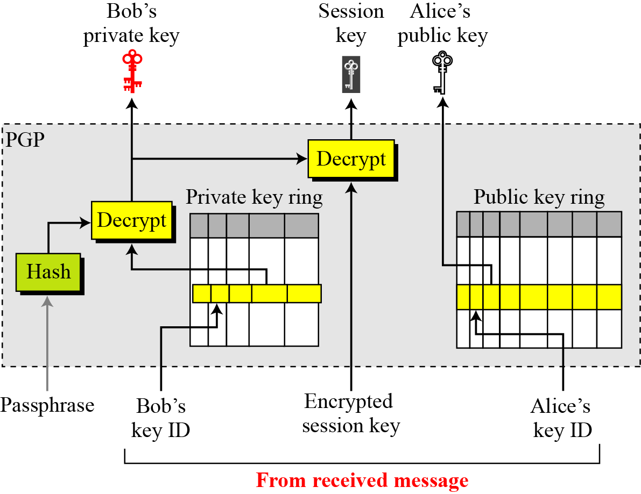
Extracting Information from Rings: receiver site
4. E-Voting CS580_F15

Slide 38
ANDOS
All-Or-Nothing Disclosure of Secrets
An protocol that involves two parties, a vendor and a buyer
It allows the vendor, who holds several secrets, to disclose one of them to the buyer, with the guarantee that no information about the other secrets will be gained.
Furthermore, the buyer can freely choose his secret and has the guarantee that the vendor will not be able to find out which secret he picked.
4. E-Voting CS580_F15

Slide 39
ANDOS : Scenario
Alice is a former agent of the former Soviet Union
She wants to sell secrets to make money
Anyone who pays the price can buy a secret
Alice’s secrets are listed on a catalog by number, with tantalizing titles
  Where is Jimmy Hoffa?
  Who is securely controlling Trilateral Commission? ,…
Bob wants to buy a secret, but he doesn’t want to tell Alice which secret he wants.
  Alice could add “What secrets Bob is interested in” to her catalog if Alice knows which secrets Bob bought
4. E-Voting CS580_F15

Slide 40
ANDOS
The protocol allows multiple parties (>=2) to buy individual secrets from a single seller
Definition: Fixed Bit Index (FBI)
  Take two bit strings, x and y
  The FBI of x and y are the bit positions where the i^{th} bit of x equals the i^{th} bit of y
Eg: x= 110101001011
y=101010000110
FBI(x,y) = [1,4,5,11]
(read bits from right to left, with the right-most bit as 0)
4. E-Voting CS580_F15

Slide 41
ANDOS : protocol
Alice is the seller.
Bob and Carol are buyers.
Alice has k n-bit secrets: S₁, S₂,… S_{k}
Bob wants to buy S_{b}
Carol wants to buy S_{c}
4. E-Voting CS580_F15

Slide 42
ANDOS : protocol
Alice generates a public key/private-key pair and tells Bob (but not Carol) the public key. She generates another public key/private key pair and tells Carol(but not Bob) the public key
Bob generates k n-bite random numbers, B₁,B₂,…,B_{k}, and tells them to Carol. Carol generates k n-bit random numbers, C₁, C₂,…, C_{k}, and tells them to Bob
Bob encrypts C_{b} (S_{b} is the secret he wants to buy) with the public key from Alice. He computes the FBI of C_{b} and the result he just encrypted. He sends this FBI to Carol.
Carol encrypts B_{c} (S_{c} is the secret she wants to buy) with the public key from Alice. She computes the FBI of B_{c} and the result she just encrypted. She sends this FBI to Bob.
4. E-Voting CS580_F15

Slide 43
ANDOS : protocol
Bob takes each of the n-bit numbers B₁,B₂,…,B_{k} , and replaces every bit whose index is in the FBI he received from Carol with its complement. He sends this new list of n-bit numbers B’₁,B’₂,…,B’_{k} to Alice.
Carol takes each of the n-bit numbers C₁,C₂,…,C_{k} , and replaces every bit whose index is in the FBI he received from Bob with its complement. He sends this new list of n-bit numbers C’₁,C’₂,…,C’_{k} to Alice.
4. E-Voting CS580_F15

Slide 44
ANDOS : protocol
Alice decrypts all Ci’ with Bob’s private key, giving her k n-bit numbers C’’₁,C’’₂,…,C’’_{k} . She computes Si ⊕ C’’_{i} for i=1 to k, and sends the results to Bob
Alice decrypts all Bi’ with Carol’s private key, giving her k n-bit numbers B’’₁,B’’₂,…,B’’_{k} . She computes Si ⊕ B_{i}’’ for i=1 to k, and sends the results to Carol
4. E-Voting CS580_F15

Slide 45
ANDOS : protocol
Bob computes S_{b} by XORing C_{b} and the b^{th} number he received from Alice
Carol computes S_{c} by XORing B_{c} and the c^{th} number he received from Alice
4. E-Voting CS580_F15

Slide 46
ANDOS : example
Alice has the following 8 12-bit secrets for sale:
S1 = 1990 = 011111000110
S2 = 471 = 000111010111
S3 = 3860 = 111100010100
S4 = 1487 = 010111001111
S5 = 2235 = 100010111011
S6 = 3751 = 111010100111
S7 = 2546 = 100111110010
S8 = 4043 = 111111001011
4. E-Voting CS580_F15

Slide 47
ANDOS: example
Bob wants to buy S7=2546
Carol wants to buy S2=471
4. E-Voting CS580_F15

Slide 48
ANDOS: example
Alice uses RSA algorithm. She generates two key pairs, one for Bob and the other one for Caro’ She tells Bob and Carol each their public key.
The key pair for Bob is n1=7387 (p1=83, p2=89) , e1=5145, d1=777.
Alice sends Bob (5145, 7387)
The key pair for Carol is n2=2747(p2=67 c2=41),e2=1421,d2=2261.
Alice sends Carol (1421, 2747)
4. E-Voting CS580_F15

Slide 49
ANDOS: example
Bob generates 8 12-bit random numbers and sends the numbers to Carol
B1 = 743 = 001011100111
B2 = 1988 = 011111000100
B3 = 4001 = 111110100001
B4 = 2942 = 101101111110
B5 = 3421 = 110101011101
B6 = 2210 = 100010100010
B7 = 2306 = 100100000010
B8 = 912 = 001110010000
4. E-Voting CS580_F15

Slide 50
ANDOS: example
Carol generates 8 12-bit random numbers and sends the numbers to Bob
C1 = 1708 = 011010101100
C2 = 711 = 001011000111
C3 = 1969 = 011110110001
C4 = 3112 = 110000101000
C5 = 4014 = 111110101110
C6 = 2308 = 100100000100
C7 = 2212 = 100010100100
C8 = 222 = 000011011110
4. E-Voting CS580_F15

Slide 51
ANDOS: example
Bob wants to buy S7, so he encrypts C7=2212 with his public key
2212⁵¹⁴⁵ mod 7387 = 5928
Now, 2212 = 0100010100100
5928= 1011100101000
So, the FBI of the two numbers is [0,1,4,5,6].
Bob sends FBI = [2,3,7,8,9,10,11,12] to Carol
4. E-Voting CS580_F15

Slide 52
ANDOS: example
Carol wants to buy S2, so she encrypts B2 = 1988 with her public key
1988¹⁴²¹ mod 2747 = 1660
computes the FBI of B2 with the encryption result.
FBI = [0, 1, 2, 6, 9, 10]
She sends FBI = [3, 4, 5, 7, 8] to Bob
4. E-Voting CS580_F15

Slide 53











ANDOS: example
Bob takes B1, B2, …,B8, and replaces every bit whose index is in the set [3, 4, 5, 7, 8] with its complement. For example:
B’1= 001101011111 (001011100111) = 863
B’2= 011001111100 (011111000100) = 1660
B’3= 111000011001 (111110100001) = 3609
B’4= 101011000110 (101101111110) = 2758
B’5= 110011100101 (110101011101) = 3301
B’6= 100100011010 (100010100010) = 2330
B’7= 100010111010 (100100000010) = 2234
B’8= 001000101000 (001110010000) = 552
He sends B’1, B’2,…, B’8 to Alice
4. E-Voting CS580_F15

Slide 54
ANDOS: example
Carol takes C1, C2, …,C8, and replaces every bit whose index is in the set [2,3,7,8,9,10,11,12] with its complement. For example:
C’1= 1100100100000(011010101100) = 6432
C’2= 1110101001011(001011000111) = 7499
C’3= 1100000111101(011110110001) = 6205
C’4= 1001110100100(110000101000) = 5028
C’5= 1000000100010(111110101110) = 4130
C’6= 1011010001000(100100000100) = 5768
C’7= 1011100101000(100010100100) = 5928
C’8= 1111101010010(000011011110) = 8018
She sends C’1, C’2,…, C’8 to Alice
4. E-Voting CS580_F15

Slide 55
ANDOS: example
Alice decrypts all C’i with Bob’s private key (777, 7387) and XORs the results with Si.
i=1 6432⁷⁷⁷ mod 7387 = 5897; 5897⊕ 1990 =4303
i=2 7499⁷⁷⁷ mod 7387 = 5546; 5546 ⊕471=5245
i=3 6205⁷⁷⁷ mod 7387 = 4161; 4161 ⊕3860=8021
i=4 5028⁷⁷⁷ mod 7387 = 4345; 4345 ⊕ 1487 =5430
i=5 4130⁷⁷⁷ mod 7387 = 6070; 6070 ⊕2235=7949
i=6 5768⁷⁷⁷ mod 7387 = 1219; 1219⊕3751=1219
i=7 5928⁷⁷⁷ mod 7387 = 2212; 2212⊕ 2546 =342
i=8 8018⁷⁷⁷ mod 7387 = 1469; 1469 ⊕4043=2678
She sends the results to Bob
4. E-Voting CS580_F15

Slide 56
ANDOS: example
Alice decrypts all B’i with Carol’s private key (2261, 2747) and XORs the results with Si.
i=1 863²²⁶¹ mod 2747 = 576; 576⊕1990 =1414
i=2 1660²²⁶¹ mod 2747 = 1988; 1988⊕471=1555
i=3 3609²²⁶¹ mod 2747 = 1477; 1477⊕3860=2769
i=4 2758²²⁶¹ mod 2747 = 2162; 2162⊕ 1487 =3517
i=5 3301²²⁶¹ mod 2747 = 677; 677 ⊕2235=2590
i=6 2330²²⁶¹ mod 2747 = 581; 581⊕3751=3298
i=7 2234²²⁶¹ mod 2747 = 840; 840⊕ 2546 =2746
i=8 552²²⁶¹ mod 2747 = 473; 473⊕4043=3602
She sends the results to Carol
4. E-Voting CS580_F15

Slide 57
ANDOS: example
Bob computes S7 by XORing C7 and the 7th number he received from Alice
2212 ⊕ 342=2546
Carol computes S2 by XORing B2 and the 2nd number he received from Alice
1988 ⊕ 1555=471
4. E-Voting CS580_F15

Slide 58
Secure election protocol: Requirements
Only authorized voters can vote
Authorized voters can vote only once
All voters can verify that their vote has been taken into account and tabulated
No one can determine for whom anyone voted
No one can change anyone else’s vote
Everyone knows who voted and who didn’t
4. E-Voting CS580_F15

Slide 59
Simplistic voting protocol #1
Each voter encrypts his vote with the public key of a Central Tabulating Facility (CTF)
Each voter sends his vote in to the CTF
The CTF decrypts the votes, tabulates them and make the results public
4. E-Voting CS580_F15

Slide 60
Simplistic voting protocol #1
Pros
  CTF doesn’t know identities of voters
  No one can change anyone else’s vote
Cons
  CTF cannot verify the eligibility of voters
  Voters can vote repeatly
4. E-Voting CS580_F15

Slide 61
Simplistic voting protocol #2
Each voter signs his vote with his private key
Each voter encrypts his signed vote with the CTF’s public key
Each voter sends his vote to the CTF
The CTF decrypts the votes, checks the signatures, tabulates the votes and makes the results public
4. E-Voting CS580_F15

Slide 62
Simplistic voting protocol #2
Pros
  Only authorized voters can vote
  No one can vote more than once
  No one can change anyone else’s vote
Cons
  CTF knows who voted for whom
4. E-Voting CS580_F15

Slide 63
Voting with two central facilities
Central Legitimization Agency (CLA)
  Certify voters
Central Tabulating Facility (CTF)
  Count votes
4. E-Voting CS580_F15

Slide 64
Voting with two central facilities
The CLA certifies the voters:
    Each voter sends a message to the CLA asking for a validation number
    The CLA returns a random validation number and maintains a list of validation numbers and the corresponding recipients.
    The CLA sends the list of validation numbers to the CTF.
4. E-Voting CS580_F15

Slide 65
Voting with two central facilities
The CTF counts the votes:
  The voters sends their vote to the CTF.
  The CTF checks the voters validation numbers against the list received from the CLA: if the validation number is valid then the vote is counted and the validation number disabled (to prevent multiple votes from the same voter).
  After all the votes are entered, the CTF publish the election results.
4. E-Voting CS580_F15

Slide 66
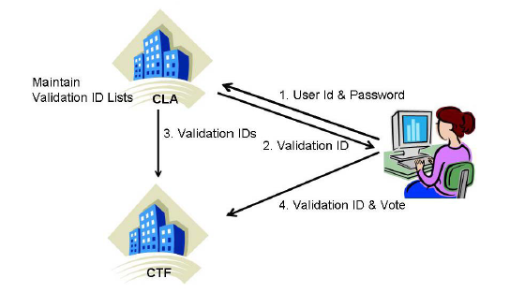
Voting with two central facilities
4. E-Voting CS580_F15

Slide 67
Voting with two central facilities
Pros
  CTF and CLA watch each other.
  The voter can make sure his vote was counted
  No single facility knows everything about a voter
Cons
  The CLA could certify ineligible voters or certify eligible voters multiple times.
  If CLA and CTF collude, they know everything
4. E-Voting CS580_F15

