Slide 1
CS580
Internet Security Protocols
5. Secret Sharing
Huiping Guo
Department of Computer Science
California State University, Los Angeles

Slide 2
Outline
Secret Sharing
  Motivation
  Simple secret sharing
  Scenario
  Threshold secret sharing
  Generalized secret sharing scheme [11]
  Verifiable secret sharing [9-10]
Bit commitment
Secure multiparty computation
Anonymous message broadcast
5. Secret Sharing CS580_F15

Slide 3

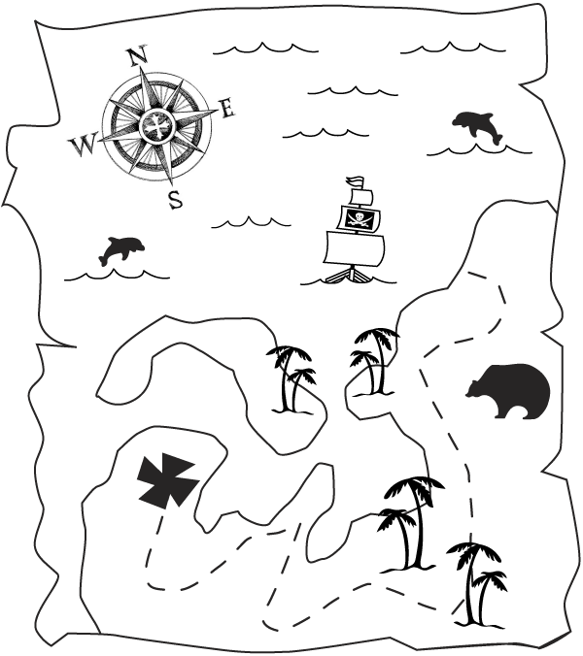
Motivation
5. Secret Sharing CS580_F15

Slide 4
Motivation
Suppose Alice and Bob accidentally discovered a map that helps them find a box full of treasure
Alice and Bob are very excited and would like to go home and get ready for the exciting journey to the great fortune.
Now who is going to keep the map?
  Suppose Alice and Bob do not really trust each other
  They are afraid that, if the other one has the map, he/she might just go alone and take everything
5. Secret Sharing CS580_F15

Slide 5
Motivation
We need a scheme that could make sure that the map is shared in a way so that no one would be left out in this trip
The scheme is called secret sharing scheme!
  split the map into two pieces and make sure that both pieces are needed in order to find the treasure box
  Each can happily go home and be assured that the other has to go with you in order to find the treasure
5. Secret Sharing CS580_F15

Slide 6
Motivation
Secret and confidential information theft is a major computer crime
  Some criminals’ tools (like viruses) tend to destroy information.
  More than 80% of organizations reported virus’s attacks.
I have to keep a copy of some important information
If the copy is destroyed, there is no way to retrieve it
  What to do?
  Duplicate!
Replicating the important information will give more chance to intruders to gain access to it.
There is a need to keep information in a secure and reliable way.
  Secret Sharing!!!
5. Secret Sharing CS580_F15

Slide 7
Simple secret sharing schemes
Also called secret splitting
  Take a message and divide it up into pieces
  Each piece by itself means nothing
  Put the pieces together, the original message appears
Secret sharing between two people
  Trent generates a random bit string R, the same length as message M
  Trent XORs M with R to generate S
  S = M ⊕ R
  Trent gives R to Alice and S to Bob
  M is discarded
To reconstruct the message
  Alice and Bob just XOR their pieces
  S ⊕ R = M
5. Secret Sharing CS580_F15

Slide 8
Simple secret sharing schemes
Example. M = 343A
5. Secret Sharing CS580_F15

Slide 9
Simple secret sharing schemes
How to share M among more than two people?
  XOR more random bit strings
Share M among 4 people
  Trent generates 3 random bit strings, R, S and T, the same length as M
  Trent XORs M with the 3 random bit strings to generate U = M ⊕ R ⊕ S ⊕ T
  Trent gives R to Alice, S to Bob, T to Carol and U to Dave
To reconstruct M
  Alice, Bob, Carol and Dave get together and compute
  U ⊕ R ⊕ S ⊕ T = M
5. Secret Sharing CS580_F15

Slide 10
Example
Example. M = 343A
5. Secret Sharing CS580_F15

Slide 11
Problem with this scheme?
If any of the pieces is lost, so does the message
5. Secret Sharing CS580_F15

Slide 12
Scenario 2
You’re setting up a launch program for a nuclear missile.
Who can launch the missile
  The general and two colonels are authorized to launch the missile
  Five colonels are required to initiate a launch
5. Secret Sharing CS580_F15

Slide 13
Threshold Schemes
A (t, n) threshold scheme t<=n
  A secret is divided into n pieces, called shares or shadows, such that any t of them can be used to reconstruct the secret
Eg: a (3, 4) threshold scheme
  Trent can divide a secret message among Alice, Bob, Carol and Dave, each holds a share
  Any 3 of them can put their shares together and reconstruct the message
    If Alice gets run over by a bus, Bob, Carol and Dave can reconstruct the message
5. Secret Sharing CS580_F15

Slide 14
Shamir’s Threshold Scheme
It’s a (t,n) threshold scheme
  A trusted party T called dearler distributes a secret S (>=0) to n users
  Any group of t users can pool their shares to recover S
1. Set up:
1) T chooses a prime p > max (S, n), and defines a₀ = S
2) T selects t-1 random and independent coefficients
a_{1,} a_{2,} …. a_{t-1} ( 0 <= a_{j} <= p-1)
3) T defines a polynomial over Z_{p}
f(x) = a_{t-1} x^{t-1} + …. + a₂ x² + a₁ x¹ + a₀
5. Secret Sharing CS580_F15

Slide 15
Shamir’s Threshold Scheme
  3) T selects n distinct i (1<= i <= p-1) and computes
  S_{i} = f(i) mod p
  4) T securely transfers shares S_{i} to users P_{i}, along with the public index i
2. Pooling of shares
1) Any group of t or more users pool their shares
2) Their shares provide n distinct points (x,y) = (i,S_{i})
3) Using Lagrange Interpolation, the coefficients of the polynomial f(x) can be computed
4) The secret S = f(0) = a₀
5. Secret Sharing CS580_F15

Slide 16
Example
(t,n) = (2,2) s = 5 p = 251
5. Secret Sharing CS580_F15

Slide 17
Example
(t,n) = (3,3) s = 5, p = 251
5. Secret Sharing CS580_F15

Slide 18
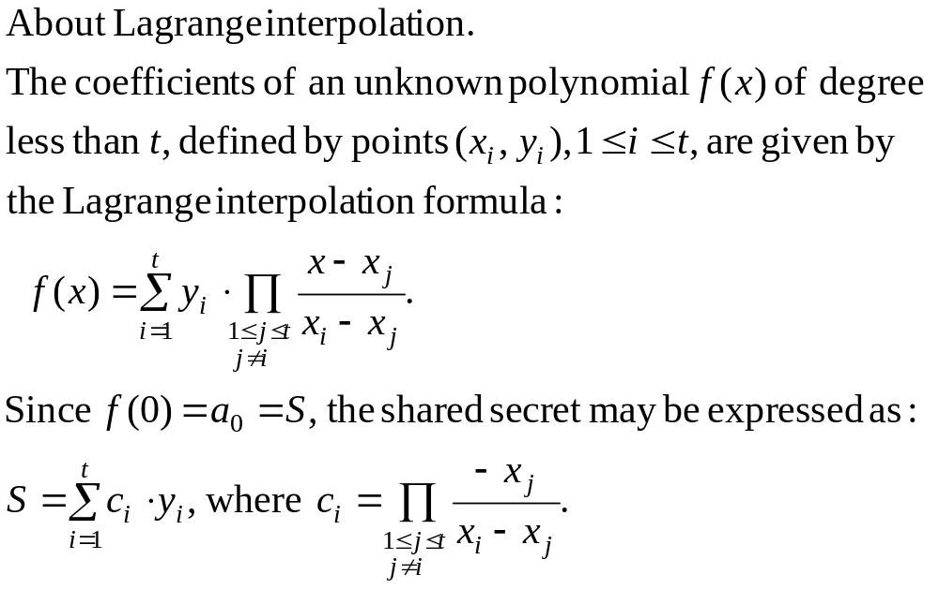
Shamir’s Threshold Scheme
5. Secret Sharing CS580_F15

Slide 19
Shamir’s Threshold Scheme
Each group member may compute S as a linear combination of t shares Yi
Since ci is a non-secret constant, for a fixed group of t, users may be pre-computed.
5. Secret Sharing CS580_F15

Slide 20
Example 1
Construct a (2,3) threshold scheme to share a secret S = 12
  Choose p =
  Choose a1= a2=
  f(x) =
  Select ? distinct i, and computes Si = f(i)
  Assign (i, Si) to users
5. Secret Sharing CS580_F15

Slide 21
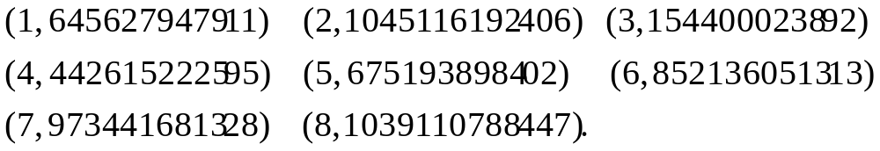
Example 2
Let’s construct a (3,8) threshold scheme
Suppose S = 190503180520, p=1234567890113
Select 2 random coefficents
a₁= 482943028839, a₂=1206749628665
f(x) = a₂x² + a₁x + S
=1206749628665x² + 482943028839 x + 190503180520
We now give 8 people pairs (i, Si), where i=1,2…8
We distribute the following pairs, one to each person
5. Secret Sharing CS580_F15

Slide 22
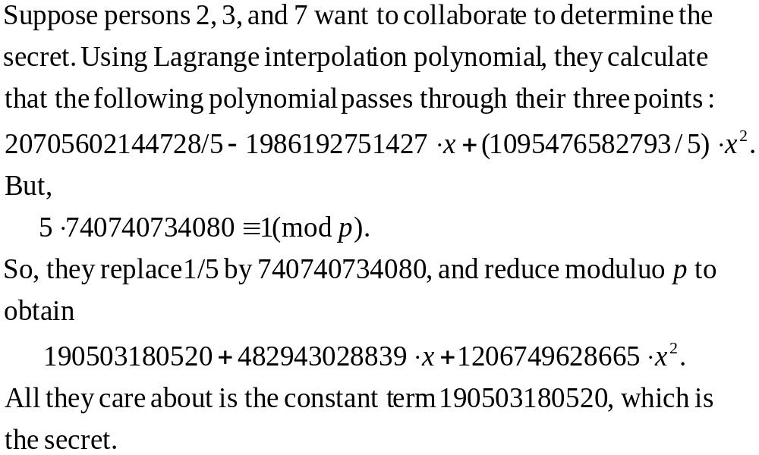
Example 2
5. Secret Sharing CS580_F15

Slide 23
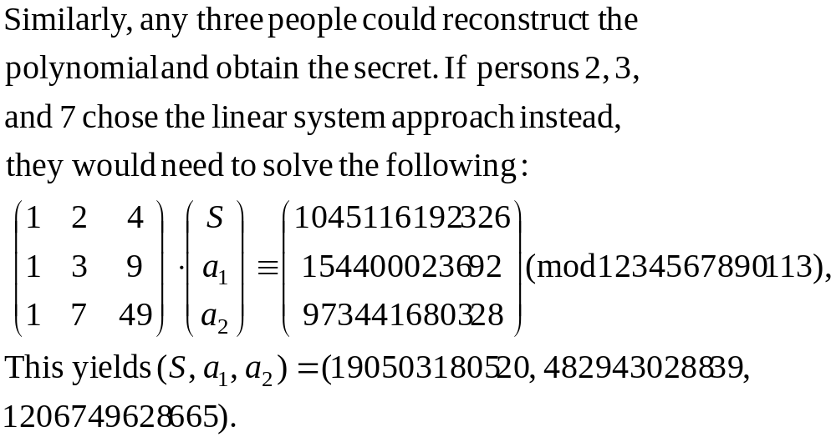
Example 2
5. Secret Sharing CS580_F15

Slide 24
Shamir’s Threshold Scheme: properties
Perfect
  Given any t-1 or fewer shares, all values 0<=S<=p-1 of the shared secret remain equally probable
Ideal
  The size of one share is the size of the secret
Extendable for new users
  New shares for new users can be computed and distributed without affecting shares of existing users
Varying levels of control are available
No unproven assumptions
5. Secret Sharing CS580_F15

Slide 25
Generalized secret sharing scheme
Shamir’ (t, n) threshold scheme
  ANY t out of n participants can recover the shared secret
Can we make it more flexible?
Eg: three participants: Alice, Bob and Carol
  Alice and Bob can recover the secret
  Carol and Bob can recover the secret
  Alice and Carol cannot recover the secret
5. Secret Sharing CS580_F15

Slide 26
Access structure
An access structure for a set P of participants is a set of subsets of P, each subset is a group of participants who are authorized to recover the secret
  Eg: AS = { {P1,P2}, {P1,P3} }
  Only (P1 and P2) or ( P1 and P3) can recover the secret
Each subset in AS is minimal
  Eg: in the above example, we don’t list {p1,p2,p3} in AS
5. Secret Sharing CS580_F15

Slide 27
Perfect Secret Sharing Scheme for AS
A perfect secret sharing scheme realizing the access structure AS is a method of sharing a secret S among a set P of parties such that:
  1) Any authorized subset of AS can recover S
  2) No unauthorized subset can recover S or obtain any partial information about S
Given an access structure AS, we want a perfect secret sharing scheme realizing AS
  Boolean circuit corresponding to AS and a secret-splitting scheme
  Shamir’s secret sharing
5. Secret Sharing CS580_F15

Slide 28
Boolean Circuit for AS
Inputs to the circuit:
  a wire for every element in a subnet in AS
Output of the circuit:
  The secret S to be recovered
Can be constructed from the “minimal elements” of AS
5. Secret Sharing CS580_F15

Slide 29
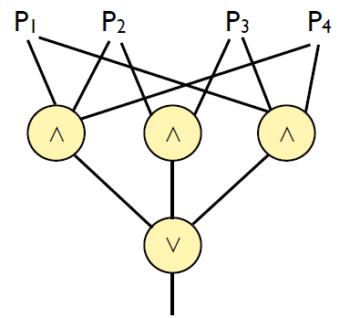
Example
P = {p1, p2, p3, p4}
AS = { {p1, p2, p4}, {p1,p3,p4}, {p2, p3} }
5. Secret Sharing CS580_F15

Slide 30
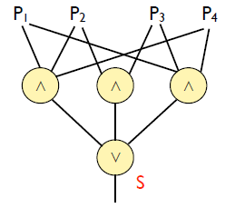
Example
Given a secret S as a bit string
First set output wire of circuit to be S
5. Secret Sharing CS580_F15

Slide 31
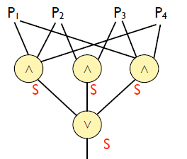
Example
Then duplicate S back through a V node
5. Secret Sharing CS580_F15

Slide 32
Example
For every Λ node, do a (t, t) secret splitting of the output node among the inputs of the node
5. Secret Sharing CS580_F15

Slide 33
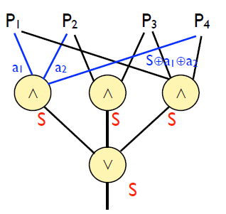
Example
For every Λ node, do a (t, t) secret splitting of the output node among the inputs of the node
5. Secret Sharing CS580_F15

Slide 34
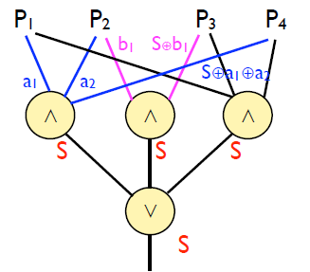
Example
For every Λ node, do a (t, t) secret splitting of the output node among the inputs of the node
5. Secret Sharing CS580_F15

Slide 35
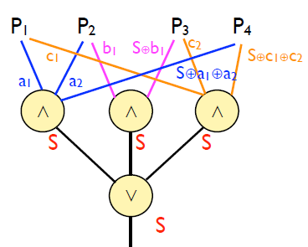
Example
For every Λ node, do a (t, t) secret splitting of the output node among the inputs of the node
5. Secret Sharing CS580_F15

Slide 36
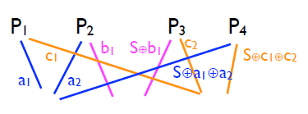
Example
Give the appropriate shares to each partyby looking at the wires out of that party
P1 gets {a1, c1} P2 gets {a2, b1}
P3 gets {S⊕b1, c2} P4 gets {S⊕a1⊕a2, S⊕c1⊕c2}
5. Secret Sharing CS580_F15

Slide 37
Generalized Secret Sharing with Shamir’s scheme
Given an AS, find AS
AS contains a set of subsets of P, each subset is a group of participants who are UNauthorized to recover the secret
  Each subset is maximal
Let t be the number of subsets in AS
Use Sharmir’s (t,t) scheme to generate t shares
For each subset in AS, assign one share to the participants that are NOT in the subset
5. Secret Sharing CS580_F15

Slide 38
Example
P = {p1, p2, p3, p4}
AS = { {p1, p2, p4}, {p1,p3,p4}, {p2, p3} }
AS = { {p1, p2}, {p1,p3}, {p1,p4}, {p2,p4}, {p3,p4} }
t = |AS| = 5
Use Shamir’s (5,5) scheme to generate 5 shares
s1, s2, s3, s4, s5
5. Secret Sharing CS580_F15

Slide 39
Example
{p1, p2}, give s1 to {p3, p4)
{p1,p3}, give s2 to {p2, p4}
{p1, p4}, give s3 to {p2, p3}
{p2, p4}, give s4 to {p1, p3}
{p3, p4}, give s5 to {p1, p2}
P1 gets {s4, s5} P2 gets {s2, s3, s5}
P3 gets {s1, s3, s4} P4 gets {s1, s2}
5. Secret Sharing CS580_F15

Slide 40
Exercise
P = {p1, p2, p3, p4}
AS = { {p1, p2}, {p3,p4}, {p2, p3} }
5. Secret Sharing CS580_F15

Slide 41
Verifiable secret sharing
In Shamir’s scheme, the dealer T is reliable
A misbehaving dealer may give invalid shares to users, from which they are not able to reconstruct the shares
  The shares are inconsistent
To prevent such malicious behavior of the dealer, one needs to implement a protocol through which a consistent dealing can be verified by the recipients of shares
5. Secret Sharing CS580_F15

Slide 42
Verifiable secret sharing
The problem of verifiable secret sharing is to convince shareholders that their shares (collectively) are ,t-Consistent
  every subset of t shares out of n (that the Dealer distributed) defines the same secret.
It is easy to see that in Shamir’s scheme, the distributed shares are t-Consistent if and only if the interpolation of the points yields a polynomial of degree at most t-1.
5. Secret Sharing CS580_F15

Slide 43
Verifiable secret sharing
The basic idea is that the dealer sends extra information to each participant during the distribution and each participant verifies that his/her secret share is consistent with this extra information.
Additional requirement: The encryption algorithm should have the homomorphic property both with respect to addition and to multiplication (Diffie-Hellman)
  E(x+y) = E(x) * E(y)
  E(x*y) = E(x)^{y} = E(y)^{x}
5. Secret Sharing CS580_F15

Slide 44
homomorphic property example
E(x+y) = E(x) * E(y)
Diffie-Hellman: E(x) = g^{x} mod p
E(x+y) = g^{x+y} mod p = (g^{x} mod p) * (g^{y} mod p)
= E(x) * E(y)
E(x*Y) = E(x)^{y} = E(y)^{x}
E(x*y) = g^{x*y} mod p = (g^{x})^{y}
= E(x)^{y}
= E(y)^{x}
5. Secret Sharing CS580_F15

Slide 45
Verifiable secret sharing
The Dealer uses Shamir’s secret sharing scheme; for a secret s, the Dealer creates f(x), in which (also marked as a₀):
f(x) = a₀ + a₁ x + … + a_{t-1} x^{t-1}
and distributes the shares: , one for each participant.
In addition, the Dealer publishes the encryption of all the t coefficients:
E(a_{o}) = gª0 mod p , E(a₁) = gª1 mod p , … E(a_{t-1}) = gªt-1 mod p
5. Secret Sharing CS580_F15

Slide 46
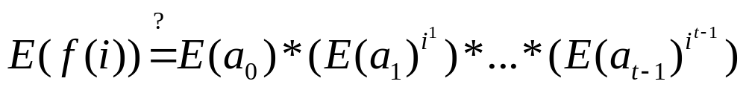
Verifiable secret sharing
Each i^{th} shareholder verifies his/her own share by checking the following equation:
If this equation holds, the i^{th} shareholder broadcasts a message saying that he/she accepts his/her share as proper.
If all the shareholders find their shares correct, then the dealing phase is completed successfully.
If for some k, the k’th shareholder finds the above equation incorrect, then the k’th shareholder publishes an accusation against the dealer.
The honest shareholders can decide whether it is the Dealer or the accuser that misbehaves.
5. Secret Sharing CS580_F15

Slide 47
Example
Our secret is s = 5.
n = 7, meaning that we have 7 shareholders.
The polynomial is of degree: t-1 = 3.
p is large enough
5. Secret Sharing CS580_F15

Slide 48





Example
=
The Dealer randomly chooses the coefficients
The polynomial is
The shares are: f(1) = 10, f(2) = 29,… f(7) = 754
The encryption of the coefficients are
The i^{th} shareholder verifies the validity of his/her share
For the first shareholder (i =1)
should be equal to
5. Secret Sharing CS580_F15

Slide 49
Question
How the 2nd shareholder verifies the validity of his/her share?
5. Secret Sharing CS580_F15

Slide 50
Bit commitment: Scenario
Stockbroker Alice wants to convince investor Bob that her method of picking winning stocks is sound
Bob: Pick 5 stocks for me. If they’re all winners, I’ll give you my business
Alice: If I pick 5 stocks for you, you could invest in them without paying me. Why don’t I show you the stocks I picked last month?
Bob: How do I know you didn’t change last month’s picks after you knew their outcome. If you tell me your picks now, I know you cannot change them. I won’t invest in the those stocks until after I purchased your method. Trust me.
Alice: I’d rather show you my picks from last month. I didn’t change them. Trust me.
5. Secret Sharing CS580_F15

Slide 51
Bit commitment: Scenario
Alice wants to commit to a prediction (a bit or a series of bits)
She doesn’t want to reveal her prediction until sometime later
Bob wants to make sure that Alice cannot change her mind after she has committed her prediction
5. Secret Sharing CS580_F15

Slide 52
Bit commitment using One-Way Functions
Alice generates two random-bit strings, R1 and R2
Alice creates a message consisting of her random strings and the bit she wishes to commit to (R1, R2, b)
Alice computes the one-way function on the message and sends the result, as well as one of the random strings, to Bob H(R1, R2, b), R1
  The transmission from Alice is evidence of commitment.
  The one way function prevents Bob from inverting the function and determining the bit
5. Secret Sharing CS580_F15

Slide 53
Bit commitment using One-Way Functions
When it comes time for Alice to reveal her bit, the protocol continues
Alice sends Bob the original message (R1,R2,b)
Bob computes the one-way function on the message and compares it and R1, with the value and random strings he received in step 3. If they match, the bit is valid
5. Secret Sharing CS580_F15

Slide 54
Secure multiparty computation
There are a group of people P1, P2, …, Pn
Each member in the group has a variable v
  P1 has v1, P2 has v2,…, Pn has vn
They want to work together to calculate f(v1, v2,…, vn).
The result of the function is known to all members in the group
No one learns anything about the inputs of other members from the result
5. Secret Sharing CS580_F15

Slide 55
Example
How can a group of people calculate their average salary without anyone learning the salary of anyone else?
  Suppose Alice, Bob, Carol and Dave are the group members
  Alice adds a secret random number to her salary, encrypts the result with Bob’s public key, and sends it to Bob
  Bob decrypts Alice’s s result with his private key. He adds his salary to decryption result, encrypts the result with Carol’s public key, and sends it to carol
5. Secret Sharing CS580_F15

Slide 56
Example
  Carol decrypts Bob’s result with her private key. She adds her salary to what he received from Bob, encrypts the result with Dave’s public key, and sends it to Dave
  Dave decrypts Carol’s result with his private key. He adds his salary to what he received from Carol, encrypts the result with Alice’s public key, and sends it to Alice
  Alice decrypts Dave’s result with her private key. She subtracts the random number from step 1 to recover the sum of everyone’s salary
  Alice divides the result by the number of people and announces the result
5. Secret Sharing CS580_F15

Slide 57
Secure Multiparty Computation
Yao’s millionaire problem
  A special case of secure multiparty computation
  Alice knows the integer i
  Bob knows the integer j
  Alice and Bob wish to know whether i<=j or if i>j
  Neither Alice nor Bob wish to reveal the integer each knows
Assumption
  i and j range from 1 to 100
  Bob has a public key and a private key
5. Secret Sharing CS580_F15

Slide 58
Secure Multiparty Computation
Alice chooses a large random number, x, and encrypts it with Bob’s public key
c=E_{B}(x)
E_{B} is the encryption algorithm with Bob’s public key
Alice computes c-i and sends the results to Bob
Bob computes the following 100 numbers:
y_{u} = D_{B} (c-i+u), for 1<=u<=100
D_{B} is the decryption algorithm with Bob’s private key
5. Secret Sharing CS580_F15

Slide 59
Secure Multiparty Computation
Bob chooses a large random prime p
  p should be smaller than x
  Bob doesn’t know x, but Alice could easily tell him the size of x
Bob computes the following 100 numbers:
z_{u} = (y_{u} mod p), for 1<=u<=100
Bob verifies that, for all u≠ v
| z_{u} – z_{v} | >= 2 and that for all u
0 < z_{u} < p-1
If this is not true, Bob chooses another prime and try again.
5. Secret Sharing CS580_F15

Slide 60
Secure Multiparty Computation
Bob sends Alice this sequence of numbers in this exact order
z₁, z₂, …, z_{j}, z_{j+1} +1, z_{j+2} +1, …, z₁₀₀ +1, p
Alice checks whether the i^{th} number is in the sequence is congruent to x mod p.
  If it is, she concludes that i <= j
  If it is not, she concludes that i > j
Alice tells Bob the conclusion
5. Secret Sharing CS580_F15

Slide 61
Example
RSA is used.
Bob’s public key is 7
His private key is 23.
n=55
Alice’s secret value i, is 4
Bob’s secret value j, is 2.
Only the values 1,2,3, and 4 are possible for i and j
5. Secret Sharing CS580_F15

Slide 62
Example
Alice chooses x = 39 and c=E_{B}(39) = 19
Alice computes c-i = 19-4 = 15. She sends 15 to Bob
Bob computes the following 4 numbers
y₁ = D_{B}(15+1) = 26
y₂ = D_{B}(15+2) = 18
y₃ = D_{B}(15+3) = 2
y₄ = D_{B}(15+4) = 39
5. Secret Sharing CS580_F15

Slide 63
Example
Bob chooses a prime p = 31
Bob computes the following 4 numbers:
z₁ = (26 mod 31) = 26
z₂ = (18 mod 31) = 18
z₃ = (2 mod 31) = 2
z₄ = (39 mod 31) = 8
Bob does all the verification and confirms that the sequence is fine.
5. Secret Sharing CS580_F15

Slide 64
Example
Bob sends Alice this sequence of numbers in this exact order
z₁, z₂, …, z_{j}, z_{j+1} +1, z_{j+2} +1, …, z₁₀₀ +1, p
= 26, 18, 2+1, 8+1, 31
= 26, 18, 3, 9, 31
Alice checks whether the 4th number is in the sequence is congruent to 39 mod 31.
  No. she concludes that i > j (4>2)
Alice tells Bob the conclusion
5. Secret Sharing CS580_F15

Slide 65
Discussion
All the verification Bob in steps 3-6 is to guarantee that no number appears twice in the generated in step 7
  Otherwise, if z_{a} = z_{b}, Alice knows that a <= j < b
One drawback of the protocol
  Alice learns the results of the computation before Bob does
  Nothing stops her from completing the protocol up to step 8 and then refusing to tell Bob the results in step 9
  She could even lie to Bob in step 9
5. Secret Sharing CS580_F15

Slide 66
Anonymous message broadcast
Dining cryptographers problem
Three cryptographers share a meal
The meal is paid either by NSA (National Security Agency) or by one of them anonymously.
The cryptographers would like to know whether NSA is paying or not, but without knowing the identity of the cryptographer who is paying (if any).
5. Secret Sharing CS580_F15

Slide 67
Protocol
Each cryptographer flips an unbiased coin behind his menu, between him and the cryptographer to his right, so that only the two of them can see the outcome
Each cryptographer then states aloud whether two coins he can see fell on the same sides or on different sides
If one of the cryptographers is the payer, he states the opposite of what he sees
An odd number of differences indicates that a cryptographer is paying
An even number of differences indicates that NSA is paying
5. Secret Sharing CS580_F15

