Slide 1
CS580
Internet Security Protocols
6. Blind Signature
Huiping Guo
Department of Computer Science
California State University, Los Angeles

Slide 2
Outline
Blind signature
  Blind signature vs. traditional digital signature
  RSA based blind signature
  RSA based partially blind signature
Digital Cash
Acknowledgement: The materials are adapted from slides by
Dr. Chun-I Fan, and Dr. David Evans.
6. Blind signature CS580_F15

Slide 3
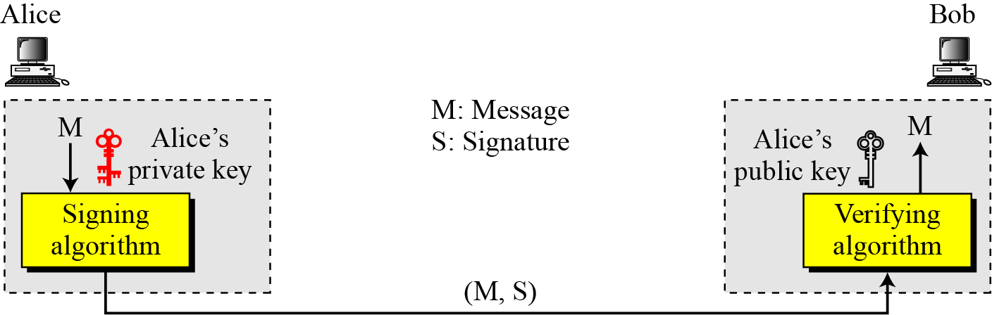
Traditional digital signature
6. Blind signature CS580_F15

Slide 4

Traditional signature
❶ Message
Requester
Signer
❷ Signature on Message
Linkable
Signer
The signer’s signature on “Message”
6. Blind signature CS580_F15

Slide 5
Signature Generation and Verification
Signer
Key
Message
Signature
Generator
Requester
Signature
Signature
Verifier
True / False
6. Blind signature CS580_F15

Slide 6
Blind signature
A technique to digitally sign a message without revealing the message to the signer
The message to be signed is combined with a blinding factor, which prevents the signer from reading the message but can later be removed without damaging the signature
6. Blind signature CS580_F15

Slide 7
Blind signature properties
1. Correctness: the correctness of the signature of a message signed through the signature scheme can be checked by anyone using the signer’s public key.
2. Authenticity: a valid signature implies that the signer deliberately signed the associated message.
3. Unforgeability: only the signer can give a valid signature for the associated message.
4. Non-reusability: the signature of a message can not be used on another message .
6. Blind signature CS580_F15

Slide 8
Blind signature properties
5. Non-repudiation: the signer can not deny having signed a message that has valid signature.
6. Integrity: ensure the contents have not been modified.
7. Blindness: the content of the message should be blind to the signer; the signer of the blind signature does not see the content of the message.
8. Untraceability: the signer of the blind signature is unable to link the message-signature pair even when the signature has been revealed to the public.
6. Blind signature CS580_F15

Slide 9
Blind Signature
❶
Message
Requester
Signer
❷ Signature on
Message
Unlinkable
Signer
❸ The signer’s signature on “Message”
6. Blind signature CS580_F15

Slide 10
Blind Signature
❶
“Message”
: the blinded message
❷ Signature on
“Message”
: the blind signature
❸ Signature on “Message”: to be obtained after unblinding
Unlinkability: it is intractable for the signer to
link the signature to the message
6. Blind signature CS580_F15

Slide 11
Signature Generation and Verification
User
Signer
Message
Message
Key
Blinding
Signing
Unblinding
Blind Signature
Signature
Message
Signature
Verifier
True / False
6. Blind signature CS580_F15

Slide 12
Applications of (partially) blind signature
Electronic Cash / Digital cash
  Digital cash is blindly signed by bank
  Bank has no way to track where the digital cash is spent
Online election protocol
  A voter’s vote is blindly signed by authorized party
  No one knows whom the voter votes for.
6. Blind signature CS580_F15

Slide 13












The Chaum scheme
Initializing phase
  Signer chooses two primes and , then computes , .
  Choose two large numbers and such that mod and .
  Let be the signer’s public key and be the signer’s privacy key. Signer keeps secure and publishes
6. Blind signature CS580_F15

Slide 14
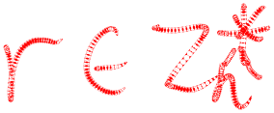


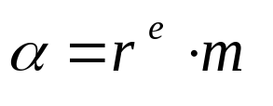


The Chaum scheme
Blinding phase
  Requester has a message ,then randomly selects an integer as the blinding factor ,
  Requester computes mod , and sends to the signer.
6. Blind signature CS580_F15

Slide 15

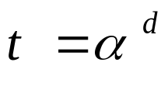
The Chaum scheme
Signing phase
  After receiving from the requester, the signer computes mod and replies it to the requester.
6. Blind signature CS580_F15

Slide 16

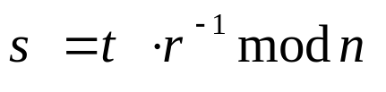

The Chaum scheme
Unblinding phase
  Upon receiving ,The requester computes
  and gets the signature of the message
6. Blind signature CS580_F15

Slide 17

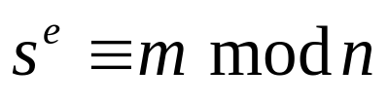
The Chaum scheme
Verifying phase
is the signature on the message . Any one can verify the signature by checking whether
6. Blind signature CS580_F15

Slide 18
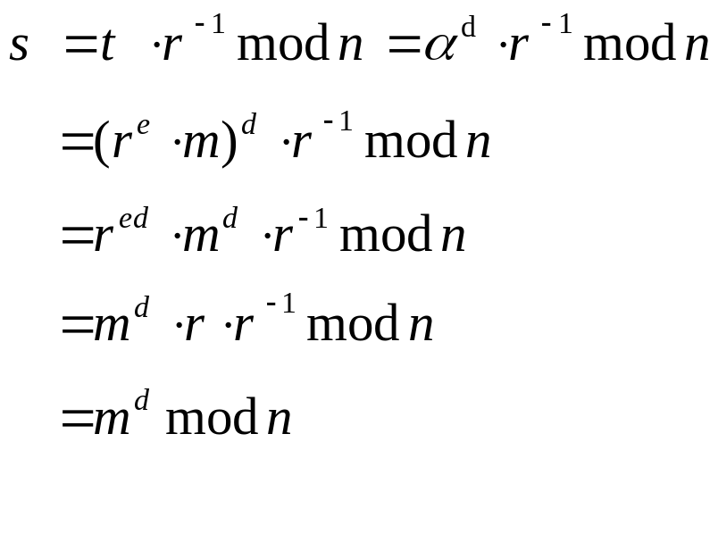
Proof
The blind factor is removed as
Since
  ed ≡ 1 mod ф(n))
  r^{ed} ≡ r mod n (Fermat’s little theorem)
6. Blind signature CS580_F15

Slide 19
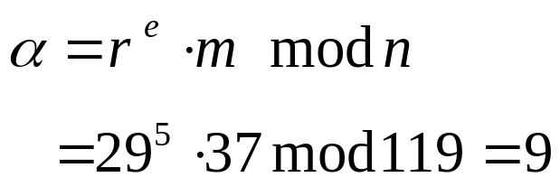
Example
The signer’s public key is (5,119), the private key is (77, 119), p=7, q=17
Blinding phase
  The requester wants a signature on m=37
  He select a random blinding factor r =29 and blinds the message m
  The requester sends 9 to the signer
6. Blind signature CS580_F15

Slide 20

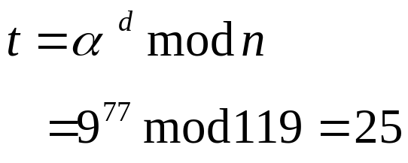
Example
Signing phase
  After receiving , the signer calculates the blind signature
  The singer sends 25 to the requester
6. Blind signature CS580_F15

Slide 21

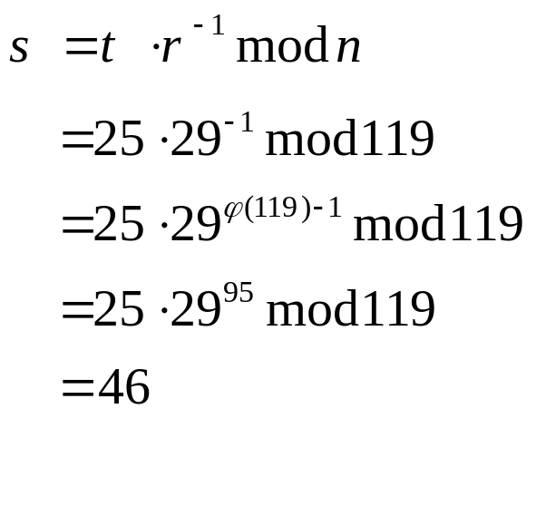
Example
Unblinding phase
  Upon receiving ,the requester computes
  46 is the signature of m=37
6. Blind signature CS580_F15

Slide 22
Problem
With the completely blind signature protocol, the requester (Alice) can have the signer(Bob) sign anything
  “Bob owes Alice a million dollors”
How to prevent Alice from cheating?
6. Blind signature CS580_F15

Slide 23
Scenario
There is a group of counterintelligence agents.
Their identities are secret; not even the counterintelligence agency knows who they are.
The agency’s director wants to give each agent a signed document stating “The bearer of this signed document, (insert agent’s cover name here), has full diplomatic immunity”
Each of the agents has his own list of cover names, so the agency cannot just hand out signed documents.
The agents don’t want to sent their cover names to the agency.
  The enemy might have corrupted the agency’s computer
6. Blind signature CS580_F15

Slide 24
Scenario
On the other hand, the agency doesn’t want to blindly sign any document an agent gives it.
  A clever agent might substitute a message like “ Agent (name) has retired and collects a million-dollar-a-year-pension”. Signed, Mr. President”.
Improved blind signature protocol
  Assume that all the agents have 10 possible cover names, which they have chosen themselves and which no one else knows.
  Also assume that the agents don’t care under which cover name they’re going to get diplomatic immunity
  Agent---Alice, Agency--Bob
6. Blind signature CS580_F15

Slide 25
Improved blind signature protocol
Alice prepares 10 documents, each using a different cover name, giving herself diplomatic immunity
Alice blinds each of these documents with a different blinding factor
Alice sends the 10 blinded documents to Bob
Bob chooses 9 documents at random and asks Alice for the blinding factors for each of those documents
Alice sends Bob the appropriate blinding factor
Bob opens the 9 documents and makes sure they are correct—not pension authorization
Bob signs the remaining document and sends it to Alice
Alice removes the blinding factor and gets his new cover name on the signed document.
6. Blind signature CS580_F15

Slide 26
Partially Blind Signatures
❶
Message = (
m₁
# m₂)
User
Signer
❷ Signature on (
m₁
# m₂)
❸ The signer’s signature on (m₁ # m₂)
★
All of the signatures with the same m₂ are indistinguishable from the signer’s point of view.
6. Blind signature CS580_F15

Slide 27
Signature Generation and Verification
User
Signer
m₁, m₂
m₁
# m₂
Key
Blinding
Signing
Unblinding
Partially
Blind Signature
Signature on (m₁ # m₂)
(m₁, m₂)
Signature
Verifier
True / False
6. Blind signature CS580_F15

Slide 28
Chien’s partially blind signature
Step 1: Initialization
Step 2: Requesting
Step 3: Signing
Step 4: Extraction and verification
6. Blind signature CS580_F15

Slide 29
Step 1: Initialization
The signer randomly chooses two large primes p and q , and computes n = p . q and ø(n) = ( p-1)x(q-1)
The signer selects an integer e, gcd(ø(n),e)=1; 1<e<ø(n)
The signer calculates d=e⁻¹ mod ø(n)
The signer publishes (e, n) as his public key and keeps (d, p , q) secretly.
The signer also publishes a one-way hash function h such as SHA-1 or MD5
6. Blind signature CS580_F15

Slide 30
Step 2 Requesting
The requester prepares the message m and the common information a
He also randomly chooses two number r and u , where r and u belong to Zn* . then, computes σ = r^{e}h(m)(u²+1) mod n and sends the tuple (a, σ) to the signer.
After verifying the common information a , the signer randomly chooses a positive integer x less than n and sends it to the requester.
Upon receiving x, the requester randomly selects an integer r’ and lets b = r . r ’ .
Then he computes β = b^{e}(u-x) mod n and sends β to the signer.
6. Blind signature CS580_F15

Slide 31
Step 3 Signing
The signer computes β⁻¹ mod n
The signer computes
t =h(a)^{d} (σ(x²+1) β⁻²)^{2d} mod n
Then he submits (β⁻¹, t ) to the requester
6. Blind signature CS580_F15

Slide 32
Step 4 Extraction and verification
Upon receiving (β⁻¹, t ), the requester acquires the signature by computing
c = (ux+1) * β⁻¹ * b^{e}
= ( ux + 1) * (u – x )⁻¹ mod n
s = t*r²*r’⁴ mod n
The tuple (a, c, s) is the signature on message m
To verify the signature, check
s^{e} = h(a)*h(m)²*(c²+1)² mod n
6. Blind signature CS580_F15

Slide 33
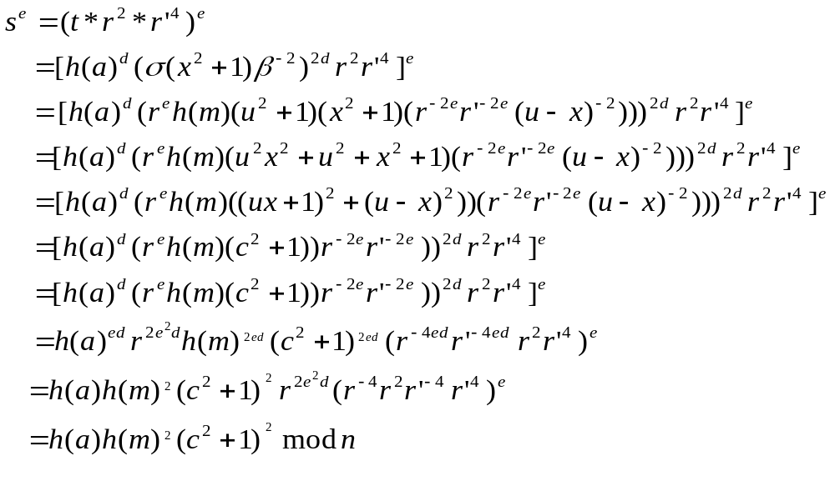
Proof
6. Blind signature CS580_F15

Slide 34
Example
Step 1
  The signer’s public key is (5, 119)
  The signer keeps (d, p , q) = (77, 7, 17) secure
6. Blind signature CS580_F15

Slide 35
Example: step 2
The requester prepares the message m=35 with h(m)=12 and the common information a=28 with h(a)=15
He also randomly chooses two number r=4 and u=8, where r and u belong to Z_{119*} . then, computes
σ = r^{e}h(m)(u²+1) mod n = 4⁵*12*(64+1) mod 119 = 111
The requester sends the tuple (a, σ)=(28,111) to the signer.
After verifying the common information a=28 , the signer randomly chooses a positive integer x = 17 and sends it to the requester.
Upon receiving x=17, the requester randomly selects an integer r’ =22 and lets b = r . r ’ = 4*22 = 88.
Then he computes β = b^{e}(u-x) mod n = 88⁵*(8-17) mod 119 = 108 and sends β=108 to the signer.
6. Blind signature CS580_F15

Slide 36
Step 3 Signing
The signer computes β⁻¹ mod n
φ(119) = φ(7x17) =96
108⁻¹ mod 119 = 108⁹⁵ mod 119 = 54
The signer computes
t =h(a)^{d} (σ(x²+1) β⁻²)^{2d} mod n
= 15⁷⁷ (111*(17²+1)*108⁻²)^{2*77} mod 119
= 36*(111*290*54²) ^{2*77} mod 119
= 100
Then he submits (β⁻¹, t )=(54, 100) to the requester
6. Blind signature CS580_F15

Slide 37
Step 4 Extraction and verification
Upon receiving (β⁻¹, t )=(54, 100), the requester acquires the signature by computing
c = (ux+1) * β⁻¹ * b^{e}
= (8*17+1)*54*88⁵ mod 119 = 117
s = t*r²*r’⁴ mod n
= 100* 4² * 22⁴ mod 119 = 60
The tuple (a, c, s) = (28,117,60) is the signature on message m=35
6. Blind signature CS580_F15

Slide 38
Step 4 Extraction and verification
To verify the signature, check
s^{e} = h(a)*h(m)²*(c²+1)² mod n ?
s^{e} = 60⁵ mod 119 = 93
h(a)*h(m)²*(c²+1)² mod n
15*12²* (117²+1)² mod 119
=15*25*25 mod 119
= 93
6. Blind signature CS580_F15

Slide 39
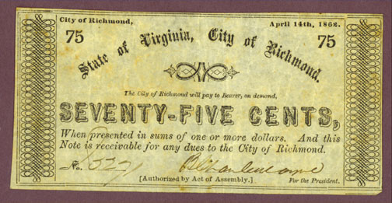
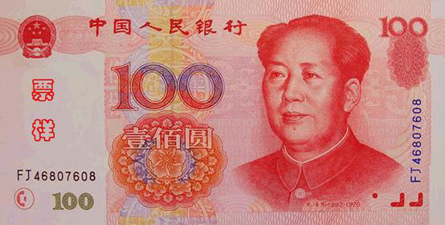
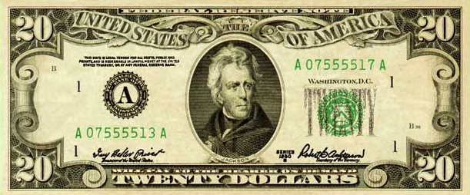
Properties of Physical Cash
Easy to transfer
Anonymous
Works even when the banks are closed
Big and Heavy
  500 US bills / pound
  Bill Gates net worth would be ~200 tons in $100 bills
You could be the target of thieves.
Paper cash is also a media for bacteria.
6. Blind signature CS580_F15

Slide 40
What is Digital Cash?
Can we replace paper cash with digital/Electronic cash?
Digital cash is a digitally signed payment message that serves as a medium of exchange
Some forms of money are already in digital formats:
  Credit or debit cards.
  E-banking.
  Money transfer btw different accounts via e-banking or Electronic Funds Transfer (EFT)
However, these are not digital cash, because they fail to meet some essential requirements for digital cash
6. Blind signature CS580_F15

Slide 41
Requirements
Three parities in digital cash: a customer, a merchant, and the bank
  Security: The digital cash cannot be forged and/or reused by a user illegally.
  Privacy (Untraceability) : Nobody, including the bank, can reveal the relationship btw the identities of customers and the digital cash. It includes both unlinkability and anonymity.
  Transferability: Digital cash can be transferred btw customers without the help from the bank
  Divisibility: A user can subdivide a piece of e-cash into smaller pieces of e-cash in small denominations
6. Blind signature CS580_F15

Slide 42
Digital Cash vs Credit Card
Anonymous | Identified
Online or Off-line | Online
Store money in digital wallet | Money is in the Bank
6. Blind signature CS580_F15

Slide 43
Digital Cash
On-line digital cash
  Merchant needs to contact bank during each payment
  Verify that the digital cash has not been used before
  Necessary for transactions that need a high value of security
Off-line digital cash
  Customer can freely pass value to Merchant at any time of the day without involving any third party like a bank
  preferable from a practical viewpoint, they are however susceptible to the multi-spending problem
  Suitable for low value transactions.
6. Blind signature CS580_F15

Slide 44
The Online Model
Structure Overview
Link with other banks
Bank
Withdraw Cash
Deposit Cash
Customer
Payment
Merchant
6. Blind signature CS580_F15

Slide 45
Pros and Cons of the online scheme
Pros
  Provides fully anonymous and untraceable digital cash.
  No double spending problems.
  Don't require additional secure hardware – cheaper to implement.
Cons
  Communications overhead between merchant and the bank.
  Huge database of cash records.
  Difficult to scale, need synchronization between bank servers.
6. Blind signature CS580_F15

Slide 46
The Offline Model
Bank
Others
T.R.D.
Temper-resistant
device
Customer
Merchant
6. Blind signature CS580_F15

Slide 47
Pros and Cons of the offline model
Advantages
  Off-line scheme
  User is fully anonymous unless double spend
  Bank can detect double spender
  Banks don’t need to synchronize database in each transaction.
Disadvantages
  Might not prevent double spending immediately
  More expensive to implement
6. Blind signature CS580_F15

Slide 48
Traceable Signature Protocol
Merchant
Customer
Bank
m
message m = amount, serial no
send
m
(m)^{d}
d is secret key of the Bank
(m)^{d}
spend
(m)^{d}
send
(m)^{d}
verify
6. Blind signature CS580_F15

Slide 49

Digital Cash, Protocol #1
Alice prepares 100 money orders for $1000 each.
m₁ = (…, $1000, …)
m₁₀₀ = (…, $1000, …)
m₁
m₁₀₀
, …,
6. Blind signature CS580_F15

Slide 50
Digital Cash, Protocol #1 cont.
3. Alice Creates blinding factors:b₁e,…, b₁₀₀e
4. Blind the units - m₁b₁e, …, m₁₀₀ b₁₀₀e
m₁ = (…, $1000, …)
m₁₀₀ = (…, $1000, …)
m₁b₁e
m₁₀₀b₁₀₀e
, …,
6. Blind signature CS580_F15

Slide 51
Digital Cash, Protocol #1 cont.
Gives envelopes to bank.
Bank
6. Blind signature CS580_F15

Slide 52
Digital Cash, Protocol #1 cont.
Band randomly chooses envelopes to check
  Bank ask Alice for the 99 blinding factors
  Bank opens the 99 envelopes and checks they contain money order for $1000.
i
6. Blind signature CS580_F15

Slide 53

Digital Cash, Protocol #1 cont.
Bank signs the remaining envelope without opening it ((m_{i}b^{e}_{i})^{d} = m_{i}^{d}b_{i}), sends it back, and deducts $1000 from Alice’s account
Customer
6. Blind signature CS580_F15

Slide 54
Digital Cash, Protocol #1 cont.
Alice removes the blinding using b_{i}⁻¹ → m_{i}^{d}, and spends the money order.
Merchant checks the Bank’s signature.
Merchant deposits money order.
Bank verifies its signature and credits Merchant’s account.
6. Blind signature CS580_F15

Slide 55
Digital Cash, Protocol #1
Is it anonymous?
Can Alice cheat?
  Make one of the money orders for $100000, 1% chance of picking right bill, 99% chance bank detects attempted fraud.
    Better make the penalty for this high (e.g., jail)
  Copy the signed money order and re-spend it.
Can Merchant cheat?
  Copy the signed money order and re-deposit it.
6. Blind signature CS580_F15

Slide 56
Digital Cash, Protocol #2
Idea: prevent double-spending by giving each money order a unique ID.
Problem: how do we provide unique IDs without losing anonymity?
Solution: let Alice generate the unique IDs, and keep them secret from bank.
6. Blind signature CS580_F15

Slide 57
Digital Cash, Protocol #2
Alice prepares 100 money orders for $1000 each, adds a long, unique random ID to each note.
Alice Creates blinding factors:b₁e,…, b₁₀₀e
Blinds the units - m₁b₁e, …, m₁₀₀ b₁₀₀e , puts each one in a different sealed envelope, and gives envelopes to bank.
Bank asks Alice for the 99 blinding factors, opens the 99 envelopes and checks they contain money order for $1000.
Bank signs the remaining envelope without opening it.
6. Blind signature CS580_F15

Slide 58
Digital Cash, Protocol #2 cont.
Bank returns envelope to Alice and deducts $1000 from her account.
Alice opens envelope by removing the blinding factor, and spends the money order.
Merchant checks the Bank’s signature.
Merchant deposits money order.
Bank verifies its signature, checks that the unique random ID has not already been spent, credits Merchant’s account, and records the unique random ID.
6. Blind signature CS580_F15

Slide 59
Digital Cash, Protocol #2
Is it anonymous?
Can Alice cheat?
Can Merchant cheat?
Can bank identify cheaters?
6. Blind signature CS580_F15

Slide 60
Digital Cash, Protocol #3
Alice prepares 100 money orders for $1000 each, adds a long, unique random ID to each note.
Alice Creates blinding factors:b₁e,…, b₁₀₀e
Blinds the units - m₁b₁e, …, m₁₀₀ b₁₀₀e , puts each one in a different sealed envelope, and gives envelopes to bank.
Bank asks Alice for the 99 blinding factors, opens the 99 envelopes and checks they contain money order for $1000.
Bank signs the remaining envelope without opening it.
6. Blind signature CS580_F15

Slide 61
Digital Cash, Protocol #3 cont.
Bank returns envelope to Alice and deducts $1000 from her account.
Alice opens envelope by removing the blinding factor, and spends the money order.
Merchant checks the Bank’s signature and makes sure the money order is legitimate
Merchant asks Alice to write a random identity string on the money order and Alice complies
Merchant deposits money order.
Bank verifies its signature, checks its database to make sure that the unique random ID has not already been spent, credits Merchant’s account, and records the unique random ID and the identity string in a database
6. Blind signature CS580_F15

Slide 62
Digital Cash, Protocol #3 cont.
If the uniqueness string is in the database. The bank refuses to accept the money order.
  It compares the identity string on the money order with the one stored in the database.
  If it is the same, the bank knows that the merchant photocopied the money order.
  If it is different, the bank knows that the person who bought the money order photocopied it.
6. Blind signature CS580_F15

Slide 63
Digital Cash, Protocol #3 cont.
Assumption: Merchant cannot change the identity string once Alice writes it on the money order
What if Alice frames the merchant?
  She could spend a copy of the money order a second time, giving the same identity string in step 9
If the bank found that the person who bought the money order cheated, can bank catch the cheater?
6. Blind signature CS580_F15

Slide 64
Anonymity for Non-Cheaters
Spend a bill once – maintain anonymity
Spend a bill twice – lose anonymity
Have we seen anything like this?
6. Blind signature CS580_F15

Slide 65
Digital Cash, Protocol #4
Alice prepares n money orders each containing:
  Amount Uniqueness String: X
  Identity Strings: I₁ = (I_{1L}, I_{1R})
  ...
  I_{n} = (I_{nL}, I_{nR})
Each I_{n} pair reveals Alice’s identity (name, address, etc.). I = I_{iL} ⊕ I_{iR}.
  Each money order contains n pairs two parts
  Alice’s identity is split into two shares in n different ways.
  Any pair reveals Alice’s identity
6. Blind signature CS580_F15

Slide 66
Digital Cash, Protocol #4
Alice blinds all n money orders, using a blind signature protocol, and sends them to bank.
Bank asks Alice to any n-1 of the blinding factors and all its corresponding identity strings.
Bank checks money orders. If okay, signs the remaining blinded money order, and deducts amount from Alice’s account.
6. Blind signature CS580_F15

Slide 67
Digital Cash, Protocol #4
Alice unblinds the signed the money order, and spends it with a Merchant
The merchant verifies the bank’s signature to make sure the money order is legitimate
Merchant asks Alice to randomly reveal either I_{iL} or I_{iR} for each i.
  Merchant gives Alice a random n-bit selector string, b1, b2,…, bn.
Alice sends Merchant corresponding I_{iL}’s or I_{iR}’s.
6. Blind signature CS580_F15

Slide 68
Digital Cash, Protocol #4
Merchant takes money order and identity string halves to bank.
Bank verifies its signature, and checks uniqueness string. If it has not been previously deposited, bank credits Merchant and records uniqueness string and identity string halves.
6. Blind signature CS580_F15

Slide 69
Digital Cash, Protocol #4
If the uniqueness string is in the database, the bank refuses to accept the money order.
  It compares the identity string on the money order with the one stored in the database
  If same, the bank knows that the merchant copied the money order
  If different, the bank knows that the person who bought the money order photocopied it
    Since the second merchant who accepted the money order handed Alice a different selector string that did the first merchant, the bank finds a bit position where one merchant has Alice open the left half and the other merchant has Alice open the right half
    The bank XORs the two halves together to reveal Alice’s identity
6. Blind signature CS580_F15

Slide 70
Digital Cash, Protocol #4
Can Alice cheat?
Can merchant cheat?
Can Alice and merchant collude to cheat bank?
Can bank find identity of Alice if Alice is honest?
6. Blind signature CS580_F15

Slide 71
Digital Cash Summary
Preserves anonymity of non-cheating spenders (assuming large bank and standard denominations)
Doesn’t preserve anonymity of Merchants
Requires a trusted off-line bank
Expensive – lots of computation for one transaction
6. Blind signature CS580_F15

