Slide 1
CS580
Internet Security Protocols
7. Advanced digital signatures
Huiping Guo
Department of Computer Science
California State University, Los Angeles

Slide 2
Outline
Undeniable digital signature
Convertible undeniable digital signature
Proxy signatures
Group signatures
7. Advanced signatures CS580_F15

Slide 3
Undeniable digital signature: motivation
Normal digital signatures can be copied exactly
Anyone is able to verify digital signatures
What we want:
  A digital signature can be proven valid
  But the recipient cannot show to a third party without the signer’s consent
7. Advanced signatures CS580_F15

Slide 4
Scenario
The Alice Software Company distributes DEW and it’s virus-free
They include a digital signature with each copy
They only want legitimate buyers of the software, not software pirates, to be able to verify the signature
If copies of DEW are found to contain a virus, Alice should be unable to deny the signature
7. Advanced signatures CS580_F15

Slide 5
Undeniable signature by chaum
A large prime p and a generator g are made public
Alice chooses her private key x (relatively prime to p-1) and publishes her public key y=g^x mod p
To sign a message m, Alice computes s=m^x mod p
To verify the signature
  Bob chooses 2 random numbers, a and b, both less than p, send sends Alice c = s^a * y^b mod p
  Alice computes t = x^(-1) mod p-1, and sends Bob
  d=c^t mod p
  Bob accepts the signature if d= m^a * g^b mod p
7. Advanced signatures CS580_F15

Slide 6
Example
P = 79 g=3
Alice’s private key x=17, public key y=3^17 mod 79 = 48
To sign m= 25, s = m^x mod p = 25^17 mod 79 = 9
To verify the signature
  Bob chooses a = 11, b = 15 and sends to Alice
  C = s^a * y^b mod p = 9^11 * 48^15mod 79 = 77
  Alice computes t = x^(-1) mod p-1 =23 , and sends Bob
  d=c^t mod p = 77^23 mod 79 = 7
  Bob accepts the signature if d= m^a * g^b mod p
  m^a * g^b mod p = 25^11 * 3^15 mod 79 = 7
7. Advanced signatures CS580_F15

Slide 7
Convertible Undeniable Signature
Signatures can be verified, disavowed, and also converted to a conventional digital signatures
Based on Elgammal signature algorithm
7. Advanced signatures CS580_F15

Slide 8
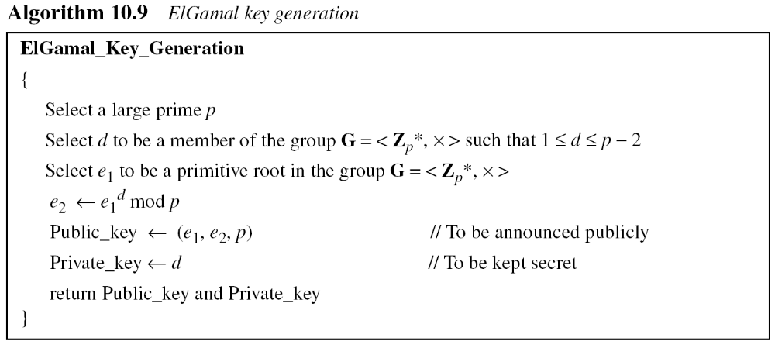
Review: ElGamal digital signature
7. Advanced signatures CS580_F15

Slide 9
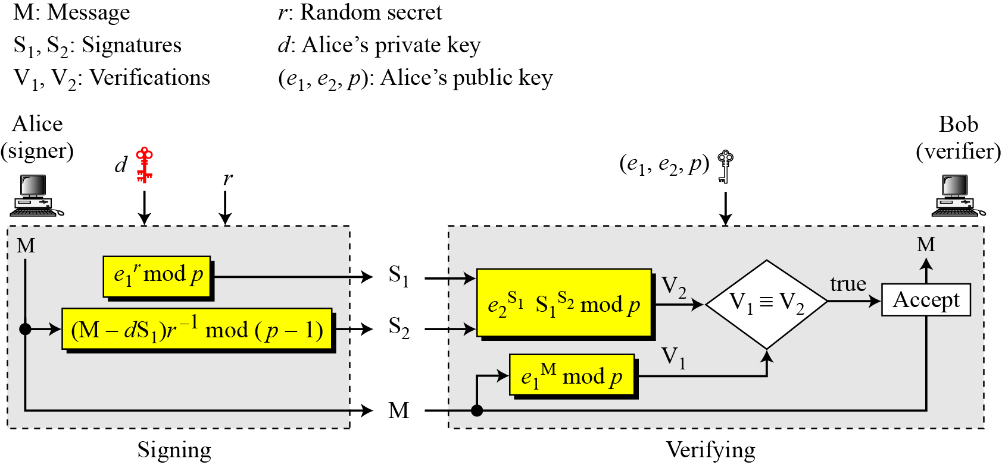
Review: ElGamal digital signature
r should be relative prime to p-1
7. Advanced signatures CS580_F15

Slide 10
Convertible Undeniable Signature
Choose two primes, p and q, such that q divides p-1
Choose a generator g
The private keys are two different random numbers, x and z, both less than q.
The public keys are p, q, g, y and u
y=g^x mod p u=g^z mod p
Generate the convertible undeniable signature of message m
  choose a random number t, which is less than q-1,
  Calculate T = g^t mod p, m’ = Ttzm mod q
7. Advanced signatures CS580_F15
Notes:
g is the generator of order q in Zp

Slide 11
Convertible Undeniable Signature
Compute the standard Elgammal signature on m’
  Choose a random number r which is relatively prime to p-1
  Computes s1 = g^ r mod p
  Computes s2 = (m’- xs1) r^(-1) mod p-1
  The signature is the ElGammal signature (s1,s2,T)
7. Advanced signatures CS580_F15

Slide 12
Convertible Undeniable Signature
Signature verification
  Bob generates two random numbers, a and b.
  He calculates c = T^(Tma) *g^b mod p and sends it to Alice
  Alice generates a random number, k, and calculates
  h1 = cg^k mod p and h2=h1^z mod p
  Alice sends h1 and h2 to Bob
  Bob sends Alice a and b
  Alice verifies that c = T^(Tma) *g^b mod p. She sends k to Bob
  Bob verifies that h1 = T^(Tma)*g^(b+k) mod p
  h2 = y^(s1a)*s1^(s2a)*u^(b+k) mod p
7. Advanced signatures CS580_F15

Slide 13
Convertible Undeniable Signature
Alice can convert all of her undeniable signatures to conventional signatures by publishing z
Now, anyone any verify her signature without her help
T^(Tmz) = y^s1*s1^s2 mod p
7. Advanced signatures CS580_F15

Slide 14
Proof
h1 = T^(Tma)*g^(b+k)
h1 = cg^k = T^(Tma) * g^b * g^k
= T^(Tma)*g^(b+k)
7. Advanced signatures CS580_F15

Slide 15
Proof
h2 = y^(s1a)*s1^(s2a)*u^(b+k)
In order to prove the equation, we need to prove:
h2 = g^{xs1a} * S1^{(m’-xs1)ar-1} * u^{b+k}
= g^{xs1a} * g^{r(m’-xs1)ar-1} * u^{b+k}
= g^{xs1a} * g^{m’ a-xs1a} * u^{b+k}
= g^{m’ a} * u^{b+k}
7. Advanced signatures CS580_F15

Slide 16
Proof
Now, prove: h2 = g^{m’ a} * u^{b+k}
h2=h1^{z} = (cg^{k})^{z} = c^{z}* g^{kz}
= T^{Tmaz}*g^{bz}* g^{kz}
= g^{tTmaz}*g^{bz+kz}
= g^{m’a} * g^{bz+kz}
= g^{m’a} * u^{b+k}
7. Advanced signatures CS580_F15

Slide 17
Example
p = 743, q = 53, g=38
Private keys: x = 18, z = 25
Calculate public keys
  y = g^x mod p = 38^18 mod 743 = 639
  u = g^z mod p = 38^25 mod 743 = 280
  Public keys: (p,q,g,y,u) = (743, 53, 38, 639, 280)
Calculate the convertible undeniable signature of message m = 32
  choose a random number t=11, which is less than q-1,
  Calculate T = g^t mod p = 38^11 mod 743 = 166
  Calculate m’ = Ttzm mod q = 166*11*25*32 mod 53 = 14
7. Advanced signatures CS580_F15

Slide 18
Example
Compute the standard Elgammal signature on m’=14
  Choose a random number r=13, which is relatively prime to p-1
  Computes s1 = g^ r mod p = 38^13 mod 743 = 458
  Computes s2 = (m’- xs1) r^(-1) mod p-1
  =(14-18*458)*13^(-1) mod 742
  = 674*13^(6*52-1) mod 742
  =674*685 mod 742 = 166
  The signature is the ElGammal signature (458,166, 166)
7. Advanced signatures CS580_F15

Slide 19
Example
Signature verification
  Bob generates two random numbers, a = 11 and b=21.
  He calculates c = T^(Tma) *g^b mod p
  =166^ (166 *32*11) * 38^ 21 mod 743
  = 295 * 295 mod 743 = 94
  Alice generates a random number k = 22
  Alice calculates
  h1 = cg^k mod p = 94*38^22 mod 743 = 166
  h2=h1^z mod p = 360^ 25 mod 743 = 239
  Alice sends h1 and h2 to Bob
  Bob sends Alice a and b
7. Advanced signatures CS580_F15
Notes:
K=46
h1 = cg^k mod p = 94*38^46 mod 743 = 50
h2=h1^z mod p = 50^ 25 mod 743 = 128
h1 = T^(Tma)*g^(b+k) mod p
= 166^(166*32*11) * 38^(21+46) mod 743
= 295* 315mod 743 = 50
h2 = y^(s1a)*s1^(s2a)*u^(b+k) mod p
= 639^(458*11) * 458 ^(166*11) * 280^(21+46) mod 743
= 639^586* 458 ^342* 675 mod 743
= 38 * 368* 675 mod 743 = 128

Slide 20
Example
Signature verification
  Alice verifies that c = T^(Tma) *g^b mod p. She sends k to Bob
  Bob verifies that
  h1 = T^(Tma)*g^(b+k) mod p
  = 166^(166*32*11) * 38^(21+22) mod 743
  = 295* 600mod 743 = 166
  h2 = y^(s1a)*s1^(s2a)*u^(b+k) mod p
  = 639^(458*11) * 458 ^(166*11) * 280^(21+22) mod 743
  = 639^586* 458 ^342* 82 mod 743
  = 38 * 368* 82 mod 743 = 239
7. Advanced signatures CS580_F15

Slide 21
Example
Signature conversion
Alice releases z=25
Anyone can verify signature (s1, s2, T) = (458,166,166)
T^(Tmz) mod p = 166^(166*32*25) mod 743 = 315
y^s1*s1^s2 mop = 639^458*458^166 mod 743 = 315
7. Advanced signatures CS580_F15

Slide 22
Proxy signature
Scenario
  Alice needs to go on a business trip to someplace which doesn’t have network access
  She expects to receive some important email and has instructed her secretary Bob to respond accordingly
  How can Alice give Bob the power to sign messages for her, without giving him her private key?
Solution: proxy signature
  Alice gives Bob a proxy so that Bob can generate proxy signatures for messages
7. Advanced signatures CS580_F15

Slide 23
Proxy signature properties
Distinguishablility
  Proxy signatures are distinguishable from normal signatures by anyone
Unforgeability
  Only the original signer and the designated proxy signer can create a valid proxy signature
Proxy signer’s deviation
  A proxy signer cannot create a valid proxy signature not detected as a proxy signature
Verifiability
  From a proxy signature, a verifier can be convinced of the original signer’s agreement on the signed message
7. Advanced signatures CS580_F15

Slide 24
MUO’s proxy signature
System parameters:
  A prime p, g is a generator for Z_{p}*
  The original signer’s private key x is a random number in Z_{p-1}
  The corresponding public key is y=g^{x} mod p
Step 1: proxy key generation
  The original signer selects a random k in Z_{p-1}
  Computes t = g^{k} mod p
  Calculates the proxy signature key s = (x + kt) mod p-1
Step 2: proxy key delivery
  The original signer gives (s, t) to a proxy signer in a secure way
7. Advanced signatures CS580_F15

Slide 25
MUO’s proxy signature
Step 3: proxy key verification
  The proxy signer checks that
  g^{s} = yt^{t} mod p
  If (s, t) passes this congruence , it’s accepted as a valid proxy signature key
Step 4: signing by the proxy signer
  The proxy signer needs to sign a message m on behalf of the original signer
  Computes S_{p} using the original signature scheme and s as the secret signature key
  The proxy signature is (S_{p} , t)
7. Advanced signatures CS580_F15

Slide 26
MUO’s proxy signature
Step 5: verification of the proxy signature
  The verification is carried out by the same checking operation as in the original signature scheme except for replacing y with y’ = yt^{t} mod p
Original signature schemes
  ElGamal digital signature or other signature scheme based on discrete logarithm
7. Advanced signatures CS580_F15

Slide 27
MUO’s proxy signature for ELGamal scheme
A proxy signer generates a random number r in Z_{p-1}*
To sign m, he computes
  S1 = g^{r} mod p
  S2 = (M-s*S1) r⁻¹ mod p-1
  s is the proxy’s secret signature key
To verify the signature, a verifier checks
g^{m} = (yt^{t})^{S1}S1^{S2} mod p
If the check has succeeded, (m, (S1,S2,t) ) is properly signed.
7. Advanced signatures CS580_F15

Slide 28
Example
p=137, g=3
The original signer’s private key x=6, the public key is y=g^x mod p = 3^6 mod 137 = 44
Step 1: proxy key generation
  The original signer selects a random k=12 in Z_{p-1}
  Computes t = g^{k} mod p = 3^12 mod 137 = 18
  Calculates the proxy signature key s = (x + kt) mod p-1 = (6+12*18) mod 136 = 86
Step 2: proxy key delivery
  The original signer gives (s, t) = (86, 18) to a proxy signer in a secure way
7. Advanced signatures CS580_F15

Slide 29
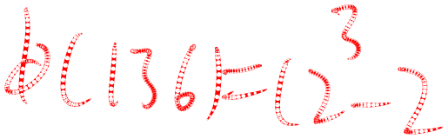

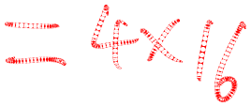




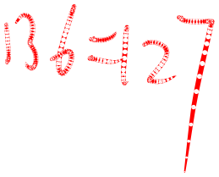
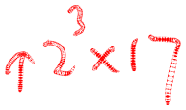
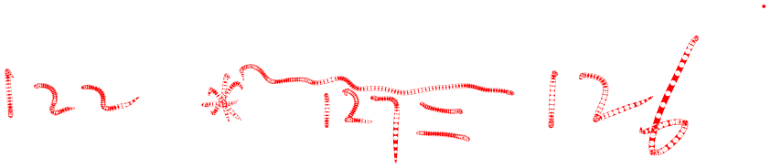


Example
Step 3: proxy key verification
  The proxy signer checks that
  g^{s} = yt^{t} mod p
  3^86 mod 137 = 30
  44*(18^18) mod 137 = 30
Step 4: signing by the proxy signer
  The proxy signer needs to sign a message m=20 on behalf of the original signer
  selects a random number r=15 in Z_{p-1}*
  Calculates S1 = g^r mod p = 3^15 mod 137 = 6 = 75
  Calculates S2 = (M-s*S1) r⁻¹ mod p-1
  = (20-86*75)*15⁻¹ mod 136
7. Advanced signatures CS580_F15

Slide 30


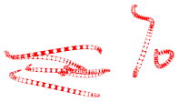

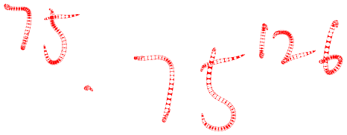

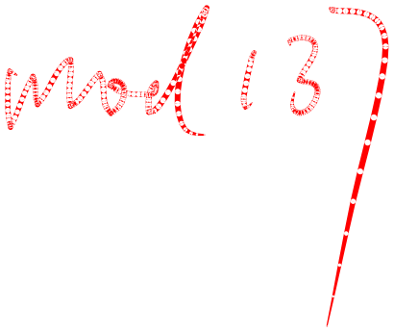

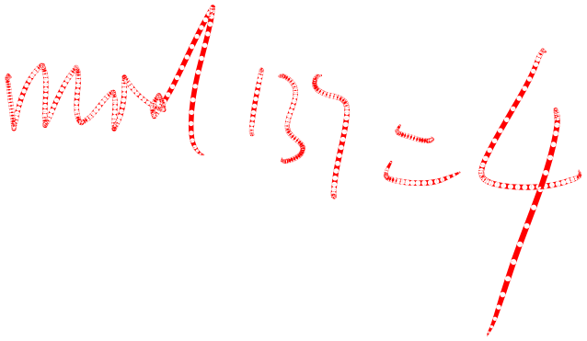




Example
Step 5: Signature verification
  To verify the signature, a verifier checks
g^{m} = (yt^{t})^{S1}S1^{S2} mod p
7. Advanced signatures CS580_F15

Slide 31
Group signature
A group has several members
Each authorized member is able to sign a message on behalf of the group without revealing the identity of the signer
7. Advanced signatures CS580_F15

Slide 32
Group signature
Authorization
  Only authorized group members can generate group signatures
Unforgeability
  A group signature is not forgeable by unauthorized group of persons
Untraceability
  It’s impossible to find out which member signed the signature
Unlinkability
  It’s impossible to find out which messages are signed by the same member
Recoverability
  In case of a dispute, the group manager can identify the signer
7. Advanced signatures CS580_F15

Slide 33
Group signature with a Trusted Arbitrator
Trent generates a large pile of public key/private key pairs and gives every member of the group a different list of unique private keys. No key on any list are identical
  If there are n members of the group, and each member gets m key pairs, then there are n*m total key pairs
Trent publishes the master list of all public keys for the group, in random order. Trent keeps a secret record of which keys belong to whom
When group members want to sign a document, he chooses a key at random from his personal list
When someone wants to verify that a signature belongs to the group, he looks on the master list for the corresponding public key and verifies the signature
In the event of a dispute, Trent knows which public keys corresponds to which group member
7. Advanced signatures CS580_F15

Slide 34
Group signature: Tseng-Jan Scheme: Set up
Choose 2 primes p and q, q divides p-1
Choose a generator g
A user Ui selects his private key x_{i} in Z_{q*} , his public key is y_{i} = g^{x}i mod p
Group manager(GM) selects a random number x and publishes his public key y=g^{x} mod p
Group manager(GM) selects a one way hash function h(.)
To join the group
  U_{i} sends his public key y_{i} to GM
  GM chooses a random number k_{i} in Z_{q*}, calculates and sends the following pair to U_{i} privately
  r_{i}=g^{-k}i*y_{i}^{k}i mod p
  s_{i}= k_{i}-r_{i}*x mod q
7. Advanced signatures CS580_F15

Slide 35
Group signature: Tseng-Jan Scheme: Signing
To sign a message M, U_{i} first chooses 4 random numbers is Z_{q*}
  a,b,d,t
Calculate the signature (R, S, A,B,C,D,E) as follows
  A = r_{i}ª mod p
  B = a*s_{i} – b * h(A||C||D||E) mod q
  C = a*r_{i} – d mod q
  D = g^b mod p
  E = y^d mod p
  α = (g^B)* (y^C) * E * D^h(A||C||D||E)mod p
  R = α^t mod p
  S = t⁻¹ * (h(M||R) – R*x_{i} ) mod q
7. Advanced signatures CS580_F15

Slide 36
Group signature: Tseng-Jan Scheme: Verification
On receiving signature (R, S, A,B,C,D,E) and message M, a verifier first computes α
Then, check the validity of the signature
α^{h(M||R}) = (α*A)^{R} * R^{S} mod p
The above equation holds since the follow equations hold
  g^{s}i * y^{r}i = y^{k}i mod p
  α = g^(a*k_{i}) mod p
  α*A = α^x_{i} mod p
7. Advanced signatures CS580_F15

Slide 37
Proof:
g^{s}i * y^{r}i = y^{k}i mod p
g^{s}i * y^{r}i = g^{s}i * g^{xr}i = g^{s}i ^{+ xr}i = g^{k}i
7. Advanced signatures CS580_F15

Slide 38
α = g^(a*k_{i}) mod p
α = (g^B)* (y^C) * E * D^h(A||C||D||E)mod p
=g^{as}i ^{– b*h()}* g^{x(ar}i ^{– d)}* g^{xd} * g^{b*h()}
= g^{as}i ^{+ axr}i
= g^{a(s}i ^{+ xr}i⁾
= g^{ak}i
7. Advanced signatures CS580_F15

Slide 39
α*A = α^x_{i} mod p
α*A = g^{ak}i * r_{i}ª
= g^{ak}i * (g^{-k}i * g^{x}i^{k}i)ª
= g^{ax}i^{k}i
= α^x_{i}
7. Advanced signatures CS580_F15

Slide 40
α^{h(M||R}) = (α*A)^{R} * R^{S} mod p
(α*A)^{R} * R^{S} = α^{x}i^{R} * R^{S}
= α^{x}i^{R} * R^{t-1 *(h(M||R)-Rx}i⁾
= α^{x}i^{R} * α^{t*t-1 *(h(M||R)-Rx}i⁾
= α^{h(M||R})
7. Advanced signatures CS580_F15

Slide 41
Group signature: Tseng-Jan Scheme: Open
To identify the signer of a valid group signature (R, S, A,B,C,D,E) on message M, GM first computes α
Then, find the signer by searching the pair (ri, si, ki) that satisfies
α = (g^{C} * E^{x-1 mod q})^(r_{i}⁻¹*k_{i} mod q) mod p
7. Advanced signatures CS580_F15

