Slide 1
Presentation 1.2 – Technology Value Stream
By: James Pinson

Slide 2
What is The Technology Value Stream?
The Technology Value Stream originated from the manufacturing value stream and replaced physical product with technology work.
In DevOps the technology value stream is the process required to convert a business hypothesis into a technology enabled service that delivers value to customers.
This starts when we accept the work in development.
Value is only created when our services are running in production.
Due to this we must ensure fast flow and that our deployments can be performed without causing chaos and disruptions.
The value stream begins when an engineer checks a change into version control and ends when that change is successfully running in production.

Slide 3
Lead Time vs Processing Time
The lead time starts when the request is made and ends when it is fulfilled.
Process time starts only when we begin work on the customer request and omits the time work is waiting to be processed.
Lead time is what the customers experience so that is typically the focus for improvement.
The process time serves as an important measure of efficiency.
In order to achieve fast flow and lead times we must reduce the time our work is waiting in queues.
The goal is to find ways to decrease lead time from a matter of months to a matter of minutes.

Slide 4
Deployment Lead Times of Minutes
The DevOps ideal puts a focus on providing constant feedback to developers quickly.
This feedback enables them to independently implement, integrate, and validate their code.
One of the ways we do this is continually checking small code changes into our version control repository, preforming automated and exploratory testing, and deploying it into production.
This gives us a high degree of confidence that our changes will operate as intended in production.
This is achieved easily when our architecture is modular and loosely coupled so small teams are able to work with high degrees of autonomy.
All this comes together to form our value stream map which will be shown in the next slide.

Slide 5
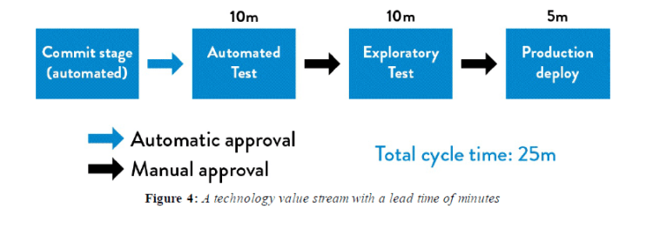
Value Stream Map

Slide 6
The Principles Underpinning DevOps
The DevOps behaviors and patterns are derived by a set of underpinning principles known as the Three Ways.
The First way enables fast left to right flow of work from development to operations to the customer.
In order to do this we must make our work visible, reduce bath size, and build in quality.
The Second Way enables fast and constant flow of feedback from right to left at all stages of the value stream.
When we do this we create quality at the source and generate knowledge where it is needed.
The Third Way enables to creation of a generative, high trust culture, that supports a dynamic, disciplined and scientific approach to experimentation and risk taking.
This facilitates the creation of organizational learning from both the successes and failures.

Slide 7
Making Work Visible
The major difference between technology and manufacturing value streams is that DevOps work is invisible.
It is not easy for us the see the flow and where it is being impeded.
Since it is so easy for work to move back and forth it can start to bounce between teams endlessly due to incomplete information or work.
Also problems can be passed down remaining invisible until the end of the production period which causes the application to fail.
In order to prevent this we need to make our work visible.
We can do this by creating visual work boards such as Kanban boards or sprint planning boards.

Slide 8
Limiting Work In Process
In technology work is usually dynamic especially with shared services where teams must satisfy the demands of multiple stakeholders.
This leads to a lot of requests for urgent work coming through all the different communication mechanisms.
Interruptions in technology are easy cause often the consequences are invisible but the negative impact on productivity is great.
Studies show that multitasking significantly decreases productivity.
We can solve this by putting limits to the amount of WIP or work in process that can be in one work center at a given time.
This keeps us from adding new cards and projects to a team that already has items in WIP and allows them to be more productive in getting those items finished.

Slide 9
Reducing Batch Sizes
Another component in creating a smooth and fast flow is operating in smaller batch sizes.
Before the lean manufacturing revolution it was common to work in large batch sizes and work on individual parts at a time to create one big batch.
However large batch sizes can result in long lead times and poor quality. Often times because if a problem was found it effected the entire batch and had to be fixed or redone.
The lowest limit for batch size is single-piece flow where each operation is performed one unit at a time.
The goal is to complete each step in the batch so when you are finished you have a complete product ready to be deployed.
Smaller batch sizes result in less WIP, faster lead times, faster detection of errors, and less rework.

Slide 10
Identify and Elevate Constraints
In order to reduce lead times we must discover our systems constraints and improve its work capacity.
If we don’t improve at the constraint this it is not actually an improvement in our work flow.
Some examples of constraints may include environment creation, code deployment, test setup and run, and overly tight architecture.
The idea is to find ways to break the constraints such as creating a more loosely coupled architecture or automating our test.
This however doesn’t mean to eliminate all our constraints we just want to ensure that the constraints we do have align with our goals.
When your constraints are aligned then you can maximize productivity and efficiency.

Slide 11
Building New Knowledge
The idea here is that when problems occur we should swarm them and mobilize whoever is required to solve the problem.
The goal is to contain the problems now allowing them to spread.
This builds a deeper knowledge of how to manage the systems which changes ignorance into knowledge.
Swarming prevents the problem from progressing downstream where the cost and effort to repair the problem accumulates.
Also if the problem is not addressed and solved then the work center could potentially have the same issues in future operations.
The biggest upside of swarming is that it enables learning. It focuses on solving the problem and turning that into knowledge for future use.

Slide 12
Enabling Organizational Learning
It is very important to create an environment that enables and promotes organizational learning.
It is impossible for us to predict all the outcomes for any action we take.
You want to create a generative organization which actively seeks and shares information to better enable the organization to achieve its goal.
With this responsibilities are shared throughout the value stream, and failure results in reflection and inquiry.
When we do this we create what is called organizational learning.
This allows for organizations to become more self diagnosing, self-improving, skilled at detecting problems, and solving them.

Slide 13
References
Kim, G., Debois, P., Willis, J., Humble, J., & Allspaw, J. (2017). The DevOps handbook: how to create world-class agility, reliability, and security in technology organizations. IT Revolution Press, LLC.
Haver, P. byT. (2021, May 9). Book Club: The DevOps Handbook (Chapter 1. Agile, Continuous Delivery, and the Three Ways). Red Green Refactor. https://red-green-refactor.com/2020/11/04/book-club-the-devops-handbook-chapter-1-agile-continuous-delivery-and-the-three-ways/.

