Slide 1
The Assignment

Slide 2
The Task
An end user, requires a webform so they can capture, store, and retrieve data from a backend database. They need to capture three or four fields of information: name, address, contact details, reason for contact.

Slide 3
Initial Plan
Capture the data from the user.
Using HTML, create a webpage that allows users to input and submit data. The webpage should also provide the user with a key upon submission of their data and allows the user access and edit their data at any time.
Capture the data as an object in JavaScript.
Using JavaScript, create a script that would allow the users data to be captured and temporarily stored as an object.
Store it in an Excel workbook.
Using JavaScript, create a script that could be used to read and write to an excel workbook.
Read and write to the workbook, as necessary.
Using the object of user data, write that data to the excel workbook or upon user request read and display their personal data.

Slide 4
Technologies Used
Visual Studio Code
Excel
HTML, JavaScript
Node.js, NPM

Slide 5
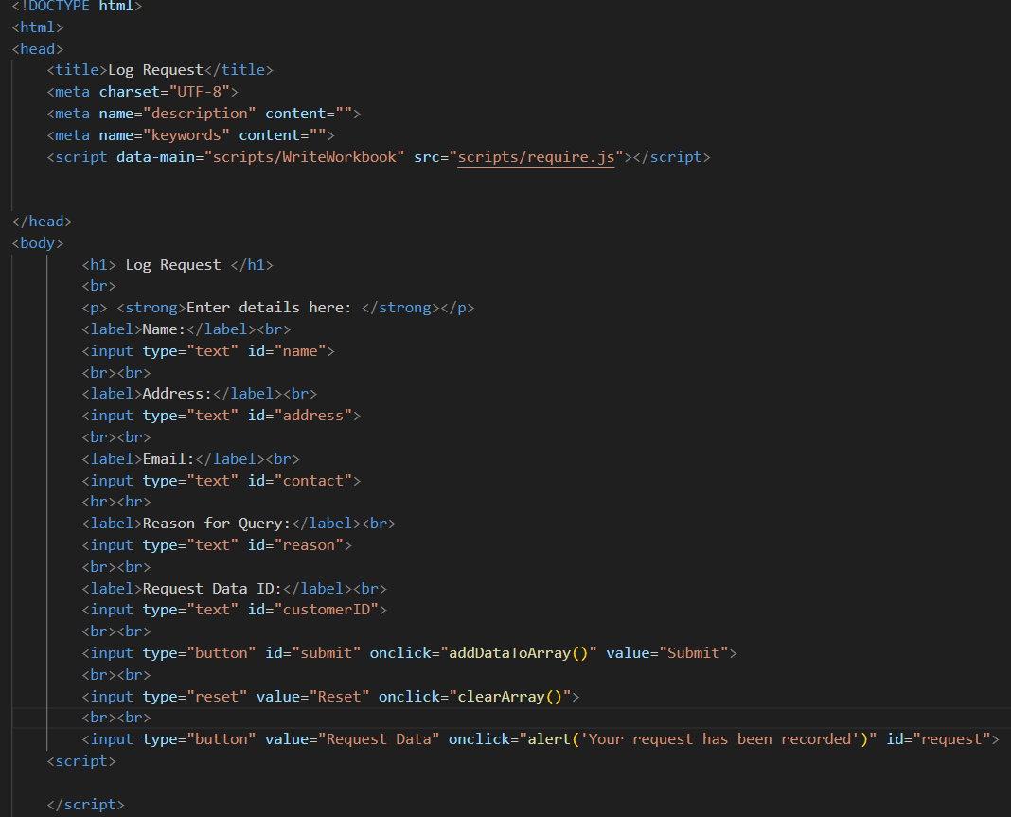
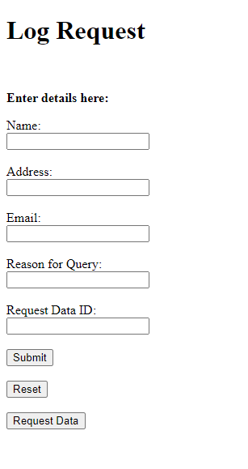
Development – User Input

Slide 6
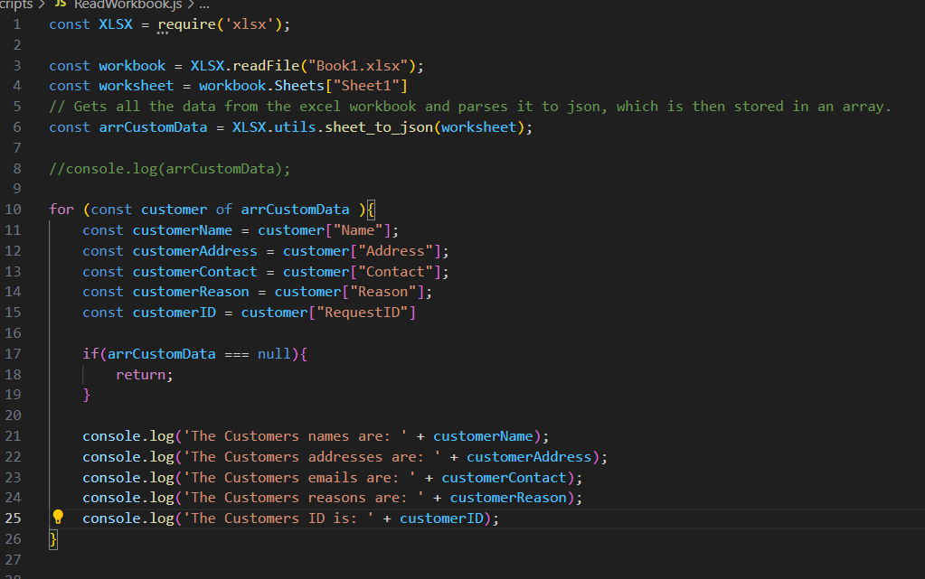
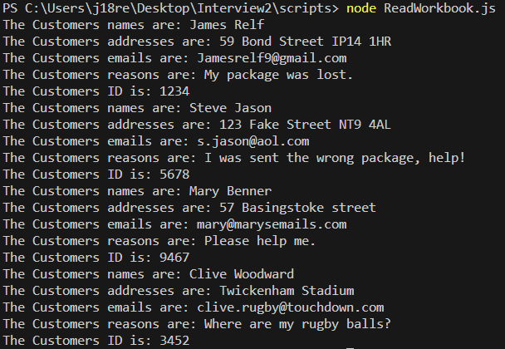
Development – Read Excel Workbook

Slide 7
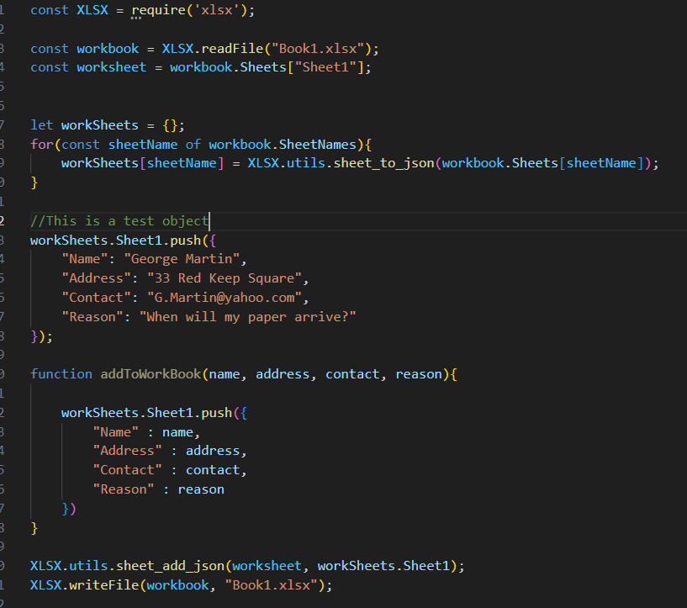
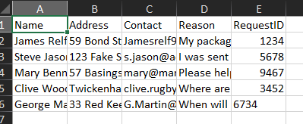
Development – Write to Excel Workbook

Slide 8
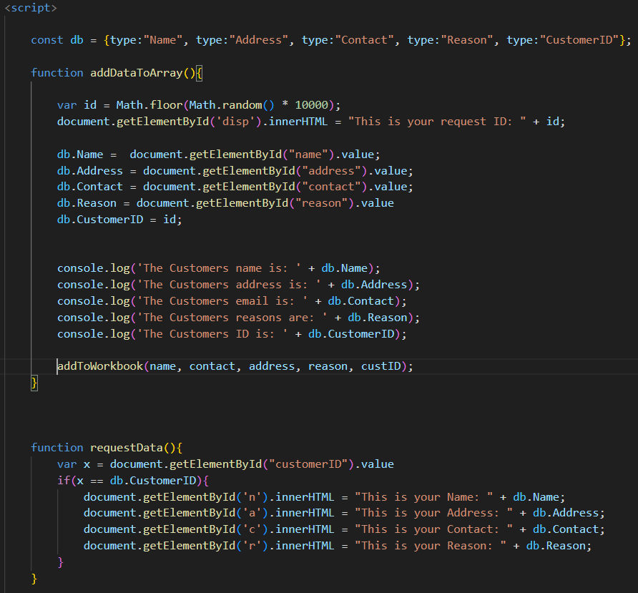
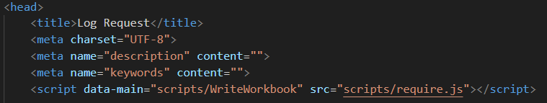
Development – User input to Excel

Slide 9
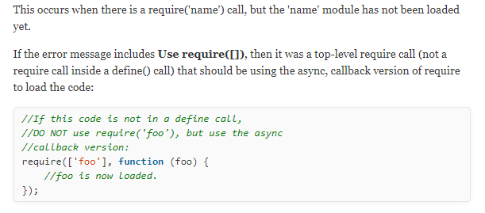

Development – Problems

Slide 10

Resolution

Slide 11
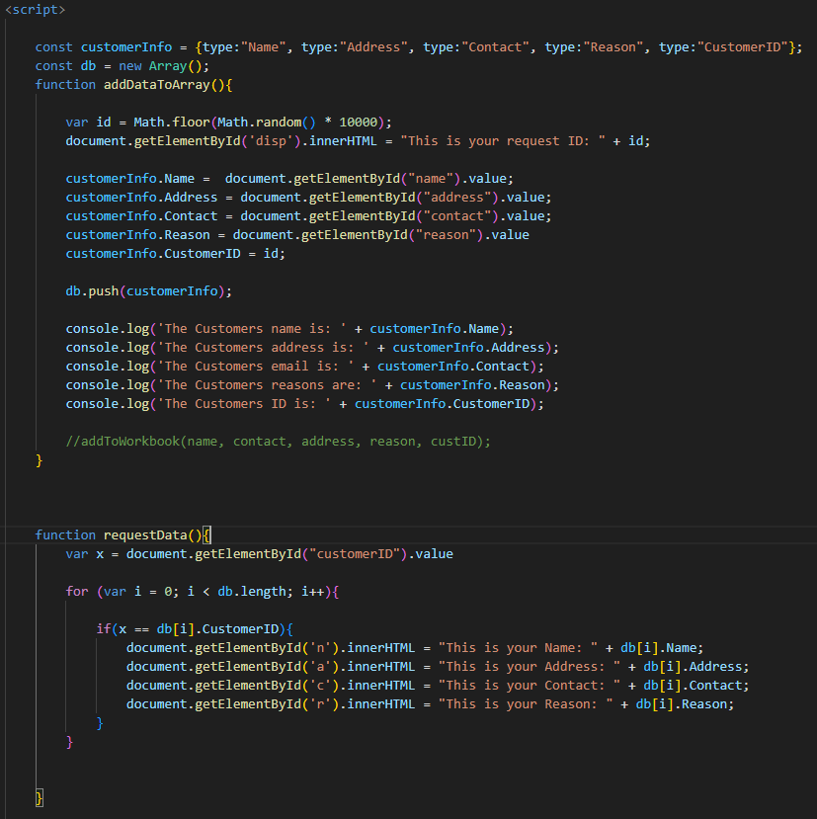
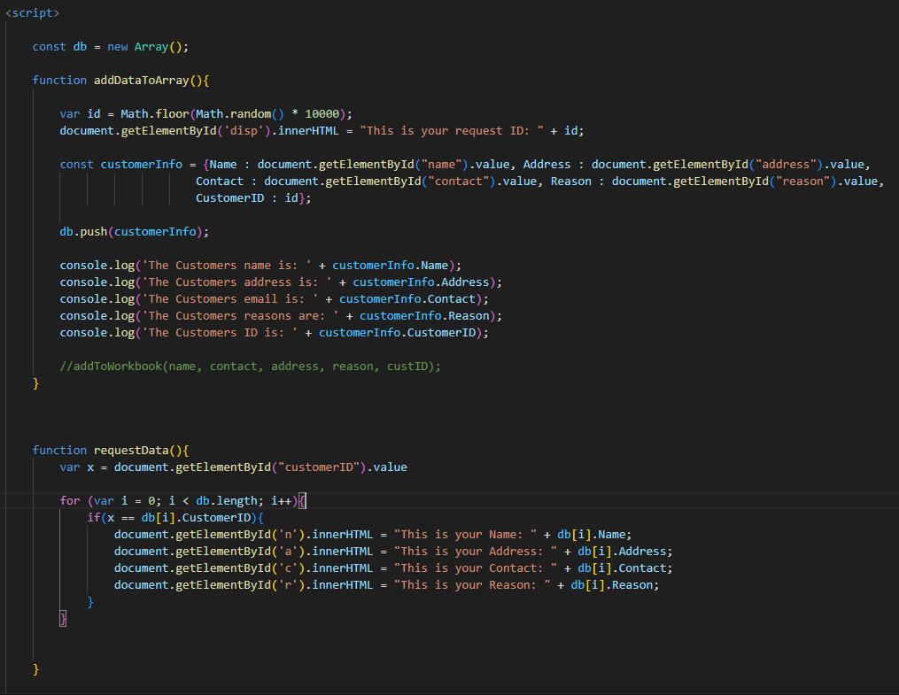
Resolution

Slide 12
Improvements
Make the first way work.
Add some CSS.
Allow for users to overwrite their old data.
Don’t use a third-party package to access files that contain sensitive information.

Slide 13
Final Thoughts
Start smaller.
If something is not working, move onto something that will work.
Find a balance.

Slide 14

Questions?

Slide 15
Resources
https://www.w3schools.com/
https://www.youtube.com/watch?v=cjxSaTwPfGE&t=176s
https://www.youtube.com/watch?v=3Fw5N2WXRPQ&t=383s
https://www.youtube.com/watch?v=TDGsVqVzW4A

