Slide 1

Q3-Chat
By:
James R.P., Aiden V., and Mitchell M.

Slide 2
Introduction
Gather Documentation Info from Client
Create Description and Specification Documentation
Identify language, libraries, and stack
Prepare a simple home server

Slide 3
Sprint Objectives
Create Requirements Document
Establish Client Baseline
Identify Stack and Prepare Demo
Create Project Overview Documents

Slide 4
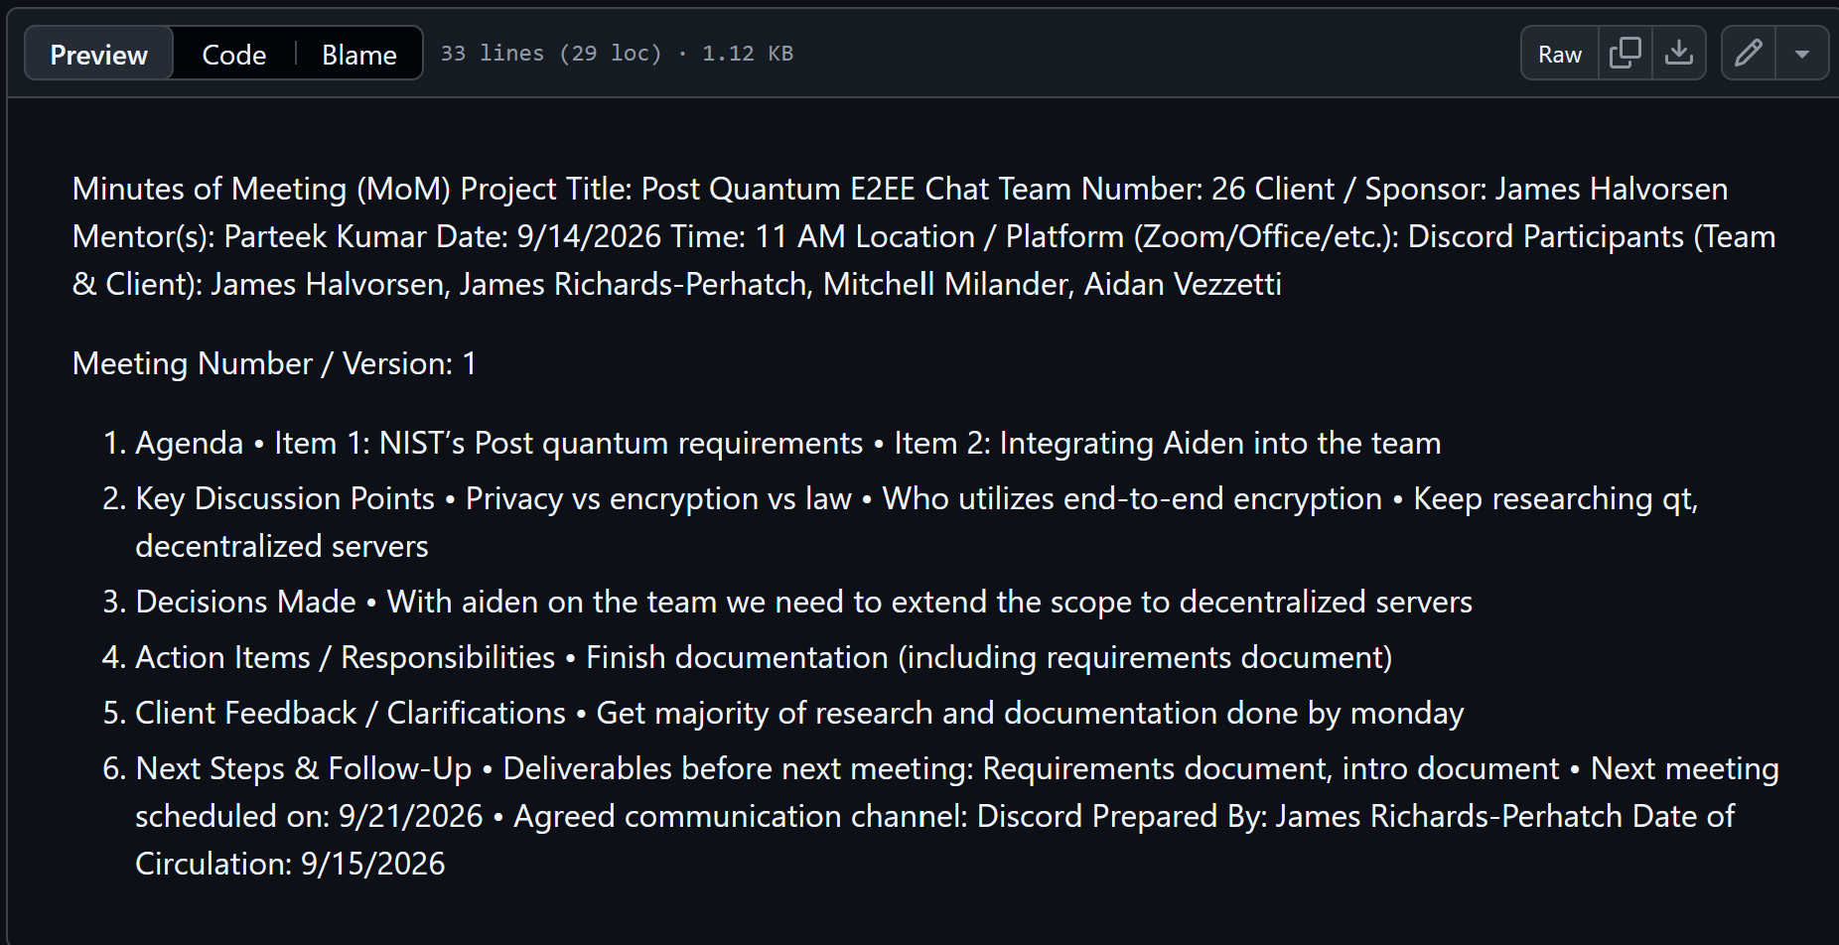
Requirements Gathering Process
4 Client Meetings

Slide 5
Requirements
End-to-end Encrypted
Decentralized
Utilizing Post-Quantum Encryption
Chat Application

Slide 6
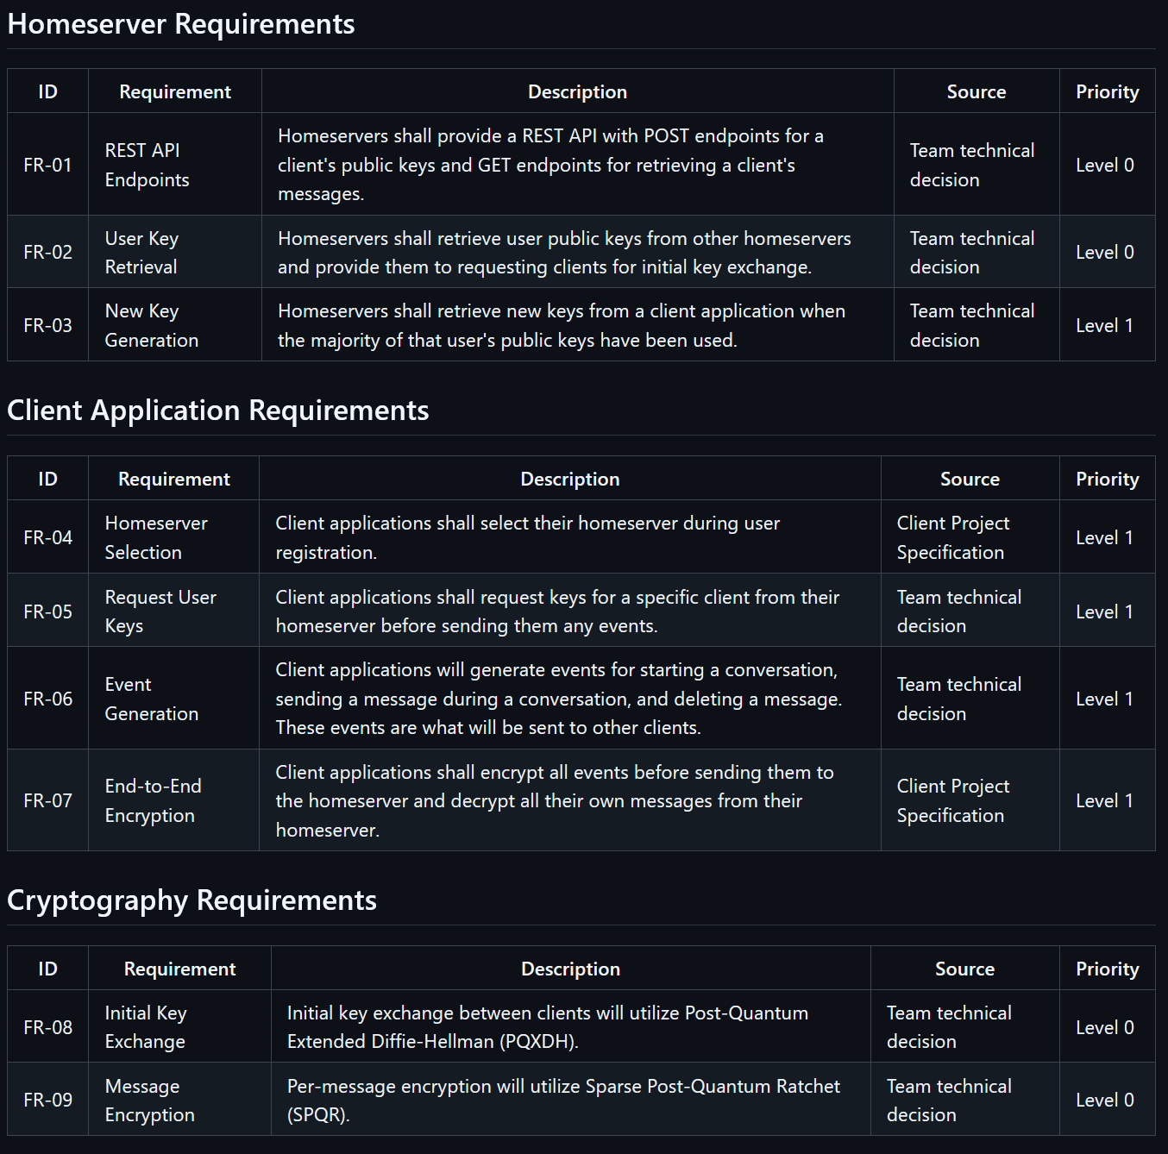
Functional Requirements

Slide 7
User Stories
Access Chat Application
Connect to Client-Server
Send Messages

Slide 8
Use Cases
Establish an Encrypted Conversation
Send an End-to-End Encrypted Message

Slide 9
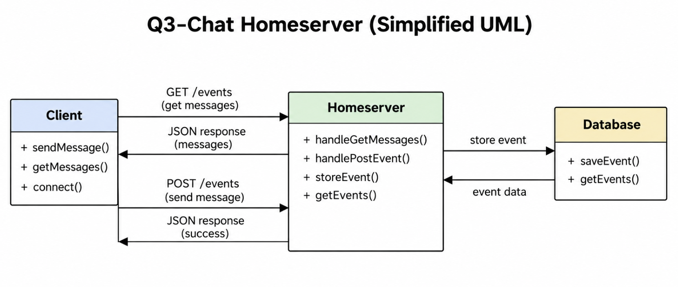
UML Diagram

Slide 10
Existing Solutions
Whatsapp
Matrix
Signal

Slide 11
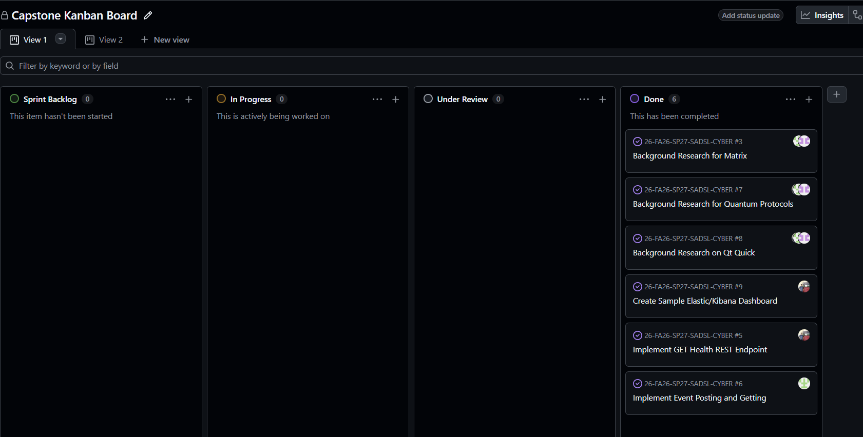
Kanban Overview

Slide 12
Contributions
James
Aiden
Mitchell

Slide 13
Demonstration

Slide 14
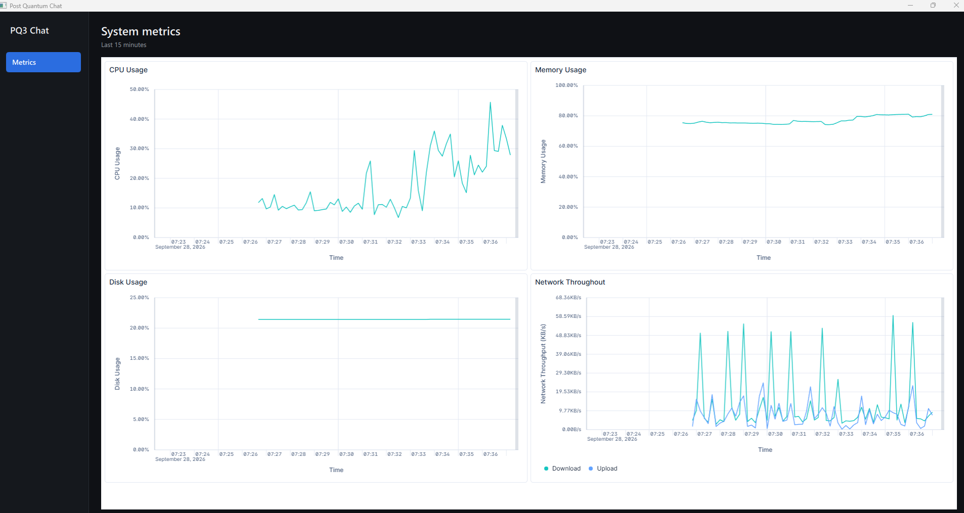

Slide 15
Learnings
James
Aiden
Mitchell

Slide 16
Sprint Achievements
Established Client Connection and Gathered Requirements
Completed Project Overview Document
Completed Requirements Document
QT Quick Sample
Home Server Sample

Slide 17
AI Statement

Slide 18
Next Sprint
Basic Client Application
Event Handling and User Registration
SQL Database

Slide 19
Reflection
Good Client Communication
Handled Deadlines
Gathered Necessary Knowledge to Move Forward

Slide 20
Conclusion

